Slide 1
Universally-composable Security of Key Distribution from Causality Constraints
Based on results by: Masanes, Renner, Christandl, Winter and Barrett

Slide 2
Main Idea

Slide 3









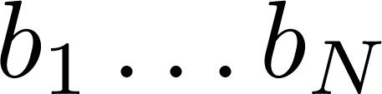


Main Idea

Slide 4
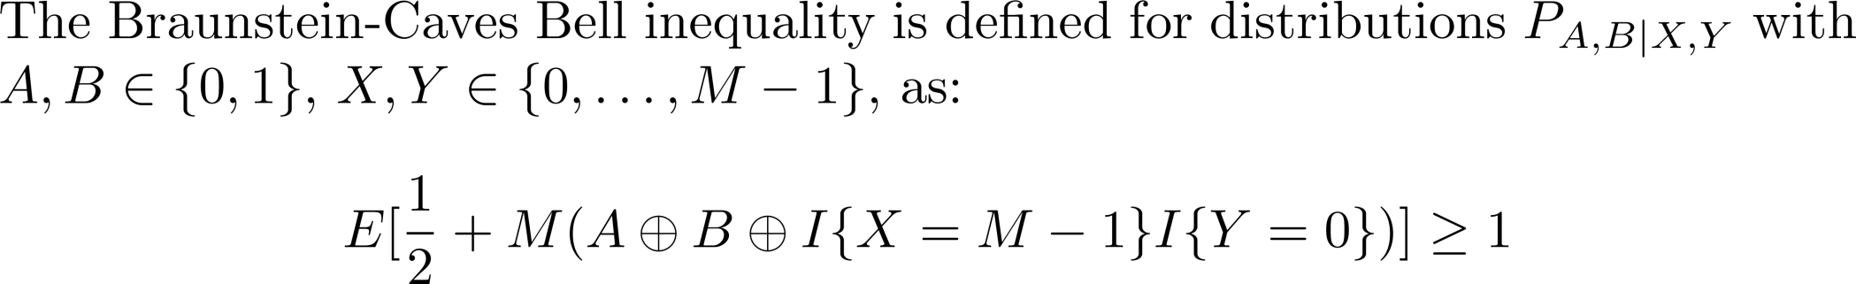
Braunstein-Caves Bell Inequality

Slide 5

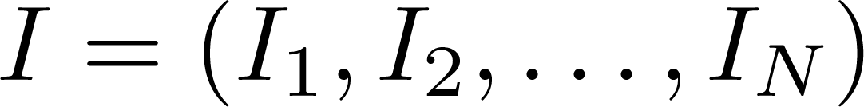
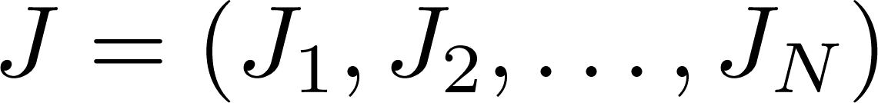

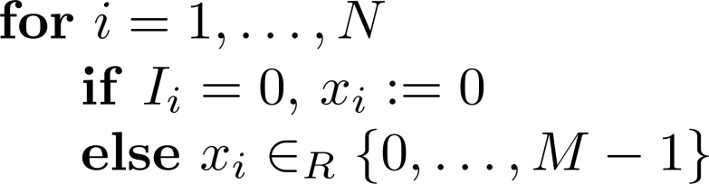
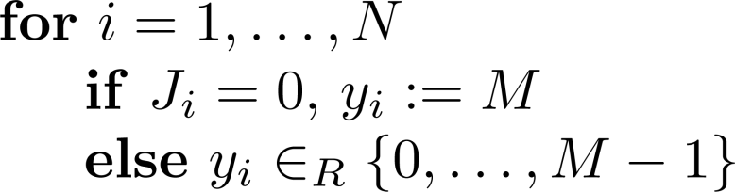
The Protocol
Alice
Bob

Slide 6
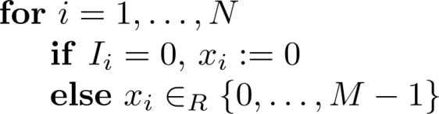
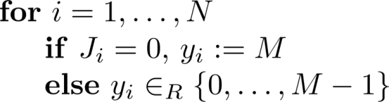
The Protocol
Alice
Bob

Slide 7




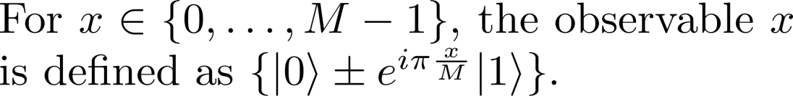

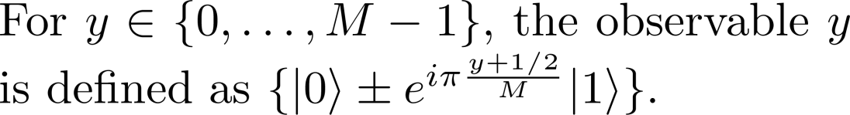






In terms of quantum measurements…

Slide 8

The Protocol
Alice
Bob
Nonlocality Estimation
I
J

Slide 9






The Protocol
Alice
Bob
Nonlocality Estimation
I
J
Error Correction
c=f(a)
EC
Thanks!
Privacy Amplification
Got it!

Slide 10
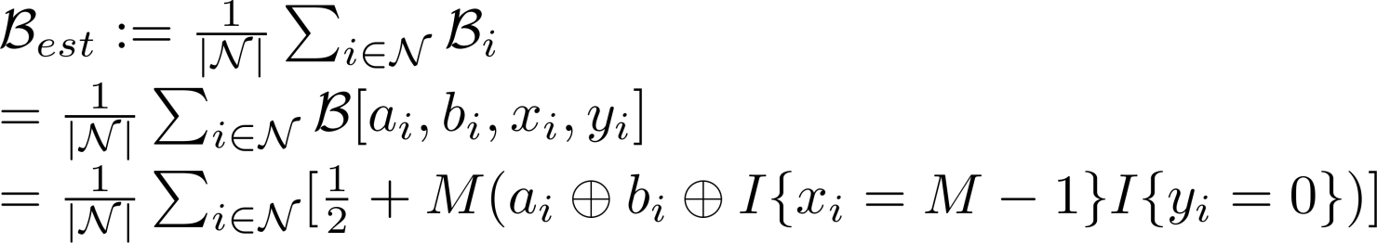
Nonlocality Estimation

Slide 11
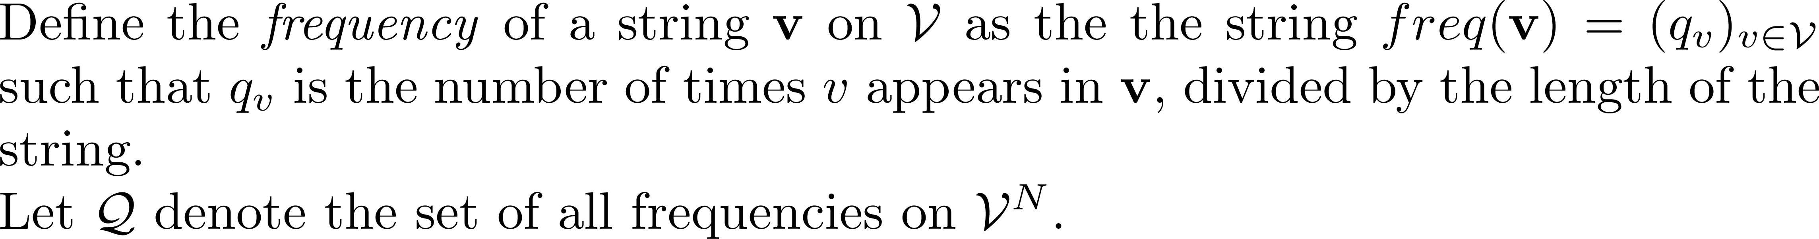
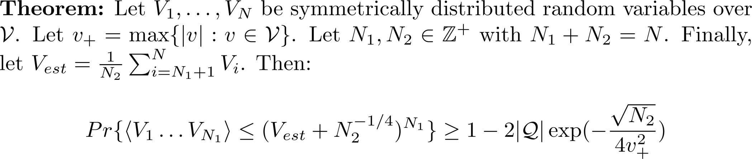
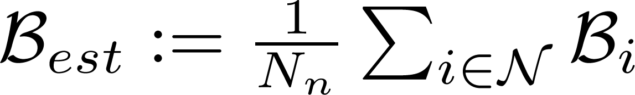

Nonlocality Estimation

Slide 12
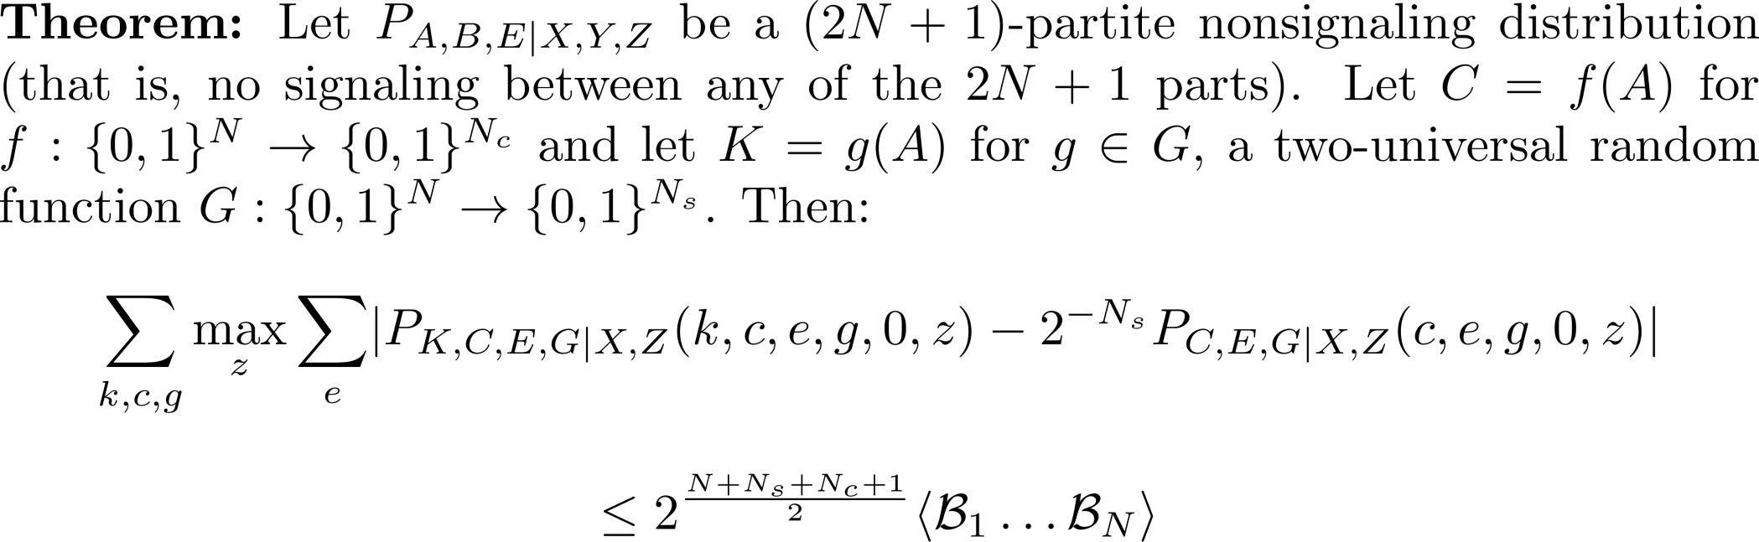
Privacy Amplification

Slide 13
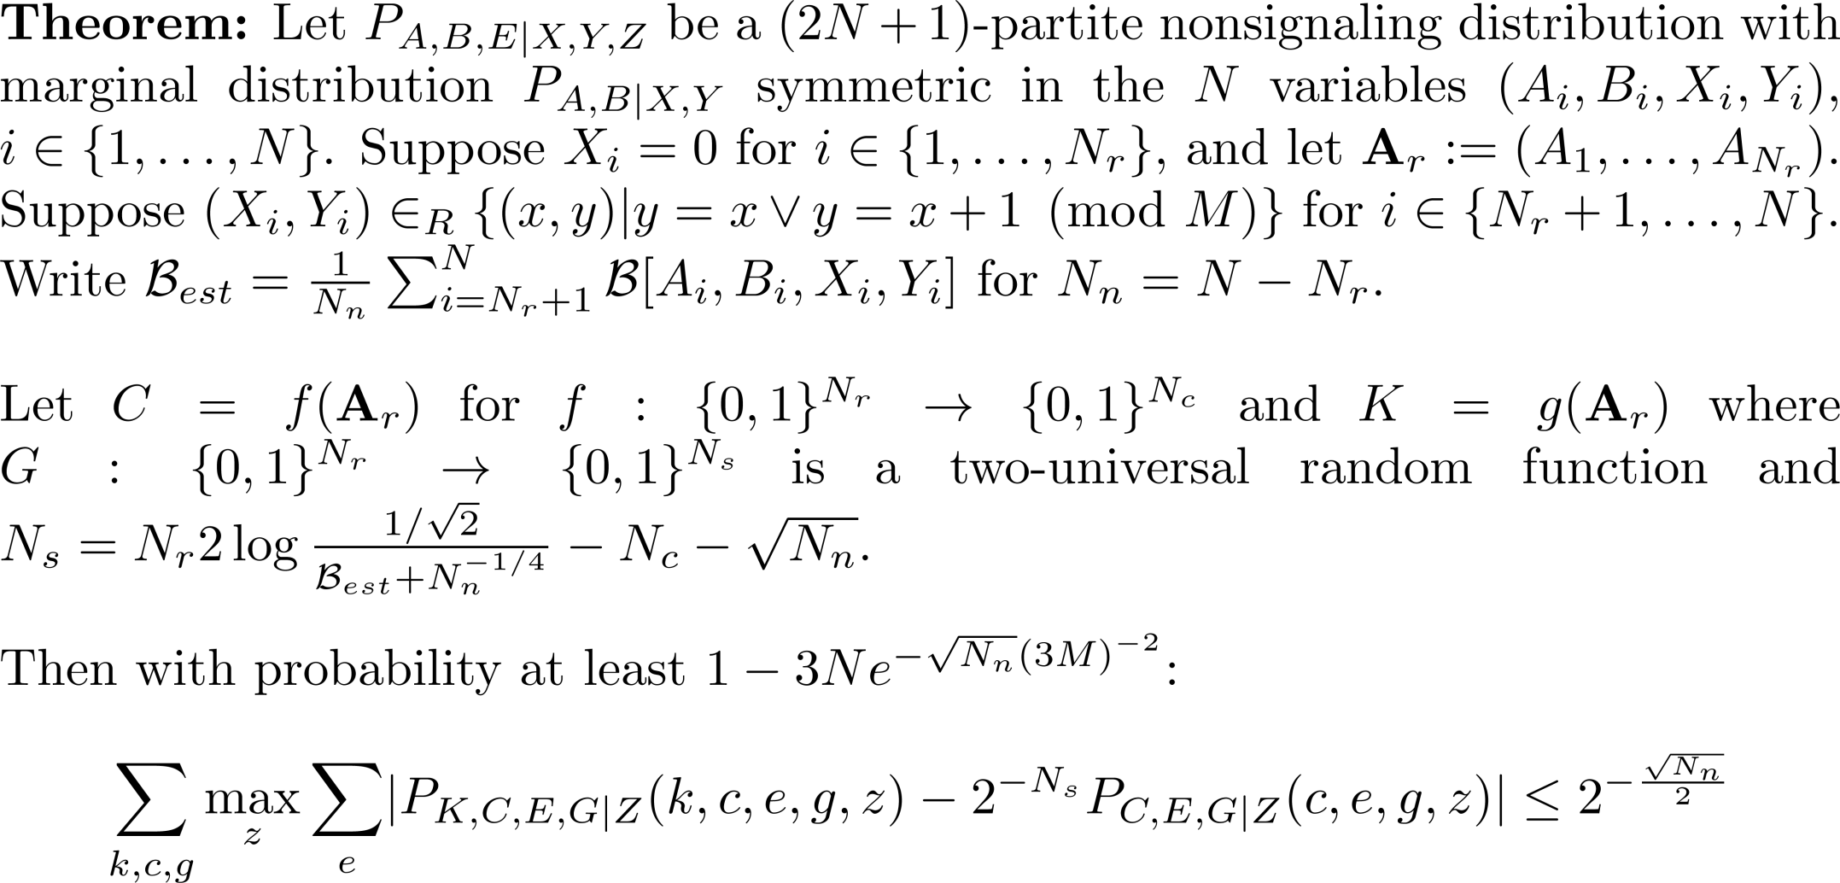
Universally-composable Security

Slide 14
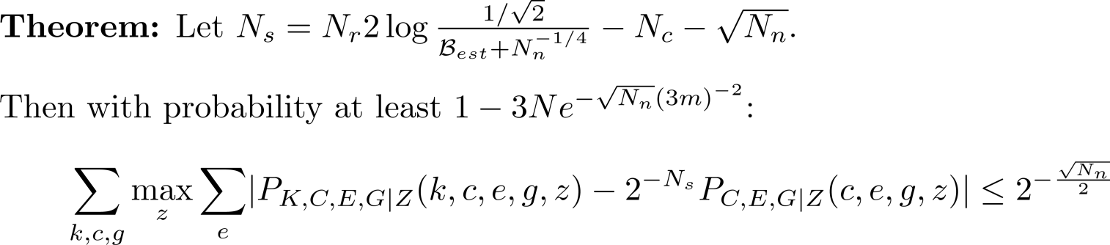


Universally-composable Security

Slide 15
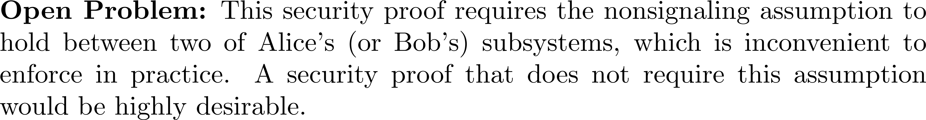
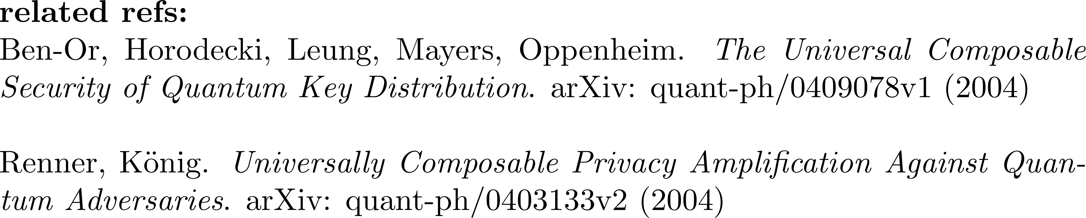
Conclusions and Open Problems
References

