Slide 1
Systematic approach to decoupling in NMR quantum computation
----a critical evaluation
Rui Xian(Patrick)
D. W. Leung, et al., Efficient implementation of coupled logic gates for quantum computation, Phys. Rev. A, 61, 042310(2000)
CO781, July 2010

Slide 2
Outline
Motivation
Introduction to J-coupling
Decouple the ZZ interaction
Experimental feasibility

Slide 3
Motivation
Excluding undesired coupling
Pruning Hamiltonian
5
2
1
4
3

Slide 4
Motivation
Context different in QC than conventional NMR(broadband decoupling)
Number of time intervals grows exponentially(nested pulse sequence)
Length of each time interval can be ~milliseconds(J: 10Hz~100Hz)

Slide 5


Introduction to J-coupling
magnetically equivalent(homonuclear, heteronuclear)
magnetically inequivalent(homonuclear, heteronuclear)
Not always ZZ, only under certain averaging
1
2
5
1

Slide 6
Introduction to J-coupling
Physical origin:
Fermi contact
Electron-mediated nuclear interaction(indirect)
N
e
e
N
Ramsey & Purcell Phys. Rev. 85, 143(1952)

Slide 7

Introduction to J-coupling
Free evolution(under H0)
Driven evolution(under H0+H1)
strong pulse approximation

Slide 8
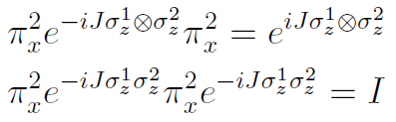



Decouple the ZZ interaction
2 coupled spin-1/2
effective propagator
Sign of J-coupling
time
spin 1
+
+
spin 2
+
-
“sign matrix”
Hadamard!

Slide 9
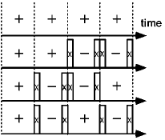
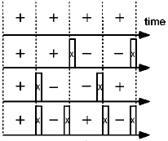
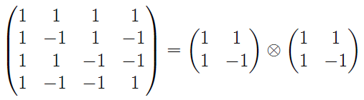
Decouple the ZZ interaction
4 coupled spin-1/2
spin 1
spin 1
spin 2
spin 2
spin 3
spin 3
spin 4
spin 4
A larger Hadamard!

Slide 10


Decouple the ZZ interaction
Generalize the previous scheme,
Define: Hadamard matrix of order n
Existence:
Hadamard’s conjecture: H(n) exist for every n≡0 mod 4(verified for all n<428)
Sylvester’s construction: If H(n) and H(m) exist, then H(nm) = H(n) H(m)
Paley’s construction: if an odd prime q≡3 mod 4 then H(q+1) exists; if q≡1 mod 4, then H(2(q+1)) exists

Slide 11
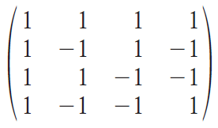
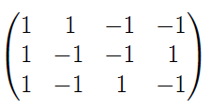
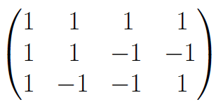
Decouple the ZZ interaction
Multiple(n) spins
when H(n) exist, choose H(n)
when H(n) does not exist, choose a submatrix of H(m) (m is the smallest integer satisfying n<m with existing H(m))
No three-body interaction

Slide 12
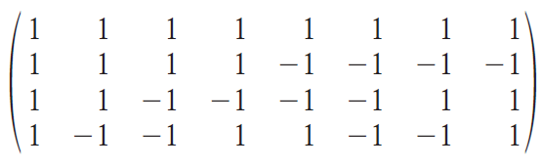
Decouple the ZZ interaction
Efficiency criterion: m-n<<n, let m=cn, from Paley’s construction, c≈1

Slide 13

Decouple the ZZ interaction
Alternative approach: noncomplete graph(suggested in J. A. Jones, E. Knill, J. Magn. Reson., 141, 322(1999))
Spin-off techniques:
selective decoupling
(selective) recoupling

Slide 14
Experimental feasibility
Not all Js are of similar strength
Simplification is anticipated
5
2
1
4
3

Slide 15
Experimental feasibility
1-shot scheme, not robust against pulse defects
Generalizability—not straightforward to expand to decouple other types of interaction

Slide 16
Reference
C. P. Slichter<Principles of Magnetic Resonance>
Ernst, Bodenhausen & Wokaun<Principles of Nuclear Magnetic Resonance in One and Two Dimensions>
A. J. Shaka, J. Keeler, Broadband spin decoupling in isotropic liquids, Progress in Nuclear Magnetic Resonance Spectroscopy, 19, 47(1987)
D. Cory, M. Price, and T. Havel, Physica D, 120, 82(1998)
D. W. Leung, et al., Efficient implementation of coupled logic gates for quantum computation, Phys. Rev. A, 61, 042310(2000)
J. A. Jones, E. Knill, Efficient Refocusing of One-Spin and Two-Spin Interactions for NMR Quantum Computation, J. Magn. Reson., 141, 322(1999)
L. M. K. Vandersypen, I. L. Chuang, NMR techniques for quantum control and computation, Rev. Mod. Phys. 76, 1037 (2004)
N. Linden et al., Pulse sequence for NMR quantum computers: how to manipulate nuclear spins while freezing the motion of coupled neighbours, Chem. Phys. Lett., 305, 28(1999)

Slide 17
Thanks!

