Slide 1
Electrophysiological approaches for examining “physiological” & “pathological” brain population (rhythmic) activities in rodent models
Liang Zhang
Toronto Western Research Institute
University Health Network
liangz@uhnres.utoronto.ca
Rm 13-411, Toronto Western Hospital

Slide 2
In vivo and in vitro approaches
Electroencephalography (EEG) in behaving animals
Extracellular and single cell recordings in acutely isolated brain tissues

Slide 3
Electroencephalography
(EEG)

Slide 4
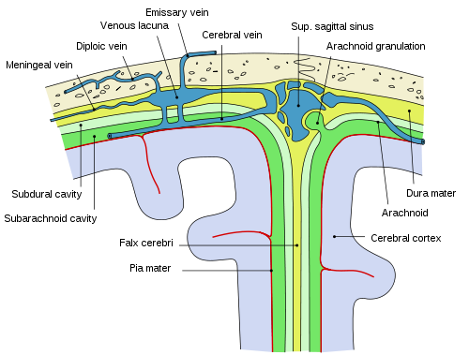
Positions of EEG electrodes
Scalp surface electrodes
Epidural electrodes
Deeper
electrodes

Slide 5
Pros & corns of EEG electrode positions
Epidural electrodes
Presumably no damage to brain tissues
Easy to position
Relatively weak but stable signals
Deep electrodes
Potential damage of brain tissues
Local field potentials of targeted regions
Histology for verification of implanted electrodes

Slide 6
Types of electrodes
Simple electrodes
isolated and tip-exposed wires
microelectrodes or wires (tip diameter ≤50 µm)
fine electrodes (tip diameter of 100-200 µm)
Multi-electrode array
Single probe with vertically orientated multiple contacts
Horizontally orientated arrays

Slide 7
Recording modes
Differential recordings
Signals - difference between paired electrodes
Often used for epidural recordings
Single end recordings
Signals – relative to ground or reference electrode
Used for simple or multi-electrode recordings

Slide 8
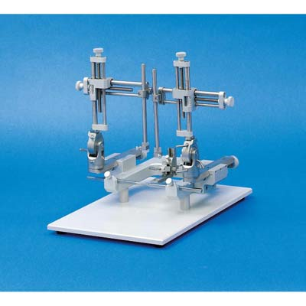
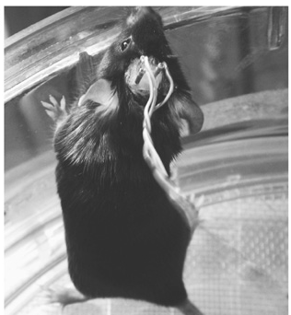
Surgical procedure
Animals anesthetized and held onto a stereotaxic frame
Small holes drilled through the skull
Electrodes inserted by micromanipulators according to XYZ coordinates of targeted regions
Electrodes secured onto skull surface via dental cement or glue
Baseline recordings after a few days of recovery.
Brain histology at the end of experiments

Slide 9
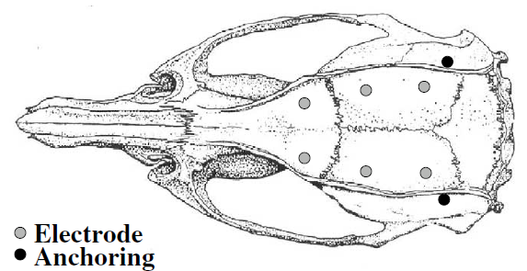
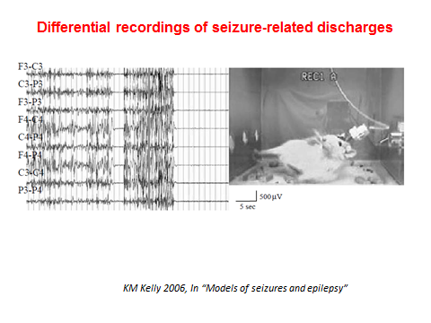
Epidural / differential recordings
often used with epidural electrodes
Signals - difference between paired electrodes
rejecting noises from common sources
Relatively stable
weak signals, not region-specific

Slide 10
Single end recordings
Used for simple or multi-electrode recordings
region-specific signals
signals relative to ground
Relatively strong signals
Precise position and histological verification
Brain tissue damage
Influence by noise
instability of electrodes

Slide 11
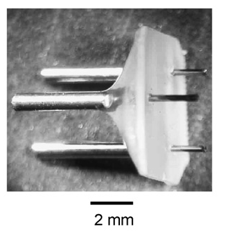
Simple intracranial electrodes we used
Polyamide-coated stainless steel wires
0.12 mm O.D, <1Ω/10mm,
80-90 mg fro a 3-electrode array
Secured onto skull surface via glue
Low cost, but need experience to make
Minimal brain damage
For mice from 19 day-old to 2 year-old
Wu et al. J Neurosci Meth. 2008

Slide 12
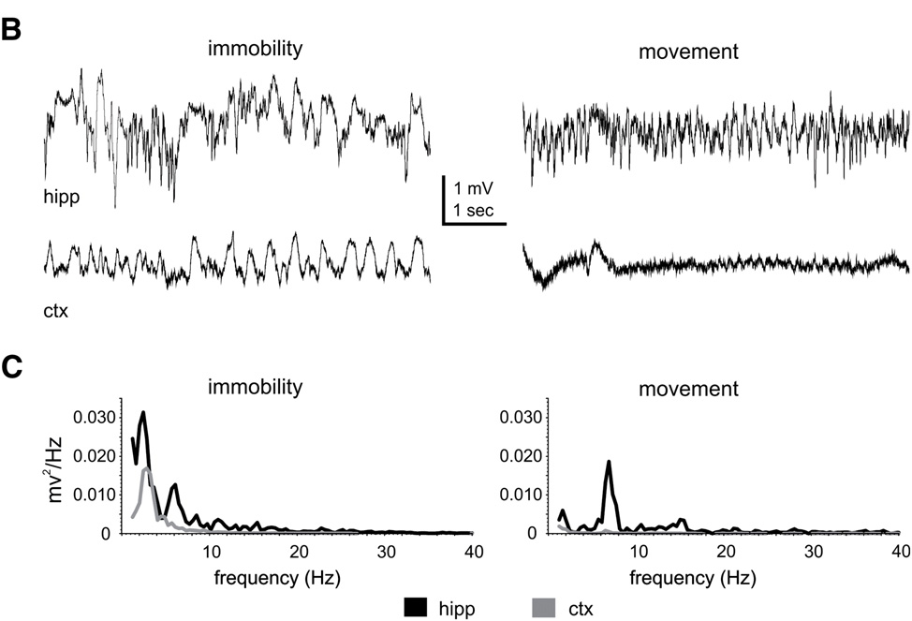
Behavioral state-dependent EEG

Slide 13
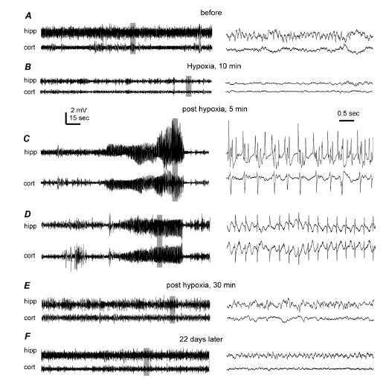
Hypoxia-induced EEG discharges in a young mouse
Wais et al
Neurosci 2009

Slide 14
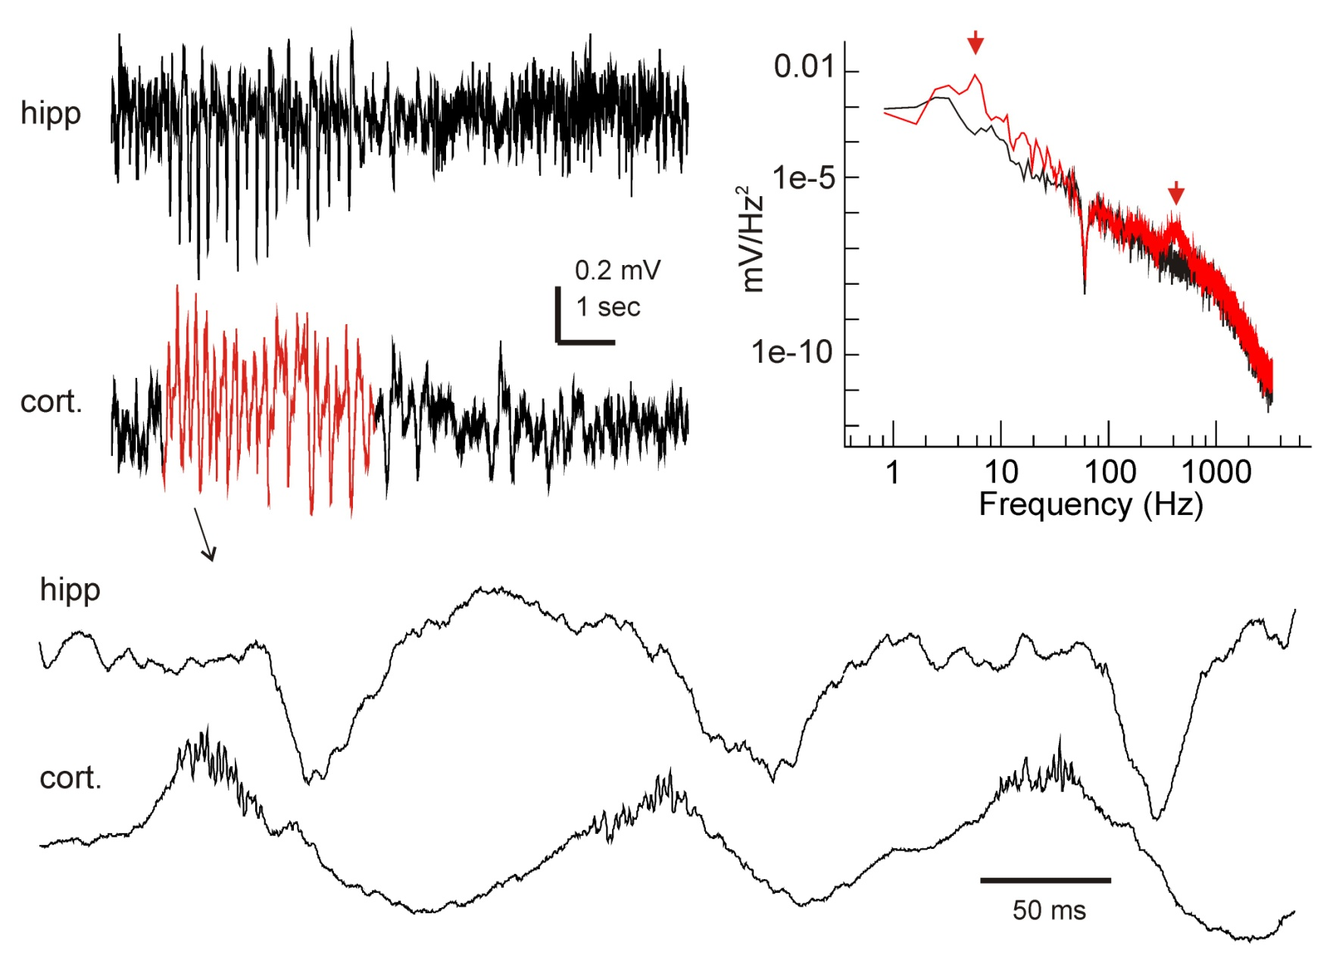
Cortical discharges recorded via tethered EEG from MeCP2-dificient mice (a mouse model of Rett syndrome)
Zhang et al, in preparation

Slide 15
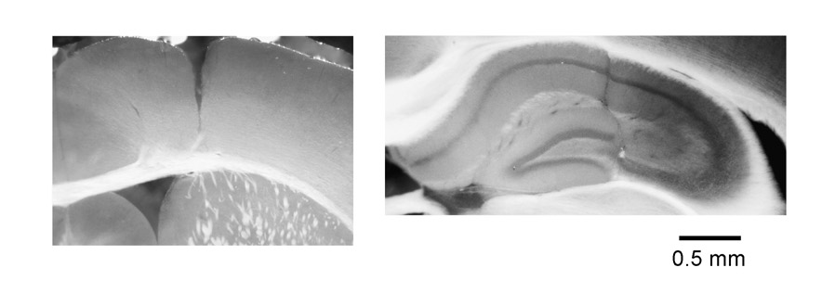
Histological verification of implanted electrodes

Slide 16
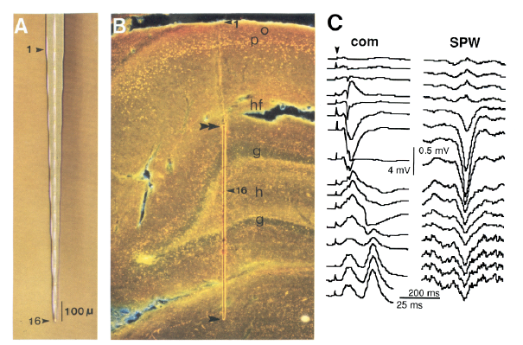
Multi-electrode probes
Stable chronic monitoring?
Ylinen et al., J Neurosci 1995

Slide 17
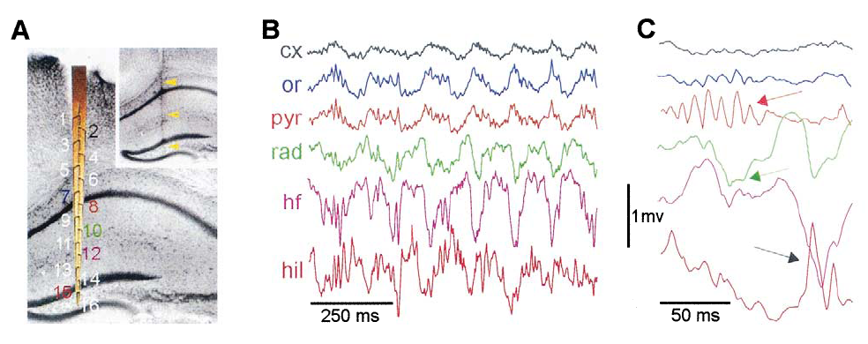
Multi-electrode EEG recordings in mice
Buzsaki et al. Neurosci. 2003

Slide 18
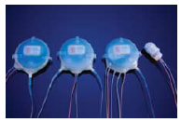
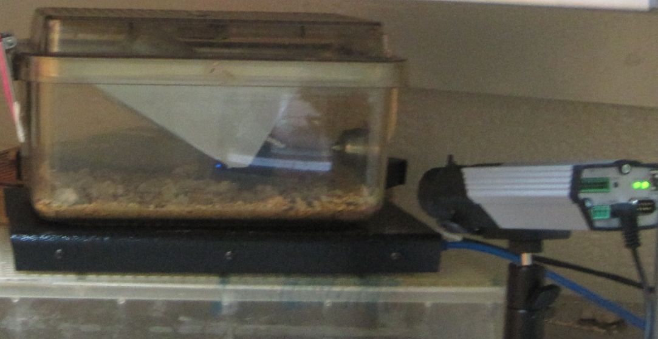
Transmitter for telemetric
1.6g
Transmitter implanted subcutaneously or in peritoneal cavity
Continuous recording in home cage (24 hrs/day, up to 2 months)
Simultaneous monitoring of EEG, temperature and gross movement
Minimal cable/movement-related artifacts
Single bio-potential channel, low sampling rate (up to 200 Hz)
Limitation by battery life

Slide 19
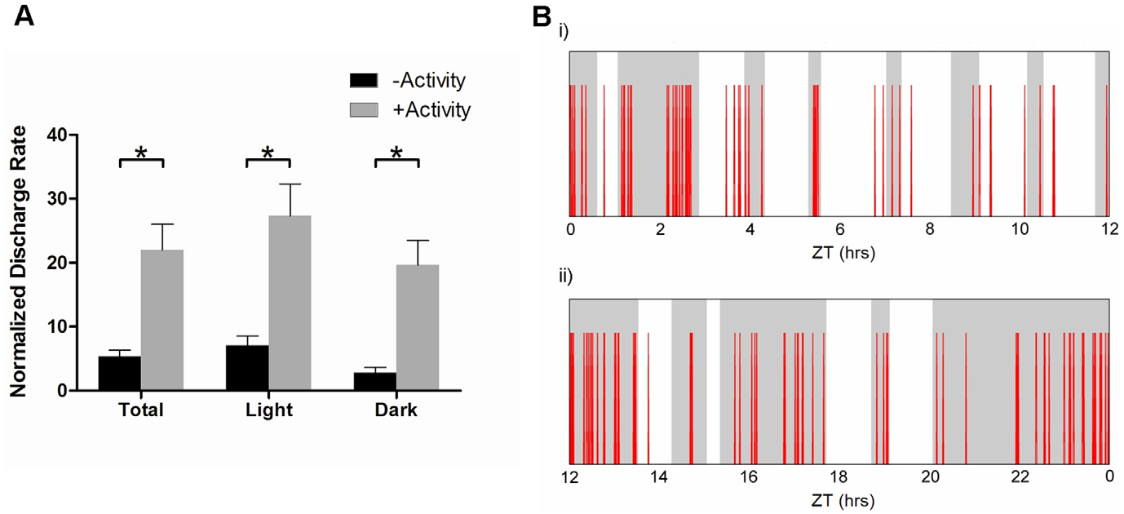
Discharges recorded via telemetric EEG from MeCP2-dificient mice
Wither et al, Plos One, 2012

Slide 20
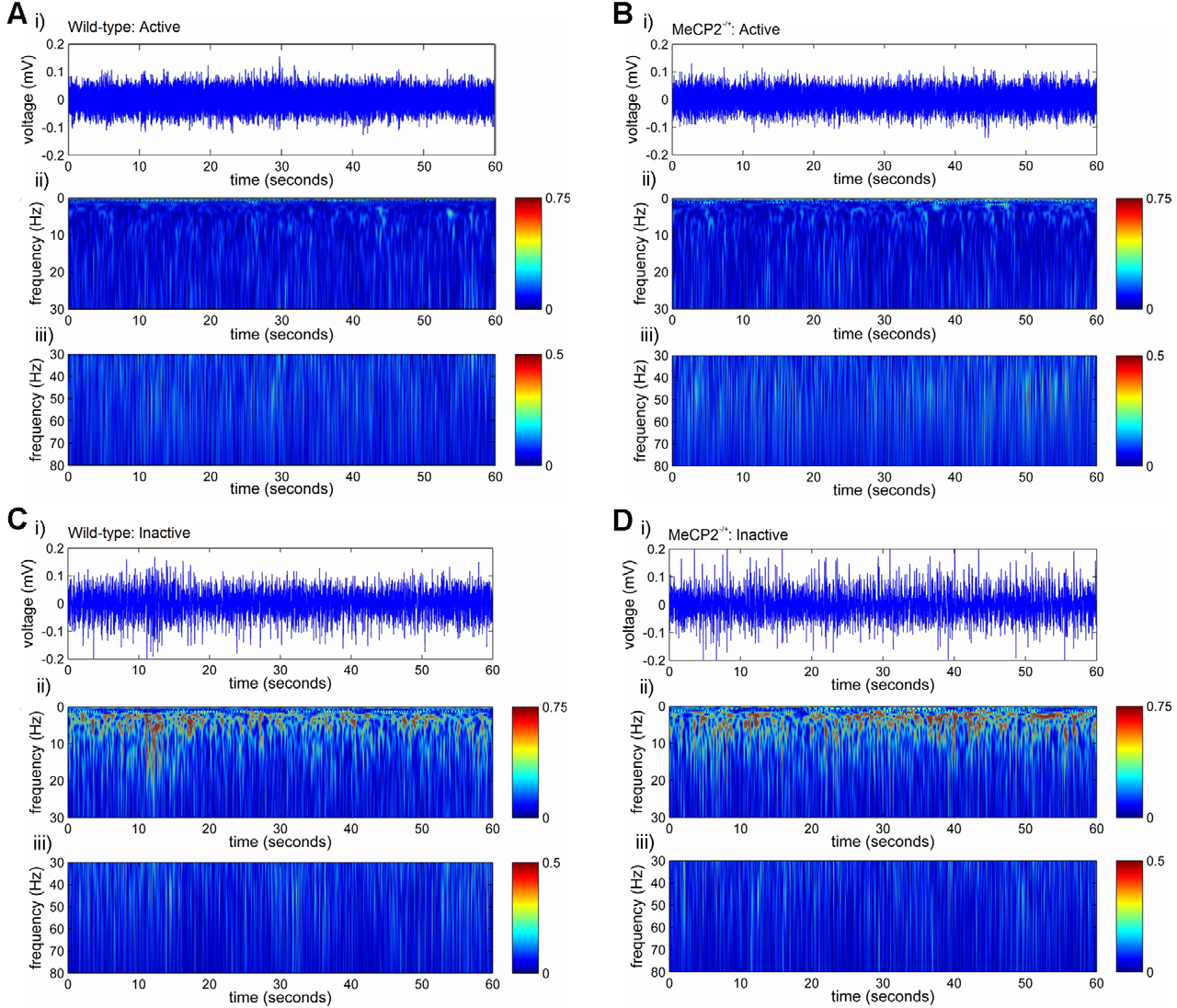
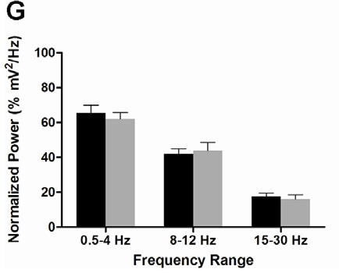
Telemetric recordings of cortical EEG from wild type and MeCP2-dificient mice
Wither et al,
Plos One, 2012

Slide 21
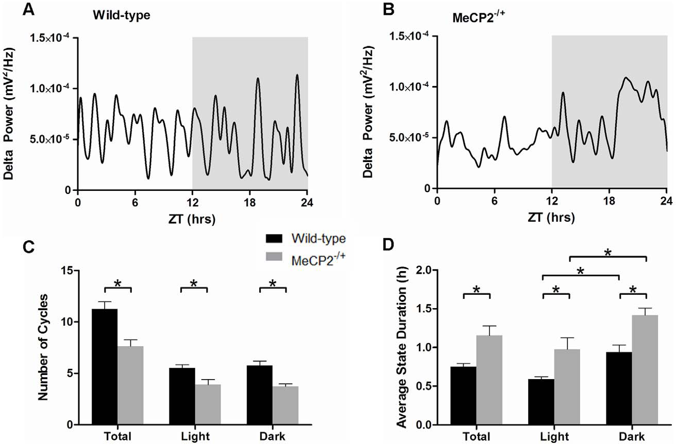
Alterations of cortical delta periodicity in in MeCP2-deficient mice

Slide 22
Summary
Feasibility of intracranial EEG recordings in rodents models
Tethered or telemetric or Multi-electrode recording
Brain activities under “physiological” and “pathophyological” conditions
Experienced rodent surgeons
Experienced electrode makers
Ways to secure electrodes onto skull

Slide 23
Examinations of population rhythms in isolated brain preparations in vitro
Isolated whole brain from guinea pigs
Isolated whole hippocampal preparation from rats or mice
Thick (0.7-1 mm) hippocampal-subicular-entorhinal slices from mice

Slide 24
In vitro approaches

Slide 25
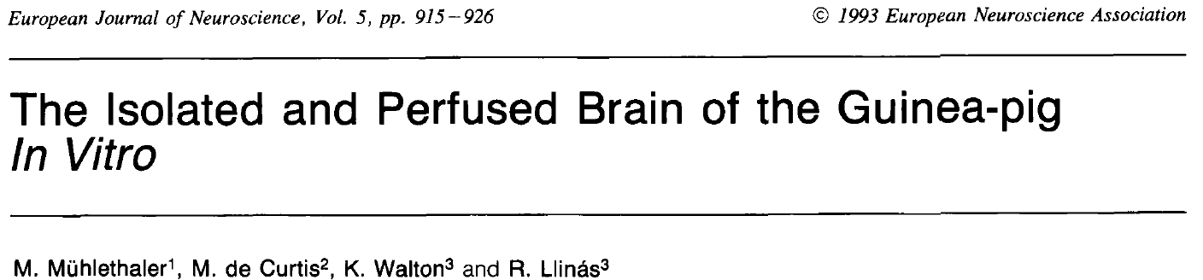
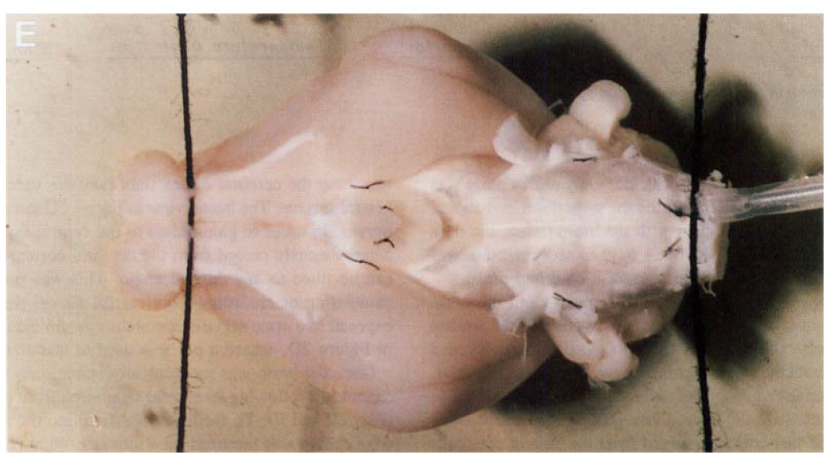
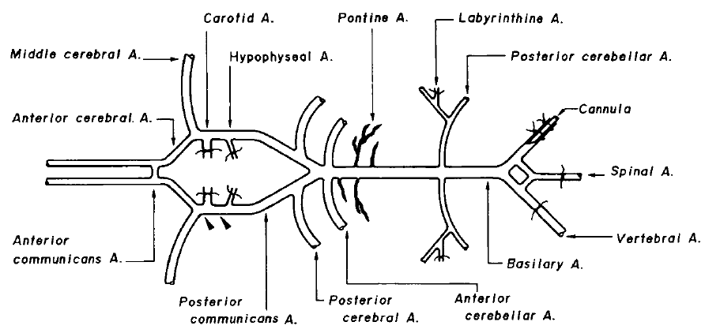

Slide 26
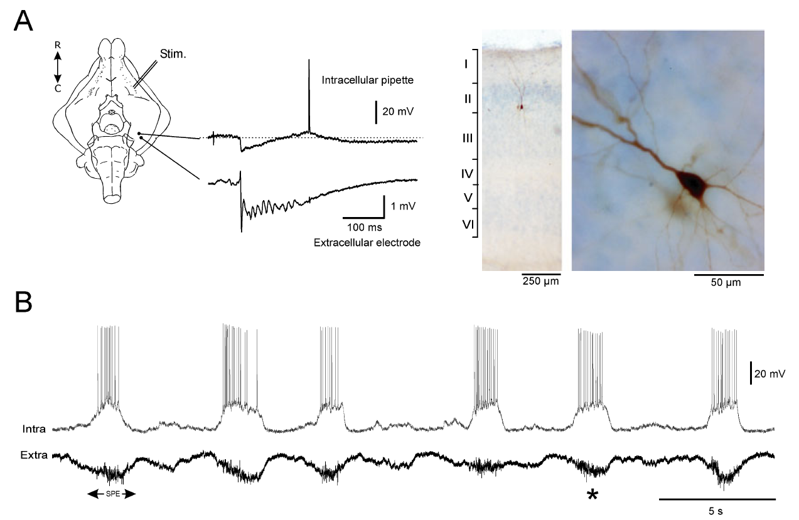
Spontaneous rhythmic activities of entorhinal cortex recorded from isolated whole brain of guinea pigs
Gnatkovsky et al., Eur J Neurosci 2007

Slide 27
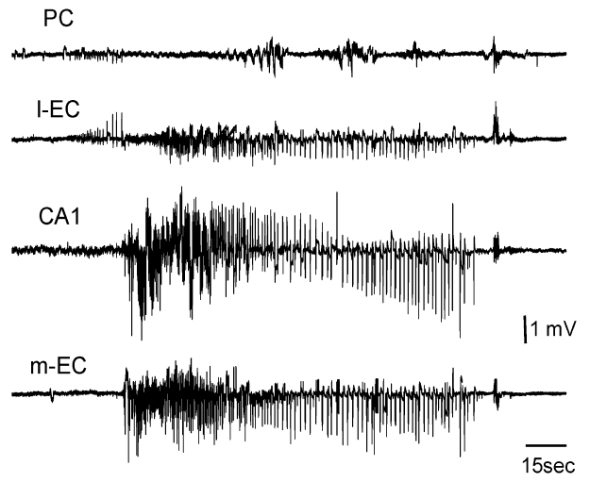
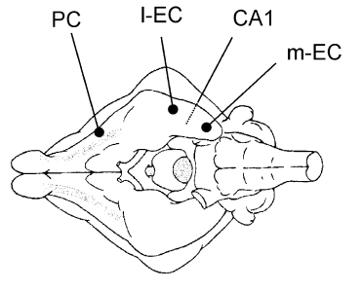
4-AP induced epileptiform activities in isolated whole brain of guinea pigs
Uva et al., Eur J Neurosci 2009

Slide 28
Issues about isolated whole brain preparation
Macroscopic circuitry
Extracellular-single cell recordings
Pharmacological manipulation
Animal protocol
Recordings from basal brain regions
Suitability for rats or mice?

Slide 29
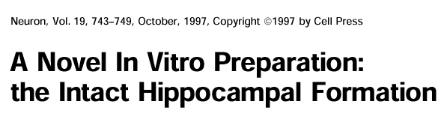
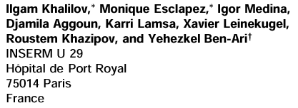
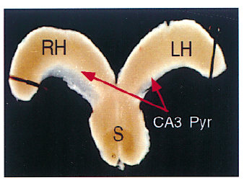

Slide 30
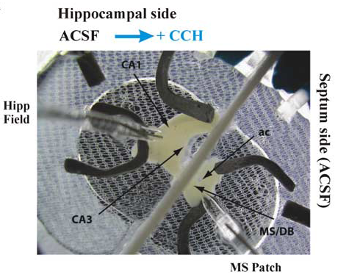
Isolated whole septal-hippocampal preparation
Manseau et al, J Neurosci 2008

Slide 31
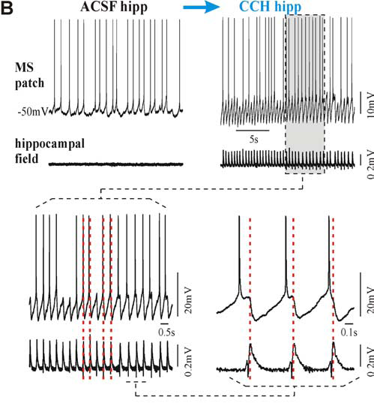
Isolated whole septal-hippocampal preparation
Manseau et al,
J Neurosci 2008

Slide 32
Issues about isolated whole hippocampal or septal-hippocampal preparations
Macroscopic circuitry
Feasibility of extracellular-single cell recordings
Pharmacological manipulations
Whole hippocampal preparation (neonatal animals, <postnatal day 10)
Septal-hippocampal preparation (immature animals, postnatal day 12-18)

Slide 33
In vitro preparations
Cultured neurons or slices
Acutely isolated brain slices
Acutely isolated whole hippocampal and hippocampal-septal tissues
Acutely isolated whole brain

Slide 34
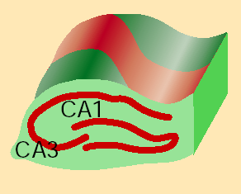
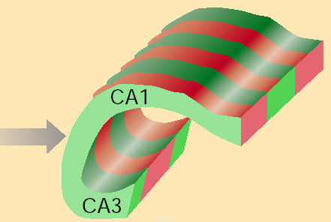
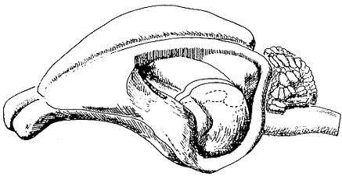
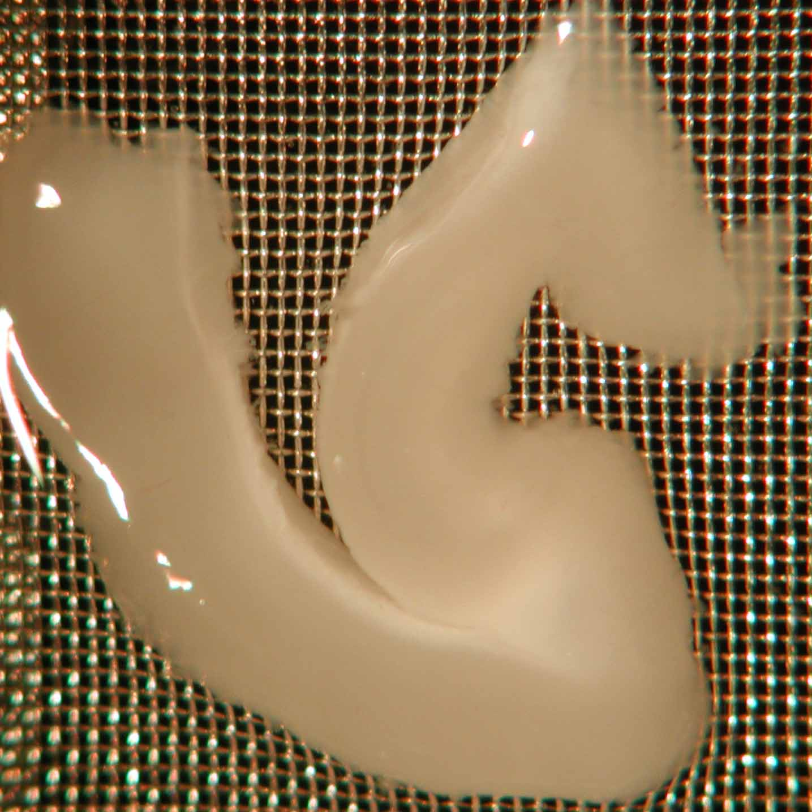
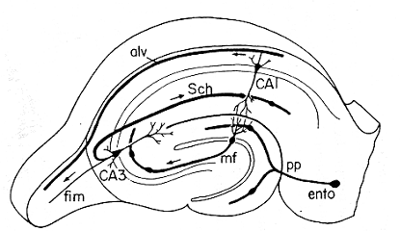
Thick hippocampal slices from adult mice
CA3
DG
CA1
Thickness of 0.7-1 mm
Thickness of ~0.4 mm
sub
EC

Slide 35
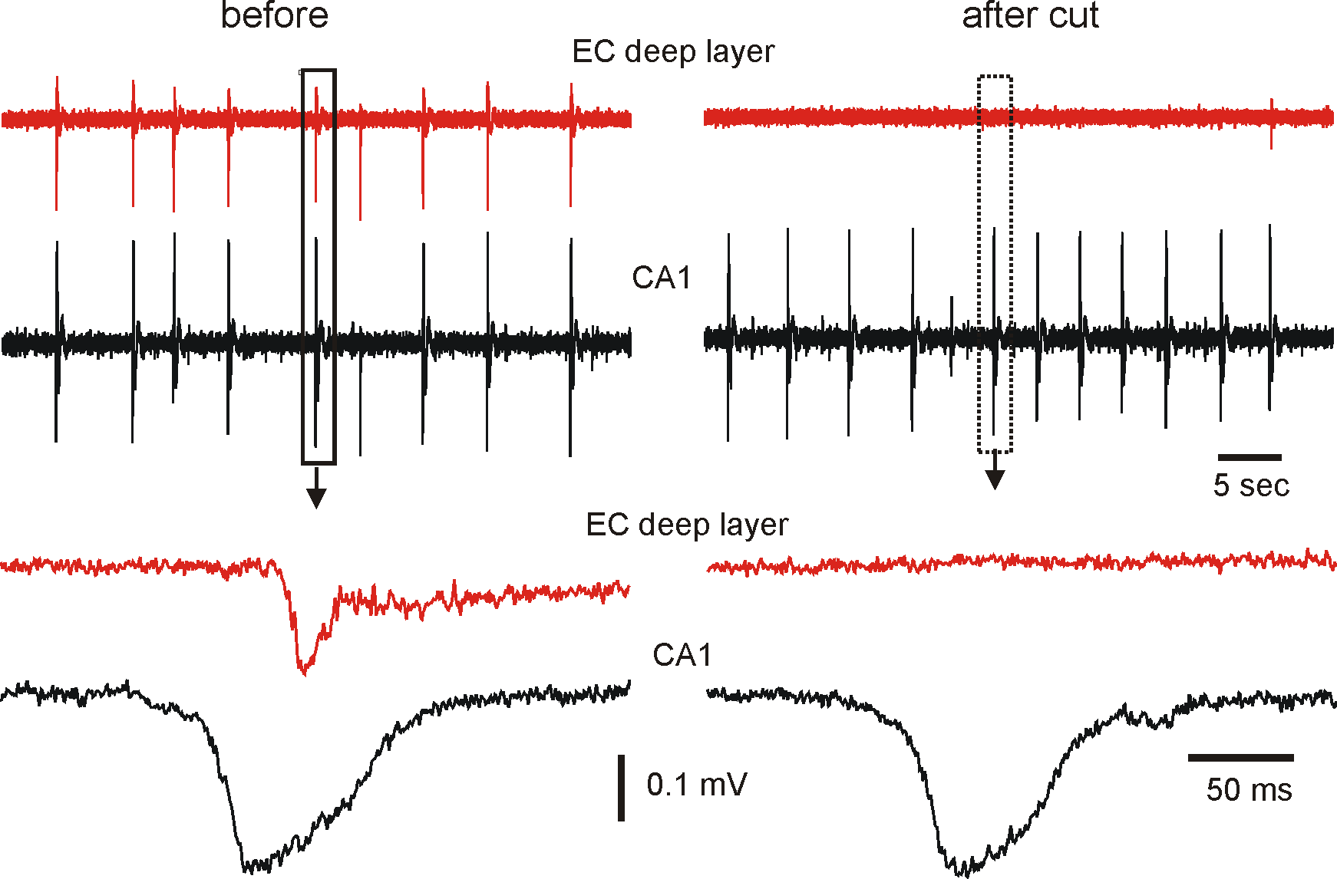
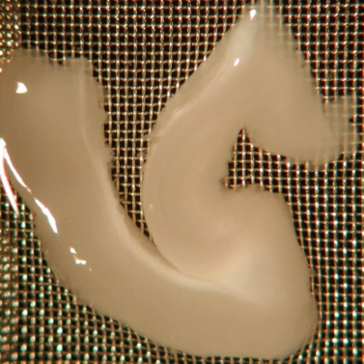
Hippocampal-entorhinal spread of in vitro sharp waves
CA1
EC
Wu et al., unpublished data

Slide 36
Issues about thick slice preparation
Suitable for adult mice (up to 9 month-old)
Spontaneous and induced population activities
Extracellular-single cell recordings
Pharmacological manipulation
Potential dissection damage or irritation
Suitable for mouse models of diseases?

Slide 37
Summary
In vitro preservation of relatively large circuitry
Generation, propagation and modulation of intrinsic rhythms or epileptiform activities
Multiple extracellular and single cell recordings
animal age
disease models
influences by dissection damage and/or tissue deterioration in vitro

Slide 38

Acknowledgement
Chiping Wu Berj L. Bardakjian
Jennifer Anne D'Cruz James H Eubanks
Sinisa Colic Frances Skinner
Robert G. Wither Peter Carlen
Min Lang Taufik Valiante
Salman Aljarallah
Kaushik Shampur
Tariq Zahid
Youssef El-Hayek
NSERC, CIHR
International Rett Syndrome Foundation

