Slide 1
Data Analysis and Visualization
Wayne Oldford Statistics & Actuarial Science

Slide 2
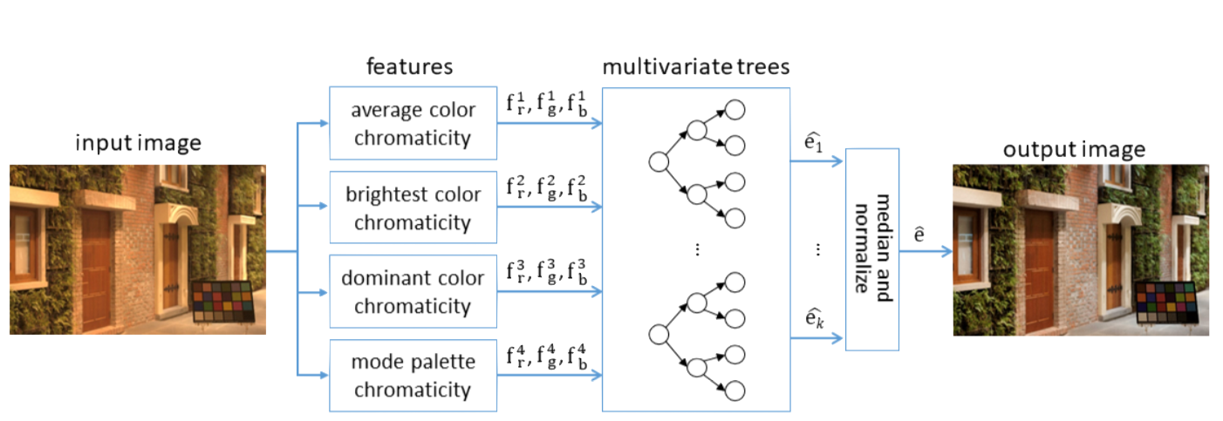
Research interests
Data analysis and predictive analytics
man - machine tradeoff:
from enabled to automated analytics
AUTOMATED: Computational photography — illuminant estimation
accurate (competitive with deep neural nets)
compact and efficient (can be implemented on board the camera)
meaningful (models well understood colour features and human colour discrimination)

Slide 3
Research interests
Data analysis and predictive analytics
man - machine tradeoff:
from enabled to automated analytics
ENABLING THE ANALYST: Browser-based dashboard for Hillary Clinton’s emails
rshiny.math.uwaterloo.ca/clinton

Slide 4
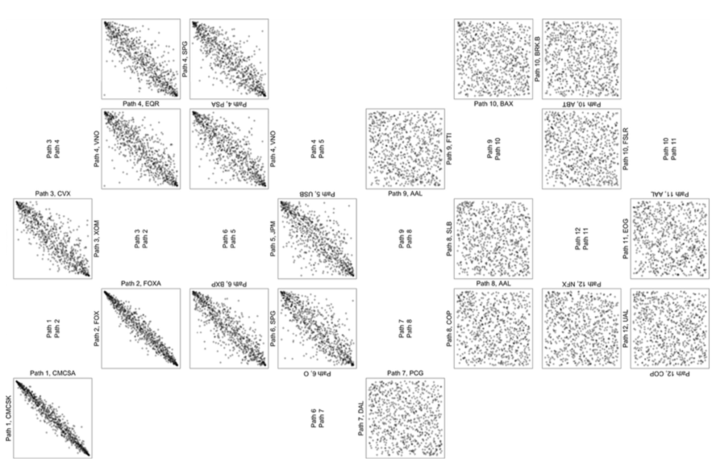
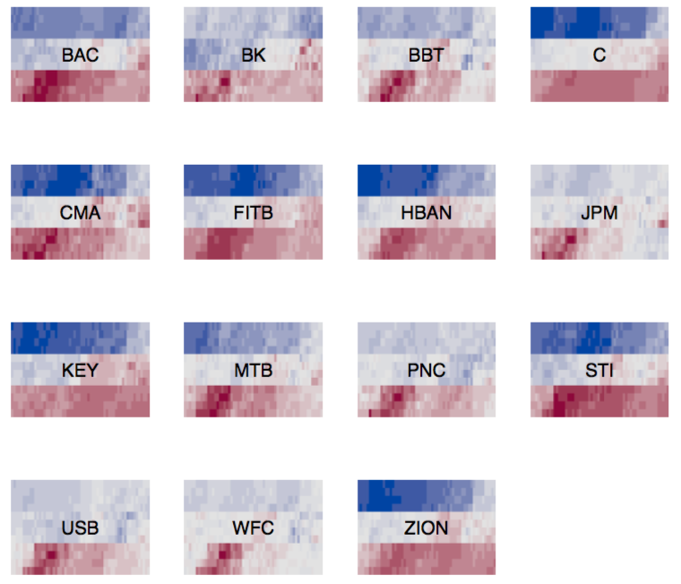
Research interests
Guided analytics and visualization
Search for interesting patterns:
pre-compute, sort, and search geometric and statistical measures
present meaningful displays to show unanticipated pattern
S&P 500 daily returns 2007-2009
10 most and least dependent pairs of stocks
Banks: three years of daily returns

Slide 5
Research interests
Guided analytics and visualization
Data reduction:
numbers of observations, numbers of variates/attributes
preserve patterns (e.g. distribution and geometry)
560 dimensions -> 5

Slide 6
Research interests
Guided analytics and visualization
Data reduction:
numbers of observations, numbers of variates/attributes
preserve patterns (e.g. distribution and geometry)
560 dimensions -> 5

Slide 7
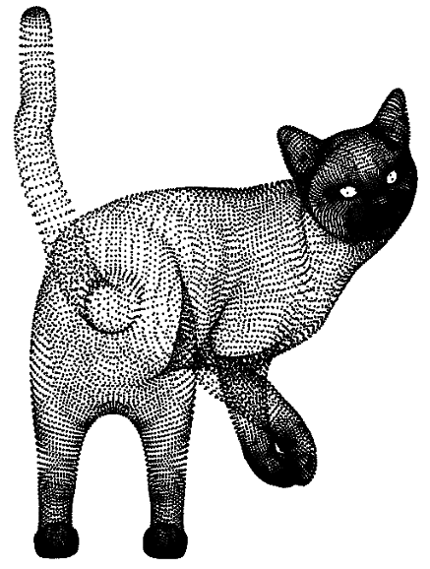
Research interests
Guided analytics and visualization
Data reduction:
numbers of observations, numbers of variates/attributes
preserve patterns (e.g. distribution and geometry)
about 28,000 points -> 5,000 points

Slide 8
Research interests
Guided analytics and visualization
Data reduction:
numbers of observations, numbers of variates/attributes
preserve patterns (e.g. distribution and geometry)
about 28,000 points -> 5,000 points
random sampling
our method

Slide 9
Research interests
Data analysis and predictive analytics
man - machine tradeoff:
from enabled to automated analytics
Guided analytics and visualization
Search for interesting patterns:
pre-compute, sort, and search geometric and statistical measures
present meaningful displays to show unanticipated pattern
Data reduction:
numbers of observations, numbers of variates/attributes
preserve patterns (e.g. distribution and geometry)
Power tools for interactive data analysis
Software tools:
LOON: interactive data visualization in R
ZENPLOTS: automated layout of hundreds of plots
numerous other R packages and statistical analysis software

