Slide 1
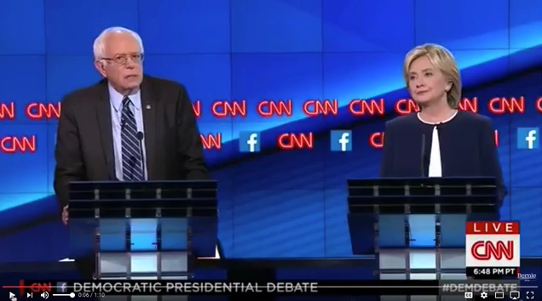

Slide 2
The Interactive Filter and Display of Hillary Clinton’s Emails
Presented by: Christopher Salahub
Joint work with R. Wayne Oldford
Based on work published in
Significance June 2018

Slide 3
The Emails
Roughly half of all emails from clintonemail.com (Registered January 13, 2009)
  Other half irrevocably deleted
A corpus of 32,795 documents as of May 2018
  Emails and attachments

Slide 4
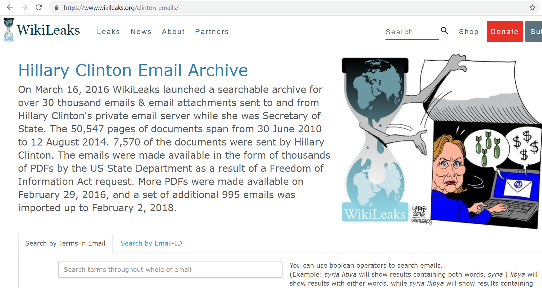
Getting the Emails
Released by the State Department (FOIA request)
Processed from PDF to HTML by Wikileaks
Wikileaks HTML extracted and processed

Slide 5
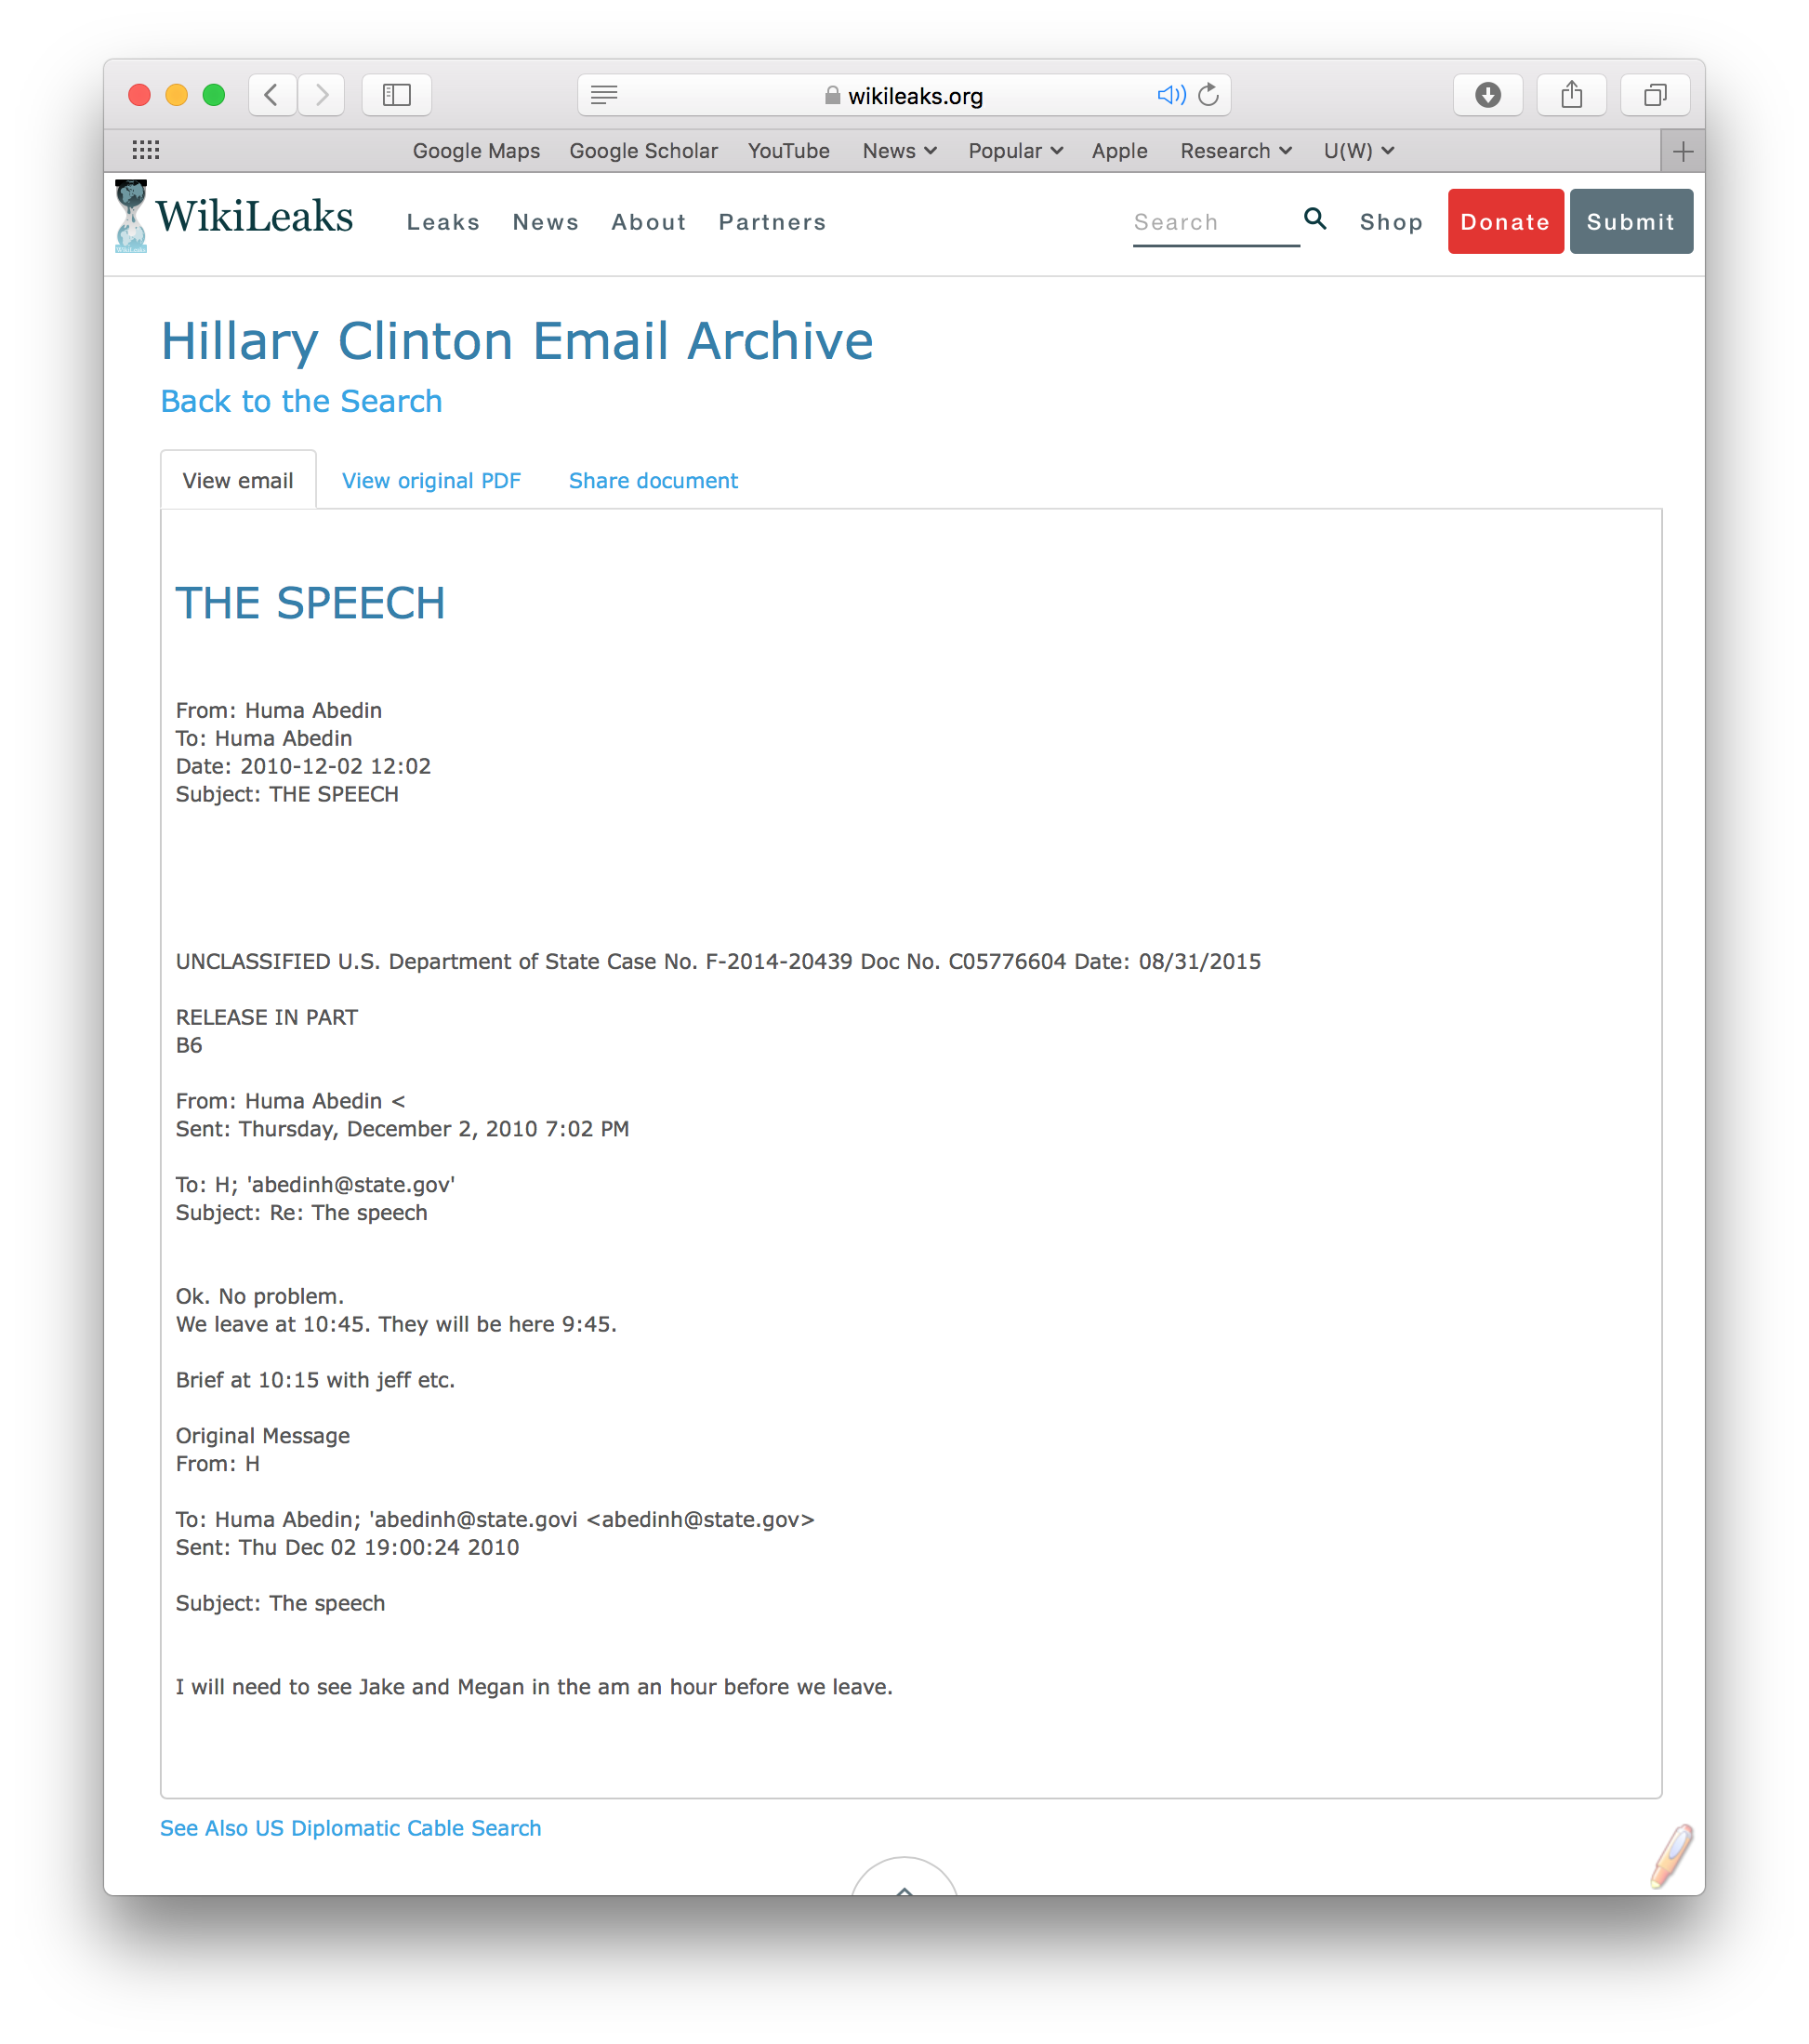
Final Data
Header
  Subject, email addresses, date and time
Body
  Email content

Slide 6

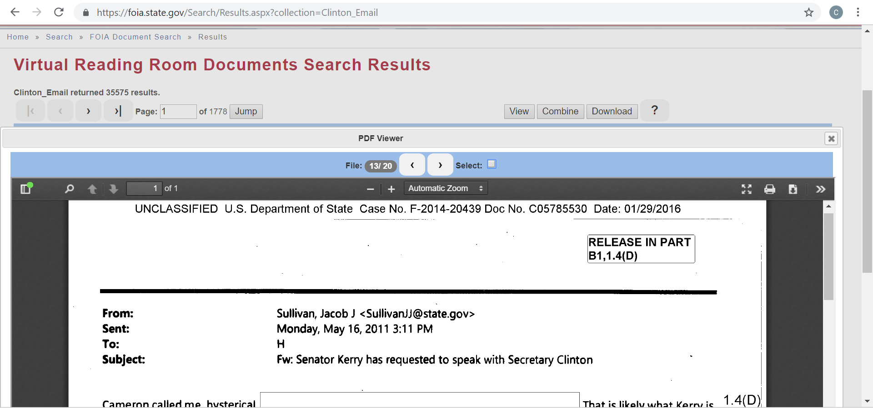
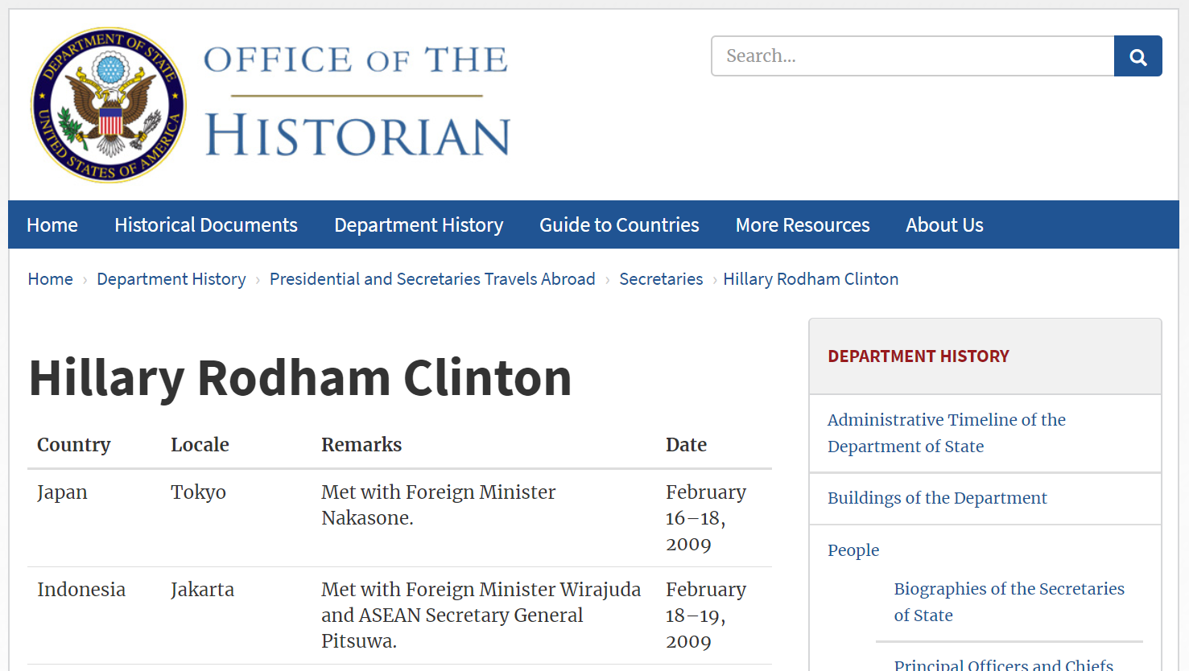
Auxiliary and Synthetic Data
FOIA redaction codes
Term frequency
TF-IDF (term “importance”)
Official travel schedule

Slide 7
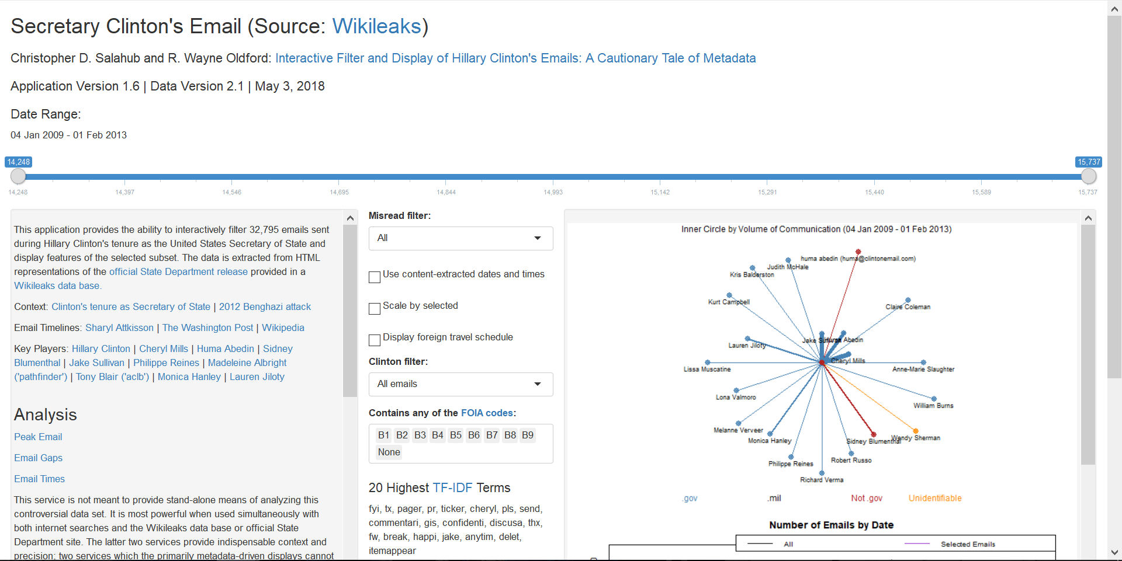
Putting it All Together
https://shiny.math.uwaterloo.ca/sas/clinton/

Slide 8
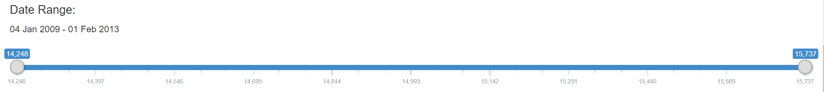
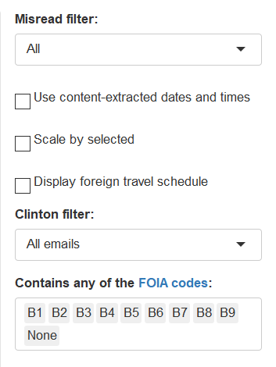
Features: Filter the Data
Date
Wikileaks data errors
Display settings
Clinton to/from
FOIA codes

Slide 9
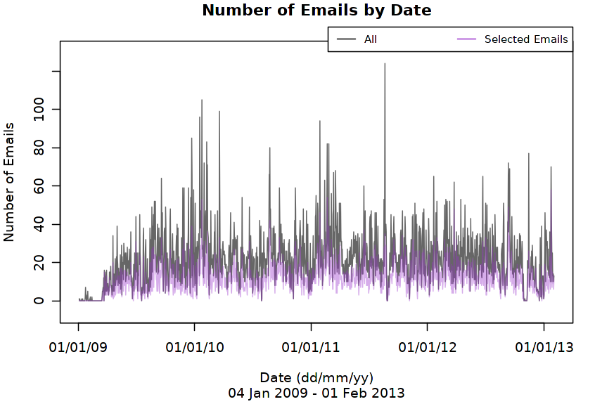
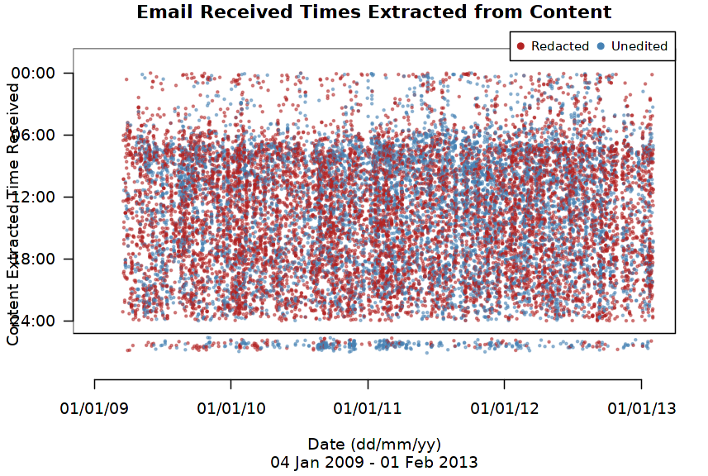
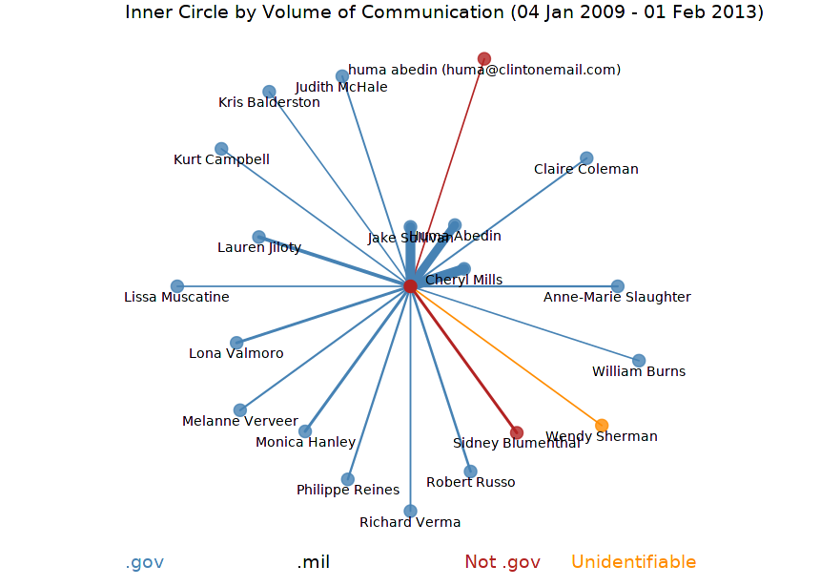
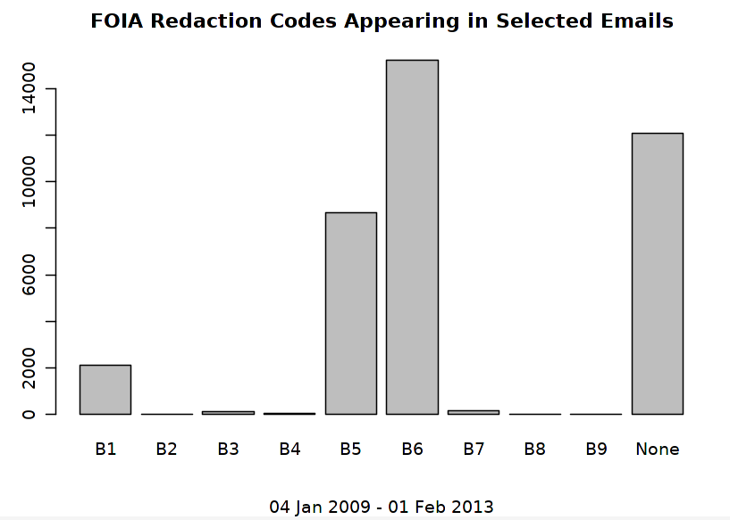
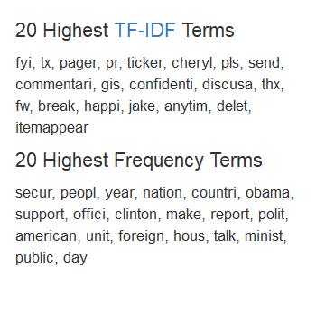
Features: Interactively Visualize

Slide 10
What should we do with this?

Slide 11
Explore!

Slide 12
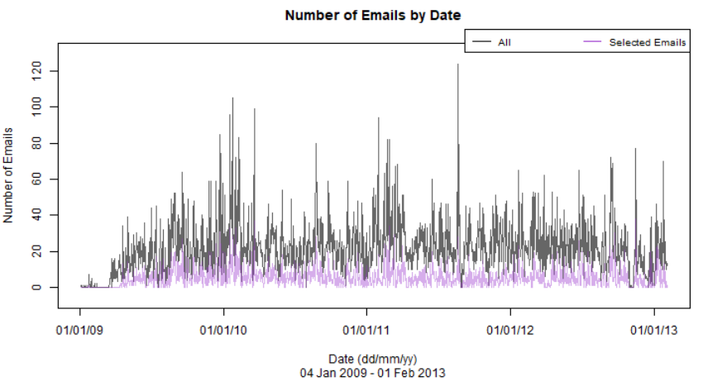
Missing Emails?
A conspicuous gap…

Slide 13
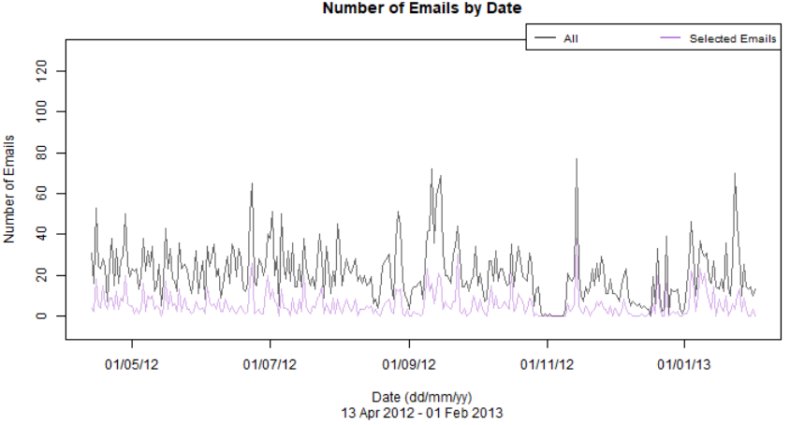
Missing Emails?
Filter by time…

Slide 14


Missing Emails?
But is this gap of six days (Nov. 3-9 2012) “significant?”
  In other words: would we expect such a gap to be present as the result of random sampling?

Slide 15
A Tale of Two Tests
Parametric
  Estimate the probability of a day with no email
  Simulate independent random samples and note the largest gap
Non-parametric
  Duplicate each email
  Remove gaps by shifting dates
  Sample half of these email dates and note the largest gap
  Meant to mimic the selection process

Slide 16
A Tale of Two Tests

Slide 17
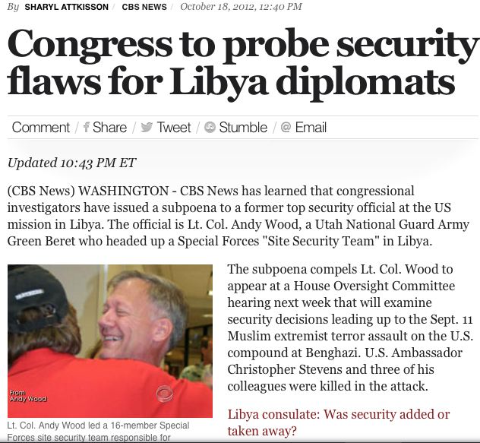
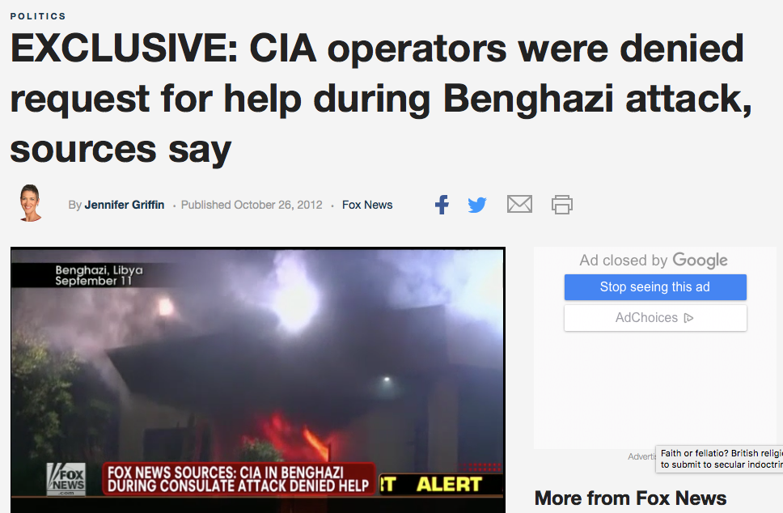
Why the Gap?
Unfortunately, controversy…
  Benghazi attack commission
  State Department narrative unravels
    Coordinated rather than spontaneous attack
    Ansar al-Sharia
  Use of BleachBit, sorting event by Clinton’s staff

Slide 18
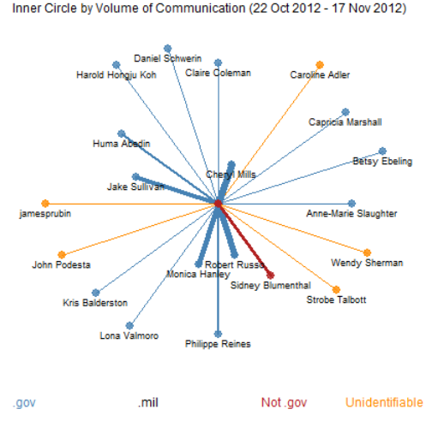
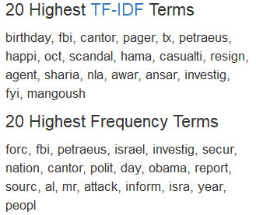
Why the Gap?
Event seems unlikely by chance…
  What is happening around the event?

Slide 19
Confirmation Bias
We should be extra careful with such a polarized topic
Perform a coarse Google search, maybe something controversial is always going on?
  10 month year combinations
  First page of results examined
  Verdict: many months had controversial headlines, none related to the emails except for December 2012

Slide 20
Conclusions
Data has inherent limitations
  Context and expertise are critical
Statisticians as facilitators
  Assisting experts and interested individuals
Look at the data for yourself:
  https://github.com/Salahub/Clinton-Emails

Slide 21
Thanks for listening! Any questions?

Slide 22
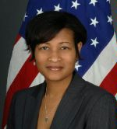
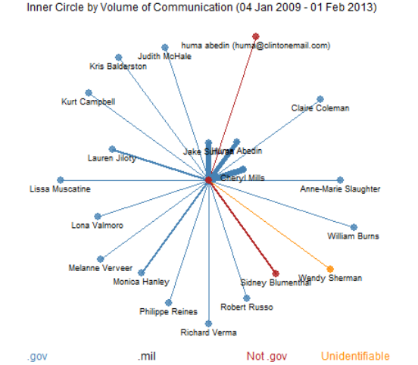
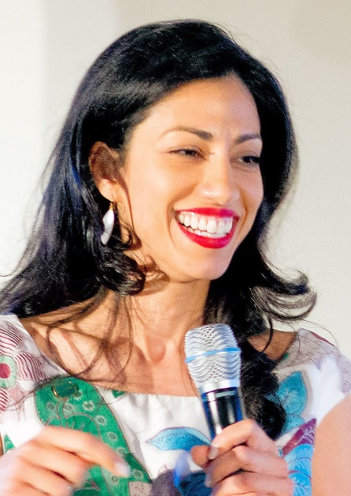
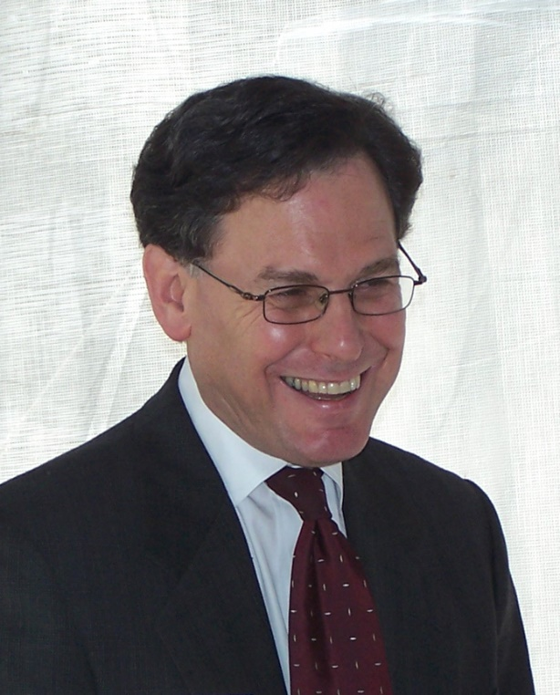
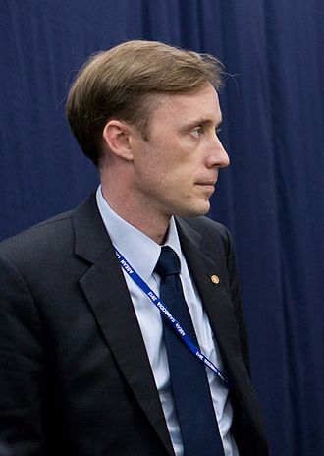
Who’s Who: The Spiral Network Plot
Cheryl Mills
Photo: US State Dept.
Huma Abedin
Photo: Maggie Hallahan
Sidney Blumenthal
Photo: Larry D. Moore
Jake Sullivan
Photo: The White House

Slide 23
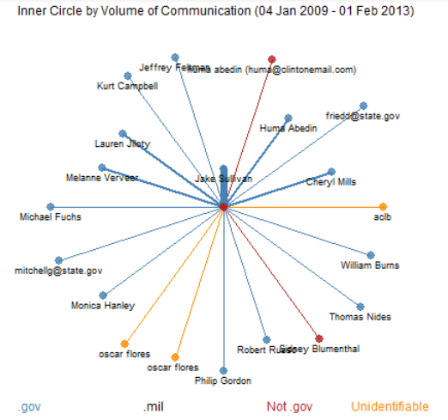
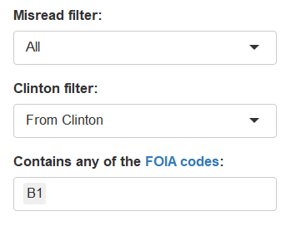
A More Interesting Who’s Who

Slide 24
A More Interesting Who’s Who
(b)(1) (A) specifically authorized under criteria established by an Executive order to be kept secret in the interest of national defense or foreign policy and (B) are in fact properly classified to such Executive order
Source:https://vault.fbi.gov/explanation-of-exemptions

