Slide 1
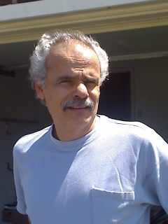
Happy 60th Birthday!

Slide 2
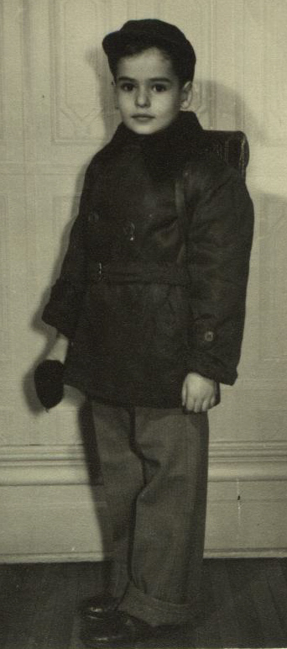
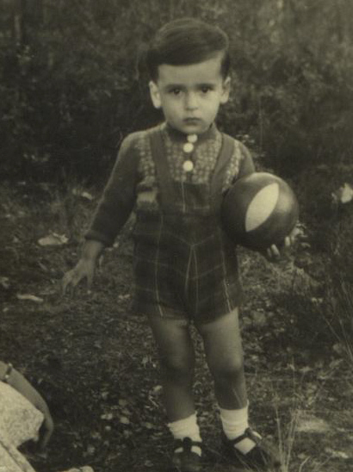
Henry’s Highlights
1948: Born February 25th

Slide 3
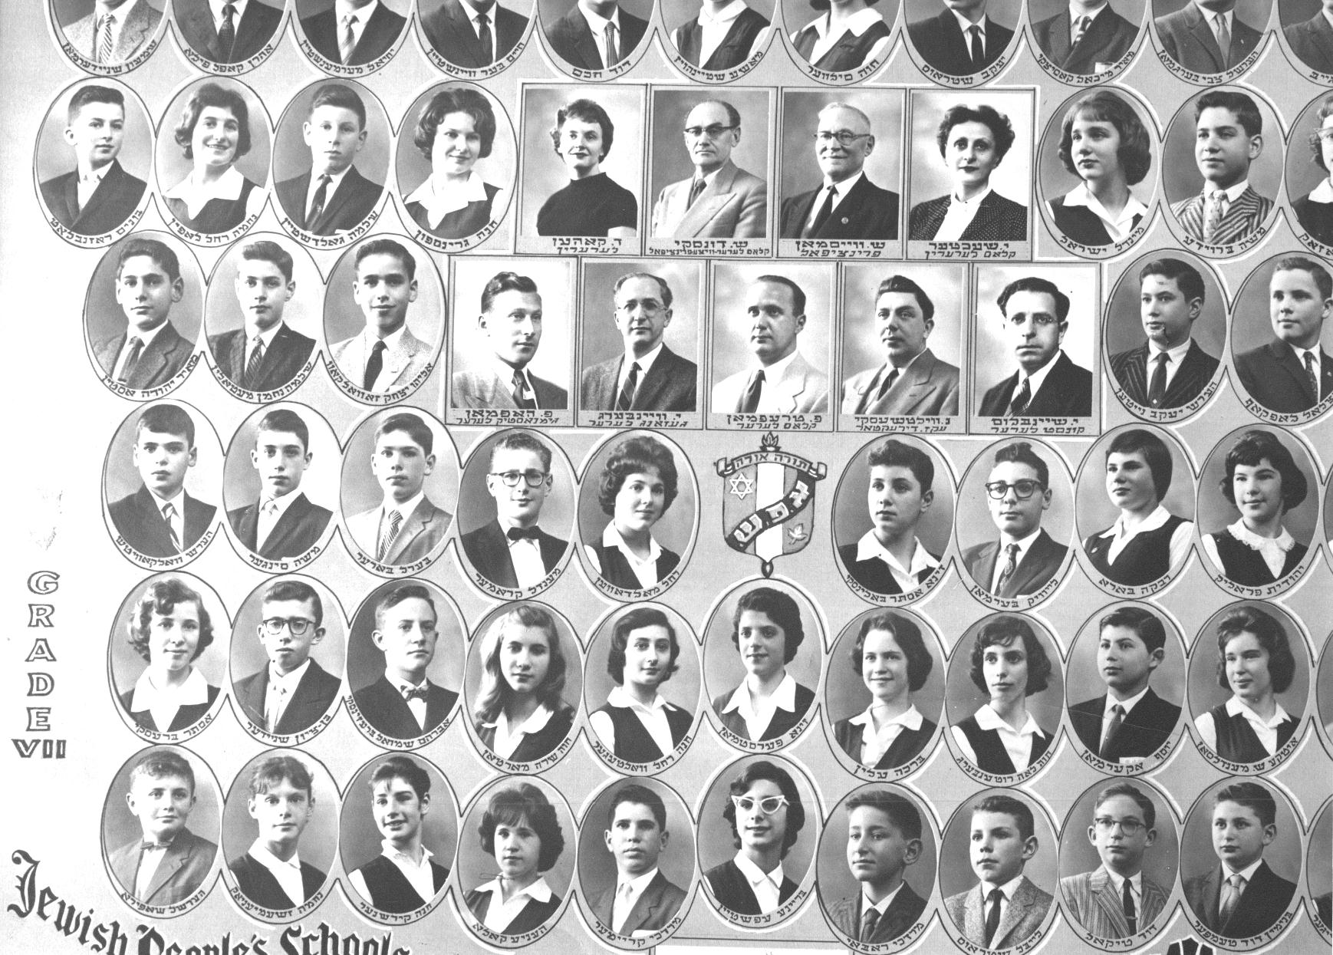

Slide 4
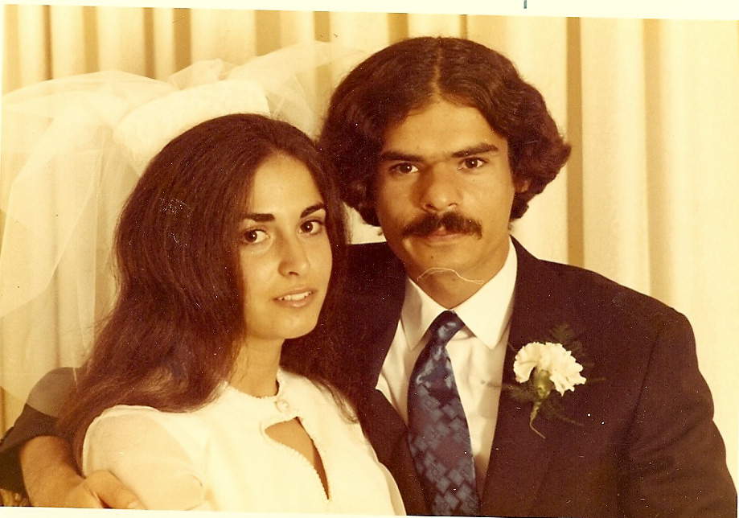
Henry’s Highlights
1968: Met Gail
1970: Married Gail

Slide 5

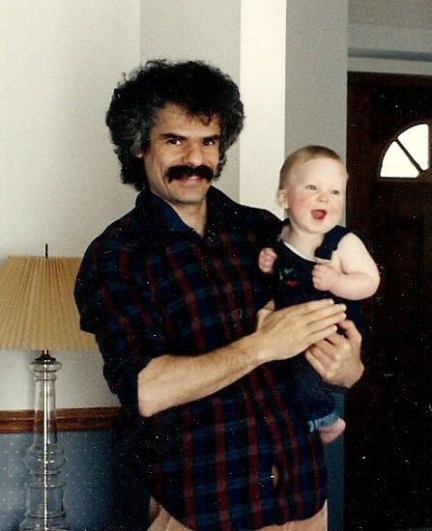
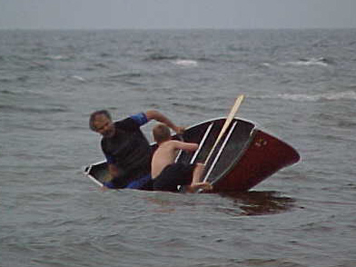
Henry’s Highlights
1978: Awarded PhD from McGill
1990: Became a father to Daniel

Slide 6
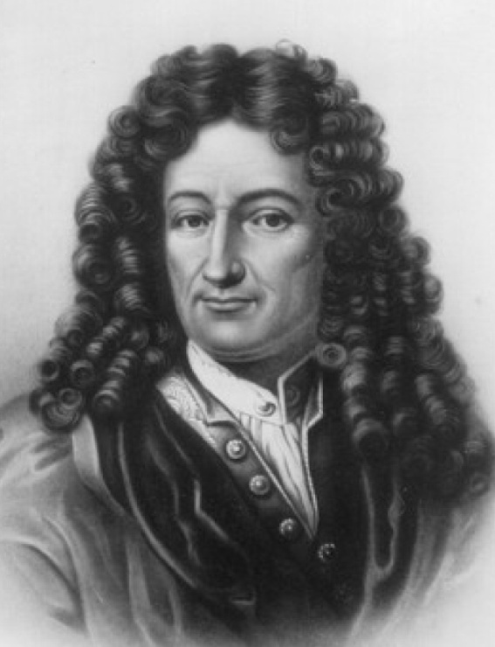
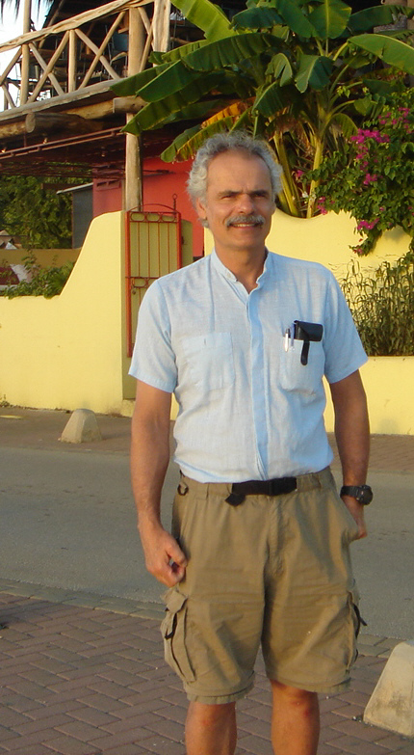
Henry’s Heritage
Leibniz
Jacob Bernoulli
Johann Bernoulli
Euler
Lagrange
Poisson
… …
Charnes
Ben-Israel
Zlobec
HENRY
Bourgin

Slide 7
Henry's Greatest Hits
An interior-point method for semidefinite programming (with C. Helmberg, F. Rendl & R.J. Vanderbei, 1996): 376 citations
Handbook of Semidefinite Programming: Theory, Algorithms, and Applications (with R. Saigal & L. Vandenberghe, 2000): 368 citations
A semidefinite framework for trust region subproblems with applications to large scale minimization (with F. Rendl,1997): 100 citations

Slide 8
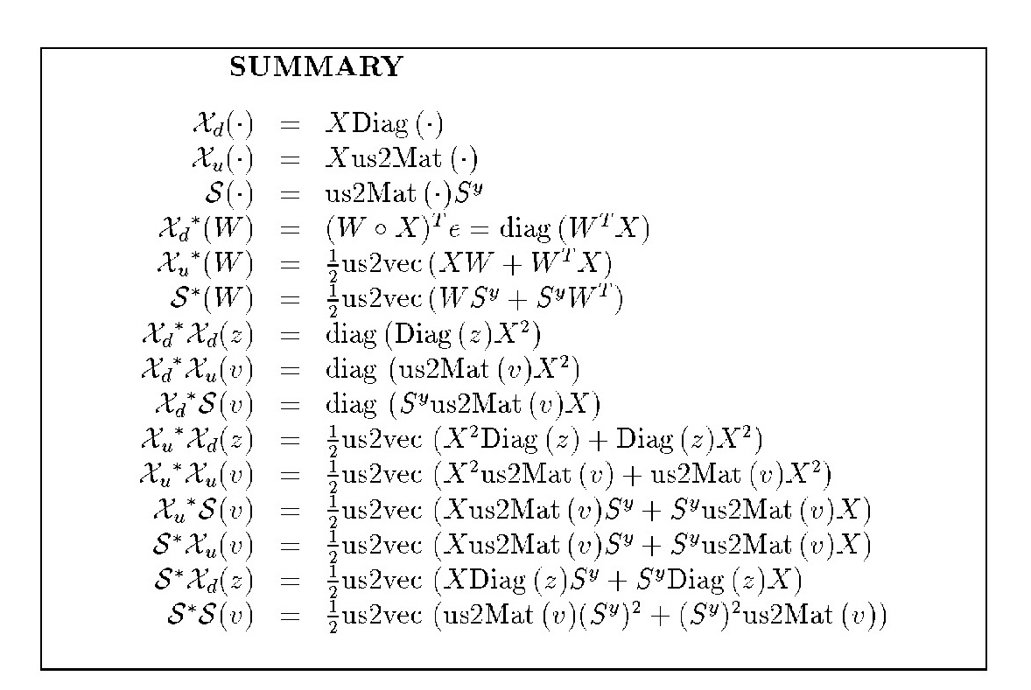
Oh Henry!

Slide 9
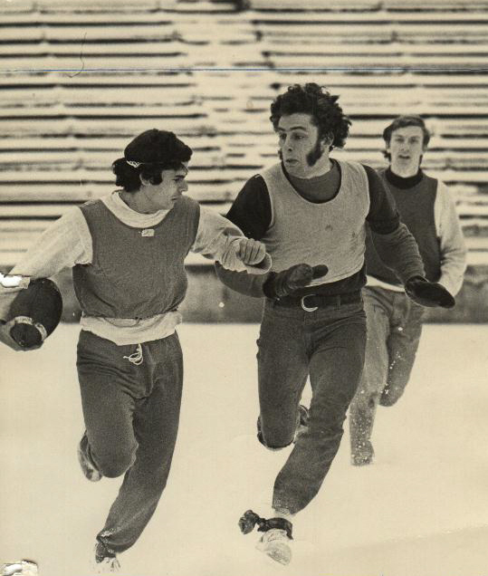
Henry’s Accomplices
Grad students
Postdocs
Co-authors

Slide 10
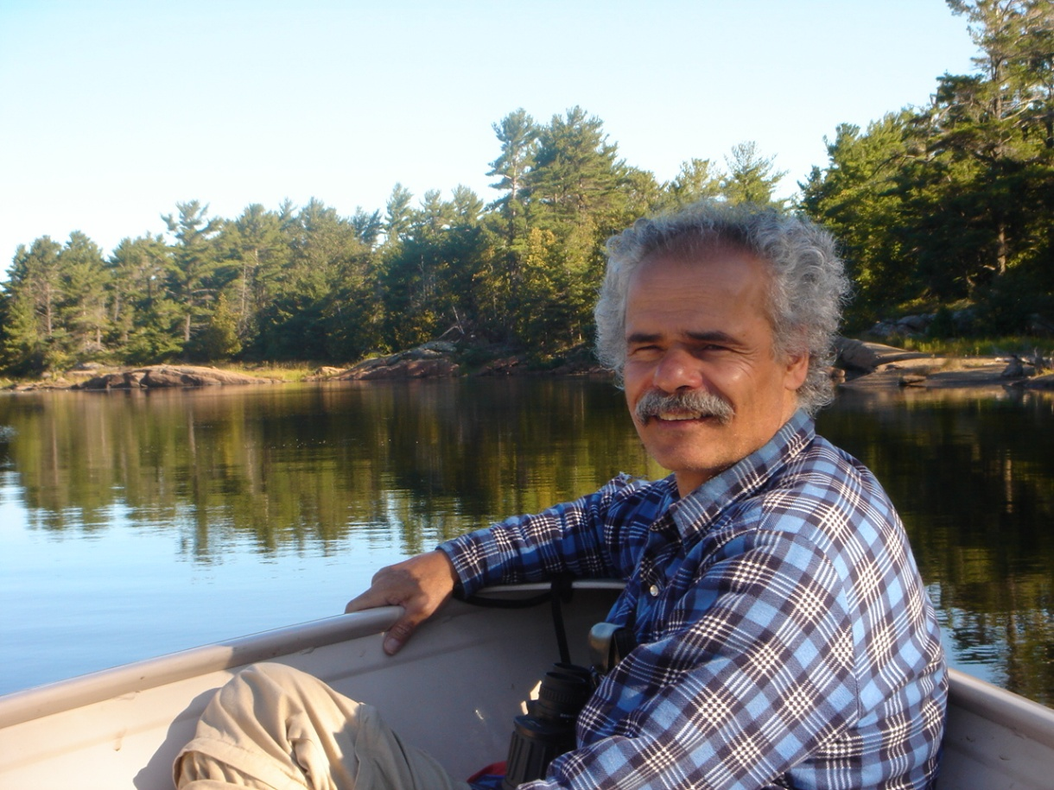
Henry on Being a Professor:
“I am actually paid to do what I would do anyway!”

