Slide 1
Statistically Efficient Nonlinear Stochastic Gradient Methods
Tao Jiang
In collaboration with Zeyuan Allen-Zhu and Lin Xiao
Nov 8, 2024

Slide 2




Problem setup
$$\min_{x}{h\left(x\right)}$$
PL: $||∇h\left(x\right)||^{2}≥2ℓ(h\left(x\right)−h^{∗})$
$L$-smooth, nonconvex, PL condition
$$g=∇h\left(x\right)+ξ$$
i.i.d. mean-zero symmetric heavy-tailed noise $∼p$
Goal: Design first-order methods: $x_{t+1}=x_{t}−γ_{t}φ(g_{t})$.
Notes:
Show one by one (animation)

Slide 3

Mitigating heavy-tailed noise
Heuristics and robust schemes to combat heavy-tailed noise
Techniques to mitigate heavy-tailed noise that show various successes:
SignSGD (Bernstein et al…) $x_{t+1}=x_{t}−γ_{t}sign\left(g_{t}\right)$
ClippedSGD (Zhang et al…) $x_{t+1}=x_{t}−γ_{t}clip\left(g_{t},−a,a\right)$
Our work: Identify a theoretically sound approach of designing nonlinear stochastic gradient methods that are customized to combat heavy-tailed noise.
Bernstein, J., Wang, Y. X., Azizzadenesheli, K., & Anandkumar, A. (2018, July). signSGD: Compressed optimisation for non-convex problems. In International Conference on Machine Learning (pp. 560-569). PMLR.
Zhang, J., Karimireddy, S. P., Veit, A., Kim, S., Reddi, S., Kumar, S., & Sra, S. (2020). Why are adaptive methods good for attention models?. Advances in Neural Information Processing Systems, 33, 15383-15393.
Notes:
you might wanna just animate and have the paper screenshots show up stacked on top of each other
Common heuristics
Bulletpoint
One slides
et al
-sign
-clip
-limiting version of popular adam
Backup slides
Do not derive
Spend time on each slide

Slide 4
Principled approach
from Polyak & Tsypkin (1984)
Polyak, B. T., & Tsypkin, Y. Z. (1984). Criterial algorithms of stochastic optimization. Avtomatika i Telemekhanika, (6), 95-104.

Slide 5
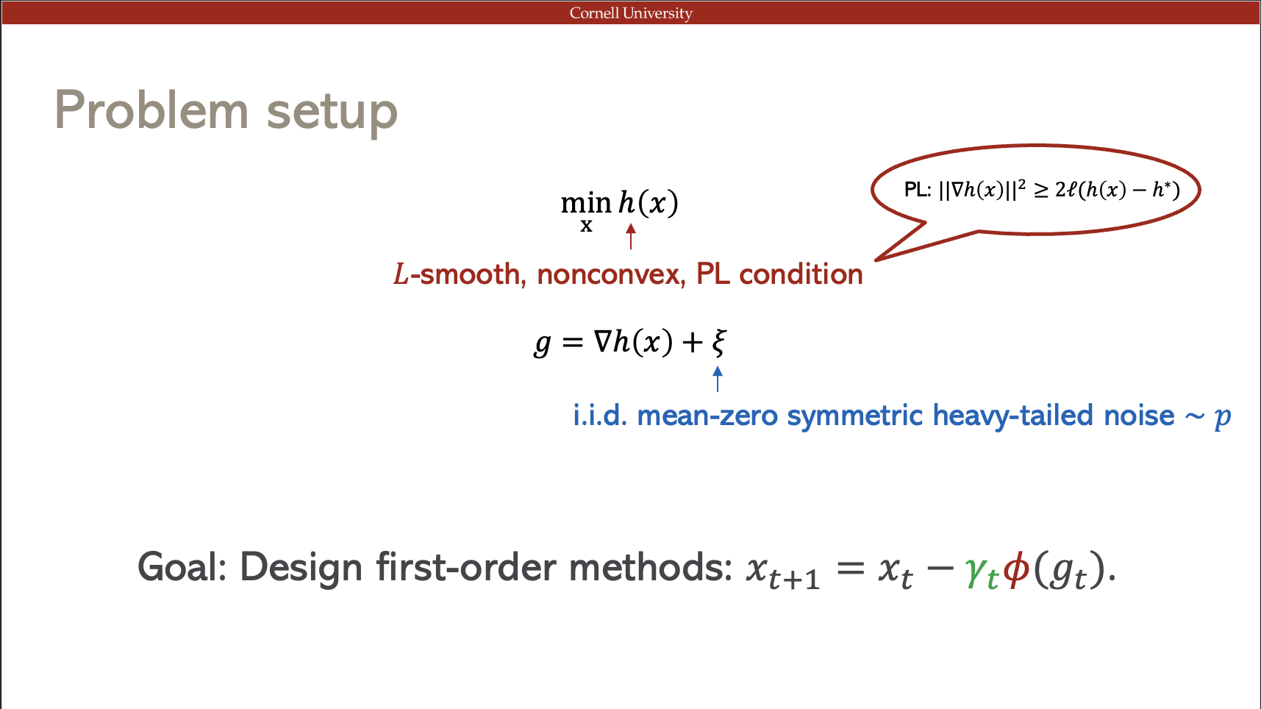
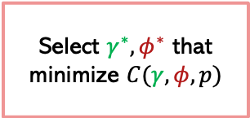
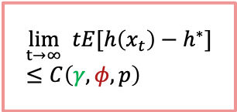
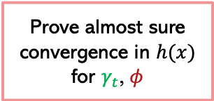



“Optimal” $γ_{t}^{∗}, φ^{∗}$: framework
$$x_{t+1}=x_{t}−γ_{t}φ(g_{t})$$
P-T ‘84
Any $γ_{t}=\frac{γ}{t}$
Prove almost sure convergence in $h(x)$ for $γ_{t}$, $φ$
$$\lim_{t→∞} tE[h\left(x_{t}\right)−h^{∗}]≤C\left(γ, φ,p\right)$$
Select $γ^{∗},φ^{∗}$ that minimize $C(γ, φ,p)$
Any $φ∈Φ$

Slide 6
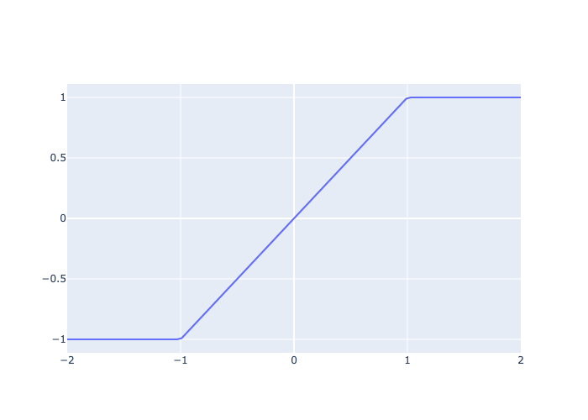
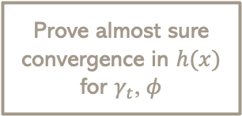
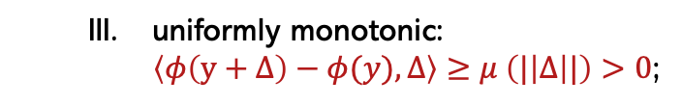



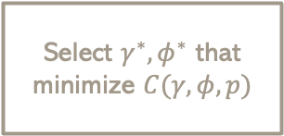
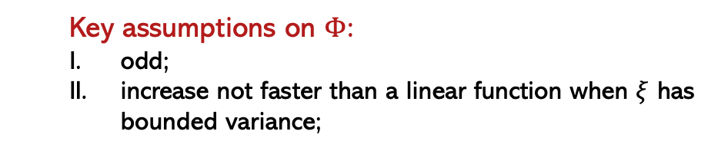
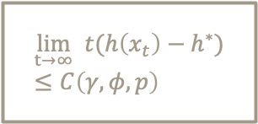

“Optimal” $γ_{t}^{∗}, φ^{∗}$: nonlinear mapping
P-T ‘84
Any $γ_{t}=\frac{γ}{t}$
Prove almost sure convergence in $h(x)$ for $γ_{t}$, $φ$
$$\lim_{t→∞} t(h\left(x_{t}\right)−h^{∗})≤C\left(γ, φ,p\right)$$
Select $γ^{∗},φ^{∗}$ that minimize $C(γ, φ,p)$
Any $φ∈Φ$
$$φ\left(y\right)=clip(y, −1, 1)$$
  Key assumptions on $Φ$:
  odd;
  increase not faster than a linear function when $ξ$ has bounded variance;
  uniformly monotonic:
  $\left\langle φ\left(y+Δ\right)−φ(y),Δ\right\rangle ≥μ \left(|\left|Δ\right||\right)>0$;
$$y$$
monotonically nondecreasing
Notes:
Crop the figures
Iv figure out the last assumption
Sufficient conditions
Change notations
Vector valued function: monotonically nondecreasing

Slide 7
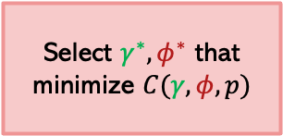
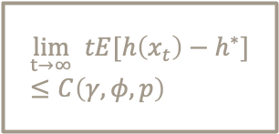

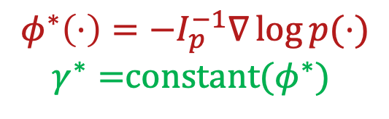
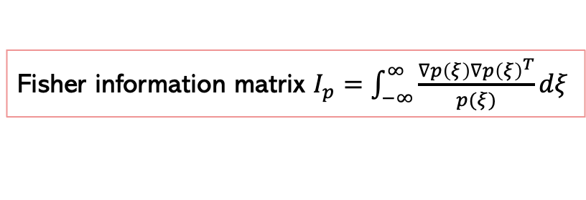
“Optimal” $γ_{t}^{∗}, φ^{∗}$
P-T ‘84
Any $γ_{t}=\frac{γ}{t}$
Prove almost sure convergence in $h(x)$ for $γ_{t}$, $φ$
$$\lim_{t→∞} tE[h\left(x_{t}\right)−h^{∗}]≤C\left(γ, φ,p\right)$$
Select $γ^{∗},φ^{∗}$ that minimize $C(γ, φ,p)$
Any $φ∈Φ$
Fisher information matrix $I_{p}=\int_{−∞}^{∞}{\frac{∇p\left(ξ\right)∇p{\left(ξ\right)}^{T}}{p(ξ)}dξ}$
$φ^{∗}\left(⋅\right)=−I_{p}^{−1}∇\log{p(⋅)}$
$γ^{∗}=$constant($φ^{∗}$)
Notes:
Reveal fisher matrix second
Simple information first

Slide 8
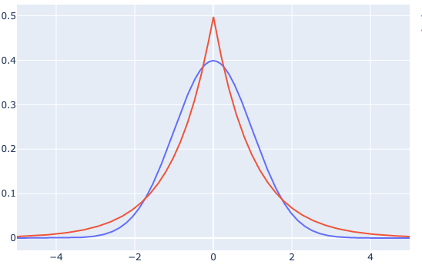
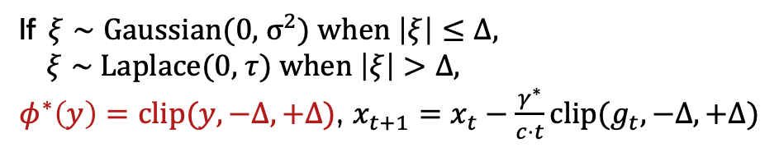




$φ^{∗}$ for different distributions
$\text{Laplace}\text{(0, }τ\text{)}$
$\text{Gaussian}\text{(0,}1\text{)}$
P-T ‘84
$φ^{∗}(⋅)={−I}_{p}^{−1}∇\log{p(⋅)}$
If $ξ∼\text{Gaussian}\text{(0,}{ σ}^{2}\text{),}$ $φ^{∗}(y)=y$, $x_{t+1}=x_{t}−\frac{γ^{∗}}{t}g_{t}$
If $ξ∼\text{Laplace}\text{(0, }τ\text{)}$, $φ^{∗}\left(y\right)=τ⋅sign(y)$, $x_{t+1}=x_{t}−\frac{γ^{∗}}{τ⋅t}{sign(g}_{t})$
If $ξ∼\text{Gaussian}\text{(0,}{ σ}^{2}\text{)}$ when $\left|ξ\right|≤Δ,$
$ξ∼$Laplace(0, $τ$) when $\left|ξ\right|>Δ,$
$φ^{∗}\left(y\right)=clip(y,−Δ,+Δ)$, $x_{t+1}=x_{t}−\frac{γ^{∗}}{c⋅t}clip(g_{t}, −Δ, +Δ)$

Slide 9


“Optimal” $γ_{t}^{∗}, φ^{∗}$
P-T ‘84
Any $γ_{t}=\frac{γ}{t}$
Prove almost sure convergence in $h(x)$ for $γ_{t}$, $φ$
$$\lim_{t→∞} tE[h\left(x_{t}\right)−h^{∗}]≤C\left(γ, φ,p\right)$$
Select $γ^{∗},φ^{∗}$ that minimize $C(γ, φ,p)$
Any $φ∈Φ$
What if $p$ is unknown?
$φ^{∗}(⋅)={−I}_{p}^{−1}∇\log{p(⋅)}$
$γ^{∗}=$constant($φ^{∗}$)
Notes:
t

Slide 10

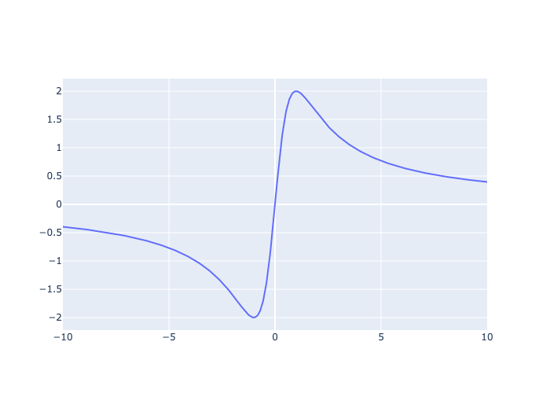
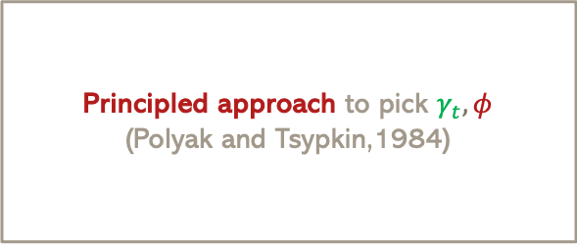




So far…
Designing first-order methods (i.e. picking $γ_{t},φ$ for $x_{t+1}=x_{t}−γ_{t}φ(g_{t})$) in presence of heavy-tailed noise.
Principled approach to pick $γ_{t},φ$
(Polyak and Tsypkin,1984)
Only applies to asymptotic settings when $t→∞$ and $∇h≈0$.
In practice, limited budget on $t$ and $∇h∈R^{d}$.
Only allows monotonically nondecreasing mappings $φ$.
Non-monotonic $φ$might be helpful.
Cannot handle some common heavy-tailed distributions such as Student’s t and Cauchy.
$φ^{∗}(⋅)=I_{p}^{−1}∇\log{p (⋅)}$ is non-monotonic; theory breaks down; unclear how to pick optimal $φ$ for these distributions.
Our work
$ξ∼\text{Cauchy}\text{(0,}τ\text{),}$ $φ^{∗}\left(y\right)=I_{p}^{−1}∇\log{p\left(y\right)}=\frac{4τ^{2}y}{τ^{2}+y^{2}}$
Extending Polyak and Tsypkin (1984) to non-asymptotic settings for non-monotonic mappings, providing a way to choose statistically efficient nonlinear mappings for a wider class of heavy-tailed distributions.
$$φ^{∗}(y)$$
$$y$$
Notes:
Two pieces of evidence
Evidence for my claim: maybe the noise is not that simple, other types of

Slide 11
So far…
Designing first-order methods (i.e. picking $γ_{t},φ$ for $x_{t+1}=x_{t}−γ_{t}φ(g_{t})$) in presence of heavy-tailed noise.
Principled approach to pick $γ_{t},φ$
(Polyak and Tsypkin,1984)
Only applies to asymptotic settings when $t→∞$ and $∇h≈0$.
In practice, limited budget on $t$ and $∇h∈R^{d}$.
Only allows monotonically nondecreasing mappings $φ$.
Non-monotonic $φ$might be helpful.
Cannot handle some common heavy-tailed distributions such as Student’s t and Cauchy.
$φ^{∗}(⋅)=I_{p}^{−1}∇\log{p (⋅)}$ is non-monotonic; theory breaks down; unclear how to pick optimal $φ$ for these distributions.
Does not directly translate to implementable algorithms for machine learning.
Notes:
Two pieces of evidence
Evidence for my claim: maybe the noise is not that simple, other types of

Slide 12




Implementations without exact knowledge of $p$
Implementing ${x_{t+1}=x_{t}+\frac{γ}{t}I}_{p}^{−1}∇\log{p(⋅)}$ requires the exact knowledge of $p$.
Method 1: Assuming $ξ∼$ special distributions
Method 1: Assuming $ξ∼$ special distributions
These assumptions are specific;
Special distribution: it is unclear why stochastic noise should follow one of these special distributions.
Readily known algorithms such as SGD, SignSGD and ClipSGD.

Slide 13
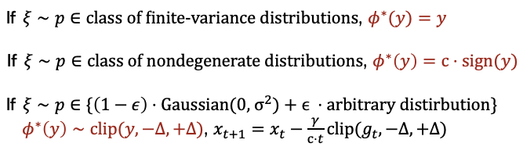

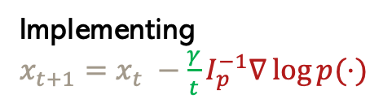
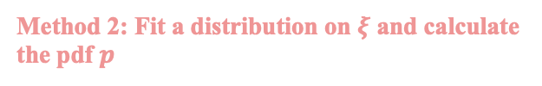

Implementations without exact knowledge of $p$
Implementing ${x_{t+1}=x_{t}+\frac{γ}{t}I}_{p}^{−1}∇\log{p(⋅)}$ requires the exact knowledge of $p$.
Method 1: Assuming $ξ∼$ special distributions
Method 1: Assuming $ξ∼$ special distributions
These assumptions are either too specific;
Special distribution: it is unclear why stochastic noise should follow one of these special distributions.
Method 2: Fit a distribution on $ξ$ and calculate the pdf $p$
Method 2: Fit a distribution on $ξ$ and calculate the pdf $p$
Readily known algorithms such as SGD, SignSGD and ClipSGD.
Implementing ${x_{t+1}=x_{t} −\frac{γ}{t}I}_{p}^{−1}∇\log{p(⋅)}$
Hard, expensive, inaccurate

Slide 14
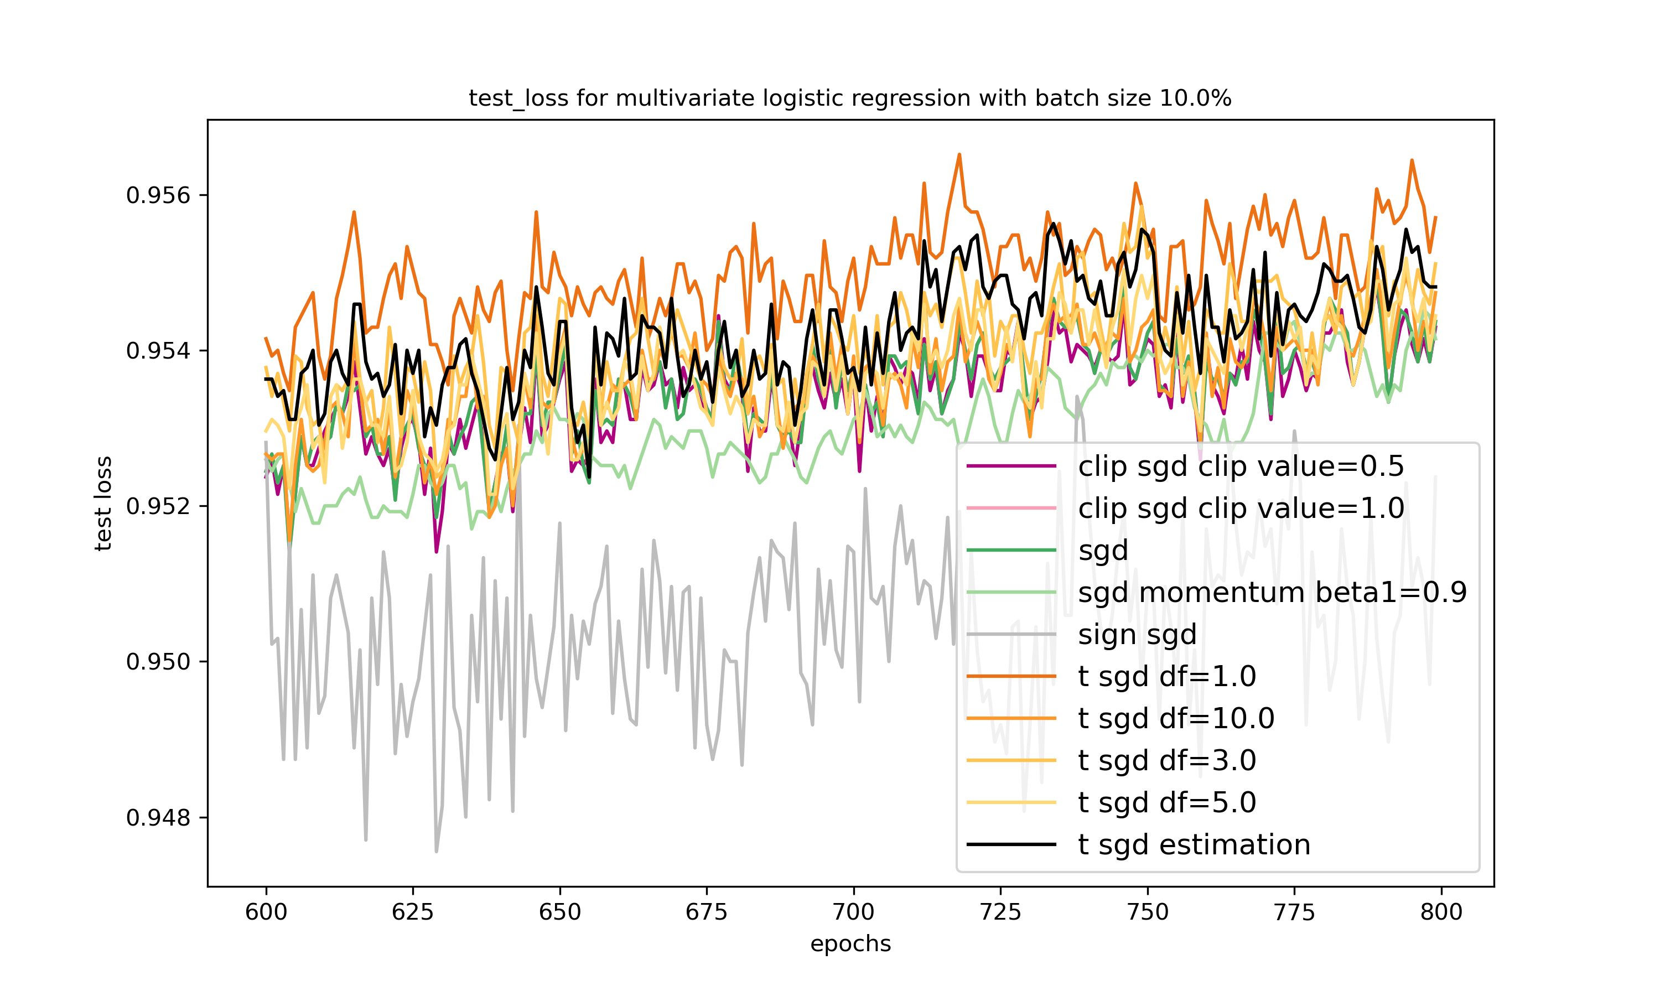


Empirical Contributions
An implementable algorithm for that works for machine learning.
Our method:
Our method in practice: (e.g., MNIST)
Conduct extensive empirical studies on stochastic noise $ξ$ and find Student’s t to be a flexible family of distributions to model $ξ$.
Derive a simple analytical $φ^{∗}$ using Student’s t pdf.
Develop a simple method to estimate distribution parameters in an online manner.

Slide 15
Theoretical results

Slide 16
Statistically efficient $φ^{∗}$: framework
J, Xiao, and Allen-Zhu (2024)
Notes:
Linear convergence to neihborhood of of size gamma*var(update)

Slide 17
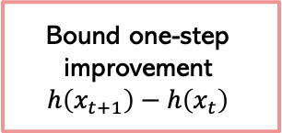
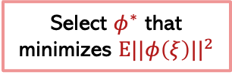
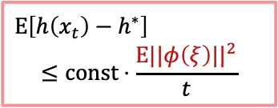
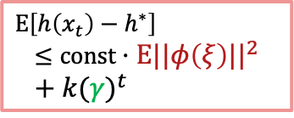



Statistically efficient $φ^{∗}$: framework
J, Xiao, and Allen-Zhu (2024)
$$E\left[h\left(x_{t}\right)−h^{∗}\right]$$
$$≤const⋅\frac{E||φ\left(ξ\right)||^{2}}{t}$$
Any $γ_{t}=\frac{γ}{t}$
Bound one-step improvement
$$h\left(x_{t+1}\right)−h\left(x_{t}\right)$$
Any $φ∈Φ$
Select $φ^{∗}$ that minimizes $E||φ\left(ξ\right)||^{2}$
$$E\left[h\left(x_{t}\right)−h^{∗}\right]$$
$$≤const⋅E||φ\left(ξ\right)||^{2}+{k(γ)}^{t}$$
Any $γ_{t}=γ$
Notes:
Linear convergence to neihborhood of of size gamma*var(update)

Slide 18
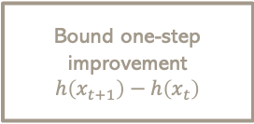


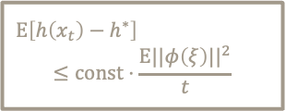
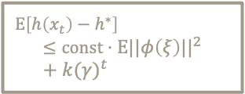
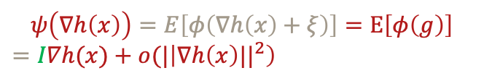




Statistically efficient $φ^{∗}$
J, Xiao and Allen-Zhu (2024)
$$E\left[h\left(x_{t}\right)−h^{∗}\right]$$
$$≤const⋅\frac{E||φ\left(ξ\right)||^{2}}{t}$$
Any $γ_{t}=\frac{γ}{t}$
Bound one-step improvement
$$h\left(x_{t+1}\right)−h\left(x_{t}\right)$$
Any $φ∈Φ$
Select $φ^{∗}$ that minimizes $E||φ\left(ξ\right)||^{2}$
$$E\left[h\left(x_{t}\right)−h^{∗}\right]$$
$$≤const⋅E||φ\left(ξ\right)||^{2}+{k(γ)}^{t}$$
Any $γ_{t}=γ$
Define $ψ(⋅)=E[φ\left(⋅+ξ\right)]$, the expected update.
$$ψ\left(∇h\left(x\right)\right)=E\left[φ\left(∇h\left(x\right)+ξ\right)\right]=E\left[φ\left(g\right)\right]$$
$=I∇h(x)+o(|\left|∇h\left(x\right)||^{2}\right)$
  Key assumptions on $φ$:
  odd;
  $ψ$is twice differentiable with Lipschitz second-order derivative;
  $ψ′\left(0\right)=I$;

Slide 19


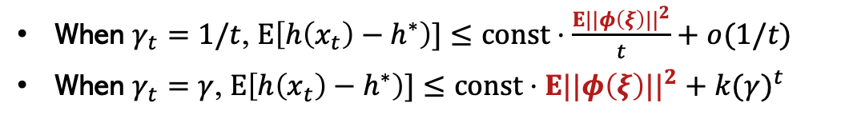


Statistically efficient $φ^{∗}$
J, Xiao and Allen-Zhu (2024)
$$E\left[h\left(x_{t}\right)−h^{∗}\right]$$
$$≤const⋅\frac{E||φ\left(ξ\right)||^{2}}{t}$$
Any $γ_{t}=\frac{γ}{t}$
Bound one-step improvement for $φ$
Any $φ∈Φ$
Select $φ^{∗}$ that minimizes $E||φ\left(ξ\right)||^{2}$
$$E\left[h\left(x_{t}\right)−h^{∗}\right]$$
$$≤const⋅E||φ\left(ξ\right)||^{2}+{k(γ)}^{t}$$
Any $γ_{t}=γ$
$$E\left[h\left(x_{t+1}\right)−h^{∗}|F_{t}\right]≤\left(1−const_{1}\left(γ_{t}\right)\right)⋅\left(h\left(x_{t}\right)−h^{∗}\right)+ const_{2}\left(γ_{t}\right)⋅E||φ\left(ξ\right)||^{2}$$
When $γ_{t}=1/t$, $E\left[h\left(x_{t}\right)−h^{∗}\right)]≤const⋅\frac{E||φ\left(ξ\right)||^{2}}{t}+o(1/t)$
When $γ_{t}=γ$, $E\left[h\left(x_{t}\right)−h^{∗}\right)]≤const⋅E||φ\left(ξ\right)||^{2}+{k(γ)}^{t}$
Key: Pick $φ^{∗}$ that minimizes $E||φ\left(ξ\right)||^{2}$.

Slide 20
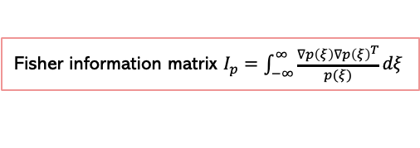

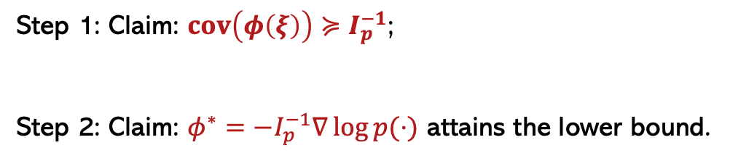
Statistically efficient $φ^{∗}$
Key: Pick $φ^{∗}$ that minimizes $E||φ\left(ξ\right)||^{2}=tr\left(cov\left(φ\left(ξ\right)\right)\right)$.
Fisher information matrix $I_{p}=\int_{−∞}^{∞}{\frac{∇p\left(ξ\right)∇p{\left(ξ\right)}^{T}}{p(ξ)}dξ}$
Step 1: Claim: $cov\left(φ\left(ξ\right)\right)≽I_{p}^{−1}$;
Step 2: Claim: $φ^{∗}=−I_{p}^{−1}∇\log{p(⋅)}$ attains the lower bound.
Cramér-Rao inequality: $cov\left(φ\left(ξ\right)\right)≽I_{p}^{−1}$
Simple substitution + Definition of Fisher Information matrix
$$φ^{∗}\left(⋅\right)=−I_{p}^{−1}∇\log{p\left(⋅\right), }$$
statistically efficient estimator

Slide 21
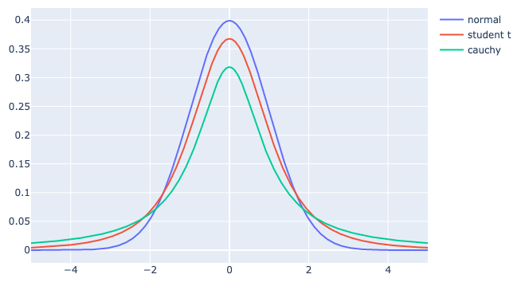
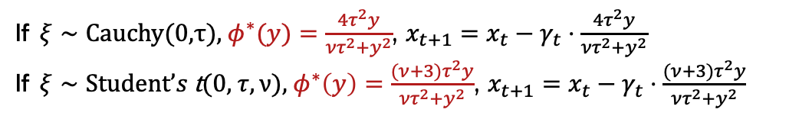
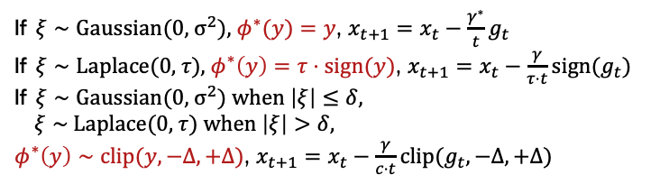

Statistically efficient $φ^{∗}$
$φ^{∗}\left(⋅\right)=−I_{p}^{−1}∇\log{p(⋅)}$
If $ξ∼\text{Gaussian}\text{(0,}{ σ}^{2}\text{),}$ $φ^{∗}(y)=y$, $x_{t+1}=x_{t}−\frac{γ^{∗}}{t}g_{t}$
If $ξ∼\text{Laplace}\text{(0, }τ\text{)}$, $φ^{∗}\left(y\right)=τ⋅sign(y)$, $x_{t+1}=x_{t}−\frac{γ}{τ⋅t}{sign(g}_{t})$
If $ξ∼\text{Gaussian}\text{(0,}{ σ}^{2}\text{)}$ when $\left|ξ\right|≤δ,$
$ξ∼$Laplace(0, $τ$) when $\left|ξ\right|>δ,$
$φ^{∗}\left(y\right)∼clip(y,−Δ,+Δ)$, $x_{t+1}=x_{t}−\frac{γ}{c⋅t}clip(g_{t}, −Δ, +Δ)$
If $ξ∼\text{Cauchy}\text{(0,}τ\text{),}$ $φ^{∗}(y)=\frac{4τ^{2}y}{{ντ}^{2}+y^{2}}$, $x_{t+1}=x_{t}−γ_{t}⋅\frac{4τ^{2}y}{{ντ}^{2}+y^{2}}$
If $ξ∼\text{Student}’s \text{t}\text{(0, }τ,ν\text{)}$, $φ^{∗}\left(y\right)=\frac{(ν+3)τ^{2}y}{{ντ}^{2}+y^{2}}$, $x_{t+1}=x_{t}−γ_{t}⋅\frac{(ν+3)τ^{2}y}{{ντ}^{2}+y^{2}}$
Notes:
List more distributions

Slide 22



Statistically efficient $φ^{∗}$
$ξ∼\text{Cauchy}\text{(0,}τ\text{),}$ $φ^{∗}(y)=\frac{4τ^{2}y}{τ^{2}+y^{2}}$
$$φ^{∗}(y)$$
$$y$$

Slide 23
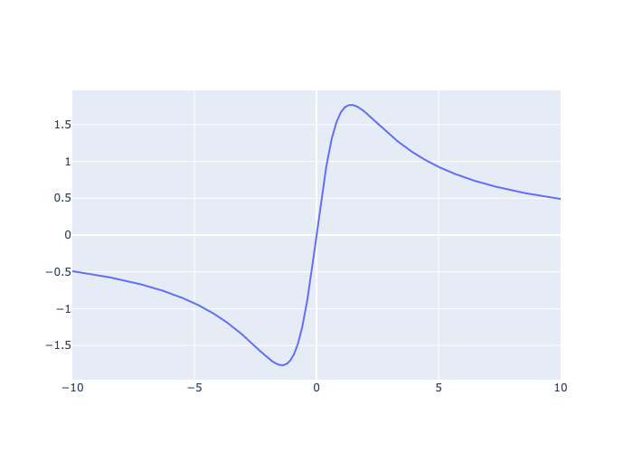

Statistically efficient $φ^{∗}$
$ξ∼\text{Student}$-$\text{t}\text{(0, }τ,ν=2\text{)}$, $φ^{∗}\left(y\right)=\frac{(ν+3)τ^{2}y}{{2τ}^{2}+y^{2}}$
$$φ^{∗}(y)$$
$$y$$

Slide 24
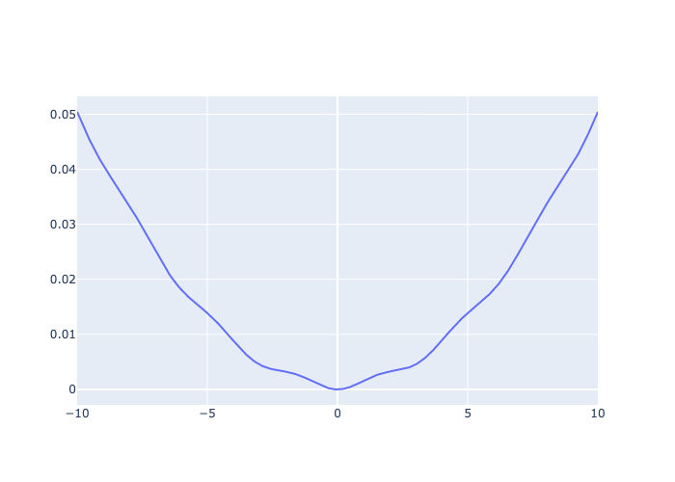
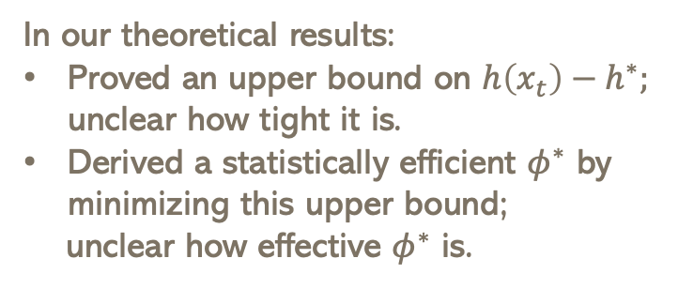

Numerical Verification
$$h\left(x\right)=0.005{(x}^{2}+{sin⁡(x)}^{2})$$
In our theoretical results:
Proved an upper bound on $h\left(x_{t}\right)−h^{∗};$ unclear how tight it is.
Derived a statistically efficient $φ^{∗}$ by minimizing this upper bound;
unclear how effective $φ^{∗}$ is.
Conduct numerical experiments to verify our results;
Choose simple functions; inject different types of noise to the true gradients; compare the performance of various algorithms.
Algorithm: SGD, SignSGD, ClipSGD, t-SGD, CauchySGD, P-J iterate averaging
Step size: constant

Slide 25
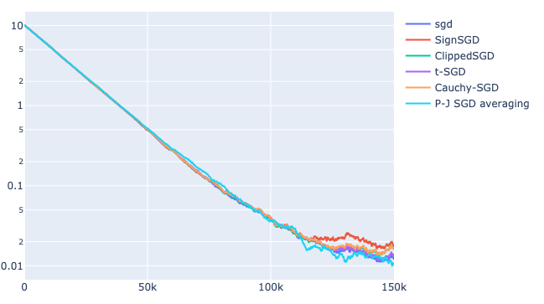
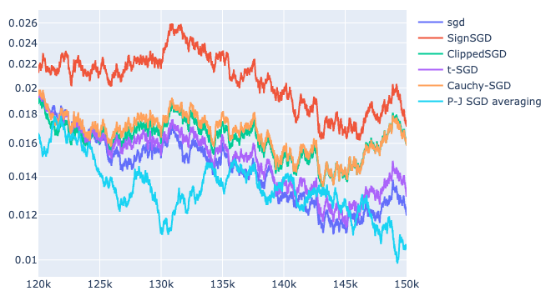






Numerical Verification of Function Gap Upper Bound
When $γ_{t}=γ$, $E\left[h\left(x_{t}\right)−h^{∗}\right)]≤const⋅E||φ\left(ξ\right)||^{2}+{k(γ)}^{t}$
$$h\left(x\right)=0.005{(x}^{2}+{sin⁡(x)}^{2})$$
$$h\left(x\right)=0.005{(x}^{2}+{sin⁡(x)}^{2})$$
$$E[h\left(x_{t}\right)]$$
$$E[h\left(x_{t}\right)]$$
iteration $t$
iteration $t$
$g=∇h\left(x\right)+ξ,$where $ξ∼\text{Gaussian}\text{(0,1), }$statistically efficient $φ^{∗}(y)=y$

Slide 26
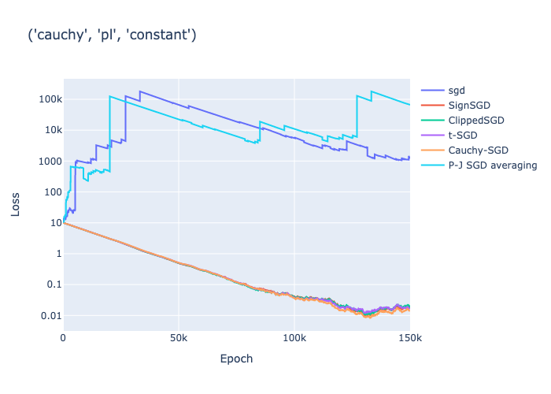
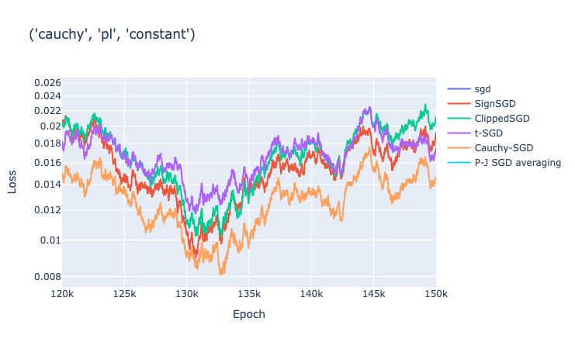




Numerical Verification of Function Gap Upper Bound
When $γ_{t}=γ$, $E\left[h\left(x_{t}\right)−h^{∗}\right)]≤const⋅E||φ\left(ξ\right)||^{2}+{k(γ)}^{t}$
$$h\left(x\right)=0.005{(x}^{2}+{sin⁡(x)}^{2})$$
$$h\left(x\right)=0.005{(x}^{2}+{sin⁡(x)}^{2})$$
$$E[h\left(x_{t}\right)]$$
$$E[h\left(x_{t}\right)]$$
iteration $t$
iteration $t$
$g=∇h\left(x\right)+ξ,$where $ξ∼\text{Cauchy}\text{(0,1), }$statistically efficient $φ^{∗}(y)=\frac{4y}{1+y^{2}}$

Slide 27
Empirical results
An implementable algorithm for that works for machine learning

Slide 28






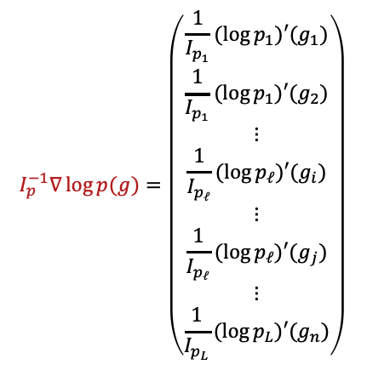

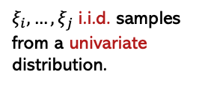
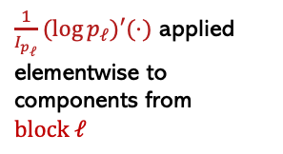
Empirical distribution
Empirical pdf
Simplified assumptions:
noise is elementwise independent
noise from the same block follows the same distribution
$x_{t+1}=x_{t}+γ_{t}I_{p}^{−1}∇\log{p(g)}$
$$I_{p}^{−1}∇\log{p(g)}=\left(\begin{aligned}\frac{1}{I_{p_{1}}}(\log{p_{1})′(g_{1})} \\ \frac{1}{I_{p_{1}}}(\log{p_{1})′(g_{2})} \\ ⋮ \\ \frac{1}{I_{p_{ℓ}}}(\log{p_{ℓ})′(g_{i})} \\ ⋮ \\ \frac{1}{I_{p_{ℓ}}}(\log{p_{ℓ})′(g_{j})} \\ ⋮ \\ \frac{1}{I_{p_{L}}}(\log{p_{L})′(g_{n})}\end{aligned}\right)$$
$$\left(\begin{aligned}ξ_{1} \\ ξ_{2} \\ ⋮ \\ ξ_{i} \\ ⋮ \\ ξ_{j} \\ ⋮ \\ ξ_{n}\end{aligned}\right)$$
$$block 1$$
$$block 1$$
Empirical distributions
$$\{p_{1},p_{2},…, p_{L}\}$$
$$block ℓ$$
$ξ_{i},…, ξ_{j}$ i.i.d. samples from a univariate distribution.
$$block ℓ$$
$\frac{1}{I_{p_{ℓ}}}(\log{p_{ℓ})′(⋅)}$ applied elementwise to components from $block ℓ$
Notes:
List more distributions

Slide 29

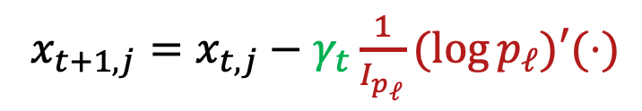
Empirical distribution
What is $p_{ℓ}$?
$x_{t+1,j}=x_{t,j}−γ_{t}\frac{1}{I_{p_{ℓ}}}(log{p_{ℓ})′(⋅)}$
Empirical noise distribution machine learning tasks is
more heavy-tailed than Gaussian and Laplace distributions;
less heavy-tailed than Cauchy distribution;
symmetric;
Student’s t could be a good model for noise distribution.
Notes:
List more distributions

Slide 30
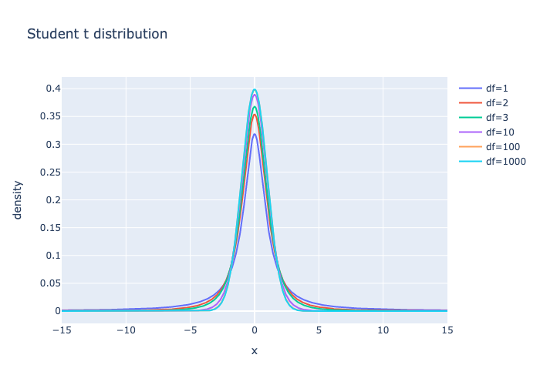


Empirical distribution
$$ξ_{j}∼\text{t}\text{(0, }τ,ν\text{)}$$
Student’s t could be a good model for noise distribution.
Flexibility: Student’s t distributions with various degrees of freedom $ν$ can cover
from light-tailed distributions of Gaussian to heavy-tailed distributions of Cauchy.
Notes:
List more distributions

Slide 31

Empirical distribution
$$ξ_{j}∼\text{t}\text{(0, }τ,ν\text{)}$$
Student’s t could be a good model for noise distribution.
Flexibility: Student’s t distributions with various degree of freedom $ν$ can cover
from light-tailed distributions of Gaussian to heavy-tailed distributions of Cauchy.
Simplicity: $φ^{∗}$for Student’s t admits a simple analytical form $φ^{∗}\left(y\right)=\frac{(ν+3)τ^{2}y}{{ντ}^{2}+y^{2}}$.
Notes:
List more distributions

Slide 32

Statistically efficient $φ^{∗}$ for Student’s t
$ξ_{j}∼\text{t}\text{(0, }τ,ν=\text{1}\text{)}$, $φ^{∗}(y)=\frac{4τ^{2}y}{τ^{2}+y^{2}}$
$$φ^{∗}(y)$$
$$y$$

Slide 33

Statistically efficient $φ^{∗}$ for Student’s t
$ξ_{j}∼\text{t}\text{(0, }τ,ν=2\text{)}$, $φ^{∗}\left(y\right)=\frac{5τ^{2}y}{{2τ}^{2}+y^{2}}$
$$φ^{∗}(y)$$
$$y$$

Slide 34


Statistically efficient $φ^{∗}$ for Student’s t
$ξ_{j}∼\text{t}\text{(0, }τ,ν=\text{3}\text{)}$, $φ^{∗}\left(y\right)=\frac{6τ^{2}y}{{3τ}^{2}+y^{2}}$
$$φ^{∗}(y)$$
$$y$$

Slide 35


Statistically efficient $φ^{∗}$ for Student’s t
$ξ_{j}∼\text{t}\text{(0, }τ,ν=\text{100}\text{)}$, $φ^{∗}\left(y\right)=\frac{103τ^{2}y}{{100τ}^{2}+y^{2}}$
$$φ^{∗}(y)$$
$$y$$

Slide 36


Statistically efficient $φ^{∗}$ for Student’s t
$ξ_{j}∼\text{t}\text{(0, }τ,ν=\text{1000}\text{)}$, $φ^{∗}\left(y\right)=\frac{1003τ^{2}y}{{1000τ}^{2}+y^{2}}$
$$φ^{∗}(y)$$
$$y$$

Slide 37


Statistically efficient $φ^{∗}$ for Student’s t
$ξ∼\text{t}\text{(0, }τ,ν=\text{10000}\text{)}$, $φ^{∗}\left(y\right)=\frac{10003τ^{2}y}{{10000τ}^{2}+y^{2}}$
$$φ^{∗}(y)$$
$$y$$

Slide 38

Empirical distribution
$$ξ_{j}∼\text{t}\text{(0, }τ,ν\text{)}$$
Student’s t could be a good model for noise distribution.
Flexibility: Student’s t distributions with various degree of freedom $ν$ can cover
from light-tailed distributions of Gaussian to heavy-tailed distributions of Cauchy.
Simplicity: $φ^{∗}$for Student’s t admits a simple analytical form $φ^{∗}\left(y\right)=\frac{(ν+3)τ^{2}y}{{ντ}^{2}+y^{2}}$.
Few parameters: there are only two parameters to estimate, $τ,ν$.
Notes:
List more distributions

Slide 39





Parameter estimation
$$ξ_{j}∼\text{t}\text{(0, }τ,ν\text{)}\text{, } φ^{∗}\left(y\right)=\frac{(ν+3)τ^{2}y}{{ντ}^{2}+y^{2}}$$
Observation i: the magnitude of $var\left(ξ_{j}\right)=var\left(g_{j}\right)≫|E\left[g_{j}\right]|^{2}$.
$$ξ_{j}≈g_{j}−\overline{g}$$
Observation ii: Student’s t is a location-scale family.
$$\frac{g_{j}−\overline{g}}{τ}∼t\left(0,1,ν\right)$$
$$\frac{α\text{−}\text{quantile}(g_{j}−\overline{g})}{α\text{−}\text{quantile}(t\left(0,1,ν\right)) }=\frac{β\text{−}\text{quantile}(g_{j}−\overline{g})}{β\text{−}\text{quantile}(t\left(0,1,ν\right))}=\text{Scale} τ$$
$$\frac{α\text{−}\text{quantile}(g_{j}−\overline{g})}{β\text{−}\text{quantile}(g_{j}−\overline{g})}=\frac{α\text{−}\text{quantile}(t\left(0,1,ν\right))}{β\text{−}\text{quantile}(t\left(0,1,ν\right))}$$
Notes:
List more distributions

Slide 40



Parameter estimation: degree of freedom
$$ξ_{j}∼\text{t}\text{(0, }τ,ν\text{)}\text{, } φ^{∗}\left(y\right)=\frac{(ν+3)τ^{2}y}{{ντ}^{2}+y^{2}}$$
$$\frac{α\text{−}\text{quantile}(g_{j}−\overline{g})}{β\text{−}\text{quantile}(g_{j}−\overline{g})}=\frac{α\text{−}\text{quantile}(t\left(0,1, ν\right))}{β\text{−}\text{quantile}(t\left(0,1, ν\right))}$$
Empirical quantile sequence $Q≔\left\{q_{1},q_{2}, …,q_{n}\right\}$ of $n$ quantiles for r.v. $g_{j}−\overline{g}$
Empirical quantile ratio sequence $R≔\left\{\frac{q_{2}}{q_{1}},\frac{q_{3}}{q_{1}}, …,\frac{q_{n}}{q_{1}}\right\}$
Theoretical quantiles sequence $Q_{ν}≔\left\{q_{ν,1},q_{ν,2}, …,q_{ν,n}\right\}$ of $n$ quantiles for $t\left(0,1,ν\right), ν∈\{2,3,…,50\}$
Theoretical quantiles ratio sequence $R_{ν}≔\left\{\frac{q_{ν, 2}}{q_{ν,1}},\frac{q_{ν, 3}}{q_{ν, 1}}, …,\frac{q_{ν, n}}{q_{ν, 1}}\right\}$
Notes:
List more distributions

Slide 41




Parameter estimation: degree of freedom
$$ξ_{j}∼\text{t}\text{(0, }τ,ν\text{)}\text{, } φ^{∗}\left(y\right)=\frac{(ν+3)τ^{2}y}{{ντ}^{2}+y^{2}}$$
$$\frac{α\text{−}\text{quantile}(g_{j}−\overline{g})}{β\text{−}\text{quantile}(g_{j}−\overline{g})}=\frac{α\text{−}\text{quantile}(t\left(0,1,ν\right))}{β\text{−}\text{quantile}(t\left(0,1,ν\right))}$$
Empirical quantile ratio sequence $R≔\left\{\frac{q_{2}}{q_{1}},\frac{q_{3}}{q_{1}}, …,\frac{q_{n}}{q_{1}}\right\}$
Theoretical quantiles ratio sequence $R_{ν}≔\left\{\frac{q_{ν, 2}}{q_{ν,1}},\frac{q_{ν, 3}}{q_{ν, 1}}, …,\frac{q_{ν, n}}{q_{ν, 1}}\right\}$
Degree of freedom $ν^{∗}=\arg{\min{||R−R_{ν}||^{2}}}$
Notes:
List more distributions

Slide 42



Parameter estimation: scale
$$ξ_{j}∼\text{t}\text{(0, }τ,ν\text{)}\text{, } φ^{∗}\left(y\right)=\frac{(ν+3)τ^{2}y}{{ντ}^{2}+y^{2}}$$
$\frac{α\text{−}\text{quantile}(g_{j}−\overline{g})}{α\text{−}\text{quantile}(t\left(0,1,ν\right)) }=\frac{β\text{−}\text{quantile}(g_{j}−\overline{g})}{β\text{−}\text{quantile}(t\left(0,1,ν\right))}=$ Scale $τ$
Empirical quantile sequence $Q≔\left\{q_{1},q_{2}, …,q_{n}\right\}$ of $n$ quantiles for r.v. $g_{j}−\overline{g}$
Theoretical quantiles sequence $Q_{ν^{∗}}≔\left\{q_{ν,1},q_{ν,2}, …,q_{ν,n}\right\}$ of $n$ quantiles for $t\left(0,1,ν\right)$
Scale parameter $τ≔\arg{\min{\sum_{j}{{\left(τ−\frac{q_{j}}{q_{ν^{∗}, j}}\right)}^{2}}}}$
Notes:
List more distributions

Slide 43


Synthetic quadratic experiments
$$x_{t+1,j}=x_{t,j}−γ⋅\frac{\left(ν+3\right)τ^{2}g_{j}}{ντ^{2}+g_{j}^{2}}$$
Notes:
List more distributions

Slide 44

Synthetic quadratic experiments
$$x_{t+1,j}=x_{t,j}−γ⋅\frac{\left(ν+3\right)τ^{2}g_{j}}{ντ^{2}+g_{j}^{2}}$$
Notes:
List more distributions

Slide 45

Synthetic quadratic experiments
$$x_{t+1,j}=x_{t,j}−γ⋅\frac{\left(ν+3\right)τ^{2}g_{j}}{ντ^{2}+g_{j}^{2}}$$
Notes:
List more distributions

Slide 46


MNIST
$$x_{t+1,j}=x_{t,j}−γ⋅\frac{\left(ν+3\right)τ^{2}g_{j}}{ντ^{2}+g_{j}^{2}}$$
Notes:
List more distributions

Slide 47
Summary
Identify a theoretically sound approach of designing nonlinear stochastic gradient methods that are customized to combat heavy-tailed noise.
Develop an implementable, adaptive algorithm that achieves robust performance in machine learning tasks.

Slide 48

Future work and discussions
Can we characterize a class of heavy-tailed distributions that our method applies?
What if noise in the current iterate $ξ_{t}$ is correlated with noise from past iterates $ξ_{1},…,ξ_{t−1}$?

