Slide 1
On the Approximability of Quadratic Maximization over Convex Sets
Vijay Bhattiprolu (Waterloo) based on joint work with Euiwoong Lee and Assaf Naor

Slide 2
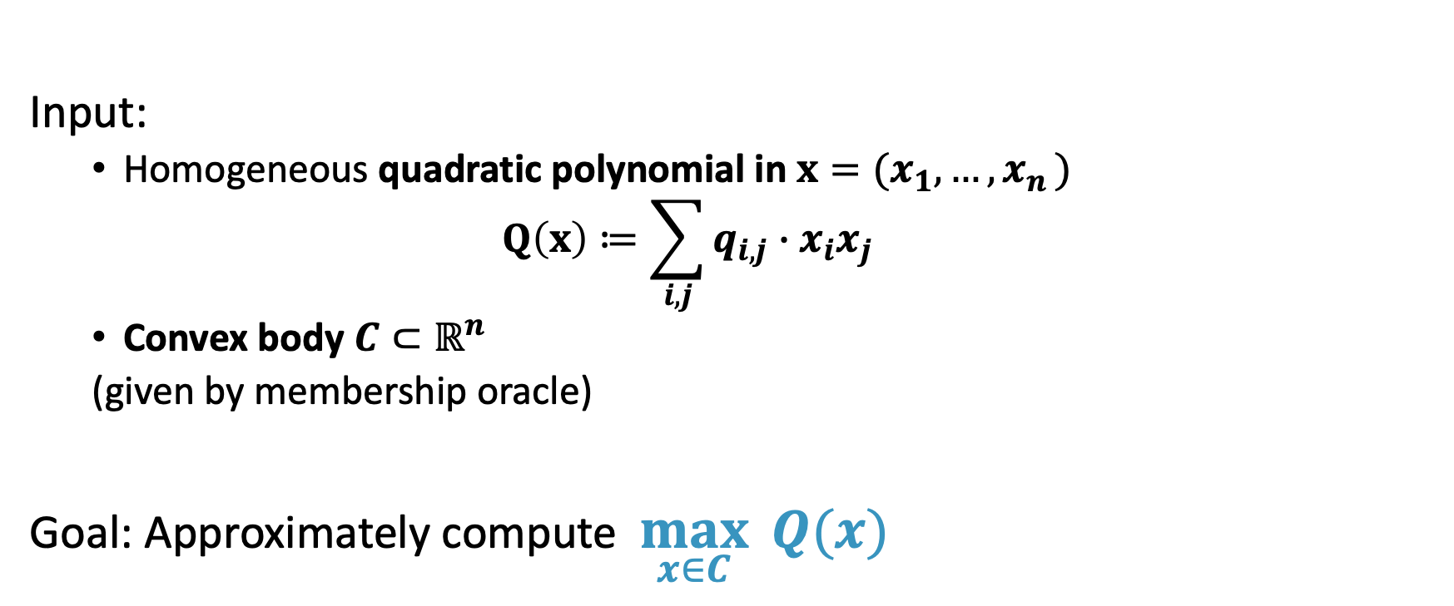
Quadratic maximization over convex sets
Input:
Homogeneous quadratic polynomial in $x=(x_{1}, …{,x}_{n})$ $Q\left(x\right)≔\sum_{i,j}{q_{i,j}∙x_{i}x_{j}}$
Convex body $C⊂ℝ^{n}$
(given by membership oracle)
Goal: Approximately compute $\max_{x∈C}{Q(x)}$

Slide 3
Quadratic maximization is rich and expressive
Crisp mathematical framework capturing problems of fundamental stature in disparate areas
Exhibits varied approximability behavior (some easy, some hard)
Connected to central open questions in some of these fields

Slide 4
Examples

Slide 5
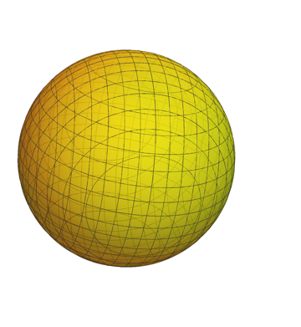
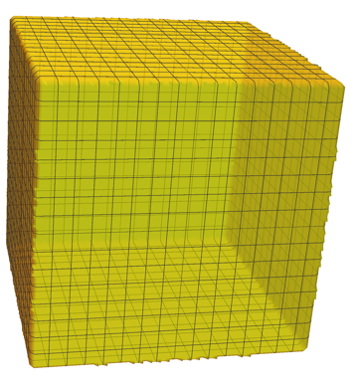
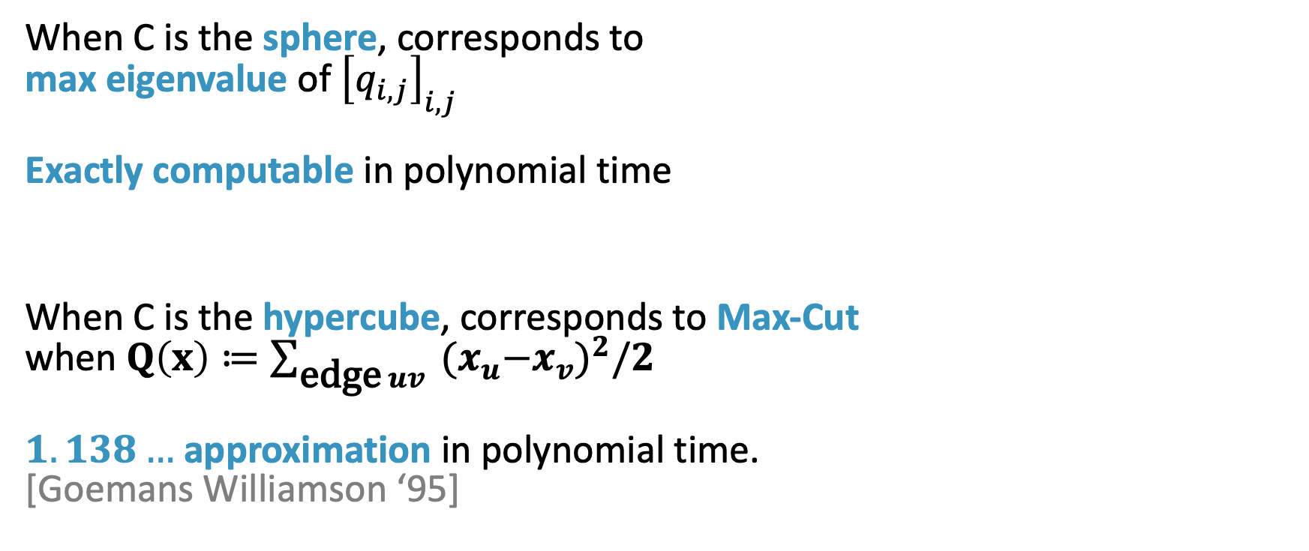
Examples
When C is the sphere, corresponds to max eigenvalue of ${\left[q_{i,j}\right]}_{i,j}$ Exactly computable in polynomial time
When C is the hypercube, corresponds to Max-Cut when $Q\left(x\right)≔\sum_{\text{edge} uv}{{{ (x}_{u}−x_{v})}^{2}/2}$ $1.138…$ approximation in polynomial time. [Goemans Williamson ‘95]

Slide 6
Example: Machine Learning
Robust Principal Component Analysis:
Find the subspace closest to a given set of n vectors.
Constant factor approximation known.

Slide 7
Example: Small Set Expansion
Find the most expanding small set S
[Raghavendra Steurer ‘10]: Small Set Expansion Hypothesis (SSEH): NP-Hard to approximate within any constant factor.

Slide 8
Quantum Computation
Complexity Theory
Quantum Separability
Quantum XOR Games
Game Theory
Robust PCA Machine Learning
Sparsest Vector in Subspace Compressed Sensing
Quadratic Maximization over Convex Sets
Clustering
Statistical Physics
Graph Optimization
Grothendieck’s Inequality
Small-Set Expansion
Densest k-Subgraph
Constraint Satisfaction Problems
Graph Regularity
Max-Cut

Slide 9
Unified theory of the approximability of quadratic maximization over convex sets?
Hope: Theory leads to new algorithmic and impossibility results
Approximability depends critically on certain geometric invariants of the convex set! (Informally, the smoothness is important)

Slide 10
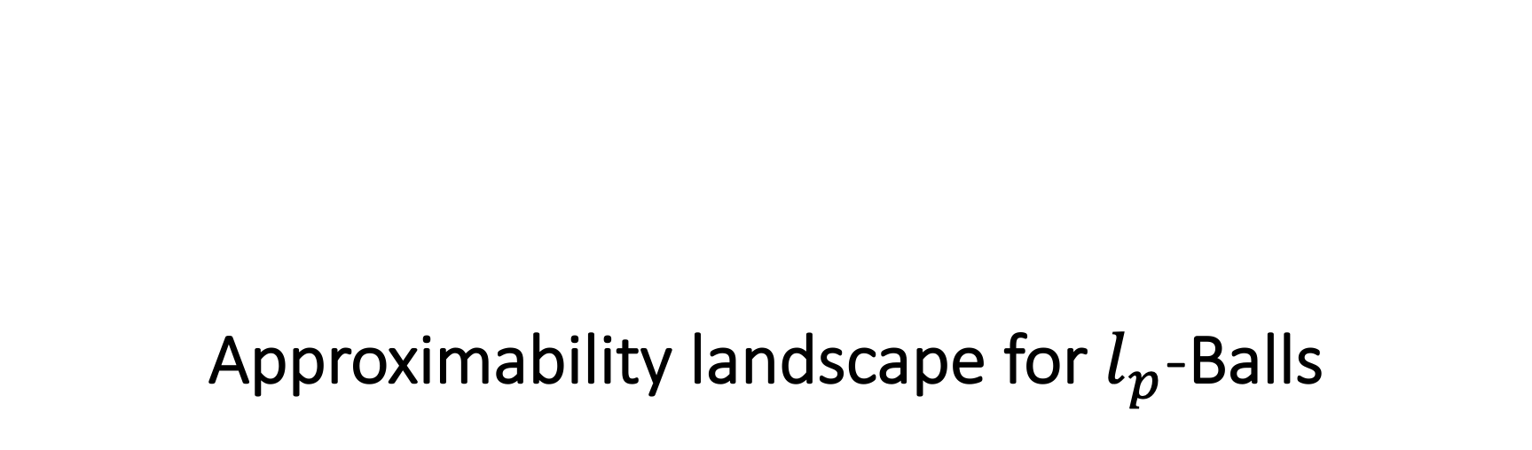
Approximability landscape for $l_{p}$-Balls

Slide 11
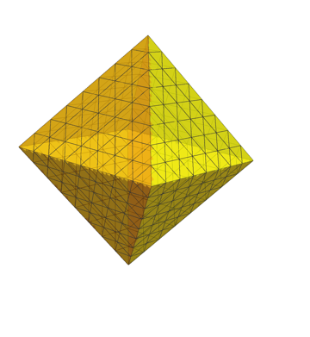
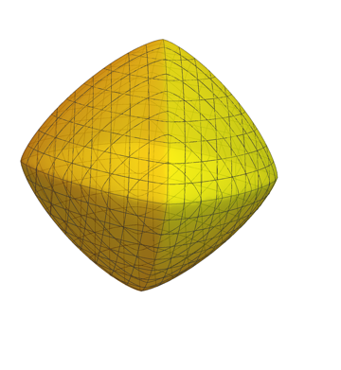
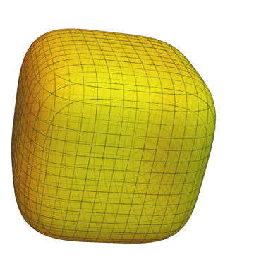


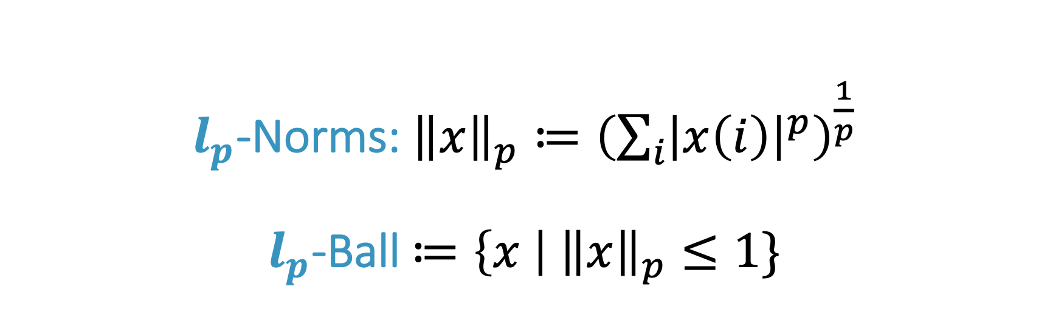



$l_{p}$-Norms: ${\left\|x\right\|}_{p}≔{\left(\sum_{i}{{\left|x\left(i\right)\right|}^{p}}\right)}^{\frac{1}{p}}$ $l_{p}$-Ball $≔\left\{x \right| {\left\|x\right\|}_{p}≤1\}$
$$l_{1}$$
$$l_{4/3}$$
$$l_{2}$$
$$l_{4}$$
$$l_{∞}$$

Slide 12





Approximability landscape for $l_{p}$-Balls
Approximation Factor
[Barak Brandao Harrow Kelner Steurer Zhao ’12] SSEH $ω\left(1\right)$
[Naor Schechtman ‘09] [Guruswami Rao Saket Wu ‘12]
$$n^{Ω(1)}$$
$$O(1)$$
$$\log{n}$$
$$l_{1}$$
$$l_{4/3}$$
$$l_{2}$$
$$l_{4}$$
$$l_{∞}$$

Slide 13
Geometric Invariant: Type-2

Slide 14
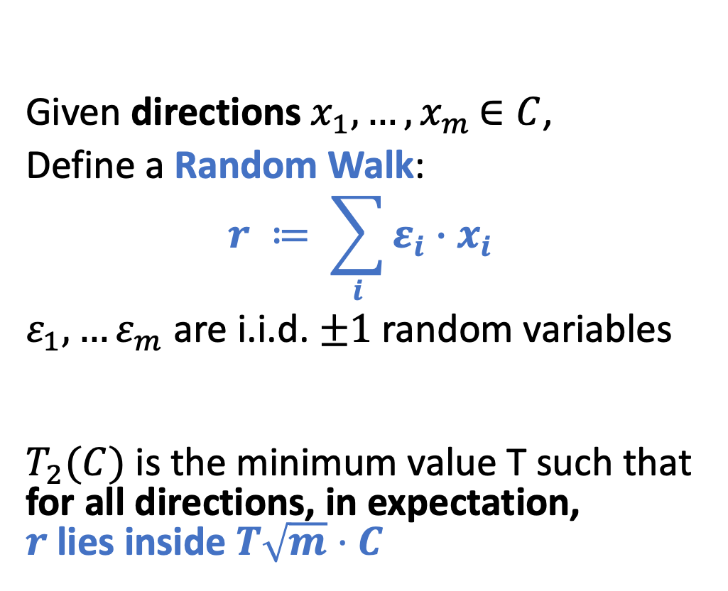
Type-2 Value of C
Given directions $x_{1}, …{,x}_{m}∈C$,
Define a Random Walk:
$$r ≔ \sum_{i}{ε_{i}}∙x_{i}$$
$ε_{1},…ε_{m}$ are i.i.d. $±1$random variables
$T_{2}(C)$ is the minimum value T such that for all directions, in expectation, $r$ lies inside $T\sqrt{m}⋅C$
C

Slide 15
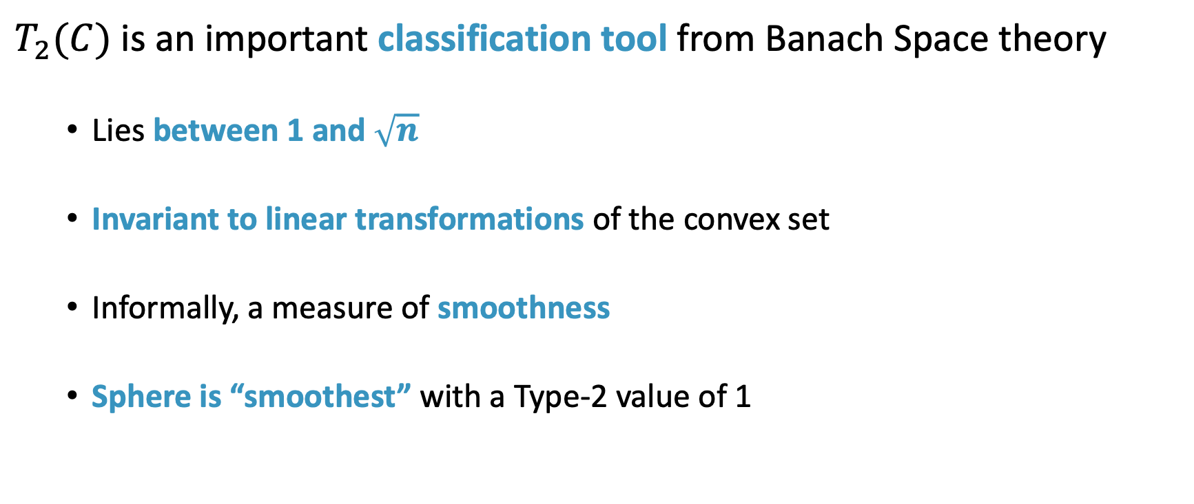
More about Type-2
$T_{2}(C)$ is an important classification tool from Banach Space theory
Lies between 1 and $\sqrt{n}$
Invariant to linear transformations of the convex set
Informally, a measure of smoothness
Sphere is “smoothest” with a Type-2 value of 1

Slide 16


Type-2 of $l_{p}$-Balls
Type-2 Value
$$n^{Ω(1)}$$
$$O(1)$$
$$\sqrt{\log{n}}$$
$$l_{1}$$
$$l_{4/3}$$
$$l_{2}$$
$$l_{4}$$
$$l_{∞}$$

Slide 17
Results

Slide 18
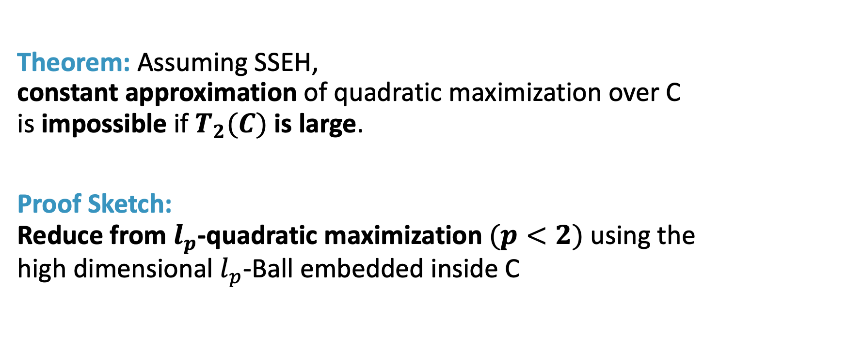
Results: [Bhattiprolu Lee Naor 2021] A necessary condition for constant approximation
Theorem: Assuming SSEH, constant approximation of quadratic maximization over C is impossible if $T_{2}(C)$ is large.
Proof Sketch: Reduce from $l_{p}$-quadratic maximization $(p<2)$ using the high dimensional $l_{p}$-Ball embedded inside C

Slide 19
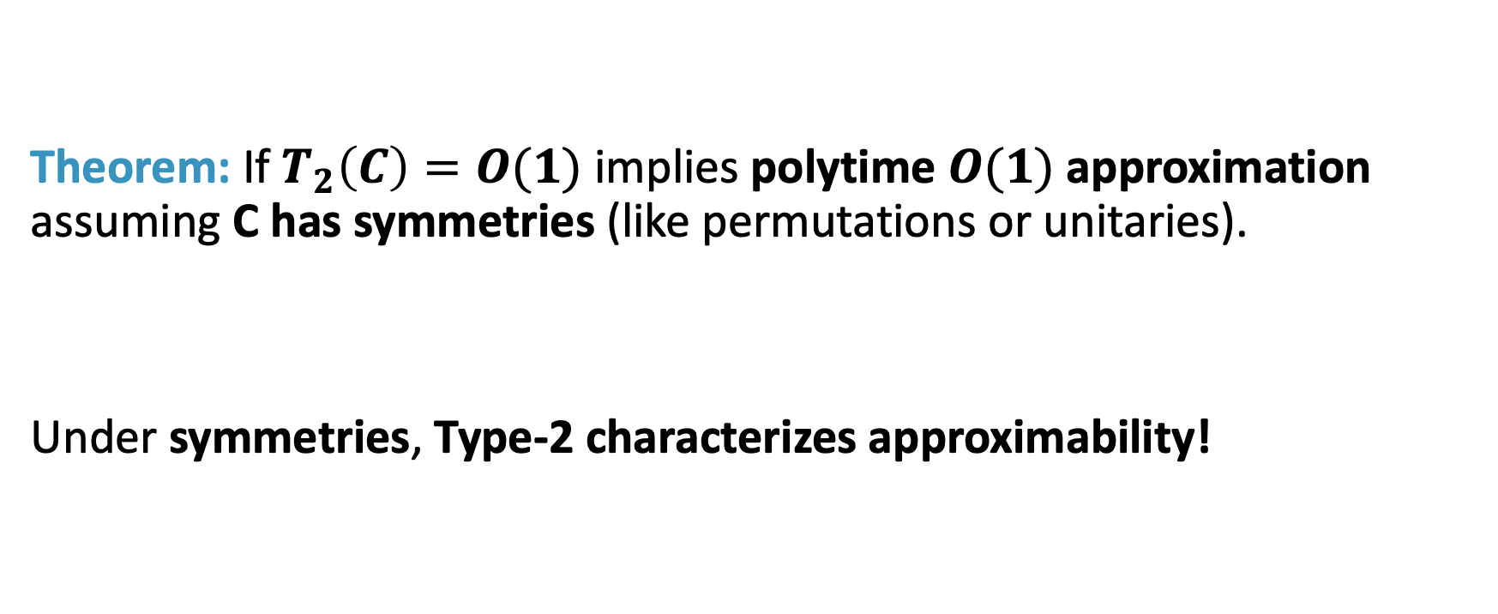
Results: [Bhattiprolu Lee Naor 2021] Condition is also sufficient given symmetries
Theorem: If $T_{2}\left(C\right)=O(1)$ implies polytime $O(1)$approximation assuming C has symmetries (like permutations or unitaries).
Under symmetries, Type-2 characterizes approximability!

Slide 20

Results: [Bhattiprolu Lee Naor 2021] In general, bounded Type-2 is insufficient
Observation: Even if $T_{2}\left(C\right)=O(1)$, there are convex sets for which $n^{0.1}$ approximation is impossible in even exponential ($2^{n^{0.1}}$) time. Need exponential membership queries to estimate $l_{2}$ diameter!
Hull
vs.

Slide 21
Even within bounded Type-2 bodies, approximability landscape is nuanced.

Slide 22
Results: [Bhattiprolu Lee Naor 2021] Generic algorithmic framework
Encompasses situations where constant approximations were known
Unifies Grothendieck: Bilinear Maximization over Hypercube and Non-commutative Grothendieck: Bilinear Maximization over Unitaries

Slide 23
Results: [Bhattiprolu Lee Naor 2021] Generic Algorithmic Framework
Encompasses situations where constant approximations were known
Rich family of new examples admitting constant approximation
Assuming bounded Type-2, Constant Approximability is Preserved under the following Type-2 Preserving Operations on Convex Sets:
Minkowski Sum
Intersection
Quotients
Subspaces
(Complex) Interpolation

Slide 24
Results: [Bhattiprolu Lee Naor 2021] Generic algorithmic framework
Encompasses situations where constant approximations were known
Rich family of new examples admitting constant approximation
Bounded Type-2 yields constant approximation under symmetries

Slide 25
Sketch of Generic Algorithmic Framework

Slide 26
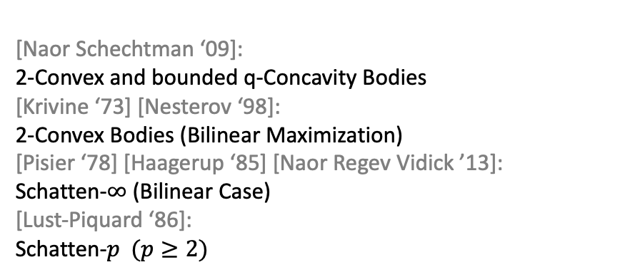
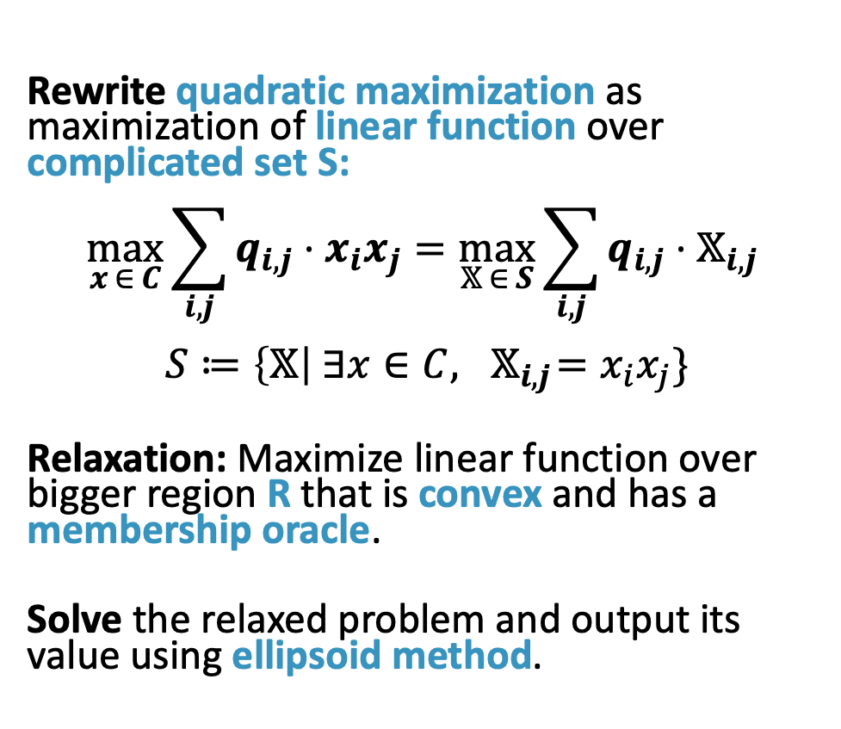
Prior approaches in Special Cases
Rewrite quadratic maximization as maximization of linear function over complicated set S: $$\max_{x ∈ C}\sum_{i,j}{q_{i,j}⋅x_{i}x_{j}}=\max_{𝕏 ∈ S}{\sum_{i,j}{q_{i,j}⋅𝕏_{i,j}}}$$ $$S≔\left\{𝕏\right| ∃x∈C,{ 𝕏}_{i,j}=x_{i}x_{j}\}$$
Relaxation: Maximize linear function over bigger region R that is convex and has a membership oracle.
Solve the relaxed problem and output its value using ellipsoid method.
S
R
[Naor Schechtman ‘09]: 2-Convex and bounded q-Concavity Bodies [Krivine ‘73] [Nesterov ‘98]:
2-Convex Bodies (Bilinear Maximization) [Pisier ‘78] [Haagerup ‘85] [Naor Regev Vidick ’13]: Schatten-$∞$ (Bilinear Case) [Lust-Piquard ‘86]: Schatten-$p (p≥2)$

Slide 27
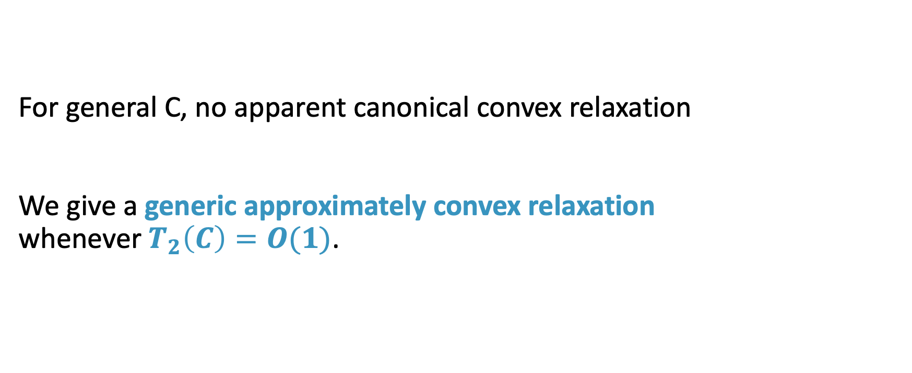
First Insight: Abandon Convexity
For general C, no apparent canonical convex relaxation We give a generic approximately convex relaxation whenever $T_{2}\left(C\right)=O(1)$.

Slide 28

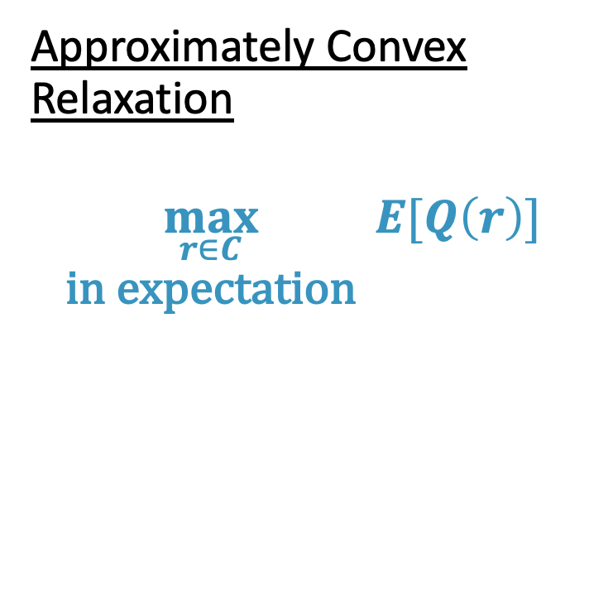
Generic approximately convex relaxation
Approximately Convex Relaxation
$$\max_{\begin{aligned}r∈C \\ \text{in} \text{expectation}\end{aligned}}{E[Q\left(r\right)]}$$
Original Optimization
$$\max_{x∈C}{Q(x)}$$

Slide 29
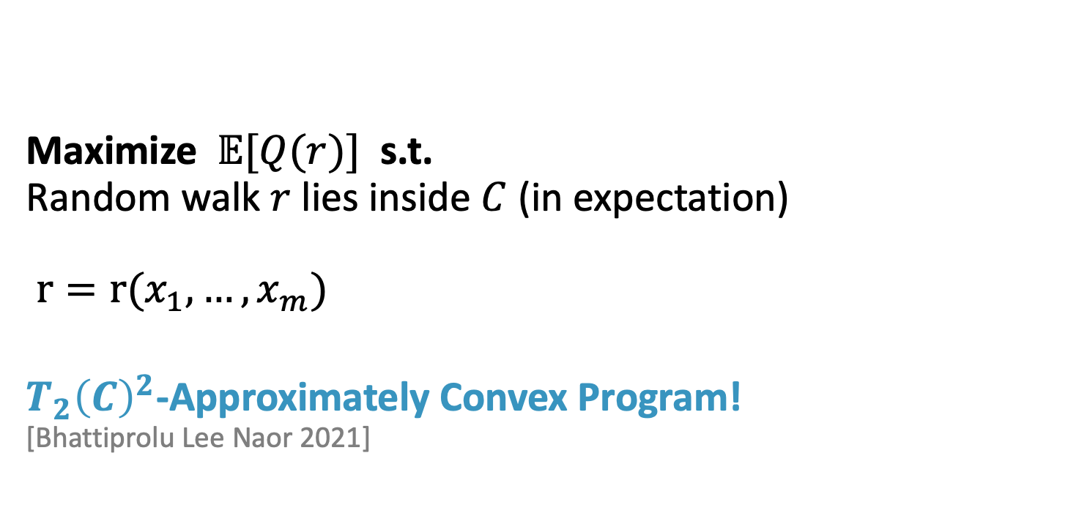
Generic approximately convex relaxation
Maximize $𝔼[Q(r)]$ s.t. Random walk $r$ lies inside $C$ (in expectation) $r=r(x_{1}, …, x_{m})$
$T_{2}{\left(C\right)}^{2}$-Approximately Convex Program! [Bhattiprolu Lee Naor 2021]

Slide 30
Approximate convex optimization
Ellipsoid:
Approximate ellipsoid
Maximize linear function over Convex Set R that has a Membership Oracle.
Maximize linear function over Apx. Convex Set R that has an Apx. Separation Oracle.

Slide 31
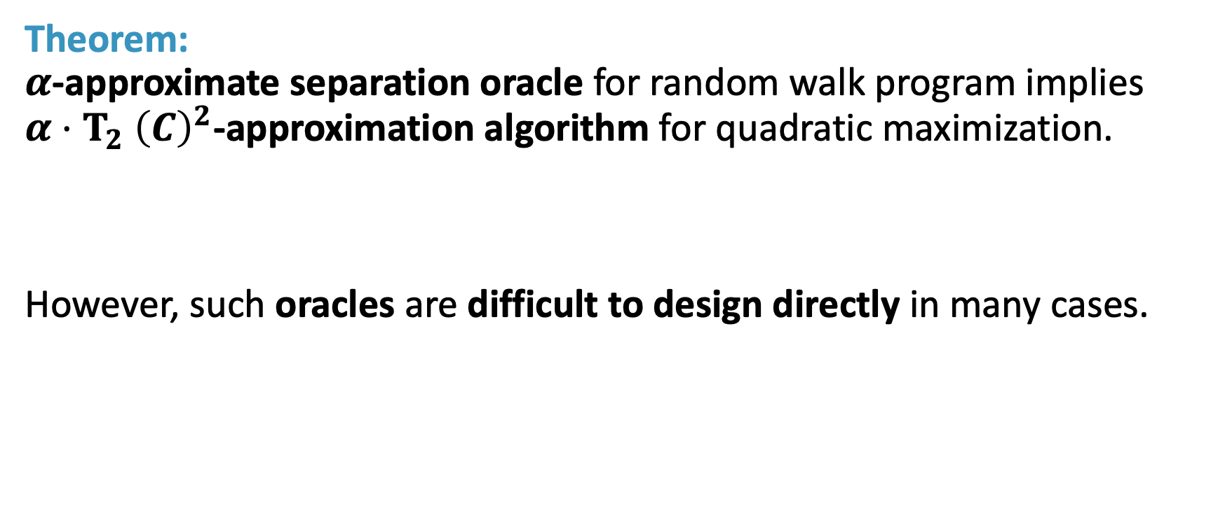
Theorem: $α$-approximate separation oracle for random walk program implies $α{⋅T}_{2}{\left(C\right)}^{2}$-approximation algorithm for quadratic maximization.
However, such oracles are difficult to design directly in many cases.

Slide 32
Thank You

Slide 33
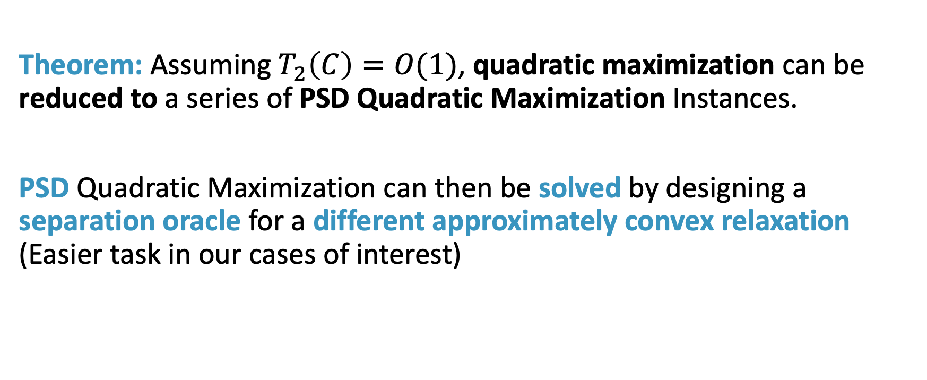
Final Algorithm: Reduce to PSD quadratic maximization
Theorem: Assuming $T_{2}\left(C\right)=O(1)$, quadratic maximization can be reduced to a series of PSD Quadratic Maximization Instances.
PSD Quadratic Maximization can then be solved by designing a separation oracle for a different approximately convex relaxation (Easier task in our cases of interest)

Slide 34
Future Directions

Slide 35
Is there a generic algorithm for polynomial maximization over convex sets?
Generic convex relaxation optimal for every constraint satisfaction problem assuming UGC [Raghavendra’08]

