Slide 1
C&O 750
Randomized Algorithms
Winter 2011
Lecture 24
Nicholas Harvey
TexPoint fonts used in EMF.
Read the TexPoint manual before you delete this box.: AAAAAAAAAA

Slide 2
Matchings
Perfect matching
Set of edges hitting
each vertex once
History
  Tutte ’47: Characterized graphs with a perfect matching, implying Matching 2 NP Å coNP
  Edmonds ’65: Defined the notion of polynomial time algorithms and proved Matching 2 P.

Slide 3
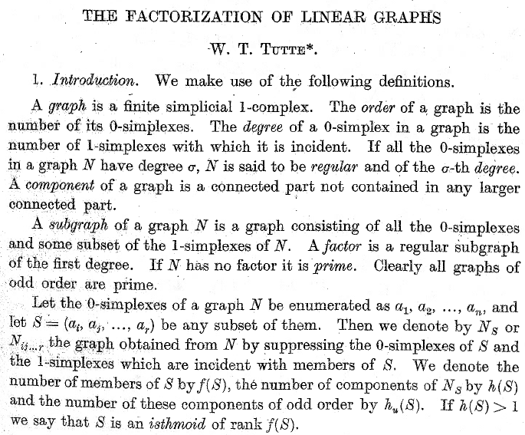
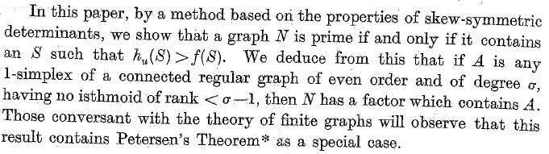

Slide 4
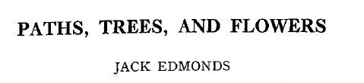
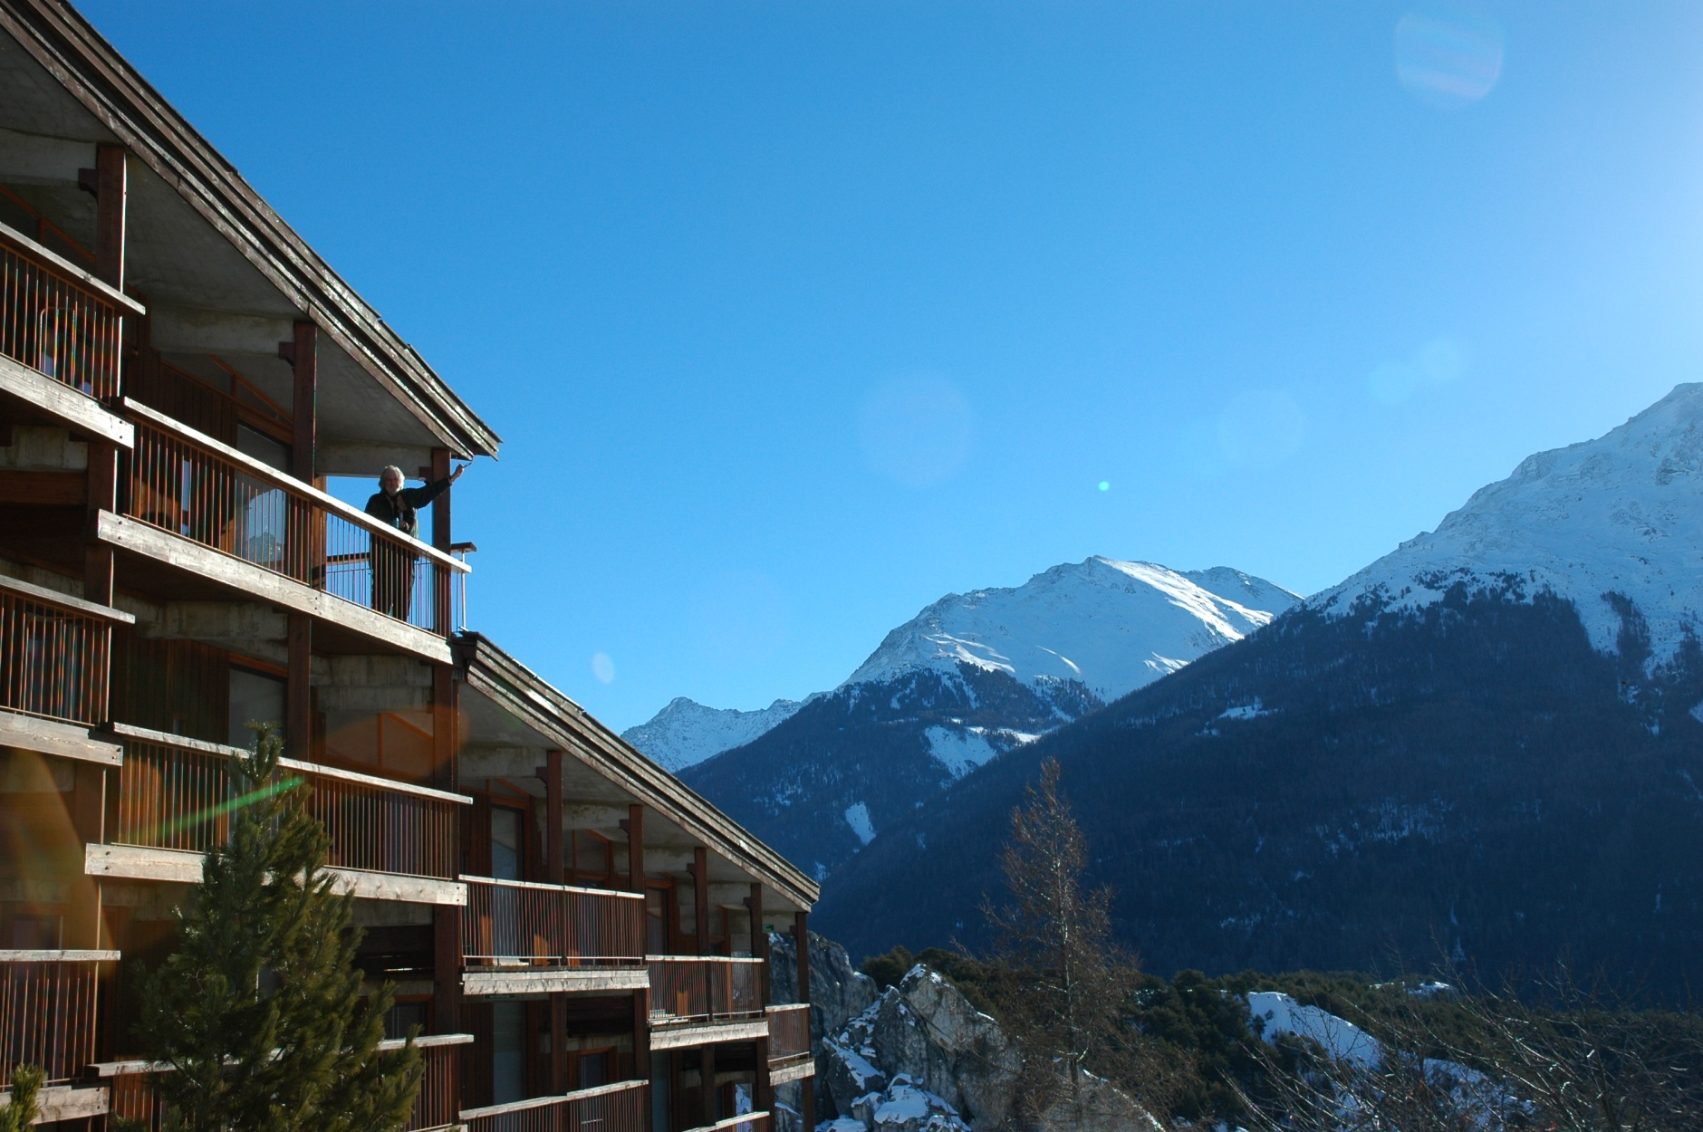
Birth of Computational Complexity
2008, Aussois, France
1965

Slide 5
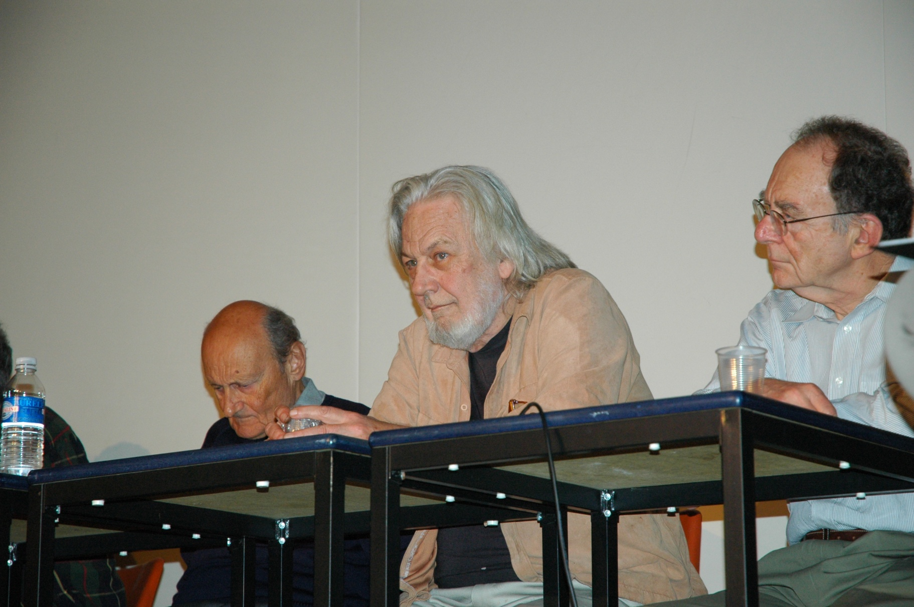
Birth of Computational Complexity
1965
Richard Karp
2008, Aussois, France

Slide 6
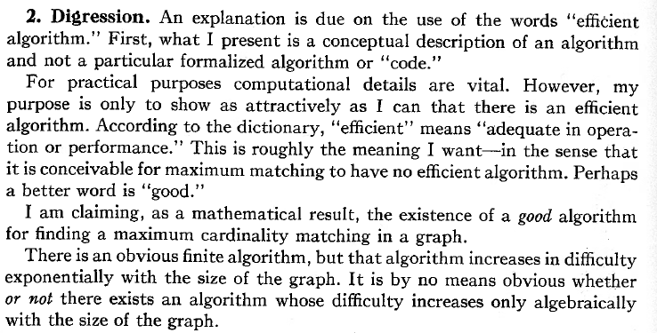
Efficient algorithm for matching,
even in non-bipartite graphs
This means “polynomial time”.
So Edmonds is defining the complexity class P.

Slide 7
Matching Algorithms
Edmonds ’65 | O(n² m)
Micali-Vazirani ’80-’90 | O(√n m)
Mucha-Sankowski ’04 | O(n^{ω})
O(n⁴)
O(n^{2.5})
Dense Graphs
m=Θ(n²)
O(n^{2.38})
n = # vertices m = # edges
ω<2.38 is exponent for matrix multiplication
All are intricate
Mucha ’05: “[Our] algorithm is quite complicated and heavily relies on graph theoretic results and techniques.
It would be nice to have a strictly algebraic, and possibly simpler, matching algorithm”.

Slide 8
Matching Algorithms
Edmonds ’65 | O(n⁴)
Micali-Vazirani ’80-’90 | O(n^{2.5})
Mucha-Sankowski ’04 | O(n^{2.38})
Harvey ’06 | O(n^{2.38})
Dense Graphs
m=Θ(n²)
*
*
Advantages
  Simple divide-and-conquer
  Self-contained
  Easily implementable (60 lines in MATLAB)
* Randomized, Las Vegas (like QuickSort)

Slide 9
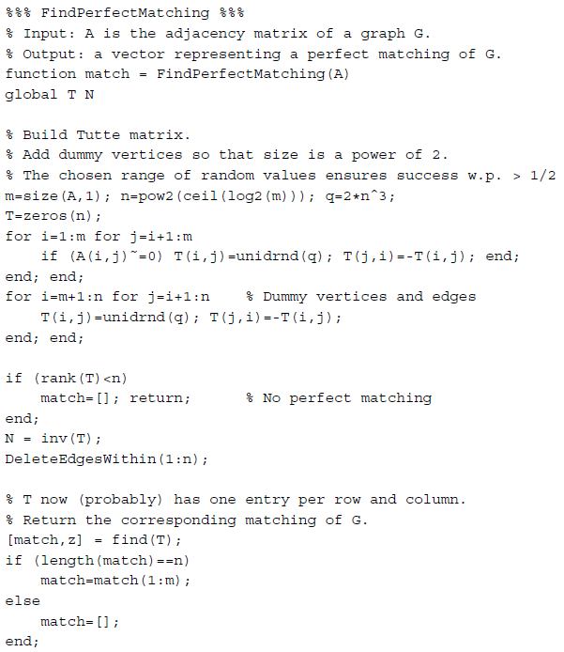
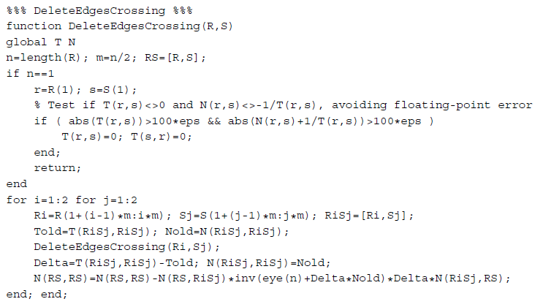
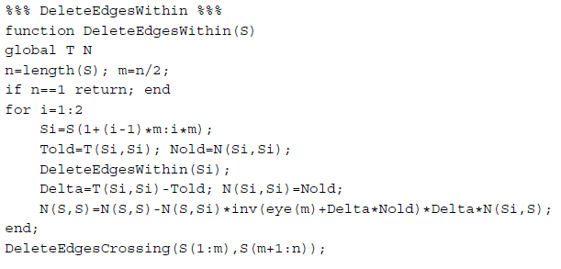
Complete Matlab Code

Slide 10
Matching & Tutte Matrix
Let G=(V,E) be a graph
Define variable x_{{u,v}} ∀{u,v}∈E
Define a skew-symmetric matrix T s.t.
± x_{{u,v}}
if {u,v}∈E
T_{u,v} =
0
otherwise
0 | -x_{{a,b}} | -x_{{a,c}}
x_{{a,b}} | 0 | -x_{{b,c}}
x_{{a,c}} | x_{{b,c}} | 0
a
b
c

Slide 11

Properties of Tutte Matrix
Lemma [Tutte ’47]: G has a perfect matching
iff T is non-singular.
Formally, let M = { all matchings of G }.
Define
It was previously known that det T = Pf(T)².
Since the T_{u,v} (=x_{u,v}) are distinct variables, the monomial for matching ¹ cannot cancel out
the monomial for another matching ¹’.
So, if one matching exists, det T = Pf(T)² ≠ 0.

Slide 12
Properties of Tutte Matrix
Lemma [Tutte ’47]: G has a perfect matching
iff T is non-singular.
Lemma [Rabin, Vazirani ’89]: G[ V\{u,v} ] has a perfect matching iff (T⁻¹)_{u,v} ≠ 0.
{u,v} is contained in a perfect matching ⇔ (T⁻¹)_{u,v}≠0

Slide 13
Properties of Tutte Matrix
Lemma [Tutte ’47]: G has a perfect matching
iff T is non-singular.
Lemma [Rabin, Vazirani ’89]: G[ V\{u,v} ] has a perfect matching iff (T⁻¹)_{u,v} ≠ 0.
{u,v} is contained in a perfect matching ⇔ (T⁻¹)_{u,v}≠0
u
(T⁻¹)_{u,v} ≠ 0
v

Slide 14
Properties of Tutte Matrix
Lemma [Tutte ’47]: G has a perfect matching
iff T is non-singular.
Lemma [Rabin, Vazirani ’89]: G[ V\{u,v} ] has a perfect matching iff (T⁻¹)_{u,v} ≠ 0.
{u,v} is contained in a perfect matching ⇔ (T⁻¹)_{u,v}≠0
G[ V\{u,v} ] has
perfect
matching
(T⁻¹)_{u,v} ≠ 0

Slide 15
Properties of Tutte Matrix
Lemma [Tutte ’47]: G has a perfect matching
iff T is non-singular.
Lemma [Rabin, Vazirani ’89]: G[ V\{u,v} ] has a perfect matching iff (T⁻¹)_{u,v} ≠ 0.
{u,v} is contained in a perfect matching ⇔ (T⁻¹)_{u,v}≠0
G[ V\{u,v} ] has
perfect
matching
(T⁻¹)_{u,v} ≠ 0

Slide 16
Properties of Tutte Matrix
Lemma [Tutte ’47]: G has a perfect matching
iff T is non-singular.
Lemma [Rabin, Vazirani ’89]: G[ V\{u,v} ] has a perfect matching iff (T⁻¹)_{u,v} ≠ 0.
{u,v} is contained in a perfect matching ⇔ (T⁻¹)_{u,v}≠0
u
G[ V\{u,v} ] has
perfect
matching
(T⁻¹)_{u,v} ≠ 0
v

Slide 17
Properties of Tutte Matrix
Lemma [Tutte ’47]: G has a perfect matching
iff T is non-singular.
Lemma [Rabin, Vazirani ’89]: G[ V\{u,v} ] has a perfect matching iff (T⁻¹)_{u,v} ≠ 0.
Computing T⁻¹ very slow: Contains variables!
Lemma [Lovász ’79]: These results hold w.h.p.
if we randomly choose values for T_{u,v}’s.
{u,v} is contained in a perfect matching ⇔ (T⁻¹)_{u,v}≠0

Slide 18
Properties of Tutte Matrix
Lemma [Lovász ’79]: These results hold w.h.p.
if we randomly choose values for T_{u,v}’s.
Consequence of the Schwartz-Zippel Lemma:
Let p(x₁,…,x_{m}) be a non-zero polynomial of total degree d over a field F. Let SµF. Choose r₁,…,r_{m} independently and uniformly from S. Then:
Pr[ p(r₁,…,r_{m}) = 0 ] · d/|S|.
Implies randomized alg to test if graph has p.m.
How can we construct a p.m.?

Slide 19
Algorithm #1: Self-Reducibility
[Rabin, Vazirani ’89]
If G has no p.m. then Error
For each {u,v} ∈ E
  Temporarily delete edge {u,v}
  If G still has p.m.
    Permanently delete edge {u,v}
Randomly choose values for T_{u,v}’s
If det T=0 then Error (test if has p.m.)
For each {u,v} ∈ E
  Set T=T; T_{u,v}=T_{v,u}=0; (temporarily delete edge)
  If det T≠0 (test if still has p.m.)
    Set T=T (permanently delete edge)
~
~
~
~
O(n^{ω}) time
~
Total time: O(n^{ω+2}) time
Can we compute det T more quickly?
~

Slide 20
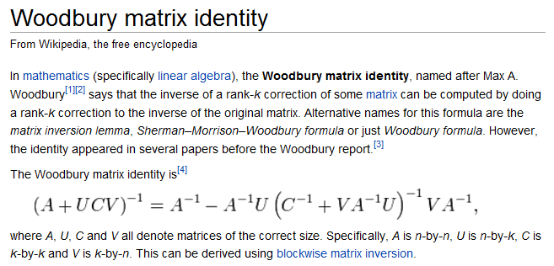
Updating Submatrices
(Sherman-Morrison-Woodbury Formula)

Slide 21
Updating Submatrices
(Sherman-Morrison-Woodbury Formula)
A
~
A
Δ := M_{A,A}-M_{A,A}
M =
~
Matrix
M =
N =
~
Inverse
N =
~
Claim: M is non-sing ⇔ det(I + Δ∙N_{A,A}) ≠ 0
Claim: N = N - N_{*,A}∙(I + Δ∙N_{A,A})⁻¹∙Δ∙N_{A,*}
~
=
-
∙
∙
∙
rank-|A| update

Slide 22
Algorithm #2: Matrix Updates
Compute N=T⁻¹
For each {u,v} ∈ E
If T still non-singular after deleting {u,v}
(i.e., G still has p.m. after deleting {u,v})
    Delete edge {u,v}
    Update N
By Sherman-Morrison-Woodbury,
can do this by examining N
O(n²) time
Total time: O(n⁴) time
Can we improve running time further?
Can also do this using
Sherman-Morrison-Woodbury

Slide 23
Algorithm #2: Matrix Updates
Compute N=T⁻¹
For each {u,v} ∈ E
If T still non-singular after deleting {u,v}
(i.e., G still has p.m. after deleting {u,v})
    Delete edge {u,v}
    Update N
Iteratively delete edges
Total time: O(n⁴) time
Can we improve running time further?
Key idea: make algorithm recursive instead of iterative!

Slide 24
Recursive Decomposition of Graph
Define:
E[S] = { {u,v} : u,v∈S and {u,v}∈E } “within”
E[S₁,S₂] = { {u,v} : u∈S₁, v∈S₂, and {u,v}∈E } “crossing”
Claim: Let S=S₁⋃S₂. Then
E[S] = E[S₁] ⋃ E[S₂] ⋃ E[S₁,S₂]
S₁
S₂
E[S₁]
E[S]
E[S₂]
E[S₁,S₂]

Slide 25
Recursive Decomposition of Graph
Define:
E[S] = { {u,v} : u,v∈S and {u,v}∈E } “within”
E[R,S] = { {u,v} : u∈R, v∈S, and {u,v}∈E } “crossing”
Claim: Let R=R₁⋃R₂ and S=S₁⋃S₂. Then
E[R,S] = E[R₁,S₁] ⋃ E[R₁,S₂] ⋃ E[R₂,S₁] ⋃ E[R₂,S₂]
R
S

Slide 26
Recursive Decomposition of Graph
Define:
E[S] = { {u,v} : u,v∈S and {u,v}∈E } “within”
E[R,S] = { {u,v} : u∈R, v∈S, and {u,v}∈E } “crossing”
Claim: Let R=R₁⋃R₂ and S=S₁⋃S₂. Then
E[R,S] = E[R₁,S₁] ⋃ E[R₁,S₂] ⋃ E[R₂,S₁] ⋃ E[R₂,S₂]
R
S
R₁
S₁
R₂
S₂

Slide 27
Algorithm #2: Matrix Updates
Compute N=T⁻¹
For each {u,v} ∈ E
If T still non-singular after deleting {u,v}
(i.e., G still has p.m. after deleting {u,v})
    Delete edge {u,v}
    Update N
Iteratively delete edges
Key idea: make algorithm recursive instead of iterative!

Slide 28
FindMatching( G=(V,E) )
Construct T and N=T⁻¹
DeleteWithin(V)
Recursively delete edges
DeleteWithin(S)
If |S|=1 then Return
Partition S=S₁⋃S₂
For i∈{1,2}
DeleteWithin(S_{i})
Update N
DeleteCrossing(S₁,S₂)
DeleteCrossing(R,S)
If |R|=|S|=1
Try to delete R-S edge; Return
Partition R=R₁⋃R₂ and S=S₁⋃S₂
For i∈{1,2} and j∈{1,2}
DeleteCrossing(R_{i},S_{j})
Update N
S₁
S₂
DeleteWithin(S₁)
E[S₁]
V
DeleteWithin(S₂)
E[S₂]
DeleteCrossing(S₁,S₂)
E[S₁,S₂]

Slide 29
FindMatching( G=(V,E) )
Construct T and N=T⁻¹
DeleteWithin(V)
Recursively delete edges
DeleteWithin(S)
If |S|=1 then Return
Partition S=S₁⋃S₂
For i∈{1,2}
DeleteWithin(S_{i})
Update N
DeleteCrossing(S₁,S₂)
DeleteCrossing(R,S)
If |R|=|S|=1
Try to delete R-S edge; Return
Partition R=R₁⋃R₂ and S=S₁⋃S₂
For i∈{1,2} and j∈{1,2}
DeleteCrossing(R_{i},S_{j})
Update N
S₁
DeleteWithin(S₁)
DeleteWithin(S₂)
S₂
DeleteCrossing(S₁,S₂)

Slide 30
FindMatching( G=(V,E) )
Construct T and N=T⁻¹
DeleteWithin(V)
Recursively delete edges
DeleteWithin(S)
If |S|=1 then Return
Partition S=S₁⋃S₂
For i∈{1,2}
DeleteWithin(S_{i})
Update N
DeleteCrossing(S₁,S₂)
DeleteCrossing(R,S)
If |R|=|S|=1
Try to delete R-S edge; Return
Partition R=R₁⋃R₂ and S=S₁⋃S₂
For i∈{1,2} and j∈{1,2}
DeleteCrossing(R_{i},S_{j})
Update N
S₁
DeleteWithin(S₁)
S₂
DeleteWithin(S₂)
DeleteCrossing(S₁,S₂)

Slide 31
FindMatching( G=(V,E) )
Construct T and N=T⁻¹
DeleteWithin(V)
Recursively delete edges
DeleteWithin(S)
If |S|=1 then Return
Partition S=S₁⋃S₂
For i∈{1,2}
DeleteWithin(S_{i})
Update N
DeleteCrossing(S₁,S₂)
DeleteCrossing(R,S)
If |R|=|S|=1
Try to delete R-S edge; Return
Partition R=R₁⋃R₂ and S=S₁⋃S₂
For i∈{1,2} and j∈{1,2}
DeleteCrossing(R_{i},S_{j})
Update N
Try to delete R-S edge; Return
S₁
S₂
DeleteWithin(S₁)
DeleteWithin(S₂)
DeleteCrossing(S₁,S₂)

Slide 32
Correctness
FindMatching( G=(V,E) )
Construct T and N=T⁻¹
DeleteWithin(V)
To make correct decision here, need N_{R[S,R[S} = T⁻¹_{R[S,R[S}
DeleteWithin(S)
If |S|=1 then Return
Partition S=S₁⋃S₂
For i∈{1,2}
DeleteWithin(S_{i})
Update N
DeleteCrossing(S₁,S₂)
DeleteCrossing(R,S)
If |R|=|S|=1
Try to delete R-S edge; Return
Partition R=R₁⋃R₂ and S=S₁⋃S₂
For i∈{1,2} and j∈{1,2}
DeleteCrossing(R_{i},S_{j})
Update N
Update N_{S,S}
Update N_{R[S,R[S}
Invariants:
T always non-singular
In DeleteWithin(S), N[S,S] = T⁻¹[S,S]
In DeleteCrossing(R,S), N[R⋃S,R⋃S] = T⁻¹[R⋃S,R⋃S]

Slide 33
Updates
S
S₁
S₂
FindMatching( G=(V,E) )
Construct T and N=T⁻¹
DeleteWithin(V)
DeleteCrossing(R,S)
If |R|=|S|=1
Let u∈R and v∈S
If T_{u,v} ≠ 0 and T_{u,v} ≠ -1/N_{u,v}
    T_{{u,v},{u,v}} := 0
    Update N
Return
Partition R=R₁⋃R₂ and S=S₁⋃S₂
For i∈{1,2} and j∈{1,2}
DeleteCrossing(R_{i},S_{j})
Update N
S₁
S
~
S₂
T =
DeleteWithin(S)
If |S|=1 then Return
Partition S=S₁⋃S₂
For i∈{1,2}
DeleteWithin(S_{i})
Update N
DeleteCrossing(S₁,S₂)
~
~
N := T⁻¹ N := T⁻¹
~
Δ := T_{S1,S1}-T_{S1,S1}
~
N := N-N_{*,S1}∙(I+Δ∙N_{S1,S1})⁻¹∙Δ∙N_{S1,*}
N_{S,S} := N_{S,S}-N_{S,S1}∙(I+Δ∙N_{S1,S1})⁻¹∙Δ∙N_{S1,S}
=
-
∙
∙
∙
Invariants:
T always non-singular
In DeleteWithin(S), N[S,S] = T⁻¹[S,S]
In DeleteCrossing(R,S), N[R⋃S,R⋃S] = T⁻¹[R⋃S,R⋃S]
Time required: O(|S|^{ω})

Slide 34
Runtime Analysis
DeleteWithin(S)
If |S|=1 then Return
Partition S=S₁⋃S₂
For i∈{1,2}
DeleteWithin(S_{i})
Update N_{S,S}
DeleteCrossing(S₁,S₂)
DeleteCrossing(R,S)
If |R|=|S|=1
Try to delete R-S edge; Return
Partition R=R₁⋃R₂ and S=S₁⋃S₂
For i∈{1,2} and j∈{1,2}
DeleteCrossing(R_{i},S_{j})
Update N_{R[S,R[S}
Runtime: f(n), where n=|S|
Runtime: g(n), where n=|R|=|S|
By Sherman-Morrison-Woodbury Formula, can do each update in O(n^{ω}) time
f(n) = 2∙f(n/2)+g(n)+O(n^{ω})
g(n) = 4∙g(n/2) + O(n^{ω})
⇒ f(n) = O(n^{ω})
⇒ g(n) = O(n^{ω})
Total runtime of algorithm is O(n^{ω}) time

Slide 35
FindMatching( G=(V,E) )
Construct T and N=T⁻¹
DeleteWithin(V)
DeleteWithin(S)
If |S|=1 then Return
Partition S=S₁⋃S₂
For i∈{1,2}
DeleteWithin(S_{i})
Update N_{S,S}
DeleteCrossing(S₁,S₂)
DeleteCrossing(R,S)
If |R|=|S|=1
Try to delete R-S edge; Return
Partition R=R₁⋃R₂ and S=S₁⋃S₂
For i∈{1,2} and j∈{1,2}
DeleteCrossing(R_{i},S_{j})
Update N_{R[S,R[S}
Conclusion:
  The remaining edges form a perfect matching
  The total running time is O(n^{ω}) time

Slide 36
A ZPP Algorithm
Cheriyan ‘97: Gave an RP algorithm for the dual of the matching problem.
Its running time is O(n^{2.376}).
So run both the matching algorithm and Cheriyan’s algorithm until one succeeds.
(i.e., we get a perfect matching, or a dual proving there is no perfect matching)
This is an ZPP algorithm.

