Slide 1
C&O 355 Mathematical Programming Fall 2010 Lecture 8
N. Harvey
TexPoint fonts used in EMF.
Read the TexPoint manual before you delete this box.: AAAAAAAAAA

Slide 2
Polynomial Time Algorithms
P = { computational problems that can be solved efficiently } i.e., solved in time ·n^{c}, for some constant c, where n=input size
This is a bit vague
Consider an LP max { c^{T}x : Ax·b } where A has size m x d
Input is a binary file containing the matrix A, vectors b and c
Two ways to define “input size”
# of bits used to store the binary input file
# of numbers in input file, i.e., m¢d + m + d
Leads to two definitions of “efficient algorithms”
Running time ·n^{c} where n = # bits in input file
Running time ·n^{c} where n = m¢d + m + d
“Polynomial Time
Algorithm”
“Strongly Polynomial Time Algorithm”

Slide 3
Algorithms for Solving LPs
Name | Publication | Running Time | Practical?
Fourier-Motzkin Elimination | Fourier 1827, Motzkin 1936 | Exponential | No
Simplex Method | Dantzig '47 | Exponential | Yes
Perceptron Method | Agmon '54, Rosenblatt '62 | Exponential | Sort of
Ellipsoid Method | Khachiyan '79 | Polynomial | No
Interior Point Method | Karmarkar '84 | Polynomial | Yes
Analytic Center Cutting Plane Method | Vaidya '89 & '96 | Polynomial | No
Random Walk Method | Bertsimas & Vempala '02-'04 | Polynomial | Probably not
Boosted Perceptron Method | Dunagan & Vempala '04 | Polynomial | Probably not
Random Shadow-Vertex Method | Kelner & Spielman '06 | Polynomial | Probably not
Unsolved Problems:
Is there a strongly polynomial time algorithm?
Does some implementation of simplex method run in polynomial time?

Slide 4

The Genius behind the Ellipsoid Method
“Intelligence gathered by this and other governments leaves no doubt that the Iraq regime continues to possess and conceal some of the most lethal weapons ever devised”
George W. Bush, 3/18/2003

Slide 5

WMD in Iraq
“We are learning more as we interrogate or have discussions with Iraqi scientists and people within the Iraqi structure, that perhaps he destroyed some, perhaps he dispersed some. And so we will find them.” George W. Bush, 4/24/2003
Notes:
Intelligence gathered by this and other governments leaves no doubt that the Iraq regime continues to possess and conceal some of the most lethal weapons ever devised.
George Bush March 18, 2003
We are learning more as we interrogate or have discussions with Iraqi scientists and people within the Iraqi structure, that perhaps he destroyed some, perhaps he dispersed some. And so we will find them.
George Bush April 24, 2003

Slide 6
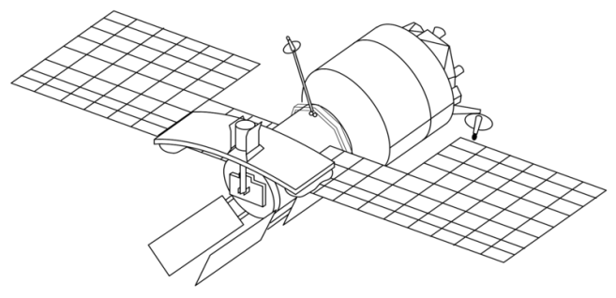
Finding WMD
USA have a satellite with a WMD detector
The detector scans a round region of the earth
It can compare two halves of the region, and decide which half is “more likely” to have WMD

Slide 7
Finding WMD
USA have a satellite with a WMD detector
The detector scans a round region of the earth
It can compare two halves of the region, and decide which half is “more likely” to have WMD
It continues by rescanning the “more likely” half

Slide 8
Finding WMD
USA have a satellite with a WMD detector
The detector scans a round region of the earth
It can compare two halves of the region, and decide which half is “more likely” to have WMD
It continues by rescanning the “more likely” half

Slide 9

Finding WMD
USA have a satellite with a WMD detector
The detector scans a round region of the earth
It can compare two halves of the region, and decide which half is “more likely” to have WMD
It continues by rescanning the “more likely” half

Slide 10
Finding WMD
It continues by rescanning the “more likely” half
If region is so small that it obviously contains no WMD, then conclude: Iraq has no WMD
“No one was more surprised than I that we didn't find [WMDs].” U.S. General Tommy Franks, 12/2/2005
http://www.flickr.com/photos/sunfox/17620516/

Slide 11
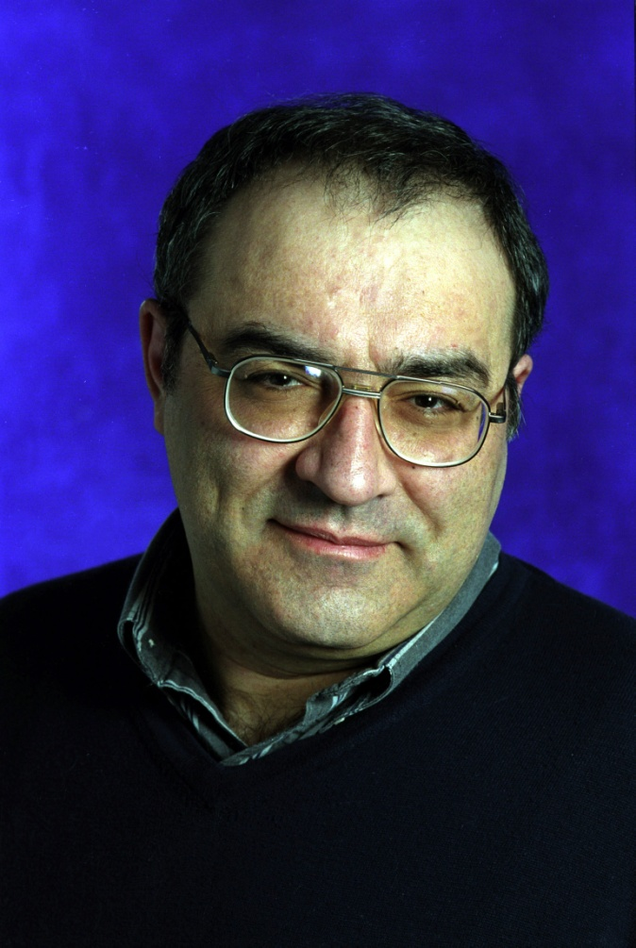
Generalization to Higher Dimensions
Leonid Khachiyan
Even smarter than George W. Bush!

Slide 12
The Ellipsoid Method
Want to find x2P
Have ellipsoid E(M,z) ¶ P
If z∉P then it violates a constraint “a_{i}^{T}x · b_{i}”
So P µ { x : a_{i}^{T}x · a_{i}^{T}z }
So P µ E(M,z) Å { x : a_{i}^{T}x · a_{i}^{T}z }
E(M,z)
z
P

Slide 13
The Ellipsoid Method
Have ellipsoid E(M,z) ¶ P
If z∉P then it violates a constraint “a_{i}^{T}x · b_{i}”
So P µ { x : a_{i}^{T}x · a_{i}^{T}z }
So P µ E(M,z) Å { x : a_{i}^{T}x · a_{i}^{T}z }
Let E(M’,z’) be ellipsoid covering E(M,z) Å {x : a_{i}^{T}x·a_{i}^{T}z}
Repeat…
E(M’,z’)
z’
P

Slide 14
The Ellipsoid Method
Input: A polytope P = { Ax·b } (e.g., P=WMD)
Output: A point x2P, or announce “P is empty”
and R and r.
Let E(M,z) be an ellipsoid s.t. PµE(M,z) (e.g., E(M,z)=B(0,R))
If vol E(M,z) < vol B(0,r) then Halt: “P is empty”
If z2P, Halt: “z 2 P”
Else
Let “a_{i}^{T}x · b_{i}” be a constraint of P violated by z (i.e., a_{i}^{T}z>b_{i})
Let H = { x : a_{i}^{T}x · a_{i}^{T}z } (so P µ E(M,z)ÅH)
Let E(M’,z’) be an ellipsoid covering E(M,z)ÅH
Set M←M’ and z←z’ and go back to Start
How to find this?
Notation: Let B(z,r) = ball of radius r around point z2R^{n}
Assumptions:
“The WMD is in Iraq”: 9R>0 such that P µ B(0,R)
“WMD bigger than cow”: If P≠; then 9r>0, z2R^{n} s.t. B(z,r)µP

Slide 15
Covering Half-ellipsoids by Ellipsoids
Let E be an ellipsoid centered at z
Let H_{a} = { x : a^{T}x · a^{T}z }
H_{a}
E’
E
z
Solution
In Lecture 7 we found an ellipsoid E’ such that
EÅH_{a} µ E’
vol(E’) · vol(E) ¢ e^{-1/4(n+1)}

Slide 16
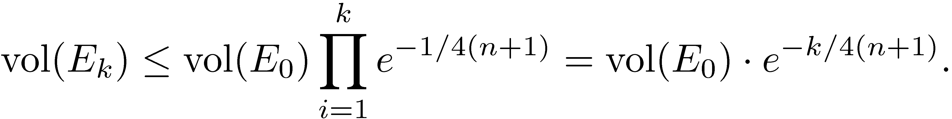
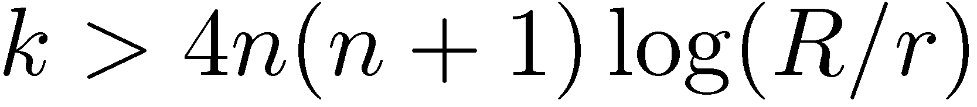
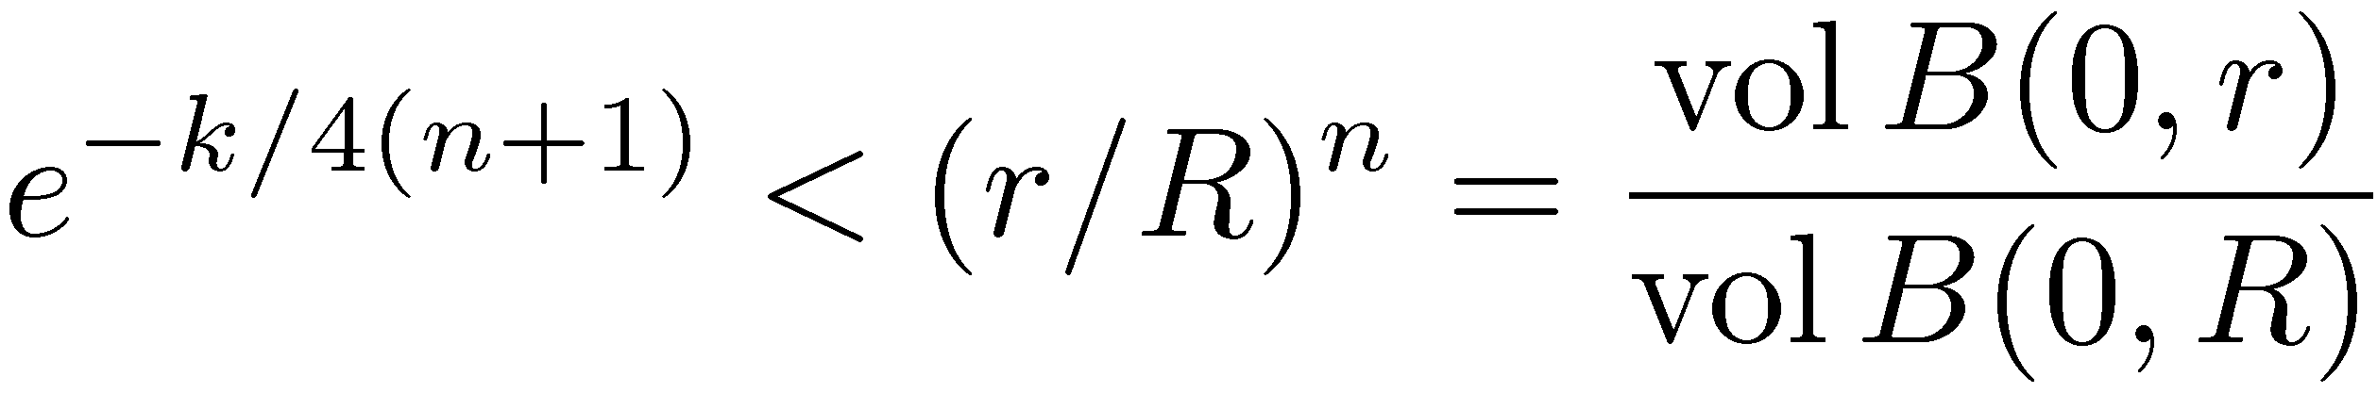
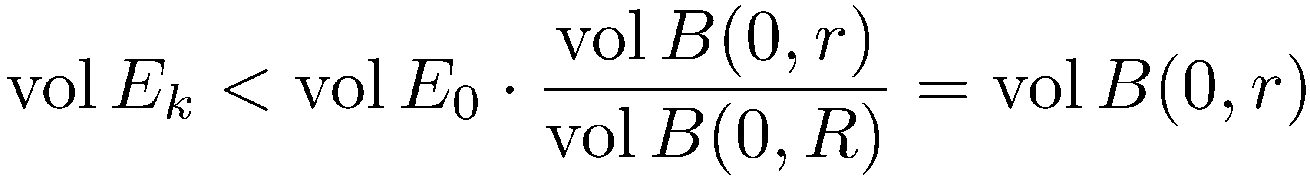
How many iterations?
E_{i} = ellipsoid in i^{th} iteration. Initially E₀ = B(0,R)
Claim 1:
Proof: We showed
So ¥
Claim 2: Number of iterations · 4 n(n+1) log(R/r).
Proof: Suppose
Then
So
By Claim 1,
So the algorithm stops. ¥

Slide 17
Ellipsoid Method for Solving LPs
Ellipsoid method finds feasible point in P = { x : Ax · b } i.e., it can solve a system of inequalities
But we want to optimize, i.e., solve max { c^{T}x : x2P }
Restatement of Strong Duality Theorem: (from Lecture 3) Primal has optimal solution , Dual has optimal solution , the following system is solvable:
Important Point Solving an LP is equivalent to solving a system of inequalities
) Ellipsoid method can be used to solve LPs

Slide 18
Ellipsoid Method for Solving LPs
Ellipsoid method finds feasible point in P = { x : Ax · b } i.e., it can solve a system of inequalities
But we want to optimize, i.e., solve max { c^{T}x : x2P }
Alternative approach: Binary search for optimal value
Suppose we know optimal value is in interval [L,U]
Add a new constraint c^{T}x ¸ (L+U)/2
If LP still feasible, replace L with (L+U)/2 and repeat
If LP not feasible, replace U with (L+U)/2 and repeat
c^{T}x¸(L+U)/2
c^{T}x = L
c^{T}x = U
P

Slide 19
Issues with Ellipsoid Method
It needs to compute square roots, so it must work with irrational numbers
Solution: Approximate irrational numbers by rationals. Approximations proliferate, and it gets messy.
Can only work with bounded polyhedra P
Solution: If P non-empty, there exists a feasible x s.t. |x_{i}|·U 8i, where U is a bound based on numbers in A and b. So we can assume that -U · x_{i} · U for all i.
Polyhedron P needs to contain a small ball B(z,k)
Solution: If P = { x : Ax·b } then we can perturb b by a tiny amount. The perturbed polyhedron is feasible iff P is, and if it is feasible, it contains a small ball.
Notes:
See:
- Korte-Vygen “Combinatorial Optimization: Theory and Algorithms”, Chapter 4
- Schrijver “Theory of Linear and Integer Programming”, Chapter 13
- Grotschel-Lovasz-Schrijver “Geometric Algorithms and Combinatorial Optimization”
The main trouble in Issue 3 is that P might not be full-dimensional (i.e., it has volume 0). The perturbation makes it full-dimensional.

Slide 20
Ellipsoid Method in Polynomial Time
Input: A polyhedron P = { x : Ax·b } where A has size m x d. This is given as a binary file containing matrix A and vector b.
Input size: n = # of bits used to store this binary file
Output: A point x2P, or announce “P is empty”
Boundedness: Can add constraints -U·x_{i}·U, where U = 16^{d2n}. The new P is contained in a ball B(0,R), where R<n¢U.
Contains ball: Add ² to b_{i}, for every i, where ² = 1/U². The new P contains a ball of radius r = ²¢2^{-dn} > 1/U³.
Iterations: We proved that: # iterations · 4d(d+1)log(R/r), and this is < 40d⁶n²
Each iteration does only basic matrix operations and can be implemented in polynomial time.
Conclusion: Overall running time is polynomial in n (and d)!

Slide 21
What Does Ellipsoid Method Need?
The algorithm uses no properties of polyhedra
It just needs to (repeatedly) answer the question: Is z2P? If not, give me a constraint “a^{T}x·b” of P violated by z
Let E(M,z) be an ellipsoid s.t. PµE(M,z)
If vol E(M,z) < vol B(0,r) then Halt: “P is empty”
If z2P, Halt: “z 2 P”
Else
Let “a_{i}^{T}x · b_{i}” be a constraint of P violated by z (i.e., a_{i}^{T}z>b_{i})
Let H = { x : a_{i}^{T}x · a_{i}^{T}z } (so P µ E(M,z)ÅH)
Let E(M’,z’) be an ellipsoid covering E(M,z)ÅH
Set M←M’ and z←z’ and go back to Start
Input: A polytope P = { Ax·b }
Output: A point x2P, or announce “P is empty”

Slide 22
The Ellipsoid Method
The algorithm uses almost nothing about polyhedra (basic feasible solutions, etc.)
It just needs to (repeatedly) answer the question:
The algorithm works for any convex set P, as long as you can give a separation oracle.
P still needs to be bounded and contain a small ball.
Remarkable Theorem: [Grotschel-Lovasz-Schijver ‘81] For any convex set PµR^{n} with a separation oracle, you can find a feasible point efficiently.
Caveats:
“Efficiently” depends on size of ball containing P and inside P.
Errors approximating irrational numbers means we get “approximately feasible point”
Separation Oracle
Is z2P?
If not, find a vector a s.t. a^{T}x<a^{T}z 8x2P

Slide 23


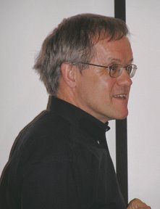
Martin Grotschel
Laszlo Lovasz
Alexander Schrijver

Slide 24
The Ellipsoid Method For Convex Sets
Feasibility Theorem: [Grotschel-Lovasz-Schijver ‘81] For any convex set PµR^{n} with a separation oracle, you can find a feasible point efficiently.
Ignoring (many, technical) details, this follows from ellipsoid algorithm
Optimization Theorem: [Grotschel-Lovasz-Schijver ‘81]
For any convex set PµR^{n} with a separation oracle, you can solve optimization problem max { c^{T}x : x2P }.
How?
Follows from previous theorem and binary search on objective value.
This can be generalized to minimizing non-linear (convex) objective functions.
Separation Oracle
Is z2P?
If not, find a vector a s.t. a^{T}x<a^{T}z 8x2P

Slide 25
Separation Oracle for Ball
Let’s design a separation oracle for the convex set P = { x : kxk·1 } = unit ball B(0,1).
Input: a point z2R^{n}
If kzk·1, return “Yes”
If kzk>1, return a=z/kzk
For all x2P we have a^{T}x = z^{T}x/kzk · kxk Why?
For z we have a^{T}z = z^{T}z/kzk = kzk > 1 ¸ kxk ) a^{T}x < a^{T}z
Separation Oracle
Is z2P?
If not, find a vector a s.t. a^{T}x<a^{T}z 8x2P
Cauchy-Schwarz

Slide 26
Separation Oracle for Ball
Let’s design a separation oracle for the convex set P = { x : kxk·1 } = unit ball B(0,1).
Separation Oracle
Is z2P?
If not, find a vector a s.t. a^{T}x<a^{T}z 8x2P
Conclusion: Since we were able to give a separation oracle for P, we can optimize a linear function over it.
Note: max { c^{T}x : x2P } is a non-linear program. (Actually, it’s a convex program.)

