Slide 1
C&O 355 Mathematical Programming Fall 2010 Lecture 7
N. Harvey
TexPoint fonts used in EMF.
Read the TexPoint manual before you delete this box.: AAAAAAAAAA

Slide 2
Covering Hemispheres by Ellipsoids
H_{u}
B’
B
u
Let B = { unit ball }.
Let H_{u} = { x : x^{T}u¸0 }, where kuk=1.
Find a small ellipsoid B’ that covers BÅH.

Slide 3
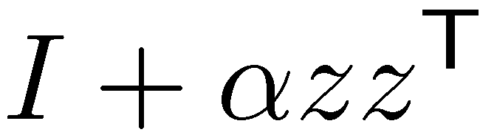
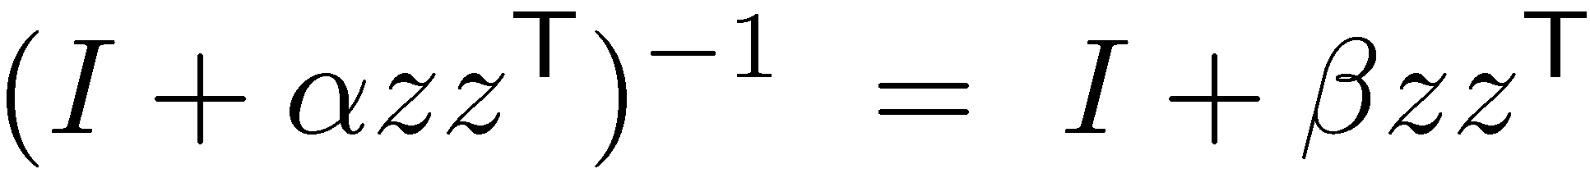

Rank-1 Updates
Def: Let z be a column vector and ® a scalar. A matrix of the form is called a rank-1 update matrix.
Claim 1: Suppose ® ≠ -1/z^{T}z. Then where ¯ = -®/(1+®z^{T}z).
Claim 2: If ®¸-1/z^{T} z then is PSD. If ®>-1/z^{T} z then is PD.
Claim 3:
Notes:
Claim 1: (I + azz^T) (I+bzz^T) = I + azz^T + bzz^T + abzz^Tzz^T
= I + (a+b+abz^Tz) zz^T (since z^T z is a scalar, it commutes)
= I, because a+b(1+az^Tz) = 0.

Slide 4
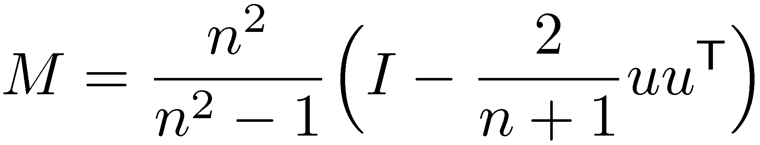
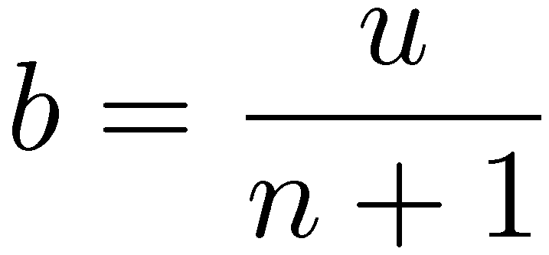
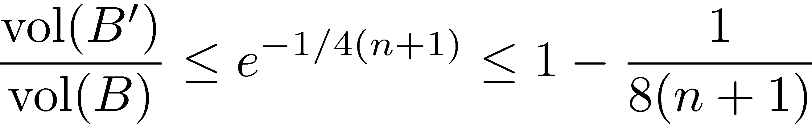
Main Theorem:
Let B = { x : kxk·1 } and H_{u} = { x : x^{T}u¸0 }, where kuk=1.
Let and .
Let B’ = E( M, b ). Then:
1) B Å H_{u} µ B’.
2)
Remark: This notation only makes sense if M is positive definite. Claim 2 on rank-1 updates shows that it is, assuming n¸2.

Slide 5
Covering Half-ellipsoids by Ellipsoids
H_{a}
E’
E
z
Let E be an ellipsoid centered at z
Let H_{a} = { x : a^{T}x ¸ a^{T}z }
Find a small ellipsoid E’ that covers EÅH_{a}

Slide 6
Use our solution for hemispheres!
H_{u}
B’
E’
B
H_{a}
E
z
Goal Find an affine map f and choose u such that: f(B) = E and f(H_{u}) = H_{a} Define E’ = f(B’). Claim: E’ is an ellipsoid. Claim: E Å H_{a} µ E’.
Notes:
Why is E’ an ellipsoid? Recall that an ellipsoid is obtained from applying a (non-singular) affine map to the unit ball. B’ is obtained in such a way. And E’ is obtained by applying a linear map to B’. Composing those two maps shows that E’ is also obtained by applying an affine map to the unit ball.

Slide 7
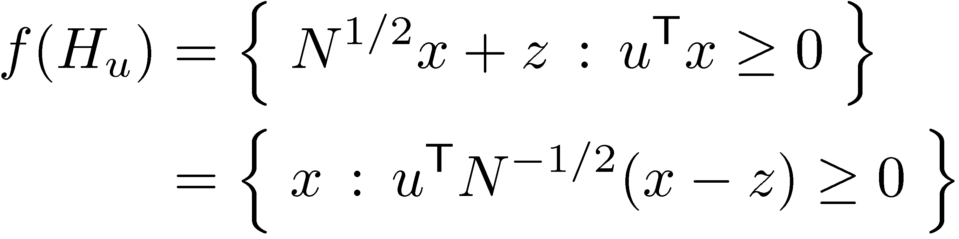
Choosing u
H_{u}
B’
E’
B
H_{a}
E
z
H_{u} = { x : u^{T}x¸0 }
H_{a} = { x : a^{T}(x-z) ¸ 0 }
Assume E=E(N,z) and consider the map f(x) = N^{1/2}x + z. In Lecture 6 we showed that E = f(B).
Now choose u such that f(H_{u}) = H_{a}.
) take u = N^{1/2} a

