Slide 1
C&O 355 Mathematical Programming Fall 2010 Lecture 5
N. Harvey
TexPoint fonts used in EMF.
Read the TexPoint manual before you delete this box.: AAAAAAAAAA

Slide 2
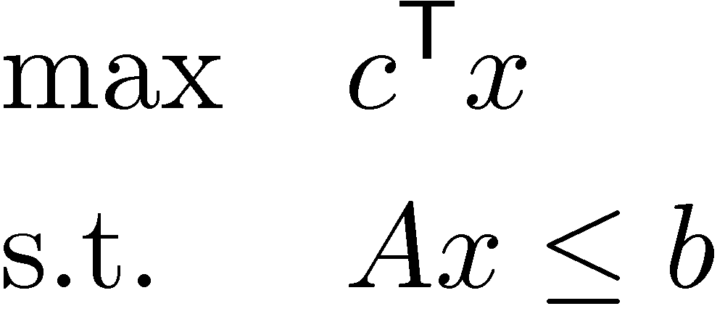
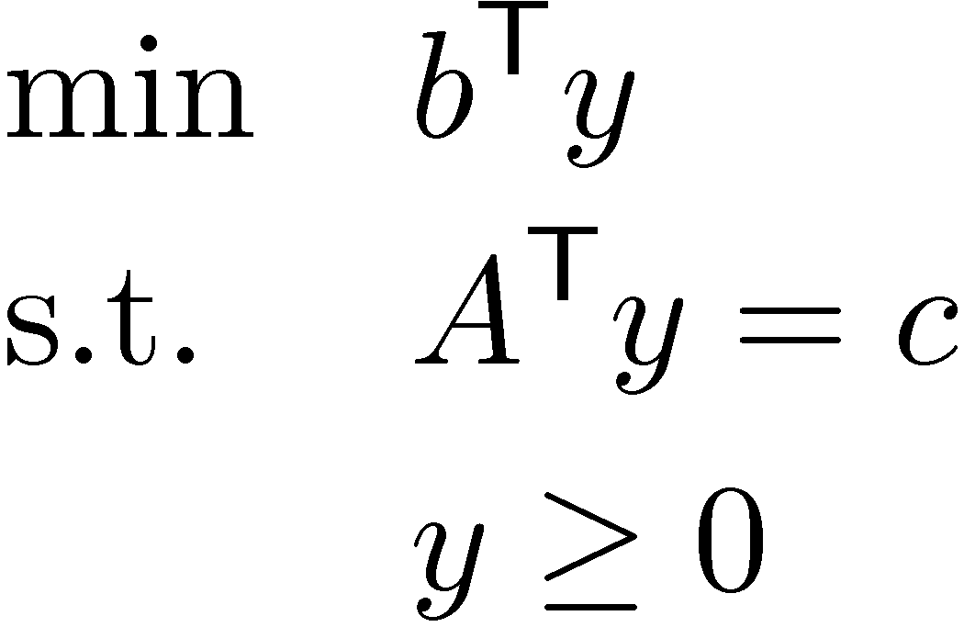
Review of our Theorems
Primal LP:
Dual LP:
Fundamental Theorem of LP: Every LP is either Infeasible, Unbounded, or has an Optimal Solution.
Not Yet Proven!
Weak Duality Theorem: If x feasible for primal and y feasible for dual then c^{T}x · b^{T}y.
Strong LP Duality Theorem: 9x optimal for primal ) 9y optimal for dual. Furthermore, c^{T}x=b^{T}y. Since the dual of the dual is the primal, we also get: 9y optimal for dual ) 9x optimal for primal.
Notes:
FTLP is Theorem 2.12 in Cunningham-Lewis and Theorem 4.2.3 in Matousek-Gartner.
Weak Duality Theorem is Proposition 2.1 in Cunningham-Lewis and Proposition 6.1.1 in Matousek-Gartner.
Strong Duality Theorem is Theorem 2.5 in Cunningham-Lewis and Matousek-Gartner, p83.
However, beware than Cunningham-Lewis look at different forms of the Primal & Dual LPs.

Slide 3
Variant of Strong Duality
Primal LP:
Dual LP:
Fundamental Theorem of LP: Every LP is either Infeasible, Unbounded, or has an Optimal Solution.
Variant of Strong LP Duality Theorem: If primal is feasible and dual is feasible, then 9x optimal for primal and 9y optimal for dual. Furthermore, c^{T}x=b^{T}y.
Proof: Since primal and dual are both feasible, primal cannot be unbounded. (by Weak Duality)
By FTLP, primal has an optimal solution x.
By Strong Duality, dual has optimal solution y and c^{T}x=b^{T}y. ¥
Notes:
This variant is Theorem 2.10 in Cunningham-Lewis. It is also stated in Matousek-Gartner, p83.
However, beware than Cunningham-Lewis look at different forms of the Primal & Dual LPs.

Slide 4
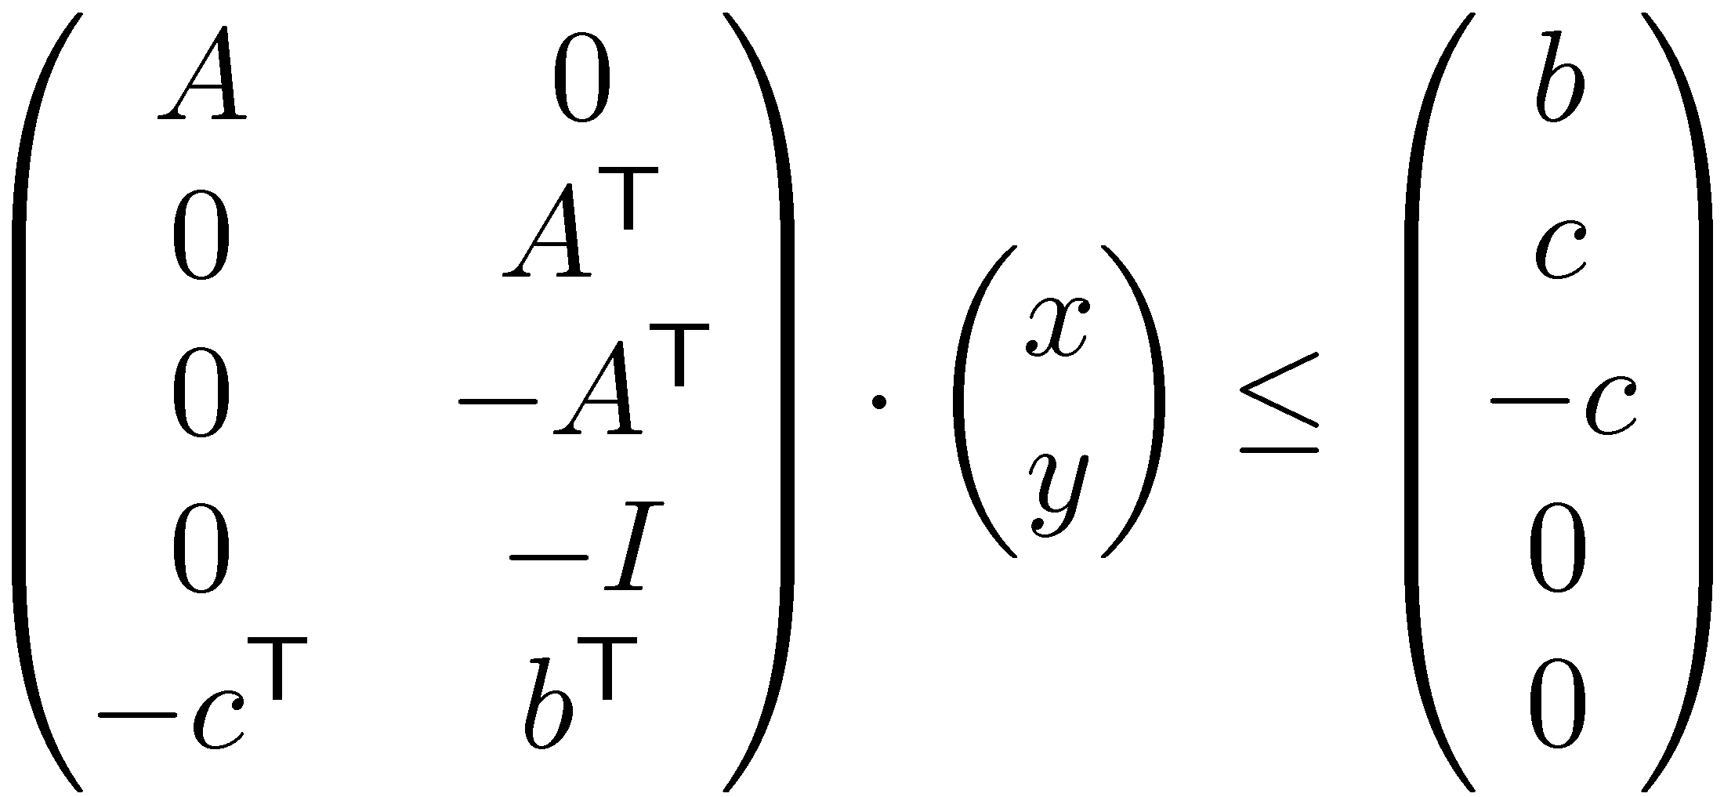
Proof of Variant from Farkas’ Lemma
Primal LP:
Dual LP:
Theorem: If primal is feasible and dual is feasible, then 9x optimal for primal and 9y optimal for dual. Furthermore, c^{T}x=b^{T}y.
Existence of optimal solutions is equivalent to solvability of { A x · b, A^{T} y = c, y ¸ 0, c^{T} x ¸ b^{T} y }
We can write this as:
Suppose this is unsolvable.
Farkas’ Lemma: If Mp ·d has no solution, then 9q¸0 such that q^{T} M=0 and q^{T}d < 0.
Notes:
This variant is Theorem 2.10 in Cunningham-Lewis. It is also stated in Matousek-Gartner, p83.
However, beware than Cunningham-Lewis look at different forms of the Primal & Dual LPs.
We will prove FTLP using this variant. So first we prove the variant itself.

Slide 5
Farkas’ Lemma: If Mp ·d has no solution, then 9q¸0 such that q^{T} M=0 and q^{T}d < 0.
Note: ® 2 R
So if this is unsolvable, then there exists [ u, v₁, v₂, w, ® ] ¸ 0 s.t. [ u, v₁, v₂, w, ® ] M = 0 [ u, v₁, v₂, w, ® ] [ b, c, -c, 0, 0 ]^{T} < 0
Equivalently, let v = v₂-v₁. Then 9 u¸0, w¸0, ®¸0 such that u^{T} A - ® c^{T} = 0 -v^{T} A^{T} - w^{T} + ® b^{T} = 0 u^{T} b - v^{T} c < 0
Equivalently, 9u¸0, ®¸0 such that A^{T} u = ® c A v · ® b b^{T} u < c^{T} v

Slide 6
Primal LP:
Dual LP:
We’ve shown: if primal & dual have no optimal solutions, then 9u¸0, ®¸0 such that A^{T}u = ®c, Av · ®b, b^{T}u < c^{T}v.
Case 1: ®>0. WLOG, ®=1. (Just rescale u, v and ®.)
Then Av · b ) v feasible for primal.
A^{T}u = c, u ¸ 0 ) u is feasible for dual.
b^{T}u < c^{T}v ) Weak Duality is violated. Contradiction!
Case 2: ®=0.
Let x be feasible for primal and y feasible for dual. Then
u^{T} b ¸ u^{T} (Ax) = (u^{T}A) x = 0^{T}x = 0^{T}y ¸ (v^{T}A^{T}) y = v^{T} (A^{T} y) = v^{T} c
This contradicts b^{T}u < c^{T}v!
So primal and dual must have optimal solutions. ¥
Since u¸0 and Ax·b
Since u^{T} A = 0
Since Av·0 and y¸0
Since A^{T} y=c

Slide 7
Primal LP:
Dual LP:
Theorem: (Variant of Strong Duality) If primal is feasible and dual is feasible, then 9x optimal for primal and 9y optimal for dual.
Fundamental Theorem of LP: Every LP is either Infeasible, Unbounded, or has an Optimal Solution.
Lemma: Primal feasible & Dual infeasible ) Primal unbounded.
You’ll solve this on Assignment 2.
Proof of FTLP:
If Primal is infeasible or unbounded, we’re done.
So assume Primal is feasible but bounded.
By Lemma, Dual must be feasible.
By Theorem, Primal has an optimal solution. ¥

Slide 8
Complementary Slackness
Simple conditions showing when feasible primal & dual solutions are optimal.
(Sometimes) Gives a way to construct dual optimal solution from primal optimal solution.

Slide 9
Duality: Geometric View
We can “generate” a new constraint aligned with c by taking a conic combination (non-negative linear combination) of constraints tight at x.
What if we use constraints not tight at x?
x₂
-x₁+x₂· 1
x
x₁ + 6x₂ · 15
Objective Function c
x₁

Slide 10
Duality: Geometric View
We can “generate” a new constraint aligned with c by taking a conic combination (non-negative linear combination) of constraints tight at x.
What if we use constraints not tight at x?
x₂
-x₁+x₂· 1
x
Doesn’t prove x is optimal!
x₁ + 6x₂ · 15
Objective Function c
x₁

Slide 11
Duality: Geometric View
What if we use constraints not tight at x?
This linear combination is a feasible dual solution, but not an optimal dual solution
Complementary Slackness: To get an optimal dual solution, must only use constraints tight at x.
x₂
-x₁+x₂· 1
x
Doesn’t prove x is optimal!
x₁ + 6x₂ · 15
Objective Function c
x₁

Slide 12
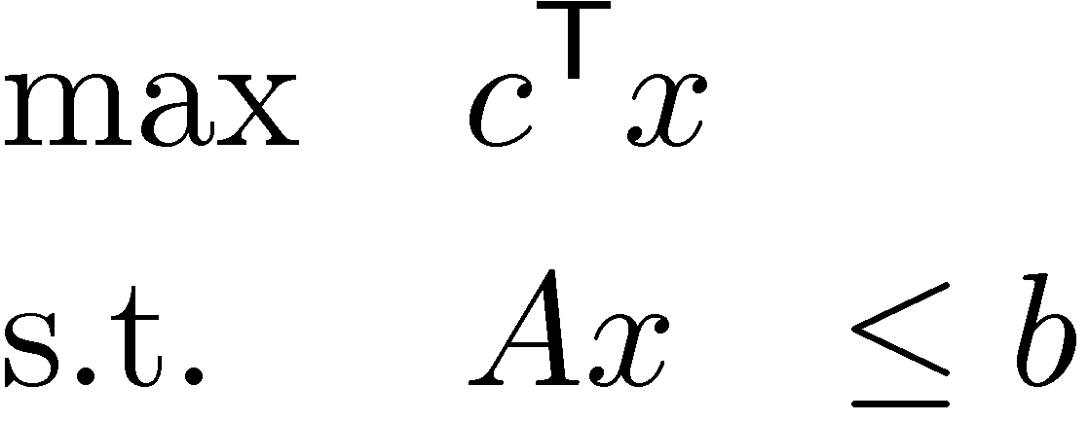
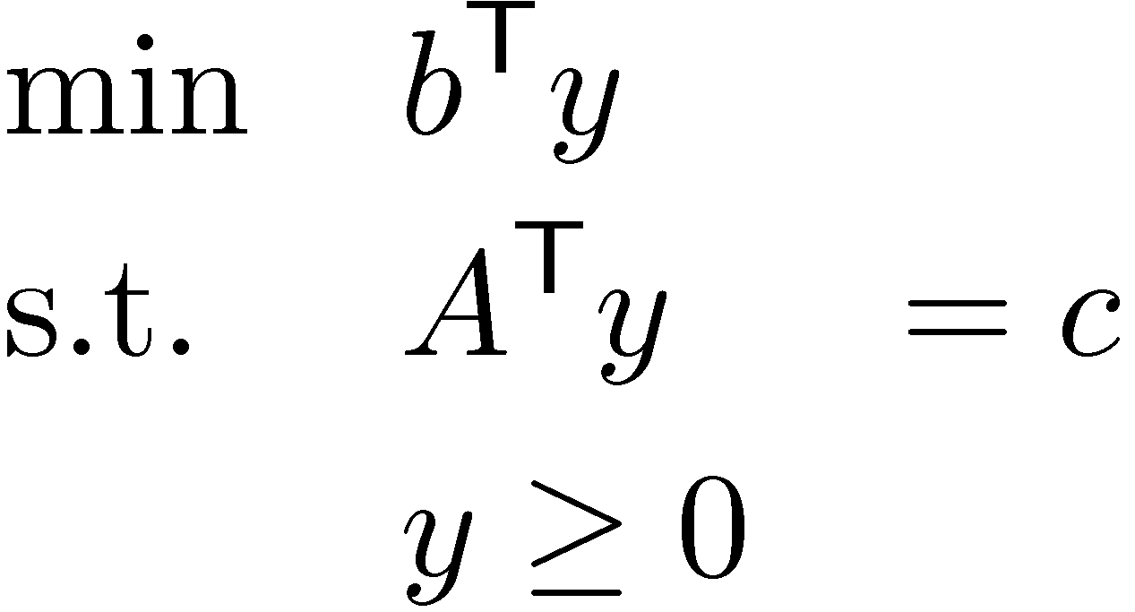
Weak Duality
Primal LP
Dual LP
Theorem: “Weak Duality Theorem” If x feasible for Primal and y feasible for Dual then c^{T}x · b^{T}y.
Proof: c^{T} x = (A^{T} y)^{T} x = y^{T} A x · y^{T} b. ¥
Since y¸0 and Ax·b

Slide 13
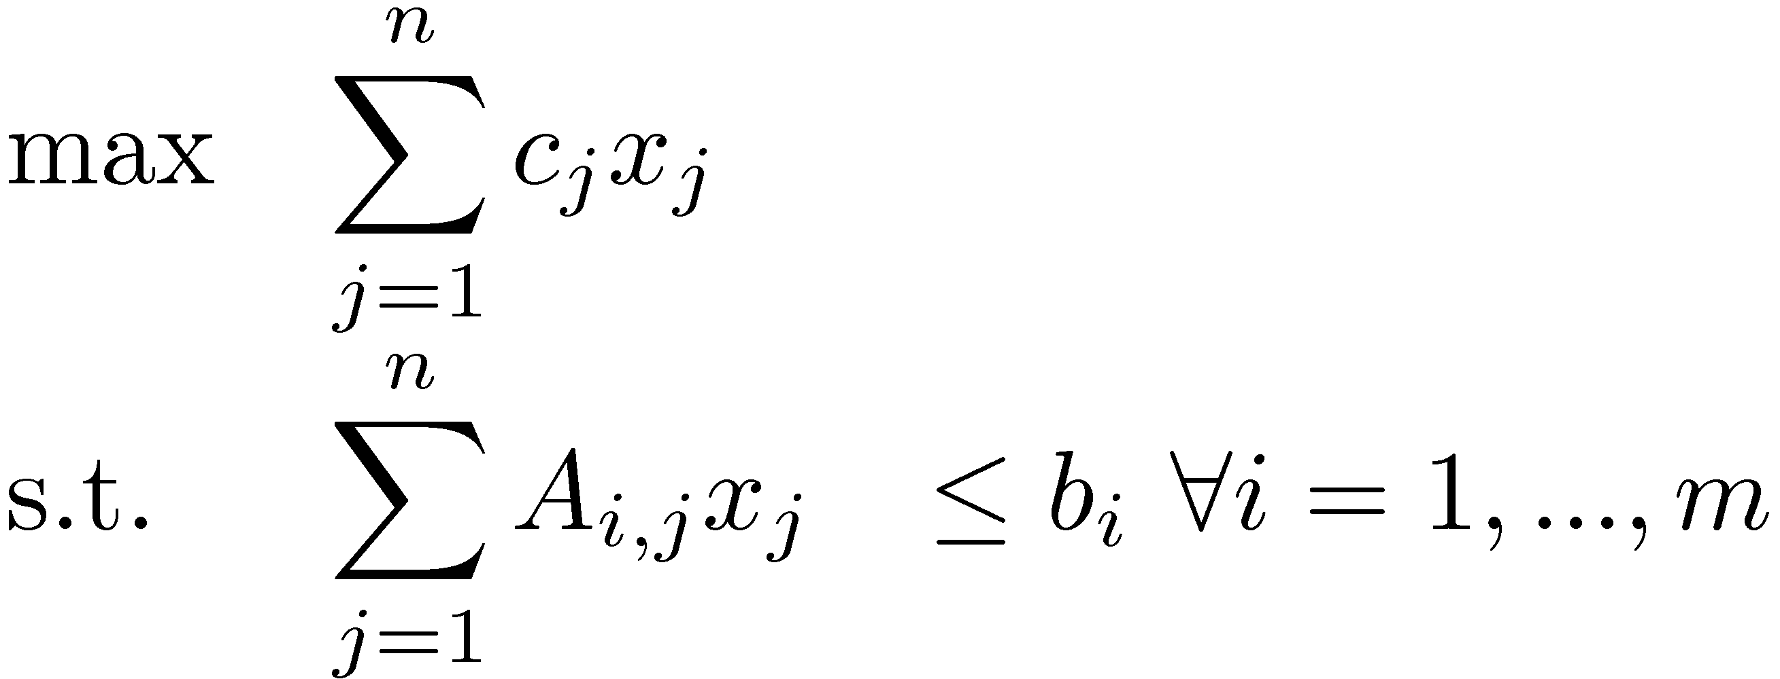
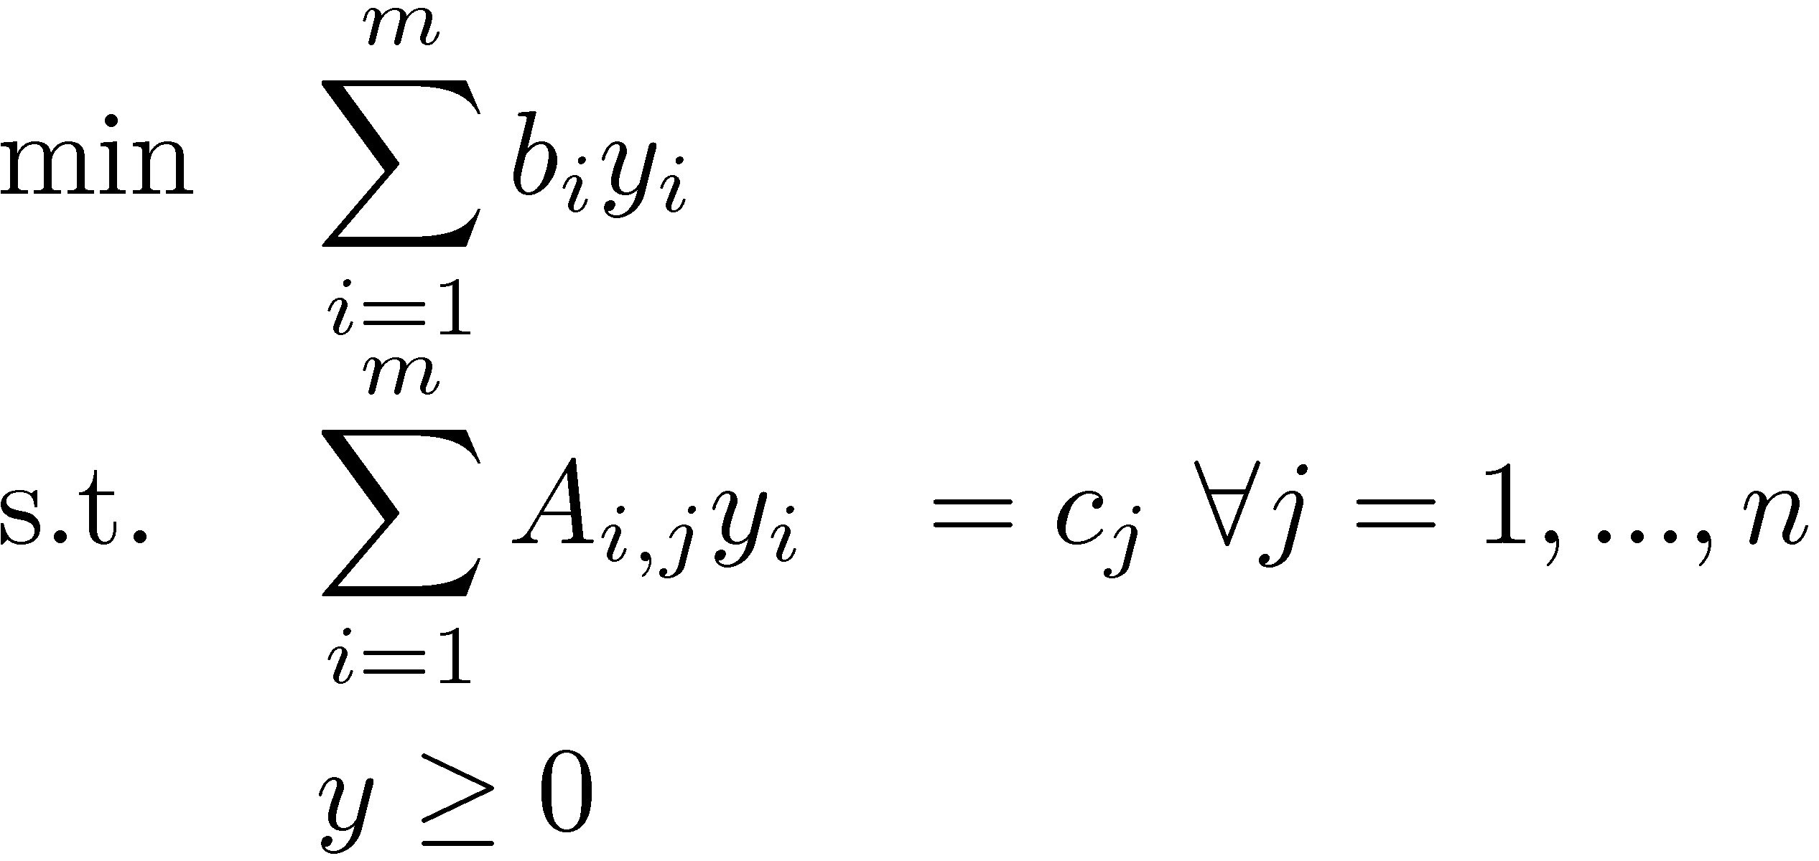
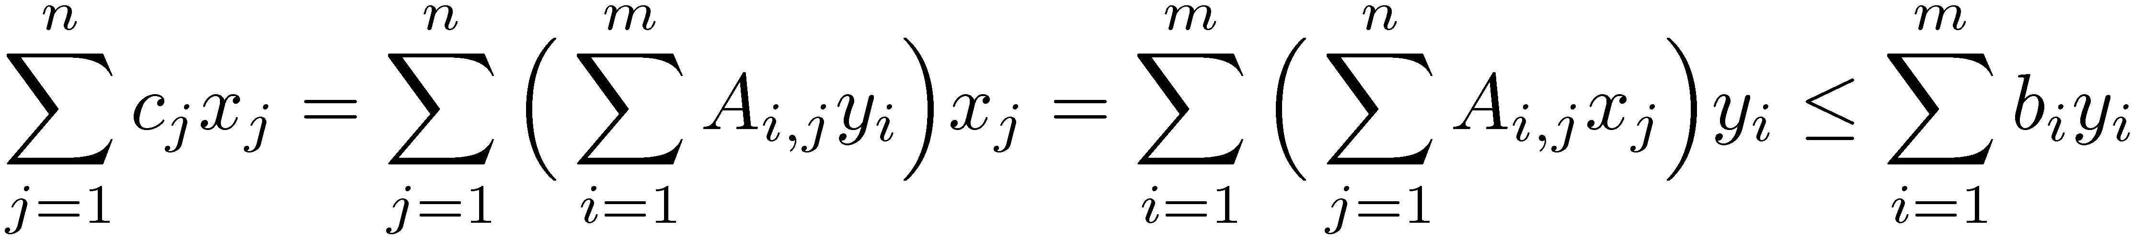
Weak Duality
Primal LP
Dual LP
Theorem: “Weak Duality Theorem” If x feasible for Primal and y feasible for Dual then c^{T}x·b^{T}y.
Proof:
When does equality hold here?
Corollary: If x and y both feasible and c^{T}x=b^{T}y then x and y are both optimal.

Slide 14
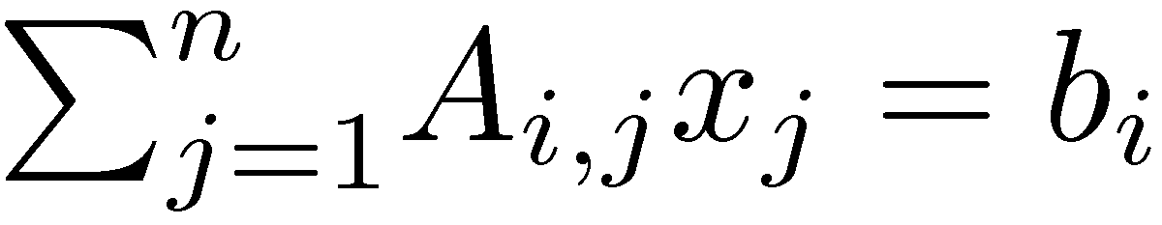
Weak Duality
Primal LP
Dual LP
Theorem: “Weak Duality Theorem” If x feasible for Primal and y feasible for Dual then c^{T}x·b^{T}y.
Proof:
When does equality hold here?
Equality holds for i^{th} term if either y_{i}=0 or

Slide 15
Weak Duality
Primal LP
Dual LP
Theorem: “Weak Duality Theorem” If x feasible for Primal and y feasible for Dual then c^{T}x·b^{T}y.
Proof:
Theorem: “Complementary Slackness” Suppose x feasible for Primal, y feasible for dual, and for every i, either y_{i}=0 or . Then x and y are both optimal.
Proof: Equality holds here. ¥

Slide 16
General Complementary Slackness Conditions
Let x be feasible for primal and y be feasible for dual.
 | Primal | Dual
Objective | max c^{T}x | min b^{T}y
Variables | x₁, …, x_{n} | y₁,…, y_{m}
Constraint matrix | A | A^{T}
Right-hand vector | b | c
Constraints versus Variables | i^{th} constraint: · i^{th} constraint: ¸ i^{th} constraint: = x_{j} ¸ 0 x_{j} · 0 x_{j} unrestricted | y_{i} ¸ 0 y_{i} · 0 y_{i} unrestricted j^{th} constraint: ¸ j^{th} constraint: · j^{th} constraint: =
for all i, equality holds either for primal or dual
and
for all j, equality holds either for primal or dual
,
x and y are both optimal

Slide 17
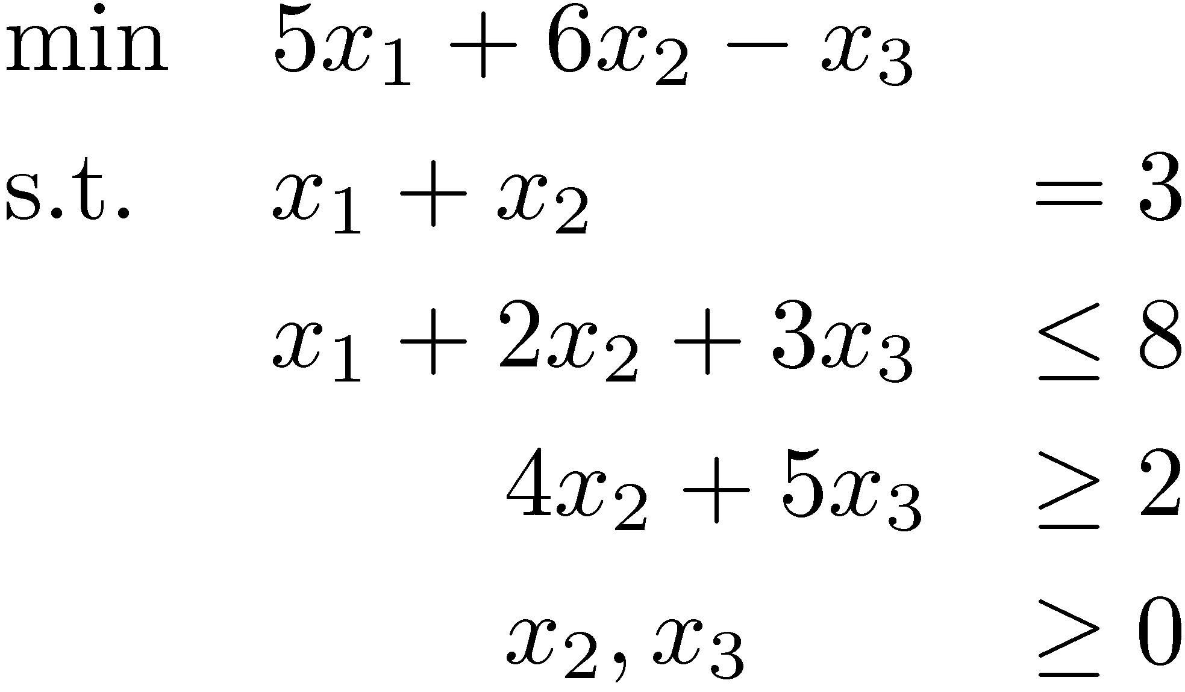
Example
Primal LP
Challenge:
What is the dual?
What are CS conditions?
Claim: Optimal primal solution is x=(3,0,5/3). Can you prove it?

Slide 18
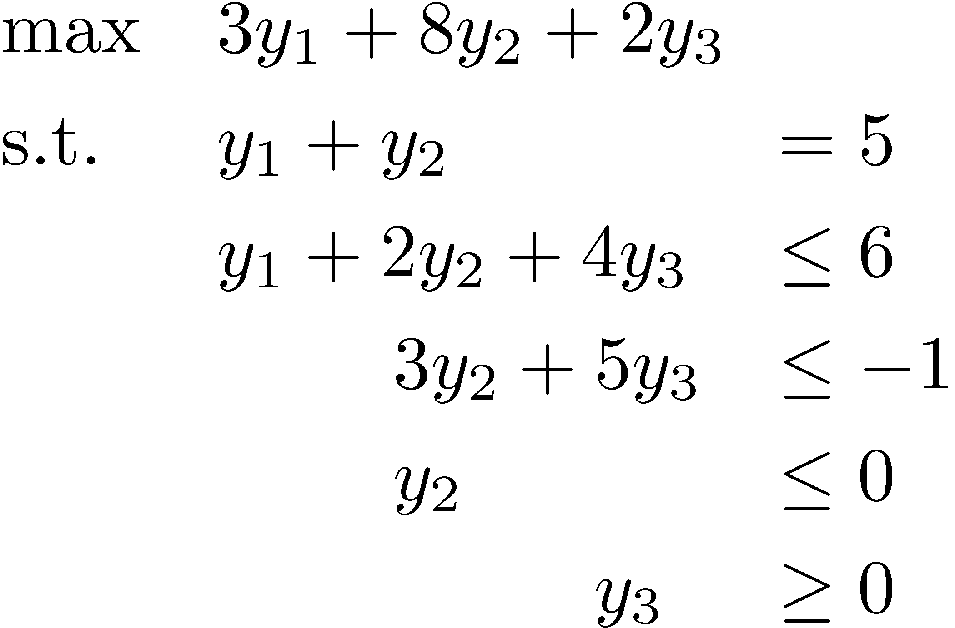
Example
Primal LP
Dual LP
CS conditions:
Either x₁+2x₂+3x₃=8 or y₂=0
Either 4x₂+5x₃=2 or y₃=0
Either y₁+2y+2+4y₃=6 or x₂=0
Either 3y₂+5y₃=-1 or x₃=0
x=(3,0,5/3) ) y must satisfy:
y₁+y₂=5 y₃=0 y₂+5y₃=-1
) y = (16/3, -1/3, 0)
Since y is feasible for the dual, y and x are both optimal.
If y were not feasible, then x would not be optimal.

Slide 19
Complementary Slackness Summary
Gives “optimality conditions” that must be satisfied by optimal primal and dual solutions
(Sometimes) gives useful way to compute optimum dual from optimum primal
Extremely useful in “primal-dual algorithms”. Much more of this in
C&O 351: Network Flows
C&O 450/650: Combinatorial Optimization
C&O 754: Approximation Algorithms

