Slide 1
C&O 355 Mathematical Programming Fall 2010 Lecture 4
N. Harvey
TexPoint fonts used in EMF.
Read the TexPoint manual before you delete this box.: AAAAAAAAAA

Slide 2
Outline
Solvability of Linear Equalities & Inequalities
Farkas’ Lemma
Fourier-Motzkin Elimination
Proof of Farkas’ Lemma
Proof of Strong LP Duality

Slide 3
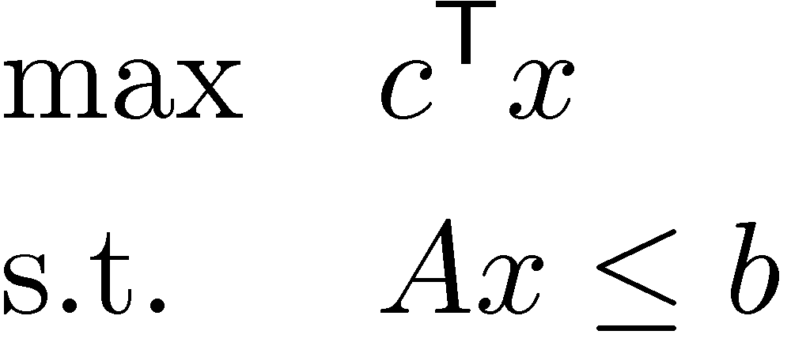
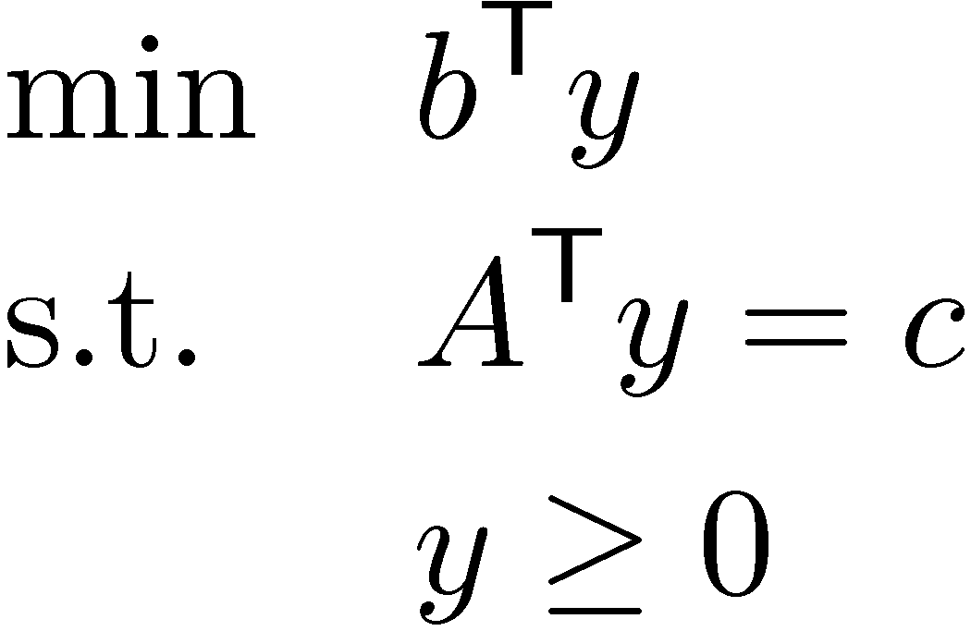
Strong Duality
Primal LP:
Dual LP:
Strong Duality Theorem: Primal has an opt. solution x , Dual has an opt. solution y. Furthermore, optimal values are same: c^{T}x = b^{T}y.
Our Goals:
Understand when Primal and Dual have optimal solutions
Compute those optimal solutions
Combining Primal & Dual into a System of Inequalities: x is optimal for Primal and y is optimal for Dual , x and y are solutions to these inequalities:
Can we characterize when systems of inequalities are solvable?

Slide 4
Systems of Equalities
Lemma: Exactly one of the following holds:
There exists x satisfying Ax=b
There exists y satisfying y^{T}A=0 and y^{T}b>0
Geometrically…
(b is in column space of A)
x₂
span(A₁,…,A_{n}) = column space of A
b
A₁
A₂
x₁
x₃

Slide 5
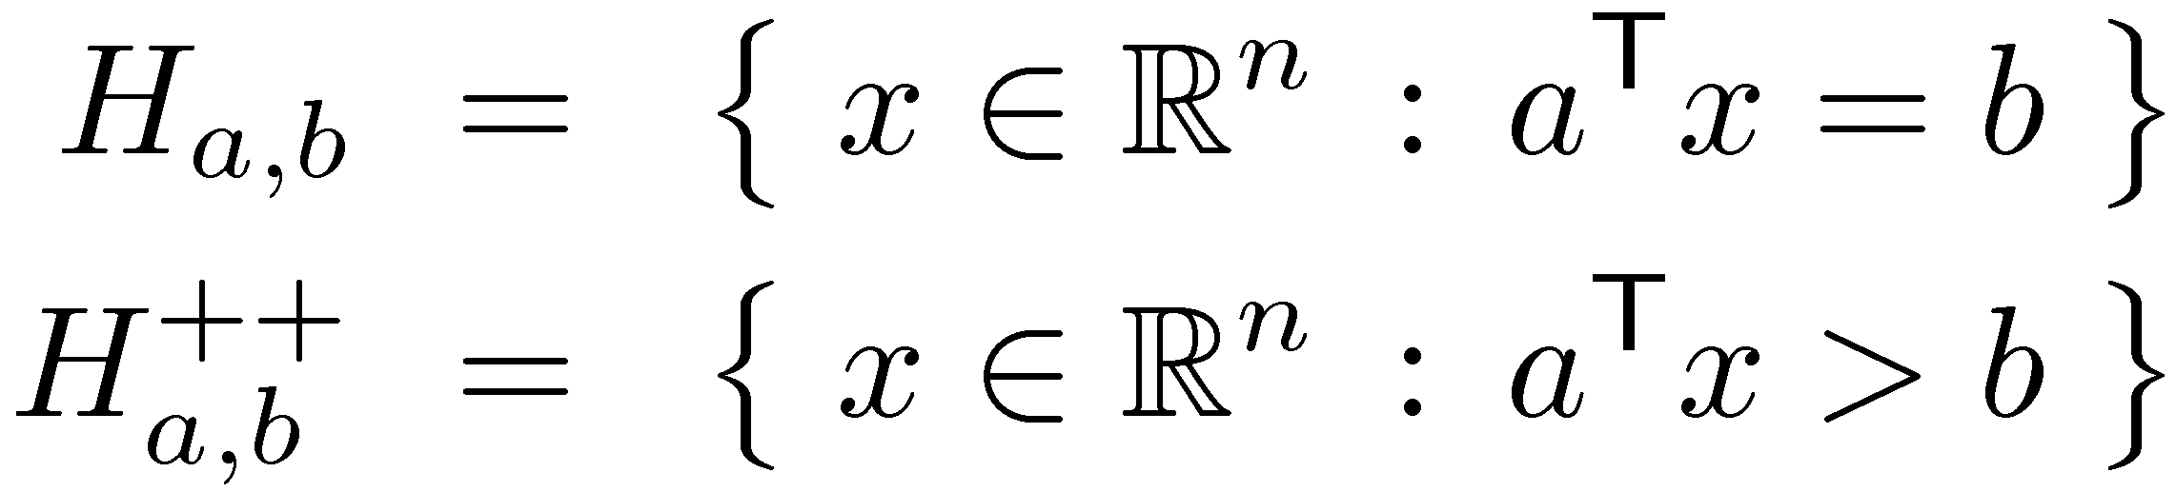
Systems of Equalities
Lemma: Exactly one of the following holds:
There exists x satisfying Ax=b (b is in column space of A)
There exists y satisfying y^{T}A=0 and y^{T}b>0 (or it is not)
Geometrically…
col-space(A)µH_{y,0} but b2H_{y,0}
++
Hyperplane
Positive open halfspace
b
y
x₂
column space of A
A₂
x₁
H_{a,0}
A₁
x₃

Slide 6
Systems of Inequalities
Lemma: Exactly one of the following holds:
There exists x¸0 satisfying Ax=b
There exists y satisfying y^{T}A¸0 and y^{T}b<0
Geometrically… Let cone(A₁,…,A_{n}) = { §_{i} x_{i}A_{i} : x¸0 } “cone generated by A₁,…,A_{n}” (Here A_{i} is the i^{th} column of A)
(b is in cone(A₁,…,A_{n}))
x₂
b
cone(A₁,…,A_{n})
A₂
A₃
A₁
x₁
x₃

Slide 7
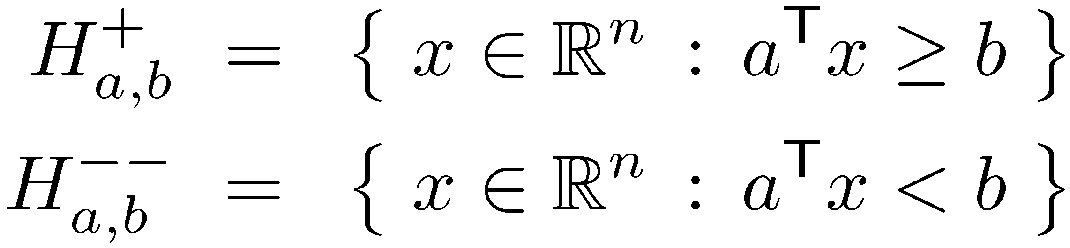
Systems of Inequalities
Lemma: Exactly one of the following holds:
There exists x¸0 satisfying Ax=b (b is in cone(A₁,…,A_{n}))
There exists y satisfying y^{T}A¸0 and y^{T}b<0
Geometrically…
(y gives a separating hyperplane)
+
--
cone(A₁,…,A_{n})2H_{y,0} but b2H_{y,0}
Positive closed halfspace
Negative open halfspace
x₂
y
cone(A₁,…,A_{n})
A₂
A₃
A₁
H_{y,0}
b
x₁
x₃

Slide 8
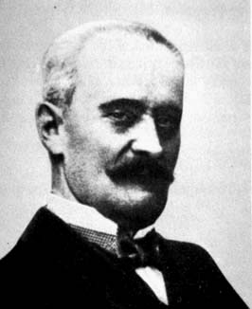
Systems of Inequalities
Lemma: Exactly one of the following holds:
There exists x¸0 satisfying Ax=b (b is in cone(A₁,…,A_{n}))
There exists y satisfying y^{T}A¸0 and y^{T}b<0 (y gives a “separating hyperplane”)
This is called “Farkas’ Lemma”
It has many interesting proofs.
There are 3 proofs in Ch. 6 of Matousek-Gartner
It is “equivalent” to strong duality for LP.
There are several “equivalent” versions of it.
Gyula Farkas

Slide 9
Variants of Farkas’ Lemma
Gyula Farkas
The System | Ax · b | Ax = b
has no solution x¸0 iff | 9y¸0, A^{T}y¸0, b^{T}y<0 | 9y2R^{n}, A^{T}y¸0, b^{T}y<0
has no solution x2R^{n} iff | 9y¸0, A^{T}y=0, b^{T}y<0 | 9y2R^{n}, A^{T}y=0, b^{T}y<0
These are all “equivalent” (each can be proved using another)
This is the simple lemma on systems of equalities
Notes:
See p92 in Matousek-Gartner.
The bottom-left statement is Theorem 2.7 in Cunningham-Lewis

Slide 10
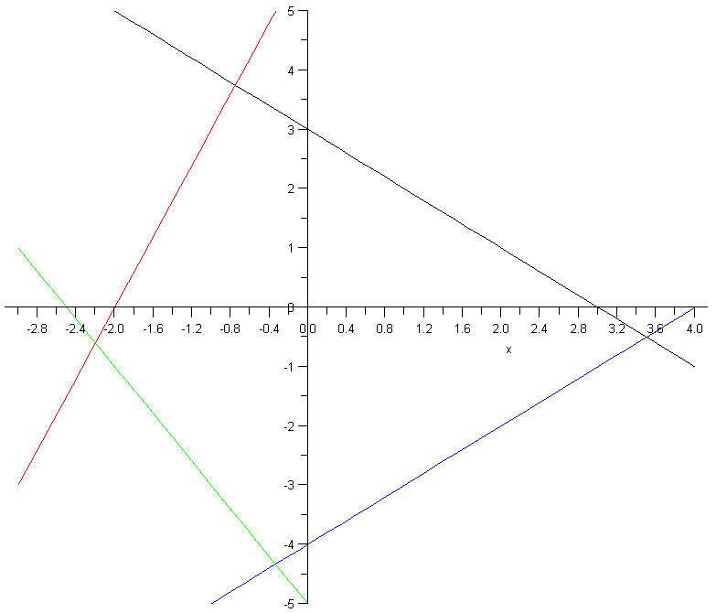
2D System of Inequalities
y
-3x+y·6
x+y·3
Consider the polyhedron
Q = { (x,y) : -3x+y·6, x+y·3,
-y-2x·5,
x-y·4 }
x
x-y·4
-y-2x·5
Given x, for what values of y is (x,y) feasible?
Need: y·3x+6, y·-x+3, y¸-2x-5, and y¸x-4

Slide 11
2D System of Inequalities
x=-3
x=-0.8
y
-3x+y·6
x+y·3
Consider the polyhedron
Q = { (x,y) : -3x+y·6, x+y·3,
-y-2x·5,
x-y·4 }
x
x-y·4
-y-2x·5
Given x, for what values of y is (x,y) feasible?
i.e., y·min{3x+6, -x+3} and y¸max{ -2x-5, x-4 }
For x=-0.8, (x,y) feasible if y·min{3.6,3.8} and y¸max{-3.4,-4.8}
For x=-3, (x,y) feasible if y·min{-3,6} and y¸max{1,-7}
Impossible!

Slide 12
2D System of Inequalities
Consider the set Q = { (x,y) : -3x+y·6, x+y·3, -y-2x·5, x-y·4 }
Given x, for what values of y is (x,y) feasible?
i.e., y·min{3x+6, -x+3} and y¸max{ -2x-5, x-4 }
Such a y exists , max{-2x-5, x-4} · min{3x+6, -x+3}
, the following inequalities are solvable
Conclusion: Q is non-empty , Q’ is non-empty.
This is easy to decide because Q’ involves only 1 variable!
-2x-5 · 3x+6
x-4 · 3x+6
-2x-5 · -x+3
x-4 · -x+3
-5x·11
-2x·10
-x·8
2x·7
x¸-11/5
x¸-5
x¸-8
x·7/2
Every “lower” constraint is · every “upper” constraint
´
Q’ = x :
= x :

Slide 13
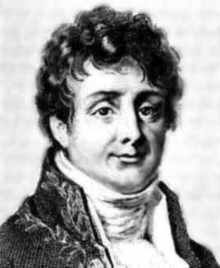

Fourier-Motzkin Elimination
Joseph Fourier
Theodore Motzkin
Generalization: given a set Q = { (x₁,…,x_{n}) : Ax·b }, we want to find set Q’ = { (x’₁,…,x’_{n-1}) : A’x’·b’ } satisfying
(x₁,…,x_{n-1})2Q’ , 9x_{n} s.t. (x₁,…,x_{n-1},x_{n})2Q
Q’ is called a projection of Q (onto the first n-1 coordinates)
Fourier-Motzkin Elimination is a procedure for producing Q’ from Q
Consequences:
An (inefficient!) algorithm for solving systems of inequalities, and hence for solving LPs too
A way of proving Farkas’ Lemma by induction

Slide 14
Lemma: Let Q = { (x₁,…,x_{n}) : Ax·b }. We can construct Q’ = { (x’₁,…,x’_{n-1}) : A’x’·b’ } satisfying
(1) (x₁,…,x_{n-1})2Q’ , 9x_{n} s.t. (x₁,…,x_{n-1},x_{n})2Q
(2) Every inequality defining Q’ is a non-negative linear combination of the inequalities defining Q.
Proof: Put inequalities of Q in three groups: (a_{i} = i^{th} row of A) Z={ i : a_{i,n}=0 } P={ j : a_{j,n}>0 } N={ k : a_{k,n}<0 }
WLOG, a_{j,n}=1 8j2P and a_{k,n}=-1 8k2N
For any x2R^{n}, let x’2R^{n-1} be vector obtained by deleting coordinate x_{n}
The constraints defining Q’ are:
a_{i}’x’·b_{i} 8i2Z
a_{j}’x’+a_{k}’x’ · b_{j}+b_{k} 8j2P, 8k2N
This proves (2).
In fact, (2) implies the “( direction” of (1): For every x2Q, x’ satisfies all inequalities defining Q’.
Why? Because every constraint of Q’ is a non-negative lin. comb. of constraints from Q, with n^{th} coordinate equal to 0.
This is sum of j^{th} and k^{th} constraints of Q, because n^{th} coordinate of a_{j} +a_{k} is zero!
Notes:
This proof is from Matousek-Gartner Section 6.7

Slide 15
Lemma: Let Q = { (x₁,…,x_{n}) : Ax·b }. We can construct Q’ = { (x’₁,…,x’_{n-1}) : A’x’·b’ } satisfying
(x₁,…,x_{n-1})2Q’ , 9x_{n} s.t. (x₁,…,x_{n-1},x_{n})2Q
Every inequality defining Q’ is a non-negative linear combination of the inequalities defining Q.
Proof: Put inequalities of Q in three groups: Z={ i : a_{i,n}=0 } P={ j : a_{j,n}=1 } N={ k : a_{k,n}=-1 }
The constraints defining Q’ are:
a_{i}’x’·b_{i} 8i2Z
a_{j}’x’+a_{k}’x’ · b_{j}+b_{k} 8j2P, 8k2N
It remains to prove the “) direction” of (1).
Note that: a_{k}’x’-b_{k} · b_{j}-a_{j}’x’ 8j2P, 8k2N.
) max_{k2N} { a_{k}’x’-b_{k} } · min_{j2P} { b_{j}-a_{j}’x’ }
Let x_{n} be this value, and let x = (x’₁,…,x’_{n-1},x_{n}).
Then: a_{k}x-b_{k} = a_{k}’x’-x_{n}-b_{k} · 0 8k2N
b_{j}-a_{j}x = b_{j}-a_{j}’x’-x_{n} ¸ 0 8j2P
a_{i}x = a_{i}’x’ · b_{i} 8i2Z
By definition of x, and since a_{k,n} = -1
By definition of x_{n}, a_{k}’x’ - b_{k} · x_{n}
) x2Q
¥

Slide 16
Variants of Farkas’ Lemma
Gyula Farkas
The System | Ax · b | Ax = b
has no solution x¸0 iff | 9y¸0, A^{T}y¸0, b^{T}y<0 | 9y2R^{n}, A^{T}y¸0, b^{T}y<0
has no solution x2R^{n} iff | 9y¸0, A^{T}y=0, b^{T}y<0 | 9y2R^{n}, A^{T}y=0, b^{T}y<0
We’ll prove this one
Notes:
This is Theorem 2.7 in Cunningham-Lewis

Slide 17
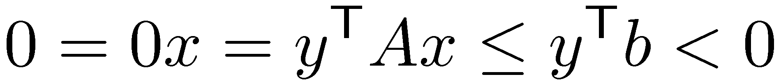
Lemma: Exactly one of the following holds:
There exists x2R^{n} satisfying Ax·b
There exists y¸0 satisfying y^{T}A=0 and y^{T}b<0
Proof: Suppose x exists. Need to show y cannot exist.
Suppose y also exists. Then:
Contradiction! y cannot exist.
Notes:
See Matousek-Gartner p103-104.

Slide 18
Lemma: Exactly one of the following holds:
There exists x2R^{n} satisfying Ax·b
There exists y¸0 satisfying y^{T}A=0 and y^{T}b<0
Proof: Suppose no solution x exists.
We use induction. Trivial for n=0, so let n¸1.
We use Fourier-Motzkin Elimination.
Get an equivalent system A’x’·b’ where
(A’|0)=MA b’=Mb for some non-negative matrix M.
Lemma: Let Q = { (x₁,…,x_{n}) : Ax·b }. We can construct Q’ = { (x₁,…,x_{n-1}) : A’x’·b’ } satisfying
Q is non-empty , Q’ is non-empty
Every inequality defining Q’ is a non-negative linear combination of the inequalities defining Q.
(This statement is slightly simpler than our previous lemma)

Slide 19
Lemma: Exactly one of the following holds:
There exists x2R^{n} satisfying Ax·b
There exists y¸0 satisfying y^{T}A=0 and y^{T}b<0
Proof:
Get an equivalent system A’x’·b’ where
(A’|0)=MA b’=Mb for some non-negative matrix M.
We assume Ax · b has no solution, so A’x’·b’ has no solution.
By induction, 9y’¸0 s.t. y’^{T}A’=0 and y’^{T}b’< 0.
Define y=M^{T} y’.
Then: y¸0 , because y’¸0 and M non-negative
y^{T}A = y’^{T}MA = y’^{T}(A’|0) = 0
y^{T}b = y’^{T} Mb = y’^{T} b’ < 0 ¥

Slide 20
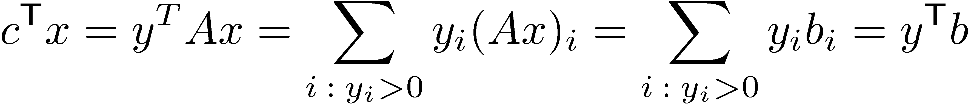
Farkas’ Lemma ) Strong Duality
Primal LP:
Dual LP:
By Asst 1 Q6, if x is feasible then either: (1) x is not an optimal solution (2) c is a non-negative lin. comb of the constraints tight at x
More formally, (2) says: there exists y¸0 s.t. y^{T} A = c^{T} and y_{i}>0 only when a_{i}^{T}x = b_{i} (a_{i} = i^{th} row of A)
Suppose x is optimal for Primal. (i.e., (1) doesn’t hold)
Then such a y exists. It is clearly feasible for Dual, and:
So x and y are both optimal ¥

