Slide 1
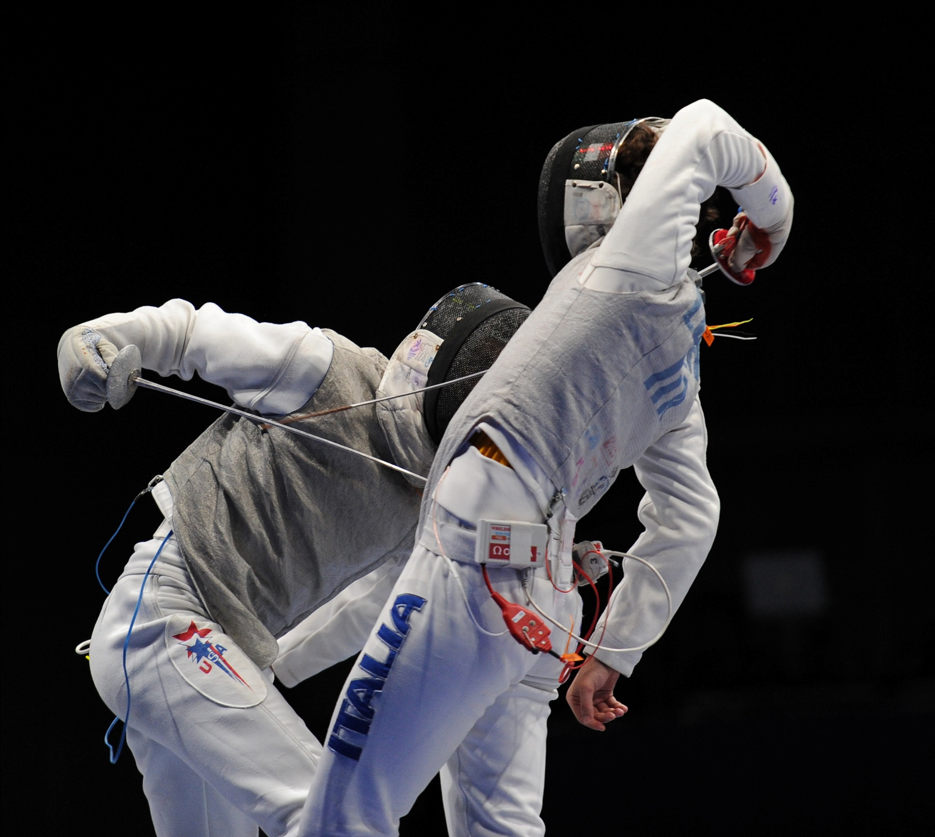
C&O 355
Mathematical Programming
Fall 2010
Lecture 3
N. Harvey
Image: http://www.flickr.com/photos/singapore2010/4902039196/
TexPoint fonts used in EMF.
Read the TexPoint manual before you delete this box.: AAAAAAAAAA

Slide 2
C&O 355
Mathematical Programming
Fall 2010
Lecture 1
N. Harvey
TexPoint fonts used in EMF.
Read the TexPoint manual before you delete this box.: AAAAAAAAAA

Slide 3
Duality: Geometric View
Suppose c=[-1,1]
Then every feasible x satisfies c^{T}x = -x₁+x₂ · 1
If this constraint is tight at x ) x is optimal
i.e. -x₁+x₂=1
i.e. x lies on the red line
(because equality holds here)
x₂
-x₁+x₂· 1
x₁ + 6x₂ · 15
Objective Function c
x₁

Slide 4
Duality: Geometric View
Suppose c=[1,6]
Then every feasible x satisfies c^{T}x = x₁+6x₂ · 15
If this constraint is tight at x ) x is optimal
i.e. x₁+6x₂=15
i.e. x lies on the red line
(because equality holds here)
x₂
-x₁+x₂· 1
x₁ + 6x₂ · 15
Objective Function c
x₁

Slide 5
Duality: Geometric View
Suppose c=®¢[1,6], where ®¸0
Then every feasible x satisfies c^{T}x = ®¢(x₁+6x₂)·15®
If this constraint is tight at x ) x is optimal
i.e. x₁+6x₂=15
i.e. x lies on the red line
(because equality holds here)
x₂
-x₁+x₂· 1
x₁ + 6x₂ · 15
Objective Function c
x₁

Slide 6
Duality: Geometric View
What if c does not align with any constraint?
Can we “generate” a new constraint aligned with c?
x₂
-x₁+x₂· 1
x₁ + 6x₂ · 15
Objective Function c
x₁

Slide 7
Duality: Geometric View
Can we “generate” a new constraint aligned with c?
One way is to “average” the tight constraints
Example: Suppose c = u+v.
Then every feasible x satisfies
c^{T}x = (u+v)^{T}x = (-x₁+x₂) + (x₁+6x₂) · 1 + 15 = 16
x is feasible and both constraints tight ) x is optimal
v=[1,6]
u=[-1,1]
-x₁+x₂· 1
x₂
x₁+6x₂·15
Objective Function c
x₁

Slide 8
Duality: Geometric View
Can we “generate” a new constraint aligned with c?
One way is to “average” the tight constraints
More generally: Suppose c = ®u+¯v for ®,¯¸0
Then every feasible x satisfies
c^{T}x = (®u+¯v)^{T}x = ®(-x₁+x₂) + ¯(x₁+6x₂) · ®+15¯
x is feasible and both constraints tight ) x is optimal
v=[1,6]
u=[-1,1]
-x₁+x₂· 1
x₂
x₁+6x₂·15
Objective Function c
x₁

Slide 9
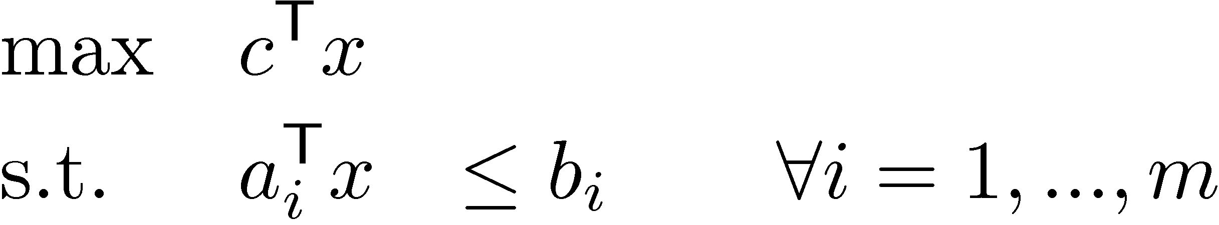
Duality: Algebraic View
Definition: A new constraint a^{T}x·b is valid if it is satisfied by all feasible points
x feasible ) a₁^{T} x · b₁ and a₂^{T} x · b₂
) (a₁+a₂)^{T} x · b₁+b₂ (new valid constraint)
More generally, for any ¸₁,…,¸_{m}¸0
x feasible ) (§_{i} ¸_{i}a_{i})^{T} x · §_{i} ¸_{i}b_{i} (new valid constraint)
“Any non-negative linear combination of the constraints gives a new valid constraint”
To get upper bound on objective function c^{T}x, need (§_{i} ¸_{i}a_{i}) = c
(because then our new valid constraint shows c^{T} x · §_{i} ¸_{i}b_{i})
Want best upper bound ) want to minimize §_{i} ¸_{i}b_{i}
Notes:
Note: This is not quite the same as what appears in Cunningham-Lewis Section 2.2 because they also assume x >= 0. In that case, you can relax the condition “\sum_i \lambda_i a_i = c” to“\sum_i \lambda_i a_i <= c”. See “Rules for Duals” below.

Slide 10
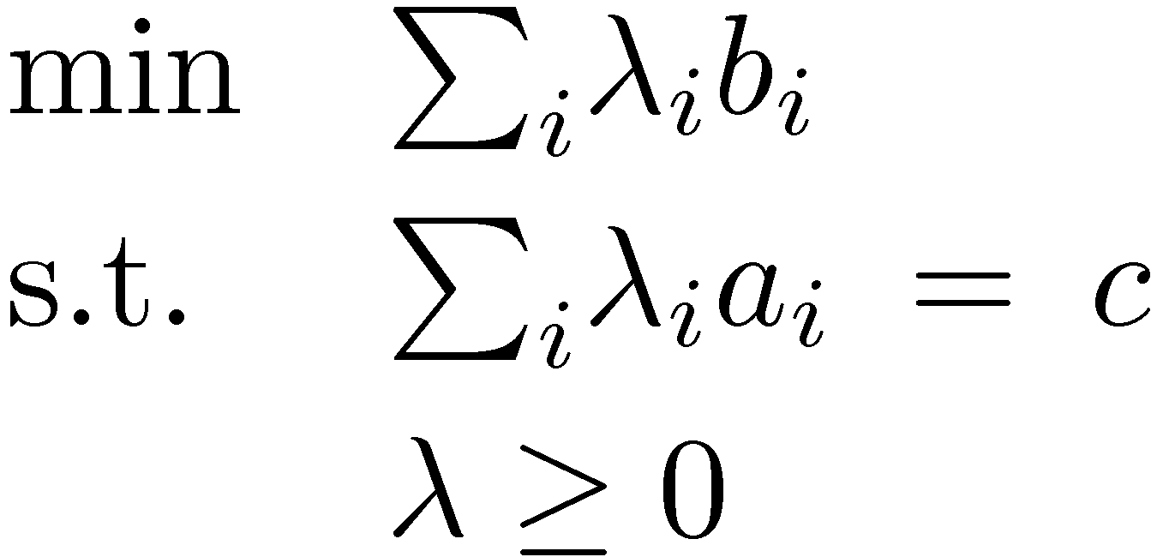
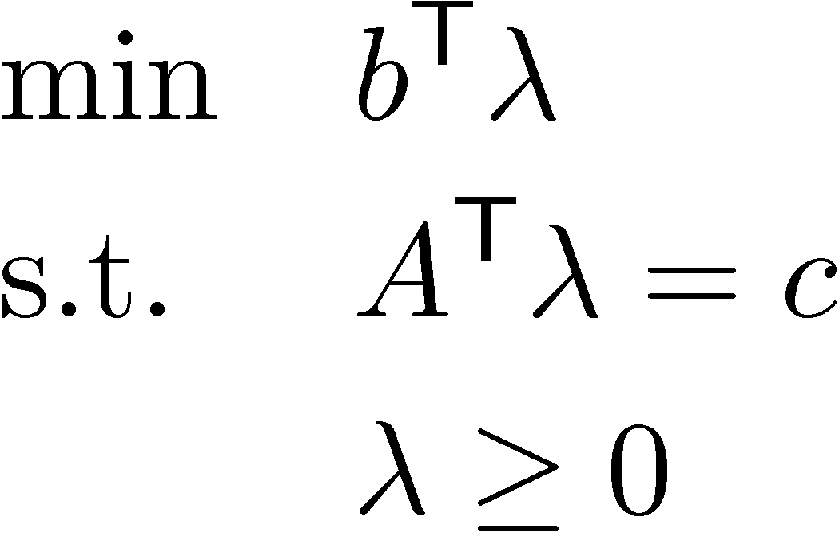
Duality: Algebraic View
Primal LP
To get upper bound on objective function c^{T}x, need (§_{i} ¸_{i}a_{i}) = c
Want best upper bound ) want to minimize §_{i} ¸_{i}b_{i}
We can write this as an LP too!
´
Dual LP
Theorem: “Weak Duality Theorem”
If x feasible for Primal and ¸ feasible for Dual then c^{T}x · b^{T}¸.
Proof: c^{T} x = (A^{T} ¸)^{T} x = ¸^{T} A x · ¸^{T} b. ¥
Since ¸¸0 and Ax·b
Notes:
Cunningham-Lewis Prop 2.1

Slide 11
Duality: Algebraic View
Primal LP
To get upper bound on objective function c^{T}x, need (§_{i} ¸_{i}a_{i}) = c
Want best upper bound ) want to minimize §_{i} ¸_{i}b_{i}
We can write this as an LP too!
´
Dual LP
Theorem: “Weak Duality Theorem”
If x feasible for Primal and ¸ feasible for Dual then c^{T}x · b^{T}¸.
Corollary: If x feasible for Primal and ¸ feasible for Dual and c^{T}x = b^{T}¸
then x optimal for Primal and ¸ optimal for Dual.
Notes:
Cunningham-Lewis Cor 2.2

Slide 12

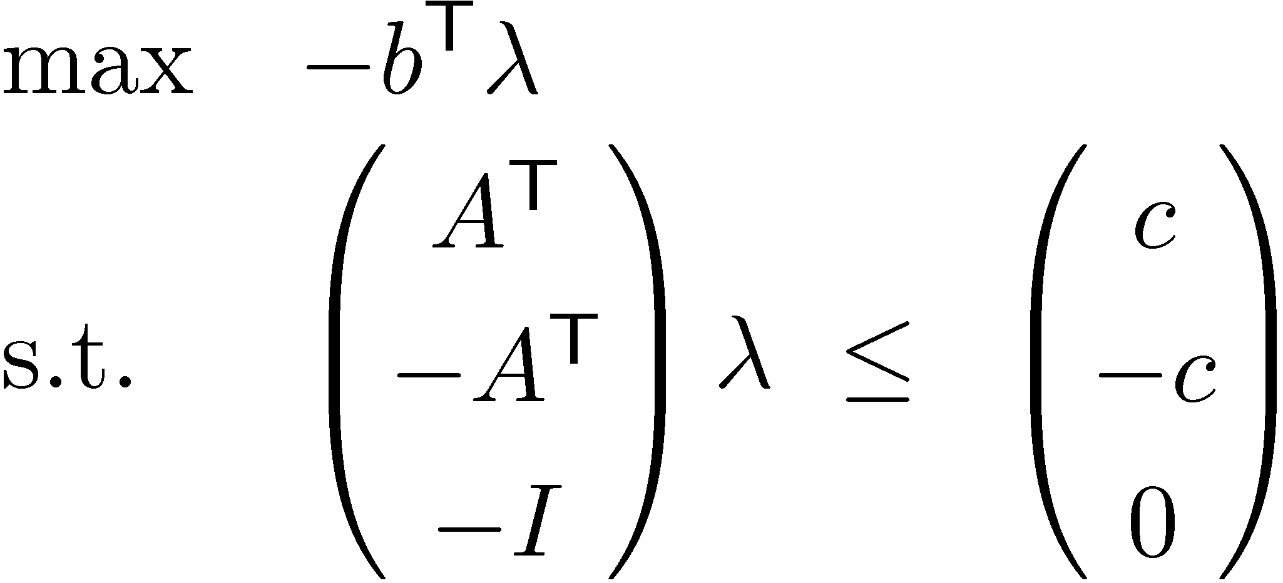
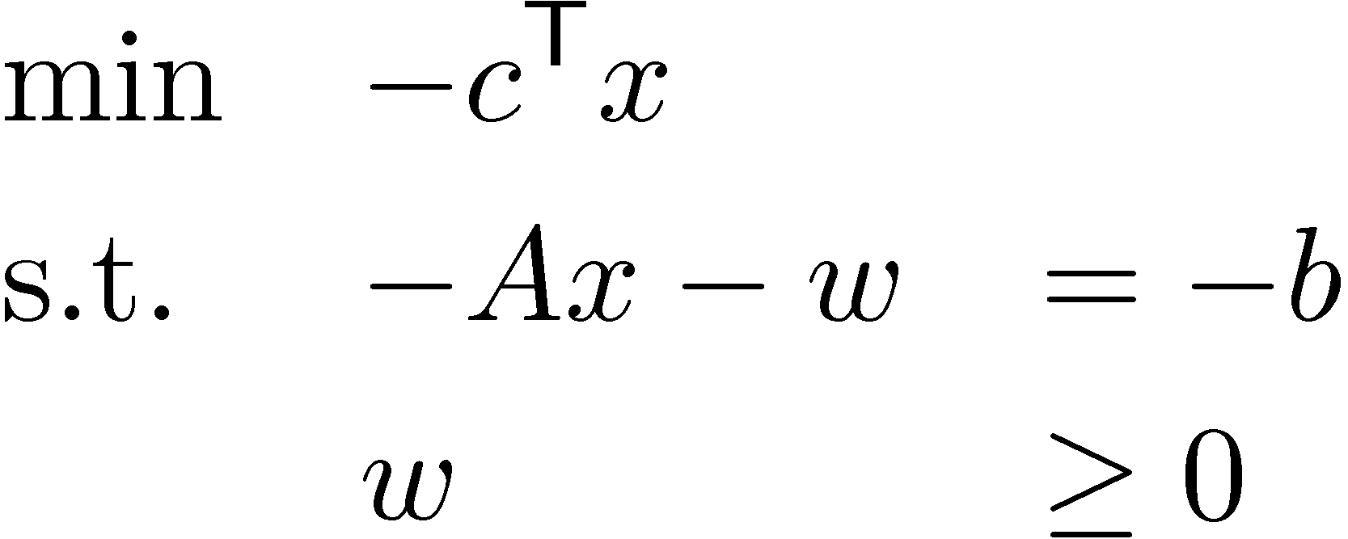
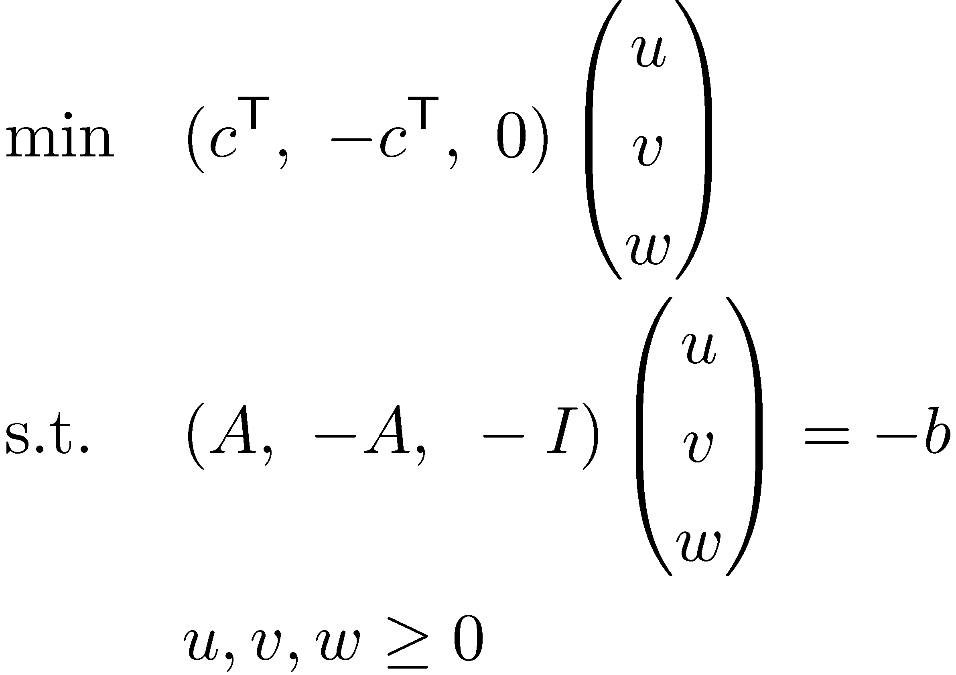
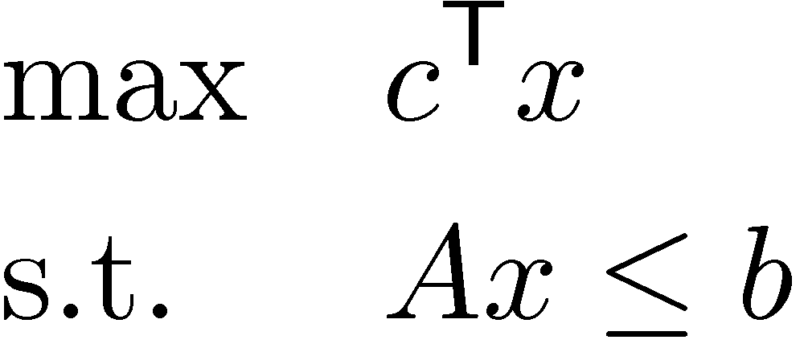
Dual of Dual
A has size m x n
c 2 R^{n} and b 2 R^{m}
Dual LP
Inequality Form
´
transpose
transpose
transpose
Dual of Dual
new variables
(non-negative)
Let x = v-u
u2R^{n}
v2R^{n}
w2R^{m}
´
´
Primal:
Conclusion: “Dual of Dual is Primal!”

Slide 13
Rules for Duals
 | Primal | Dual
Objective | max c^{T}x | min b^{T}y
Variables | x₁, …, x_{n} | y₁,…, y_{m}
Constraint matrix | A | A^{T}
Right-hand vector | b | c
Constraints versus Variables | i^{th} constraint: · i^{th} constraint: ¸ i^{th} constraint: = x_{i} ¸ 0 x_{i} · 0 x_{i} unrestricted | y_{i} ¸ 0 y_{i} · 0 y_{i} unrestricted j^{th} constraint: ¸ j^{th} constraint: · j^{th} constraint: =
A has size m x n
Note:
Not symmetric
“Natural”
Useful Mnemonic
“Natural” bound on a variable is ¸ 0
“Natural” constraint for a maximization problem is · 0
“Natural” constraint for a minimization problem is ¸ 0

Slide 14
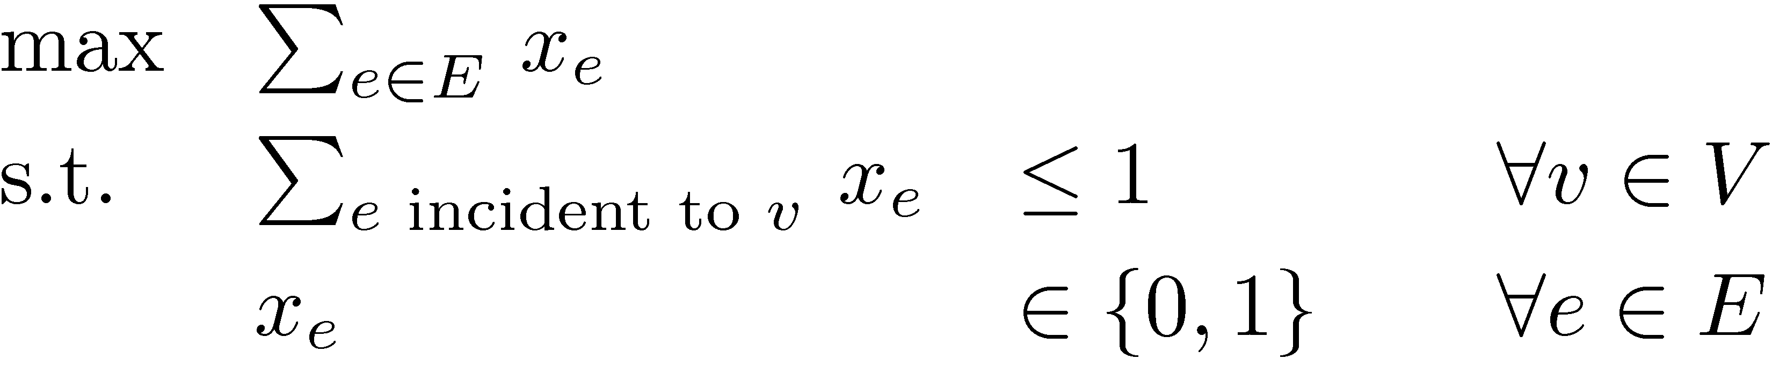
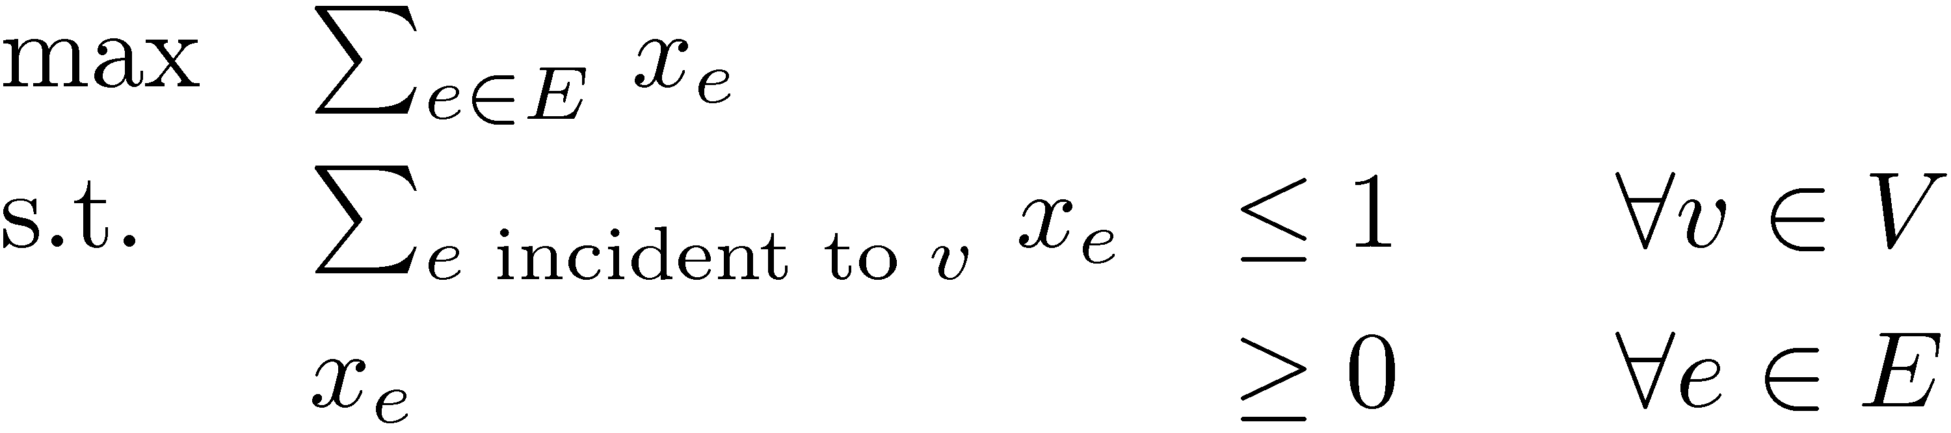
Example: Bipartite Matching
(from Lecture 2)
Given bipartite graph G=(V, E)
Find a maximum size matching
  A set M µ E s.t. every vertex has at most one incident edge in M
Write an integer program
(IP)
But we don’t know how to solve IPs. Try an LP instead.
(LP)
Notes:
Textbook Section 3.2. We will probably do the proof in Section 8.2 (Theorem 8.2.2).

Slide 15
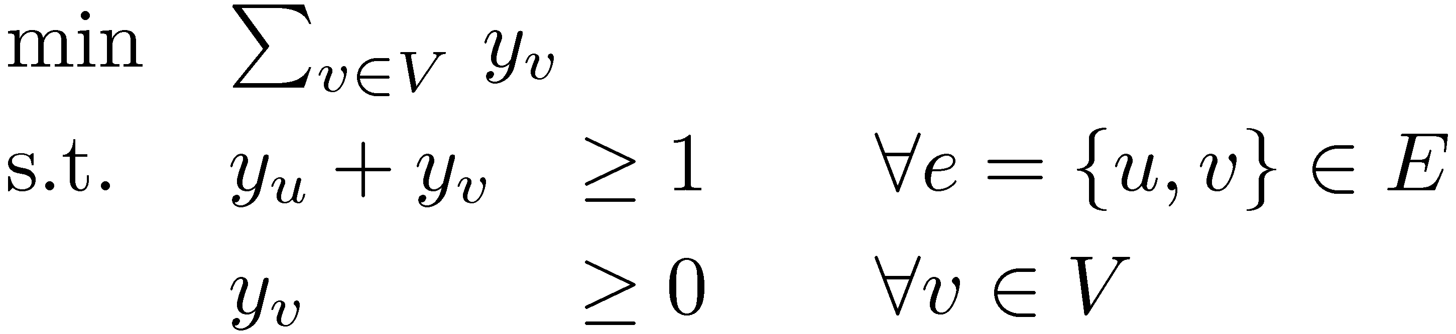
Example: Bipartite Matching
(from Lecture 2)
The LP formulation is:
(Primal)
Using “Rules for Duals”:
(Dual)
If you add the constraint y_{v} 2 {0,1} to (Dual), it becomes the
“vertex cover problem”. There is a nice duality between the
bipartite matching and vertex cover problems. (We’ll see this later in the course.)
Notes:
Matousek-Gartner Section 3.2 and Cunningham-Lewis Section 4.5.

Slide 16
Primal vs Dual
Fundamental Theorem of LP: For any LP, the outcome is either:
Infeasible, Unbounded, Optimum Point Exists.
Weak Duality Theorem:
If x feasible for Primal and ¸ feasible for Dual then c^{T}x · b^{T}¸.
Primal
(maximization)
Exercise!
 | Infeasible | Unbounded | Opt. Exists
Infeasible
Unbounded
Opt. Exists
Dual
(minimization)
Possible
Possible
Impossible
Possible
Impossible
Impossible
Impossible
Impossible
Possible
Strong Duality Theorem:
If Primal has an opt. solution x, then Dual has an opt. solution ¸.
Furthermore, optimal values are same: c^{T}x = b^{T}¸.
Notes:
See Cunningham-Lewis Thm 2.5

Slide 17

Certificates
For any LP, I can convince you that optimal value is…
¸ k: by giving a primal feasible x with obj. value ¸ k.
· k: by giving a dual feasible ¸ with obj. value · k.
Theorem: Such certificates always exists. (stated in Lecture 2)
Proof: Immediate from strong duality theorem. ¥
Theorems like this are very strong and useful.
Other famous examples:
Konig / Hall’s Theorem (Graph theory)
Max-flow Min-cut Theorem (Network flow theory)
Hilbert’s Nullstellensatz (Algebraic geometry)

Slide 18

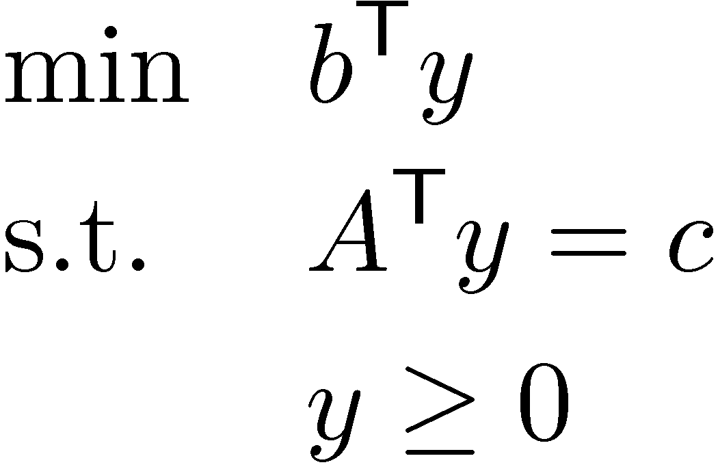
Strong Duality
Primal LP:
Dual LP:
Strong Duality Theorem:
Primal has an opt. solution x , Dual has an opt. solution y.
Furthermore, optimal values are same: c^{T}x = b^{T}y.
Weak Duality implies c^{T}x·b^{T}y. So strong duality says c^{T}x¸b^{T}y.
Restatement of Theorem:
Primal has an optimal solution
, Dual has an optimal solution
, the following system is solvable:
Punchline: Finding optimal primal & dual LP solutions
is equivalent to solving this system of inequalities.
Can we characterize when systems of inequalities are solvable?
(for any feasible x,y)
(for optimal x,y)
Notes:
Cunningham-Lewis (2.10)

Slide 19
Systems of Equalities
Lemma: Exactly one of the following holds:
  There exists x satisfying Ax=b
  There exists y satisfying y^{T}A=0 and y^{T}b<0
Proof:
Simple consequence of Gaussian elimination working.
Perform row eliminations on augmented matrix [ A | b ], so that A becomes upper-triangular
If resulting system has i^{th} row of A equal to zero
but b_{i} non-zero then no solution exists
  This can be expressed as y^{T}A=0 and y^{T}b<0.
Otherwise, back-substitution yields a solution. ¥
Or y^{T}b>0,
by negating y

Slide 20
Systems of Equalities
Lemma: Exactly one of the following holds:
  There exists x satisfying Ax=b
  There exists y satisfying y^{T}A=0 and y^{T}b<0
Geometrically…
(b is in column space of A)
x₂
span(A₁,…,A_{n}) = column space of A
b
A₁
A₂
x₁
x₃
Notes:
Cunningham-Lewis Thm 2.6

Slide 21
Systems of Equalities
Lemma: Exactly one of the following holds:
  There exists x satisfying Ax=b (b is in column space of A)
  There exists y satisfying y^{T}A=0 and y^{T}b<0 (or it is not)
Geometrically…
x₂
span(A₁,…,A_{n}) = column space of A
b
A₁
A₂
x₁
x₃

Slide 22
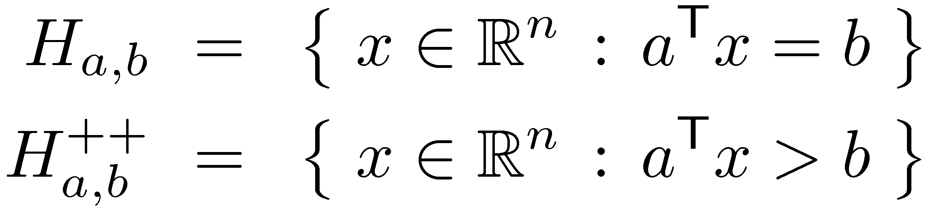
Systems of Equalities
Lemma: Exactly one of the following holds:
  There exists x satisfying Ax=b (b is in column space of A)
  There exists y satisfying y^{T}A=0 and y^{T}b>0 (or it is not)
Geometrically…
col-space(A)µH_{y,0} but b2H_{y,0}
++
Hyperplane
Positive open halfspace
b
y
x₂
column space of A
A₂
x₁
H_{a,0}
A₁
x₃

Slide 23
Systems of Inequalities
Lemma: Exactly one of the following holds:
  There exists x¸0 satisfying Ax=b
  There exists y satisfying y^{T}A¸0 and y^{T}b<0
Geometrically…
Let cone(A₁,…,A_{n}) = { §_{i} ¸_{i}A_{i} : ¸¸0 } “cone generated by A₁,…,A_{n}”
(b is in cone(A₁,…,A_{n}))
x₂
b
cone(A₁,…,A_{n})
A₂
A₃
A₁
x₁
x₃
Notes:
Cunningham-Lewis Section 2.3

Slide 24
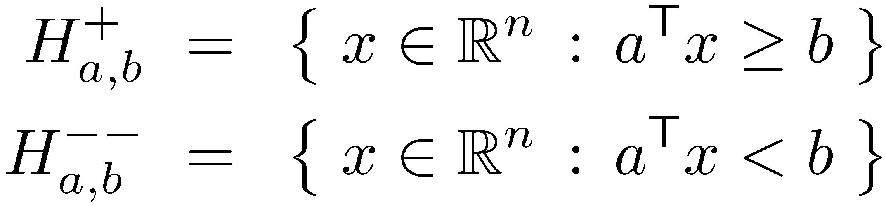
Systems of Inequalities
Lemma: Exactly one of the following holds:
  There exists x¸0 satisfying Ax=b (b is in cone(A₁,…,A_{n}))
  There exists y satisfying y^{T}A¸0 and y^{T}b<0
Geometrically…
(y gives a “separating hyperplane”)
+
--
cone(A₁,…,A_{n})2H_{y,0} but b2H_{y,0}
Positive closed halfspace
Negative open halfspace
x₂
y
cone(A₁,…,A_{n})
A₂
A₃
A₁
H_{y,0}
b
x₁
x₃

