Slide 1
C&O 355 Mathematical Programming Fall 2010 Lecture 22
N. Harvey
TexPoint fonts used in EMF.
Read the TexPoint manual before you delete this box.: AAAAAAAAAA

Slide 2
Topics
Kruskal’s Algorithm for the Max Weight Spanning Tree Problem
Vertices of the Spanning Tree Polytope

Slide 3
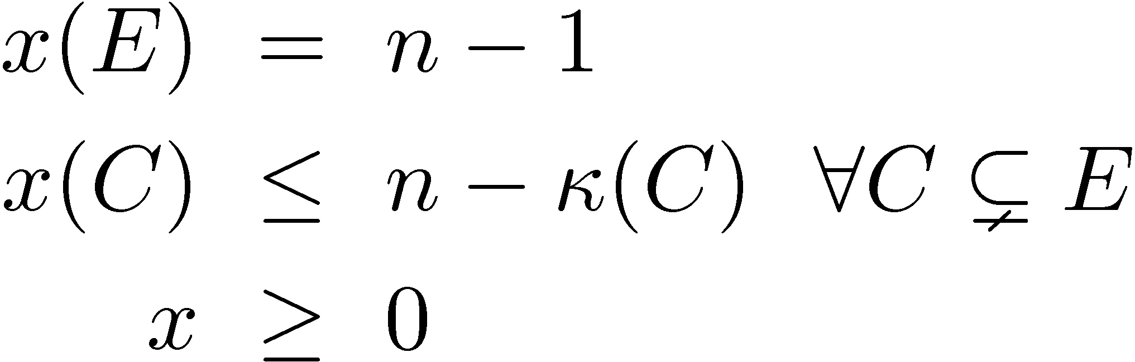
Review of Lecture 21
Defined spanning tree polytope
where ∙(C) = # connected components in (V,C).
We showed, for any spanning tree T, its characteristic vector is in P_{ST}.
We showed how to optimize over P_{ST} in polynomial time by the ellipsoid method, even though there are exponentially many constraints
This is a bit complicated: it uses the Min s-t Cut problem as a separation oracle.
P_{ST} =

Slide 4

How to solve combinatorial IPs? (From Lecture 17)
Two common approaches
Design combinatorial algorithm that directly solves IP
Often such algorithms have a nice LP interpretation
Relax IP to an LP; prove that they give same solution; solve LP by the ellipsoid method
Need to show special structure of the LP’s extreme points
Sometimes we can analyze the extreme points combinatorially
Sometimes we can use algebraic structure of the constraints. For example, if constraint matrix is Totally Unimodular then IP and LP are equivalent
TODAY
Perfect Matching
Max Flow, Max Matching

Slide 5
Kruskal’s Algorithm
Let G = (V,E) be a connected graph, n=|V|, m=|E|
Edges are weighted: w_{e}2R for every e2E
We will show:
Claim: When this algorithm adds an edge to T, no cycle is created.
Claim: At the end of the algorithm, T is connected.
Theorem: This algorithm outputs a maximum-cost spanning tree.
Order E as (e₁, ..., e_{m}), where w_{e1} ¸ w_{e2} ¸ ... ¸ w_{em}
Initially T = ;
For i=1,...,m
If the ends of e_{i} are in different components of (V,T)
Add e_{i} to T

Slide 6
Kruskal’s Algorithm
Let G = (V,E) be a connected graph, n=|V|, m=|E|
Edges are weighted: w_{e}2R for every e2E
Order E as (e₁, ..., e_{m}), where w_{e1} ¸ w_{e2} ¸ ... ¸ w_{em}
Initially T = ;
For i=1,...,m
If the ends of e_{i} are in different components of (V,T)
Add e_{i} to T
3
3
7
4
2
5
1
8
1
2
2
8
2
1
1
3

Slide 7
Order E as (e₁, ..., e_{m}), where w_{e1} ¸ w_{e2} ¸ ... ¸ w_{em}
Initially T = ;
For i=1,...,m
If the ends of e_{i} are in different components of (V,T)
Add e_{i} to T
Claim: When this algorithm adds an edge to T, no cycle is created.
Proof: Let e_{i} = {u,v}.
T[{e_{i}} contains a cycle iff there is a path from u to v in (V,T).
3
3
7
4
2
5
1
8
1
2
2
8
v
2
1
u
1
e_{i}
3

Slide 8
Order E as (e₁, ..., e_{m}), where w_{e1} ¸ w_{e2} ¸ ... ¸ w_{em}
Initially T = ;
For i=1,...,m
If the ends of e_{i} are in different components of (V,T)
Add e_{i} to T
Claim: When this algorithm adds an edge to T, no cycle is created.
Proof: Let e_{i} = {u,v}.
T[{e_{i}} contains a cycle iff there is a path from u to v in (V,T).
Since e_{i} only added when u and v are in different components, no such path exists.
Therefore (V,T) is acyclic throughout the algorithm. ¥
3
3
7
4
2
5
1
8
1
2
2
8
v
2
1
u
1
e_{i}
3

Slide 9
Order E as (e₁, ..., e_{m}), where w_{e1} ¸ w_{e2} ¸ ... ¸ w_{em}
Initially T = ;
For i=1,...,m
If the ends of e_{i} are in different components of (V,T)
Add e_{i} to T
Claim: At the end of the algorithm, T is connected.
Proof: Suppose not.
Then there are vertices u and v in different components of (V,T).
3
3
7
4
2
8
v
u
5
1
1
2
2
8
2
1
1
3

Slide 10
Order E as (e₁, ..., e_{m}), where w_{e1} ¸ w_{e2} ¸ ... ¸ w_{em}
Initially T = ;
For i=1,...,m
If the ends of e_{i} are in different components of (V,T)
Add e_{i} to T
Claim: At the end of the algorithm, T is connected.
Proof: Suppose not.
Then there are vertices u and v in different components of (V,T).
Since G is connected, there is a u-v path P in G.
Some edge e2P must connect different components of (V,T).
When the algorithm considered e, it would have added it. ¥
3
3
7
4
2
e
8
v
u
5
1
1
2
2
8
2
1
1
3

Slide 11
Our Analysis So Far
Order E as (e₁, ..., e_{m}), where w_{e1} ¸ w_{e2} ¸ ... ¸ w_{em}
Initially T = ;
For i=1,...,m
If the ends of e_{i} are in different components of (V,T)
Add e_{i} to T
We have shown:
Claim: When this algorithm adds an edge to T, no cycle is created.
Claim: At the end of the algorithm, T is connected.
So T is an acyclic, connected subgraph, i.e., a spanning tree.
We will show:
Theorem: This algorithm outputs a maximum-cost spanning tree.

Slide 12
Main Theorem
Order E as (e₁, ..., e_{m}), where w_{e1} ¸ w_{e2} ¸ ... ¸ w_{em}
Initially T = ;
For i=1,...,m
If the ends of e_{i} are in different components of (V,T)
Add e_{i} to T
In fact, we will show a stronger fact:
Theorem: Let x be the characteristic vector of T at end of algorithm. Then x is an optimal solution of max { w^{T}x : x2P_{ST} }, where P_{ST} is the spanning tree polytope:
P_{ST} =

Slide 13
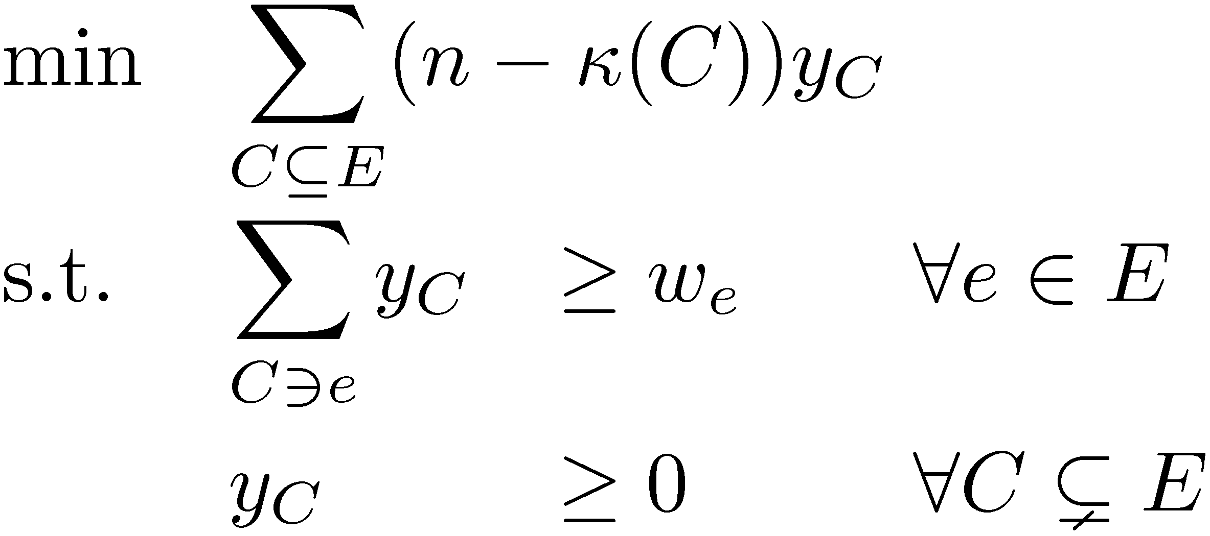
Optimal LP Solutions
We saw last time that the characteristic vector of any spanning tree is feasible for P_{ST}.
We will modify Kruskal’s Algorithm to output a feasible dual solution as well.
These primal & dual solutions will satisfy the complementary slackness conditions, and hence both are optimal.
The dual of max { w^{T}x : x2P_{ST} } is

Slide 14
Complementary Slackness Conditions (From Lecture 5)
Let x be feasible for primal and y be feasible for dual.
 | Primal | Dual
Objective | max c^{T}x | min b^{T}y
Variables | x₁, …, x_{n} | y₁,…, y_{m}
Constraint matrix | A | A^{T}
Right-hand vector | b | c
Constraints versus Variables | i^{th} constraint: · i^{th} constraint: ¸ i^{th} constraint: = x_{j} ¸ 0 x_{j} · 0 x_{j} unrestricted | y_{i} ¸ 0 y_{i} · 0 y_{i} unrestricted j^{th} constraint: ¸ j^{th} constraint: · j^{th} constraint: =
for all i, equality holds either for primal or dual
and
for all j, equality holds either for primal or dual
,
x and y are both optimal

Slide 15
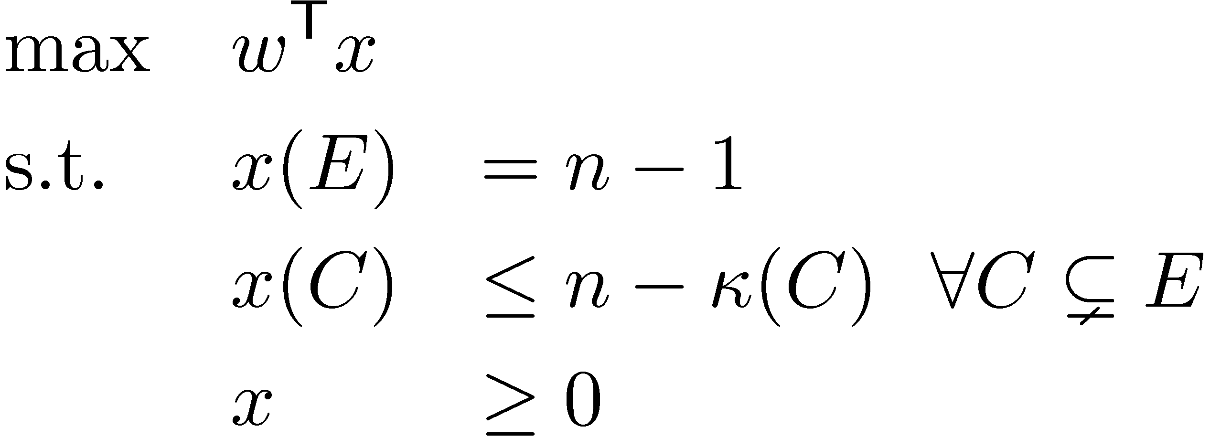
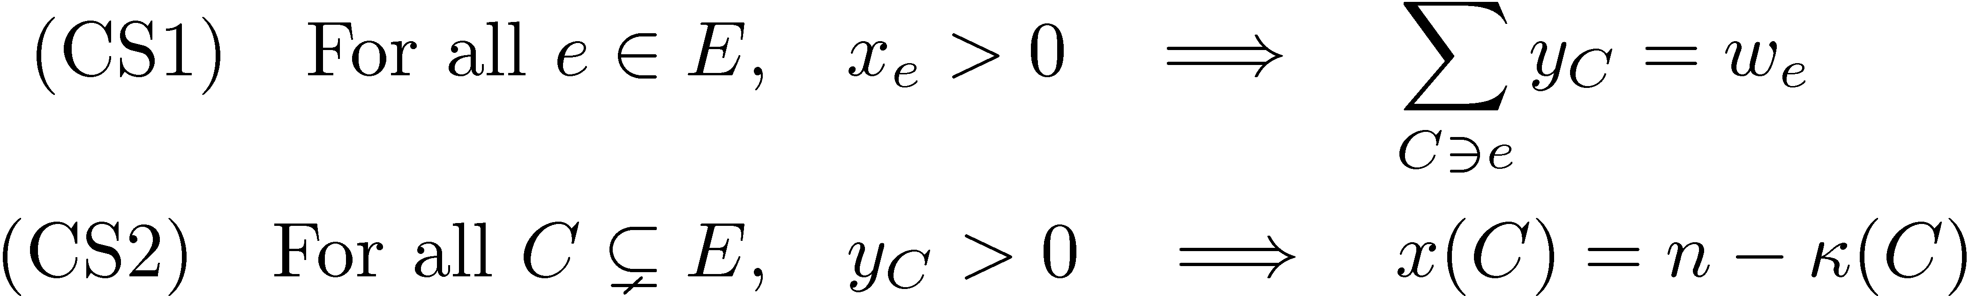
Complementary Slackness
Primal:
Dual:
Complementary Slackness Conditions:
If x and y satisfy these conditions, both are optimal.

Slide 16
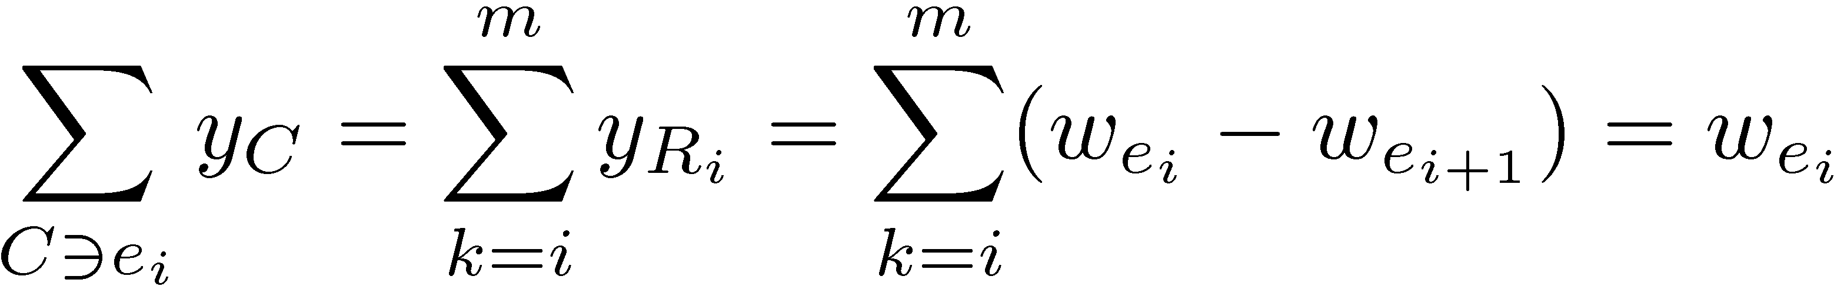
“Primal-Dual” Kruskal Algorithm
Notation: Let R_{i} = {e₁,...,e_{i}} and w_{em+1} = 0
Order E as (e₁, ..., e_{m}), where w_{e1} ¸ w_{e2} ¸ ... ¸ w_{em}
Initially T = ; and y = 0
For i=1,...,m
Set y_{Ri} = w_{ei} - w_{ei+1}
If the ends of e_{i} are in different components of (V,T)
Add e_{i} to T
Claim: y is feasible for dual LP.
Proof: y_{C}¸0 for all C(E, since w_{ei} ¸ w_{ei+1}. (Except when i=m)
Consider any edge e_{i}. The only non-zero y_{C} with e_{i}2C are y_{Rk} for k¸i.
So . ¥

Slide 17
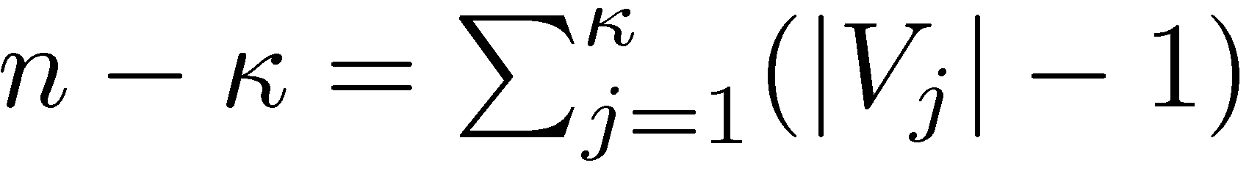
Lemma: Suppose BµE and CµE satisfy |BÅC| < n-∙(C). Let ∙=∙(C). Let the components of (V,C) be (V₁,C₁), ..., (V∙,C∙). Then for some j, (V_{j}, BÅC_{j}) is not connected.
Proof:
We showed last time that
So
So, for some j, |B Å C_{j}| < |V_{j}|-1.
So BÅC_{j} doesn’t have enough edges to form a tree spanning V_{j}.
So (V_{j},BÅC_{j}) is not connected. ¥

Slide 18
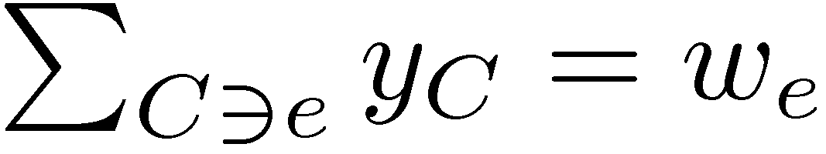
Let x be the characteristic vector of T at end of algorithm.
Claim: x and y satisfy the complementary slackness conditions.
Proof: We showed for every edge e, so CS1 holds.
Let’s check CS2. We only have y_{C}>0 if C=R_{i} for some i.
So suppose x(R_{i}) < n - ∙(R_{i}) for some i.
Recall that x(R_{i})=|TÅR_{i}|. (Since x is characteristic vector of T.)
Let the components of (V,R_{i}) be (V₁,C₁), ..., (V∙,C∙).
By previous lemma, for some a, (V_{a},TÅC_{a}) is not connected.
There are vertices u,v2V_{a} such that
u and v are not connected in (V_{a},TÅC_{a})
there is a path PµC_{a} connecting u and v in (V_{a},C_{a})
So, some edge e_{b}2P connects two components of (V_{a},TÅC_{a}), which are also two components of (V,TÅR_{i}).
Note that TÅR_{i} is the partial tree at step i of the algorithm.
So when the algorithm considered e_{b}, it would have added it. ¥

Slide 19
Vertices of the Spanning Tree Polytope
Corollary: Every vertex of P_{ST} is the characteristic vector of a spanning tree.
Proof: Consider any vertex x of spanning tree polytope. By definition, there is a weight vector w such that x is the unique optimal solution of max{ w^{T}x : x2P_{ST} }.
If we ran Kruskal’s algorithm with the weights w, it would output an optimal solution to max{ w^{T}x : x2P_{ST} } that is the characteristic vector of a spanning tree T.
Thus x is the characteristic vector of T. ¥
Corollary: The World’s Worst Spanning Tree Algorithm (in Lecture 21) outputs a max weight spanning tree.

Slide 20
What’s Next?
Future C&O classes you could take
If you’re unhappy that the ellipsoid method is too slow, you can learn about practical methods in:
C&O 466: Continuous Optimization
If you liked… | You might like…
Max Flows, Min Cuts, Spanning Trees | C&O 351 “Network Flows” C&O 450 “Combinatorial Optimization” C&O 453 “Network Design”
Integer Programs, Polyhedra | C&O 452 “Integer Programming”
Konig’s Theorem | C&O 342 “Intro to Graph Theory” C&O 442 “Graph Theory” C&O 444 “Algebraic Graph Theory”
Convex Functions, Subgradient Inequality, KKT Theorem | C&O 367 “Nonlinear Optimization” C&O 463 “Convex Optimization” C&O 466 “Continuous Optimization”
Semidefinite Programs | C&O 471 “Semidefinite Optimization”

