Slide 1
C&O 355
Mathematical Programming
Fall 2010
Lecture 21
N. Harvey
TexPoint fonts used in EMF.
Read the TexPoint manual before you delete this box.: AAAAAAAAAA

Slide 2

Topics
Max Weight Spanning Tree Problem
Spanning Tree Polytope
Separation Oracle using Min s-t Cuts
Warning!
The point of this lecture is to do things in an unnecessarily complicated way.

Slide 3
Spanning Tree
Let G = (V,E) be a connected graph, n=|V|, m=|E|
Edges are weighted: w_{e}2R for every e2E
Def: A set TµE is a spanning tree if (these are equivalent)
  |T|=n-1 and T is acyclic
  T is a maximal acyclic subgraph
  T is a minimal connected, spanning subgraph
3
7
4
2
5
1
8
1
2
8
2
2
1
1
3

Slide 4
Spanning Tree
Let G = (V,E) be a connected graph, n=|V|, m=|E|
Edges are weighted: w_{e}2R for every e2E
Def: A set TµE is a spanning tree if (these are equivalent)
  |T|=n-1 and T is acyclic
  T is a maximal acyclic subgraph
  T is a minimal connected, spanning subgraph
3
7
4
2
5
1
8
1
2
8
2
2
1
1
3

Slide 5
Spanning Tree
Let G = (V,E) be a connected graph, n=|V|, m=|E|
Edges are weighted: w_{e}2R for every e2E
Def: A set TµE is a spanning tree if (these are equivalent)
  |T|=n-1 and T is acyclic
  T is a maximal acyclic subgraph
  T is a minimal connected, spanning subgraph
Def: TµE is a max weight spanning tree if it maximizes ∑_{e2T} w_{e} over all spanning trees.
3
4
2
7
5
1
8
1
2
8
2
3
2
1
1

Slide 6
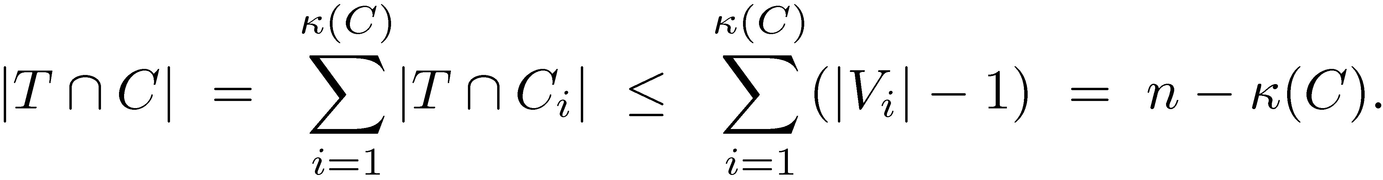
A Simple Properties of Trees
For any CµE, let ∙(C) = # connected components in (V,C)
Examples: ∙(E)=1 and ∙(;)=n
Claim: Suppose T is a spanning tree.
For every CµE, |TÅC| · n-∙(C).
Proof: Let the connected components of (V,C) be
(V₁,C₁), (V₂,C₂), ....
So V = [_{i} V_{i} and C = [_{i} C_{i}.
Since TÅC_{i} is acyclic, |TÅC_{i}|·|V_{i}|-1.
So ¥

Slide 7
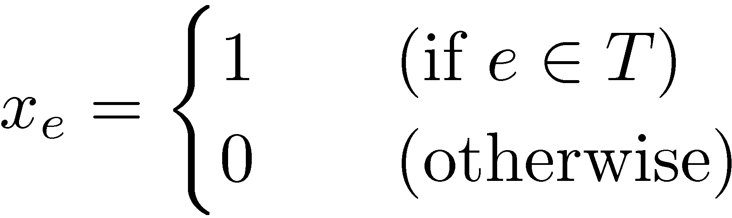
Characteristic Vectors
Notation: We consider vectors x assigning real numbers
to the edges in E. We write this as x 2 R^{E}.
Notation: For CµE, let x(C) = ∑_{e2C} x_{e}.
Examples:
  the edge weights are w 2 R^{E}
  For TµE, the characteristic vector of T is x2R^{E} where
  For any CµE, x(C) = |TÅC| · n-∙(C).
  This is a linear inequality in x: ∑_{e2C} x_{e} · n-∙(C)

Slide 8
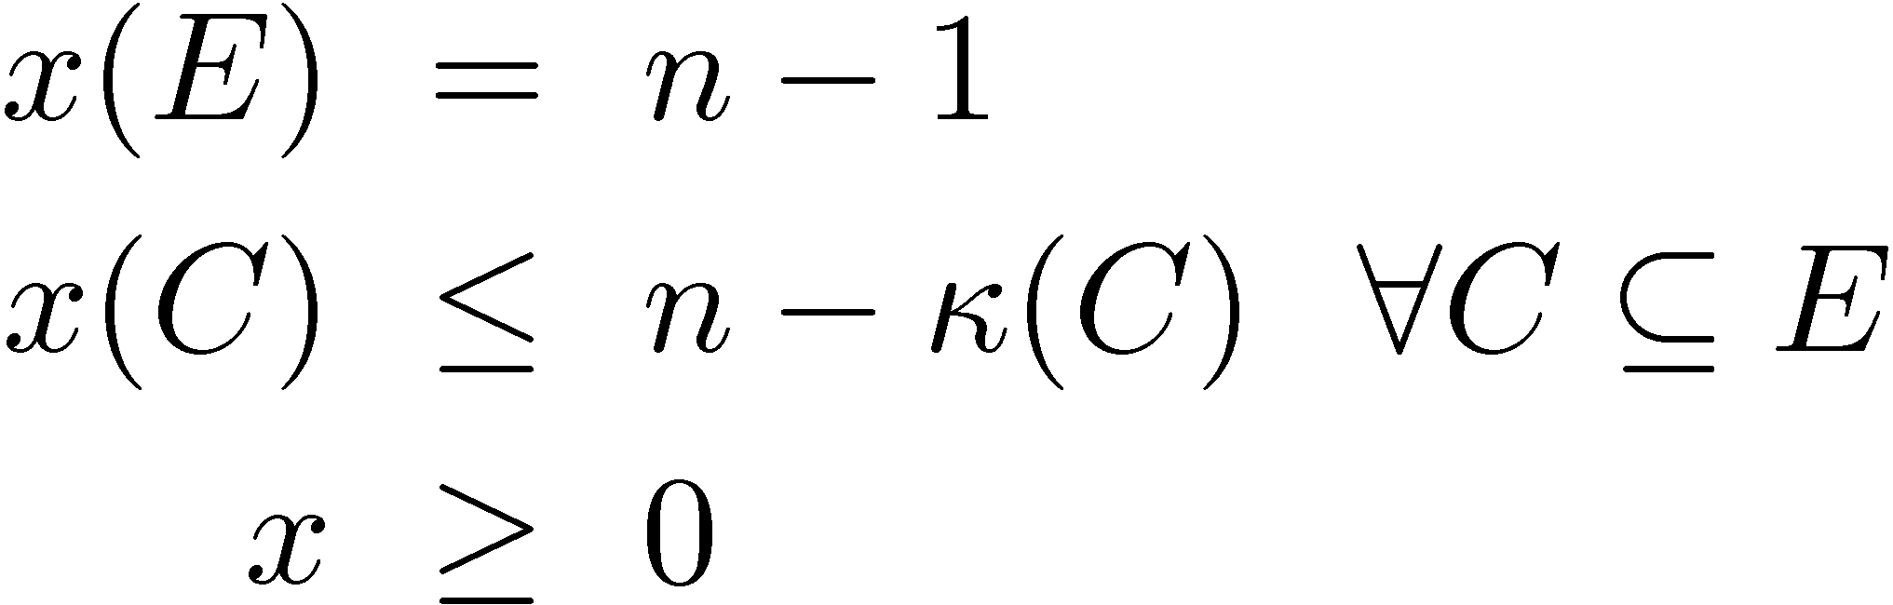
Spanning Tree Polytope
Since we know all these linear inequalities,
why not assemble them into a polyhedron?
Let
Note:
  P_{ST} is a polyhedron, because x(E) and x(C) are
  linear functions of x
  P_{ST} is a polytope, because x_{e}= x({e}) · 1,
  so P_{ST} is bounded
  If x is the characteristic vector of a spanning tree, then x2P_{ST}
P_{ST} =

Slide 9
The Main Theorems
Theorem 1: The LP max { w^{T}x : x2P_{ST} } can be
solved in polynomial time.
(In fact, we’ll do this by the ellipsoid method!)
Theorem 2: [Edmonds ‘71]
The extreme points of P_{ST} are precisely the characteristic vectors of spanning trees of G.
Corollary: A max weight spanning tree can be found
in polynomial time.
Proof: Solve the LP and find an extreme point x.
x is the characteristic vector of a tree T of weight w^{T}x.
Since w^{T}x ¸ w^{T}y for any other extreme point y,
it follows that T is a max weight spanning tree. ¥

Slide 10
“Polynomial Time”
There are many algorithms for finding
maximum weight spanning trees
Our algorithm has running time something like O(m¹²)
Hopelessly impractical! But illustrates important ideas.
Name | Running Time
Prim’s Algorithm | O(m log n)
Kruskal’s Algorithm | O(m log n)
...with fancy data structures | O(m + n log n)
...even fancier data structures | O(m ®(m,n))
Karger-Klein-Tarjan Algorithm | O(m) (randomized)
Pettie-Ramachandaran Algorithm | Optimal determistic alg, but runtime is unknown

Slide 11
Ellipsoid Method for Solving LPs
(from Lecture 8)
Ellipsoid method can find a feasible point in P
i.e., it can solve a system of inequalities
But we want to optimize, i.e., solve max { w^{T}x : x2P }
One approach: Binary search for optimal value
  Suppose we know optimal value is in interval [L,U]
  Add a new constraint w^{T}x ¸ (L+U)/2
  If LP still feasible, replace L with (L+U)/2 and repeat
  If LP not feasible, replace U with (L+U)/2 and repeat
w^{T}x¸(L+U)/2
w^{T}x = L
w^{T}x = U
P

Slide 12
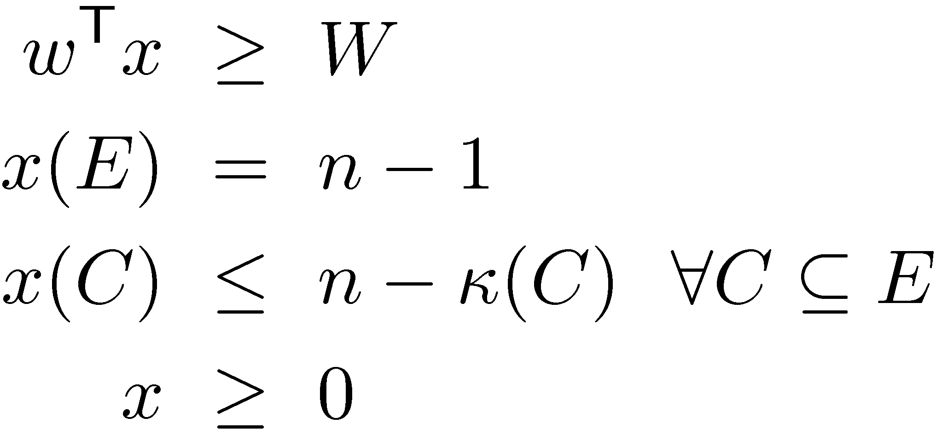
Applying the Ellipsoid Method
By binary search, we need to decide feasibility of
Main obstacle: Huge number of constraints! (2^{m})
Recall: Ellipsoid method works for any convex set P, as long as you can give a separation oracle.
P_{ST} =
Separation Oracle
Is z2P?
If not, find a vector a s.t. a^{T}x<a^{T}z 8x2P

Slide 13
Applying the Ellipsoid Method
By binary search, we need to decide feasibility of
Main obstacle: Huge number of constraints! (2^{m})
Recall: Ellipsoid method works for any convex set P, as long as you can give a separation oracle.
How quickly can we test these constraints?
We’ll show: This can be done in time polynomial in n.
P_{ST} =
Separation Oracle
Is z2P?
If not, find a violated constraint.

Slide 14

Ellipsoid method inside Ellipsoid method
Everything runs in polynomial time!
Minimum Spanning Tree Problem
Solve by Ellipsoid Method
Separation oracle uses…
Minimum S-T Cut Problem
Solve by Ellipsoid Method!

Slide 15
Separation Oracle:
Game Plan
We have graph G=(V,E) and a point z2R^{E}
We construct digraph D=(N,A) with capacities c2R^{A}
If s-t min cut in D is:
  Small: this shows that z violates a constraint of P
  Large: this shows that z is feasible for P

Slide 16
Construction of D
D=(N,A)
G=(V,E)
0.7
1
t
1
Edge b, z_{b} = 0.7
s
1
1
0.6
u_{b}
1
1
1
Edge a
z_{a} = 0.6
u_{a}
1
u_{d}
1
Edge d, z_{d} = 0.9
0.8
1
u_{c}
1
1
0.9
Edge c, z_{c} = 0.8
Nodes of D: N = V [ {s,t} [ { u_{e} : e 2 E }
Arcs of D:
  Arc (s,u_{e}) of capacity z_{e} for every edge e 2 E
  Arc (v,t) of capacity 1 for every node v2V
  Infinite capacity arcs (u_{{v,w}},v) and (u_{{v,w}},w) for all {v,w} 2 E

Slide 17
Construction of D
D=(N,A)
G=(V,E)
0.7
1
t
1
Edge b, z_{b} = 0.7
s
1
1
0.6
u_{b}
1
1
1
Edge a
z_{a} = 0.6
u_{a}
1
u_{d}
1
Edge d, z_{d} = 0.9
0.8
1
u_{c}
1
1
0.9
Edge c, z_{c} = 0.8
Lemma: z is feasible , every s-t cut has capacity ¸ n (except for the cut with only black edges).
Notes:
<== direction:
Suppose z is infeasible. i.e., there exists C s.t. z(C) > n - kappa(C).
Recall: connected components of C are (Vi,Ci).
By our first claim, some connected component (Vi,Ci) has z(Ci) > |Vi|-1.
Then z(E[Vi]) >= z(Ci) > |Vi|-1.
Let S = Vi and let E[S] = { edges with both endpoints in S }. So z(E[S]) > |S|-1.
Consider the cut in D given by U = {s} u S u { u_e : e in E[S] }.
The capacity of this cut is:
|S| + sum_{ e in E \ E[S] } z_e = |S| + z(E) - z(E[S]) = |S| + n-1 - z(E[S]) < n.
Since S is non-empty, this cuts at least one blue edge.
==> direction:
Suppose there is a min cut delta^+(U) of value < n (and it's not the cut of just black edges).
Let S = U n V. (i.e., the vertices of the original graph that are in U).
If u_{v,w} in U then clearly v in U because the arc (u_{v,w},v) has infinity capacity. Same for w.
So e not in E[S], then we cannot have e in U, otherwise the cut would have infinite capacity.
So the capacity is |S| + sum_{e not in E[S]} z_e = |S| + z(E) - z(E[S]).
Since this is < n, and since z(E) = n-1, we get z(E[S]) > |S|-1, so z is infeasible.

Slide 18
Construction of D
D=(N,A)
G=(V,E)
U
1
0.7
t
s
1
1
Edge b, z_{b} = 0.7
0.6
1
1
u_{b}
1
1
Edge a
z_{a} = 0.6
u_{a}
1
u_{d}
1
Edge d, z_{d} = 0.9
0.8
1
u_{c}
1
1
0.9
Edge c, z_{c} = 0.8
Lemma: z is feasible , every s-t cut has capacity ¸ n (except for the cut with only black edges).
Example:
  z(C) = 2.1 > n-∙(C) = 2, so z is infeasible.
  The s-t cut ±⁺(U) in D has capacity 3.9 < n = 4.

Slide 19
Separation Oracle Summary
Input: G=(V,E) and z2R^{E}
Construct the graph D=(N,A) and arc capacities
For each v2V
  Temporarily add an infinity capacity arc (s,v)
  Compute the s-t min cut value q
  (by the Ellipsoid Method)
  If q<n
    We obtain a set SµV s.t. z(E[S]) > |S|-1
    Halt: return this violated constraint
  Remove the temporary arc
End for
Halt: z is feasible

Slide 20
Summary
Some combinatorial objects are described by
LPs of exponential size
Even if an LP has exponential size, the ellipsoid
method might be able to solve it “efficiently”,
if a separation oracle can be designed
The separation oracle might use ellipsoid method too
Ellipsoid method gives impractical algorithms, but these can be a “proof of concept” for realistic algorithms

