Slide 1
C&O 355 Mathematical Programming Fall 2010 Lecture 2
N. Harvey
TexPoint fonts used in EMF.
Read the TexPoint manual before you delete this box.: AAAAAAAAAA

Slide 2
Outline
LP definition & some equivalent forms
Example in 2D
Theorem: LPs have 3 possible outcomes
Examples
Linear regression, bipartite matching, indep set
Solutions at corner points
Duality and certificates

Slide 3
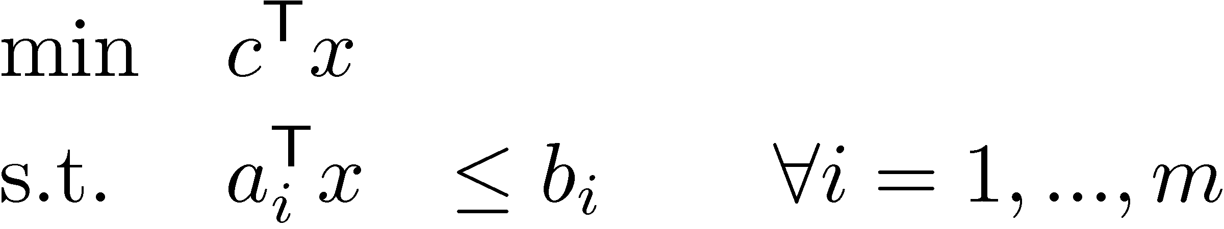
Linear Program
General definition
Parameters: c, a₁,…,a_{m}2R^{n}, b1,…,bm2R
Variables: x2R^{n}
Terminology
Feasible point: any x satisfying constraints
Optimal point: any feasible x that minimizes obj. func
Optimal value: value of obj. func for any optimal point
Objective function
Constraints

Slide 4
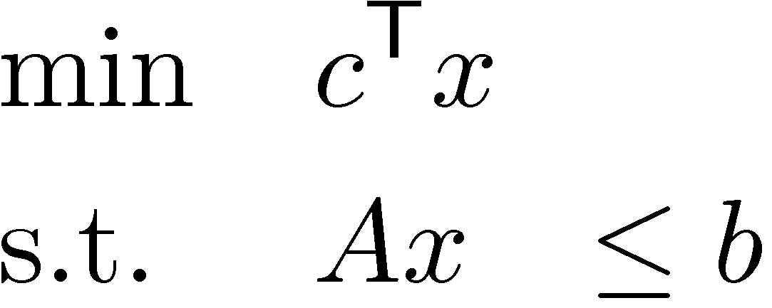
Linear Program
General definition
Parameters: c, a₁,…,a_{m}2R^{n}, b1,…,bm2R
Variables: x2R^{n}
Matrix form
Parameters: c2R^{n}, A2R^{m£n}, b2R^{m}
Variables: x2R^{n}

Slide 5
Simple LP Manipulations
“max” instead of “min”
max c^{T} x ´ min –c^{T} x
“¸” instead of “·”
a^{T}x ¸ b , -a^{T}x · -b
“=” instead of “·”
a^{T}x=b , a^{T}x · b and a^{T}x ¸ b
Note: “<“ and “>” are not allowed in constraints Because we want the feasible region to be closed, in the topological sense.

Slide 6
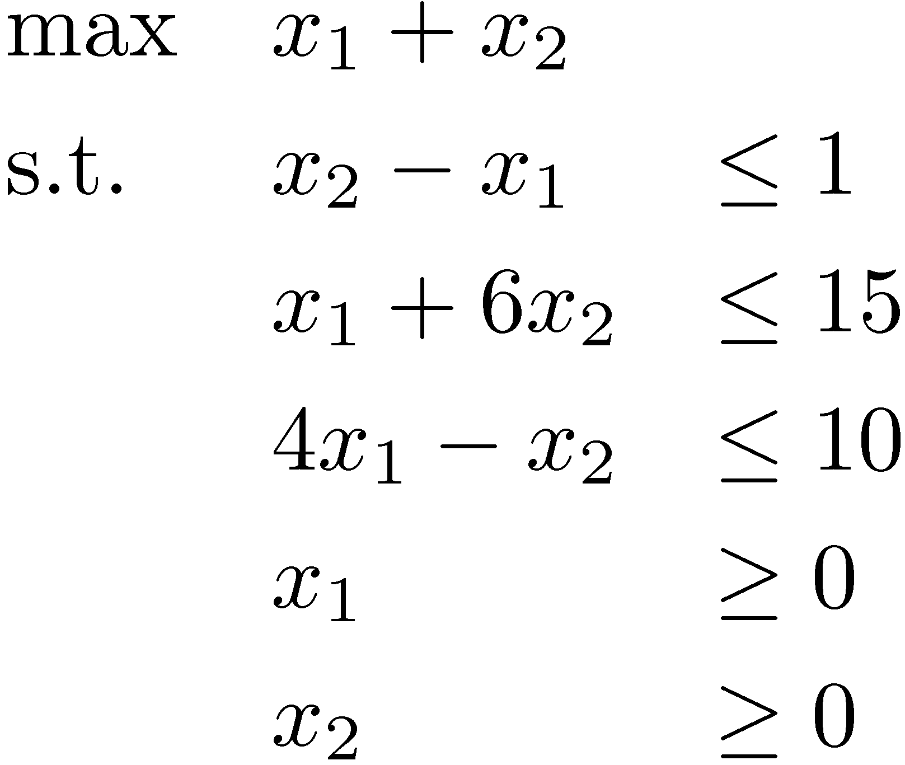
2D Example
Objective Function
Constraint
x₂
x₂ - x₁ · 1
Optimal
point
(3,2)
x₁ + 6x₂ · 15
Feasible region
Gradient of Objective Function
x₂¸0
x₁
(0,0)
x₁¸0
4x₁ - x₂ · 10
Unique optimal solution exists
Notes:
This example is from Matousek-Gartner, Chapter 1

Slide 7
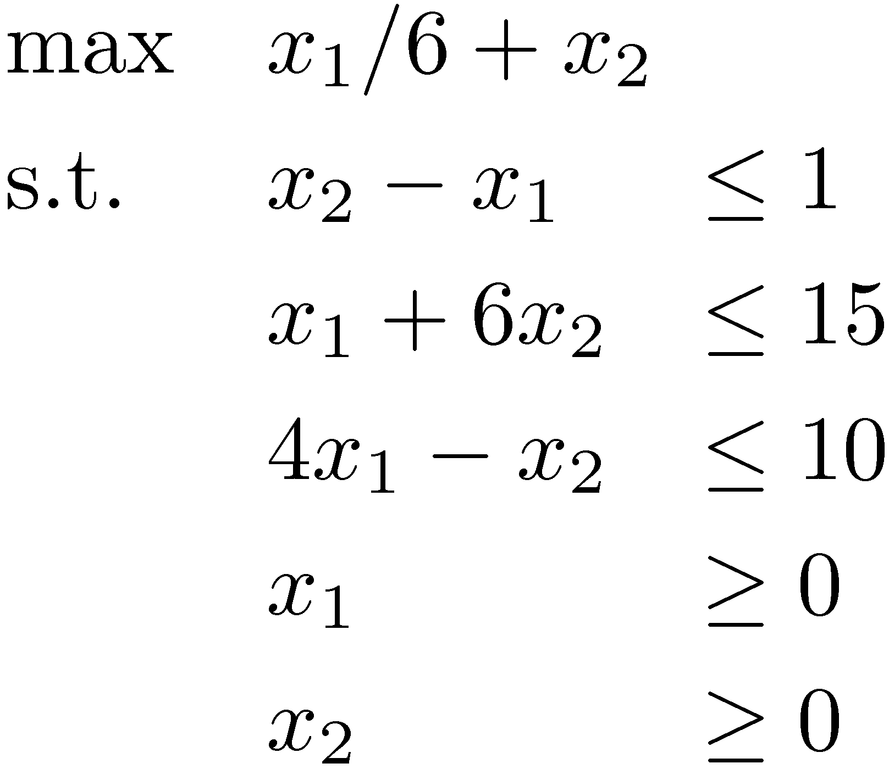
2D Example
Objective Function
Constraint
x₂
x₂ - x₁ · 1
Optimal
points
x₁ + 6x₂ · 15
Feasible region
Gradient of Objective Function
x₂¸0
x₁
(0,0)
x₁¸0
4x₁ - x₂ · 10
Optimal solutions exist:
Infinitely many!
Notes:
This example is from Matousek-Gartner, Chapter 1

Slide 8

2D Example
Constraint
x₂
x₂ - x₁ ¸ 1
x₁ + 6x₂ · 15
Feasible region is empty
Gradient of Objective Function
x₂¸0
x₁
(0,0)
x₁¸0
4x₁ - x₂ ¸ 10
Infeasible
No feasible solutions (so certainly no optimal solutions either)
Notes:
This example is from Matousek-Gartner, Chapter 1

Slide 9
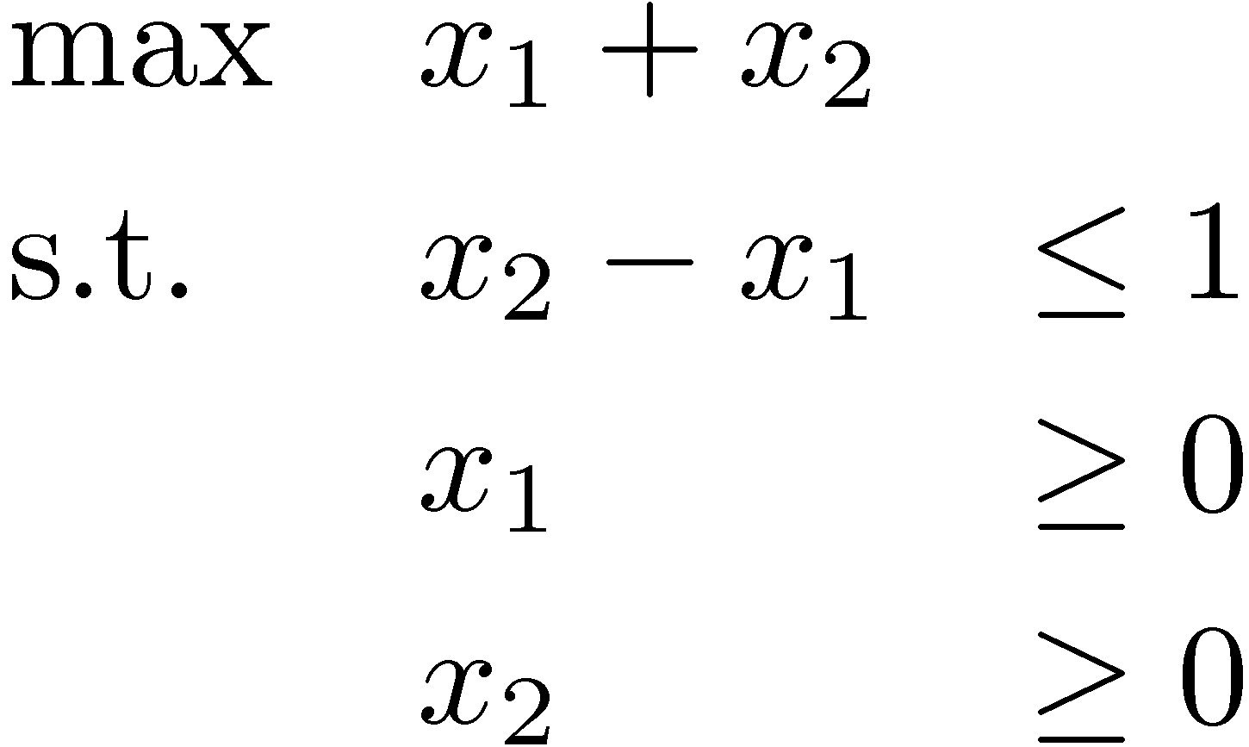
2D Example
Constraint
x₂
x₂ - x₁ · 1
Gradient of Objective Function
x₂¸0
x₁
(0,0)
x₁¸0
Feasible region
Unbounded
Feasible solutions, but no optimal solution
(Informally, “optimal value = 1”)
Notes:
This example is from Matousek-Gartner, Chapter 1
“Unbounded” means the objective value can shoot off to infinity.

Slide 10
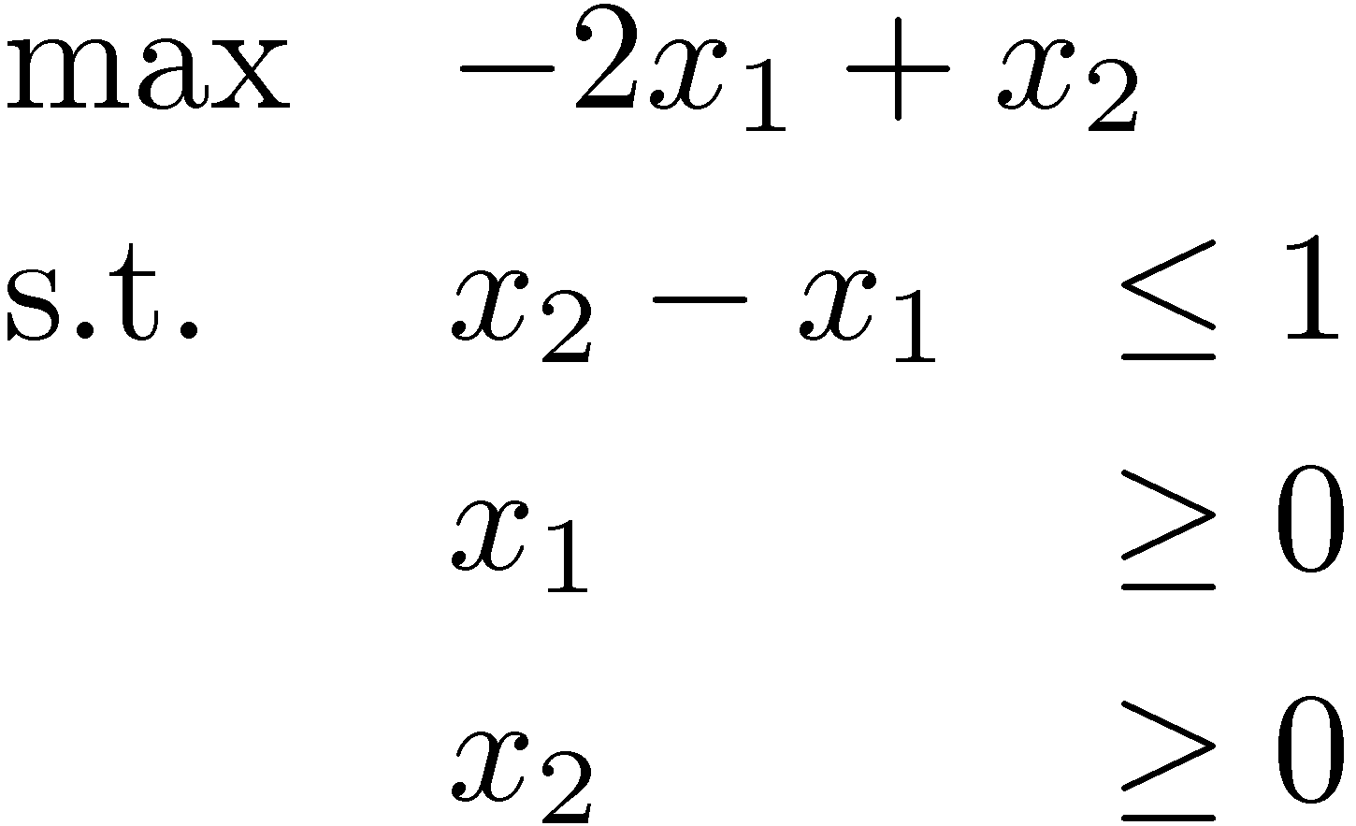
2D Example
Constraint
x₂
x₂ - x₁ · 1
Optimal point (0,1)
Gradient of Objective Function
x₂¸0
x₁
(0,0)
x₁¸0
Feasible region
Important Point: This LP is NOT unbounded.
The feasible region is unbounded, but optimal value is 1
Notes:
This example is from Matousek-Gartner, Chapter 1
Here the feasible region is infinitely big, but the objective value does not shoot off to infinity.

Slide 11
“Fundamental Theorem” of LP
Theorem: For any LP, the outcome is either:
Optimal solution (unique or infinitely many)
Infeasible
Unbounded (optimal value is 1 for maximization problem, or -1 for minimization problem)
Proof: Later in the course!
Notes:
Cunningham-Lewis p13, or Theorem 2.12
Matousek-Gartner Theorem 4.2.3

Slide 12
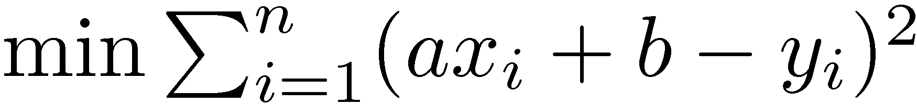

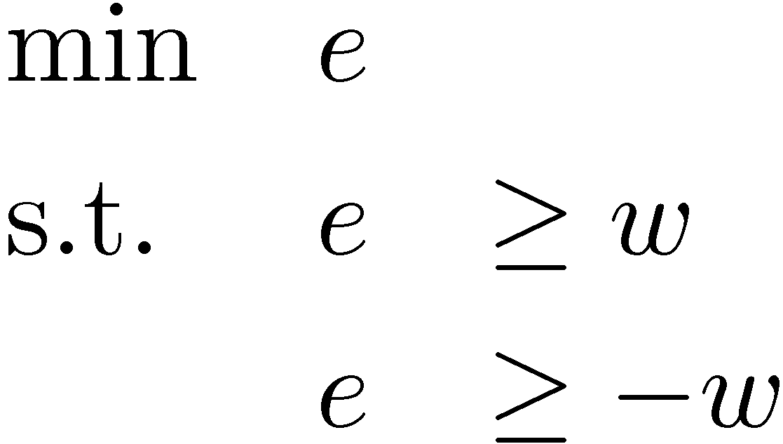
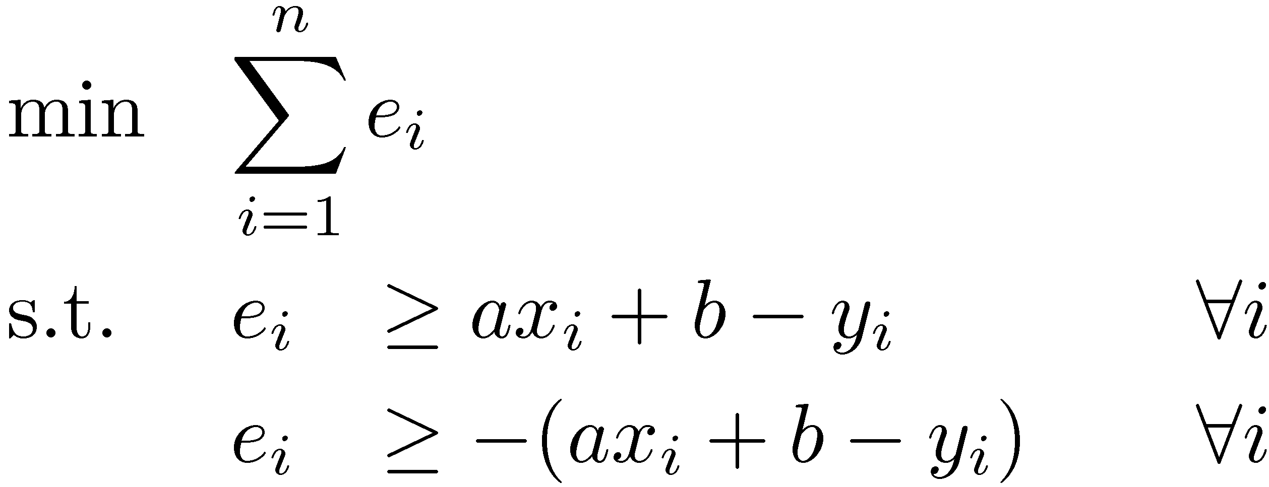
Example: Linear regression
Given data (x₁, y₁), …, (x_{n}, y_{n}) in R²
Find a line y = ax + b that fits the points
Usual setup
Our setup
Easy: differentiate, set to zero
Not differentiable!
Absolute value trick:
´
Our setup can be written as an LP
Notes:
Matousek-Gartner Section 2.4
Claim: In every optimal solution to this LP, e_i = max { a xi + b - yi, -(a xi + b - yi) } = |a xi + b - yi|.
The point here is that often problems that don’t look much like LPs actually can be solved by LPs.
But what if I do ordinary linear regression with squared error but impose the constraint a>=0 and b>=0? Then vector calculus cannot be used to solve it. But it’s still a convex program, so we can use the theory in this course to analyze it.

Slide 13
Example: Bipartite Matching
Given bipartite graph G=(V, E)
Find a maximum size matching
A set M µ E s.t. every vertex has at most one incident edge in M
Notes:
See http://en.wikipedia.org/wiki/Matching_%28graph_theory%29

Slide 14
Example: Bipartite Matching
Given bipartite graph G=(V, E)
Find a maximum size matching
A set M µ E s.t. every vertex has at most one incident edge in M
The blue edges are a matching M

Slide 15
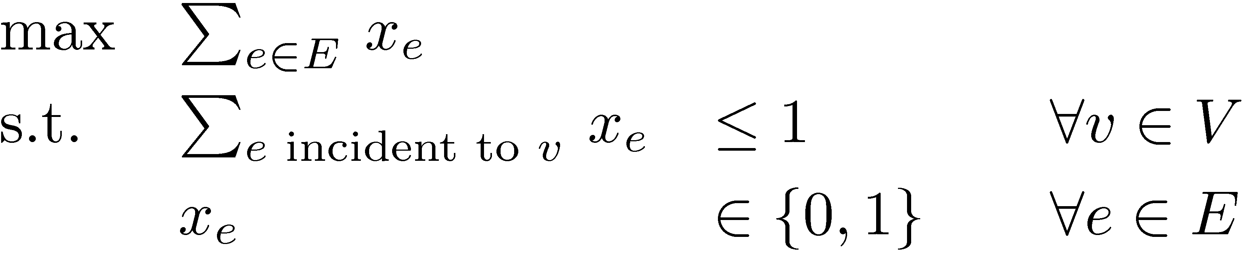
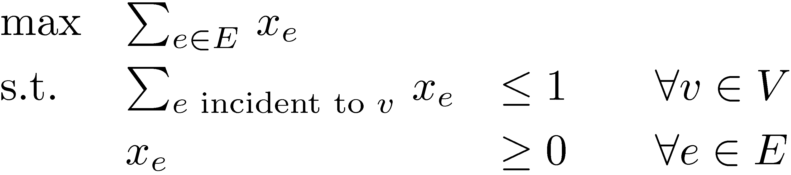
Example: Bipartite Matching
Given bipartite graph G=(V, E)
Find a maximum size matching
A set M µ E s.t. every vertex has at most one incident edge in M
The natural integer program
(IP)
Solving IPs is very hard. Try an LP instead.
(LP)
Theorem: (IP) and (LP) have the same solution!
Proof: Later in the course!
Corollary: Bipartite matching can be solved by LP algorithms.
Notes:
The point here is that:
- natural combinatorial problems can be modeled by IPs.
- sometimes you can solve IPs by solving LPs.
This is an example of why LPs are very useful for designing algorithms.

Slide 16
Example: Independent Set (a.k.a., Stable Set, or Coclique, or Anti-Clique)
Given graph G=(V, E)
Find a maximum size independent set
A set UµV s.t. {u,v} ∉ E for every distinct u,v 2 U
Notes:
See Matousek-Gartner Section 3.4
This is the same as the “clique problem” in the complementary graph: http://en.wikipedia.org/wiki/Clique_problem

Slide 17
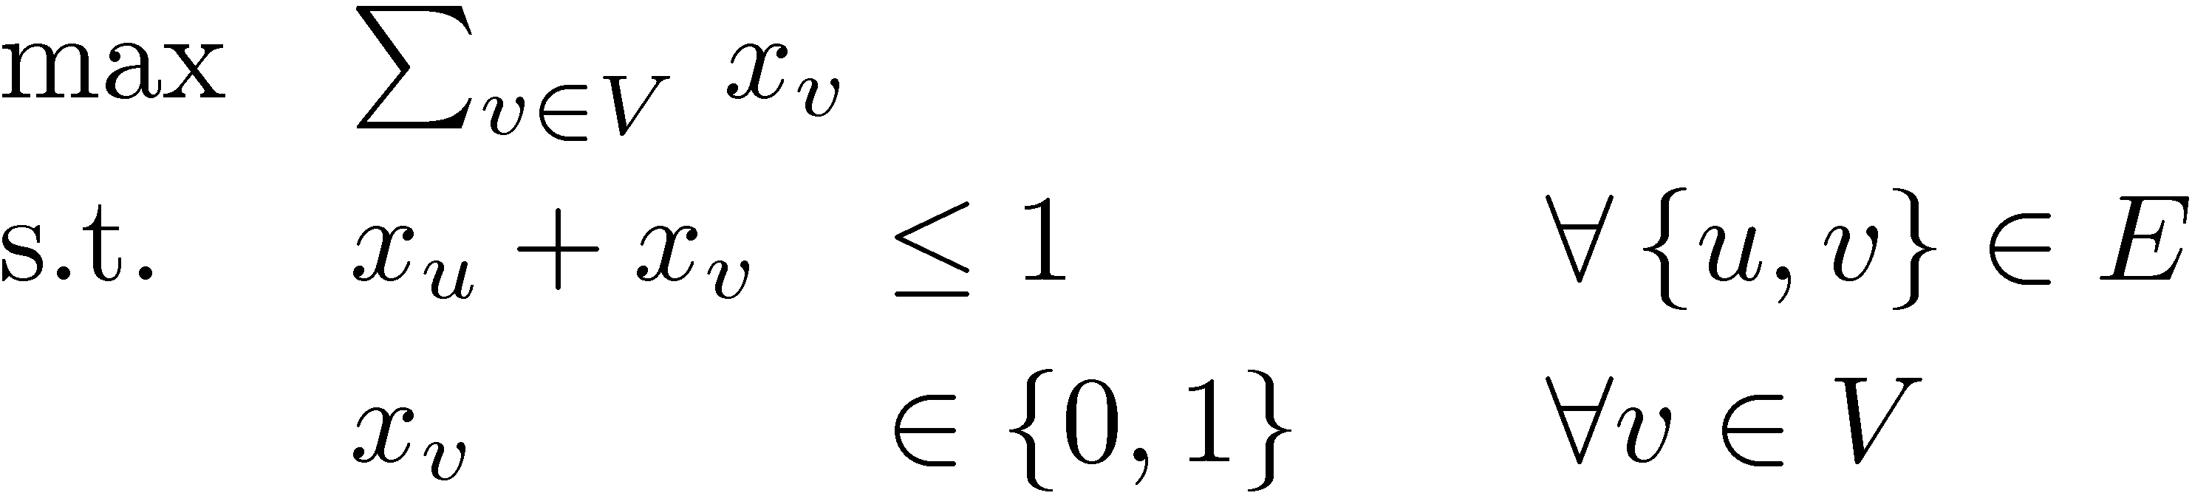
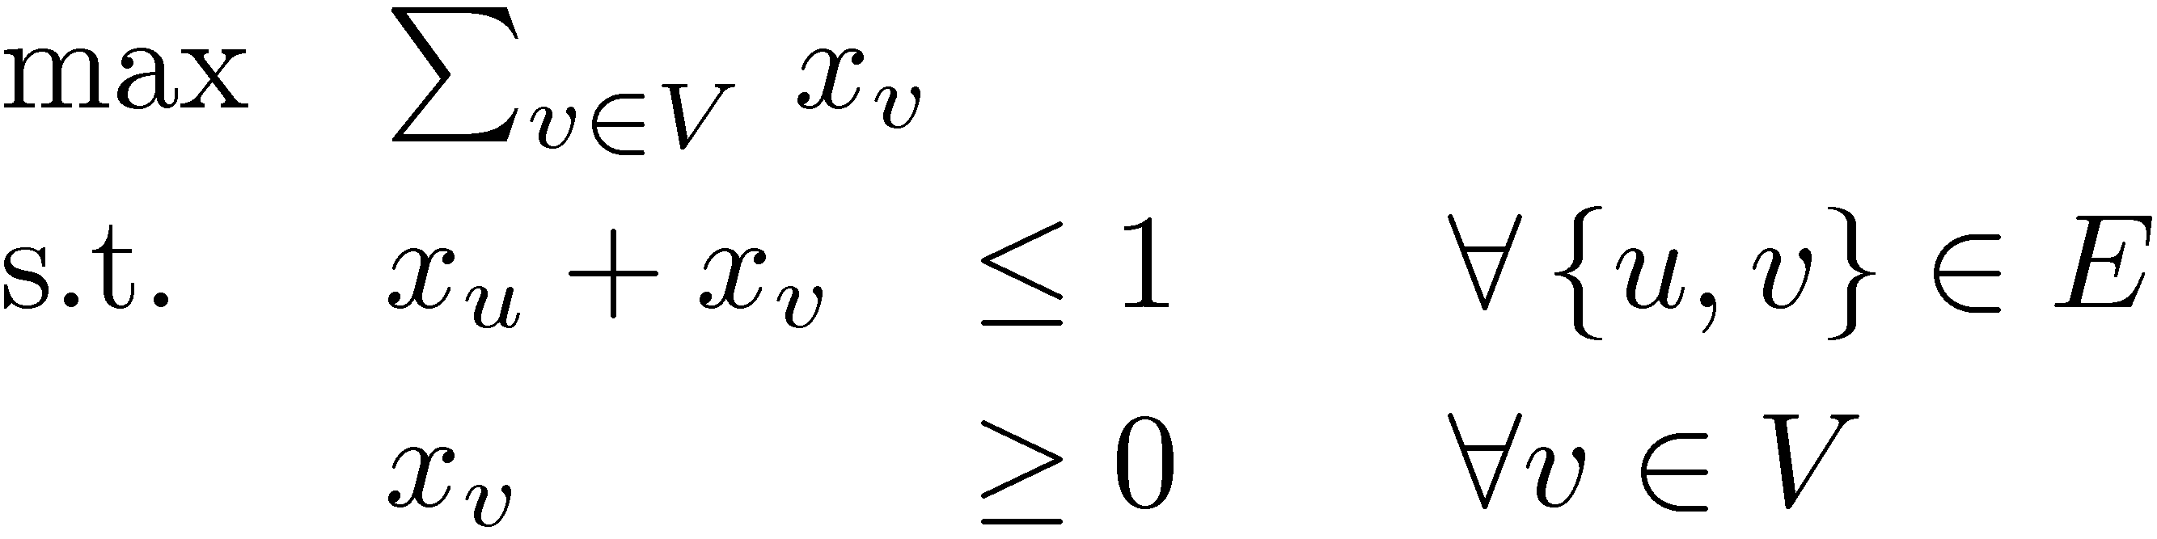
Example: Independent Set
Given graph G=(V, E) (assume no isolated vertices)
Find a maximum size independent set
A set UµV s.t. {u,v} ∉ E for every distinct u,v 2 U
Write an integer program
(IP)
Solving IPs is very hard. Try an LP instead.
(LP)
Unfortunately (IP) and (LP) are extremely different.
Fact: For any n, there are graphs with |V|=n such that OPT_{LP} / OPT_{IP} ¸ n/2.
Notes:
Here OPT_LP means the optimal value of (LP) and OPT_IP means the optimal value of (IP).
The point here is that this LP is completely useless for solving the Independent Set problem. The optimal value of (LP) bears no relation to the objective value of (IP).

Slide 18
Example: Independent Set
Given graph G=(V, E)
Find a maximum size independent set
A set UµV s.t. {u,v} ∉ E for every distinct u,v 2 U
Write an integer program
(IP)
Solving IPs is very hard. Try an LP instead.
(LP)
In fact, there is a (difficult) theorem in Complexity Theory which says (roughly) that Maximum Independent Set cannot be efficiently solved any better than (LP) does.
Notes:
The difficult theorem is:
Håstad, J. (1999), "Clique is hard to approximate within n^{1 − ε}", Acta Mathematica 182 (1): 105–142, doi:10.1007/BF02392825 .

Slide 19
Where are optimal solutions?
x₂
x₂ - x₁ · 1
x₁ + 6x₂ · 15
x₁
4x₁ - x₂ · 10

Slide 20
Where are optimal solutions?
x₂
x₂ - x₁ · 1
x₁ + 6x₂ · 15
x₁
4x₁ - x₂ · 10

Slide 21
Where are optimal solutions?
x₂
x₂ - x₁ · 1
x₁ + 6x₂ · 15
x₁
4x₁ - x₂ · 10
Lemma: For any LP, a “corner point” is an optimal solution.
(Assuming an optimal solution exists and some corner point exists).
Proof: Later in the course!
Notes:
Cunningham-Lewis Theorem 2.27 and Matousek-Gartner Theorem 4.2.3.
We’ll define corner points rigorously later on.

Slide 22

DUALITY The Deepest Idea In This Class
Notes:
Cunningham Lewis Section 2.2

Slide 23
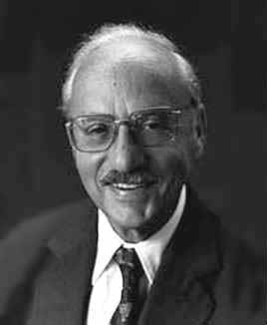
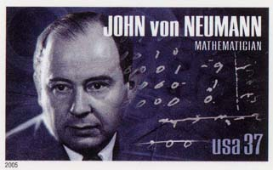
Duality
George Dantzig 1914-2005
“Another key visit took place in October 1947 at the Institute for Advanced Study (IAS) where Dantzig met with John von Neumann. Dantzig recalls, “I began by explaining the formulation of the linear programming model… I described it to him as I would to an ordinary mortal. ‘Get to the point,’ he snapped. In less than a minute, I slapped the geometric and algebraic versions of my problem on the blackboard. He stood up and said, ‘Oh that.’” Just a few years earlier von Neumann had co-authored his landmark monograph on game theory. Dantzig goes on, “for the next hour and a half he proceeded to give me a lecture on the mathematical theory of linear programs.” Dantzig credited von Neumann with edifying him on Farkas’ lemma and the duality theorem (of linear programming).”
from http://www.ams.org/notices/200703/fea-cottle.pdf

Slide 24
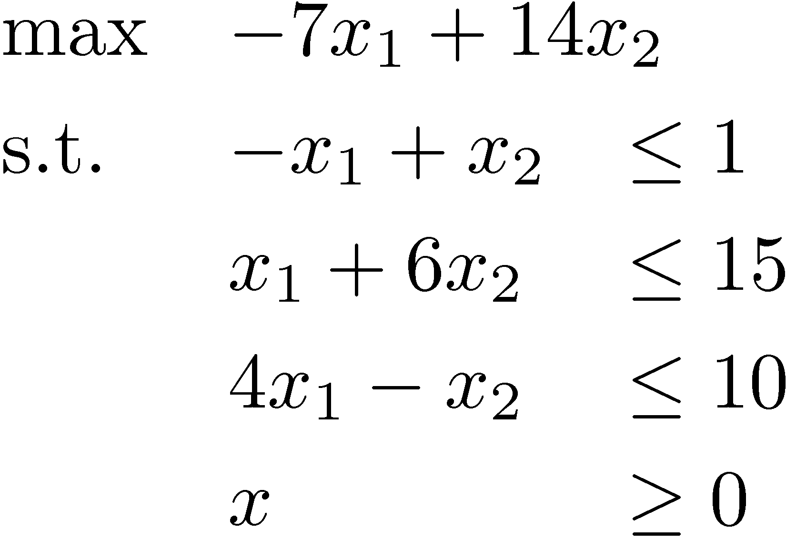
Duality: Proving optimality
Question: What is optimal point in direction c = (-7,14)?
Solution: Optimal point is x=(9/7,16/7), optimal value is 23.
How can I be sure?
Every feasible point satisfies x₁+6x₂ · 15
Every feasible point satisfies -x₁+x₂ · 1
Every feasible point satisfies their sum: -7x₁+14x₂ · 23
) -8x₁+8x₂ · 8
x₂
This is the objective function!
(9/7,16/7)
-x₁+x₂ · 1
x₁ + 6x₂ · 15
x₁
4x₁ - x₂ · 10
Notes:
This topic is called “duality”. It is quite deep.
But don’t worry if you don’t understand it yet, this just an introductory example.
We’ll revisit this topic later.
Similar examples: Cunningham-Lewis page 14 and Matousek-Gartner page 81.

Slide 25
Duality: Proving optimality
Question: What is optimal point in direction c = (-7,14)?
Solution: Optimal point is x=(9/7,16/7), optimal value is 23.
How can I be sure?
Every feasible point satisfies x₁+6x₂ · 15
Every feasible point satisfies -x₁+x₂ · 1 ) -8x₁+8x₂ · 8
Every feasible point satisfies their sum: -7x₁+14x₂ · 23
This is the objective function!
Certificates
To convince you that optimal value is ¸ k, I can find x such that c^{T} x ¸ k.
To convince you that optimal value is · k, I can find a linear combination of the constraints which proves that c^{T} x · k.
Theorem: Such certificates always exists.
Proof: Later in the course!
Notes:
This is the “strong duality theorem of linear programming”.
See Matousek-Gartner Page 83, or Cunningham-Lewis Theorem 2.10.
In fact, Matousek-Gartner contains 5 proofs, all in Chapter 6.

