Slide 1
C&O 355
Mathematical Programming
Fall 2010
Lecture 19
N. Harvey
TexPoint fonts used in EMF.
Read the TexPoint manual before you delete this box.: AAAAAAAAAA

Slide 2
Topics
Vertex Covers in Bipartite Graphs
Konig’s Theorem
Vertex Covers in Non-bipartite Graphs

Slide 3
Maximum Bipartite Matching
Let G=(V, E) be a bipartite graph.
We’re interested in maximum size matchings.
How do I know M has maximum size? Is there a 5-edge matching?
Is there a certificate that a matching has maximum size?
Blue edges are a maximum-size matching M

Slide 4
Vertex covers
Let G=(V, E) be a graph.
A set CµV is called a vertex cover if
every edge e2E has at least one endpoint in C.
Claim: If M is a matching and C is a vertex cover then |M|·|C|.
Proof: Every edge in M has at least one endpoint in C.
Since M is a matching, its edges have distinct endpoints.
So C must contain at least |M| vertices. ¤
Blue edges are a maximum-size matching M
Red vertices form a vertex cover C

Slide 5
Vertex covers
Let G=(V, E) be a graph.
A set CµV is called a vertex cover if
every edge e2E has at least one endpoint in C.
Claim: If M is a matching and C is a vertex cover then |M|·|C|.
Proof: Every edge in M has at least one endpoint in C.
Since M is a matching, its edges have distinct endpoints.
So C must contain at least |M| vertices. ¤
Suppose we find a matching M and vertex cover C s.t. |M|=|C|.
Then M must be a maximum cardinality matching:
every other matching M’ satisfies |M’| · |C| = |M|.
And C must be a minimum cardinality vertex cover:
every other vertex cover C’ satisfies |C’| ¸ |M| = |C|.
Then M certifies optimality of C and vice-versa.

Slide 6
Vertex covers & matchings
Let G=(V, E) be a graph.
A set CµV is called a vertex cover if
every edge e2E has at least one endpoint in C.
Claim: If M is a matching and C is a vertex cover then |M|·|C|.
Suppose we find a matching M and vertex cover C s.t. |M|=|C|.
Then M certifies optimality of C and vice-versa.
Do such M and C always exist?
No…
Maximum size of a matching = 1
Minimum size of a vertex cover = 2

Slide 7
Vertex covers & matchings
Let G=(V, E) be a graph.
A set CµV is called a vertex cover if
every edge e2E has at least one endpoint in C.
Claim: If M is a matching and C is a vertex cover then |M|·|C|.
Suppose we find a matching M and vertex cover C s.t. |M|=|C|.
Then M certifies optimality of C and vice-versa.
Do such M and C always exist?
No… unless G is bipartite!
Theorem (Konig’s Theorem): If G is bipartite then there exists a matching M and a vertex cover C s.t. |M|=|C|.

Slide 8
Earlier Example
Let G=(V, E) be a bipartite graph.
We’re interested in maximum size matchings.
How do I know M has maximum size? Is there a 5-edge matching?
Is there a certificate that a matching has maximum size?
Blue edges are a maximum-size matching M
Red vertices form a vertex cover C
Since |M|=|C|=4, both M and C are optimal!

Slide 9
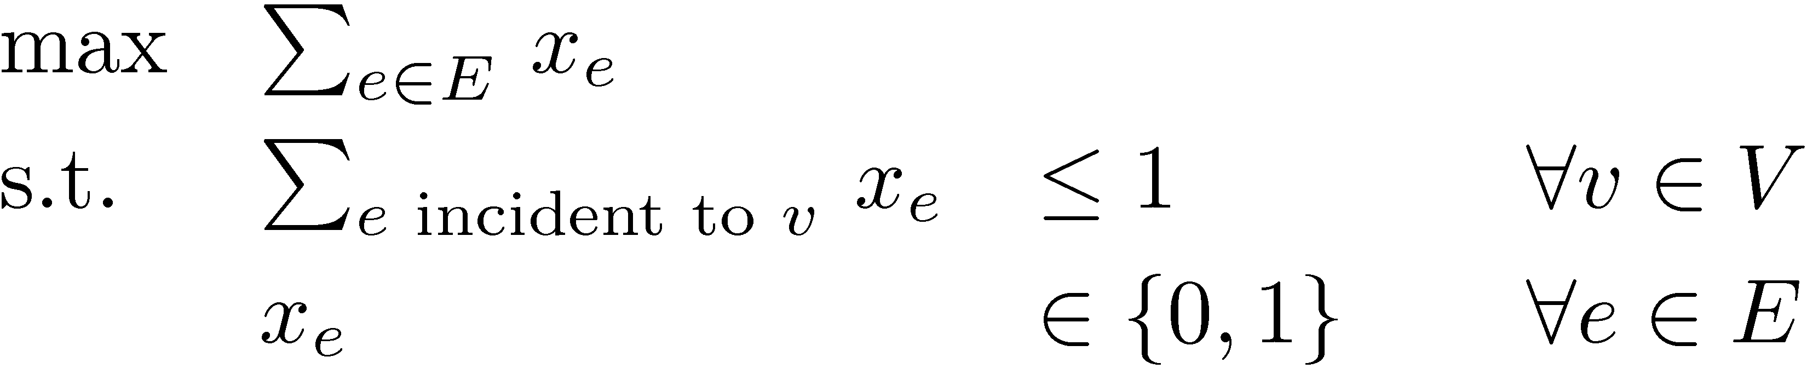
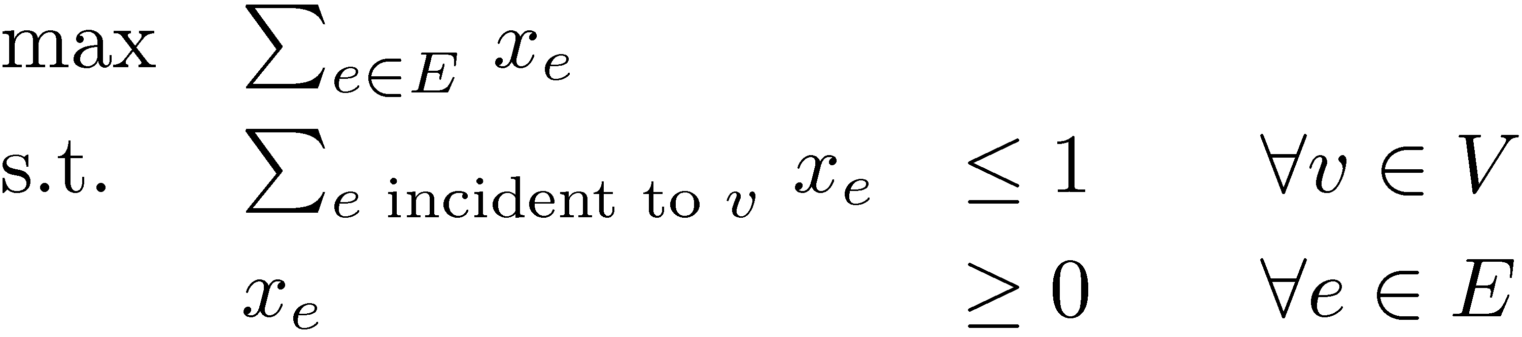
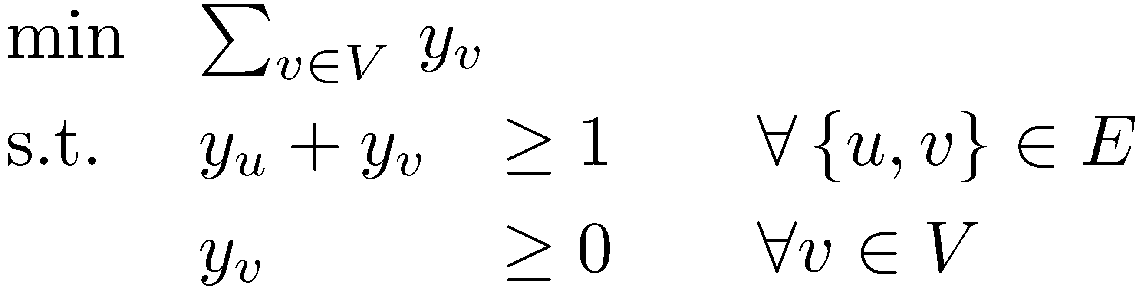
LPs for Bipartite Matching
Let G=(V, E) be a bipartite graph.
Recall our IP and LP formulations for maximum-size matching.
(IP)
(LP)
Theorem: Every BFS of (LP) is actually an (IP) solution.
What is the dual of (LP)?
(LP-Dual)

Slide 10
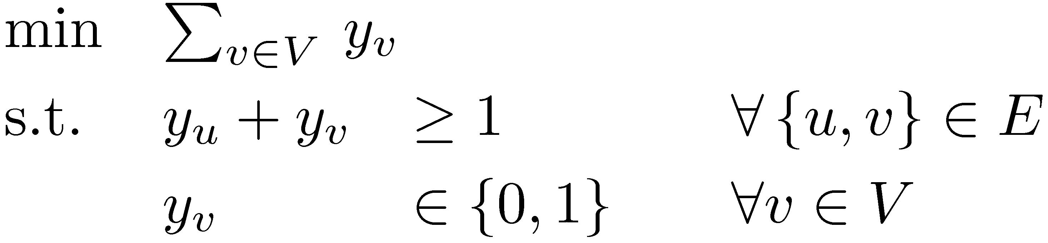
Dual of Bipartite Matching LP
What is the dual LP?
(LP-Dual)
Note that any optimal solution must satisfy y_{v} · 1 8v2V
Suppose we impose integrality constraints:
(IP-Dual)
Claim: If y is feasible for IP-dual then C = { v : y_{v}=1 } is a vertex cover. Furthermore, the objective value is |C|.
So IP-Dual is precisely the minimum vertex cover problem.
Theorem: Every optimal BFS of (LP-Dual) is an (IP-Dual) solution
(in the case of bipartite graphs).

Slide 11
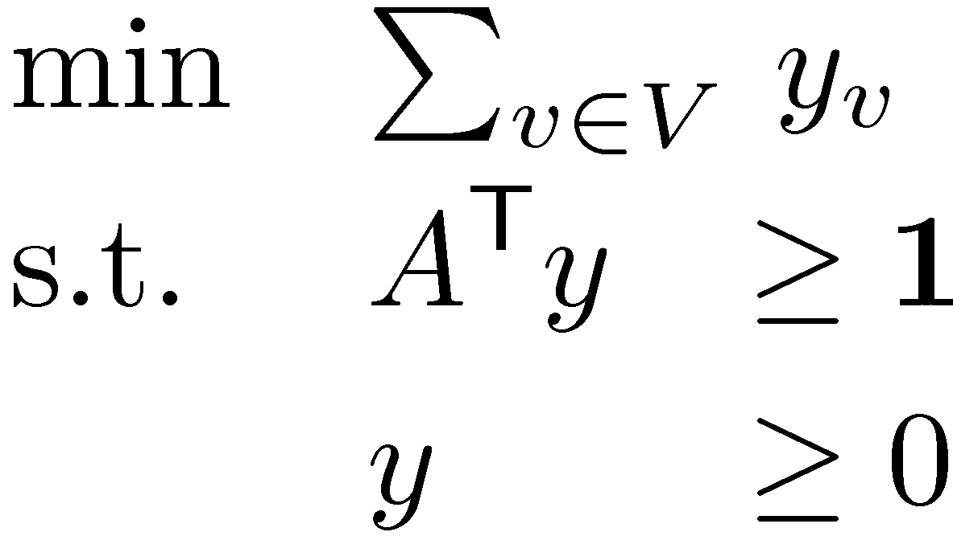
Let G=(U[V, E) be a bipartite graph. Define A by
Lemma: A is TUM.
Claim: If A is TUM then A^{T} is TUM.
Proof: Exercise?
Corollary: Every BFS of P = { x : A^{T} y¸1, y¸0 } is integral.
But LP-Dual is
So our Corollary implies every BFS of LP-dual is integral
Every optimal solution must have y_{v}·1 8v2V
) every optimal BFS has y_{v}2{0,1} 8v2V, and hence it is a feasible solution for IP-Dual. ¥
1 if vertex v is an endpoint of edge e
A_{v,e} =
0 otherwise
=

Slide 12
Proof of Konig’s Theorem
Theorem (Konig’s Theorem): If G is bipartite then there exists a matching M and a vertex cover C s.t. |M|=|C|.
Proof:
Let x be an optimal BFS for (LP).
Let y be an optimal BFS for (LP-Dual).
Let M = { e : x_{e}=1 }.
M is a matching with |M| = objective value of x. (By earlier theorem)
Let C = { v : y_{v} = 1 }.
C is a vertex cover with |C| = objective value of y. (By earlier theorem)
By Strong LP Duality:
|M| = LP optimal value = LP-Dual optimal value = |C|. ¥

Slide 13
Beyond Bipartite Graphs
Given a bipartite graph, we can efficiently find a minimum-size vertex cover. Just compute a BFS of
For non-bipartite graphs, this doesn’t work:
  Setting y_{a} = y_{b} = y_{c} = 0.5 gives a feasible solution to
  LP-Dual with objective value 1.5
  So optimal BFS has value · 1.5.
  But no vertex cover has size < 2.
(LP-Dual)
a
Maximum size of a matching = 1
Minimum size of a vertex cover = 2
b
c

Slide 14
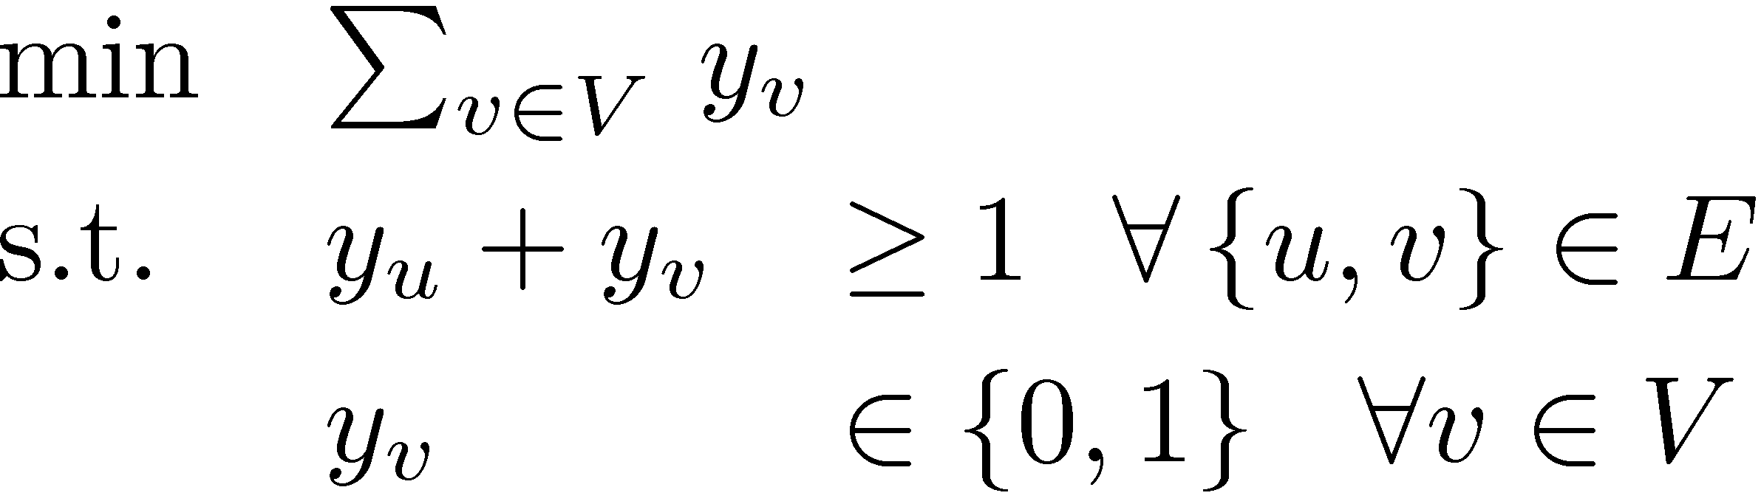
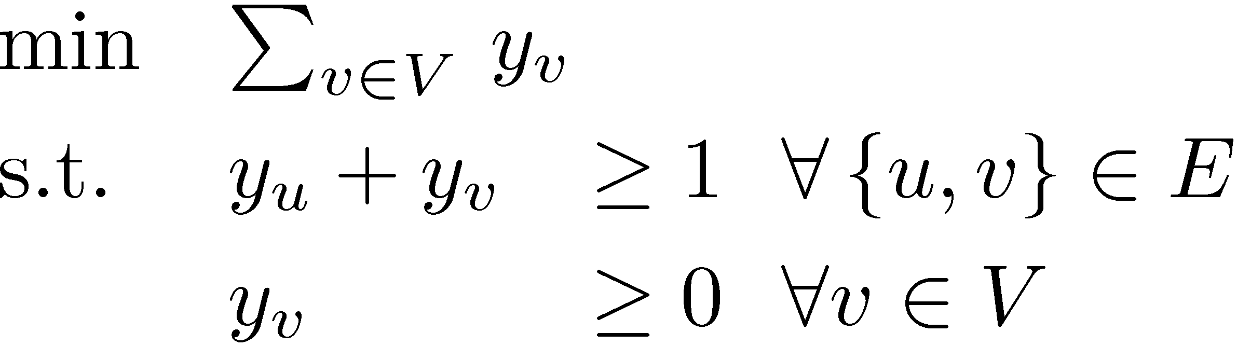
Beyond Bipartite Graphs
For non-bipartite graphs, this doesn’t work:
  Setting y_{a} = y_{b} = y_{c} = 0.5 gives a feasible solution to
  LP-Dual with objective value 1.5.
  So optimal BFS has value ·1.5. But no vertex cover has size < 2.
Key point: (IP) captures vertex cover problem,
but (LP) does not. We have no efficient way to solve (IP).
a
Maximum size of a matching = 1
Minimum size of a vertex cover = 2
b
c
(IP)
(LP)

Slide 15
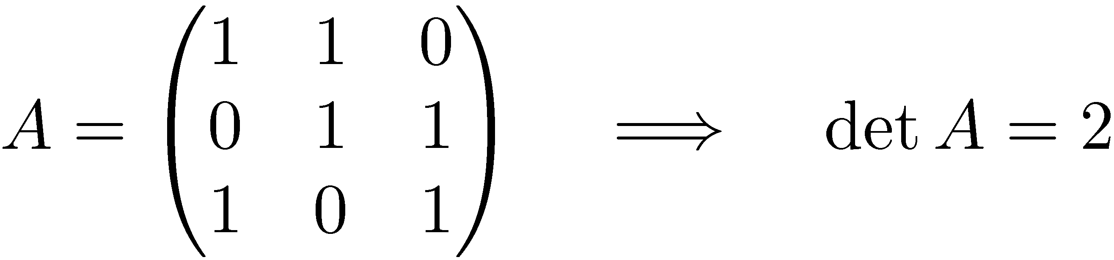
Beyond Bipartite Graphs
For non-bipartite graphs, this doesn’t work:
Key point: (IP) captures vertex cover problem,
but (LP) does not. We have no efficient way to solve (IP).
What’s the problem? The constraint matrix A is not
totally unimodular:
a
Maximum size of a matching = 1
Minimum size of a vertex cover = 2
b
c
(IP)
(LP)

Slide 16
Beyond Bipartite Graphs
For non-bipartite graphs, this doesn’t work:
  Setting y_{a} = y_{b} = y_{c} = 0.5 gives a feasible solution to
  LP-Dual with objective value 1.5.
  So optimal BFS has value ·1.5. But no vertex cover has size < 2.
Theorem: There is no efficient algorithm to find a
min size vertex cover in general graphs. (Assuming P≠NP)
Theorem: There is an efficient algorithm to find a vertex cover whose size is at most twice the minimum.
a
Maximum size of a matching = 1
Minimum size of a vertex cover = 2
b
c

Slide 17
Our Game Plan
Objective Value
0
LP Optimum
Min Vtx Cover
Our Vtx Cover
®
Solve the vtx cover LP:
Rounding: Extract Our Vtx Cover from
LP optimum solution
Prove that Our Vtx Cover is close to LP Optimum,
i.e. is as small as possible.
) Our Vtx Cover is close to Min Vtx Cover,
i.e.,
So Our Vtx Cover is within a factor ® of the minimum
Size of Our Vtx Cover
® =
LP Opt Value
Size of Our Vtx Cover
· ®
Size of Min Vtx Cover

Slide 18
Our Algorithm
Theorem: [Folklore]
There exists an algorithm to extract a
vertex cover from the LP optimum such that
Size of Vtx Cover
® =
· 2
Size of Min Vtx Cover
Astonishingly, this seems to be optimal:
Theorem: [Khot, Regev 2003]
No efficient algorithm can approximate the min vtx cover with factor better than 2, assuming a certain conjecture in complexity theory. (Similar to P≠NP)

Slide 19
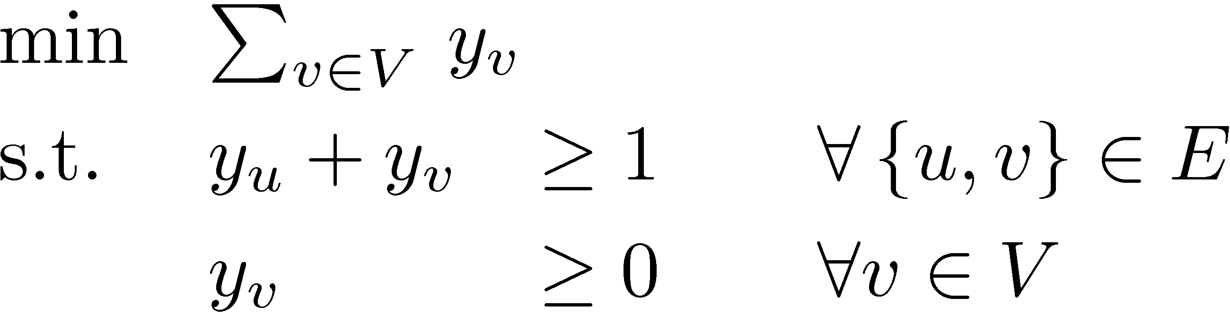
Our Algorithm
Solve the vertex cover LP
Return C = { v2V : y_{v}¸½ }
Claim 1: C is a vertex cover.
Claim 2: |C| is at most twice the size of the minimum vertex cover.

Slide 20
Our Algorithm
Solve the vertex cover LP
Return C = { v2V : y_{v}¸½ }
Claim 1: C is a vertex cover.
Proof: Consider any edge {u,v}.
Since y_{u} + y_{v} ¸ 1, either y_{u}¸½ or y_{v}¸½.
So either u2C or v2C. ¥

Slide 21
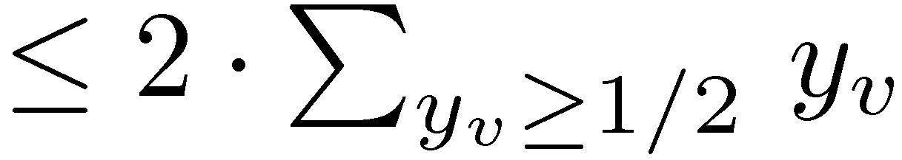
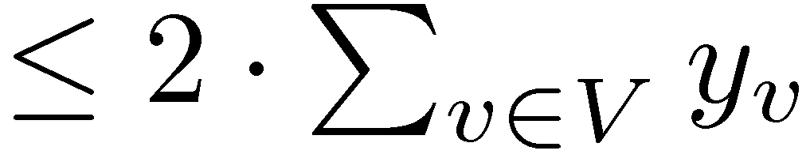
Our Algorithm
Solve the vertex cover LP
Return C = { v2V : y_{v}¸½ }
Claim 2: |C| · 2¢|minimum vertex cover|.
Proof: |C| = |{ v2V : y_{v}¸½ }|
¥
= 2 ¢ LP optimum value
· 2¢|minimum vertex cover|

Slide 22
Summary
Bipartite graphs
  Vertex cover problem is dual of matching problem
  Vertex Cover (IP) and (LP) are equivalent
  (by Total Unimodularity)
  Can efficiently find minimum vertex cover
Non-bipartite Graphs
  Vertex cover not related to matching problem
  Vertex Cover (IP) and (LP) are not equivalent
  Cannot efficiently find minimum vertex cover
  Can find a vertex cover of size at most twice minimum

