Slide 1
C&O 355 Mathematical Programming Fall 2010 Lecture 17
N. Harvey
TexPoint fonts used in EMF.
Read the TexPoint manual before you delete this box.: AAAAAAAAAA

Slide 2
Topics
Integer Programs
Computational Complexity Basics
What is Combinatorial Optimization?
Bipartite Matching
Combinatorial Analysis of Extreme Points
Total Unimodularity

Slide 3
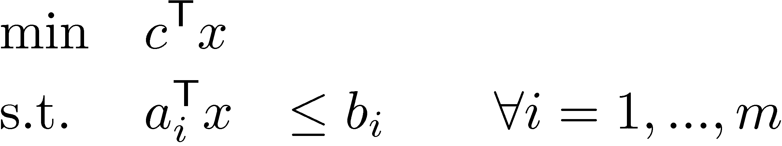
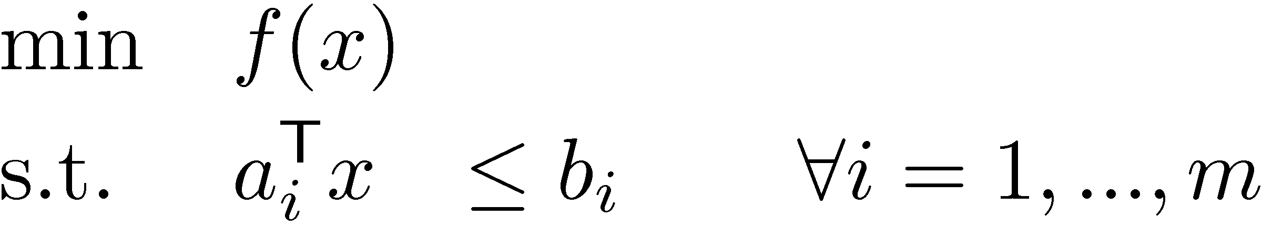
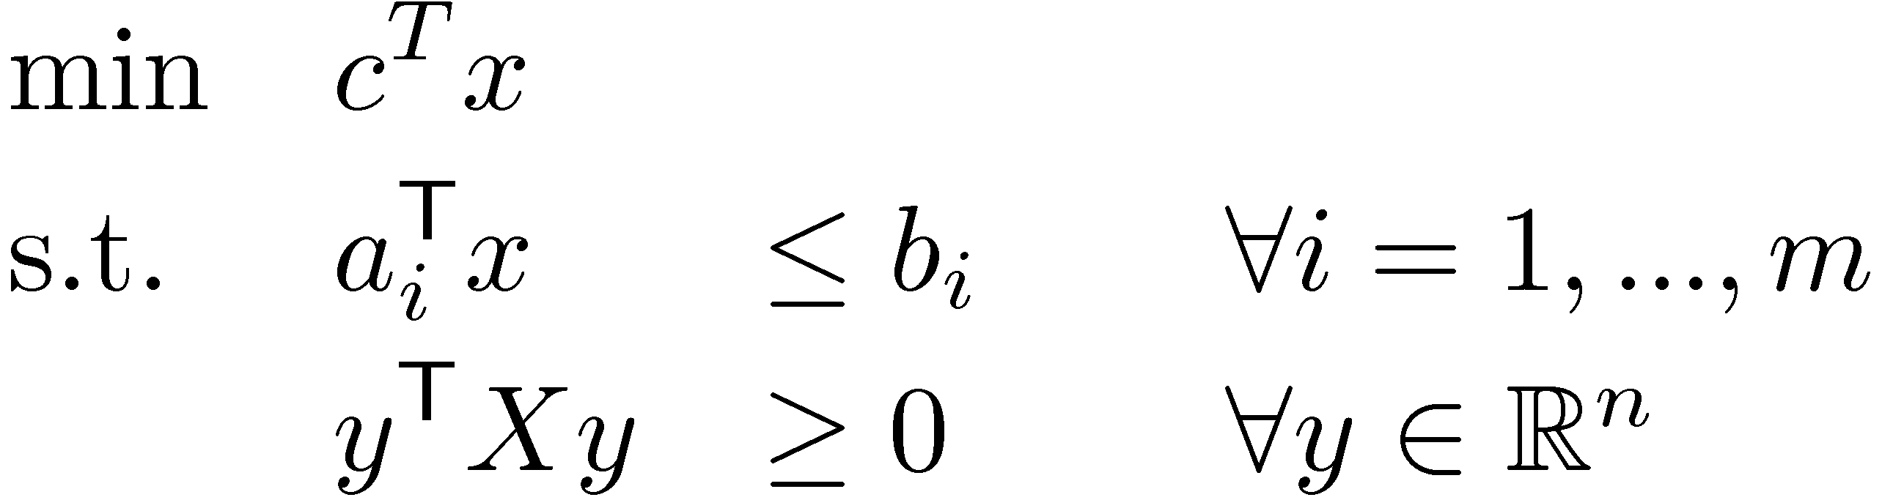
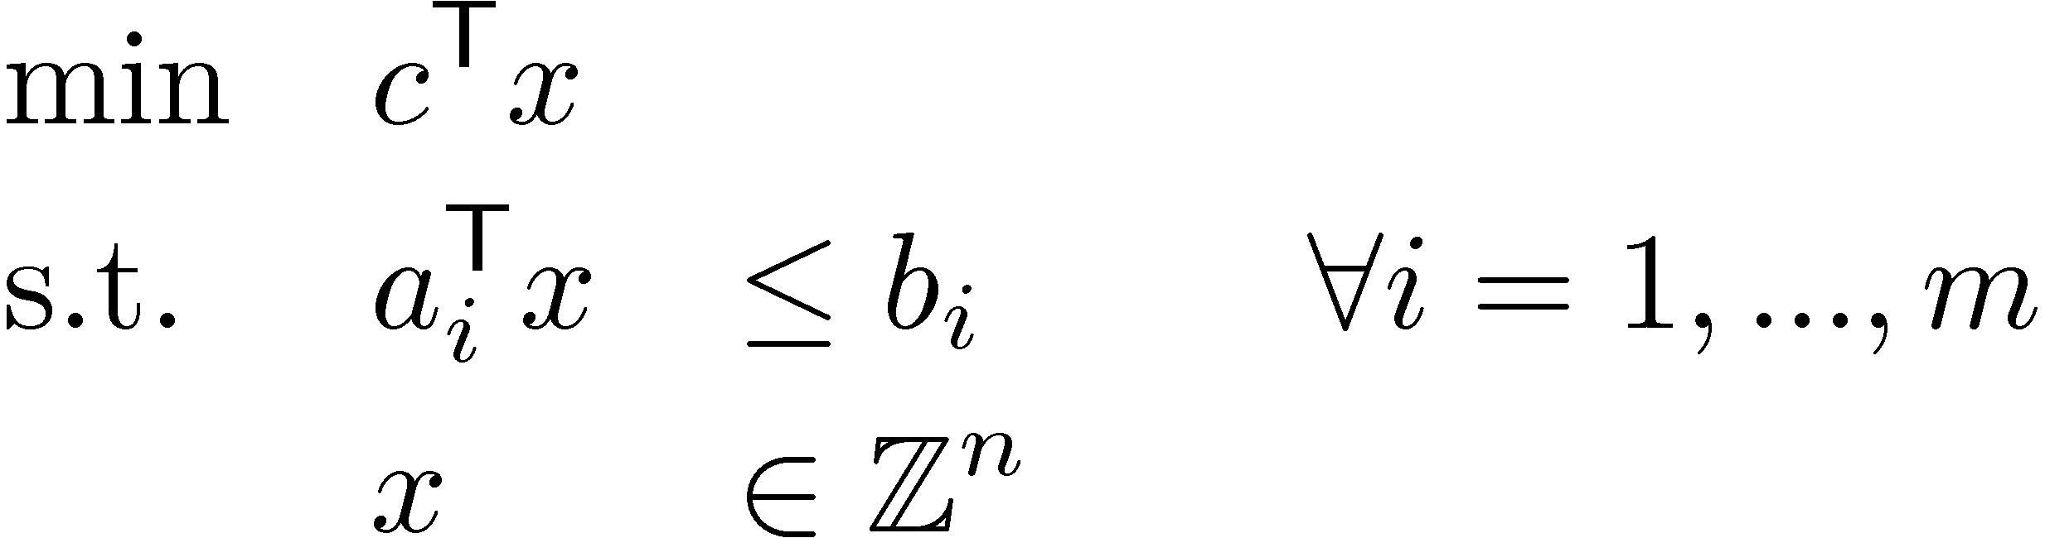
Mathematical Programs We’ve Seen
Linear Program (LP)
Convex Program
Semidefinite Program (SDP)
Integer Program (IP)
(where f is convex)
Can be efficiently solved e.g., by Ellipsoid Method
(where X is symmetric matrix corresponding to x )
Cannot be efficiently solved assuming P ≠ NP

Slide 4
Computational Complexity
NP
coNP
Can graph be colored with · k colors?
Does every coloring of graph use > k colors?
NPÅcoNP
Is integer program feasible?
Is integer program infeasible?
P
Sorting, string matching, breadth-first search, …
Is LP feasible?
If you could efficiently (i.e., in polynomial time) decide if every integer program is feasible, then P = NP
And all of modern cryptography is broken
And you win $1,000,000
…

Slide 5
Combinatorial Optimization
Study of optimization problems that have discrete solutions and some combinatorial flavor (e.g., involving graphs)
Why are we interested in this?
Applications: OR (planning, scheduling, supply chain), Computer networks (shortest paths, low-cost trees), Compilers (coloring), Online advertising (matching)...
Rich theory of what can be solved efficiently and what cannot
Underlying math can be very interesting: high-dimensional geometry, polyhedra, discrete probability, Banach space theory, Fourier analysis, ...

Slide 6
Combinatorial IPs are often nice
Maximum Bipartite Matching (from Lecture 2)
Given bipartite graph G=(V, E)
Find a maximum size matching
A set M µ E s.t. every vertex has at most one incident edge in M

Slide 7
Combinatorial IPs are often nice
Maximum Bipartite Matching (from Lecture 2)
Given bipartite graph G=(V, E)
Find a maximum size matching
A set M µ E s.t. every vertex has at most one incident edge in M
The blue edges are a matching M

Slide 8
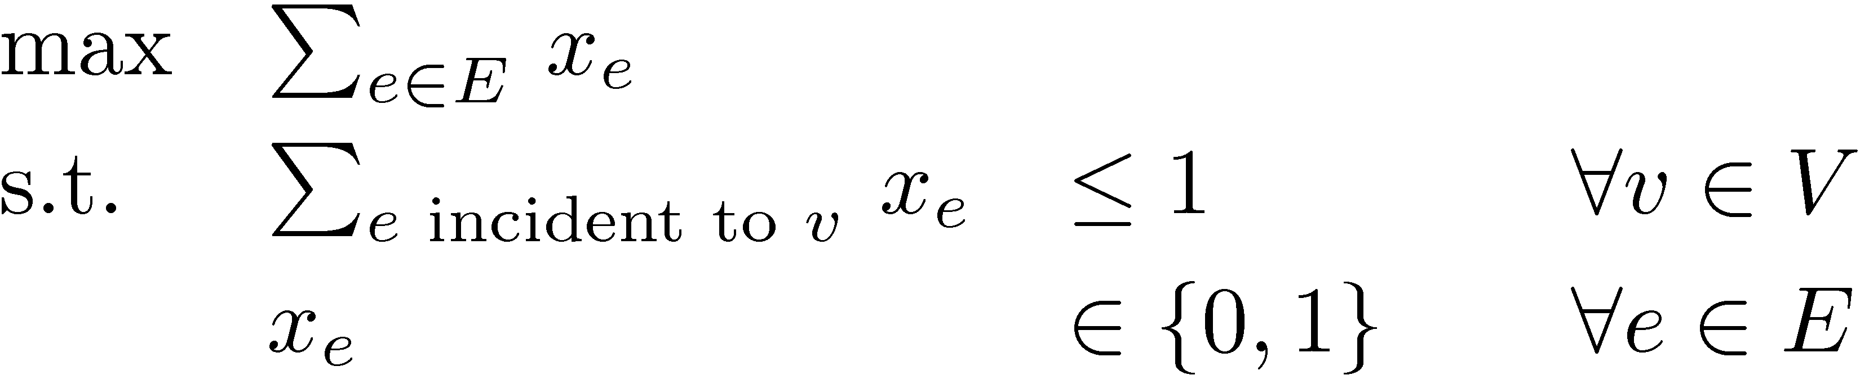
Combinatorial IPs are often nice
Maximum Bipartite Matching (from Lecture 2)
Given bipartite graph G=(V, E)
Find a maximum size matching
A set M µ E s.t. every vertex has at most one incident edge in M
The natural integer program
This IP can be efficiently solved, in many different ways

Slide 9
Combinatorial IPs are often nice
Max-Weight Perfect Matching
Given bipartite graph G=(V, E). Every edge e has a weight w_{e}.
Find a maximum-weight perfect matching
A set M µ E s.t. every vertex has exactly one incident edge in M
3
1
2
4
2
5
2
1

Slide 10
Combinatorial IPs are often nice
Max-Weight Perfect Matching
Given bipartite graph G=(V, E). Every edge e has a weight w_{e}.
Find a maximum-weight perfect matching
A set M µ E s.t. every vertex has exactly one incident edge in M
3
1
2
The blue edges are a max-weight perfect matching M
4
2
5
2
1

Slide 11
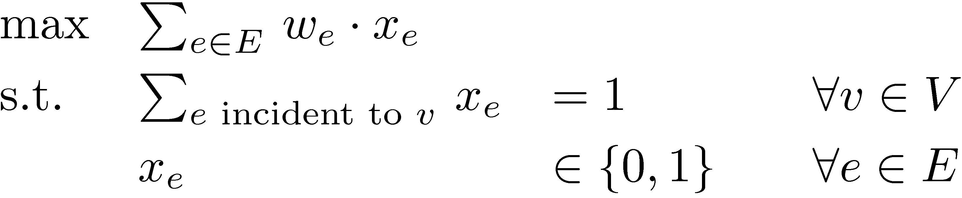
Combinatorial IPs are often nice
Max-Weight Perfect Matching
Given bipartite graph G=(V, E). Every edge e has a weight w_{e}.
Find a maximum-weight perfect matching
A set M µ E s.t. every vertex has exactly one incident edge in M
The natural integer program
This IP can be efficiently solved, in many different ways

Slide 12
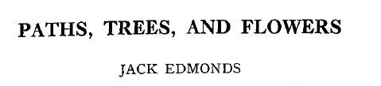
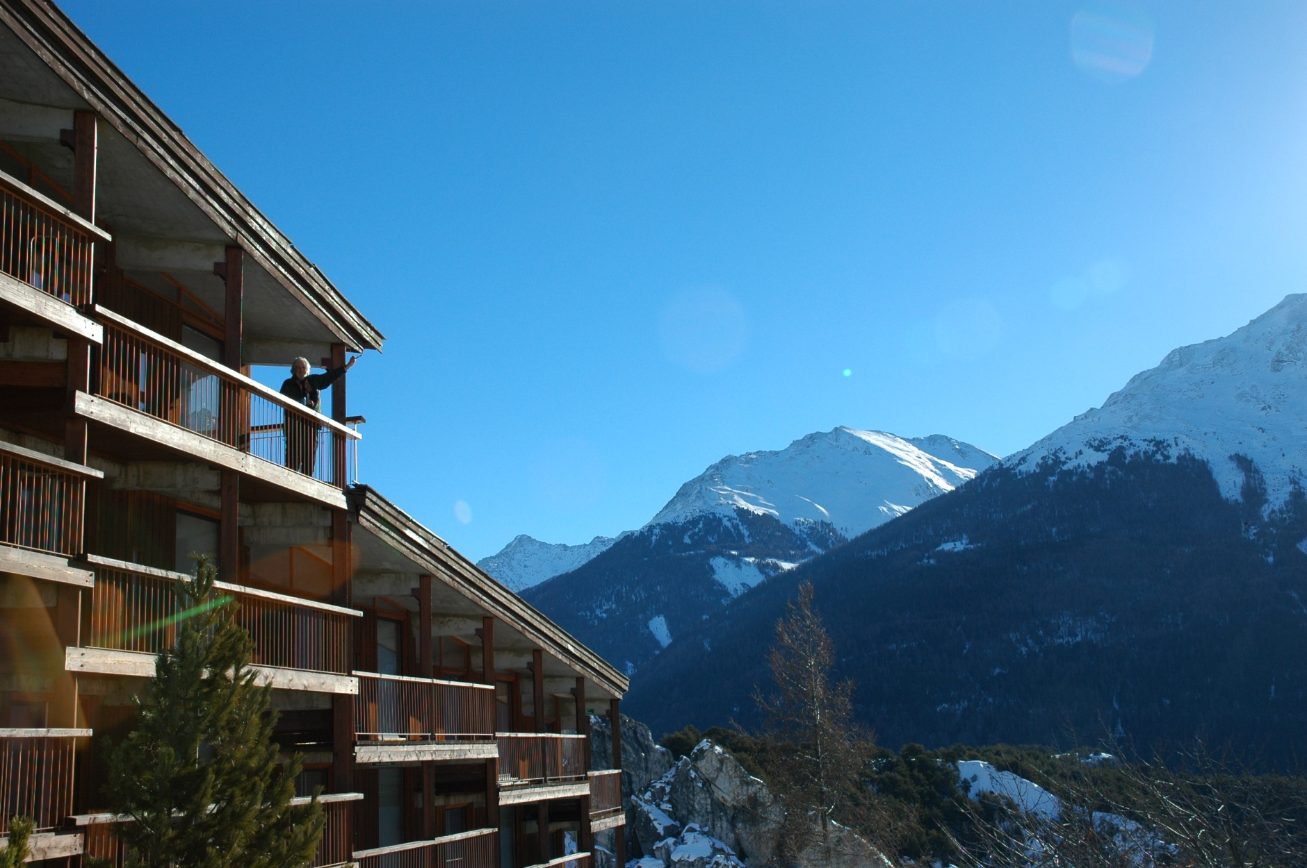
Birth of Computational Complexity
2008, Aussois, France
1965

Slide 13
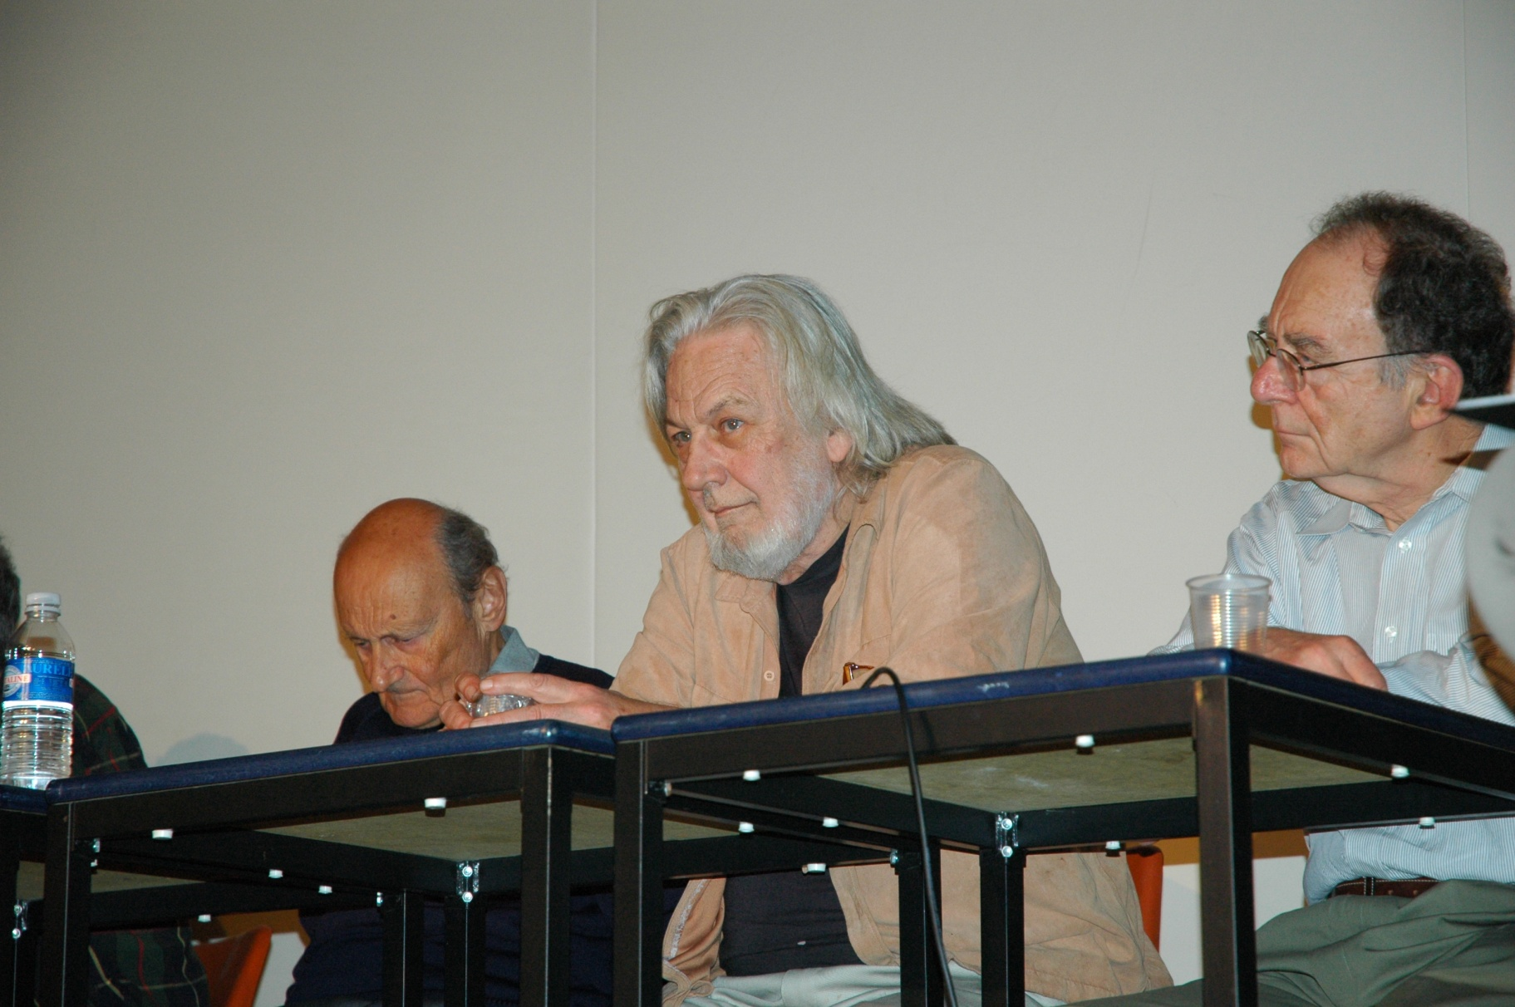
Birth of Computational Complexity
1965
Richard Karp
2008, Aussois, France

Slide 14
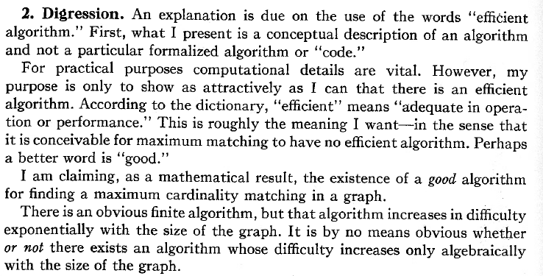
Birth of Computational Complexity
Efficient algorithm for matching, even in non-bipartite graphs
This means “polynomial time”. So Edmonds is defining the complexity class P.

Slide 15
How to solve combinatorial IPs?
Two common approaches
Design combinatorial algorithm that directly solves IP
Often such algorithms have a nice LP interpretation
Relax IP to an LP; prove that they give same solution; solve LP by the ellipsoid method
Need to show special structure of the LP’s extreme points
Sometimes we can analyze the extreme points combinatorially
Sometimes we can use algebraic structure of the constraints. For example, if constraint matrix is Totally Unimodular then IP and LP are equivalent
We’ll see examples of these approaches

Slide 16
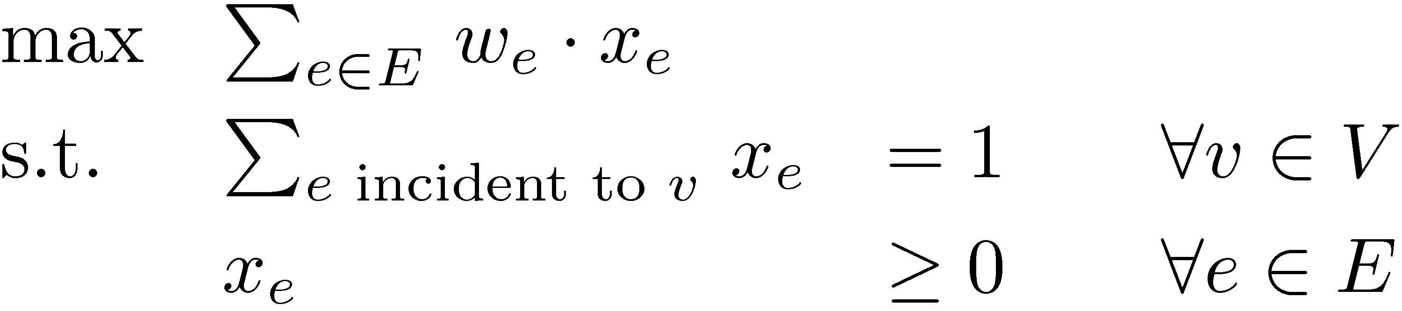
Perfect Matching Problem
Let G=(V, E) be a bipartite graph. Every edge e has a weight w_{e}.
Find a maximum-weight, perfect matching
A set MµE s.t. every vertex has exactly one incident edge in M
Write an integer program
(IP)
Relax integrality constraints, obtain an LP
(LP)
(x_{e}·1 is implicit)
c
Theorem: Every BFS of (LP) is actually an (IP) solution!

Slide 17
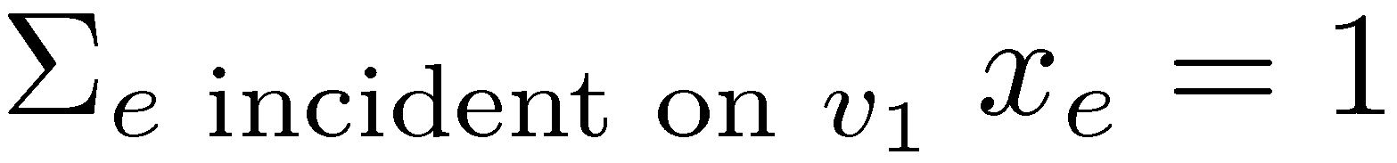

Combinatorial Analysis of BFSs
Lemma: Every BFS of perfect matching (LP) is an (IP) solution.
Proof: Let x be BFS, suppose x not integral.
Pick any edge e₁={v₀,v₁} with 0 < x_{e1} < 1.
The LP requires ) there is another edge e₂={v₁,v₂} with 0 < x_{e2} < 1.
The LP requires ) there is another edge e₃={v₂,v₃} with 0 < x_{e3} < 1.
Continue finding distinct edges until eventually v_{i}=v_{k}, i<k
We have e_{i+1}={v_{i},v_{i+1}}, e_{i+2}={v_{i+1},v_{i+2}}, …, e_{k}={v_{k-1},v_{k}}. (all edges and vertices distinct, except v_{i}=v_{k})

Slide 18
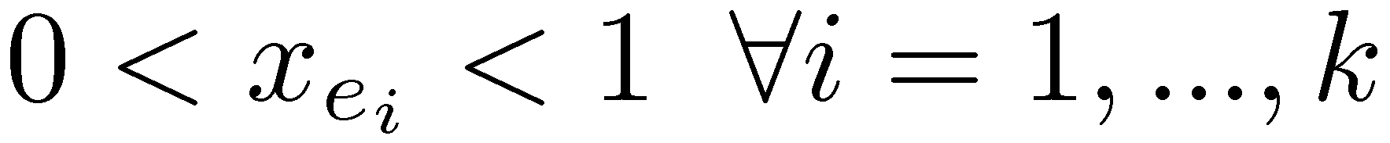
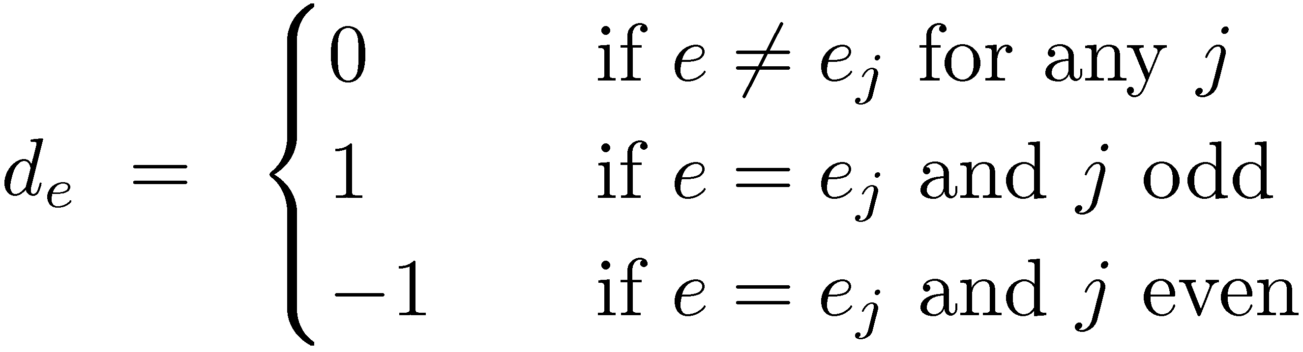
Combinatorial Analysis of BFSs
Let x be BFS of matching (LP). Suppose x not integral.
WLOG, e₁={v₀,v₁}, e₂={v₁,v₂}, …, e_{k}={v_{k-1},v_{k}} and v₀=v_{k}.
These edges form a simple cycle, of even length.
(Even length since G is bipartite.)
Define the vector:
Claim: If |²| is sufficiently small, then x+²d is feasible
So x is convex combination of x+²d and x-²d, both feasible
This contradicts x being a BFS. ¥

Slide 19

How to solve combinatorial IPs?
Two common approaches
Design combinatorial algorithm that directly solves IP
Often such algorithms have a nice LP interpretation
Relax IP to an LP; prove that they give same solution; solve LP by the ellipsoid method
Need to show special structure of the LP’s extreme points
Sometimes we can analyze the extreme points combinatorially
Sometimes we can use algebraic structure of the constraints. For example, if constraint matrix is Totally Unimodular then IP and LP are equivalent

Slide 20


LP Approach for Bipartite Matching
Let G=(V, E) be a bipartite graph. Every edge e has a weight w_{e}.
Find a maximum weight matching
A set M µ E s.t. every vertex has at most one incident edge in M
Write an integer program
(IP)
Relax integrality constraints, obtain an LP
(LP)
(x_{e}·1 is implicit)
c
Theorem: Every BFS of (LP) is actually an (IP) solution!

Slide 21
Total Unimodularity
Let A be a real mxn matrix
Definition: Suppose that every square submatrix of A has determinant in {0, +1, -1}. Then A is totally unimodular (TUM).
In particular, every entry of A must be in {0, +1, -1}
Lemma: Suppose A is TUM. Let b be any integer vector. Then every basic feasible solution of P = { x : Ax·b } is integral.
Proof: Let x be a basic feasible solution.
Then the constraints that are tight at x have rank n.
Let A’ be a submatrix of A and b’ a subvector of b corresponding to n linearly independent constraints that are tight at x.
Then x is the unique solution to A’ x = b’, i.e., x = (A’)⁻¹ b’.
Cramer’s Rule: If M is a square, non-singular matrix then (M⁻¹)_{i,j} = (-1)^{i+j} det M_{del(j,i)} / det M.
Submatrix of M obtained by deleting row j and column i

Slide 22
Total Unimodularity
Let A be a real mxn matrix
Definition: Suppose that every square submatrix of A has determinant in {0, +1, -1}. Then A is totally unimodular (TUM).
Lemma: Suppose A is TUM. Let b be any integer vector. Then every basic feasible solution of P = { x : Ax·b } is integral.
Proof: Let x be a basic feasible solution.
Then the constraints that are tight at x have rank n.
Let A’ be the submatrix of A and b’ the subvector of b containing n linearly independent constraints that are tight at x.
Then x is the unique solution to A’ x = b’, i.e., x = (A’)⁻¹ b’.
Cramer’s Rule: If M is a square, non-singular matrix then (M⁻¹)_{i,j} = (-1)^{i+j} det M_{del(j,i)} / det M.
Thus all entries of (A’)⁻¹ are in {0, +1, -1}.
Since b’ is integral, x is also integral. ¥

Slide 23
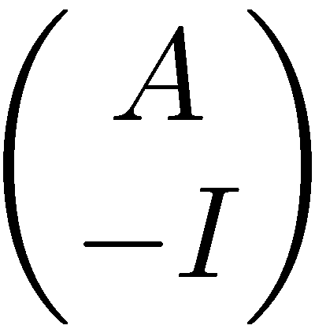
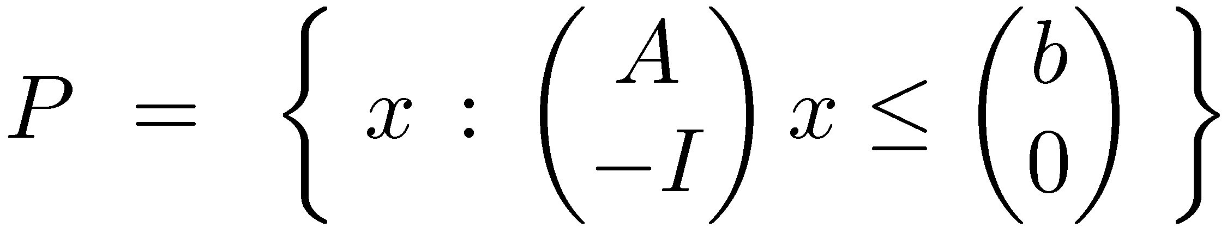
Operations Preserving Total Unimodularity
Let A be a real mxn matrix
Definition: Suppose that every square submatrix of A has determinant in {0, +1, -1}. Then A is totally unimodular (TUM).
Lemma: Suppose A is TUM. Let b be any integer vector. Then every basic feasible solution of P = { x : Ax·b } is integral.
Claim: Suppose A is TUM. Then is also TUM.
Proof: Exercise? ¤
Corollary: Suppose A is TUM. Let b be any integer vector. Then every basic feasible solution of P = { x : Ax·b, x¸0 } is integral.
Proof: By the Claim, is TUM. So apply the Lemma to
. ¥

Slide 24
Bipartite Matching & Total Unimodularity
Let G=(U[V, E) be a bipartite graph.
So all edges have one endpoint in U and the other in V.
Let A be the “incidence matrix” of G. A has a row for every vertex and a column for every edge.
Note: Every column of A has exactly two non-zero entries.
Lemma: A is TUM.
Proof: Let Q be a kxk submatrix of A. Argue by induction on k.
If k=1 then Q is a single entry of A, so det(Q) is either 0 or 1.
Suppose k>1.
If some column of Q has no non-zero entries, then det(Q)=0.
1 if vertex w is an endpoint of edge e
A_{w,e} =
0 otherwise

Slide 25
Let G=(U[V, E) be a bipartite graph. Define A by
Lemma: A is TUM.
Proof: Let Q be a kxk submatrix of A. Assume k>1.
If some column of Q has no non-zero entries, then det(Q)=0.
Suppose j^{th} column of Q has exactly one non-zero entry, say Q_{t,j} ≠0
Use “Column Expansion” of determinant:
,
where t is the unique non-zero entry in column j.
By induction, det Q_{del(t,j)} in {0,+1,-1} ) det Q in {0,+1,-1}.
1 if vertex v is an endpoint of edge e
A_{v,e} =
0 otherwise

Slide 26
Let G=(U[V, E) be a bipartite graph. Define A by
Lemma: A is TUM.
Proof: Let Q be a kxk submatrix of A. Assume k>1.
If some column of Q has no non-zero entries, then det(Q)=0.
If j^{th} column of Q has exactly one non-zero entry, use induction.
Suppose every column of Q has exactly two non-zero entries.
For each column, one non-zero is in a U-row and the other is in a V-row.
So summing all U-rows in Q gives the vector [1,1,…,1].
Also summing all V-rows in Q gives the vector [1,1,…,1].
So (sum of U-rows) – (sum of V-rows) = [0,0,…,0].
Thus Q is singular, and det Q = 0. ¥
1 if vertex v is an endpoint of edge e
A_{v,e} =
0 otherwise

Slide 27
Let G=(U[V, E) be a bipartite graph. Define A by
Lemma: A is TUM.
So every BFS of P = { x : Ax·1, x¸0 } is integral.
We can rewrite the LP max { w^{T}x : x2P } as
For every objective function w, this LP has an optimal solution at a BFS. (Since P is bounded)
So for every vector w, the LP has an integral optimal solution x.
Since 0·x_{e}·1, and x is integral, we actually have x_{e} 2 {0,1}.
So every optimal LP solution is actually an (optimal) IP solution. ) So we can solve the IP by solving the LP and returning a BFS.
1 if vertex v is an endpoint of edge e
A_{v,e} =
0 otherwise
(x_{e}·1 is implicit)

Slide 28
How to solve combinatorial IPs?
Two common approaches
Design combinatorial algorithm that directly solves IP
Often such algorithms have a nice LP interpretation
Relax IP to an LP; prove that they give same solution; solve LP by the ellipsoid method
Need to show special structure of the LP’s extreme points
Sometimes we can analyze the extreme points combinatorially
Sometimes we can use algebraic structure of the constraints. For example, if constraint matrix is Totally Unimodular then IP and LP are equivalent

