Slide 1
C&O 355
Mathematical Programming
Fall 2010
Lecture 16
N. Harvey
TexPoint fonts used in EMF.
Read the TexPoint manual before you delete this box.: AAAAAAAAAA

Slide 2
Topics
Semidefinite Programs (SDP)
Vector Programs (VP)
Quadratic Integer Programs (QIP)
QIP & SDP for Max Cut
Finding a cut from the SDP solution
Analyzing the cut

Slide 3
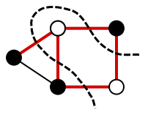
The Max Cut Problem
Our first foray into combinatorial optimization
Let G=(V,E) be a graph with n vertices.
For U µ V, let ±(U) = { {u,v} : u2U, v∉U }
Find a set U µ V such that |±(U)| is maximized.
This is a computationally hard problem:
it cannot be solved exactly. (Unless P = NP)
Our only hope: find a nearly-optimal solution,
i.e., a big cut that might not be maximum.
Philosophy: How can our powerful continuous optimization tools help to solve combinatorial problems?
U
U

Slide 4
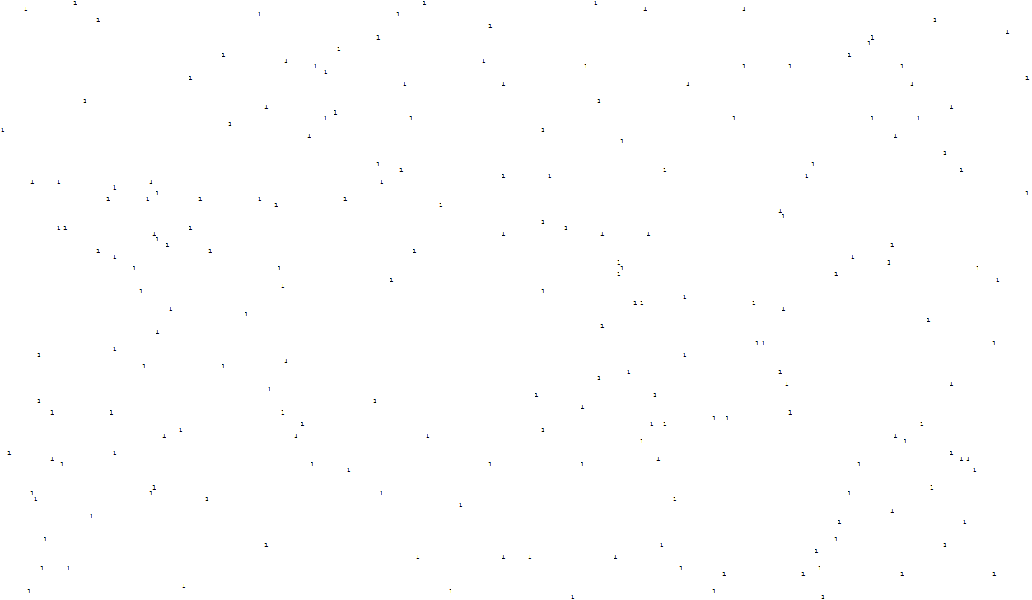
My Example Data
Here is (a portion of) the adjacency matrix of a graph with
750 vertices, 3604 edges
Probably cannot find the max cut before the end of the universe
Can we find a big cut in this example?

Slide 5
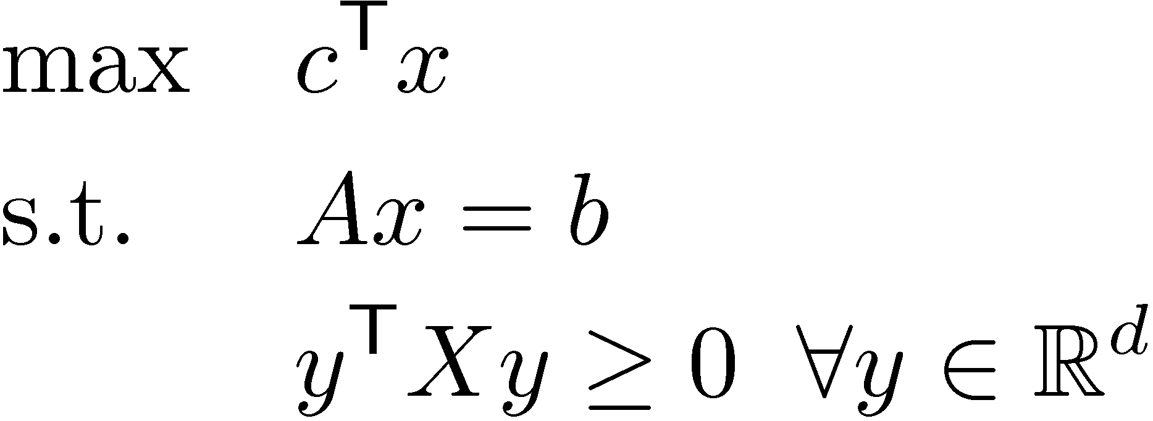
Semidefinite Programs
Where
  x2R^{n} is a vector and n = d(d+1)/2
  A is a mxn matrix, c2R^{n} and b2R^{m}
  X is a dxd symmetric matrix,
  and x is the vector corresponding to X.
There are infinitely many constraints!

Slide 6
Vectorizing a Matrix
A dxd matrix can be viewed as a vector in R^{d2}.
(Just write down the entries in some order.)
A dxd symmetric matrix can be viewed as a vector in R^{d(d+1)/2}.
Our notation: X is a dxd symmetric matrix,
and x is the corresponding vector.
1
2
3
4
1 | 2
3 | 4
1
2
4
X =
1 | 2
2 | 4
x =

Slide 7
PSD matrices ´ Vectors in R^{d}
Key Observation: PSD matrices correspond directly to vectors and their dot-products.
→: Given vectors v₁,…,v_{d} in R^{d},
let V be the dxd matrix whose i^{th} column is v_{i}.
Let X = V^{T}V. Then X is PSD and X_{i,j} = v_{i}^{T}v_{j} 8i,j.
←: Given a dxd PSD matrix X, find spectral decomposition X = U D U^{T}, and let V = D^{1/2} U.
To get vectors in R^{d}, let v_{i} = i^{th} column of V.
Then X = V^{T} V ) X_{i,j} = v_{i}^{T}v_{j} 8i,j.

Slide 8
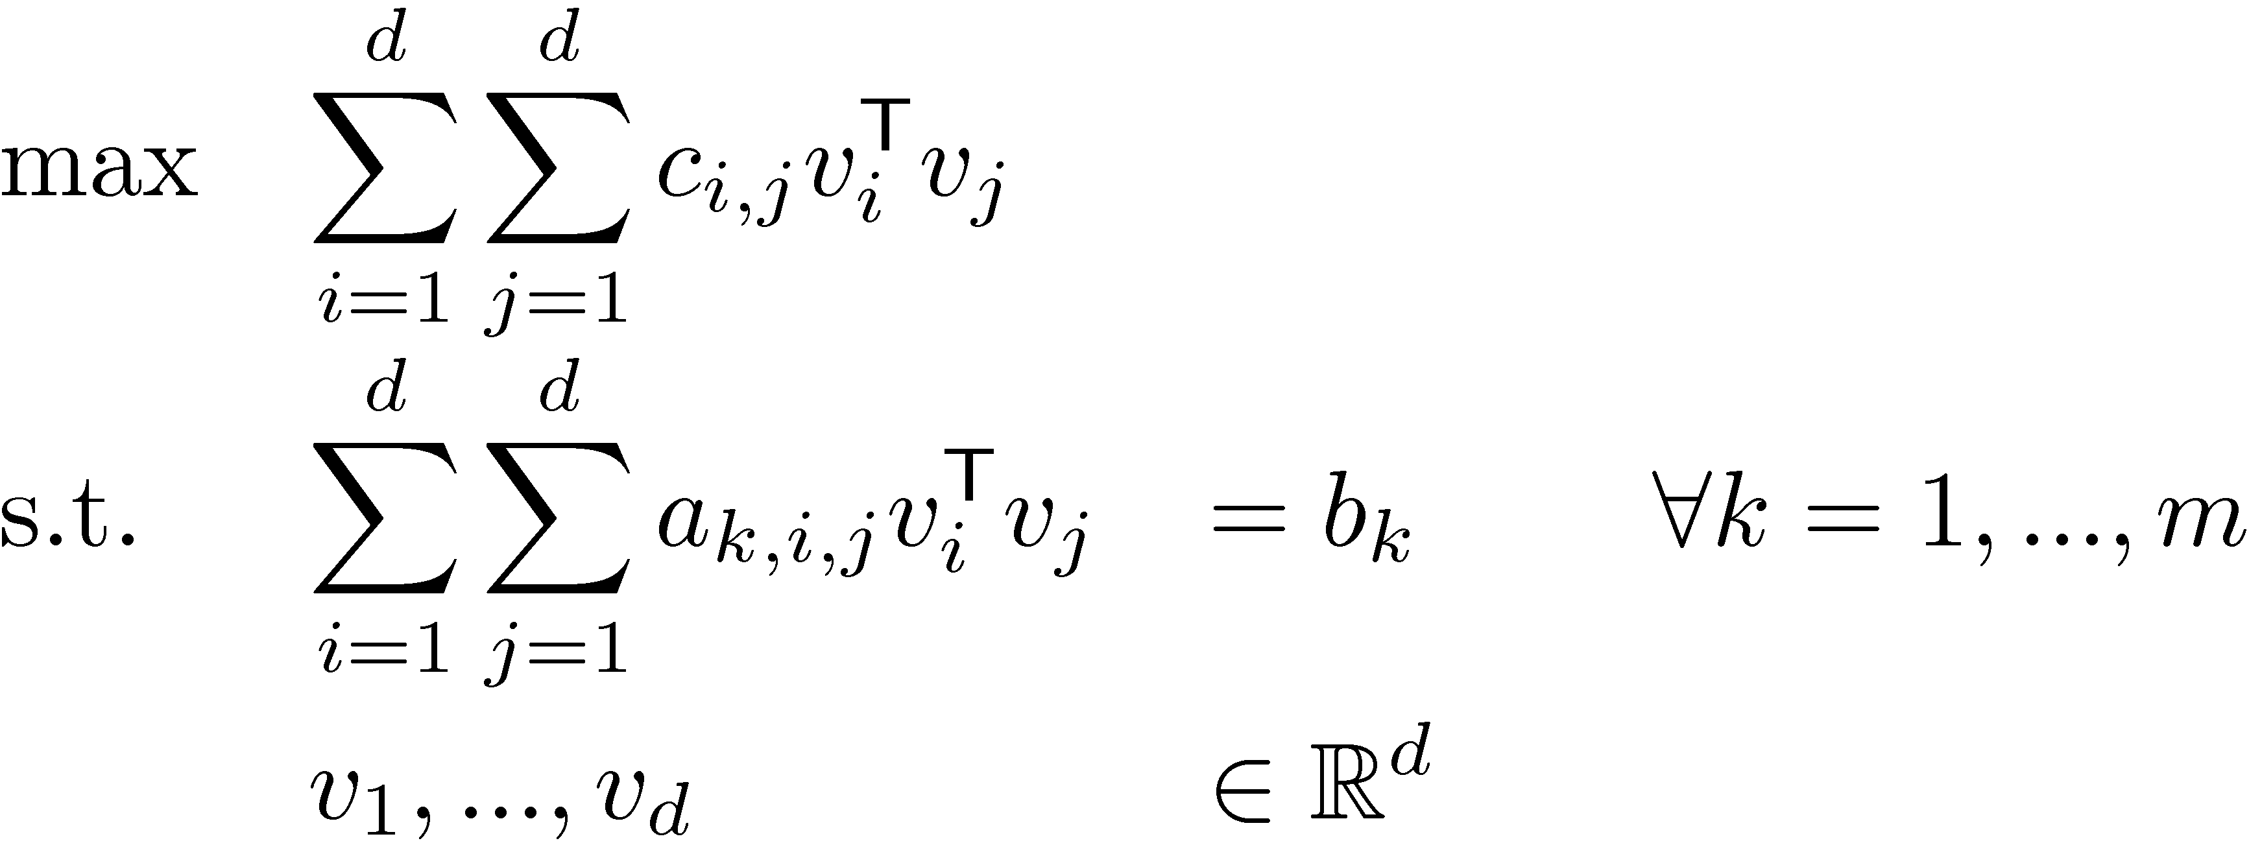
Vector Programs
A Semidefinite Program:
Equivalent definition as “vector program”

Slide 9
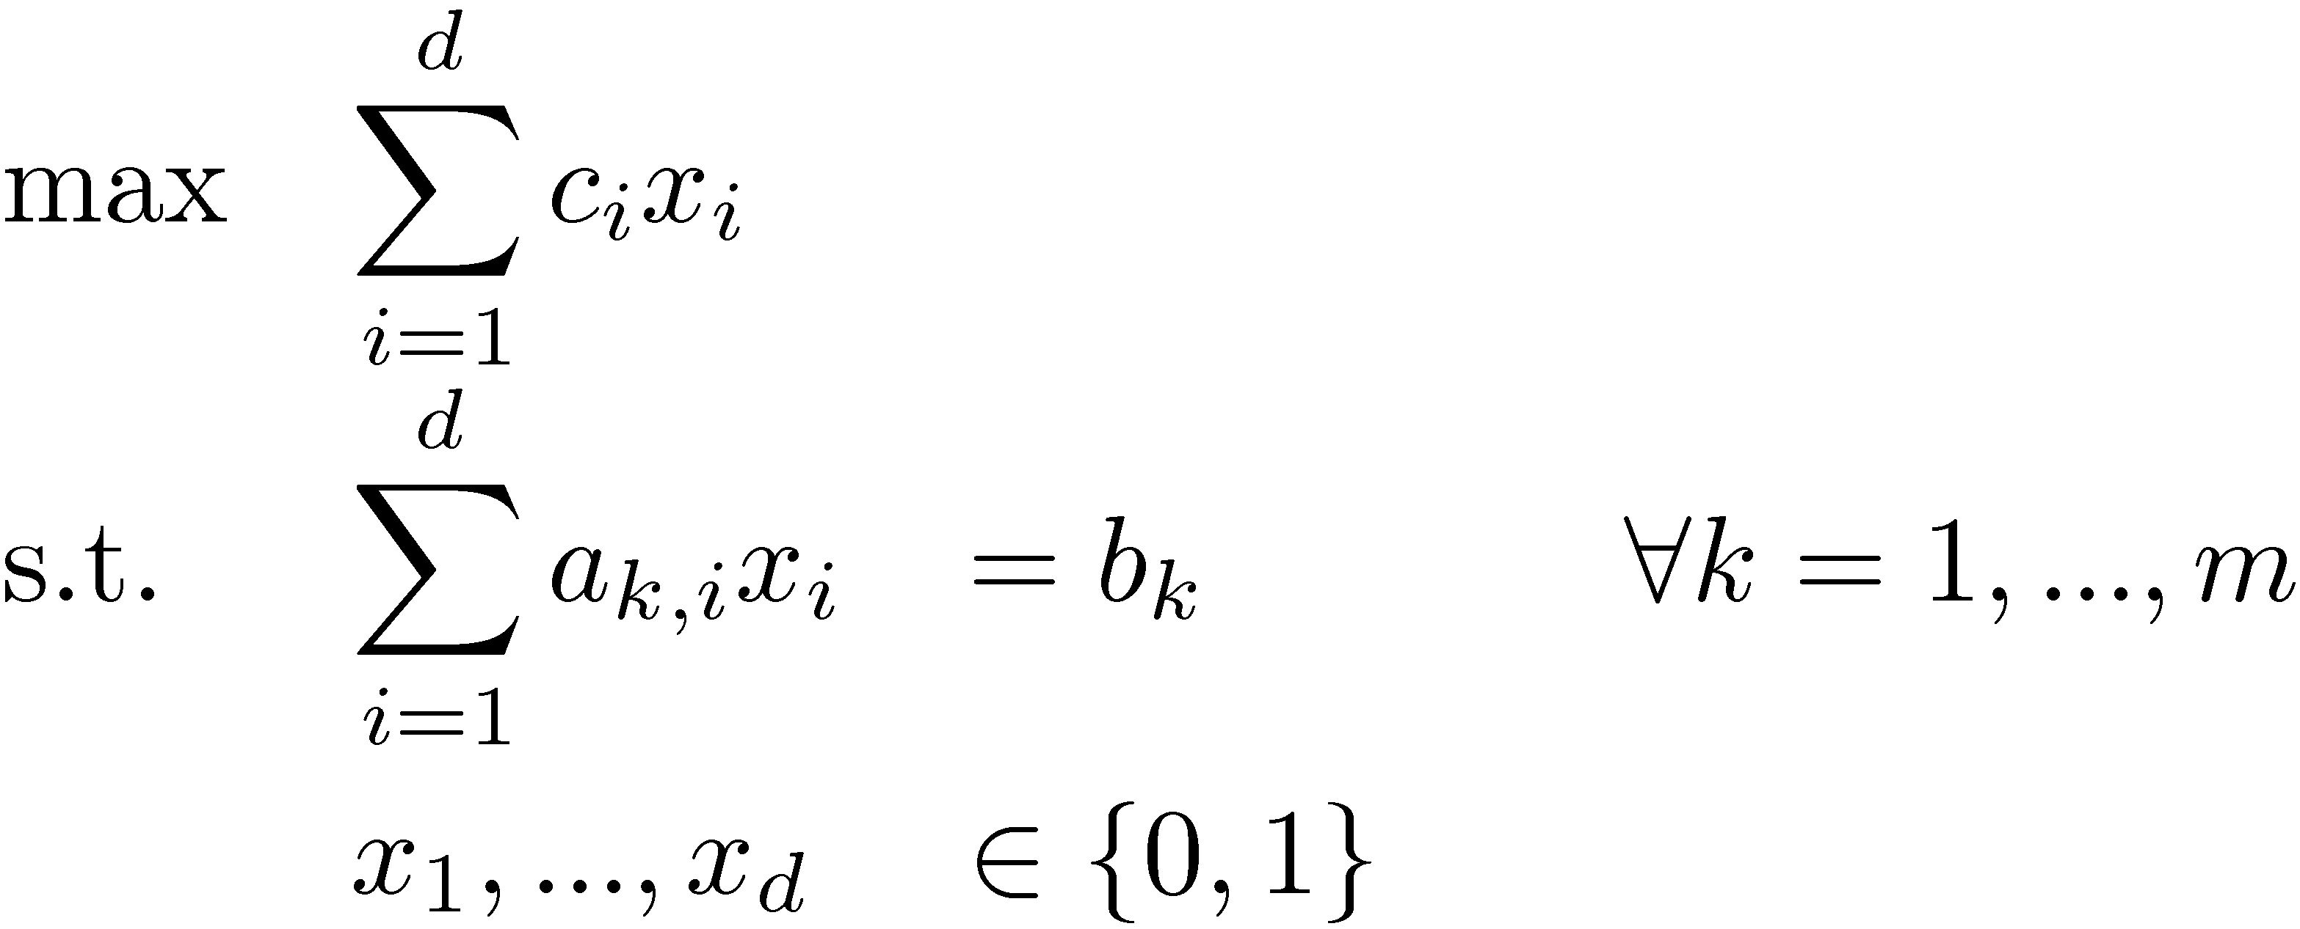
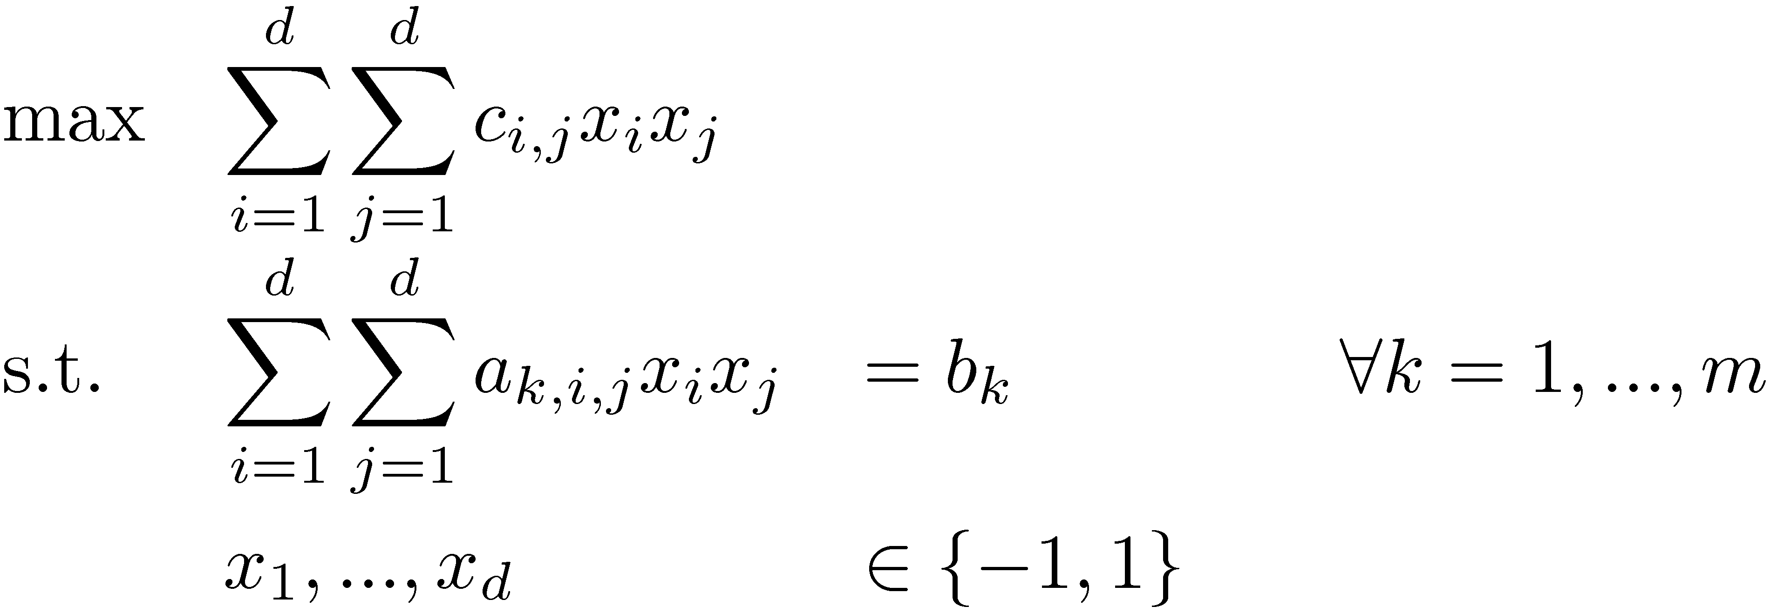
Integer Programs
Our usual Integer Program
Quadratic Integer Program
There are no efficient, general-purpose algorithms for solving IPs, assuming P≠NP.
Let’s make things even harder:
Quadratic Objective Function & Quadratic Constraints!
Could also use {0,1} here.
{-1,1} is more convenient.
Notes:
Note QIP != Quantum Interactive Proof!

Slide 10
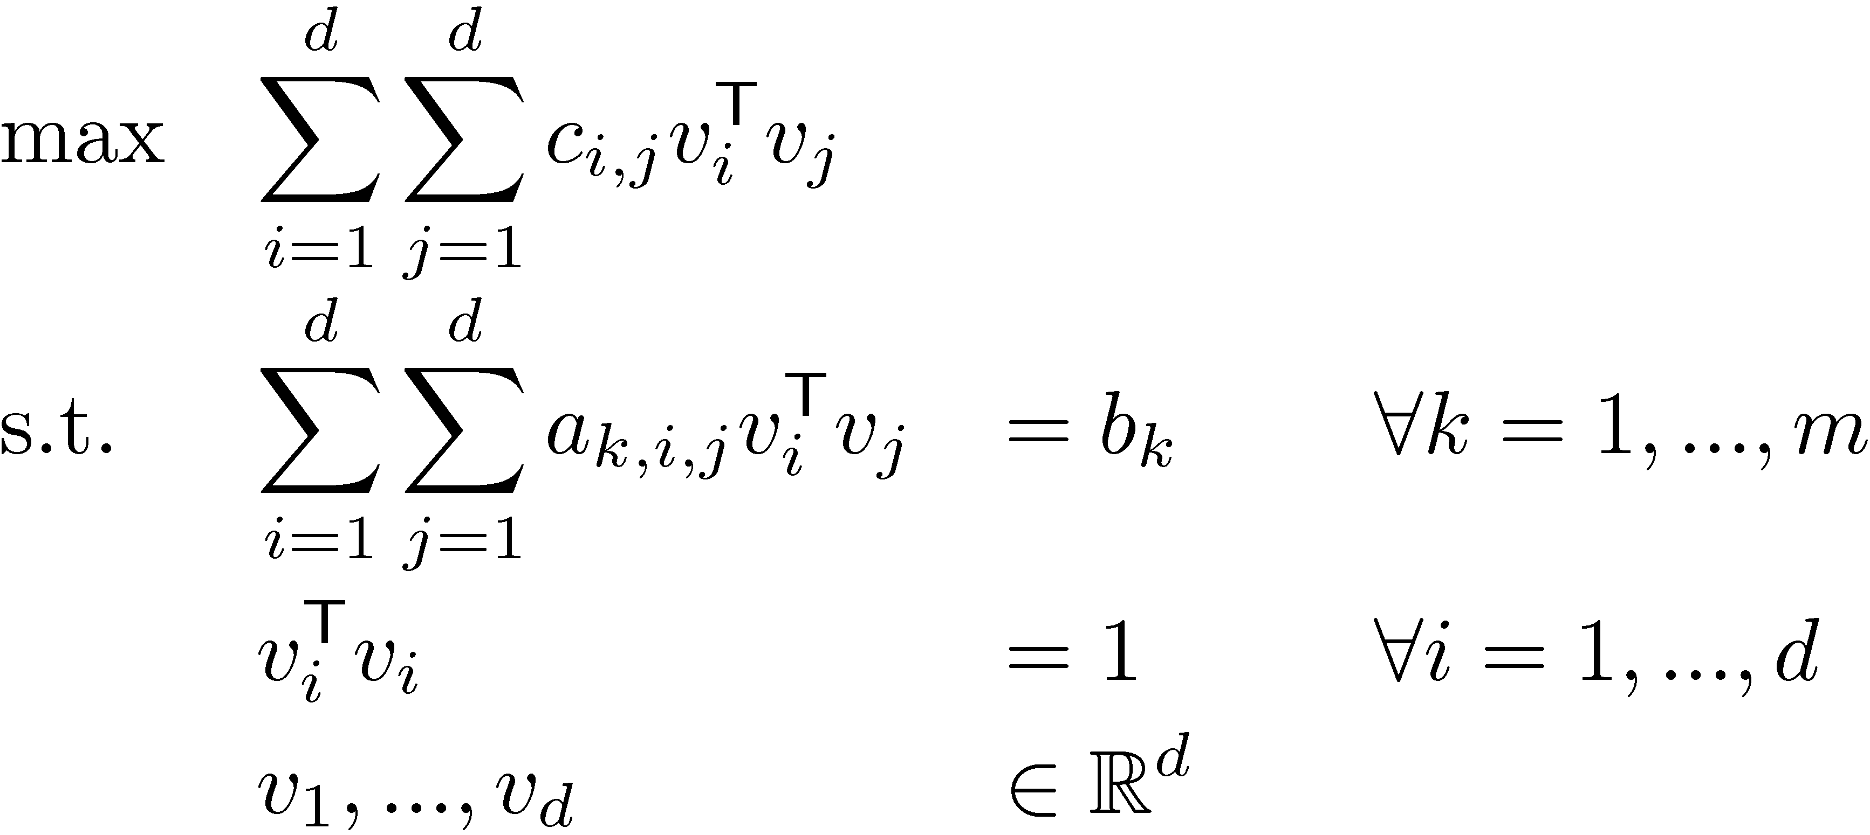
QIPs & Vector Programs
Quadratic Integer Program
Vector Programs give a natural relaxation:
Why is this a relaxation?
(QIP)
(VP)
If we added constraint
v_{i} 2 { (-1,0,…,0), (1,0,…,0) } 8i, then VP is equivalent to QIP

Slide 11
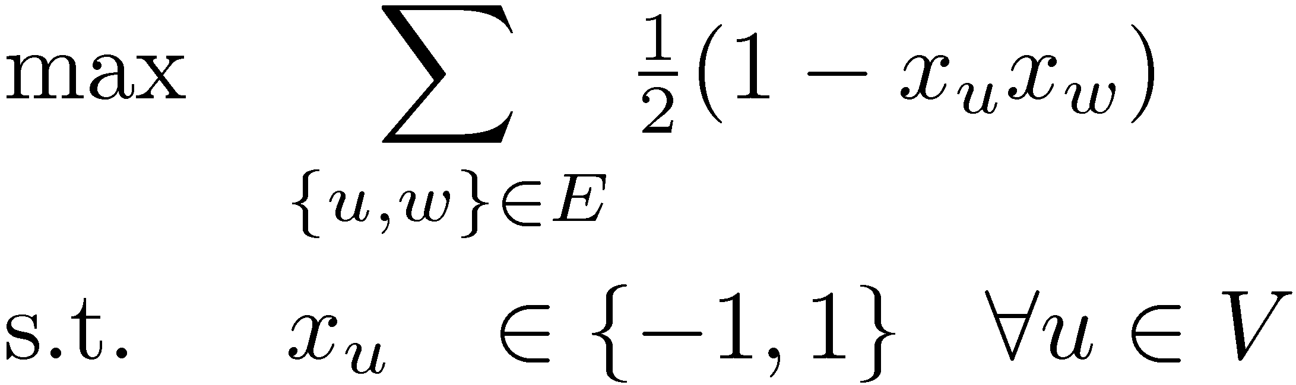
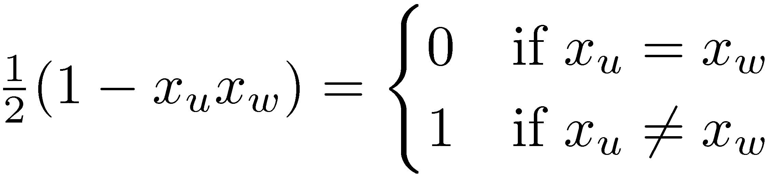
QIP for Max Cut
Let G=(V,E) be a graph with n vertices.
For U µ V, let ±(U) = { {u,v} : u2U, v∉U }
Find a set U µ V such that |±(U)| is maximized.
Make a variable x_{u} for each u 2 V
Claim: Given feasible solution x, let U = { u : x_{u} = -1 }.
Then |±(U)| = objective value at x.
Proof: Note that
So objective value = |{ {u,w} : x_{u}≠x_{w} }| = |±(U)|. ¤
(QIP)

Slide 12
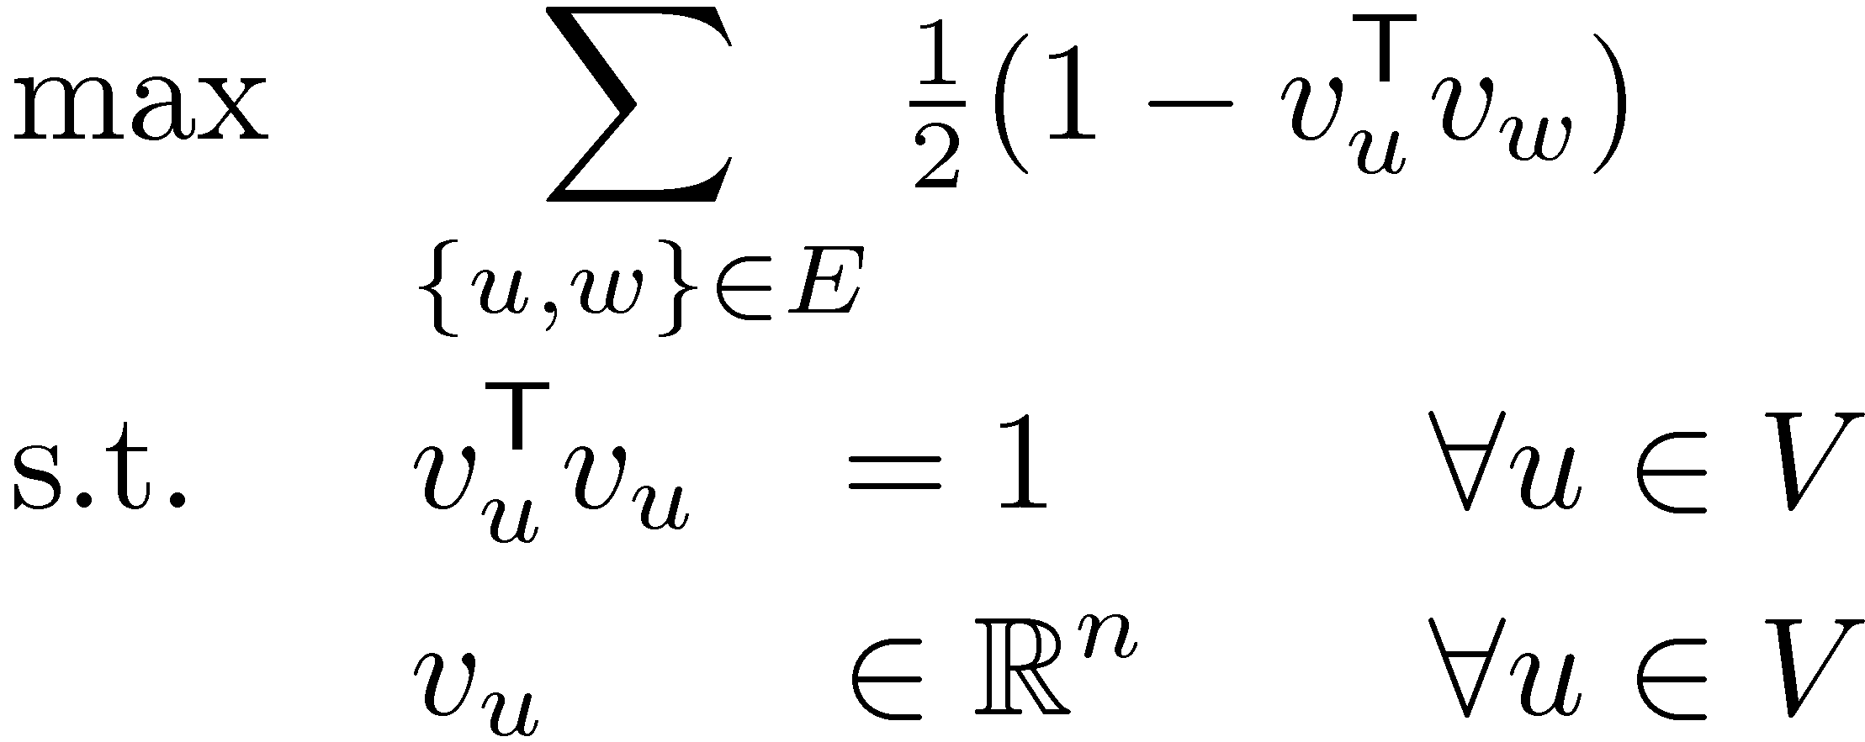
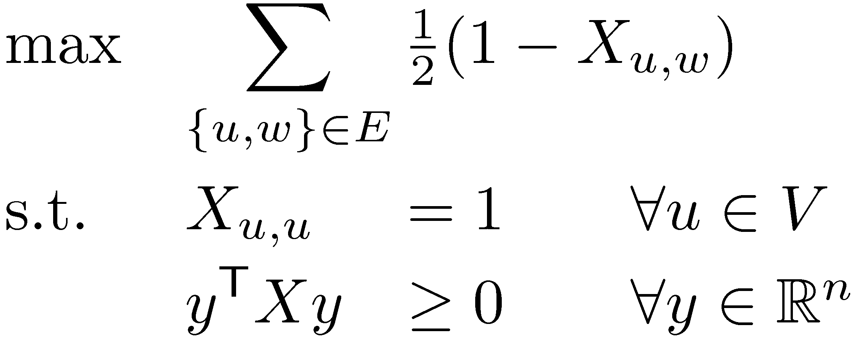
VP & SDP for Max Cut
Make a variable x_{u} for each u 2 V
Vector Program Relaxation
Corresponding Semidefinite Program
(QIP)
(VP)
This used to be d,
but now it’s n,
because n = |V|.
(SDP)

Slide 13
QIP vs SDP
(QIP)
(SDP)
Cannot be solved efficiently,
unless P = NP
Can be solved by Ellipsoid Method
How does solving the SDP help us solve the QIP?
The QIP & SDP can be quite different.
Objective Value
0
QIP Optimum
(The Max Cut)
SDP Optimum
How can the SDP Optimum be better than Max Cut?
The SDP optimum is not feasible for QIP – it’s not a cut!

Slide 14
Our Game Plan
Objective Value
0
Our Cut
QIP Optimum
(The Max Cut)
SDP Optimum
Solve the SDP
Rounding: Extract Our Cut from SDP optimum
(This will be a genuine cut, feasible for QIP)
Prove that Our Cut is close to SDP Optimum,
i.e. is as large as possible.
) Our Cut is close to QIP Optimum,
i.e.,
So Our Cut is within a factor ® of the optimum
®
Value( Our Cut )
® =
Value( SDP Opt )
Value( Our Cut )
¸ ®
Value( QIP Opt )

Slide 15
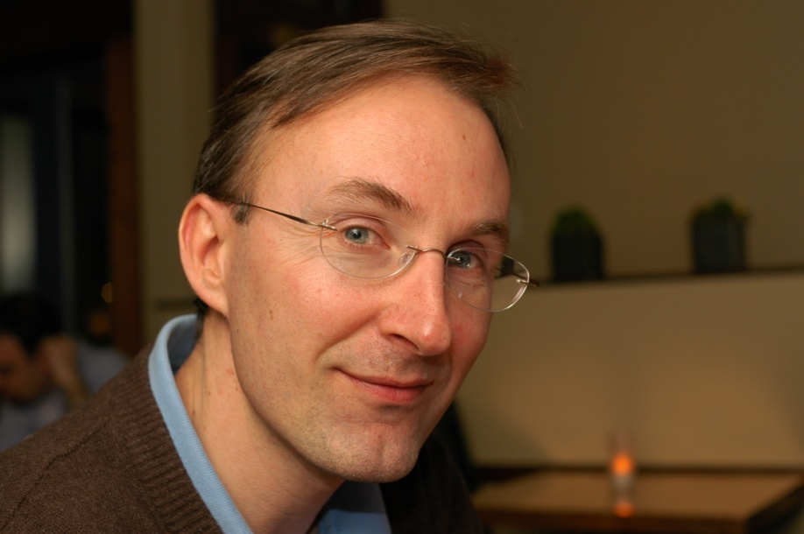

The Goemans-Williamson Algorithm
Theorem: [Goemans, Williamson 1994]
There exists an algorithm to extract a cut from the SDP optimum such that
Value( Cut )
® =
¸ 0.878…
Value( SDP Opt )
Michel Goemans
David Williamson

Slide 16
The Goemans-Williamson Algorithm
Theorem: [Goemans, Williamson 1994]
There exists an algorithm to extract a cut from the SDP optimum such that
Value( Cut )
® =
¸ 0.878…
Value( SDP Opt )
Astonishingly, this seems to be optimal:
Theorem: [Khot, Kindler, Mossel, O’Donnell 2005]
No efficient algorithm can approximate Max Cut with factor better than 0.878…, assuming a certain conjecture in complexity theory. (Similar to P≠NP)

Slide 17
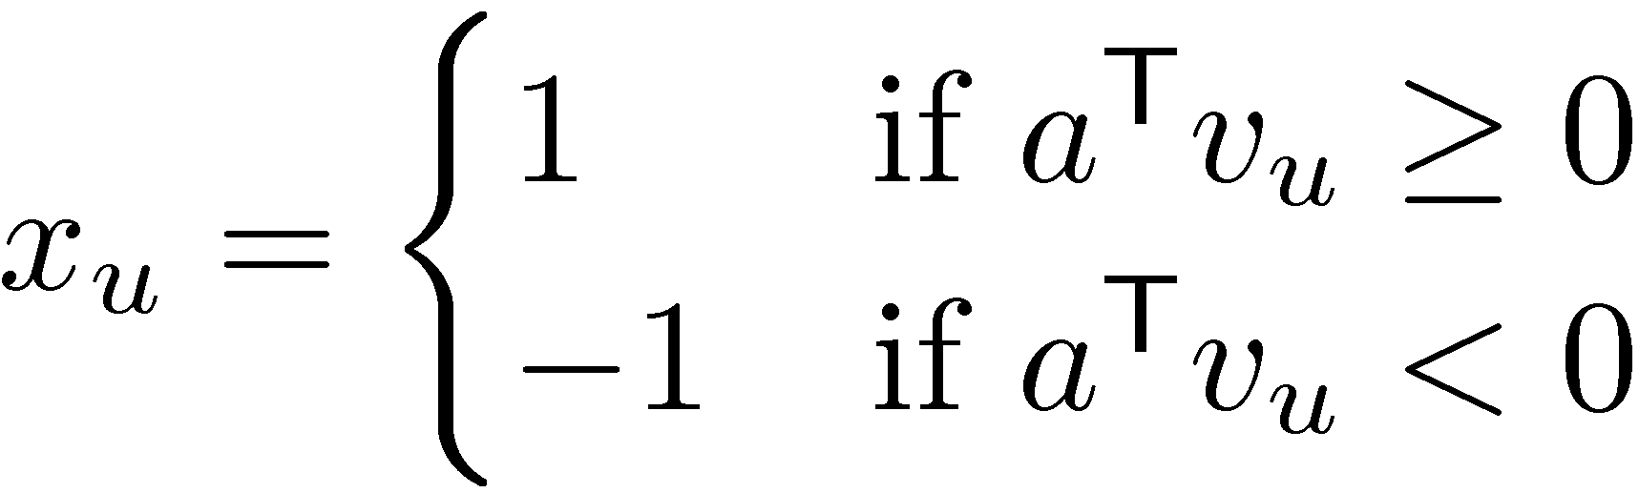
The Goemans-Williamson Algorithm
Solve the Max Cut Vector Program
Pick a random hyperplane through origin
H = { x : a^{T}x = 0 } (i.e., a is a random vector)
Return U = { u : a^{T} v_{u} ¸ 0 }
(VP)
v_{w}
v_{x}
U = { u, w, x }
v_{u}
In other words,
origin
v_{y}
v_{t}
v_{z}

Slide 18
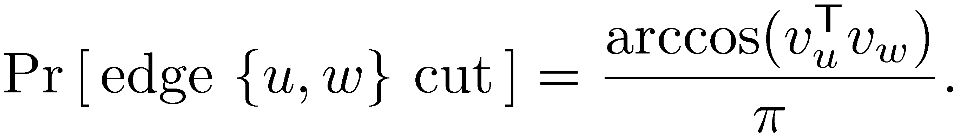
Analysis of Algorithm
Objective Value
0
Our Cut
QIP Optimum
(The Max Cut)
SDP Optimum
®
Our Cut is U = { u : a^{T} v_{u} ¸ 0 }
Need to prove is large
But a is a random vector, so U is a random set
) Need to do a probabilistic analysis
Focus on a particular edge {u,w}:
What is the probability it is cut by Our Cut?
Main Lemma:
Value( Our Cut )
® =
Value( SDP Opt )

Slide 19
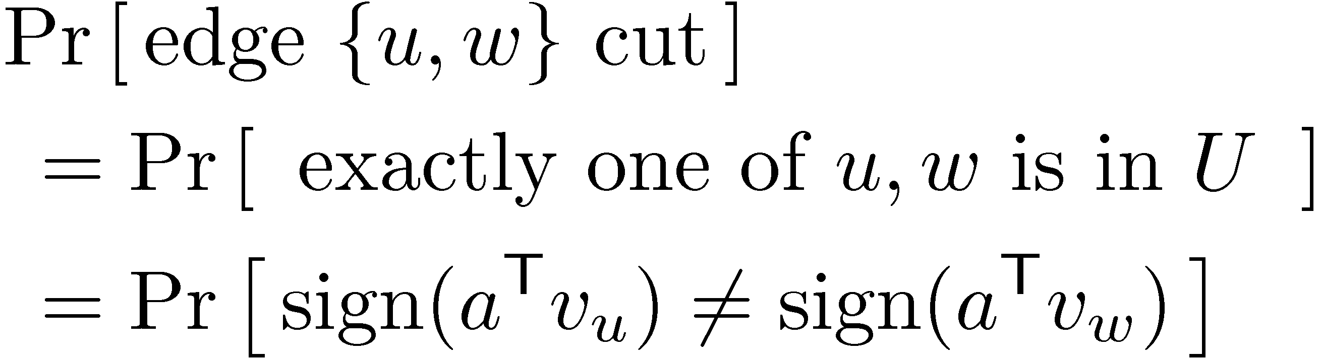
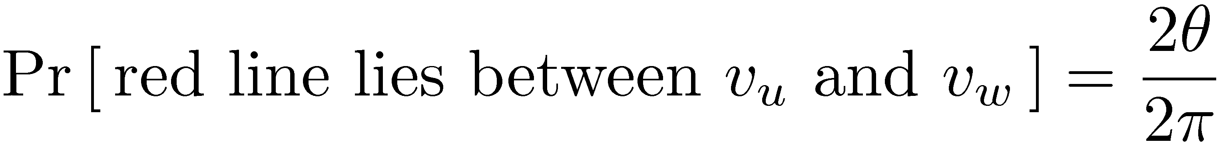
Main Lemma:
Proof:
Since direction of red line is uniformly distributed,
red line lies between v_{u} and v_{w}
v_{u}
a
µ
µ
v_{w}

Slide 20
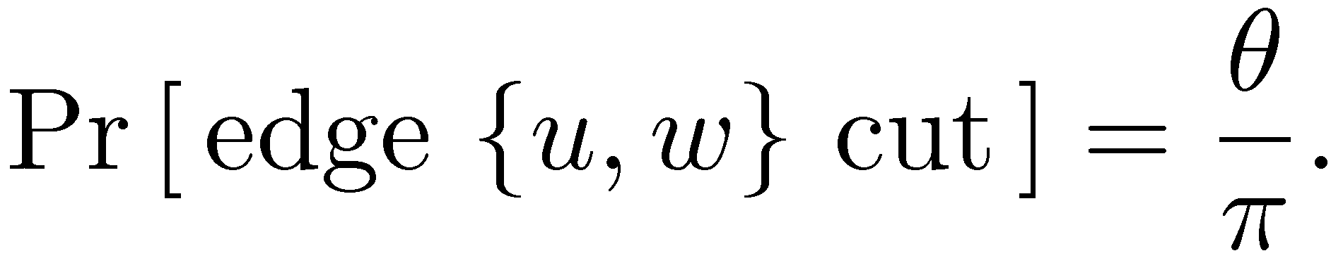
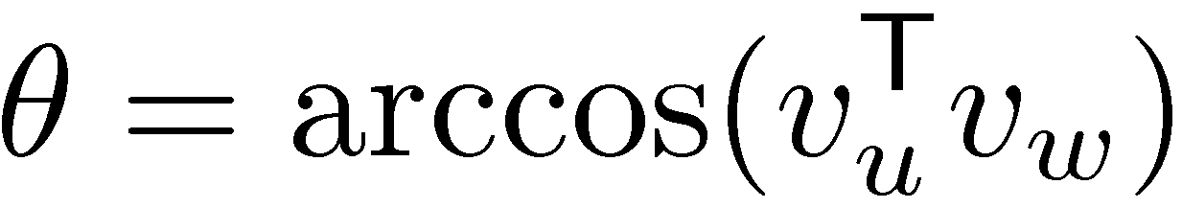
Main Lemma:
Proof:
Since direction of red line is uniformly distributed,
So
Recall: v_{u}^{T} v_{w} = kv_{u}k¢kv_{w}k ¢ cos(µ)
Since kv_{u}k=kv_{w}k=1, we have ¥
red line lies between v_{u} and v_{w}

Slide 21
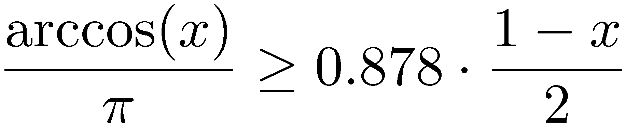
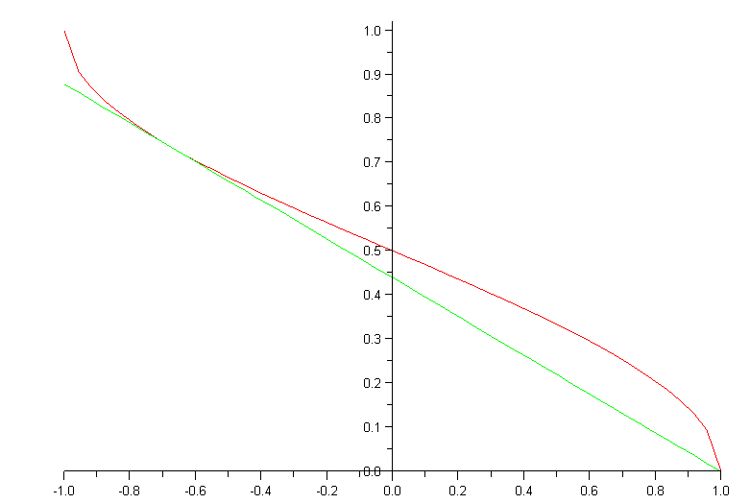
Main Lemma:
Claim: For all x2[-1,1],
Proof: By picture:
Can be formalized using calculus. ¥
arccos(x)
0.878 (1-x) /2

Slide 22
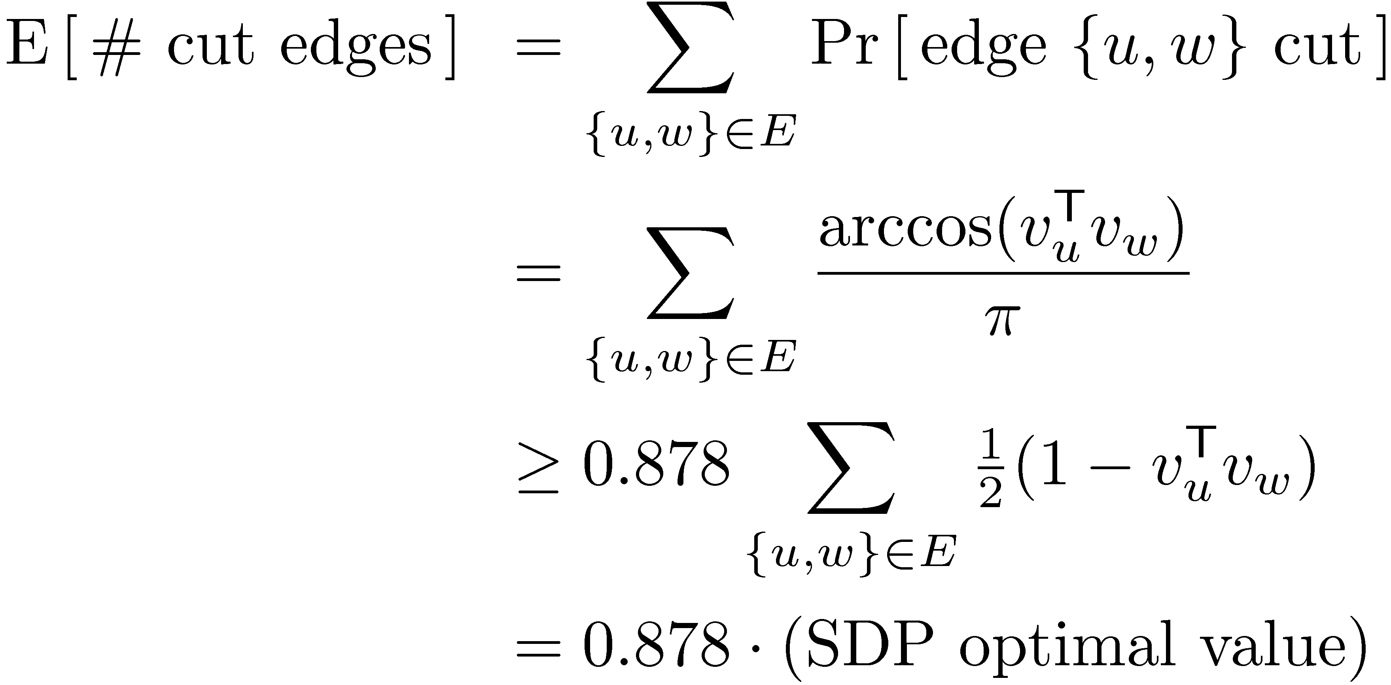
Main Lemma:
Claim: For all x2[-1,1],
So we can analyze # cut edges:
Recall: . So E[ ® ] ¸ 0.878.
Value( Our Cut )
® =
Value( SDP Opt )

Slide 23
Objective Value
So we can analyze # cut edges:
Recall: . So E[ ® ] ¸ 0.878.
0
Our Cut
QIP Optimum
(The Max Cut)
SDP Optimum
® ¸ 0.878
Value( Our Cut )
® =
Value( SDP Opt )

Slide 24
Objective Value
So, in expectation, the algorithm gives a
0.878-approximation to the Max Cut. ¥
0
Our Cut
QIP Optimum
(The Max Cut)
SDP Optimum
® ¸ 0.878

Slide 25
Matlab Example
U
Hyperplane H
Green edges are cut
38 of them
Blue edges are not cut
8 of them
SDP Opt. Value ¼ 39.56
) QIP Opt. Value · 39
® ¼ 38/39.56 = 0.9604
H cuts 38 edges
So Max Cut is either 38 or 39
Random graph: 20 vertices, 46 edges.
Embedded on unit-sphere in R²⁰, then
projected onto 2 random directions.

Slide 26
Matlab Experiments
My sample data is a graph with 750 vertices, 3604 edges
Install SDPT3 (Matlab software for solving SDPs)
It has example code for solving Max Cut.
Run this code:
Output: cut=2880, sdpOpt=3206.5, ratio=0.8982
load 'Data.txt'; A = Data; % Load adjacency matrix from file
n = size(A,1); % n = number of vertices in the graph
m = sum(sum(A))/2; % m = number of edges of the graph
[blk,Avec,C,b,X0,y0,Z0,objval,R] = maxcut(A,1,1); % Run the SDP solver
X = R{1}; % X is the optimal solution to SDP
V = chol(X); % Columns of V are solution to Vector Program
a = randn(1,n); % The vector a defines a random hyperplane
x = sign( a * V )'; % x is our integral solution
cut = m/2 - x'*A*x/4 % This counts how many edges are cut by x
sdpOpt = -objval % This is the SDP optimal value
ratio = cut/sdpOpt % This compares cut to SDP optimum
Here we use the fact that product of Normal Distributions is spherically symmetric.

