Slide 1
C&O 355
Mathematical Programming
Fall 2010
Lecture 12
N. Harvey
TexPoint fonts used in EMF.
Read the TexPoint manual before you delete this box.: AAAAAAAAAA

Slide 2
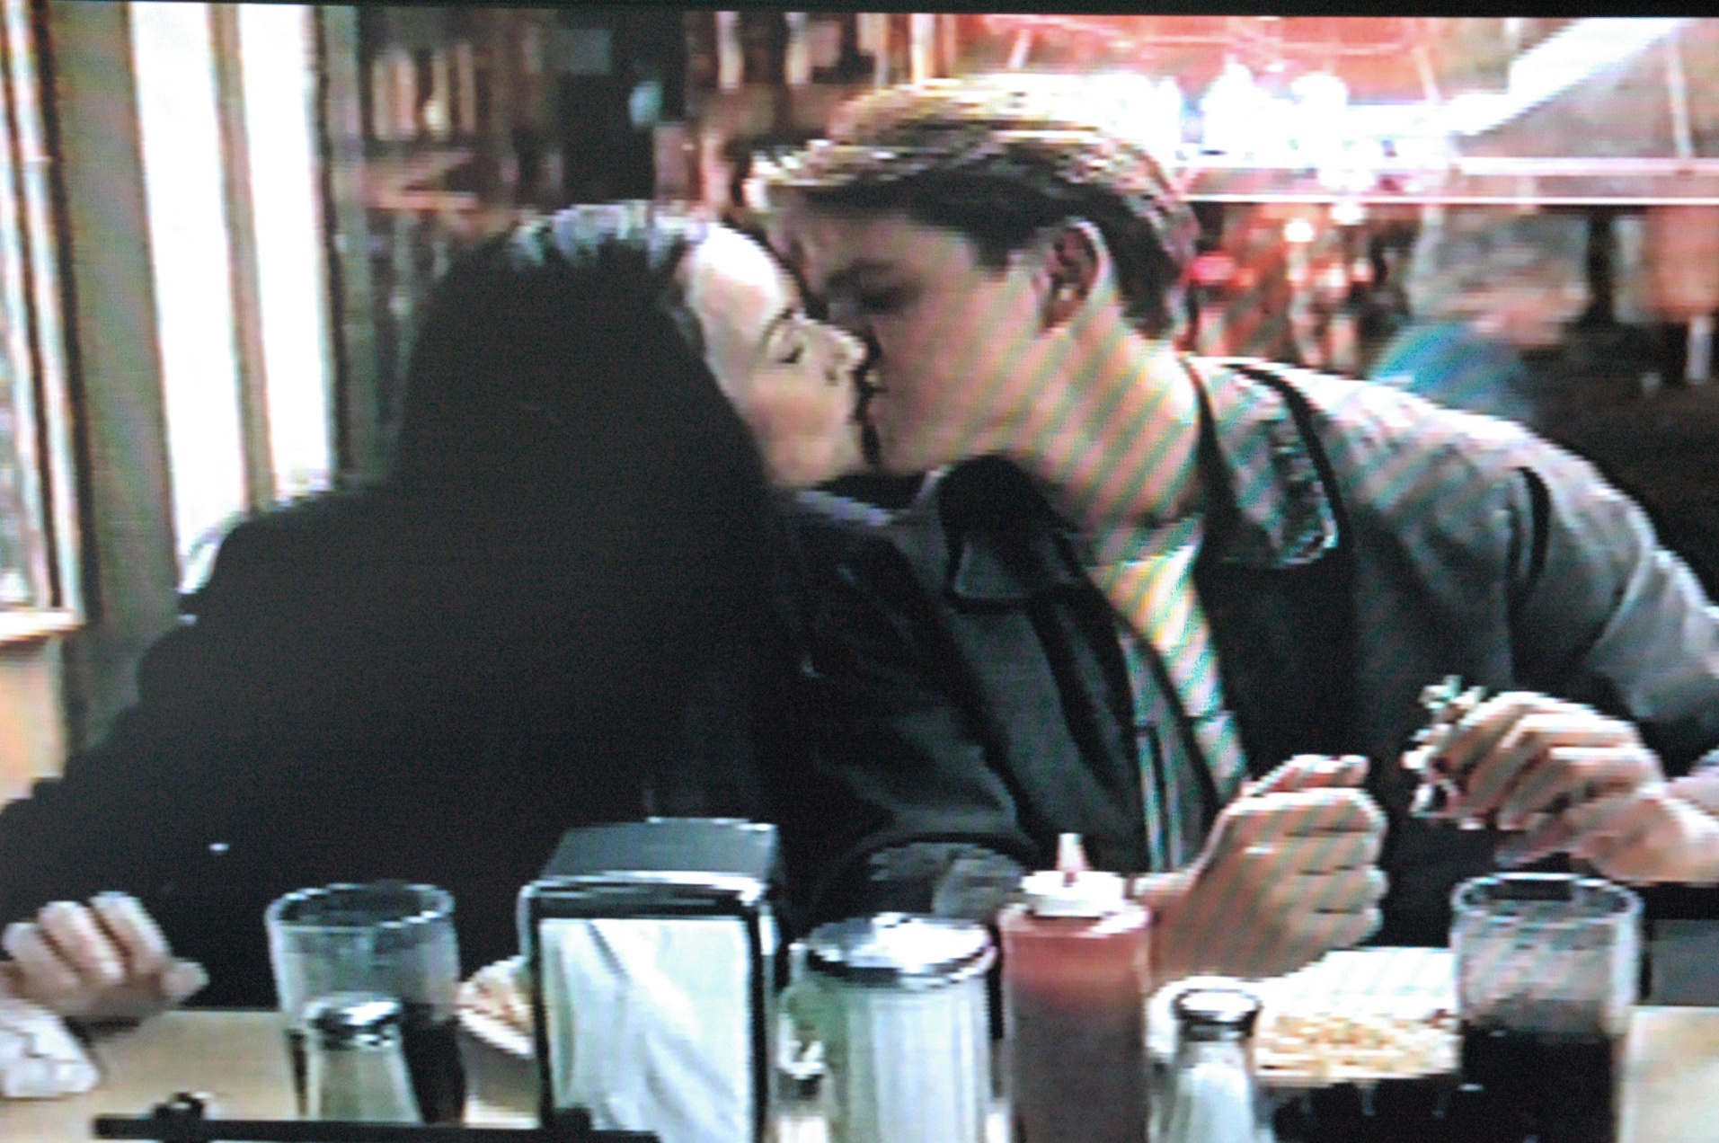
Daniel Kleitman
First person with finite Erdos-Bacon number?
What movie is this?
What is the location for this scene?
Who are the people in this scene?

Slide 3
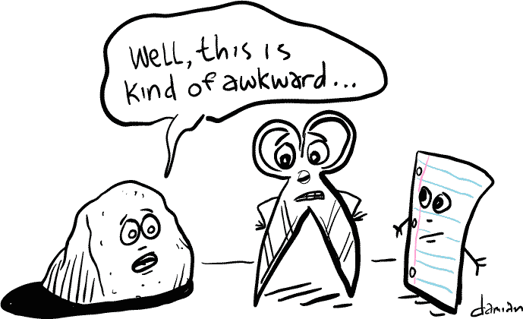
Two-Player “Zero-sum” Games
Alice and Bob play the following game
  Alice has m possible actions she can make
  Bob has n possible actions he can make
  They both simultaneously choose an action
  If Alice chooses action i and Bob chooses action j
  then Bob pays Alice M_{ij} dollars
“Zero-sum” means amount Alice wins equals amount Bob loses
Bob
 | Rock | Scissors | Paper
Rock | 0 | 1 | -1
Scissors | -1 | 0 | 1
Paper | 1 | -1 | 0
Alice
M
http://www.toddlittleton.net/

Slide 4
Randomized Strategies
As we know from Rock-Scissors-Paper, we seek randomized choices of actions that optimize the expected payoff
Suppose Alice chooses a probability distribution x 2 R^{m} over her actions and Bob chooses a distribution y 2 R^{n}
over his actions. (So x¸0, ∑_{i} x_{i} = 1, y¸0, ∑_{i} y_{i} = 1.)
The expected amount Bob pays Alice is
∑_{i} ∑_{j} M_{i,j} x_{i} y_{j} = x^{T} M y
Alice is paranoid and thinks Bob might know her distribution x. She wants x that pays well no matter
which y Bob chooses, and even if Bob knows x.
So Alice wants to solve: max_{x} min_{y} x^{T} M y
(over all distributions x and y)
Similarly, Bob wants to solve: min_{y} max_{x} x^{T} M y

Slide 5
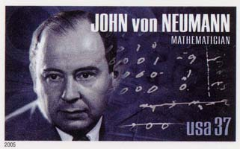
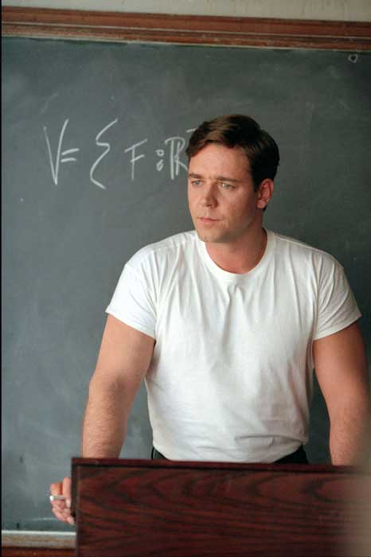
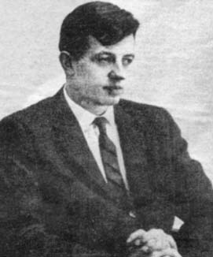
Von Neumann’s Theorem
We know: max_{x} min_{y} x^{T} M y · min_{y} max_{x} x^{T} M y (Asst 2, Q6)
(over all distributions x and y)
Does equality hold?
In other words, is Alice’s paranoid strategy
actually an optimal strategy?
Theorem: [Von Neumann, 1926] Yes! There exist x* and y* s.t.
max_{x} min_{y} x^{T} M y = x^{*T} M y* = min_{y} max_{x} x^{T} M y
Can be proven using LP duality. (Similar to Asst 2, Q7.)
Conversely, LP duality can be proven by Von Neumann’s Thm
The strategies x* and y* are called Nash equilibria
Nash’s work came later, showing equilibria in more general, non-zero-sum games.
Hollywood’s
depiction of
John Nash
John Nash,
Nobel Laureate

Slide 6
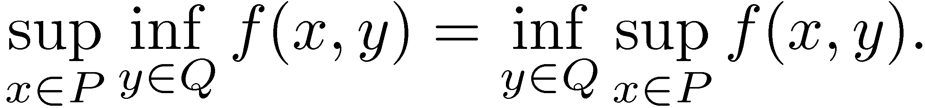
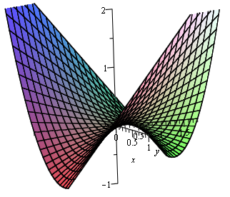
Saddle Points
It is not generally true that
Consider P = [-1,1], Q = R and f(x,y) = x^2 + xy

Slide 7
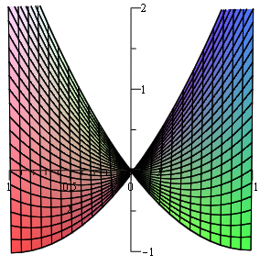
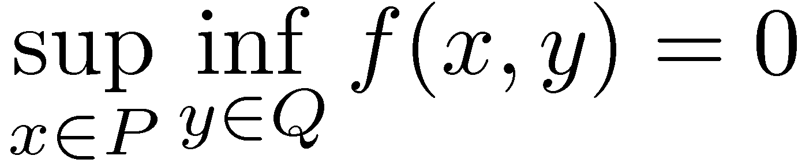
Saddle Points
It is not generally true that
Consider P = [-1,1], Q = R and f(x,y) = x^2 + xy
Looking along the y-axis,
x

Slide 8
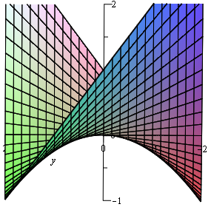
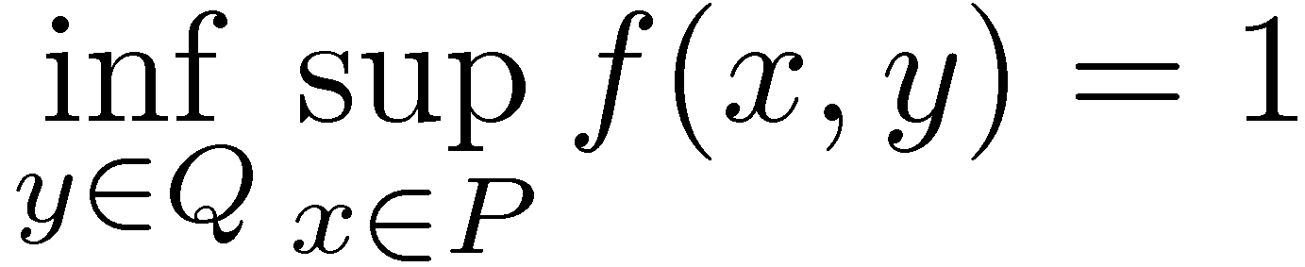
Saddle Points
It is not generally true that
Consider P = [-1,1], Q = R and f(x,y) = x^2 + xy
Looking along the y-axis,
Looking along the x-axis,
y

Slide 9
Saddle Points
It is not generally true that
x*2P and y*2Q are called saddle points if
The question “when do saddle points exist?”
is closely related to the question “when does a non-linear program satisfy strong duality?”
  Nash Equilibria of zero-sum games are saddle points
  Note: we only defined duals of linear programs
Notes:
For more on this, see Chapter 5 of Boyd and Vandenberghe, available online:
http://www.stanford.edu/~boyd/cvxbook/

Slide 10
Learning a Near-Optimal Strategy for Alice
Alice maintains weights on her actions w2R^{m}, w¸0
For T rounds
  Alice normalizes w to get distribution x = w / ∑_{i} w_{i}
  Alice tells Bob she’s going to play with distribution x
  Bob chooses an action j that is optimal against x
  Alice plays a random action chosen according to x,
  and Bob plays j
  Alice increases the weight w_{i} if M_{i,j} > 0
  and decreases the weight w_{i} if M_{i,j} < 0
Amazing Fact: If this is done carefully, then x is now a nearly optimal strategy for Alice

Slide 11
Multiplicative Weights Update Method
Alice increases and decreases her weights by a small multiplicative factor
This method is useful for many problems
  fast algorithms (max flow, ...)
  machine learning (AdaBoost, Winnow)
  complexity theory (Yao’s XOR Lemma)
  quantum computing (QIP = PSPACE)
  derandomization (pessimistic estimators, ...)
  online optimization
  ...

Slide 12
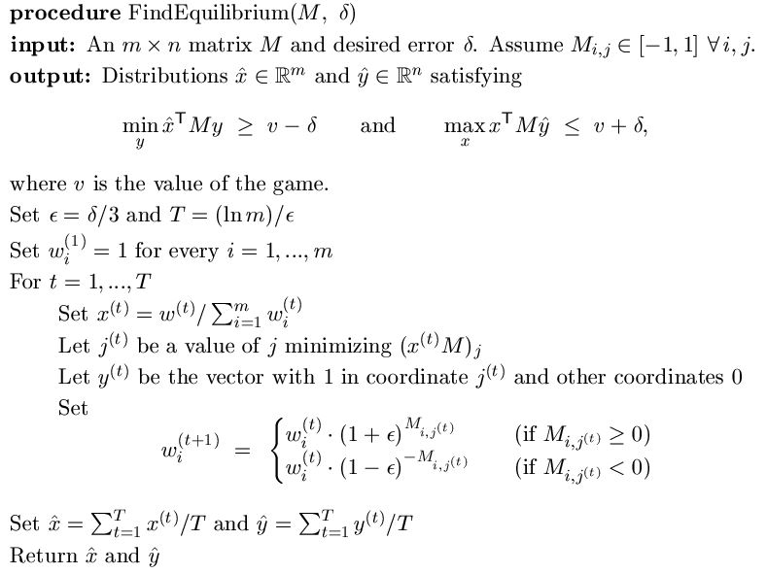
2

