Slide 1
C&O 355 Mathematical Programming Fall 2010 Lecture 10
N. Harvey
TexPoint fonts used in EMF.
Read the TexPoint manual before you delete this box.: AAAAAAAAAA

Slide 2
What is a corner point?
How should we define corner points?
Under any reasonable definition, point x should be considered a corner point
x

Slide 3
What is a corner point?
Attempt #1: “x is the ‘farthest point’ in some direction”
Let P = { feasible region }
There exists c2R^{n} s.t. c^{T}x>c^{T}y for all y2Pn{x}
“For some objective function, x is the unique optimal point when maximizing over P”
Such a point x is called a “vertex”
x is unique optimal point
c
Notes:
Textbook p53

Slide 4
What is a corner point?
Attempt #2: “There is no feasible line-segment that goes through x in both directions”
Whenever x=®y+(1-®)z with y,z≠x and ®2(0,1), then either y or z must be infeasible.
“If you write x as a convex combination of two feasible points y and z, the only possibility is x=y=z”
Such a point x is called an “extreme point”
x
z (infeasible)
y
Notes:
Textbook p55

Slide 5
What is a corner point?
Attempt #3: “x lies on the boundary of many constraints”
4x₁ - x₂ · 10
x₁ + 6x₂ · 15
x
x lies on boundary of
two constraints

Slide 6
What is a corner point?
Attempt #3: “x lies on the boundary of many constraints”
What if I introduce redundant constraints?
Not the right
condition
x₁ + 6x₂ · 15
2x₁ + 12x₂ · 30
y also lies on boundary of two constraints
y

Slide 7
What is a corner point?
Revised Attempt #3: “x lies on the boundary of many linearly independent constraints”
Feasible region: P = { x : a_{i}^{T}x·b_{i} 8 i } ½ R^{n}
Let I_{x}={ i : a_{i}^{T}x=b_{i} } and A_{x}={ a_{i} : i2I_{x} }. (“Tight constraints”)
x is a “basic feasible solution (BFS)” if rank A_{x} = n
x₁ + 6x₂ · 15
4x₁ - x₂ · 10
2x₁ + 12x₂ · 30
y
x₁ + 6x₂ · 15
y’s constraints are linearly dependent
x
x’s constraints are linearly independent

Slide 8
Lemma: Let P be a polyhedron. The following are equivalent.
x is a vertex (unique maximizer)
x is an extreme point (not convex combination of other points)
x is a basic feasible solution (BFS) (tight constraints have rank n)
Proof of (i))(ii):
x is a vertex ) 9 c s.t. x is unique maximizer of c^{T}x over P
Suppose x = ®y + (1-®)z where y,z2P and ®2(0,1).
Suppose y≠x. Then
c^{T}x = ® c^{T}y + (1-®) c^{T}z
) c^{T}x < ® c^{T}x + (1-®) c^{T}x = c^{T} x Contradiction!
So y=x. Symmetrically, z=x.
So x is an extreme point of P. ¥
· c^{T} x (since c^{T}x is optimal value)
< c^{T} x (since x is unique optimizer)
Notes:
This is Thm 2.28 in Cunningham-Lewis.
Why is this lemma worth proving?
Corner points are important, so it’s worth characterizing them in many ways.

Slide 9
Lemma: Let P={ x : a_{i}^{T}x·b_{i} 8i }½R^{n}. The following are equivalent.
x is a vertex (unique maximizer)
x is an extreme point (not convex combination of other points)
x is a basic feasible solution (BFS) (tight constraints have rank n)
Proof Idea of (ii))(iii):
x not a BFS ) rank A_{x} · n-1
Each tight constraint removes one degree of freedom
At least one degree of freedom remains
So x can “wiggle” while staying on all the tight constraints
Then x is a convex combination of two points obtained by “wiggling”.
So x is not an extreme point.
x-w
x
x+w

Slide 10
Lemma: Let P={ x : a_{i}^{T}x·b_{i} 8i }½R^{n}. The following are equivalent.
x is a vertex (unique maximizer)
x is an extreme point (not convex combination of other points)
x is a basic feasible solution (BFS) (tight constraints have rank n)
Proof of (ii))(iii): x not a BFS ) rank A_{x}<n (Recall A_{x} = { a_{i} : a_{i}^{T}x=b_{i} })
Claim: 9w2R^{n}, w≠0, s.t. a_{i}^{T}w=0 8a_{i}2A_{x} (w orthogonal to all of A_{x})
Proof: Let M be matrix whose rows are the a_{i}’s in A_{x}.
dim row-space(M) + dim null-space(M) = n
But dim row-space(M)<n ) 9w≠0 in the null space. ¤
Notes:
The fact used in the claim is sometimes called “The Fundamental Theorem of Linear Algebra”

Slide 11
Lemma: Let P={ x : a_{i}^{T}x·b_{i} 8i }½R^{n}. The following are equivalent.
x is a vertex (unique maximizer)
x is an extreme point (not convex combination of other points)
x is a basic feasible solution (BFS) (tight constraints have rank n)
Proof of (ii))(iii): x not a BFS ) rank A_{x}<n (Recall A_{x} = { a_{i} : a_{i}^{T}x=b_{i} })
Claim: 9w2R^{n}, w≠0, s.t. a_{i}^{T}w=0 8a_{i}2A_{x} (w orthogonal to all of A_{x})
Let y=x+²w and z=x-²w, where ²>0.
Claim: If ² very small then y,z2P.
Proof: First consider tight constraints at x. (i.e., those in I_{x})
a_{i}^{T}y = a_{i}^{T}x + ²a_{i}^{T}w = b_{i} + 0
So y satisfies this constraint. Similarly for z.
Next consider the loose constraints at x. (i.e., those not in I_{x})
b_{i} - a_{i}^{T}y = b_{i} - a_{i}^{T}x - ²a_{i}^{T}w
So y satisfies these constraints. Similarly for z. ¤
Then x=®y+(1-®)z, where y,z2P, y,z≠x, and ®=1/2.
So x is not an extreme point. ¥
¸ 0
Positive
As small as we like
Notes:
So taking epsilon = min { (b_i – a_i^Tx) / a_i^T w : a_i^T w >0 } is enough.

Slide 12
Lemma: Let P={ x : a_{i}^{T}x·b_{i} 8i }½R^{n}. The following are equivalent.
x is a vertex (unique maximizer)
x is an extreme point (not convex combination of other points)
x is a basic feasible solution (BFS) (tight constraints have rank n)
Proof of (iii))(i): Let x be a BFS ) rank A_{x}=n (Recall A_{x} = { a_{i} : a_{i}^{T}x=b_{i} })
Let c = §_{i2Ix} a_{i}.
Claim: c^{T}x = §_{i2Ix} b_{i}
Proof: c^{T}x = §_{i2Ix} a_{i}^{T}x = §_{i2Ix} b_{i}. ¤
Claim: x is an optimal point of max { c^{T}x : x 2 P }.
Proof: y2P ) a_{i}^{T}y · b_{i} for all i
) c^{T}y = §_{i2Ix} a_{i}^{T}y ·§_{i2Ix} b_{i} = c^{T}x. ¤
Claim: x is the unique optimal point of max { c^{T}x : x 2 P }.
Proof: If for any i2I_{x} we have a_{i}^{T}y<b_{i} then c^{T}y<c^{T}x.
So every optimal point y has a_{i}^{T}y=b_{i} for all i2I_{x}.
Since rank A_{x}=n, there is only one solution: y=x! ¤
So x is a vertex. ¥
If one of these is strict,
then this is strict.

Slide 13
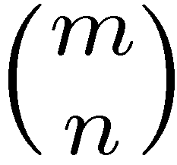
Lemma: Let P={ x : a_{i}^{T}x·b_{i} 8i }½R^{n}. The following are equivalent.
x is a vertex (unique maximizer)
x is an extreme point (not convex combination of other points)
x is a basic feasible solution (BFS) (tight constraints have rank n)
Interesting Corollary
Corollary: Any polyhedron has finitely many extreme points.
Proof: Suppose the polyhedron is defined by m inequalities.
Each extreme point is a BFS, so it corresponds to a choice of n linearly independent tight constraints.
There are · ways to choose these tight constraints. ¥
Notes:
Corollary 2.30

Slide 14
Optimal solutions at extreme points
Definition: A line is a set L={ r+¸s : ¸2R } where r,s2R^{n} and s≠0.
Lemma: Let P={ x : a_{i}^{T}x·b_{i} 8i }. Suppose P does not contain any line. Suppose the LP max { c^{T}x : x2P } has an optimal solution. Then some extreme point is an optimal solution.
Proof Idea: Let x be optimal. Suppose x not a BFS.
At least one degree of freedom remains at x
So x can “wiggle” while staying on all the tight constraints
x cannot wiggle off to infinity in both directions because P contains no line
So when x wiggles, it hits a constraint
When it hits first constraint, it is still feasible.
So we have found a point y which has a new tight constraint.
Repeat until we get a BFS.
x
y
Notes:
This is Theorem 2.27 in Cunningham-Lewis.

Slide 15
Lemma: Let P={ x : a_{i}^{T}x·b_{i} 8i }. Suppose P does not contain any line. Suppose the LP max { c^{T}x : x2P } has an optimal solution. Then some extreme point is an optimal solution.
Proof: Let x be optimal, with maximal number of tight constraints.
Suppose x not a BFS.
Claim: 9w2R^{n}, w≠0, s.t. a_{i}^{T}w=0 8i2I_{x} (We saw this before)
Let y(²)=x+²w. Suppose c^{T}w = 0.
Claim: 9± s.t. y(±)∉P. WLOG ±>0. (Otherwise P contains a line)
Set ±=0 and gradually increase ±. What is largest ± s.t. y(±)2P?
y(±)2P , a_{i}^{T}y(±)·b_{i} 8i
, a_{i}^{T}x+±a_{i}^{T}w·b_{i} 8i (Always satisfied if a_{i}^{T}w·0)
, ± · (b_{i}-a_{i}^{T}x)/a_{i}^{T}w 8i s.t. a_{i}^{T}w>0
Let h be the i that minimizes this. So ±=(b_{h}-a_{h}^{T}x)/a_{h}^{T}w.
y(±) is also optimal because c^{T}y(±) = c^{T}(x+±w) = c^{T}x.
But y(±) has one more tight constraint than x. Contradiction!
Notes:
Assume epsilon>0.
Let y(e) = x+e*w.
y(e) is feasible if a_i*y(e)<=b_i ⬄ a_i*x+e*a_i*w<=b_i.
If a_i*w<=0 then we can choose any e.
If a_i*w>0, then need b_i-a_i*x >= e*a_i*w ⬄ e <= (b_i-a_i*x)/a_i*w.
Let z(e) = x-e*w.
z(e) is feasible if a_i*z(e)<=b_i ⬄ a_i*x -e*a_i*w<=b_i.
If a_i*w>=0 then we can choose any e.
If a_i*w<0, then need a_i*x - b_i <= e*a_i*w ⬄ e <= (a_i*x – b_i)/a_i*w.

Slide 16
Lemma: Let P={ x : a_{i}^{T}x·b_{i} 8i }. Suppose P does not contain any line. Suppose the LP max { c^{T}x : x2P } has an optimal solution. Then some extreme point is an optimal solution.
Proof: Let x be optimal, with maximal number of tight constraints.
Suppose x not a BFS.
Claim: 9w2R^{n}, w≠0, s.t. a_{i}^{T}w=0 8i2I_{x} (We saw this before)
Let y(²)=x+²w. Suppose c^{T}w > 0.
Claim: 9±>0 s.t. y(±)2P. (Same argument as before)
But then c^{T}y(±) = c^{T}(x+±w) > c^{T}x.
This contradicts optimality of x. ¥

Slide 17
Lemma: Let P={ x : a_{i}^{T}x·b_{i} 8i }. Suppose P does not contain any line. Suppose the LP max { c^{T}x : x2P } has an optimal solution. Then some extreme point is an optimal solution.
Interesting Consequence
A simple but finite algorithm for solving LPs
Input: An LP max { c^{T}x : x2P } where P={ x : a_{i}^{T}x·b_{i} 8i=1…m }.
Caveat: We assume P contains no line, and the LP has an optimal solution.
Output: An optimal solution.
For every choice of n of the constraints
If these constraints are linearly independent
Find the unique point x for which these constraints are tight
If x is feasible, add it to a list of all extreme points.
End
End
Output the extreme point that maximizes c^{T}x

Slide 18
Dimension of Sets
Def: An affine space A is a set A = { x+z : x2L }, where L is a linear space and z is any vector. The dimension of A is dim L.
Let’s say dim ; = -1.
Def: Let C µ R^{n} be arbitrary. The dimension of C is min { dim A : A is an affine space with CµA }.

Slide 19
Faces
Def: Let Cµ R^{n} be any convex set. A halfspace H={ x : a^{T}x·b } is called valid if C µ H.
Def: Let PµR^{n} be a polyhedron. A face of P is a set F = P Å { x : a^{T}x = b } where H={ x : a^{T}x·b } is a valid halfspace.
Clearly every face of P is also a polyhedron.
Claim: P is a face of P.
Proof: Take a=0 and b=0.
Claim: ; is a face of P.
Proof: Take a=0 and b=1.

Slide 20
k-Faces
Def: Let PµR^{n} be a polyhedron. A face of P is a set F = P Å { x : a^{T}x = b } where H={ x : a^{T}x·b } is a valid halfspace.
Def: A face F with dim F = k is called a k-face.
Suppose dim P = d
A (d-1)-face is called a facet.
A (d-2)-face is called a ridge.
A 1-face is called an edge.
A 0-face F has the form F = {v} where v2P.
Claim: If F={v} is a 0-face then v is a vertex of P.
Notes:
Proof: { v } = P n { x : a^T x = b } where every x in P satisfies a^T x <= b.
So every x in P\{v} satisfies a^T x < b, and thus v is the unique optimal solution to max { a^T x : x in P }.

Slide 21
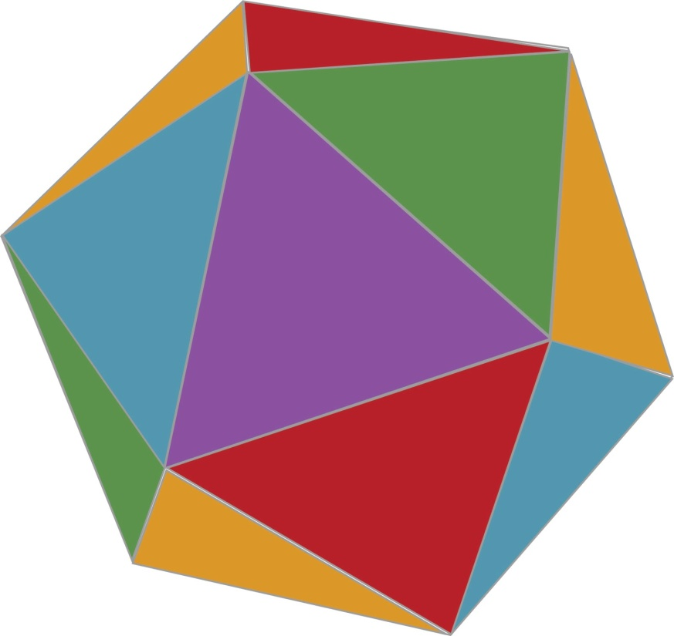
k-Faces
Def: Let PµR^{n} be a polyhedron. A face of P is a set F = P Å { x : a^{T}x = b } where H={ x : a^{T}x·b } is a valid halfspace.
Def: A face F with dim F = k is called a k-face.
0-face (vertex)
1-face (edge)
(d-1)-face (facet)
Image: http://torantula.blogspot.com/

Slide 22
The Simplex Method
“The obvious idea of moving along edges from one vertex of a convex polygon to the next” [Dantzig, 1963]
Algorithm
Let x be any vertex (we assume LP is feasible)
For each edge containing x
If moving along the edge increases the objective function
If the edge is infinitely long,
Halt: LP is unbounded
Else
Set x to be other vertex in the edge
Restart loop
Halt: x is optimal
In practice, very efficient.
In theory, very hard to analyze.
How many edges must we traverse in the worst case?
Notes:
Simplex Method is in Chapter 5 of the text.

Slide 23
Why is analyzing the simplex method hard?
For any polyhedron, and for any two vertices, are they connected by a path of few edges?
The Hirsch Conjecture (1957) Let P = { x : Ax·b } where A has size m x n. Then any two vertices are connected by a path of · m-n edges.
Example: A cube.
Dimension n=3.
# constraints m=6.
Connected by a length-3 path?
Yes!

Slide 24
Why is analyzing the simplex method hard?
For any polyhedron, and for any two vertices, are they connected by a path of few edges?
The Hirsch Conjecture (1957) Let P = { x : Ax·b } where A has size m x n. Then any two vertices are connected by a path of · m-n edges.
We have no idea how to prove this.
Disproved! There is a polytope with n=43, m=86, and two vertices with no path of length · 43 [Santos, 2010].
Theorem: [Kalai-Kleitman 1992] There is always a path with · m^{log n+2} edges.
Think you can do better? A group of (very eminent) mathematicians have a blog organizing a massively collaborative project to do just that.
Notes:
Actually, the Hirsch Conjecture was disproved for unbounded polyhedra by Klee & Walkup in 1967. The conjecture was still open for polytopes.

