Slide 1
C&O 355
Lecture 7
N. Harvey
http://www.math.uwaterloo.ca/~harvey/
TexPoint fonts used in EMF.
Read the TexPoint manual before you delete this box.: AAAAAAAAAA
Notes:
Review of Lecture 2:

Slide 2
Outline
Finding a starting point
Two small issues
Duality
  Geometric view
  Algebraic view
  Dual LP & Weak Duality
  Primal vs Dual
  Strong Duality Theorem
  Certificates

Slide 3

Local-Search Algorithm
Let B be a feasible basis (If none, Halt: LP is infeasible)
For each entering coordinate k∉B
  If “benefit” of coordinate k is > 0
  Compute y(±) (If ±=1, Halt: LP is unbounded)
  Find leaving coordinate h2B (y(±)_{h}=0)
  Set x=y(±) and B’=Bn{h}[{k}
Halt: return x
What is a corner point? (BFS and bases)
What if there are no corner points? (Infeasible)
What are the “neighboring” bases? (Increase one coordinate)
What if no neighbors are strictly better?
(Might move to a basis that isn’t strictly better (if ±=0), but whenever x changes it’s strictly better)
How can I find a starting feasible basis?
Does the algorithm terminate? (If Bland’s rule used)
Does it produce the right answer? (Yes)

Slide 4
Finding a starting point
Consider LP max { c^{T}x : x2P } where P={ x : Ax=b, x¸0 }
How can we find a feasible point?
Trick: Just solve a different LP!
  Note: c is irrelevant. We can introduce a new objective function
  WLOG, b¸0 (Can multiply constraints by -1)
  Allow “Ax=b” constraint to be violated via “artificial variables”:
  Q = { (x,y) : Ax+y=b, x¸0, y¸0 }
  Note: (x,0)2Q , x2P. Can we find such a point?
  Solve the new LP min { §_{i} y_{i} : (x,y)2Q }
  If the optimal value is 0, then x2P. If not, P is empty!
  How do we find feasible point for the new LP?
    (x,y)=(0,b) is a trivial solution!

Slide 5
Local-Search Algorithm
Let B be a feasible basis (If none, Halt: LP is infeasible)
For each entering coordinate k∉B
  If “benefit” of coordinate k is > 0
  Compute y(±) (If ±=1, Halt: LP is unbounded)
  Find leaving coordinate h2B (y(±)_{h}=0)
  Set x=y(±) and B’=Bn{h}[{k}
Halt: return x
What is a corner point? (BFS and bases)
What if there are no corner points? (Infeasible)
What are the “neighboring” bases? (Increase one coordinate)
What if no neighbors are strictly better?
(Might move to a basis that isn’t strictly better (if ±=0), but whenever x changes it’s strictly better)
How can I find a starting feasible basis? (Solve an easier LP)
Does the algorithm terminate? (If Bland’s rule used)
Does it produce the right answer? (Yes)

Slide 6
Two Small Issues
Our discussion of equational form LPs assumed that A has full row rank
  If A has contradictory constraints, LP is infeasible
  If A has redundant constraints, delete them
  See textbook p41
To start the algorithm, we need a BFS. Our trick found a feasible point, but maybe not a BFS.
  Given any feasible point x, it is easy to find a BFS y with c^{T}y ¸ c^{T}x (unless LP is unbounded).
    Very similar to our argument that polyhedra containing no line have an extreme point.
  See textbook p47-48

Slide 7
Duality
“Another key visit took place in October 1947 at the Institute for Advanced Study (IAS) where Dantzig met with John von Neumann. Dantzig recalls, “I began by explaining the formulation of the linear programming model… I described it to him as I would to an ordinary mortal. ‘Get to the point,’ he snapped. In less than a minute, I slapped the geometric and algebraic versions of my problem on the blackboard. He stood up and said, ‘Oh that.’” Just a few years earlier von Neumann had co-authored his landmark monograph on game theory. Dantzig goes on, “for the next hour and a half he proceeded to give me a lecture on the mathematical theory of linear programs.” Dantzig credited von Neumann with edifying him on Farkas’ lemma and the duality theorem (of linear programming).”
from http://www.ams.org/notices/200703/fea-cottle.pdf

Slide 8
Duality: Geometric View
If c=[-1,1] then c^{T}x=-x₁+x₂·1
x is feasible and constraint is tight ) x is optimal
x₂
-x₁+x₂· 1
x₁ + 6x₂ · 15
Objective Function c
x₁

Slide 9
Duality: Geometric View
If c=[1,6] then c^{T}x=x₁+6x₂·15
x is feasible and constraint is tight ) x is optimal
x₂
-x₁+x₂· 1
x₁ + 6x₂ · 15
Objective Function c
x₁

Slide 10
Duality: Geometric View
If c=®¢[1,6] and ®>0 then c^{T}x=®¢(x₁+6x₂)·15®
x is feasible and constraint is tight ) x is optimal
x₂
-x₁+x₂· 1
x₁ + 6x₂ · 15
Objective Function c
x₁

Slide 11
Duality: Geometric View
What if c does not align with any constraint?
Can we “generate” a new constraint aligned with c?
x₂
-x₁+x₂· 1
x₁ + 6x₂ · 15
Objective Function c
x₁

Slide 12
Duality: Geometric View
Can we “generate” a new constraint aligned with c?
One way is to “average” the tight constraints
Maybe u+v = c?
Then c^{T}x = (u+v)^{T}x = (-x₁+x₂) + (x₁+6x₂) · 1 + 15 = 16
x is feasible and both constraints tight ) x is optimal
v=[1,6]
u=[-1,1]
-x₁+x₂· 1
x₂
x₁+6x₂·15
Objective Function c
x₁

Slide 13
Duality: Geometric View
Can we “generate” a new constraint aligned with c?
One way is to “average” the tight constraints
Maybe ®u+¯v = c for ®,¯>0?
Then c^{T}x = (®u+¯v)^{T}x = ®(-x₁+x₂) + ¯(x₁+6x₂) · ®+15¯
x is feasible and both constraints tight ) x is optimal
v=[1,6]
u=[-1,1]
-x₁+x₂· 1
x₂
x₁+6x₂·15
Objective Function c
x₁

Slide 14
Duality: Geometric View
Can we “generate” a new constraint aligned with c?
One way is to “average” the tight constraints
Definition: cone(u,v)={ ®u+¯v : ®,¯¸0 }
“cone generated by u & v”
Conclusion: For any c in cone(u,v), x is optimal
v=[1,6]
u=[-1,1]
-x₁+x₂· 1
x₂
x
x₁+6x₂·15
Objective Function c
x₁

Slide 15
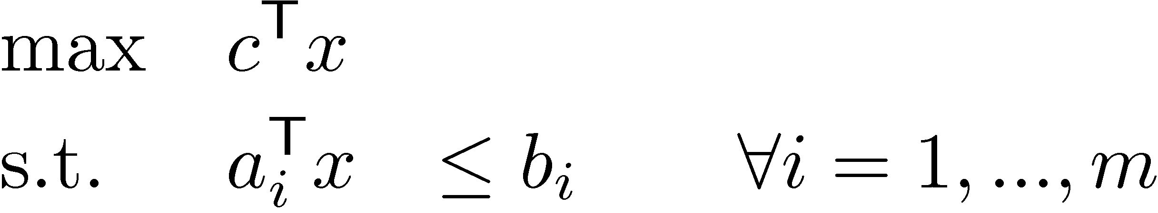
Duality: Algebraic View
Definition: A new constraint a^{T}x·b is valid if it is satisfied by all feasible points
x feasible ) a₁^{T} x · b₁ and a₂^{T} x · b₂
) (a₁+a₂)^{T} x · b₁+b₂ (new valid constraint)
More generally, for any ¸₁,…,¸_{m}¸0
x feasible ) (§_{i} ¸_{i}a_{i})^{T} x · §_{i} ¸_{i}b_{i} (new valid constraint)
“Any non-negative linear combination of the constraints gives a new valid constraint”
To get upper bound on objective function c^{T}x, need (§_{i} ¸_{i}a_{i}) = c
Want best upper bound ) want to minimize §_{i} ¸_{i}b_{i}

Slide 16
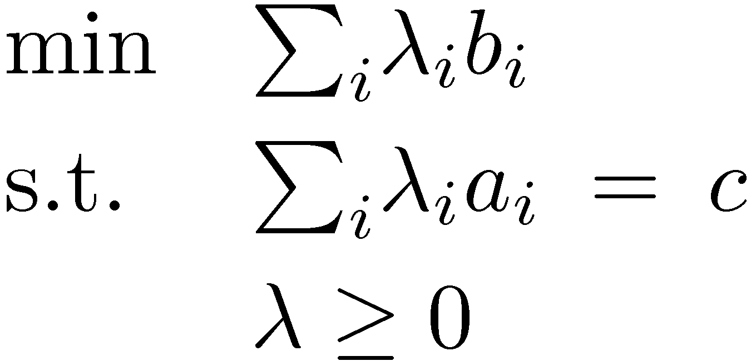
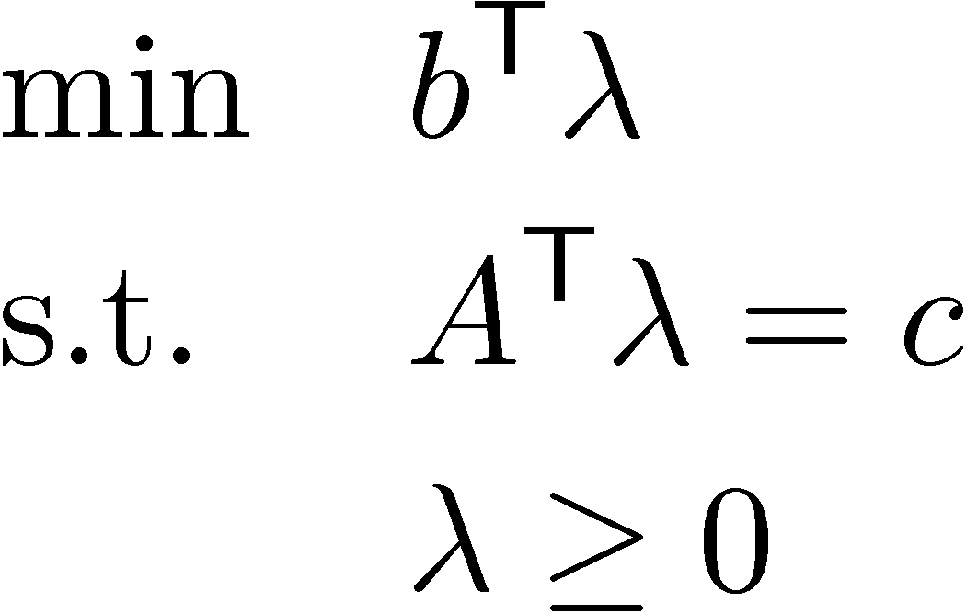
Duality: Algebraic View
Primal LP
To get upper bound on objective function c^{T}x, need (§_{i} ¸_{i}a_{i}) = c
Want best upper bound ) want to minimize §_{i} ¸_{i}b_{i}
We can write this as an LP too!
´
Dual LP
Theorem: “Weak Duality Theorem”
If x feasible for Primal and ¸ feasible for Dual then c^{T}x · b^{T}¸.
Proof: c^{T} x = (A^{T} ¸)^{T} x = ¸^{T} A x · ¸^{T} b. ¥
Since ¸¸0 and Ax·b

Slide 17
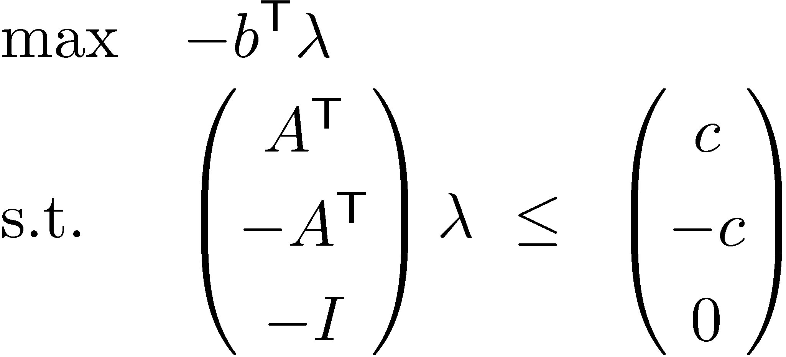
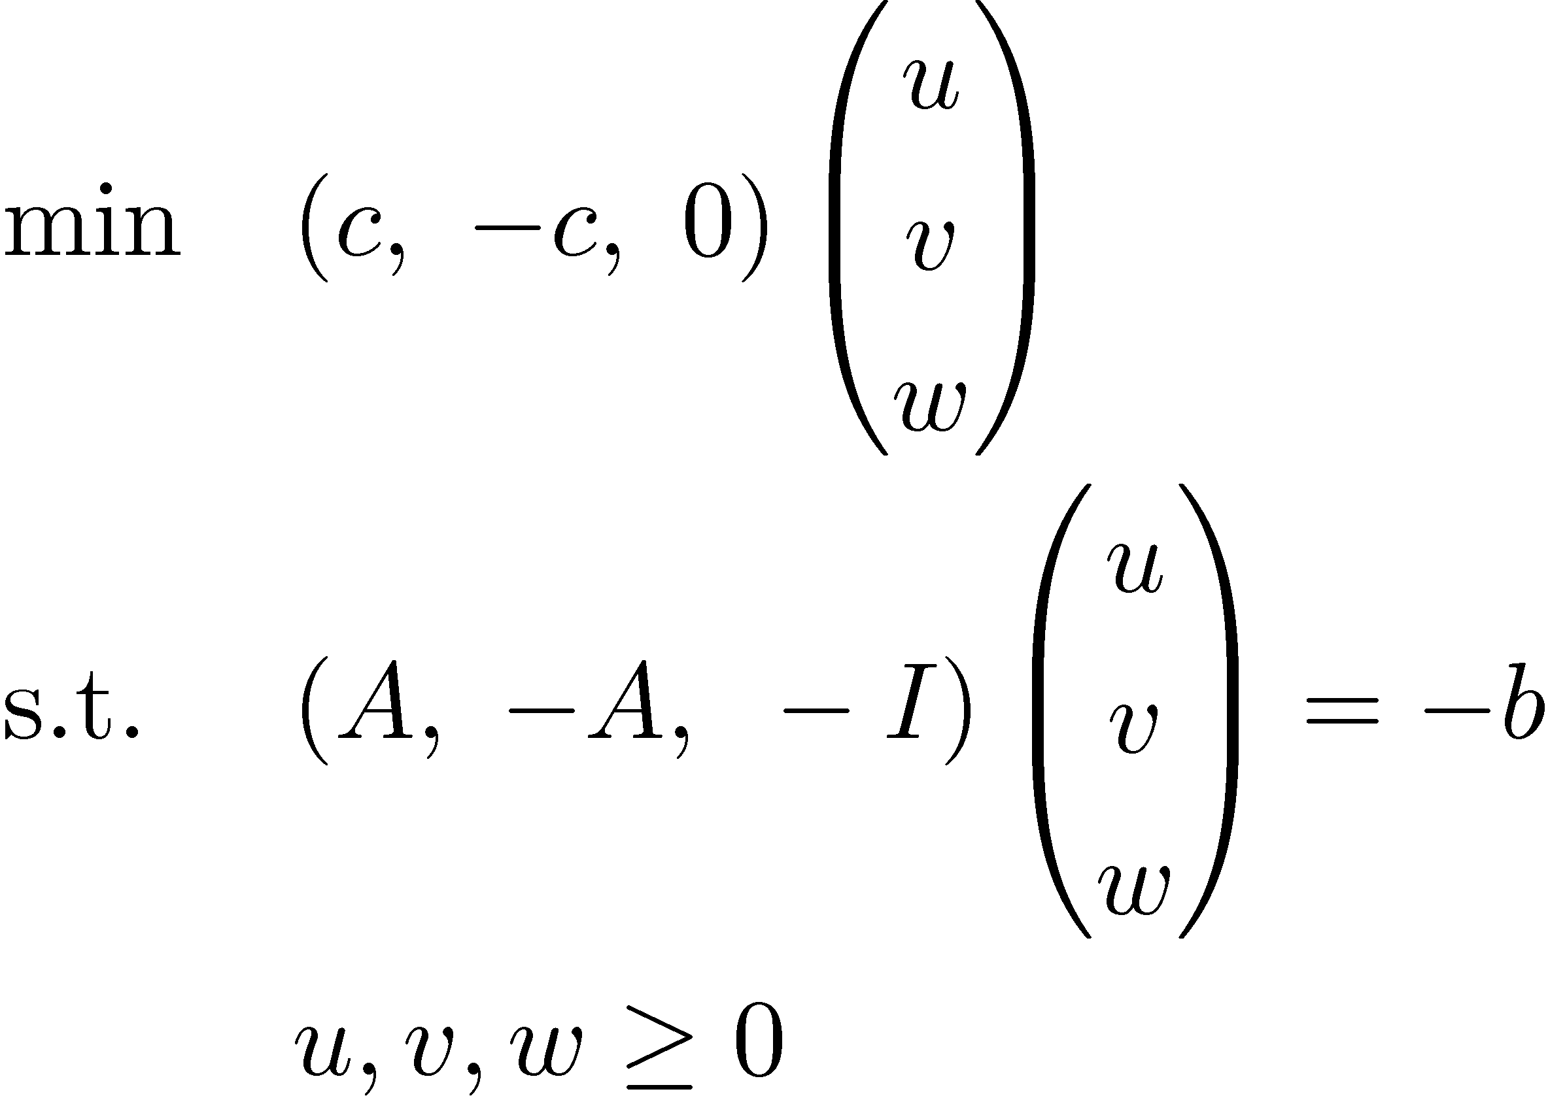
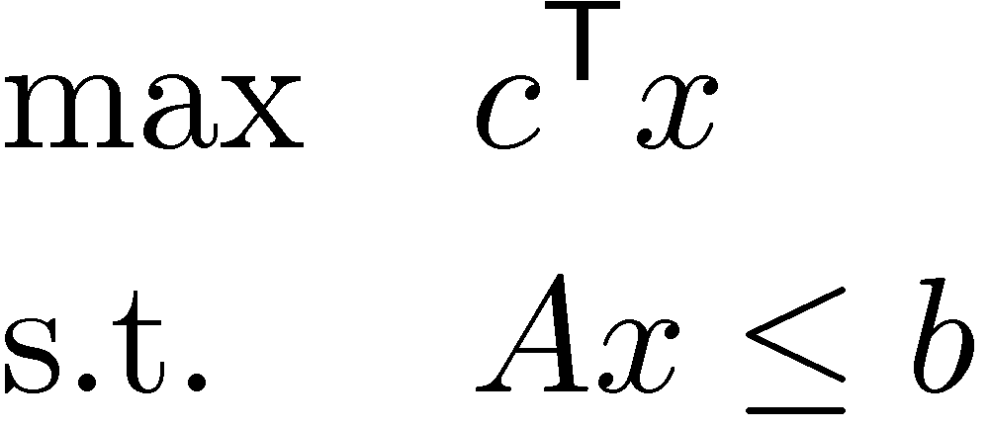
Dual of Dual
Dual LP
Inequality Form
´
transpose
transpose
transpose
new variables
(non-negative)
Primal
´
Let x = v-u
w is a “slack variable”
Dual of Dual
Conclusion: “Dual of Dual is Primal!”

Slide 18
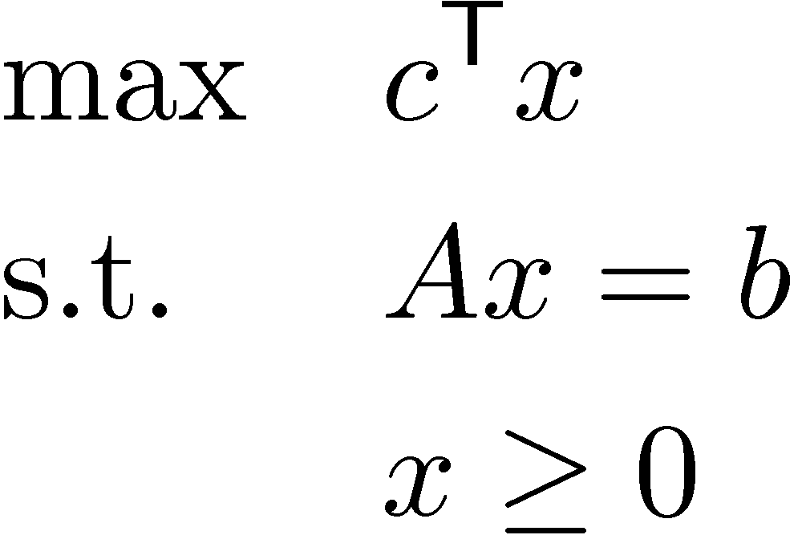
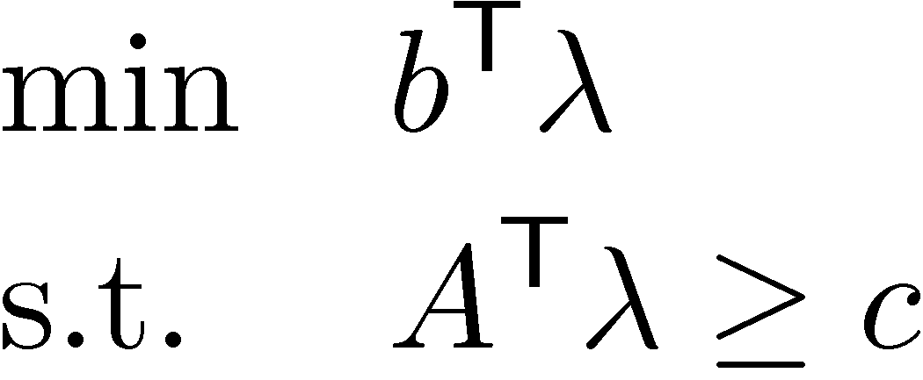
Dual of Equality Form LP
Note!
Primal LP
For any ¸2R^{m}, x feasible ) ¸^{T} Ax = ¸^{T} b (new valid constraint)
“Any linear combination of the constraints
gives a new valid constraint”
Note!
using x¸0
Get upper bound on objective function c^{T}x if ¸^{T} A ¸ c^{T}
Want best upper bound ) want to minimize ¸^{T} b
Dual LP
Similar arguments show:
“Weak Duality Theorem”
If x feasible for Primal and ¸ feasible for Dual then c^{T}x · b^{T}¸.
“Dual of Dual is Primal”

Slide 19
Rules for Duals
 | Primal | Dual
Objective | max c^{T}x | min b^{T}y
Variables | x₁, …, x_{n} | y₁,…, y_{m}
Constraint matrix | A | A^{T}
Right-hand vector | b | c
Constraints versus Variables | i^{th} constraint: · i^{th} constraint: ¸ i^{th} constraint: = x_{i} ¸ 0 x_{i} · 0 x_{i} unrestricted | y_{i} ¸ 0 y_{i} · 0 y_{i} unrestricted j^{th} constraint: ¸ j^{th} constraint: · j^{th} constraint: =
Note:
Not symmetric
“Natural”
Useful Mnemonic
“Natural” bound on a variable is ¸ 0
“Natural” constraint for a maximization problem is · 0
“Natural” constraint for a minimization problem is ¸ 0

Slide 20
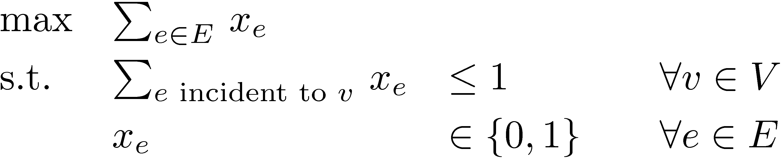
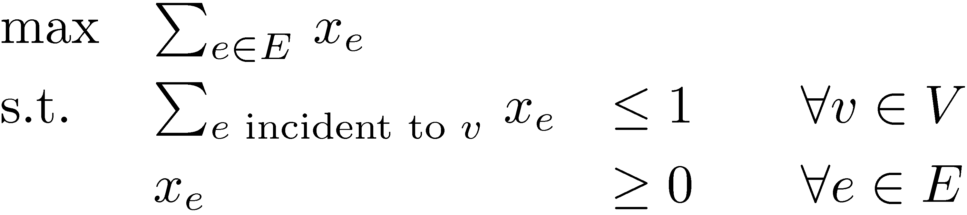
Example: Bipartite Matching
(from Lecture 2)
Given bipartite graph G=(V, E)
Find a maximum size matching
  A set M µ E s.t. every vertex has at most one incident edge in M
Write an integer program
(IP)
But we don’t know how to solve IPs. Try an LP instead.
(LP)
Notes:
Textbook Section 3.2. We will probably do the proof in Section 8.2 (Theorem 8.2.2).

Slide 21
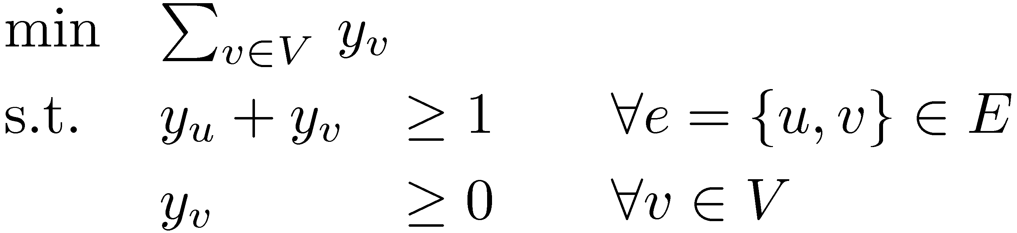
Example: Bipartite Matching
(from Lecture 2)
The LP formulation is:
(Primal)
Using “Rules for Duals”:
(Dual)
Notes:
Textbook Section 3.2. We will probably do the proof in Section 8.2 (Theorem 8.2.2).

Slide 22
Primal vs Dual
Fundamental Theorem of LP: For any LP, the outcome is either:
Infeasible, Unbounded, Optimum Point Exists.
Weak Duality Theorem:
If x feasible for Primal and ¸ feasible for Dual then c^{T}x · b^{T}¸.
Exercise!
Primal
 | Infeasible | Unbounded | Opt. Exists
Infeasible
Unbounded
Opt. Exists
Possible
Possible
Impossible
Dual
Possible
Impossible
Impossible
Impossible
Impossible
Possible
Strong Duality Theorem:
If Primal has an opt. solution x, then Dual has an opt. solution ¸.
Furthermore, optimal values are same: c^{T}x = b^{T}¸.

Slide 23
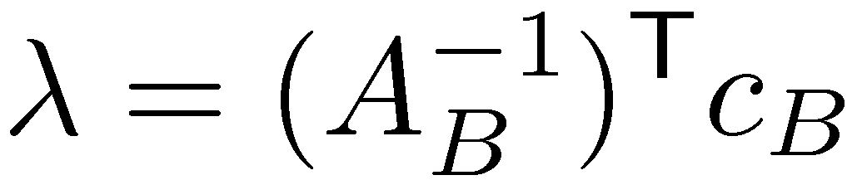
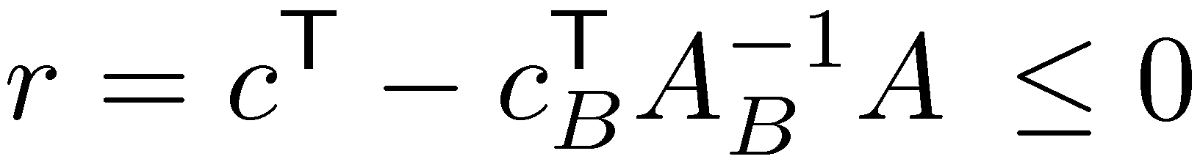
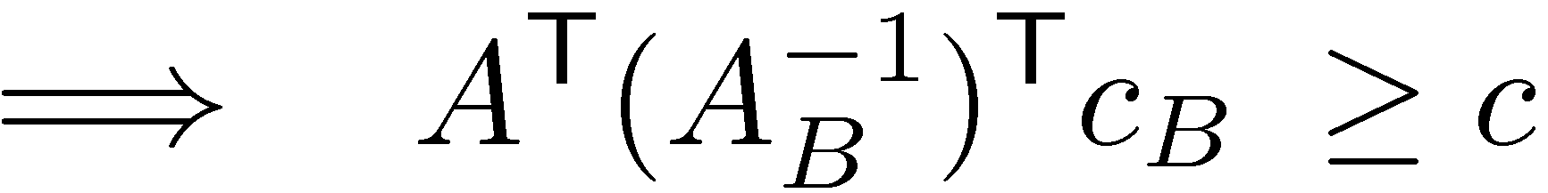
Strong Duality
(for equational form LP)
Primal LP:
Dual LP:
Suppose LP is not infeasible and not unbounded.
Algorithm terminates with BFS x defined by basis B.
Define: .
Claim: ¸ feasible for Dual LP.
Proof: alg terminates ) benefits vector
. So ¸ feasible. ¤
Claim: c^{T}x = b^{T}¸.
Proof: . ¤
So x and ¸ are both optimal! ¥
since B defines x
since x_{B} = 0

Slide 24

Certificates
For any LP, I can convince you that optimal value is…
¸ k: by giving a primal feasible x with obj. value ¸ k.
· k: by giving a dual feasible ¸ with obj. value · k.
Theorem: Such certificates always exists. (stated in Lecture 2)
Proof: Immediate from strong duality theorem. ¥
Theorems like this are very strong and useful.
Other famous examples:
Konig / Hall’s Theorem (Graph theory)
Max-flow Min-cut Theorem (Network flow theory)
Hilbert’s Nullstellensatz (Algebraic geometry)

