Slide 1
C&O 355
Lecture 4
N. Harvey
http://www.math.uwaterloo.ca/~harvey/
TexPoint fonts used in EMF.
Read the TexPoint manual before you delete this box.: AAAAAAAAAA

Slide 2
Outline
Equational form of LPs
Basic Feasible Solutions for Equational form LPs
Bases and Feasible Bases
Brute-Force Algorithm
Neighboring Bases

Slide 3

Local-Search Algorithm: Pitfalls & Details
Algorithm
Let x be any corner point
For each corner point y that is a neighbor of x
  If c^{T}y>c^{T}x then set x=y
Halt
What is a corner point?
What if there are no corner points?
What are the “neighboring” corner points?
What if there are no neighboring corner points?
How can I find a starting corner point?
Does the algorithm terminate?
Does it produce the right answer?
Notes:
So now we know what a corner point is. It is an extreme point, a vertex, and a BFS. These are all synonyms.

Slide 4
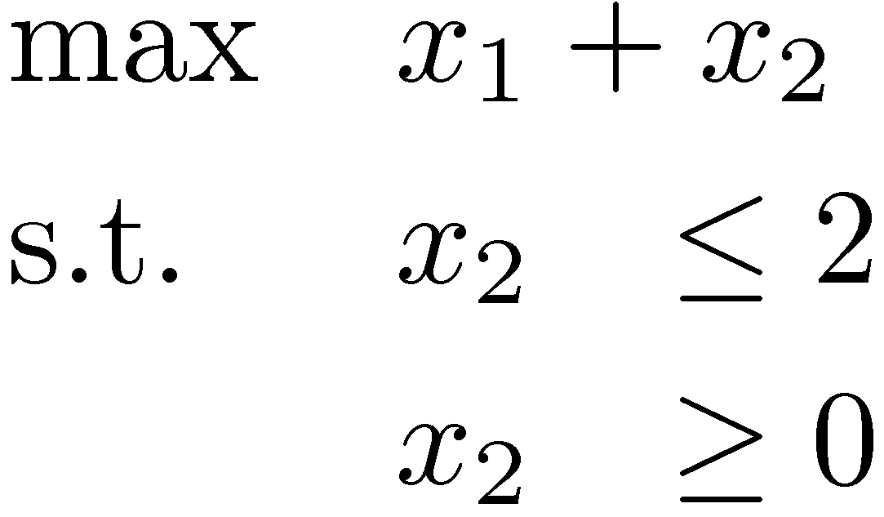
Pitfall #2: No corner points?
x₂
x₂ - x₁ ¸ 1
This is possible
  Case 1: LP infeasible
  Case 2: Not enough constraints
x₁ + 6x₂ · 15
This is unavoidable.
Algorithm must detect this case.
x₂¸0
x₁
(0,0)
x₁¸0
4x₁ - x₂ ¸ 10
x₂
x₂ · 2
A Fix!
We avoid this case by using equational form.
x₂ ¸ 0
x₁

Slide 5
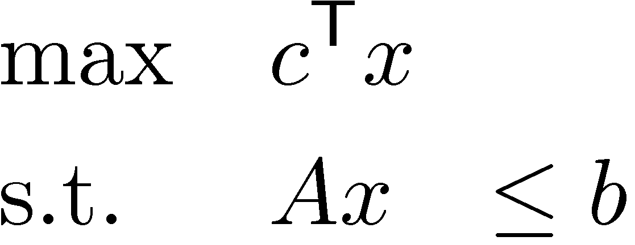
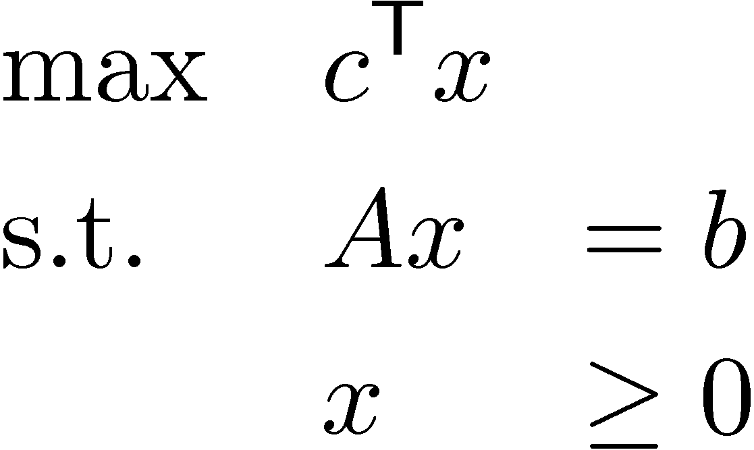
Converting to Equational Form
“Inequality form”
“Equational form”
Claim: These two forms of LPs are equivalent.
x₂
x₂ - x₁ · 1
(3,2)
x₁ + 6x₂ · 15
A
b
Tall, skinny A
x
·
x₂¸0
x₁
(0,0)
x₁¸0
4x₁ - x₂ · 10
x₂
Solutions of Ax=b
Feasible region
x
x₁
Short, fat A
A
=
b
x₃
Notes:
Textbook Section 4.1.
Textbook says “Hey, let’s suddenly switch to looking at Equational Form LPs.” They give no good justification for it. The justification is: every equational form LP has a corner point (if it is feasible).

Slide 6
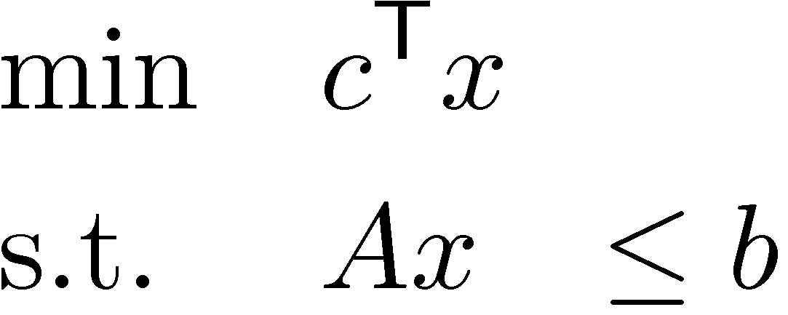
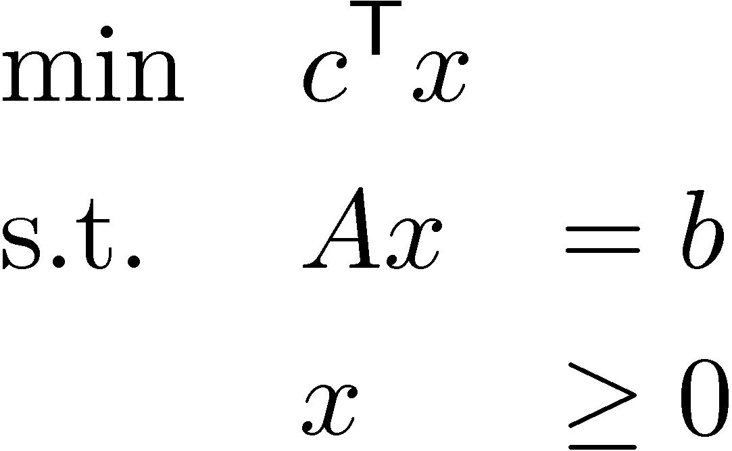
“Inequality form”
“Equational form”
←
Easy: Just use “Simple LP Manipulations” from Lecture 2
Trick 1: “¸” instead of “·”
Trick 2: “=” instead of “·”
This shows P={ x : Ax=b, x¸0 } is a polyhedron.

Slide 7
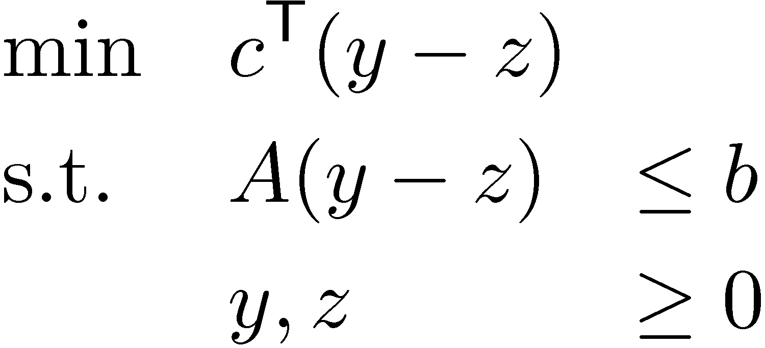
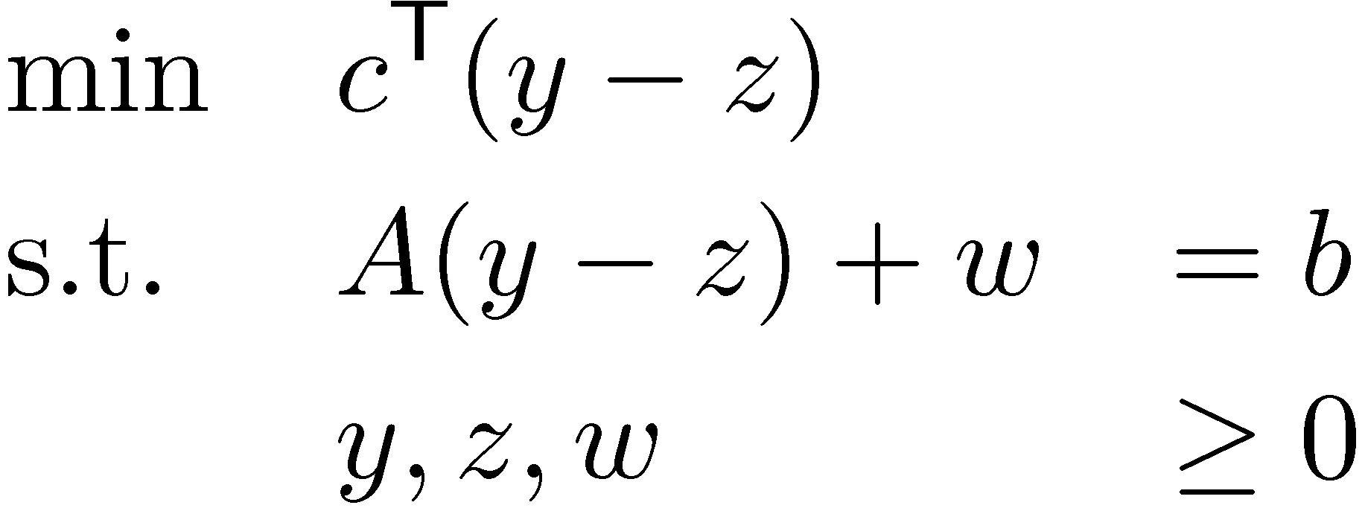

“Inequality form”
“Equational form”
→
Trick 1: x2R can be written x=y-z where y,z¸0
So
Trick 2: For u,v2R, u·v , 9w¸0 s.t. u+w=v
So
Rewrite it:
Then
´
“slack variable”
´
This is already in equational form!
´
Notes:
This is one unfortunate problem with this area. The slide contains only 2 ideas, and they’re completely trivial.
Applying those ideas to the LPs leaves a huge mess of ugly equations.

Slide 8
Pitfall #2: No corner points?
Lemma: Consider the polyhedron P = { Ax=b, x¸0 }.
If P is non-empty, it has at least one corner point.
Proof:
Claim: P contains no line.
Proof: Let L={ r+¸s : ¸2R } be a line, where r,s2R^{n} and s≠0.
WLOG s_{i}>0. Let x=r+¸s, where ¸=-r_{i}/s_{i}-1.
Then x_{i} = r_{i}+(-r_{i}/s_{i}-1)s_{i} = -s_{i} < 0 ) x∉P. ¤
Lemma from Lecture 3: “Any non-empty polyhedron containing no line must have a corner point.”
So P has a corner point. ¥
Notes:
x(\lambda) = r + \lambda s.
x(\lambda)_i = r_i + \lambda s_i.
x(\lambda)_i < 0 ⬄ r_i + \lambda s_i <0 ⬄ \lambda < -r_i / s_i

Slide 9
Local-Search Algorithm: Pitfalls & Details
Algorithm
Let x be any corner point
For each corner point y that is a neighbor of x
  If c^{T}y>c^{T}x then set x=y
Halt
What is a corner point?
What if there are no corner points?
What are the “neighboring” corner points?
What if there are no neighboring corner points?
How can I find a starting corner point?
Does the algorithm terminate?
Does it produce the right answer?
Let’s revisit #1
Notes:
So now we know what a corner point is. It is an extreme point, a vertex, and a BFS. These are all synonyms.

Slide 10
BFS for Equational Form LPs
Recall definition: x2P is a BFS , rank A_{x} = n
“x has n linearly indep. tight constraints”
Equational form LPs have another formulation of BFS
Let P = { x : Ax=b, x¸0 }µR^{n}, where A has size mxn
(Assume rank A=m, i.e., no redundant constraints)
Notation: For Bµ{1,…,n} define
A_{B} = submatrix of A containing columns indexed by B
Lemma: Fix x2P. x is a BFS , 9Bµ{1,…,n} with |B|=m s.t.
  A_{B} has full rank
  x_{i} = 0 8i∉B
Notes:
Textbook Section 4.2.
The textbook says “Hey let’s define a BFS to be a point satisfying some weird algebraic condition”. We carefully studied corner points for inequality form LPs, looked at the geometry, and gave an intuitive explanation for BFSs. Now we’ll show that this “weird algebraic condition” follows from our general definition for BFS.

Slide 11
Useful Linear Algebra Trick
W | X
0 | Y
Lemma: Let , where W and Y square.
Then det M = det W ¢ det Y.
Corollary: M non-singular , W, Y both non-singular.
M =

Slide 12
Let P = { x : Ax=b, x¸0 }. Assume rank A=m. Fix x2P.
Lemma: x is a BFS , 9Bµ{1,…,n} with |B|=m s.t.
  A_{B} has full rank
  x_{i} = 0 8i∉B
  Proof: ( direction. WLOG B={1,…,m}.
  x satisfies the constraints:
  Ax = b
  x_{i} = 0 8i∉B
  Using trick: Since A_{B} and I are non-singular, M is non-singular.
  So x satisfies n constraints of P with equality, and these constraints are linearly independent.
  ) x is a BFS. ¥
M
m
n-m
A
0 | I
m
A_{B} | A_{B}
0 | I
b
0
´
x =
n-m
B
B

Slide 13
Let P = { x : Ax=b, x¸0 }. Assume rank A=m. Fix x2P.
Lemma: x is a BFS , 9Bµ{1,…,n} with |B|=m s.t.
  A_{B} has full rank
  x_{i} = 0 8i∉B
  Proof: ) direction.
  x a BFS ) rank A_{x}=n
  The rows of A are linearly independent (m of them)
  Can augment rows of A to a basis, using only tight row-vectors
  (i.e., add n-m more tight rows, preserving linear independence)
  Let S = { i : constraint “-x_{i}·0” was added to basis }. So |S|=n-m.
  WLOG, S={m+1,…,n}.
A
-A
-I
b
-b
0
because Ax=b
The constraints:
x ·
The tight constraints:
S
S
The tight row-vectors have rank n
Note x_{i}=0 8i2S.

Slide 14
Let P = { x : Ax=b, x¸0 }. Assume rank A=m. Fix x2P.
Lemma: x is a BFS , 9Bµ{1,…,n} with |B|=m s.t.
  A_{B} has full rank
  x_{i} = 0 8i∉B
  Proof: ) direction.
  x a BFS ) rank A_{x}=n
  The rows of A are linearly indep. (m of them)
  Can augment rows of A to a basis, using only tight row-vectors
  (i.e., add n-m more tight rows, preserving linear independence)
  Let S = { i : constraint “-x_{i}·0” was added to basis }. So |S|=n-m. WLOG, S={m+1,…,n}.
  Rows are basis ) M non-sing. ) A_{S} non-sing. Take B=S. ¥
m
n-m
A_{S} | A_{S}
0 | I
m
A
0 | I
M =
rows in our basis
n-m
S
S
Note x_{i}=0 8i2S.

Slide 15
Bases
Let P = { x : Ax=b, x¸0 }. Assume rank A=m. Fix x2P.
Lemma: x is a BFS , 9Bµ{1,…,n} with |B|=m s.t.
  A_{B} has full rank
  x_{i} = 0 8i∉B
  Let’s use B to define a vector x. Set:
  x_{B} = A_{B}⁻¹ b and x_{i}=0 8i∉B
  If x¸0, B is called a feasible basis.
  Above lemma can be restated:
  If x is a BFS, then there is (at least one) feasible basis that defines it
  If basis B defines x and x¸0 then x is a BFS
B is called a “basis”
Say this x is defined by B
Note: Ax = b
Is x¸0? Maybe not…
Restrict x to components in B

Slide 16
  Our definitions:
  Bµ{1,…,n} is a basis if |B|=m and A_{B} has full rank
  Basis B defines x if A_{B}x_{B}=b and x_{i}=0 8i∉B
  Our Lemma:
  If x is a BFS, then there is (at least one) basisthat defines it
  If basis B defines x and x¸0 then x is a BFS
  Corollary: P={ x : Ax=b, x¸0 } has at most extreme points
  Gives simple algorithm for solving LP max { c^{T}x : x2P }
Brute-Force Algorithm
z = -1
For every Bµ{1,…,n} with |B|=m
  If A_{B} has full rank (B is a basis)
    Solve A_{B} x_{B} = b for x; set x_{B}=0
    If x¸0 and c^{T}x>z (x is a BFS)
    z = c^{T}x
Two Observations
It is natural to iterate over bases instead of BFS
Multiple bases can define same BFS ) algorithm can revisit same x
Gives optimal value, assuming LP is not unbounded
Notes:
Textbook p46.
Local-Search Method is a slightly-smarter version of this.

Slide 17
Revised Algorithm
Let B be a feasible basis (if none, infeasible)
For each feasible basis B’ that is a neighbor of B
  Compute BFS y defined by B’
  If c^{T}y>c^{T}x then set x=y
Halt
Revised Local-Search algorithm that gives bases a more prominent role than corner points
This will help us define “neighbors”

Slide 18
Local-Search Algorithm
Let B be a feasible basis (if none, infeasible)
For each feasible basis B’ that is a neighbor of B
  Compute BFS y defined by B’
  If c^{T}y>c^{T}x then set x=y
Halt
What is a corner point?
What if there are no corner points?
What are the “neighboring” corner points?
What if there are no neighboring corner points?
How can I find a starting corner point?
Does the algorithm terminate?
Does it produce the right answer?

Slide 19
Neighboring Bases
  Notation: A_{k} = k^{th} column of A
Suppose we have a feasible basis B (|B|=m, A_{B} full rank)
  It defines BFS x where x_{B} = A_{B}⁻¹b and x_{B} = 0
Can we find a basis “similar” to B but containing some k∉B?
…next time…

