Slide 1
C&O 355
Lecture 3
N. Harvey
http://www.math.uwaterloo.ca/~harvey/
TexPoint fonts used in EMF.
Read the TexPoint manual before you delete this box.: AAAAAAAAAA
Notes:
Review of Lecture 2:

Slide 2
Outline
Review Local-Search Algorithm
Pitfall #1: Defining corner points
  Polyhedra that don’t contain a line have corner points
Pitfall #2: No corner points?
  Equational form of LPs

Slide 3
Local-Search Algorithm: Pitfalls & Details
Algorithm
Let x be any corner point
For each corner point y that is a neighbor of x
  If c^{T}y>c^{T}x then set x=y
Halt

Slide 4
Local-Search Algorithm: Pitfalls & Details
Algorithm
Let x be any corner point
For each corner point y that is a neighbor of x
  If c^{T}y>c^{T}x then set x=y
Halt
What is a corner point?
What if there are no corner points?
What are the “neighboring” corner points?
How to choose a neighboring point?
How can I find a starting corner point?
Does the algorithm terminate?
Does it produce the right answer?

Slide 5
Pitfall #1: What is a corner point?
How should we define corner points?
Under any reasonable definition, point x should be considered a corner point
x

Slide 6
Pitfall #1: What is a corner point?
Attempt #1: “x is the ‘farthest point’ in some direction”
Let P = { feasible region }
There exists c2R^{n} s.t. c^{T}x>c^{T}y for all y2Pn{x}
“For some objective function, x is the unique optimal point when maximizing over P”
Such a point x is called a “vertex”
x is unique optimal point
c
Notes:
Textbook p53

Slide 7
Pitfall #1: What is a corner point?
Attempt #2: “There is no feasible line-segment that goes through x in both directions”
Whenever x=®y+(1-®)z with y,z≠x and ®2(0,1), then either y or z must be infeasible.
“If you write x as a convex combination of two feasible points y and z, the only possibility is x=y=z”
Such a point x is called an “extreme point”
x
z (infeasible)
y
Notes:
Textbook p55

Slide 8
Pitfall #1: What is a corner point?
Attempt #3: “x lies on the boundary of many constraints”
Note: This discussion differs from textbook
4x₁ - x₂ · 10
x₁ + 6x₂ · 15
x
x lies on boundary of
two constraints

Slide 9
Pitfall #1: What is a corner point?
Attempt #3: “x lies on the boundary of many constraints”
Note: This discussion differs from textbook
What if I introduce redundant constraints?
Not the right
condition
x₁ + 6x₂ · 15
2x₁ + 12x₂ · 30
y also lies on boundary
of two constraints
y

Slide 10
Pitfall #1: What is a corner point?
Revised Attempt #3: “x lies on the boundary of many linearly independent constraints”
Feasible region: P = { x : a_{i}^{T}x·b_{i} 8 i } ½ R^{n}
Let I_{x}={ i : a_{i}^{T}x=b_{i} } and A_{x}={ a_{i} : i2I_{x} }. (“Tight constraints”)
x is a “basic feasible solution (BFS)” if rank A_{x} = n
x₁ + 6x₂ · 15
4x₁ - x₂ · 10
2x₁ + 12x₂ · 30
y
x₁ + 6x₂ · 15
y’s constraints are linearly dependent
x
x’s constraints are linearly independent

Slide 11
Lemma: Let P be a polyhedron. The following are equivalent.
  x is a vertex
  x is an extreme point
  x is a basic feasible solution (BFS)

Slide 12
Lemma: Let P be a polyhedron. The following are equivalent.
  x is a vertex
  x is an extreme point
  x is a basic feasible solution (BFS)
Proof of (i))(ii):
x is a vertex ) 9 c s.t. x is unique maximizer of c^{T}x over P
Suppose x = ®y + (1-®)z where y,z2P and ®2(0,1).
Suppose y≠x. Then
c^{T}x = ® c^{T}y + (1-®) c^{T}z
) c^{T}x < ® c^{T}x + (1-®) c^{T}x = c^{T} x Contradiction!
So y=x. Symmetrically, z=x.
So x is an extreme point of P. ¥
· c^{T} x (since c^{T}x is optimal value)
< c^{T} x (since x is unique optimizer)

Slide 13
Lemma: Let P={ x : a_{i}^{T}x·b_{i} 8i }½R^{n}. The following are equivalent.
  x is a vertex
  x is an extreme point
  x is a basic feasible solution (BFS)
Proof Idea of (ii))(iii):
x not a BFS ) rank A_{x} · n-1
Each tight constraint removes one degree of freedom
At least one degree of freedom remains
So x can “wiggle” while staying on all the tight constraints
Then x is a convex combination of two points obtained by “wiggling”.
So x is not an extreme point.
x-w
x
x+w

Slide 14
Lemma: Let P={ x : a_{i}^{T}x·b_{i} 8i }½R^{n}. The following are equivalent.
  x is a vertex
  x is an extreme point
  x is a basic feasible solution (BFS)
Proof of (ii))(iii): We’ll show contrapositive.
x not a BFS ) rank A_{x}<n (Recall A_{x} = { a_{i} : a_{i}^{T}x=b_{i} })
Claim: 9w2R^{n}, w≠0, s.t. a_{i}^{T}w=0 8a_{i}2A_{x} (w orthogonal to all of A_{x})
Proof: Let M be matrix whose rows are the a_{i}’s in A_{x}.
dim row-space(M) + dim null-space(M) = n
But dim row-space(M)<n ) 9w≠0 in the null space. ¤
Notes:
The fact used in the claim is sometimes called “The Fundamental Theorem of Linear Algebra”

Slide 15
Lemma: Let P={ x : a_{i}^{T}x·b_{i} 8i }½R^{n}. The following are equivalent.
  x is a vertex
  x is an extreme point
  x is a basic feasible solution (BFS)
Proof of (ii))(iii): We’ll show contrapositive.
x not a BFS ) rank A_{x}<n (Recall A_{x} = { a_{i} : a_{i}^{T}x=b_{i} })
Claim: 9w2R^{n}, w≠0, s.t. a_{i}^{T}w=0 8a_{i}2A_{x} (w orthogonal to all of A_{x})
Let y=x+²w and z=x-²w, where ²>0.
Claim: If ² very small then y,z2P.
Proof: First consider tight constraints at x. (i.e., those in I_{x})
a_{i}^{T}y = a_{i}^{T}x + ²a_{i}^{T}w = b_{i} + 0
So y satisfies this constraint. Similarly for z.
Next consider the loose constraints at x. (i.e., those not in I_{x})
b_{i} - a_{i}^{T}y = b_{i} - a_{i}^{T}x - ²a_{i}^{T}w
So y satisfies these constraints. Similarly for z. ¤
¸ 0
Positive
As small as we like
Notes:
So taking epsilon = min { (b_i – a_i^Tx) / a_i^T w : a_i^T w >0 } is enough.

Slide 16
Lemma: Let P={ x : a_{i}^{T}x·b_{i} 8i }½R^{n}. The following are equivalent.
  x is a vertex
  x is an extreme point
  x is a basic feasible solution (BFS)
Proof of (ii))(iii): We’ll show contrapositive.
x not a BFS ) rank A_{x}<n (Recall A_{x} = { a_{i} : a_{i}^{T}x=b_{i} })
Claim: 9w2R^{n}, w≠0, s.t. a_{i}^{T}w=0 8a_{i}2A_{x} (w orthogonal to all of A_{x})
Let y=x+²w and z=x-²w, where ²>0.
Claim: If ² very small then y,z2P.
Then x=®y+(1-®)z, where y,z2P, y,z≠x, and ®=1/2.
So x is not an extreme point. ¥

Slide 17
Lemma: Let P={ x : a_{i}^{T}x·b_{i} 8i }½R^{n}. The following are equivalent.
  x is a vertex
  x is an extreme point
  x is a basic feasible solution (BFS)
Proof of (iii))(i):
Let x be a BFS ) rank A_{x}=n (Recall A_{x} = { a_{i} : a_{i}^{T}x=b_{i} })
Let c = §_{i2Ix} a_{i}.
Claim: c^{T}x = §_{i2Ix} b_{i}
Proof: c^{T}x = §_{i2Ix} a_{i}^{T}x = §_{i2Ix} b_{i}. ¤

Slide 18
Lemma: Let P={ x : a_{i}^{T}x·b_{i} 8i }½R^{n}. The following are equivalent.
  x is a vertex
  x is an extreme point
  x is a basic feasible solution (BFS)
Proof of (iii))(i):
Let x be a BFS ) rank A_{x}=n (Recall A_{x} = { a_{i} : a_{i}^{T}x=b_{i} })
Let c = §_{i2Ix} a_{i}.
Claim: c^{T}x = §_{i2Ix} b_{i}
Claim: x is an optimal point of max { c^{T}x : x 2 P }.
Proof: y2P ) a_{i}^{T}y · b_{i} for all i
) c^{T}y = §_{i2Ix} a_{i}^{T}y ·§_{i2Ix} b_{i} = c^{T}x. ¤
Claim: x is the unique optimal point of max { c^{T}x : x 2 P }.
Proof: If for any i2I_{x} we have a_{i}^{T}y<b_{i} then c^{T}y<c^{T}x.
So every optimal point y has a_{i}^{T}y=b_{i} for all i2I_{x}.
Since rank A_{x}=n, there is only one solution: y=x! ¤
If one of these is strict,
then this is strict.

Slide 19
Lemma: Let P={ x : a_{i}^{T}x·b_{i} 8i }½R^{n}. The following are equivalent.
  x is a vertex
  x is an extreme point
  x is a basic feasible solution (BFS)
Proof of (iii))(i):
Let x be a BFS ) rank A_{x}=n (Recall A_{x} = { a_{i} : a_{i}^{T}x=b_{i} })
Let c = §_{i2Ix} a_{i}.
Claim: c^{T}x = §_{i2Ix} b_{i}
Claim: x is an optimal point of max { c^{T}x : x 2 P }.
Claim: x is the unique optimal point of max { c^{T}x : x 2 P }.
So x is a vertex. ¥

Slide 20
More on corner points
Definition: A line is a set L={ r+¸s : ¸2R } where r,s2R^{n} and s≠0.
Lemma: Let P={ x : a_{i}^{T}x·b_{i} 8i }. Suppose P is non-empty and P does not contain any line. Then P has a corner point.
Proof Idea: Pick any x2P. Suppose x not a BFS.
At least one degree of freedom remains at x
So x can “wiggle” while staying on all the tight constraints
x cannot wiggle off to infinity in both directions because P contains no line
So when x wiggles, it hits a constraint
When it hits first constraint, it is still feasible.
So we have found a point y which has a new tight constraint.
x
y
Notes:
Assume epsilon>0.
Let y(e) = x+e*w.
y(e) is feasible if a_i*y(e)<=b_i ⬄ a_i*x+e*a_i*w<=b_i.
If a_i*w<=0 then we can choose any e.
If a_i*w>0, then need b_i-a_i*x >= e*a_i*w ⬄ e <= (b_i-a_i*x)/a_i*w.
Let z(e) = x-e*w.
z(e) is feasible if a_i*z(e)<=b_i ⬄ a_i*x -e*a_i*w<=b_i.
If a_i*w>=0 then we can choose any e.
If a_i*w<0, then need a_i*x - b_i <= e*a_i*w ⬄ e <= (a_i*x – b_i)/a_i*w.

Slide 21
Definition: A line is a set L={ r+¸s : ¸2R } where r,s2R^{n} and s≠0.
Lemma: Let P={ x : a_{i}^{T}x·b_{i} 8i }. Suppose P is non-empty and P does not contain any line. Then P has a corner point.
Proof: Pick x2P. Suppose x not a BFS.
Claim: 9w2R^{n}, w≠0, s.t. a_{i}^{T}w=0 8i2I_{x} (We saw this before)
Let y(²)=x+²w. Note y(0)=x2P.
Claim: 9² s.t. y(²)∉P. WLOG ²>0.
(Otherwise P contains a line)
Notes:
Assume epsilon>0.
Let y(e) = x+e*w.
y(e) is feasible if a_i*y(e)<=b_i ⬄ a_i*x+e*a_i*w<=b_i.
If a_i*w<=0 then we can choose any e.
If a_i*w>0, then need b_i-a_i*x >= e*a_i*w ⬄ e <= (b_i-a_i*x)/a_i*w.
Let z(e) = x-e*w.
z(e) is feasible if a_i*z(e)<=b_i ⬄ a_i*x -e*a_i*w<=b_i.
If a_i*w>=0 then we can choose any e.
If a_i*w<0, then need a_i*x - b_i <= e*a_i*w ⬄ e <= (a_i*x – b_i)/a_i*w.

Slide 22
Lemma: Let P={ x : a_{i}^{T}x·b_{i} 8i }. Suppose P is non-empty and P does not contain any line. Then P has a corner point.
Proof: Pick x2P. Suppose x not a BFS.
Claim: 9w2R^{n}, w≠0, s.t. a_{i}^{T}w=0 8i2I_{x} (We saw this before)
Let y(²)=x+²w. Note y(0)=x2P.
Claim: 9² s.t. y(²)∉P. WLOG ²>0.
So set ±=0 and gradually increase ±. What is largest ± s.t. x2P?
y(±)2P , a_{i}^{T}y(±)·b_{i} 8i
, a_{i}^{T}x+±a_{i}^{T}w·b_{i} 8i (Always satisfied if a_{i}^{T}w·0)
, ± · (b_{i}-a_{i}^{T}x)/a_{i}^{T}w 8i s.t. a_{i}^{T}w>0
Let h be the i that minimizes this. Then ±=(b_{h}-a_{h}^{T}x)/a_{h}^{T}w.
Claim: I_{x}µI_{y(±)}.
Proof: If i2I_{x} then a_{i}^{T}x=b_{i}. But a_{i}^{T}w=0, so a_{i}^{T}y(±)=b_{i} too. ¤
(Otherwise P contains a line)
Notes:
Assume epsilon>0.
Let y(e) = x+e*w.
y(e) is feasible if a_i*y(e)<=b_i ⬄ a_i*x+e*a_i*w<=b_i.
If a_i*w<=0 then we can choose any e.
If a_i*w>0, then need b_i-a_i*x >= e*a_i*w ⬄ e <= (b_i-a_i*x)/a_i*w.
Let z(e) = x-e*w.
z(e) is feasible if a_i*z(e)<=b_i ⬄ a_i*x -e*a_i*w<=b_i.
If a_i*w>=0 then we can choose any e.
If a_i*w<0, then need a_i*x - b_i <= e*a_i*w ⬄ e <= (a_i*x – b_i)/a_i*w.

Slide 23
Lemma: Let P={ x : a_{i}^{T}x·b_{i} 8i }. Suppose P is non-empty and P does not contain any line. Then P has a corner point.
Proof: Pick x2P. Suppose x not a BFS.
Claim: 9w2R^{n}, w≠0, s.t. a_{i}^{T}w=0 8i2I_{x} (We saw this before)
Let y(²)=x+²w. Note y(0)=x2P.
Claim: 9² s.t. y(²)∉P. WLOG ²>0.
So set ±=0 and gradually increase ±. What is largest ± s.t. x2P?
y(±)2P , a_{i}^{T}y(±)·b_{i} 8i
, a_{i}^{T}x+±a_{i}^{T}w·b_{i} 8i (Always satisfied if a_{i}^{T}w·0)
, ± · (b_{i}-a_{i}^{T}x)/a_{i}^{T}w 8i s.t. a_{i}^{T}w>0
Let h be the i that minimizes this. Then ±=(b_{h}-a_{h}^{T}x)/a_{h}^{T}w.
Claim: I_{x}µI_{y(±)}.
Claim: h2I_{y(±)}nI_{x}. (y(±) has at least one more tight constraint)
Proof: By definition a_{h}^{T}w>0, so h∉I_{x}.
But a_{h}^{T}y(±) = a_{h}^{T}x+±a_{h}^{T}w = a_{h}^{T}x+((b_{h}-a_{h}^{T}x)/a_{h}^{T}w)a_{h}^{T}w = b_{h} ) h2I_{y(±)}. ¤
(Otherwise P contains a line)
Notes:
Assume epsilon>0.
Let y(e) = x+e*w.
y(e) is feasible if a_i*y(e)<=b_i ⬄ a_i*x+e*a_i*w<=b_i.
If a_i*w<=0 then we can choose any e.
If a_i*w>0, then need b_i-a_i*x >= e*a_i*w ⬄ e <= (b_i-a_i*x)/a_i*w.
Let z(e) = x-e*w.
z(e) is feasible if a_i*z(e)<=b_i ⬄ a_i*x -e*a_i*w<=b_i.
If a_i*w>=0 then we can choose any e.
If a_i*w<0, then need a_i*x - b_i <= e*a_i*w ⬄ e <= (a_i*x – b_i)/a_i*w.

Slide 24
Lemma: Let P={ x : a_{i}^{T}x·b_{i} 8i }. Suppose P is non-empty and P does not contain any line. Then P has a corner point.
Proof: Pick x2P. Suppose x not a BFS.
Claim: 9w2R^{n}, w≠0, s.t. a_{i}^{T}w=0 8i2I_{x} (We saw this before)
Let y(²)=x+²w. Note y(0)=x2P.
Claim: 9² s.t. y(²)∉P. WLOG ²>0.
So set ±=0 and gradually increase ±. What is largest ± s.t. x2P?
y(±)2P , a_{i}^{T}y(±)·b_{i} 8i
, a_{i}^{T}x+±a_{i}^{T}w·b_{i} 8i (Always satisfied if a_{i}^{T}w·0)
, ± · (b_{i}-a_{i}^{T}x)/a_{i}^{T}w 8i s.t. a_{i}^{T}w>0
Let h be the i that minimizes this. Then ±=(b_{h}-a_{h}^{T}x)/a_{h}^{T}w.
Claim: I_{x}µI_{y(±)}.
Claim: h2I_{y(±)}nI_{x}. (y(±) has at least one more tight constraint)
Claim: a_{h}∉span(A_{x}).
Proof: a_{h}^{T}x<b_{h} but a_{h}^{T}y(±)=b_{h} ) 0 ≠ a_{h}^{T}( y(±)-x ) = ² a_{h}^{T}w.
But, a_{i}^{T}w=0 8a_{i}2A_{x} ) a_{i}^{T}w=0 8a_{i}2span(A_{x}) ) a_{h}∉span(A_{x}). ¤
(Otherwise P contains a line)
Notes:
Assume epsilon>0.
Let y(e) = x+e*w.
y(e) is feasible if a_i*y(e)<=b_i ⬄ a_i*x+e*a_i*w<=b_i.
If a_i*w<=0 then we can choose any e.
If a_i*w>0, then need b_i-a_i*x >= e*a_i*w ⬄ e <= (b_i-a_i*x)/a_i*w.
Let z(e) = x-e*w.
z(e) is feasible if a_i*z(e)<=b_i ⬄ a_i*x -e*a_i*w<=b_i.
If a_i*w>=0 then we can choose any e.
If a_i*w<0, then need a_i*x - b_i <= e*a_i*w ⬄ e <= (a_i*x – b_i)/a_i*w.

Slide 25
Lemma: Let P={ x : a_{i}^{T}x·b_{i} 8i }. Suppose P is non-empty and P does not contain any line. Then P has a corner point.
Proof: Pick x2P. Suppose x not a BFS.
Claim: 9w2R^{n}, w≠0, s.t. a_{i}^{T}w=0 8i2I_{x} (We saw this before)
Let y(²)=x+²w. Note y(0)=x2P.
Claim: 9² s.t. y(²)∉P. WLOG ²>0.
So set ±=0 and gradually increase ±. What is largest ± s.t. x2P?
y(±)2P , a_{i}^{T}y(±)·b_{i} 8i
, a_{i}^{T}x+±a_{i}^{T}w·b_{i} 8i (Always satisfied if a_{i}^{T}w·0)
, ± · (b_{i}-a_{i}^{T}x)/a_{i}^{T}w 8i s.t. a_{i}^{T}w>0
Let h be the i that minimizes this. Then ±=(b_{h}-a_{h}^{T}x)/a_{h}^{T}w.
Claim: I_{x}µI_{y(±)}.
Claim: h2I_{y(±)}nI_{x}. (y(±) has at least one more tight constraint)
Claim: a_{h}∉span(A_{x}).
So rank A_{y(±)} > rank A_{x}. Repeat this argument with y(±) instead of x.
Eventually find z with rank A_{z} =n ) z is a BFS. ¥
(Otherwise P contains a line)
Notes:
Assume epsilon>0.
Let y(e) = x+e*w.
y(e) is feasible if a_i*y(e)<=b_i ⬄ a_i*x+e*a_i*w<=b_i.
If a_i*w<=0 then we can choose any e.
If a_i*w>0, then need b_i-a_i*x >= e*a_i*w ⬄ e <= (b_i-a_i*x)/a_i*w.
Let z(e) = x-e*w.
z(e) is feasible if a_i*z(e)<=b_i ⬄ a_i*x -e*a_i*w<=b_i.
If a_i*w>=0 then we can choose any e.
If a_i*w<0, then need a_i*x - b_i <= e*a_i*w ⬄ e <= (a_i*x – b_i)/a_i*w.

Slide 26

Local-Search Algorithm: Pitfalls & Details
Algorithm
Let x be any corner point
For each corner point y that is a neighbor of x
  If c^{T}y>c^{T}x then set x=y
Halt
What is a corner point?
What if there are no corner points?
What are the “neighboring” corner points?
What if there are no neighboring corner points?
How can I find a starting corner point?
Does the algorithm terminate?
Does it produce the right answer?
Notes:
So now we know what a corner point is. It is an extreme point, a vertex, and a BFS. These are all synonyms.

Slide 27
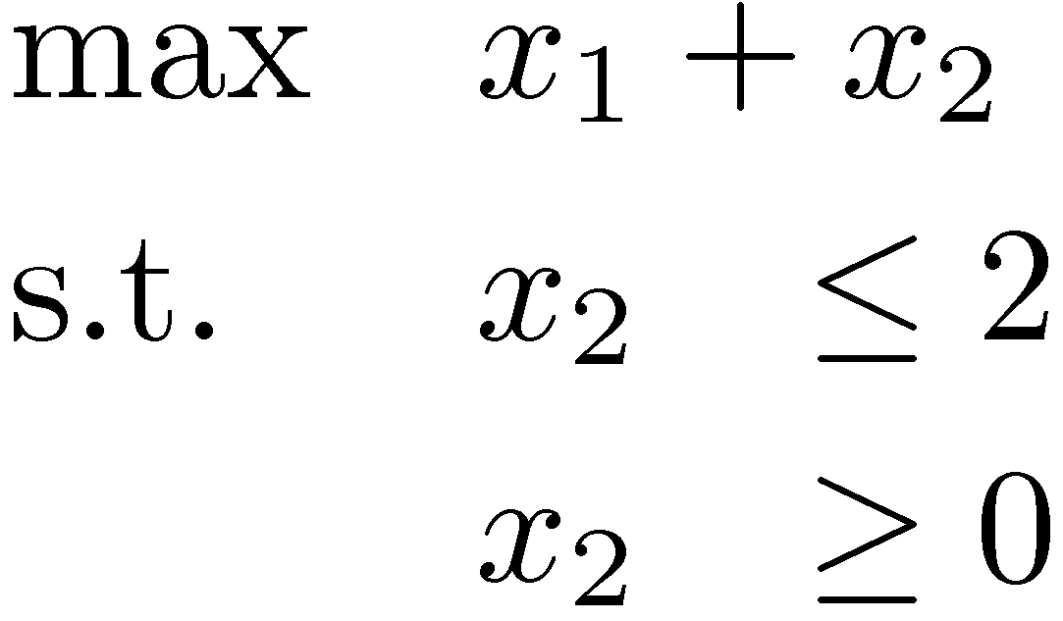
Pitfall #2: No corner points?
x₂
x₂ - x₁ ¸ 1
This is possible
  Case 1: LP infeasible
  Case 2: Not enough constraints
x₁ + 6x₂ · 15
This is unavoidable.
Algorithm must detect this case.
x₂¸0
x₁
(0,0)
x₁¸0
4x₁ - x₂ ¸ 10
x₂
x₂ · 2
A Fix!
We avoid this case by manipulating the LP a bit…
x₂ ¸ 0
x₁

Slide 28
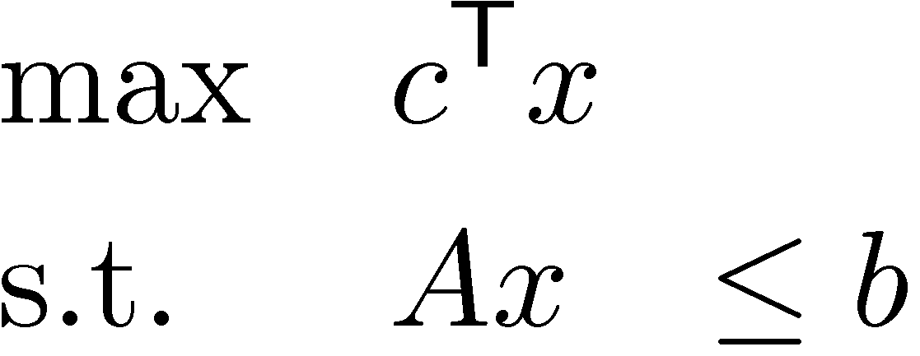
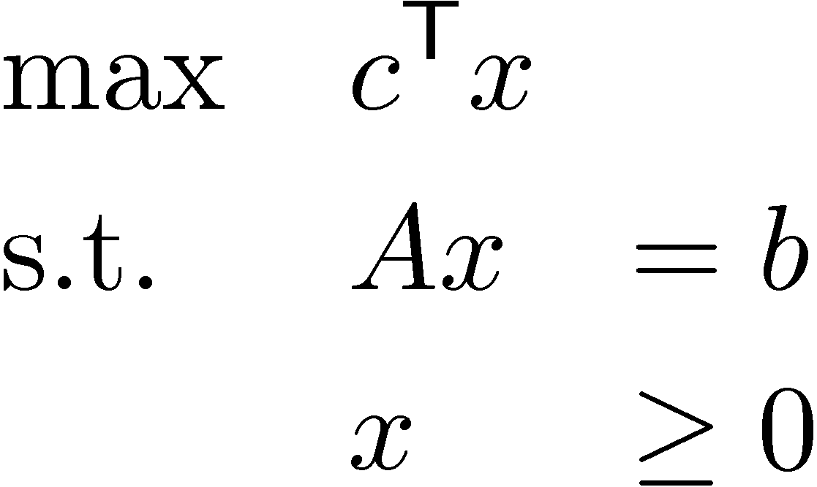
Converting to Equational Form
x₂
x₂ - x₁ · 1
General form of an LP
“Intersection of finitely
many half-spaces”
Another form of an LP
“Intersection of an affine space
with the non-negative orthant”
(3,2)
x₁ + 6x₂ · 15
x₂¸0
x₁
(0,0)
x₁¸0
4x₁ - x₂ · 10
x₂
Solutions of Ax=b
Feasible region
x₁
x₃
Notes:
Textbook Section 4.1

Slide 29
Converting to Equational Form
General form of an LP
Another form of an LP
Claim: These two forms of LPs are equivalent.
“Inequality form”
or “Canonical form”
“Equational form”
or “Standard form”
Notes:
Textbook Section 4.1

