Slide 1
C&O 355
Lecture 23
N. Harvey
TexPoint fonts used in EMF.
Read the TexPoint manual before you delete this box.: AAAAAAAAAA

Slide 2
Topics
Weight-Splitting Method
Shortest Paths
Primal-Dual Interpretation
Local-Ratio Method
Max Cut

Slide 3


Weight-Splitting Method
Let C ½ R^{n} be set of feasible solutions to some optimization problem.
Let w2R^{n} be a “weight vector”.
x is “optimal under w” if x optimizes min { w^{T} y : y2C }
Lemma: Suppose w = w₁ + w₂. Suppose that
x is optimal under w₁, and x is optimal under w₂.
Then x is optimal under w.
k
Frank ‘81
Hassin ‘82

Slide 4
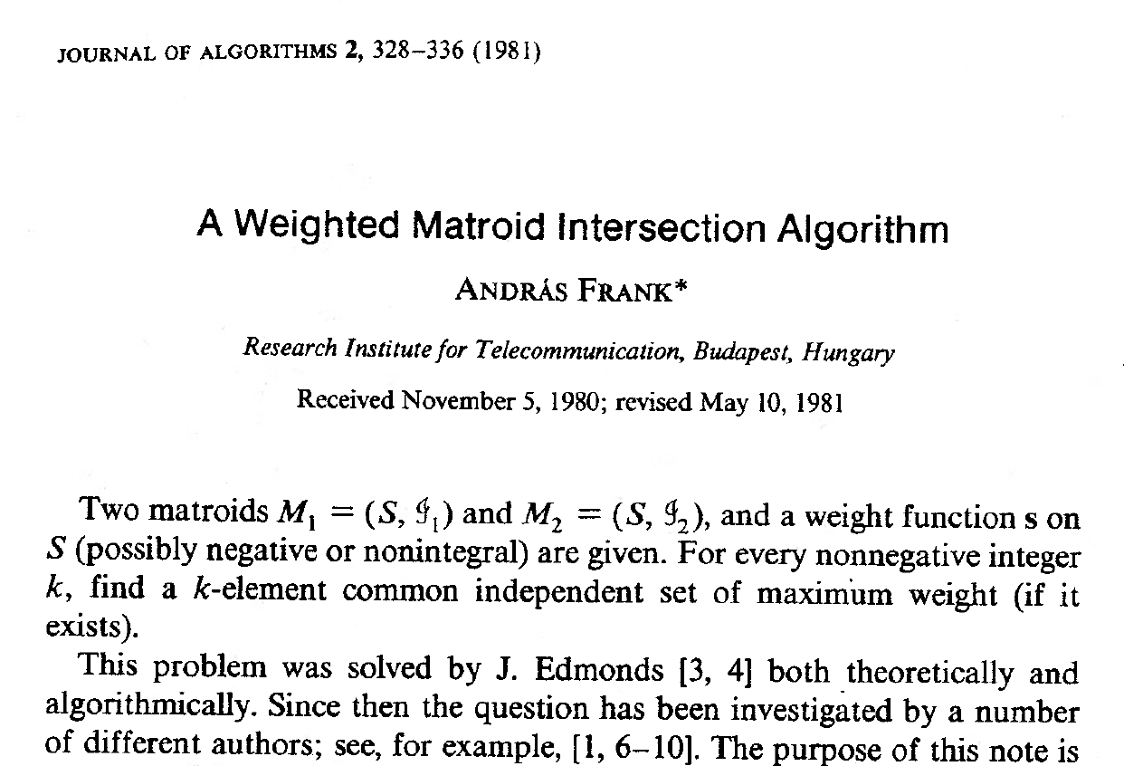
Weight-Splitting Method
Appears in this paper:
András Frank

Slide 5
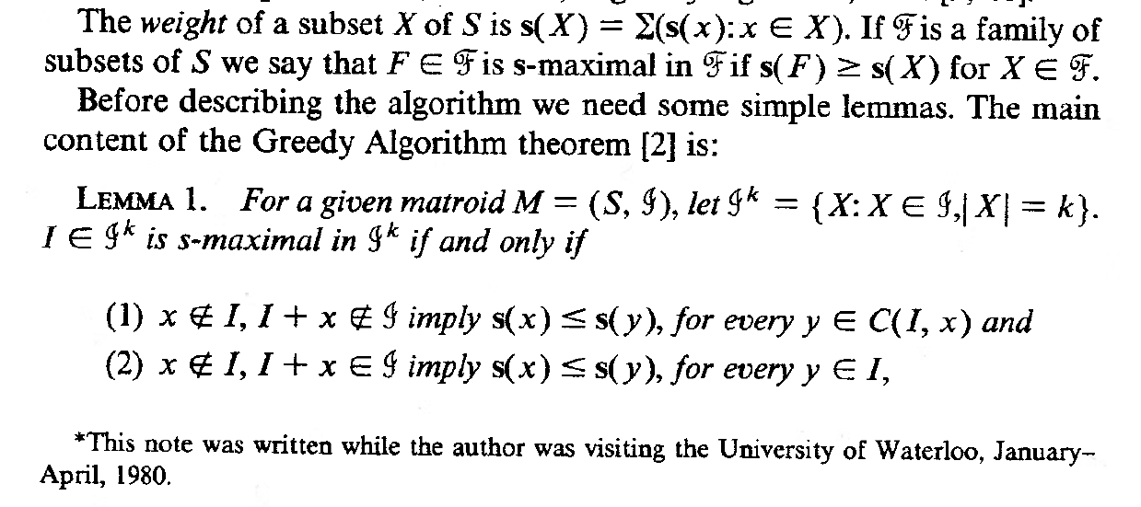
Weight-Splitting Method
Scroll down a bit…
András Frank
Weight-Splitting Method was discovered in
U. Waterloo C&O Department!

Slide 6
ShortestPath( G, S, t, w )
Input: Digraph G = (V,A), source vertices SµV,
destination vertex t2V, and integer lengths w(a),
such that w(a)>0, unless both endpoints of a are in S.
Output: A shortest path from some s2S to t.
If t2S, return the empty path p=()
Set w₁(a)=1 for all a2±⁺(S), and w¹(a)=0 otherwise
Set w₂ = w - w₁.
Set S’ = S [ { u : 9s2S with w₂( (s,u) ) = 0 }
Set p’ = (v₁,v₂,…,t) = ShortestPath( G, S’, t, w₂ )
If v₁2S, then set p=p’
Else, set p=(s,v₁,v₂,…,t) where s2S and w₂( (s,v₁) )=0
Return path p
To find shortest s-t path, run ShortestPath(G, {s}, t, w)

Slide 7
Correctness of Algorithm
Claim: Algorithm returns a shortest path from S to t.
Proof: By induction on number of recursive calls.
If t2S, then the empty path is trivially shortest.
Otherwise, p’ is a shortest path from S’ to t under w₂.
So p is a shortest path from S to t under w₂.
(Note: length_{w2}(p)=length_{w2}(p’), because if we added an arc, it has w₂-length 0.)
Note: p cannot re-enter S, otherwise a subpath of p would be a shorter S-t path. So p uses exactly one arc of ±⁺(S).
S
s
Path p
t
s'
This is a shorter S-t path

Slide 8
Correctness of Algorithm
Claim: Algorithm returns a shortest path from S to t.
Proof: By induction on number of recursive calls.
If t2S, then the empty path is trivially shortest.
Otherwise, p’ is a shortest path from S’ to t under w₂.
So p is a shortest path from S to t under w₂.
(Note: length_{w2}(p)=length_{w2}(p’), because if we added an arc, it has w₂-length 0.)
Note: p cannot re-enter S, otherwise a subpath of p would be a shorter S-t path. So p uses exactly one arc of ±⁺(S).
So length_{w1}(p)=1. But any S-t path has length at least 1 under w₁. So p is a shortest path from S to t under w₁.
) p is a shortest S-t path under arc-lengths w,
by the Weight-Splitting Lemma. ¥

Slide 9
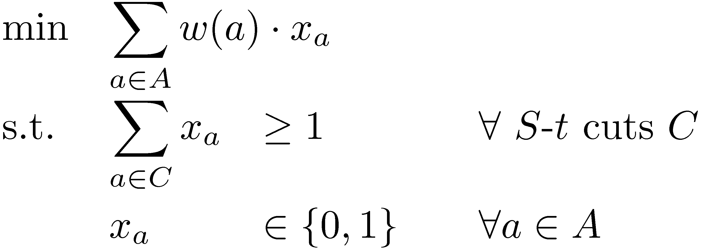
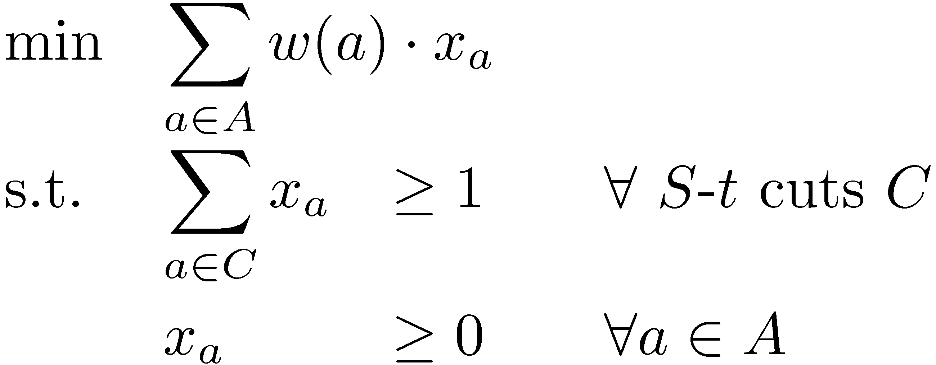
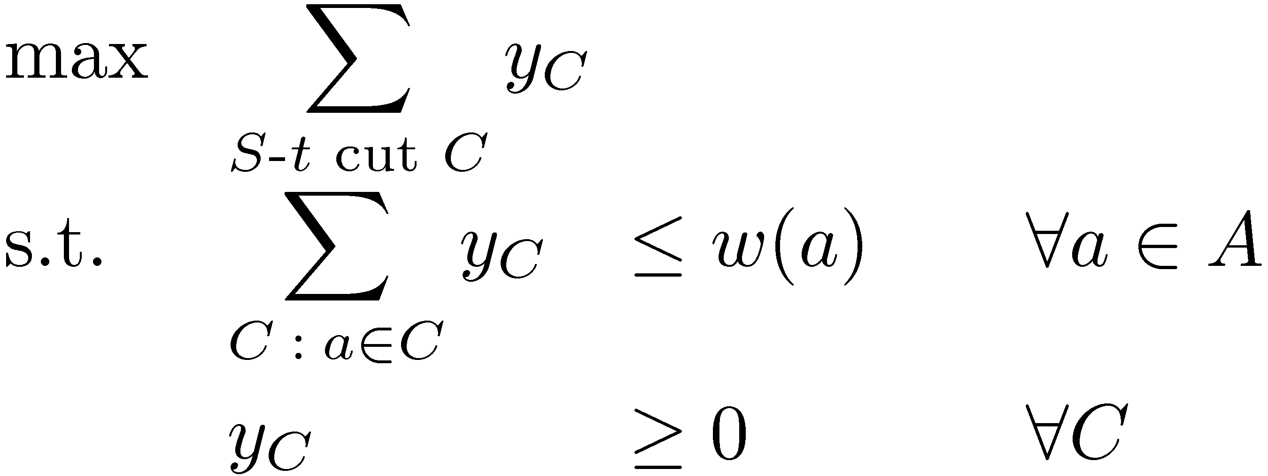
Another IP & LP for Shortest Paths
Make variable x_{a} for each arc a 2 A
The IP is:
Corresponding LP & its dual:
Make variable y_{C} for each S-t cut C
Theorem: The Weight-Splitting Algorithm finds optimal
primal and dual solutions to these LPs.

Slide 10
ShortestPath( G, S, t, w )
Output: A shortest path p from S to t, and
an optimal solution y for dual LP with weights w
If t2S
  Return (p=(), y=0)
Set w₁(a)=1 for all a2±⁺(S), and w₁(a)=0 otherwise
Set w₂ = w - w₁
Set S’ = S [ { u : 9s2S with w₂( (s,u) ) = 0 }
Set (p’,y’) = ShortestPath(G,S’,t,w₂) where p’=(v₁,v₂,…,t)
If v₁2S
  Set p=p’
Else
  Set p=(s,v₁,v₂,…,t) where s2S and w₂( (s,v₁) )=0
Set y_{C} = 1 if C=±⁺(S), otherwise y_{C} = y’_{C}
Return (p,y)

Slide 11
Proof of Theorem
Claim: y is feasible for dual LP with weights w.
Proof:
By induction, y’ feasible for dual LP with weights w²
So ∑_{C : a2C} y’_{C} · w₂(a) 8a2A
The only difference between y and y’ is y_{±+(S)} =1
So: ∑_{C : a2C} y_{C} = ∑_{C : a2C} y’_{C} + [ 1 if a2±⁺(S) ]
· w₂(a) + [ 1 if a2±⁺(S) ] = w(a)
Clearly y is non-negative
So y is feasible for dual LP with weights w. ¤

Slide 12
Let x be characteristic vector of path p,
i.e., x_{a}=1 if a2P, otherwise x_{a}=0
Note: x is feasible for primal, since p is an S-t path,
and its objective value is w^{T}x = length_{w}(p)
Claim: x is optimal for primal and y is optimal for dual.
Proof: Both x and y are feasible.
We already argued that:
length_{w2}(p)=length_{w2}(p’) and length_{w1}(p)=1
) length_{w}(p) = length_{w2}(p’) + 1
= §_{C} y’_{C} + 1
= §_{C} y_{C}
So primal objective at x = dual objective at y. ¤

Slide 13

How to solve combinatorial IPs?
Two common approaches
  Design combinatorial algorithm that directly solves IP
    Often such algorithms have a nice LP interpretation
    Eg: Weight-splitting algorithm for shortest paths
  Relax IP to an LP; prove that they give same solution; solve LP by the ellipsoid method
    Need to show special structure of the LP’s extreme points
    Sometimes we can analyze the extreme points combinatorially
    Eg: Perfect matching (in bip. graphs), Min s-t Cut, Max Flow
    Sometimes we can use algebraic structure of the constraints.
    Eg: Maximum matching, Vertex cover in bipartite graphs
    (using TUM matrices)

Slide 14
Many optimization problems are hard to solve exactly
NP
IP: max { c^{T}x : x2P, x2{0,1}^{n} }
Largest clique in graph?
Smallest vertex cover in graph?
Maximum cut in graph?
P
LP: max { c^{T}x : x2P }
Maximum Bipartite Matching, Maximum Flow,
Min s-t Cut, Shortest Path…
Since these are
hard to solve exactly, let’s instead aim for an approximate solution

Slide 15
Approximation Algorithms
Algorithms for optimization problems that give provably near-optimal solutions.
Catch-22: How can you know a solution is
near-optimal if you don’t know the optimum?
Mathematical Programming to the rescue!
Our techniques for analyzing exact solutions can often be modified to analyze approximate solutions.
  Eg: Approximate Weight-Splitting
  Eg: Relax IP to a (non-integral!) LP

Slide 16


Local-Ratio Method
(Approximate Weight-Splitting)
Let C ½ R^{n} be set of feasible solutions to an optimization problem.
Let w2R^{n} be a “weight vector”.
x is “r-approximate under w” if w^{T} x ¸ r ¢ max { w^{T} y : y2C }
Lemma: Suppose w = w₁ + w₂. Suppose that x is r-approximate under both w₁ and w₂. Then x is r-approximate under w.
Proof:
Let z be optimal under w. Let z_{i} be optimal under w_{i}, i2{1,2}.
Then:
w^{T} x = w₁^{T} x + w₂^{T} x ¸ r¢w₁^{T} z₁ + r¢w₂^{T} z₂
¸ r¢( w₁^{T} z + w₂^{T}z ) = r ¢ w^{T} z.
So x is also r-approximate under w. ¥
k
k
Bar-Yehuda
Even

Slide 17
Our Puzzle
Original Statement:
There are n students in a classroom. Every two students are either enemies or friends. The teacher wants to divide the students into two groups to work on a project while he leaves the classroom. Unfortunately, putting two enemies in the same group will likely to lead to bloodshed. So the teacher would like to partition the students into two groups in a way that maximizes the number of enemies that belong to different groups.
Restated in graph terminology:
Let G=(V,E) be a graph with n vertices.
There is an edge {u,v} if student u and v are enemies.
For U µ V, let ±(U) = { {u,v} : u2U, v∉U }
Find a set U µ V such that |±(U)| is maximized.
This is the Max Cut Problem:
max{ |±(U)| : U µ V }
This is a computationally-hard problem: there is no algorithm to solve it exactly, unless P=NP

Slide 18
Puzzle Solution
Input: |V| = 750, |E| = 3604 (# enemies)
Solutions:
A Greedy
Algorithm
Can cut at
most all edges
Who | # Cut Edges | Upper Bound on Optimum | Ratio
Student X | 1897 | 3604 | 52.6%
Me | 2962 | 3207 | 92.3%
Student Y | 2989 | 3125 | 95.6%
An algorithm
based on
Semidefinite
Programming
(Lecture 24)
Every solution cuts
at most this many edges
Simulated
Annealing
For any odd-cycle of length k,
any cut cuts at most k-1 edges.
This bound is based on
greedily packing odd-cycles.

Slide 19
History of Max Cut
Approximation Algorithms
We will see two algorithms:
  Local-Ratio Method: Also achieves ratio 50%
  Goemans-Williamson Algorithm (next Lecture)
Who | Ratio | Technique
Sahni-Gonzales 1976 | 50% | Greedy algorithm
Folklore | 50% | Random Cut
Folklore | 50% | Linear Programming
Goemans-Williamson 1995 | 87.8% | Semidefinite Programming
Trevisan 2009 | 53.1% | Spectral Graph Theory

Slide 20
Weighted Max Cut
We can handle the weighted version of the problem
Let G=(V,E) be complete graph with n vertices.
For each e2E, there is an integer weight w(e) ¸ 0
Notation:
For U µ V, let ±(U) = { {u,v} : u2U, v∉U }
Let ±(U)^{T} w denote §_{e2±(U)} w(e)
Objective:
Find a set U µ V such that ±(U)^{T} w is maximized

Slide 21
Sketch of Algorithm
  MaxCut( G, w )
  Input: Complete graph G = (V,E), edge weights w
  Output: X½V s.t. ±(X)^{T} w ¸ (1/2) ¢ optimum
If |V|=1
  Return X = ;
Else
  Pick any v2V
  Let X = MaxCut( G\v, w )
  Return either X or X[{v}, whichever is better
Analysis Idea: Either X or X[{v} cuts half the weight of edges incident on v. Since this holds for all v, we cut at least half the edges.

Slide 22
Local-Ratio Algorithm
  MaxCut( G, w )
  Input: Complete graph G = (V,E), edge weights w
  Output: X½V s.t. ±(X)^{T} w ¸ (1/2) ¢ optimum
If |V|=1
  Return X = ;
Else
  Pick any v2V
  Set w₁(e)=w(e) if e is incident on v, otherwise w₁(e)=0
  Set w₂ = w - w₁
  Let G’= G\v
  Let X’ = MaxCut( G\v, w₂ )
  Return either X’ or X’[{v}, whichever is better

Slide 23
Correctness of Algorithm
Claim: Algorithm returns X½V s.t. ±(X)^{T} w ¸ ½ optimum
Proof: By induction on |V|.
If |V|=1, then any cut is optimal.
By induction, X’ is ½-optimal for graph G’ with weights w₂.
The edges incident on v have w₂-weight zero.
So both X’ and X’[{v} are ½-optimal for G with weights w₂.
X’
X’
X’[{v}
X’
G\v
G\v
v
v

Slide 24
Correctness of Algorithm
Claim: Algorithm returns X½V s.t. ±(X)^{T} w ¸ ½ optimum
Proof: By induction on |V|.
If |V|=1, then any cut is optimal.
By induction, X’ is ½-optimal for graph G’ with weights w₂.
The edges incident on v have w₂-weight zero.
So both X’ and X’[{v} are ½-optimal for G with weights w₂.
Any cut U has w₁-weight at most §_{e2E} w₁(e)
Every edge incident on v is cut by either X’ or X’[{v}
X’
X’
X’[{v}
X’
G\v
G\v
v
v

Slide 25
Correctness of Algorithm
Claim: Algorithm returns X½V s.t. ±(X)^{T} w ¸ ½ optimum
Proof: By induction on |V|.
If |V|=1, then any cut is optimal.
By induction, X’ is ½-optimal for graph G’ with weights w₂.
The edges incident on v have w₂-weight zero.
So both X’ and X’[{v} are ½-optimal for G with weights w₂.
Any cut U has w₁-weight at most §_{e2E} w₁(e)
Every edge incident on v is cut by either X’ or X’[{v}
So ±(X’)^{T} w₁ + ±(X’[{v})^{T} w₁ = §_{e2E} w₁(e) ¸ optimum under w₁
So either X’ or X’[{v} is ½-optimal under w₁
So the better of X’ or X’[{v} is ½-optimal under w₁ and w₂
) also ½-optimal under w. ¥

Slide 26
What’s Next?
Future C&O classes you could take
If you’re unhappy that the ellipsoid method is too slow, you can learn about practical methods in:
  C&O 466: Continuous Optimization
If you liked… | You might like…
Max Flows, Min Cuts, Shortest Paths | C&O 351 “Network Flows” C&O 450 “Combinatorial Optimization” C&O 453 “Network Design”
Integer Programs | C&O 452 “Integer Programming”
Konig’s Theorem, Hall’s Theorem | C&O 342 “Intro to Graph Theory” C&O 442 “Graph Theory” C&O 444 “Algebraic Graph Theory”
Convex Functions, Subgradient Inequality, KKT Theorem | C&O 367 “Nonlinear Optimization” C&O 463 “Convex Optimization” C&O 466 “Continuous Optimization”
Semidefinite Programs | C&O 471 “Semidefinite Optimization”

