Slide 1
C&O 355
Lecture 22
N. Harvey
TexPoint fonts used in EMF.
Read the TexPoint manual before you delete this box.: AAAAAAAAAA

Slide 2
Topics
Integral Polyhedra
Minimum s-t Cuts via Ellipsoid Method
Weight-Splitting Method
Shortest Paths

Slide 3
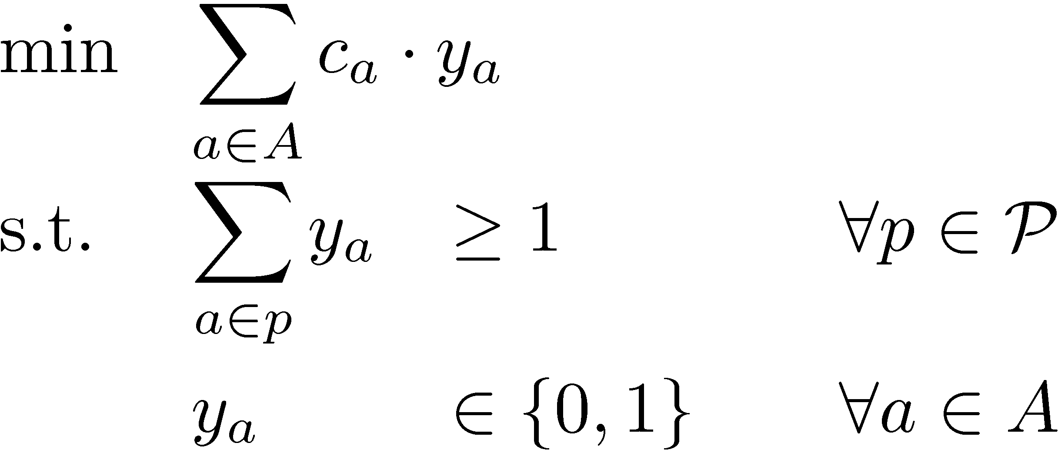
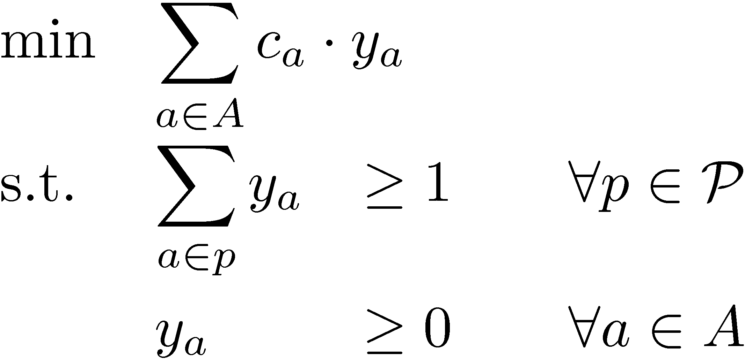
Minimum s-t Cuts
Theorem: Every optimal BFS of (LP) is optimal for (IP).
(Lecture 21)
(IP)
(LP)
So to solve (IP), we can just solve (LP) and return an optimal BFS.
To solve (LP), the separation oracle is: (Lecture 12)
Check if y_{a}<0 for any a2A. If so, the constraint “y_{a}¸0” is violated.
Check if dist_{y}(s,t)<1. If so, let p be an s-t path with length_{y}(p)<1.
Then the constraint for path p is violated.
So to compute min s-t cuts, we just need an algorithm to compute shortest dipaths!

Slide 4
Shortest Paths in a Digraph
Let G=(V,A) be a directed graph. Every arc a has a “length” w_{a}>0.
Given two vertices s and t, find a path from s to t of minimum total length.
3
7
4
2
5
1
8
1
2
t
s
2
2
2
1
1
3
These edges form a shortest s-t path

Slide 5
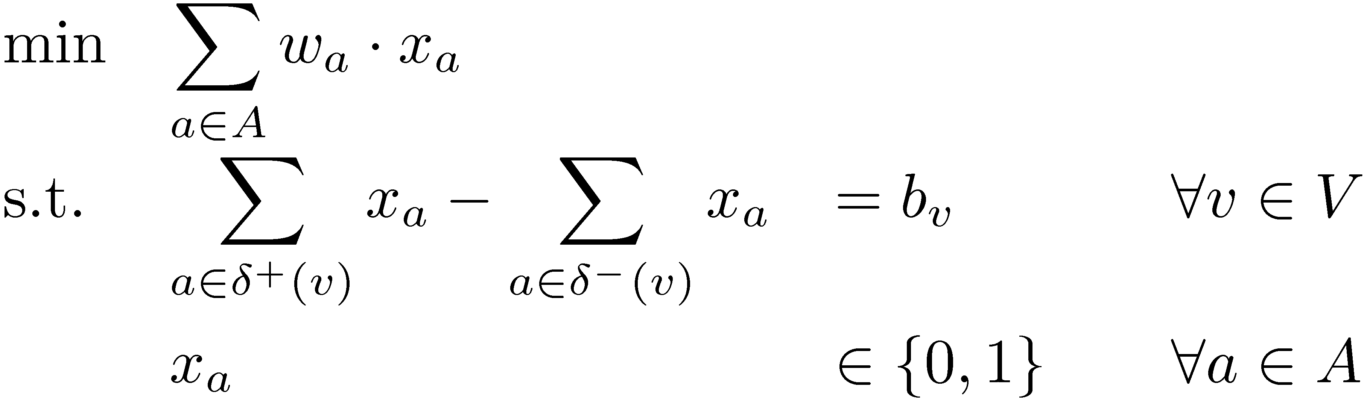
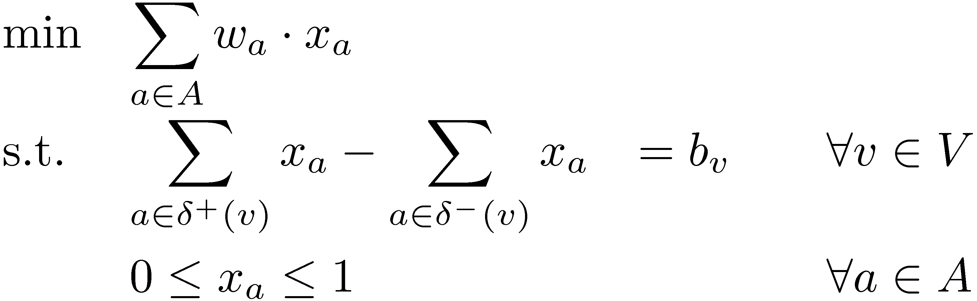
Shortest Paths in a Digraph
Let b be vector with b_{s}=1, b_{t}=-1, b_{v}=0 8v2Vn{s,t}
Consider the IP:
And the LP relaxation:
Claim: Every optimal solution of (IP) is a shortest s-t path.
(Assignment 5)
Theorem: Every optimal BFS of (LP) is optimal for (IP).

Slide 6

Our Min s-t Cut Algorithm
Minimum S-T Cut Problem
Solve by Ellipsoid Method
Separation oracle is…
Shortest Path Problem
Solve by Ellipsoid Method!
Inner LP
  Has |V| constraints, |A| variables.
  Our analysis in Lecture 12: roughly O(|A|⁶) iterations
  (actually, depends on # bits to represent lengths w)
Outer LP
  Has |P| constraints, |A| variables
  Can show O(|A|² (log² |A| + log² c_{max}) ) iterations suffice
Total
  Roughly O(|A|⁸) iterations, each taking roughly O(|A|³) time
  Total running time: roughly O(|A|¹¹)
  Best-known algorithm has running time: O(|A|^{1.5})

Slide 7
Combinatorial Algorithms
We’ve used the ellipsoid method to prove several problems are solvable in “polynomial time”
  LPs, Maximum Bipartite Matching, Max Weight Perfect Matching, Min s-t Cut, Shortest Paths
  Approximate solutions to SDPs and some Convex Programs
In practice, no one uses the ellipsoid method.
It should be viewed as a “proof of concept” that efficient algorithms exist
For many combinatorial optimization problems, combinatorial algorithms exist and are much faster
Next: a slick way to design combinatorial algorithms, based on weight splitting.

Slide 8




Weight-Splitting Method
Let C ½ R^{n} be set of feasible solutions to some optimization problem.
Let w2R^{n} be a “weight vector”.
x is “optimal under w” if x optimizes min { w^{T} y : y2C }
Lemma: Suppose w = w₁ + w₂. Suppose that
x is optimal under w₁, and x is optimal under w₂.
Then x is optimal under w.
Proof: Let z be optimal under w. Then:
w^{T} x = w₁^{T} x + w₂^{T} x · w₁^{T} z + w₂^{T} z = w^{T} z
So x is also optimal under w. ¥
k
Frank
Hassin
Bar-Yehuda
Even

Slide 9
ShortestPath( G, S, t, w )
Input: Digraph G = (V,A), source vertices SµV,
destination vertex t2V, and integer lengths w_{a},
such that w_{a}>0, unless both endpoints of a are in S.
Output: A shortest path from some s2S to t.
If t2S, return the empty path p=()
Set w₁(a)=1 for all a2±⁺(S), and w₁(a)=0 otherwise
Set w₂ = w - w₁.
Set S’ = S [ { u : 9s2S with w₂( (s,u) ) = 0 }
Set p’ = (v₁,v₂…,t) = ShortestPath( G, S’, t, w₂ )
If v₁2S, then set p=p’
Else, set p=(s,v₁,v₂,…,t) where s2S and w₂( (s,v₁) )=0
Return path p
To find shortest s-t path, run ShortestPath(G, {s}, t, w)

Slide 10
S
w
s
1
3
2
t
2
1
S
w₂
s
1
0
s
0
3
0
2
1
t
t
w₁
0
1
1
S
w₂
s
0
1
s
0
2
1
1
t
t
w₁
1
0
0
1
S
w₂
0
1
s
0
1
t
s
0
1
t
w₁
0
1
0
0

Slide 11
S
w
s
1
3
2
t
2
1
S
w₂
s
1
0
s
0
3
0
2
1
t
t
w₁
0
1
1
S
w₂
s
0
1
s
0
2
1
1
t
t
w₁
1
0
0
1
S
w₂
0
1
s
0
1
t
s
0
1
t
w₁
0
1
0
0

Slide 12
Correctness of Algorithm
Claim: Algorithm returns a shortest path from S to t.
Proof: By induction on number of recursive calls.
If t2S, then the empty path is trivially shortest.
Otherwise, p’ is a shortest path from S’ to t under w₂.
So p is a shortest path from S to t under w₂.
(Note: length_{w2}(p)=length_{w2}(p’), because if we added an arc, it has w₂-length 0.)
Note: p cannot re-enter S, otherwise a subpath of p would be a shorter S-t path. So p uses exactly one arc of ±⁺(S).
So length_{w1}(p)=1. But any S-t path has length at least 1 under w₁. So p is a shortest path from S to t under w₁.
By Weight-Splitting Lemma, p is a shortest S-t path
under arc-lengths w. ¥

