Slide 1
C&O 355
Lecture 20
N. Harvey
TexPoint fonts used in EMF.
Read the TexPoint manual before you delete this box.: AAAAAAAAAA

Slide 2
Topics
Vertex Covers
Konig’s Theorem
Hall’s Theorem
Minimum s-t Cuts

Slide 3
Maximum Bipartite Matching
Let G=(V, E) be a bipartite graph.
We’re interested in maximum size matchings.
How do I know M has maximum size? Is there a 5-edge matching?
Is there a certificate that a matching has maximum size?
Blue edges are a maximum-size matching M

Slide 4
Vertex covers
Let G=(V, E) be a graph.
A set CµV is called a vertex cover if
every edge e2E has at least one endpoint in C.
Claim: If M is a matching and C is a vertex cover then |M|·|C|.
Proof: Every edge in M has at least one endpoint in C.
Since M is a matching, its edges have distinct endpoints.
So C must contain at least |M| vertices. ¤
Blue edges are a maximum-size matching M
Red vertices form a vertex cover C

Slide 5
Vertex covers
Let G=(V, E) be a graph.
A set CµV is called a vertex cover if
every edge e2E has at least one endpoint in C.
Claim: If M is a matching and C is a vertex cover then |M|·|C|.
Proof: Every edge in M has at least one endpoint in C.
Since M is a matching, its edges have distinct endpoints.
So C must contain at least |M| vertices. ¤
Suppose we find a matching M and vertex cover C s.t. |M|=|C|.
Then M must be a maximum cardinality matching:
every other matching M’ satisfies |M’| · |C| = |M|.
And C must be a minimum cardinality vertex cover:
every other vertex cover C’ satisfies |C’| ¸ |M| = |C|.
Then M certifies optimality of C and vice-versa.

Slide 6
Vertex covers & matchings
Let G=(V, E) be a graph.
A set CµV is called a vertex cover if
every edge e2E has at least one endpoint in C.
Claim: If M is a matching and C is a vertex cover then |M|·|C|.
Suppose we find a matching M and vertex cover C s.t. |M|=|C|.
Then M certifies optimality of C and vice-versa.
Do such M and C always exist?
No…
Maximum size of a matching = 1
Minimum size of a vertex cover = 2

Slide 7
Vertex covers & matchings
Let G=(V, E) be a graph.
A set CµV is called a vertex cover if
every edge e2E has at least one endpoint in C.
Claim: If M is a matching and C is a vertex cover then |M|·|C|.
Suppose we find a matching M and vertex cover C s.t. |M|=|C|.
Then M certifies optimality of C and vice-versa.
Do such M and C always exist?
No… unless G is bipartite!
Theorem (Konig’s Theorem): If G is bipartite then there exists a matching M and a vertex cover C s.t. |M|=|C|.

Slide 8
Earlier Example
Let G=(V, E) be a bipartite graph.
We’re interested in maximum size matchings.
How do I know M has maximum size? Is there a 5-edge matching?
Is there a certificate that a matching has maximum size?
Blue edges are a maximum-size matching M
Red vertices form a vertex cover C
Since |M|=|C|=4, both M and C are optimal!

Slide 9
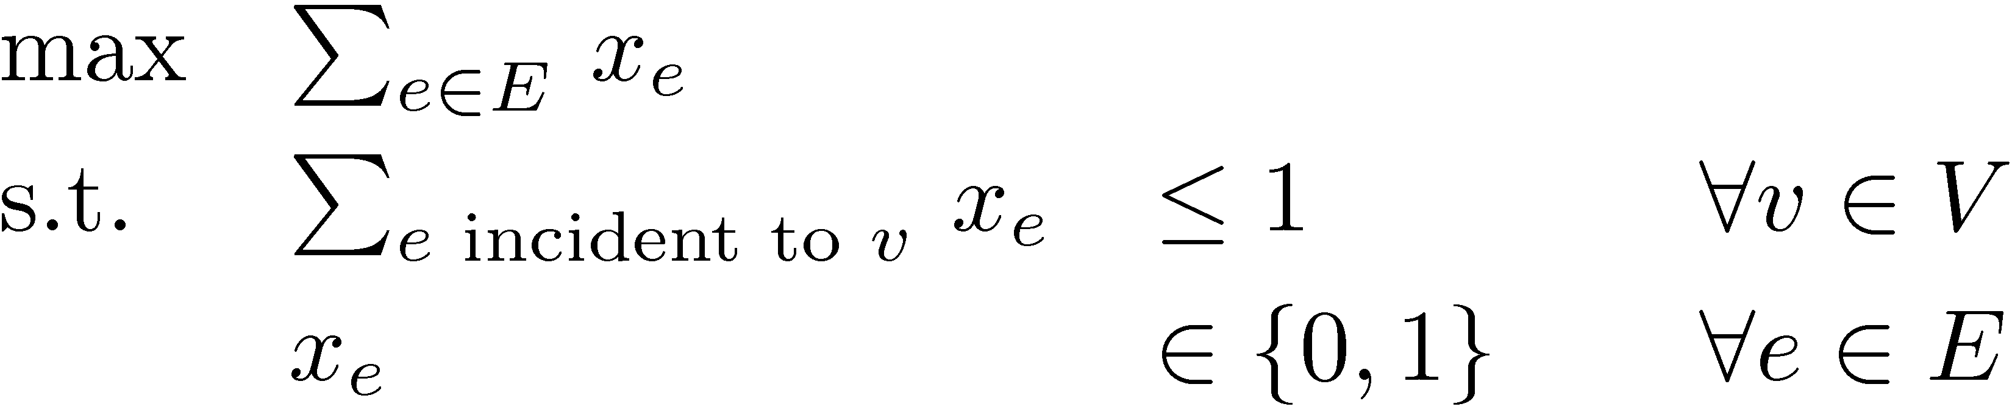
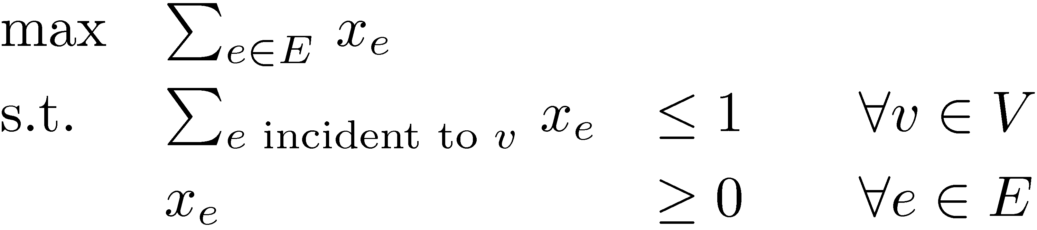
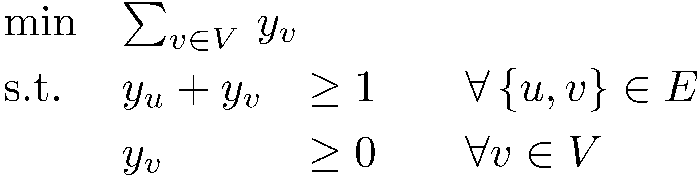
LPs for Bipartite Matching
Let G=(V, E) be a bipartite graph.
Recall our IP and LP formulations for maximum-size matching.
(IP)
(LP)
Theorem: Every BFS of (LP) is actually an (IP) solution.
What is the dual of (LP)?
(LP-Dual)

Slide 10
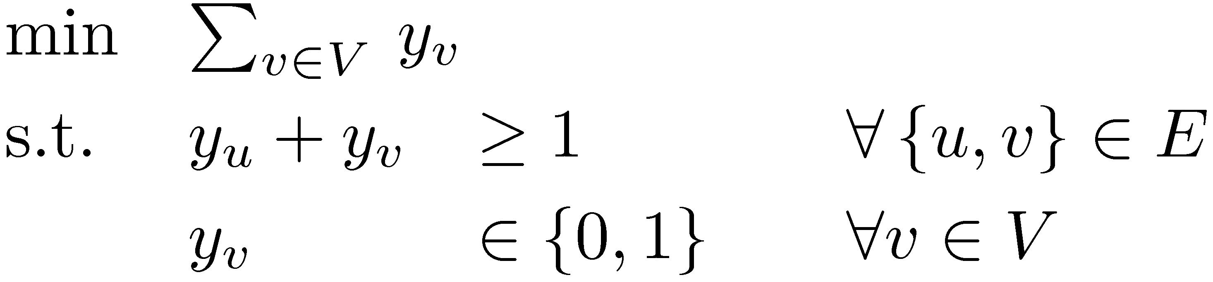
Dual of Bipartite Matching LP
What is the dual LP?
(LP-Dual)
Note that any optimal solution must satisfy y_{v} · 1 8v2V
Suppose we impose integrality constraints:
(IP-Dual)
Claim: If y is feasible for IP-dual then C = { v : y_{v}=1 } is a vertex cover. Furthermore, the objective value is |C|.
So IP-Dual is precisely the minimum vertex cover problem.
Theorem: Every optimal BFS of (LP-Dual) is an (IP-Dual) solution.

Slide 11
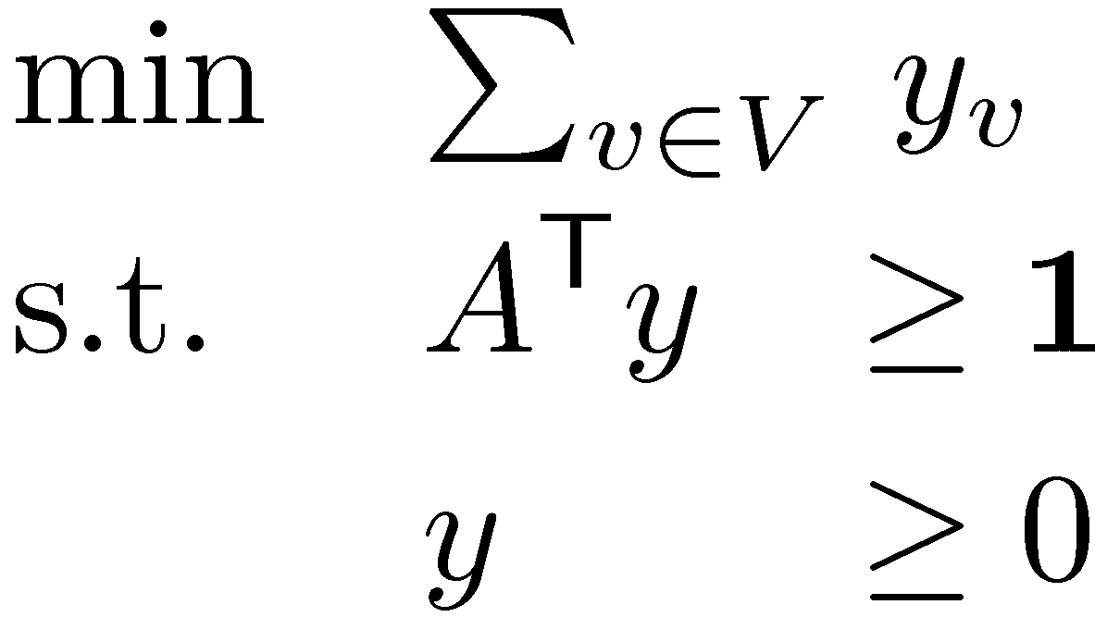
Let G=(U[V, E) be a bipartite graph. Define A by
Lemma: A is TUM.
Claim: If A is TUM then A^{T} is TUM.
Proof: Exercise on Assignment 5.
Corollary: Every BFS of P = { x : A^{T} y¸1, y¸0 } is integral.
But LP-Dual is
So our Corollary implies every BFS of LP-dual is integral
Every optimal solution must have y_{v}·1 8v2V
) every optimal BFS has y_{v}2{0,1} 8v2V, and hence it is a feasible solution for IP-Dual. ¥
1 if vertex v is an endpoint of edge e
A_{v,e} =
0 otherwise
=

Slide 12
Proof of Konig’s Theorem
Theorem (Konig’s Theorem): If G is bipartite then there exists a matching M and a vertex cover C s.t. |M|=|C|.
Proof:
Let x be an optimal BFS for (LP).
Let y be an optimal BFS for (LP-Dual).
Let M = { e : x_{e}=1 }.
M is a matching with |M| = objective value of x. (By earlier theorem)
Let C = { v : y_{v} = 1 }.
C is a vertex cover with |C| = objective value of y. (By earlier theorem)
By Strong LP Duality:
|M| = LP optimal value = LP-Dual optimal value = |C|. ¥

Slide 13
Hall’s Theorem
Let G=(U[V, E) be a bipartite graph.
Notation: For SµU,
Theorem: There exists a matching covering all vertices in U
, |¡(S)|¸|S| 8SµU.
Proof: ): This is the easy direction.
If |¡(S)|<|S| then there can be no matching covering S.
U
V
¡(S)
S

Slide 14
Theorem: There exists a matching covering all vertices in U
, |¡(S)|¸|S| 8SµU.
Proof: (: Suppose |¡(S)|¸|S| 8SµU.
Claim: Every vertex cover C has |C|¸|U|.
Then Konig’s Theorem implies there is a matching of size ¸|U|; this matching obviously covers all of U.
Proof of Claim:
Suppose C is a vertex cover with |CÅU|=k and |CÅV|<|U|-k.
Consider the set S = UnC.
Then |¡(S)| ¸ |S| = |U|-k > |CÅV|.
So there must be a vertex v in ¡(S) n (CÅV).
There is an edge {s,v} with s2S. (since v2¡(S))
But s∉C and v∉C, so {s,v} is not covered by C.
This contradicts C being a vertex cover. ¥

Slide 15
Minimum s-t Cuts
Let G=(V,A) be a digraph. Fix two vertices s,t2V.
An s-t cut is a set FµA s.t. no s-t dipath in GnF = (V,AnF)
s
t
These edges are a minimum s-t cut

Slide 16
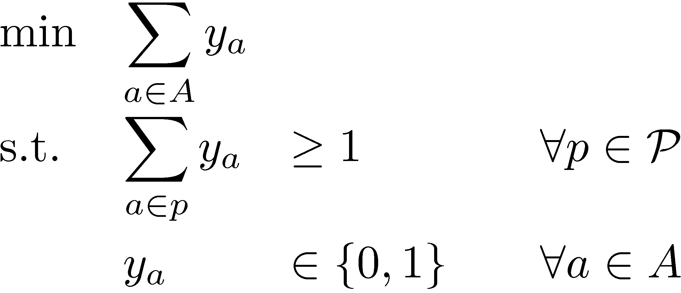
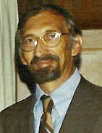
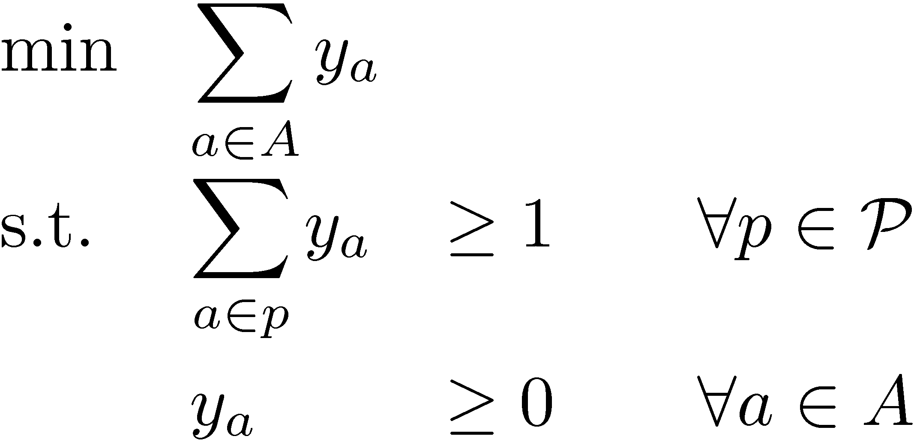
Minimum s-t Cuts
Let G=(V,A) be a digraph. Fix two vertices s,t2V.
An s-t cut is a set FµA s.t. no s-t dipath in GnF = (V,AnF)
Make variable y_{a} 8a2A. Let P be set of all s-t dipaths.
(IP)
Delbert Ray Fulkerson
(LP)
This proves half of the famous
max-flow min-cut theorem,
due to [Ford & Fulkerson, 1956].
Theorem: (Fulkerson 1970)
There is an optimal solution to (LP) that is feasible for (IP)

Slide 17
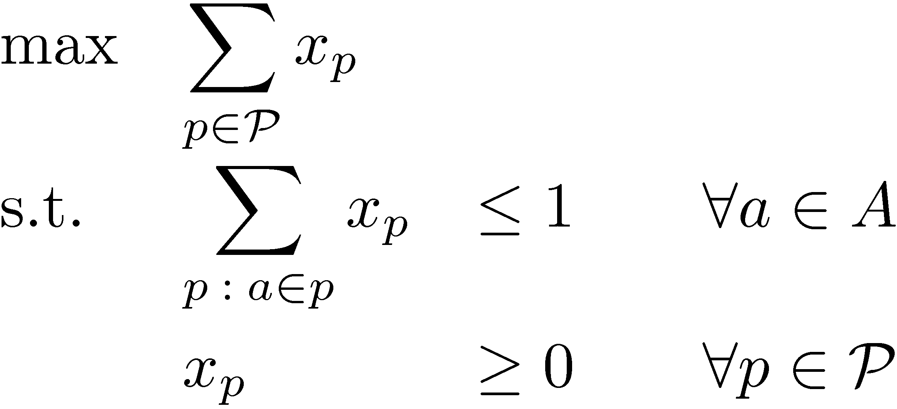
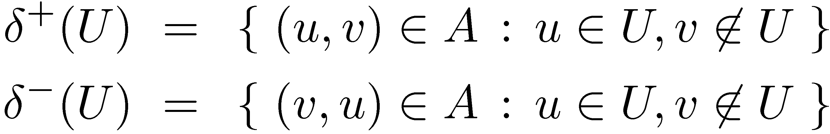
Theorem: There is an optimal solution to (LP) that is feasible for (IP)
(Fulkerson’s Proof is much more general and sophisticated than ours.)
(LP)
(LP-Dual)
=length_{y}(p)
We can think of y_{a} as the “length” of arc a
Notation: length_{y}(p) = total length of path p
dist_{y}(u,v) = shortest-path distance from u to v
For any UµV:

Slide 18
Theorem: Let y be optimal for (LP).
Let U = { u : dist_{y}(s,u)<1 }. Then ±⁺(U) is also optimal for (LP).
Note:
  s2U, since dist_{y}(s,s) = 0.
  t∉U, since length_{y}(p)¸1 for every s-t path p ) dist_{y}(s,t)¸1
Claim 1: For every path p2P, |p Å ±⁺(U)| ¸ 1.
Proof: Every path p2P starts at s2U and ends at t∉U.
So some arc of p must be in ±⁺(U). ¤
U
0.25
0.25
0
0
s
0.5
0
0
t
0
0
0
0
0
0
0.5
0.5
0
±⁺(U)

Slide 19
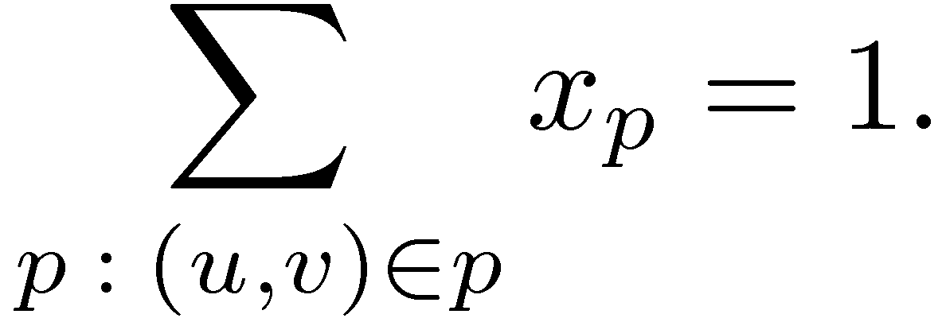
Theorem: Let y be optimal for (LP).
Let U = { u : dist_{y}(s,u)<1 }. Then ±⁺(U) is also optimal for (LP).
Claim 1: For every path p2P, |p Å ±⁺(U)| ¸ 1.
Let x be optimal for (LP-Dual).
Claim 2: For every (u,v) 2 ±⁺(U), we have y_{(u,v)}>0 and
Proof: 1 · dist_{y}(s,v) · dist_{y}(s,u) + y_{(u,v)}.
<1
This implies y_{(u,v)} > 0
since v∉U
triangle inequality
U
0.25
0.25
0
0
u
0.5
v
s
0
0
0
0
t
0
0
0
0
0.5
0.5
0
±⁺(U)

Slide 20
Theorem: Let y be optimal for (LP).
Let U = { u : dist_{y}(s,u)<1 }. Then ±⁺(U) is also optimal for (LP).
Claim 1: For every path p2P, |p Å ±⁺(U)| ¸ 1.
Let x be optimal for (LP-Dual).
Claim 2: For every (u,v) 2 ±⁺(U), we have y_{(u,v)}>0 and
Proof: 1 · dist_{y}(s,v) · dist_{y}(s,u) + y_{(u,v)}.
Since y_{(u,v)}>0, complementary slackness implies
¤
U
0.25
0.25
0
0
u
0.5
v
s
0
0
0
0
t
0
0
0
0
0.5
0.5
0
±⁺(U)

Slide 21
Claim 1: For every path p2P, |p Å ±⁺(U)| ¸ 1.
Claim 2: For every (u,v) 2 ±⁺(U), we have y_{(u,v)}>0 and
Claim 3: Every path p2P with x_{p}>0 has |p Å ±⁺(U)| = 1.
Proof: Consider a path p s.t. |p Å ±⁺(U)|¸2. (i.e., p leaves U at least twice)
Let (w,u) be any arc in p that re-enters U, i.e., (w,u) 2 pÅ±⁻(U).
length_{y}(p) ¸ dist_{y}(s,w) + y_{(w,u)} + dist_{y}(u,t)
> 1
¸ 1
> 0
U
0.25
0.25
0
0
0.5
w
s
0
0
0
0
t
0
0
0
0
0.5
0.5
0
u

Slide 22
Claim 1: For every path p2P, |p Å ±⁺(U)| ¸ 1.
Claim 2: For every (u,v) 2 ±⁺(U), we have y_{(u,v)}>0 and
Claim 3: Every path p2P with x_{p}>0 has |p Å ±⁺(U)| = 1.
Proof: Consider a path p s.t. |p Å ±⁺(U)|¸2. (i.e., p leaves U at least twice)
Let (w,u) be any arc in p that re-enters U, i.e., (w,u) 2 pÅ±⁻(U).
length_{y}(p) ¸ dist_{y}(s,w) + y_{(w,u)} + dist_{y}(u,t)
So p^{th} constraint of (LP) is not tight.
So complementary slackness implies that x_{p}=0. ¤
> 1
U
0.25
0.25
0
0
0.5
w
s
0
0
0
0
t
0
0
0
0
0.5
0.5
0
u

Slide 23
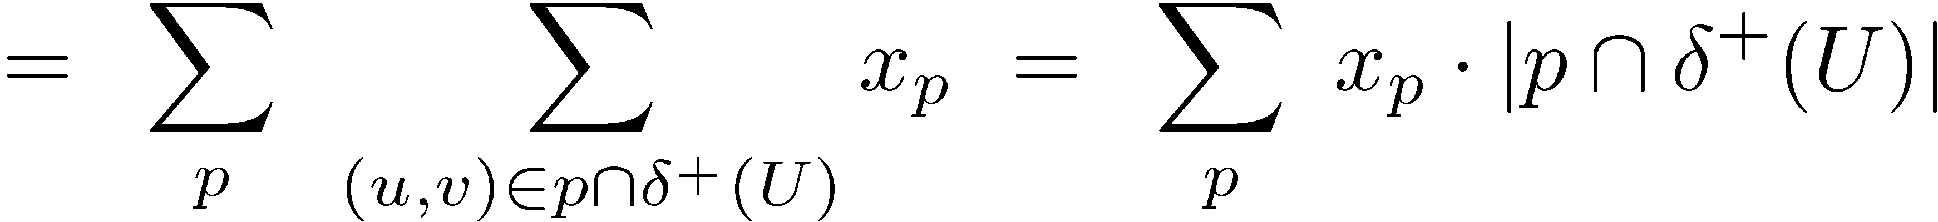
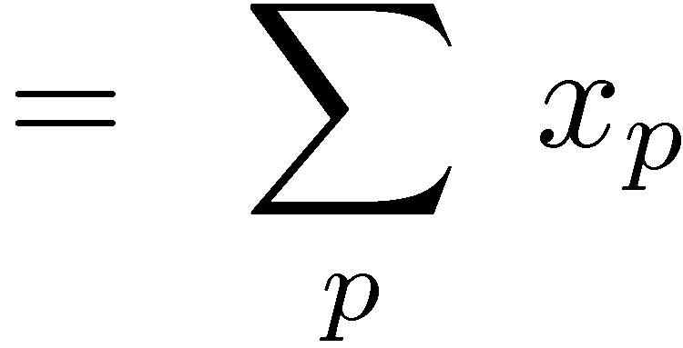
Claim 1: For every path p2P, |p Å ±⁺(U)| ¸ 1.
Claim 2: For every (u,v) 2 ±⁺(U), we have y_{(u,v)}>0 and
Claim 3: Every path p2P with x_{p}>0 has |p Å ±⁺(U)| = 1.
Define the vector z by z_{(u,v)}=1 if (u,v)2±⁺(U) and z_{(u,v)}=0 otherwise.
Note that z is feasible for (LP) and (IP). (by Claim 1)
The LP objective value at z is:
So z is optimal for (LP). ¥
by Claim 2
by Claim 3
= Optimal value of (LP-Dual)

