Slide 1
C&O 355 Lecture 2
N. Harvey
http://www.math.uwaterloo.ca/~harvey/
TexPoint fonts used in EMF.
Read the TexPoint manual before you delete this box.: AAAAAAAAAA
Notes:
Review of Lecture 1: - What is a general Mathematical Program is? Special cases: LP, Convex, SDP, IP.
- Many different areas connected to Mathematical Programming.
- If you want to work at Google, should learn Machine Learning = Statistics + Optimization.

Slide 2
Outline
LP definition & some equivalent forms
Example in 2D
Possible outcomes
Examples
Linear regression, bipartite matching, indep set
Feasible Region, Convex Sets
Corner solutions & certificates
Local-Search Algorithm

Slide 3
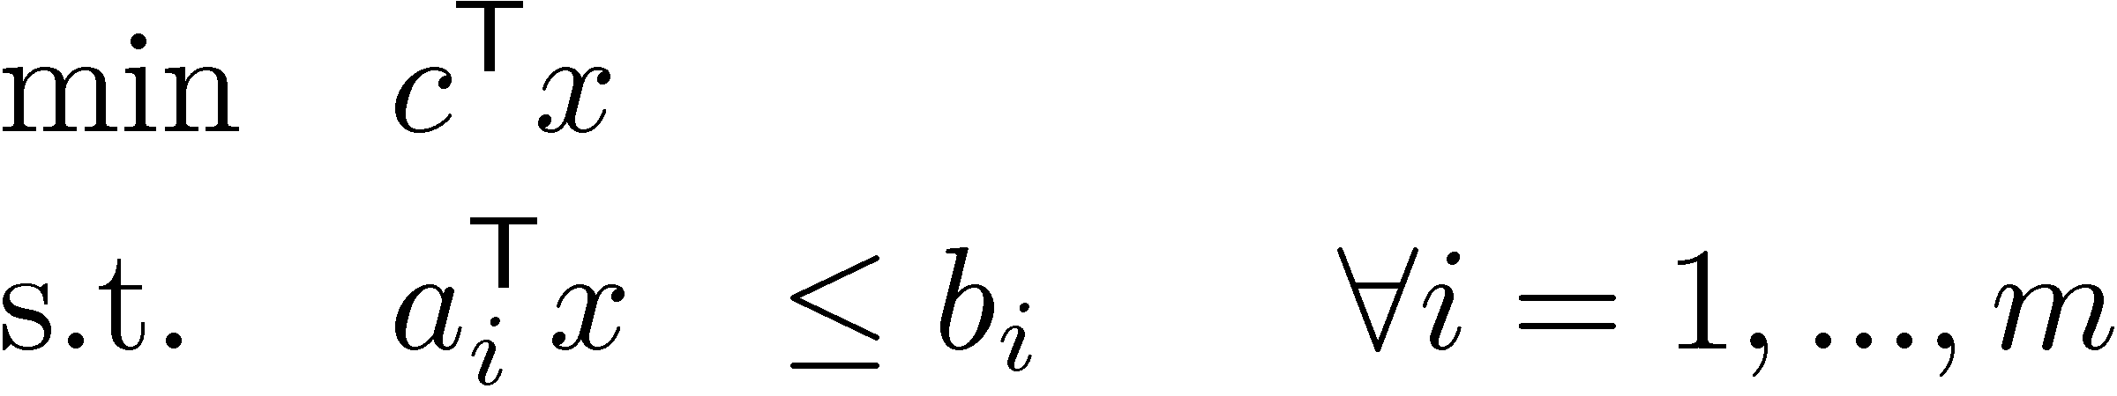
Linear Program
General definition
Parameters: c, a₁,…,a_{m}2R^{n}, b1,…,bm2R
Variables: x2R^{n}
Terminology
Feasible point: any x satisfying constraints
Optimal point: any feasible x that minimizes obj. func
Optimal value: value of obj. func for any optimal point
Objective function
Constraints

Slide 4
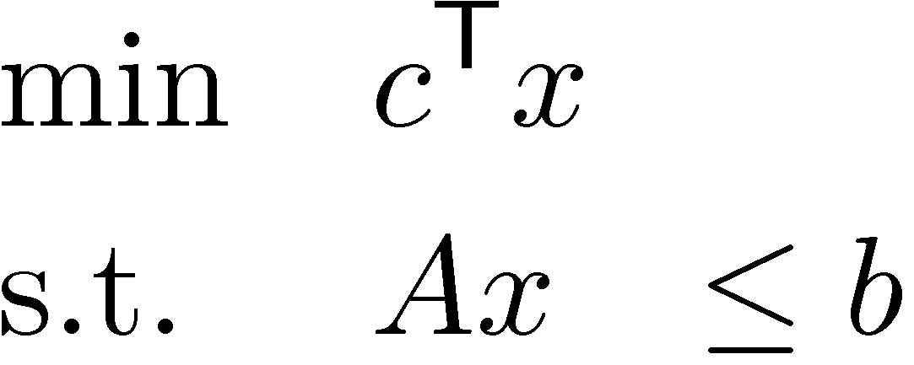
Linear Program
General definition
Parameters: c, a₁,…,a_{m}2R^{n}, b1,…,bm2R
Variables: x2R^{n}
Matrix form
Parameters: c2R^{n}, A2R^{m£n}, b2R^{m}
Variables: x2R^{n}

Slide 5
Simple LP Manipulations
“max” instead of “min”
max c^{T} x ´ min –c^{T} x
“¸” instead of “·”
a^{T}x ¸ b , -a^{T}x · -b
“=” instead of “·”
a^{T}x=b , a^{T}x · b and a^{T}x ¸ b

Slide 6
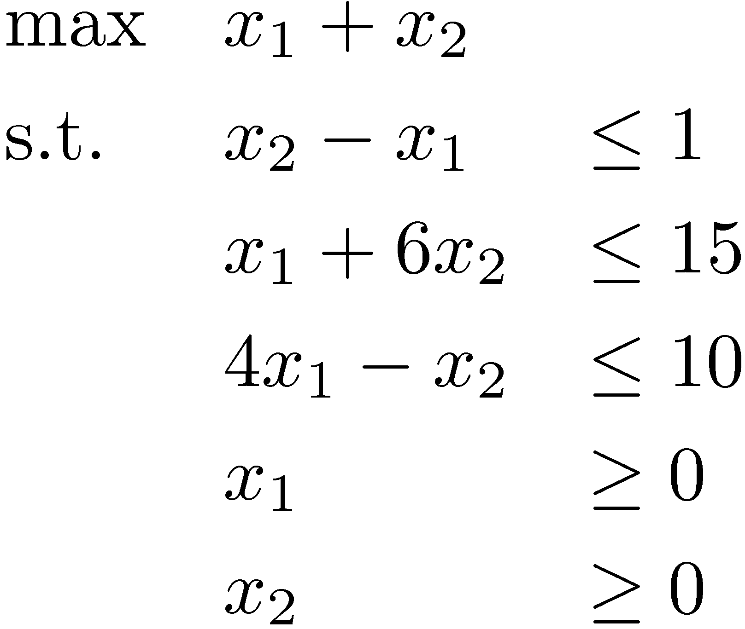
2D Example (Textbook, Ch 1)
Constraint
x₂
x₂ - x₁ · 1
Optimal
point
(3,2)
x₁ + 6x₂ · 15
Feasible region
(1,1)
x₂¸0
x₁
(0,0)
x₁¸0
4x₁ - x₂ · 10
Unique optimal solution exists

Slide 7
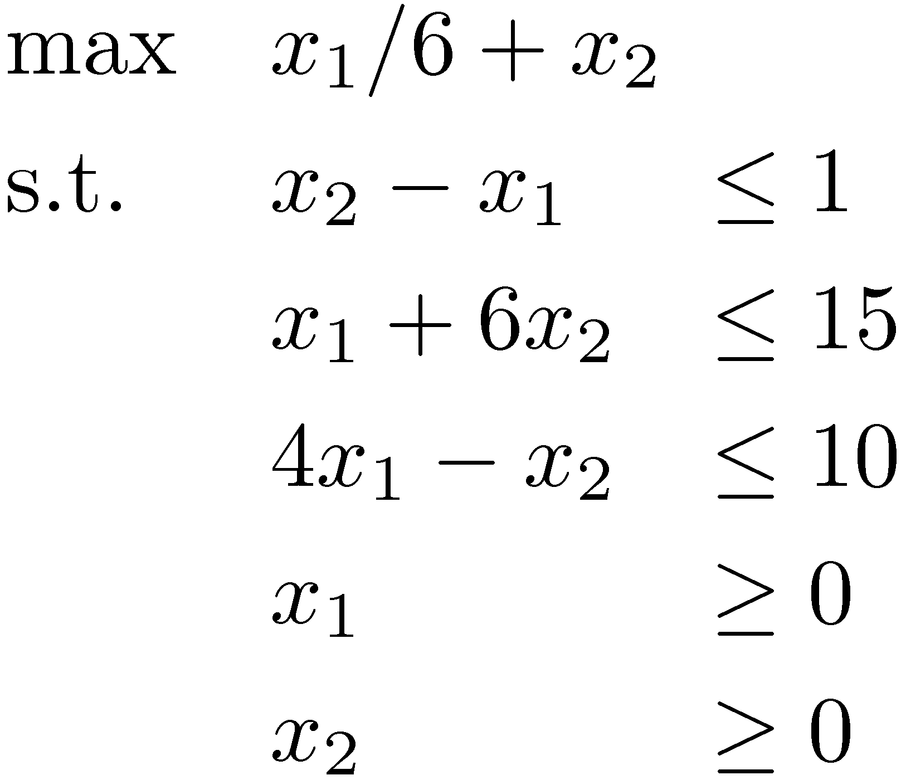
2D Example
Constraint
x₂
x₂ - x₁ · 1
Optimal
points
x₁ + 6x₂ · 15
(1/6,1)
Feasible region
x₂¸0
x₁
(0,0)
x₁¸0
4x₁ - x₂ · 10
Optimal solutions exist:
Infinitely many!

Slide 8

2D Example (Textbook, Ch 1)
Constraint
x₂
x₂ - x₁ ¸ 1
x₁ + 6x₂ · 15
No feasible region
(1,1)
x₂¸0
x₁
(0,0)
x₁¸0
4x₁ - x₂ ¸ 10
Infeasible
No feasible solutions

Slide 9
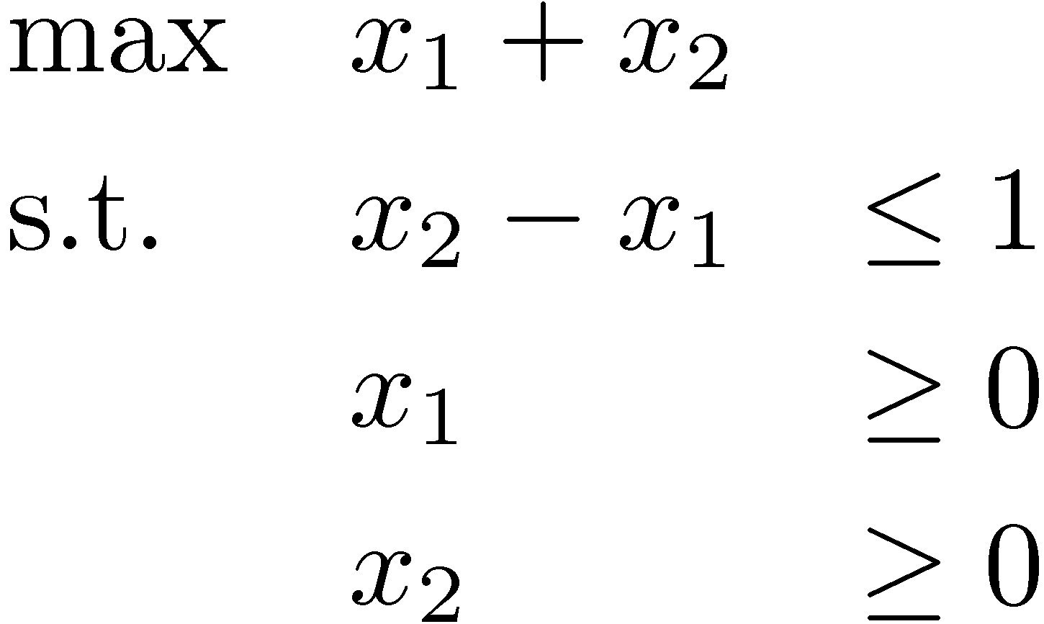
2D Example (Textbook, Ch 1)
Constraint
x₂
x₂ - x₁ · 1
(1,1)
x₂¸0
x₁
(0,0)
x₁¸0
Feasible region
Unbounded
Feasible solutions, but no optimal solution
(Optimal value = 1)

Slide 10
“Fundamental Theorem” of LP
Theorem: For any LP, the outcome is either:
Optimal solution (unique or infinitely many)
Infeasible
Unbounded (optimal value is 1 or -1)
Proof: Later in the course!
Notes:
Textbook Theorem 4.2.3

Slide 11
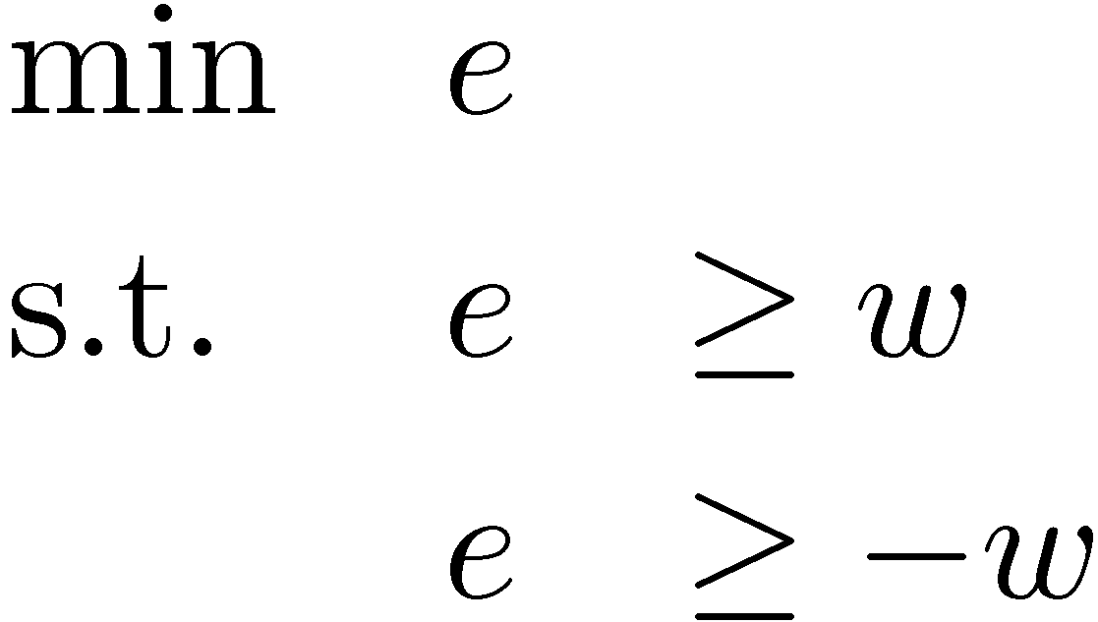
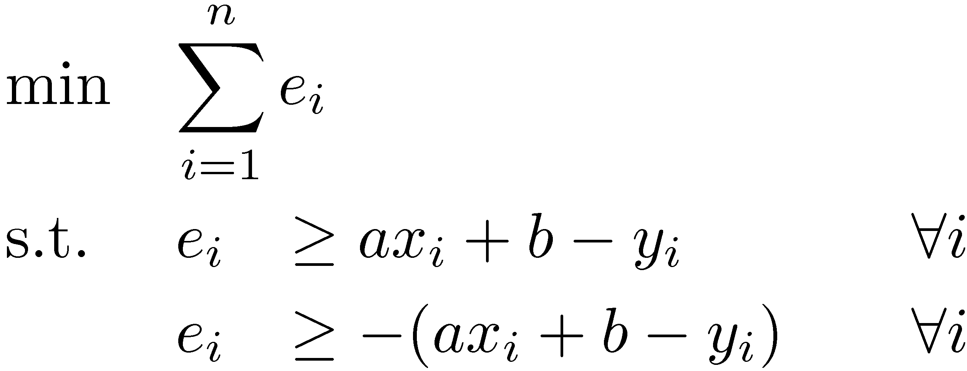
Example: Linear regression
Given data (x₁, y₁), …, (x_{n}, y_{n}) in R²
Find a line y = ax + b that fits the points
Usual setup
Our setup
Easy: differentiate, set to zero
Not differentiable!
Absolute value trick:
´
Our setup can be written as an LP
Notes:
Textbook Section 2.4
But what if I do ordinary linear regression but impose the constraint a>=0 and b>=0? Then vector calculus goes out the window. But it’s still a convex program, so we can use the theory in this course to analyze it.

Slide 12
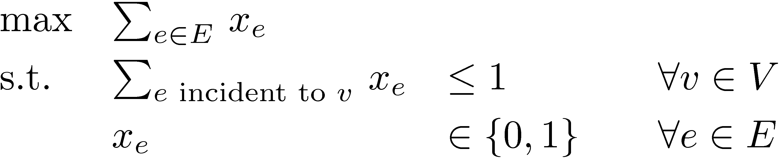
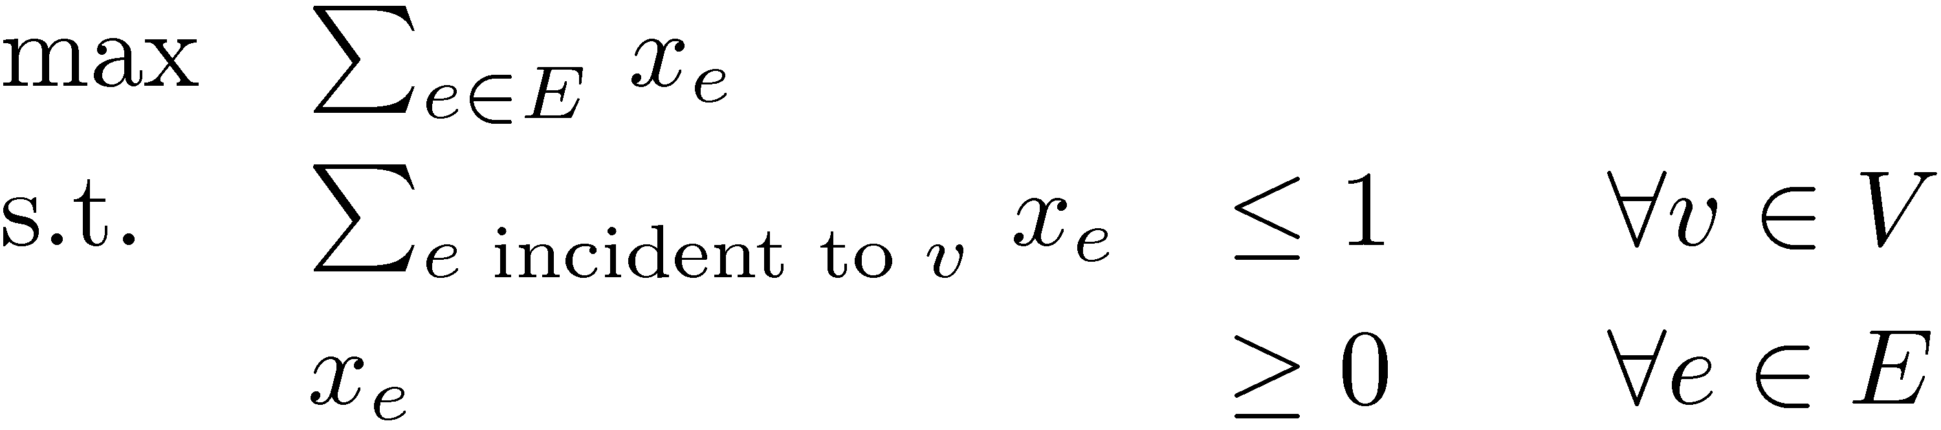
Example: Bipartite Matching
Given bipartite graph G=(V, E)
Find a maximum size matching
A set M µ E s.t. every vertex has at most one incident edge in M
Write an integer program
(IP)
But we don’t know how to solve IPs. Try an LP instead.
(LP)
Theorem: (IP) and (LP) have the same solution!
Proof: Later in the course!
Corollary: Bipartite matching can be solved efficiently (it’s in P).
Notes:
Textbook Section 3.2. We will probably do the proof in Section 8.2 (Theorem 8.2.2).

Slide 13
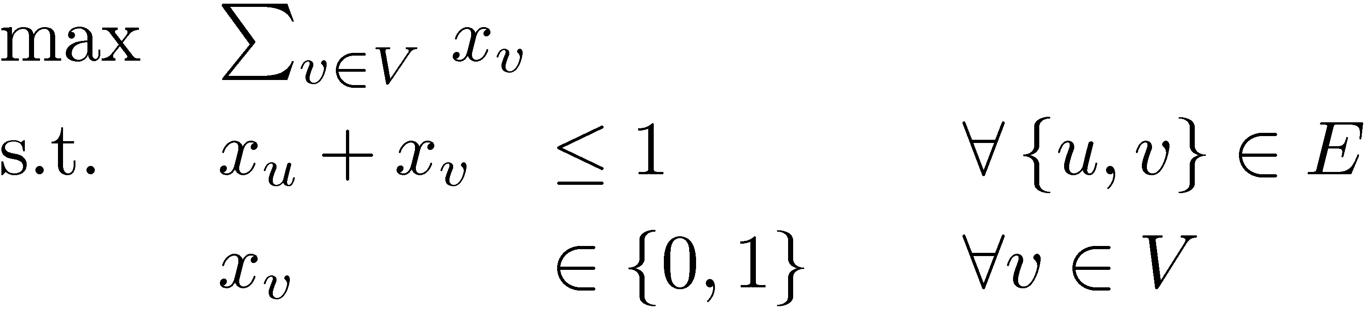
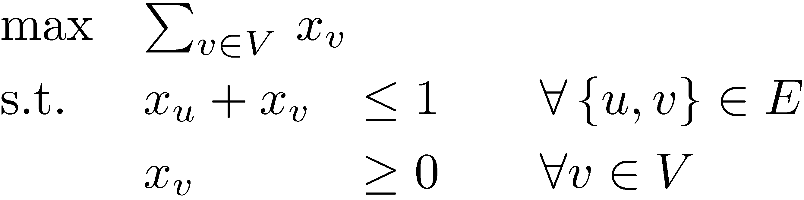
Example: Independent Set
Given graph G=(V, E)
Find a maximum size independent set
A set UµV s.t. {u,v} ∉ E for every distinct u,v 2 U
Write an integer program
(IP)
But we don’t know how to solve IPs. Try an LP instead.
(LP)
Unfortunately (IP) and (LP) are extremely different.
Fact: There are graphs for which OPT_{LP} / OPT_{IP} ¸ |V|/2.
Notes:
Textbook Section 3.4
The complete graph with x_v = 1/2 for every vertex is such an example.

Slide 14
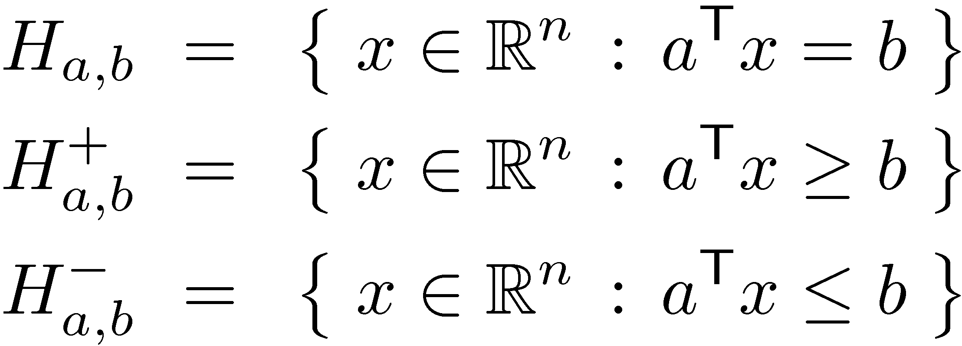
Feasible Region
For any a2R^{n}, b2R, define
So feasible region of
is
Intersection of finitely many halfspaces is polyhedron
A bounded polyhedron is a polytope, i.e., P µ { x : -M · x_{i} · M 8i } for some M
Hyperplane
Halfspaces
Notes:
Section 4.3

Slide 15
Convex Sets
C µ R^{n} is convex if for every x,y 2 C, C contains line segment between x and y.
i.e., 8®2[0,1], we have ®x + (1-®)y 2 C.
Claim 1: Any halfspace is convex.
Claim 2: The intersection of any number of convex sets is convex.
Corollary: Any polyhedron is convex.
y
y
Such a point is called a convex combination of x and y
x
x
Convex
Not convex
Notes:
1: ax<=b and ay<=b
cax<=cb and (1-c)ay<=(1-cb)
cax+(1-c)ay<=cb+(1-cb)=b
a^T(cx+(1-c)y)<=b
2: x,y in C => x,y in C_i for each i
They are convex, so cx+(1-c)y in C_i for each i
So cx+(1-c)y in C

Slide 16
Where are optimal solutions?
x₂
x₂ - x₁ · 1
x₁ + 6x₂ · 15
x₁
4x₁ - x₂ · 10

Slide 17
Where are optimal solutions?
x₂
x₂ - x₁ · 1
x₁ + 6x₂ · 15
x₁
4x₁ - x₂ · 10

Slide 18
Where are optimal solutions?
x₂
x₂ - x₁ · 1
x₁ + 6x₂ · 15
x₁
4x₁ - x₂ · 10
Lemma: For any objective function, a “corner point” is an optimal solution.
(Assuming an optimal solution exists and some corner point exists).
Proof: Later in the course!
Notes:
Textbook Theorem 4.2.3.
We’ll define corner points rigorously later on.

Slide 19
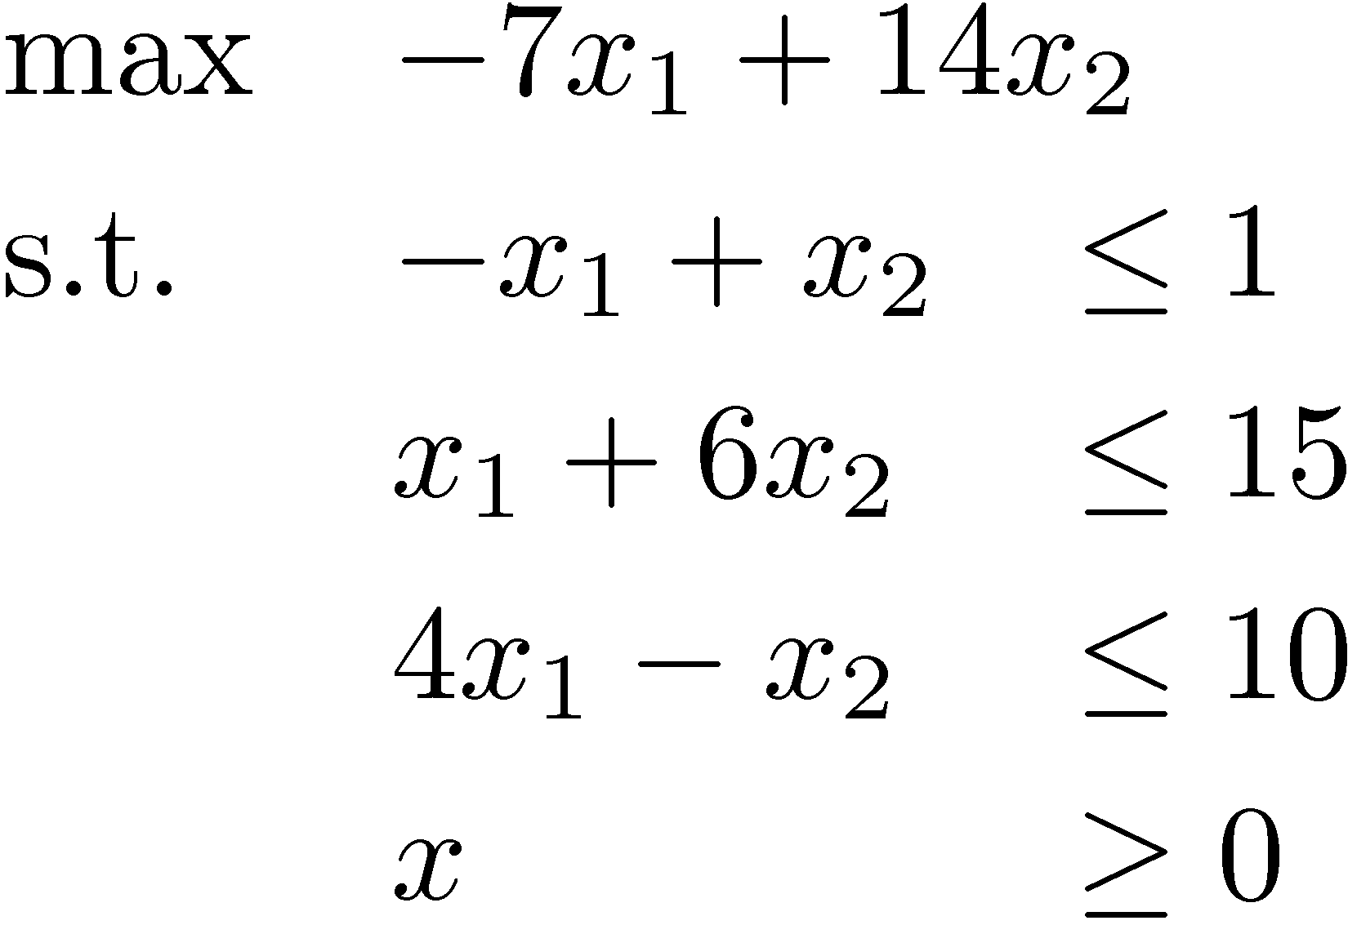
Proving optimality
Question: What is optimal point in direction c = (-7,14)?
Solution: Optimal point is x=(9/7,16/7), optimal value is 23.
How can I be sure?
Every feasible point satisfies x₁+6x₂ · 15
Every feasible point satisfies -x₁+x₂ · 1 ) -8x₁+8x₂ · 8
Every feasible point satisfies their sum: -7x₁+14x₂ · 23
x₂
This is the objective function!
(9/7,16/7)
-x₁+x₂ · 1
x₁ + 6x₂ · 15
x₁
4x₁ - x₂ · 10
Notes:
This topic is called “duality”. It is quite deep.
But don’t worry if you don’t understand it yet, this just an introductory example.
We’ll revisit this topic later.
A similar example: Textbook page 81.

Slide 20
Proving optimality
Question: What is optimal point in direction c = (-7,14)?
Solution: Optimal point is x=(9/7,16/7), optimal value is 23.
How can I be sure?
Every feasible point satisfies x₁+6x₂ · 15
Every feasible point satisfies -x₁+x₂ · 1 ) -8x₁+8x₂ · 8
Every feasible point satisfies their sum: -7x₁+14x₂ · 23
This is the objective function!
Certificates
To convince you that optimal value is ¸ k, I can find x such that c^{T} x ¸ k.
To convince you that optimal value is · k, I can find a linear combination of the constraints which proves that c^{T} x · k.
Theorem: Such certificates always exists.
Proof: Later in the course!
Notes:
This is the “strong duality theorem of linear programming”. Textbook Page 83.
The textbook contains 5 proofs, all in Chapter 6.

Slide 21
Local-Search Algorithm (The “Simplex Method”)
“The obvious idea of moving along edges from one vertex of a convex polygon to the next” [Dantzig, 1963]
Algorithm
Let x be any corner point
For each neighbor y of x
If c^{T}y>c^{T}x then set x=y
Halt
In practice, very efficient
Its analysis proves all the theorems mentioned earlier
Every known variant of this algorithm takes exponential time
Open problem: does some variant run in polynomial time?
Notes:
Simplex Method is in Chapter 5 of the text.

Slide 22
Pitfalls and missing details
Algorithm
Let x be any corner point
For each neighbor y of x
If c^{T}y>c^{T}x then set x=y
Halt
What is a corner point?
What if there are no corner points?
What are the “neighboring” corner points?
What if there are no neighboring corner points?
How can I find a starting corner point?
Does the algorithm terminate?
Does it produce the right answer?

