Slide 1
C&O 355
Lecture 12
N. Harvey
TexPoint fonts used in EMF.
Read the TexPoint manual before you delete this box.: AAAAAAAAAA

Slide 2
Topics
Polynomial-Time Algorithms
Ellipsoid Method Solves LPs in Polynomial Time
Separation Oracles
Convex Programs
Minimum s-t Cut Example

Slide 3
Polynomial Time Algorithms
  P = class of problems that can be solved efficiently
  i.e., solved in time ·n^{c}, for some constant c, where n=input size
  This is a bit vague
    Consider an LP max { c^{T}x : Ax·b } where A has size m x d
    Input is a binary file containing the matrix A, vectors b and c
  Two ways to define “input size”
      # of bits used to store the binary input file
      # of numbers in input file, i.e., m¢d + m + d
  Leads to two definitions of “efficient algorithms”
      Running time ·n^{c} where n = # bits in input file
      Running time ·n^{c} where n = m¢d + m + d
“Polynomial Time
Algorithm”
“Strongly Polynomial
Time Algorithm”

Slide 4
Algorithms for Solving LPs
Name | Publication | Running Time | Practical?
Fourier-Motzkin Elimination | Fourier 1827, Motzkin 1936 | Exponential | No
Simplex Method | Dantzig '47 | Exponential | Yes
Perceptron Method | Agmon '54, Rosenblatt '62 | Exponential | Sort of
Ellipsoid Method | Khachiyan '79 | Polynomial | No
Interior Point Method | Karmarkar '84 | Polynomial | Yes
Analytic Center Cutting Plane Method | Vaidya '89 & '96 | Polynomial | No
Random Walk Method | Bertsimas & Vempala '02-'04 | Polynomial | Probably not
Boosted Perceptron Method | Dunagan & Vempala '04 | Polynomial | Probably not
Random Shadow-Vertex Method | Kelner & Spielman '06 | Polynomial | Probably not
Unsolved Problems:
  Is there a strongly polynomial time algorithm?
  Does some implementation of simplex method run in polynomial time?

Slide 5
Why is analyzing the simplex method hard?
Recall how the algorithm works:
  It starts at a vertex of the polyhedron
  It moves to a “neighboring vertex” with better objective value
  It stops when it reaches the optimum
How many moves can this take?
For any polyhedron, and for any two vertices, can you move between them with few moves?

Slide 6
Why is analyzing the simplex method hard?
For any polyhedron, and for any two vertices, can you move between them with few moves?
The Hirsch Conjecture (1957)
Let P = { x : Ax·b } where A has size m x n.
You can move between any two vertices using
only m-n moves.
Example: A cube.
Dimension n=3.
# constraints m=6.
Do m-n=3 moves suffice?
Yes!

Slide 7
Why is analyzing the simplex method hard?
For any polyhedron, and for any two vertices, can you move between them with few moves?
The Hirsch Conjecture (1957)
Let P = { x : Ax·b } where A has size m x n.
You can move between any two vertices using
only m-n moves.
We have no idea how to prove this.
Theorem: [Kalai-Kleitman 1992] m^{log n+2} moves suffice.
Still the best known result. Proof amazingly beautiful! We might prove it later in the course…
Want to prove a better bound? A group of (eminent) mathematicians have a blog organizing a massively collaborative project to do just that.

Slide 8
Ellipsoid Method for Solving LPs
Ellipsoid method finds feasible point in P = { x : Ax · b }
i.e., it can solve a system of inequalities
But we want to optimize, i.e., solve max { c^{T}x : x2P }
Restatement of Strong Duality Theorem: (from Lecture 8)
Primal has optimal solution , Dual has optimal solution
, the following system is solvable:
“Solving an LP is equivalent to solving a system of inequalities”
) Ellipsoid method can be used to solve LPs

Slide 9
Ellipsoid Method for Solving LPs
Ellipsoid method finds feasible point in P = { x : Ax · b }
i.e., it can solve a system of inequalities
But we want to optimize, i.e., solve max { c^{T}x : x2P }
Alternative approach: Binary search for optimal value
  Suppose we know optimal value is in interval [L,U]
  Add a new constraint c^{T}x ¸ (L+U)/2
  If LP still feasible, replace L with (L+U)/2 and repeat
  If LP not feasible, replace U with (L+U)/2 and repeat
c^{T}x¸(L+U)/2
c^{T}x = L
c^{T}x = U
P

Slide 10
Issues with Ellipsoid Method
It needs to compute square roots, so it must work with irrational numbers
  Solution: Approximate irrational numbers by rationals.
  Approximations proliferate, and it gets messy.
Can only work with bounded polyhedra P
  Solution: If P non-empty, there exists a solution x s.t.
  |x_{i}|·U 8i, where U is a bound based on numbers in A and b.
  So we can assume that -U · x_{i} · U for all i.
Polyhedron P needs to contain a small ball B(z,k)
  Solution: If P = { x : Ax·b } then we can perturb b by a tiny amount. The perturbed polyhedron is feasible iff P is, and
  if it is feasible, it contains a small ball.
Notes:
See:
- Grotschel-Lovasz-Schrijver “Geometric Algorithms and Combinatorial Optimization”
- Schrijver “Theory of Linear and Integer Programming”
- Korte-Vygen “Combinatorial Optimization: Theory and Algorithms”

Slide 11
Ellipsoid Method in Polynomial Time
    Input: A polyhedron P = { x : Ax·b } where A has size m x d.
    This is given as a binary file containing matrix A and vector b.
    Input size: n = # of bits used to store this binary file
Output: A point x2P, or announce “P is empty”
Boundedness: Can add constraints -U·x_{i}·U, where U = 16^{d2n}.
The new P is contained in a ball B(0,K), where K<n¢U.
Contains ball: Add ² to b_{i}, for every i, where ² = 32^{-d2n}.
The new P contains a ball of radius k = ²¢2^{-dn} > 64^{-d2n}.
Iterations: We proved last time that:
# iterations · 4d(d+1)log(K/k), and this is < 40d⁶n²
Each iteration does only basic matrix operations and can be implemented in polynomial time.
Conclusion: Overall running time is polynomial in n (and d)!

Slide 12
What Does Ellipsoid Method Need?
The algorithm uses almost nothing about polyhedra
(basic feasible solutions, etc.)
It just needs to (repeatedly) answer the question:
Is z2P?
If not, give me a constraint “a^{T}x·b” of P violated by z
Let E(M,z) be an ellipsoid s.t. PµE(M,z)
If vol E(M,z) < vol B(0,r) then Halt: “P is empty”
If z2P, Halt: “z 2 P”
Else
Let “a_{i}^{T}x · b_{i}” be a constraint of P violated by z (i.e., a_{i}^{T}z>b_{i})
Let H = { x : a_{i}^{T}x · a_{i}^{T}z } (so P µ E(M,z)ÅH)
Let E(M’,z’) be an ellipsoid covering E(M,z)ÅH
Set M←M’ and z←z’ and go back to Start
Input: A polytope P = { Ax·b }
Output: A point x2P, or announce “P is empty”

Slide 13
The Ellipsoid Method
The algorithm uses almost nothing about polyhedra
(basic feasible solutions, etc.)
It just needs to (repeatedly) answer the question:
The algorithm works for any convex set P, as long as
you can give a separation oracle.
  P still needs to be bounded and contain a small ball.
Remarkable Theorem: [Grotschel-Lovasz-Schijver ‘81]
For any convex set PµR^{n} with a separation oracle,
you can find a feasible point efficiently.
Caveats:
  “Efficiently” depends on size of ball containing P and inside P.
  Errors approximating irrational numbers means we get “approximately feasible point”
Separation Oracle
Is z2P?
If not, find a vector a s.t. a^{T}x<a^{T}z 8x2P

Slide 14



Martin Grotschel
Laszlo Lovasz
Alexander Schrijver

Slide 15
The Ellipsoid Method For Convex Sets
Feasibility Theorem: [Grotschel-Lovasz-Schijver ‘81]
For any convex set PµR^{n} with a separation oracle,
you can find a feasible point efficiently.
  Ignoring (many, technical) details, this follows from ellipsoid algorithm
Optimization Theorem: [Grotschel-Lovasz-Schijver ‘81]
For any convex set PµR^{n} with a separation oracle,
you can solve optimization problem max { c^{T}x : x2P }.
  How?
  Follows from previous theorem and binary search on objective value.
This can be generalized to minimizing non-linear (convex) objective functions.
Separation Oracle
Is z2P?
If not, find a vector a s.t. a^{T}x<a^{T}z 8x2P

Slide 16
Separation Oracle for Ball
Let’s design a separation oracle for the convex set P = { x : kxk·1 } = unit ball B(0,1).
Input: a point z2R^{n}
If kzk·1, return “Yes”
If kzk>1, return a=z/kzk
  For all x2P we have
  a^{T}x = z^{T}x/kzk · kxk Why?
  For z we have
  a^{T}z = z^{T}z/kzk = kzk > 1 ¸ kxk ) a^{T}x < a^{T}z
Separation Oracle
Is z2P?
If not, find a vector a s.t. a^{T}x<a^{T}z 8x2P
Cauchy-Schwarz

Slide 17
Separation Oracle for Ball
Let’s design a separation oracle for the convex set P = { x : kxk·1 } = unit ball B(0,1).
Conclusion: Since we were able to give a separation oracle for P, we can optimize a linear function over it.
Note: max { c^{T}x : x2P } is a non-linear program.
(Actually, it’s a convex program.)
Our next topic:
convex analysis and convex programs!
Separation Oracle
Is z2P?
If not, find a vector a s.t. a^{T}x<a^{T}z 8x2P

Slide 18
Minimum s-t Cut in a Graph
Let G=(V,E) be a graph. Fix two vertices s,t2V.
An s-t cut is a set FµE such that, if you delete F, then s and t are disconnected
i.e., there is no s-t path in G\F = (V,E\F).
s
t

Slide 19
Minimum s-t Cut in a Graph
Let G=(V,E) be a graph. Fix two vertices s,t2V.
An s-t cut is a set FµE such that, if you delete F, then s and t are disconnected
i.e., there is no s-t path in G\F = (V,E\F).
s
t
These edges are an s-t cut

Slide 20
Minimum s-t Cut in a Graph
Let G=(V,E) be a graph. Fix two vertices s,t2V.
An s-t cut is a set FµE such that, if you delete F, then s and t are disconnected
i.e., there is no s-t path in G\F = (V,E\F).
s
t
These edges are a minimum s-t cut

Slide 21
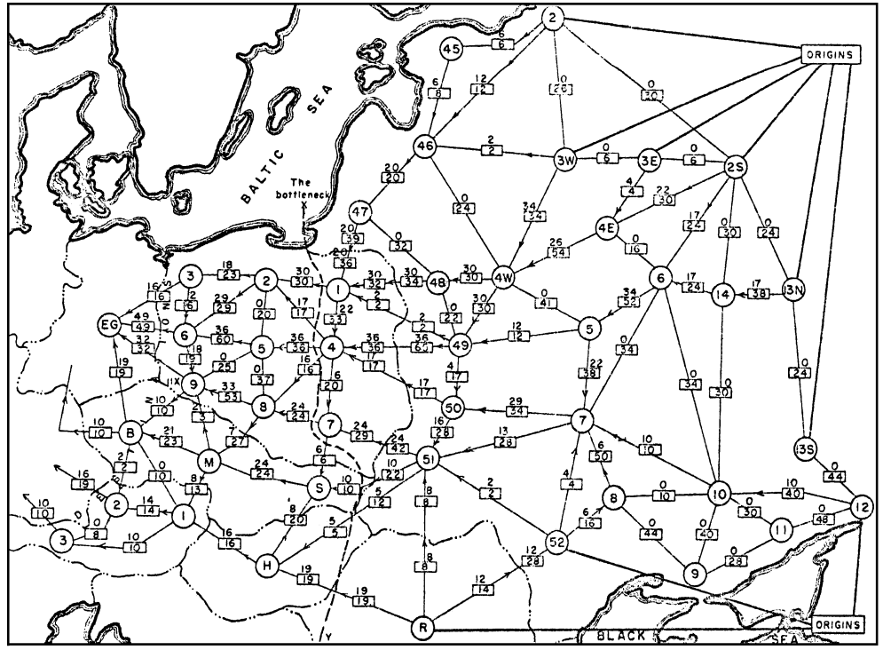
Minimum Cut Example
From Harris and Ross [1955]: Schematic diagram of the railway network of the Western Soviet
Union and Eastern European countries, with a maximum flow of value 163,000 tons from
Russia to Eastern Europe, and a cut of capacity 163,000 tons indicated as `The bottleneck'.
Notes:
From Schrijver “On the history of combinatorial optimziation (till 1960)”

Slide 22
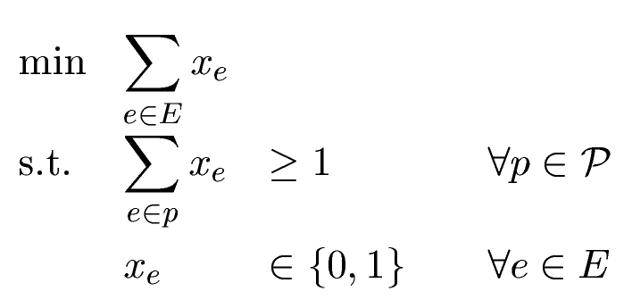
Minimum s-t Cut in a Graph
Let G=(V,E) be a graph. Fix two vertices s,t2V.
An s-t cut is a set FµE such that, if you delete F,
then s and t are disconnected
i.e., there is no s-t path in GnF = (V,EnF).
Can write this as an integer program.
Make variable x_{e} for every e 2 E.
Let P be (huge!) set of all s-t paths.

Slide 23
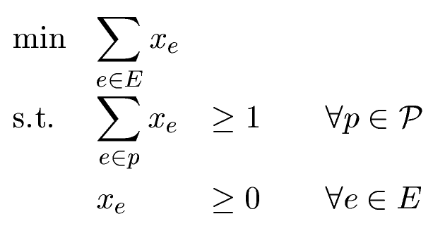
Minimum s-t Cut in a Graph
Can write this as an integer program.
Make variable x_{e} for every e 2 E.
Let P be (huge!) set of all s-t paths.
We don’t know how to deal with integer programs,
so relax it to a linear program.
Theorem: Every BFS of this LP has x_{e}2{0,1} 8e2E.
(So integer program and linear program are basically the same!)
Proof: Maybe later in the course, maybe in C&O 450.
Notes:
See Schrijver “Combinatorial Optimization: Polyhedra and Efficiency” Corollary 13.1c

Slide 24
Minimum s-t Cut in a Graph
How can we solve this LP?
If graph has |V|=n, then |P| can be enormous!
(Exponential in n).
Our local-search algorithm will take a very long time.
Can use Ellipsoid method, if we can give separation oracle.

Slide 25
Minimum s-t Cut in a Graph
Separation Oracle
Is z2P?
If not, find a vector a s.t. a^{T}x<a^{T}z 8x2P
Can use Ellipsoid method, if we can give separation oracle.
If I give you z, can you decide if it is feasible?
Need to test if §_{e2p} z_{e} ¸ 1 for every s-t path p.
Think of value z_{e} as giving “length” of edge e.
Need to test if shortest s-t path p* has length ¸ 1.
If so, z is feasible. If not, constraint for p* is violated by z.

Slide 26
Minimum s-t Cut in a Graph
If I give you z, can you decide if it is feasible?
Need to test if §_{e2p} z_{e} ¸ 1 for every s-t path p.
Think of value z_{e} as giving “length” of edge e.
Need to test if shortest s-t path p* has length ¸ 1.
If so, z is feasible. If not, constraint for p* is violated by z.
How to efficiently find shortest s-t path in a graph?
There are efficient algorithms that don’t check every path.
e.g., Dijkstra’s algorithm. Such topics are discussed in C&O 351.
Another way: Let’s use our favorite trick again.
Write down IP, relax to LP, prove they are equivalent, then solve using the Ellipsoid Method!

Slide 27

This can get crazy…
A common Linear Program
relaxation of
Traveling Salesman Problem
Everything runs in polynomial time!
Solve by Ellipsoid Method
Separation oracle uses…
Minimum S-T Cut Problem
Solve by Ellipsoid Method
Separation oracle is…
Shortest Path Problem
Solve by Ellipsoid Method!

Slide 28
Solving Discrete Optimization Problems
How to efficiently find shortest s-t path in a graph?
Let’s use our favorite trick again.
Write down IP, relax to LP, prove they are equivalent, then solve using the Ellipsoid Method!
Very general & powerful approach for solving discrete optimization problems.
Almost every problem discussed in C&O 351 and C&O 450 can be solved this way.
Main Ingredient: Proving that the Integer Program and Linear Program give the same solution.
We will discuss this topic in last few weeks of CO 355.

