Slide 1
C&O 355
Lecture 11
N. Harvey
TexPoint fonts used in EMF.
Read the TexPoint manual before you delete this box.: AAAAAAAAAA

Slide 2
Topics
The Ellipsoid Method
Covering Half-Ellipsoids by Ellipsoids

Slide 3
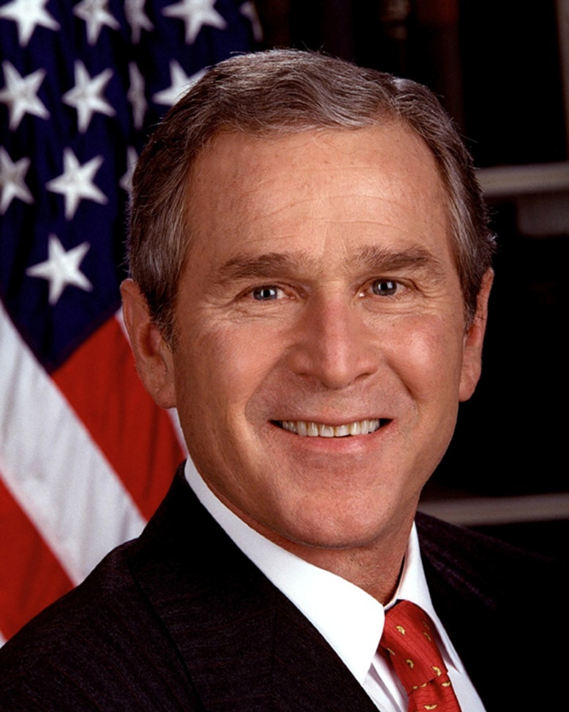
Our Hero
“Intelligence gathered by this and other governments leaves no doubt that the Iraq regime continues to possess and conceal some of the most lethal weapons ever devised”
George W. Bush, 3/18/2003

Slide 4
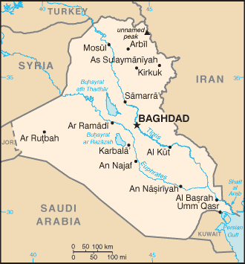
WMD in Iraq
“We are learning more as we interrogate or have discussions with Iraqi scientists and people within the Iraqi structure, that perhaps he destroyed some, perhaps he dispersed some. And so we will find them.” George W. Bush, 4/24/2003
Notes:
Intelligence gathered by this and other governments leaves no doubt that the Iraq regime continues to possess and conceal some of the most lethal weapons ever devised.
George Bush March 18, 2003
We are learning more as we interrogate or have discussions with Iraqi scientists and people within the Iraqi structure, that perhaps he destroyed some, perhaps he dispersed some. And so we will find them.
George Bush April 24, 2003

Slide 5
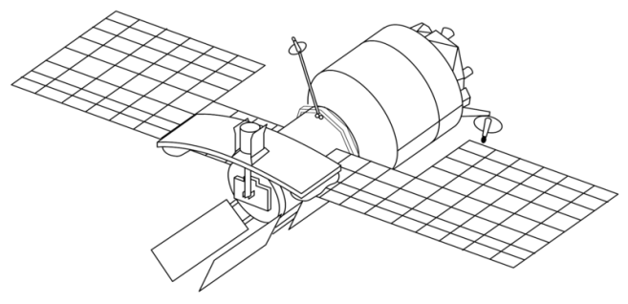
Finding WMD
UN have a satellite with a WMD detector
The detector scans a round region of the earth
It can compare two halves of the region, and decide which half is “more likely” to have WMD

Slide 6
Finding WMD
UN have a satellite with a WMD detector
The detector scans a round region of the earth
It can compare two halves of the region, and decide which half is “more likely” to have WMD
It continues by rescanning the “more likely” half

Slide 7
Finding WMD
UN have a satellite with a WMD detector
The detector scans a round region of the earth
It can compare two halves of the region, and decide which half is “more likely” to have WMD
It continues by rescanning the “more likely” half

Slide 8
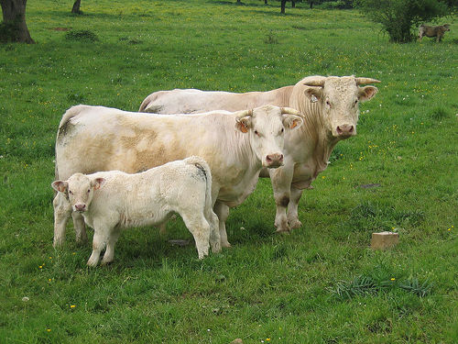
Finding WMD
UN have a satellite with a WMD detector
The detector scans a round region of the earth
It can compare two halves of the region, and decide which half is “more likely” to have WMD
It continues by rescanning the “more likely” half

Slide 9
Finding WMD
It continues by rescanning the “more likely” half
If region is so small that it obviously contains no WMD, then conclude: Iraq has no WMD
“No one was more surprised than I that we didn't find [WMDs].”
U.S. General Tommy Franks, 12/2/2005
http://www.flickr.com/photos/sunfox/17620516/

Slide 10
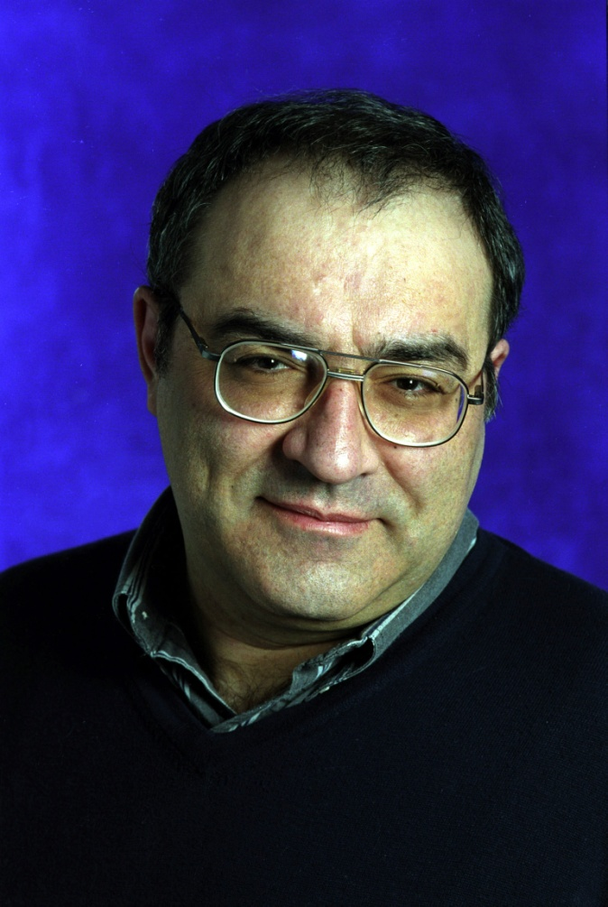
Generalization to Higher Dimensions
Leonid Khachiyan
Even smarter than George W. Bush!

Slide 11
The Ellipsoid Method
Want to find x2P
Have ellipsoid E(M,z) ¶ P
If z∉P then it violates a constraint “a_{i}^{T}x · b_{i}”
So P µ { x : a_{i}^{T}x · a_{i}^{T}z }
So P µ E(M,z) Å { x : a_{i}^{T}x · a_{i}^{T}z }
E(M,z)
z
P

Slide 12
The Ellipsoid Method
Have ellipsoid E(M,z) ¶ P
If z∉P then it violates a constraint “a_{i}^{T}x · b_{i}”
So P µ { x : a_{i}^{T}x · a_{i}^{T}z }
So P µ E(M,z) Å { x : a_{i}^{T}x · a_{i}^{T}z }
Let E(M’,z’) be ellipsoid covering E(M,z) Å {x : a_{i}^{T}x·a_{i}^{T}z}
Repeat…
E(M’,z’)
z’
P

Slide 13
The Ellipsoid Method
Input: A polytope P = { Ax·b } (e.g., P=WMD)
Output: A point x2P, or announce “P is empty”
and K and k.
Let E(M,z) be an ellipsoid s.t. PµE(M,z)
If vol E(M,z) < vol B(0,r) then Halt: “P is empty”
If z2P, Halt: “z 2 P”
Else
Let “a_{i}^{T}x · b_{i}” be a constraint of P violated by z (i.e., a_{i}^{T}z>b_{i})
Let H = { x : a_{i}^{T}x · a_{i}^{T}z } (so P µ E(M,z)ÅH)
Let E(M’,z’) be an ellipsoid covering E(M,z)ÅH
Set M←M’ and z←z’ and go back to Start
How to find this?
  Notation: Let B(z,k) = ball of radius k around point z2R^{n}
Assumptions:
  “The WMD is in Iraq”: 9K>0 such that P µ B(0,K)
  “WMD bigger than cow”: If P≠; then 9k>0, z2R^{n} s.t. B(z,k)µP

Slide 14
Covering Half-ellipsoids by Ellipsoids
H_{a}
E’
E
z
Let E be an ellipsoid centered at z
Let H_{a} = { x : a^{T}x ¸ a^{T}z }
Find a small ellipsoid E’ that covers EÅH_{a}

Slide 15
Use our solution for hemispheres!
H
B
B’
E’
H_{a}
E
z
Find a linear transformation T that
  Maps B to E
  Maps H to H_{a}
  Maps B’ to E’

Slide 16
Householder Reflection
u
v
||u||¢e₁
Want linear map that reflects points in hyperplane orthogonal to v
Vectors orthogonal to v should be unchanged
The vector v should change sign

