Slide 1
Using Interactive Activities and a Case Study to Promote Deeper Learning in Statistics
Diana Skrzydlo and Nam-Hwui Kim

Slide 2
Outline
Motivation
Activities Used
Measuring Outcomes
Analysis
What We Learned
Going Forward

Slide 3
Motivation
STAT 334 has historically been taught as most statistics courses are
  Lectures, midterms, assignments, final exam
But students are not Statistics majors
  Don’t want to be there
  Unclear understanding of theoretical models
  Don’t see relevance to real world
Goal: Try to engage students and provide deeper learning
Notes:
Probability Models for Business and Accounting
Teaching it twice so I could iterate
Small for our department

Slide 4
Activities Used
Interactive Tutorial Activities
Case Study Competition
Oral Final Exam

Slide 5
Interactive Tutorial Activities
3 questions focusing on topics from class
Rotating groups each week
Particular focus on confusing concepts
Instructor and TAs actively assisting
Graded (mostly for effort) and returned
Solutions posted promptly
Special topics: pre- and post-course questionnaire, midterm review, midterm take-up, Markov Chain exploration
Notes:
Confusing concepts: I know from STAT 333 (similar course but for stats majors) what is confusing year after year
Describe special topics BRIEFLY, do MC activity (maybe?) 1% each

Slide 6
Case Study Competition
Groups of 3 students
Had to choose a topic and model it with a Markov Chain
Presentations in class
Cash prizes for winners chosen by panel of judges
Reports due afterwards to incorporate feedback from presentations
Personal reflection paper on learning from own and others’ presentations
Notes:
Give that Business student a case study. Business students love case studies. 30%

Slide 7
Oral Final Exam
Before the written Final Exam
Conversation style – 5 Questions randomly selected from a bank:
  Define
  Advantages & Disadvantages
  Compare & Contrast
  Describe a Process
  Impact of a Change
15 minutes per student
Open book
Notes:
Have expertise giving oral exams in several courses prior to this. Worth 5%

Slide 8
Measuring Outcomes
Beforehand, we identified tools to measure outcomes:
Pre- and Post-course questionnaire
Case Study reflection
Post-course survey
Grades in the course
Grades in the follow-up course
Student course evaluations

Slide 9
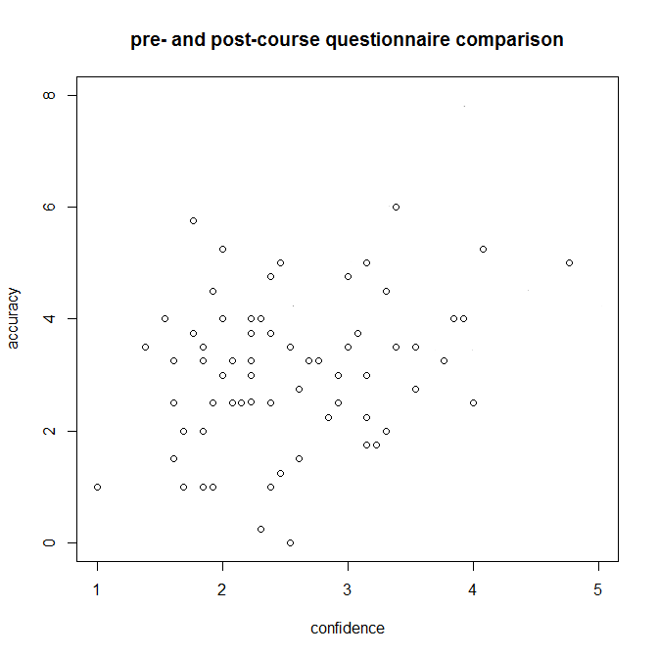
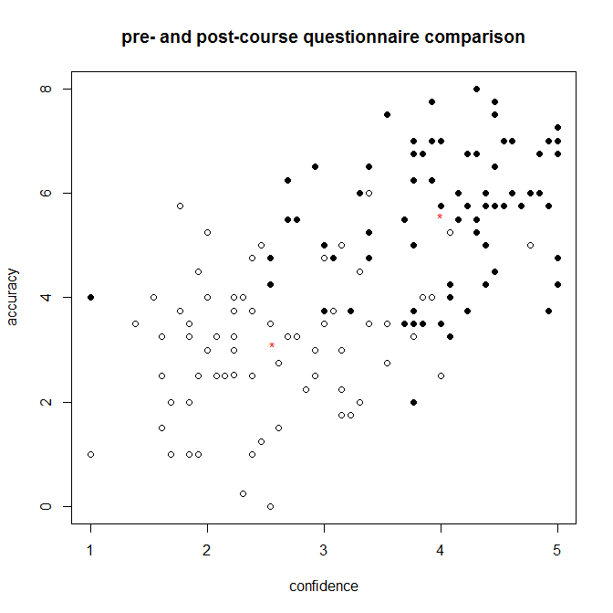
Notes:
First describe meaning of accuracy and confidence

Slide 11
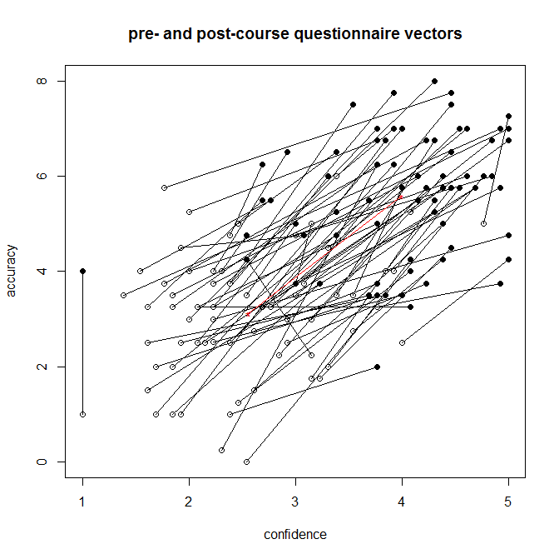

Slide 12
Pre- and Post-Course Questionnaire Results
Average accuracy improved
  2.45 pts out of 8 (31%)
Each point gained → 1.5% higher final grade (significance level p=0.03)
Average 51% of possible improvement
Each 10% improvement → 1.2% higher final grade (significance level p=0.007)

Slide 13
Case Study Reflections
Having taken many courses so far in my academic career, this case study was completely different from any other assignment I have done. It gave me a more hands-on and in-depth approach to learn the material. I found it very interesting to learn the real-life applications of Markov Chains, and not just the theory behind the concept. As well, researching a topic to choose helped me to see the array of applications of Markov Chains.

Slide 14
Case Study Reflections
I was unwittingly understanding and applying Markov Chains while I was working on the case study competition. It was a satisfying experience and a great alternative way to learn course material.

Slide 15
Case Study Reflections
The application of Markov Chains in our real life problems allowed us, as a class, to see the very appropriate application of one simple statistical concept in a kaleidoscope of areas in the world we live in today. The experience to me was one of the first, which I felt strengthened my conviction on the application of Math in everyday life.

Slide 16
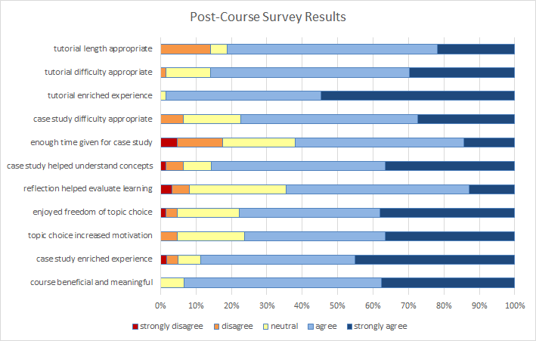
Post-Course Survey Results

Slide 17
Most positive survey results
98% “tutorials enriched learning experience”
89% “case study enriched experience”
86% “case study helped learn course concepts”
76% “the freedom to choose their topic improved their motivation”
93% “found the course beneficial and meaningful”

Slide 18
Learning from Failure: least positive survey results
62% “enough time was given for the case study”
65% “the case study reflection helped evaluate their learning”
Many students mentioned the tutorial questions were too long when asked what to improve

Slide 19
Grades
Grades in STAT 334 were about 1% higher than in previous terms but that could also be attributed to a different instructor, grading, or cohort of students
Unfortunately, no statistically significant difference was found in the grades in the follow-up course, based on the STAT 334 teaching method.

Slide 20
Student Course Evaluations
Again we have some confounding with instructor/cohort, but a higher percentage than the previous 2 years rated the course as “very interesting” (42% vs 29%)

Slide 21
What We Learned The First Time
Tutorial Activities
  Give shorter tutorial activities
  Give clearer instructions
Case Study Competition
  Give more time to form groups, choose topics
  Give clearer expectations and content suggestions for presentation and report
Oral Exams
  Give opportunity to practice
  Explain purpose and motivation

Slide 22
Going Forward
Is it sustainable?
Tutorial Activities
  Yes, easily. Already passed on materials to next instructor
Case Study Competition
  Could just be done as a regular project
  No need for panel and cash prizes
Oral Exams
  Only if class size permits

Slide 23
Thank you!

