Slide 1
Assessment Design For Learning
Presented by: Diana Skrzydlo, SAS

Slide 2
Outline
What is assessment for?
Some strategies for designing assessments:
  High Level Questions
  Interactive Tutorials
  Communication Skills
How you can use these ideas

Slide 3
Assessment Is Curriculum
What do you want your students to learn?
What skills do you want them to have?
Test them on that!
But how…

Slide 4
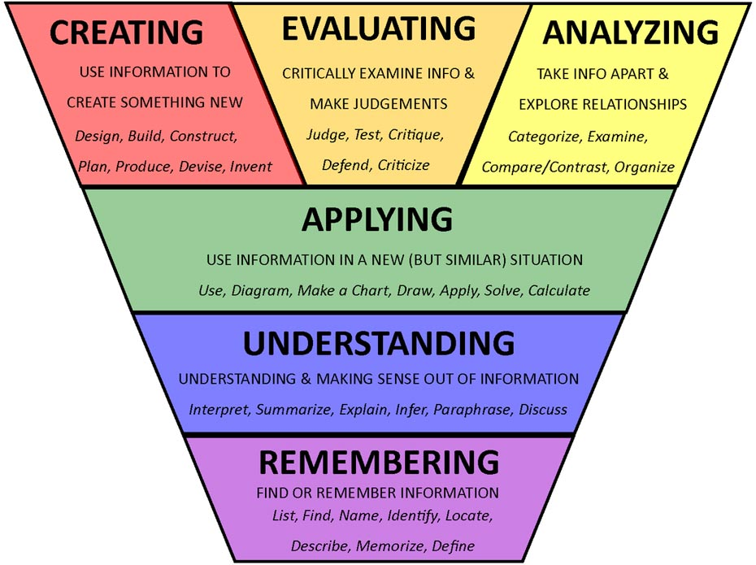
1. High Level Questions
Key Idea: Bloom’s Taxonomy of Learning

Slide 5
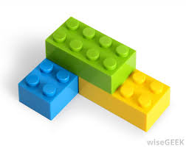
1. High Level Questions
Start with a simple calculation
  Can give the answer to less accuracy
Then some more complex calculations
  Using the first part or similar techniques
Finally a conceptual question
  Extending the material

Slide 6
1. High Level Questions
Prove/Disprove instead of True/False
Graph something
Apply models to a completely new situation
Translate between symbols and words
Identify similarities and differences
Discuss whether assumptions would hold

Slide 7
2. Interactive Tutorials
Key Idea: Threshold Concept
Designed interactive guided exercises
Students completed in groups
Graded for completion and correctness

Slide 8
2. Interactive Tutorials
Key Idea: Jigsaw
Phase 1: In groups, students summarize key information on small section of material and answer related question
Phase 2: Students split into cross-sectional groups and explain their work to their peers

Slide 9
2. Interactive Tutorials
Key Idea: Two-Stage Testing
Rather than post solutions and return tests right away, allow students to revisit material
Students complete a blank copy of the test in small groups
Variety of ways to grade

Slide 10
3. Communication Skills
Key Idea: Projects & Reports
The best way to learn is to actually do!
STAT 334: model a topic with a Markov chain
STAT 430: conduct and analyze experiment
STAT 443: find data, forecast using models
In-class presentation, report, peer evaluation

Slide 11
3. Communication Skills
Key Idea: Oral Exams
Format: 15 minutes, 5 questions:
  Definition, Advantages/Disadvantages, Compare/Contrast, Describe a Process, Predict the Impact
“I actually had to learn to understand the concepts fully in order to communicate them effectively”
- ACTSC 613 student

Slide 12
3. Communication Skills
Key Idea: “Think Like an Actuary”
Integrated into class, tutorials, assignments, tests, and final exam
Focused on professional aspects of actuarial work: external context, ethics, relationships
“Actuaries have to make decisions not only based on numbers but also based on economical, social, and political factors.”
- ACTSC 232 student

Slide 13
How You Can Use These Ideas
What do you want your students to learn?
What skills do you want them to have?
Design assessments to support these goals
You can do it!

Slide 14
Thank You
Diana Skrzydlo dkchisho@uwaterloo.ca
Teaching blog: http://www.math.uwaterloo.ca/~dkchisho/teachingblog.html

