Slide 1

Designing Exams to Test Higher Levels of Learning
Diana Skrzydlo, Continuing Lecturer

Slide 2
Outline
Learning Taxonomies
Assessment is Curriculum
Higher Level Questions
Examples
How you can use these ideas

Slide 3
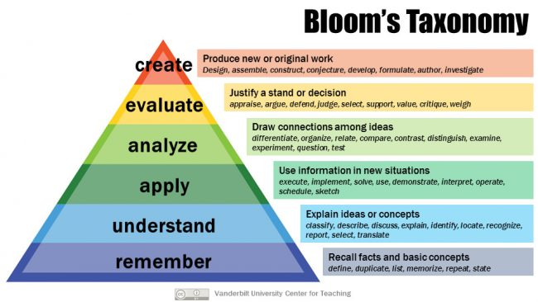
Learning Taxonomies – Bloom’s

Slide 4
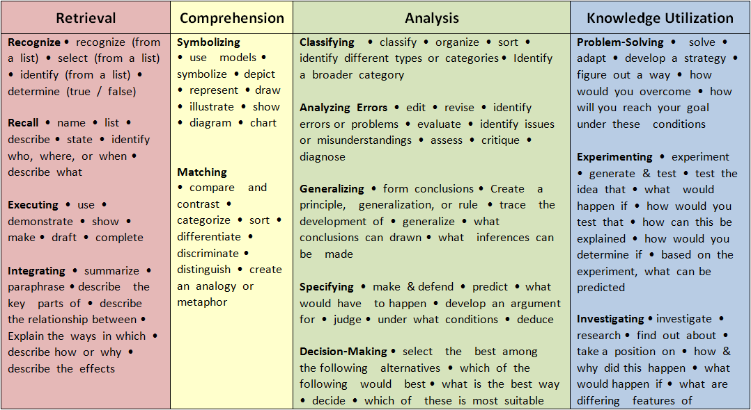
Learning Taxonomies – Marzano’s

Slide 5
Assessment is Curriculum
What is important that your students know?
What skills do you want them to have?
Test them on that!
But how…

Slide 6
How to Think of High Level Qs
Look for inspiration in Bloom/Marzano verb lists
Keep a list as you teach of interesting ideas
When creating your tests, insert where appropriate
Practice: the more you do it, the easier it gets!

Slide 7

How to Include High Level Qs
Start with a simple calculation
  Can give the answer to less accuracy – why?
Then some more complex calculations
  Using the first part or similar techniques
Finally a conceptual question
  Extending the material

Slide 8
How to Include High Level Qs
Prove/Disprove instead of True/False
Ask to graph something
Apply models to a completely new situation
Translate between symbols and words
Similarities and differences

Slide 9
How to Grade High Level Qs
Look for key words
Scan through several responses before starting, to determine quality benchmarks
Use a rubric
Design questions that can be easier to mark
  Matching/checkbox vs listing
  Graphing vs describing
  Prove/disprove

Slide 10
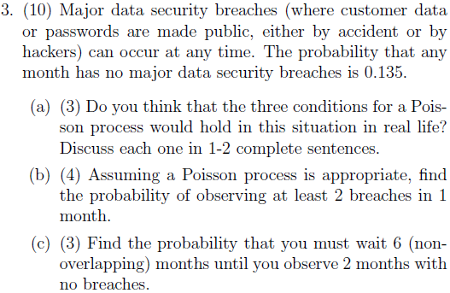
Example 1 - Probability

Slide 11
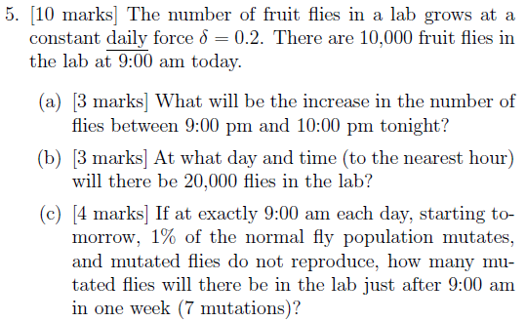
Example 2 – Financial Math

Slide 12
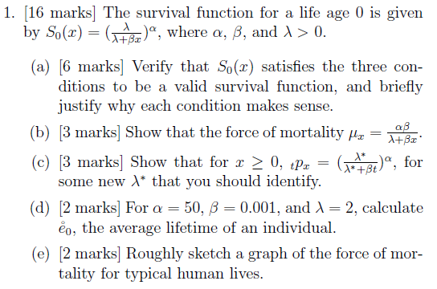
Example 3 – Life Cons 1

Slide 13
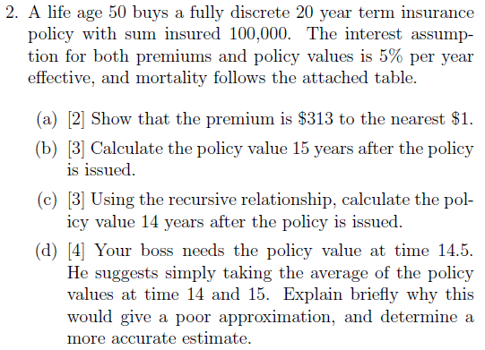
Example 4 – Life Cons 2

Slide 14
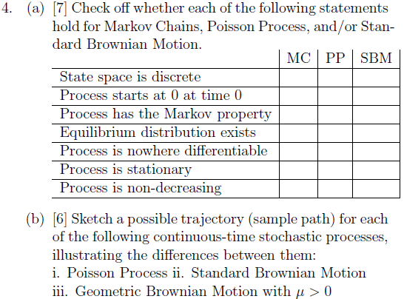
Example 5 – Probability Models

Slide 15
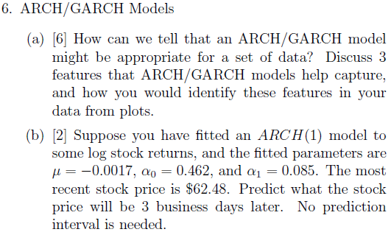
Example 6 – Time Series

Slide 16
How You Can Use These Ideas
Universally applicable
Test what you teach
Brainstorm questions throughout the term
Give students consistent assessments
Explain the importance of understanding
You can do it!

Slide 17
Thank You
Diana Skrzydlo
dkchisho@uwaterloo.ca
Teaching blog: http://www.math.uwaterloo.ca/~dkchisho/teachingblog.html

