Slide 1
Signaling in Bayesian Games
Chaitanya Swamy
University of Waterloo
Joint work with
Umang Bhaskar Yu Cheng Young Ko
TIFR , India USC Princeton

Slide 2
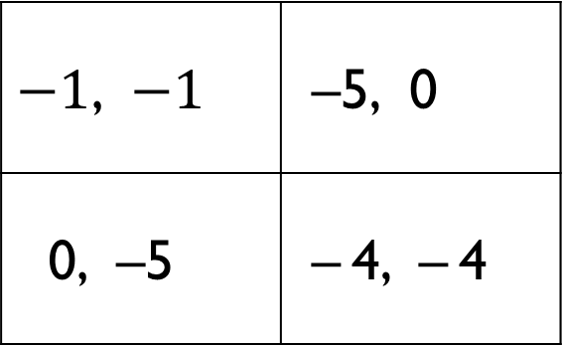
Prisoner’s Dilemma
Silent (S) | Defect (D)
2 players: Row, Col
negative payoffs ≡ costs
S
D
$−1$, $−1$ | –5, 0
0, –5 | – 4, – 4
Row’s payoff
Col’s payoff

Slide 3
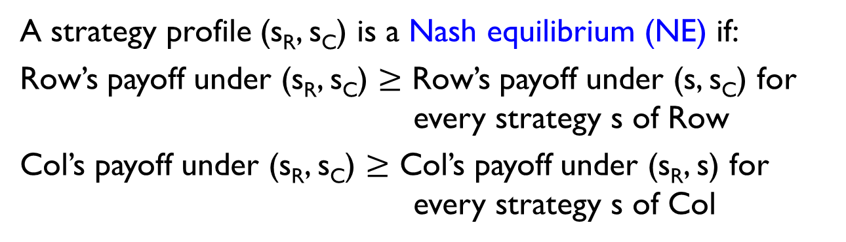
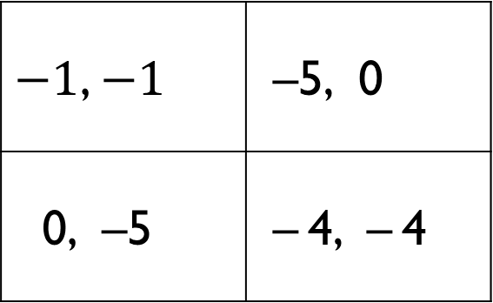
Prisoner’s Dilemma
Silent (S) | Defect (D)
Socially optimal outcome
(i.e., maximizes social welfare = Row’s payoff + Col’s payoff)
2 players: Row, Col
negative payoffs ≡ costs
S
D
$−1$, $−1$ | –5, 0
0, –5 | – 4, – 4
Nash equilibrium
A strategy profile (s_{R}, s_{C}) is a Nash equilibrium (NE) if:
Row’s payoff under (s_{R}, s_{C}) $≥$ Row’s payoff under (s, s_{C}) for every strategy s of Row
Col’s payoff under (s_{R}, s_{C}) $≥$ Col’s payoff under (s_{R}, s) for every strategy s of Col

Slide 4
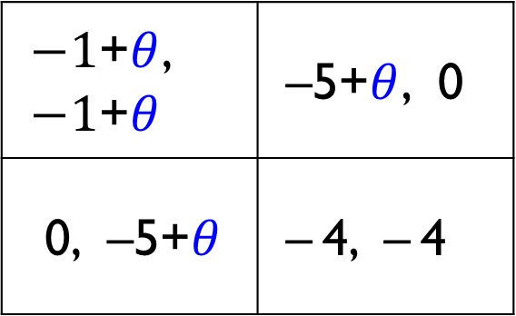
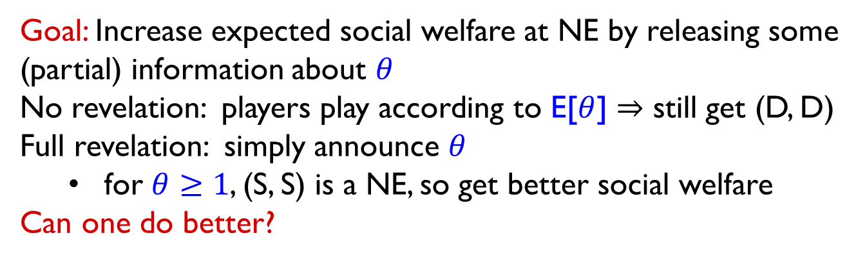
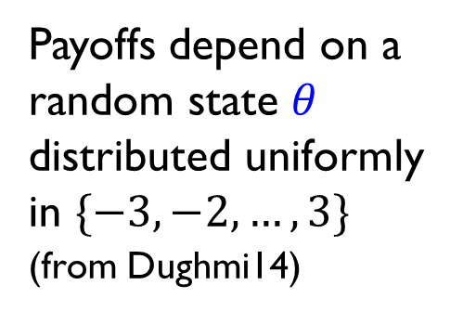
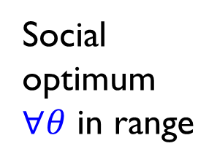
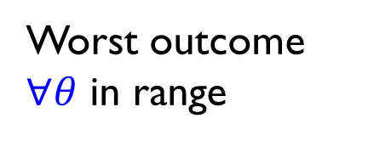
Bayesian Prisoner’s Dilemma and Signaling
Social optimum $∀θ$ in range
S | D
Payoffs depend on a random state $θ$ distributed uniformly in $\{−3, −2,…,3\}$
(from Dughmi14)
S
D
$−1$+$θ$, $−1$+$θ$ | –5+$θ$, 0
0, –5+$θ$ | – 4, – 4
Worst outcome $∀θ$ in range
Goal: Increase expected social welfare at NE by releasing some (partial) information about $θ$
No revelation: players play according to E[$θ$] $⇒$ still get (D, D)
Full revelation: simply announce $θ$
for $θ≥1$, (S, S) is a NE, so get better social welfare
Can one do better?

Slide 5
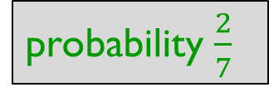
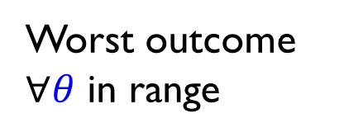
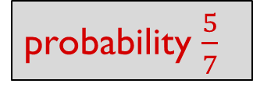
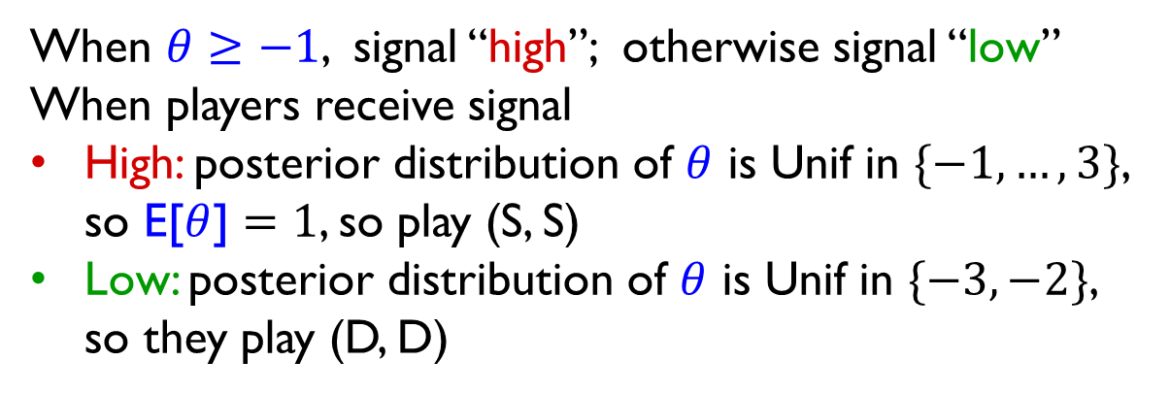
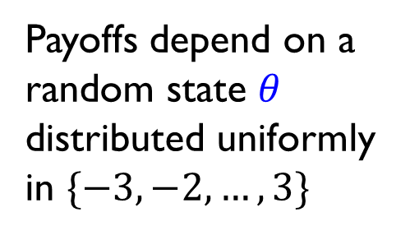
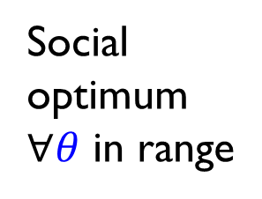
Bayesian Prisoner’s Dilemma and Signaling
Social optimum $∀θ$ in range
S | D
Payoffs depend on a random state $θ$ distributed uniformly in $\{−3, −2,…,3\}$
S
D
$−1$+$θ$, $−1$+$θ$ | –5+$θ$, 0
0, –5+$θ$ | – 4, – 4
Worst outcome $∀θ$ in range
When $θ≥−1$, signal “high”; otherwise signal “low”
When players receive signal
High: posterior distribution of $θ$ is Unif in $\{−1,…,3\}$, so E[$θ$] $=1$, so play (S, S)
Low: posterior distribution of $θ$ is Unif in $\{−3,−2\}$, so they play (D, D)
probability $\frac{5}{7}$
probability $\frac{2}{7}$

Slide 6
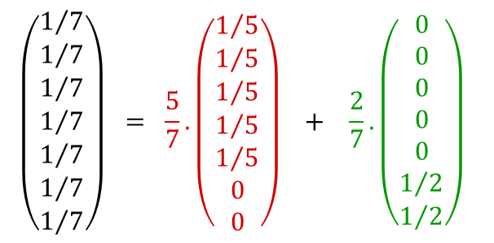
Bayesian Prisoner’s Dilemma and Signaling
S | D
Payoffs depend on a random state $θ$ distributed uniformly in $\{−3, −2,…,3\}$
S
D
$−1$+$θ$, $−1$+$θ$ | –5+$θ$, 0
0, –5+$θ$ | – 4, – 4
posterior under “high”
When $θ≥−1$, signal “high”; otherwise signal “low”
Mathematically, this signaling scheme is equivalent to:
$$\left(\begin{matrix}1/7 \\ 1/7 \\ 1/7 \\ 1/7 \\ 1/7 \\ 1/7 \\ 1/7\end{matrix}\right) = \frac{5}{7}.\left(\begin{matrix}1/5 \\ 1/5 \\ 1/5 \\ 1/5 \\ 1/5 \\ 0 \\ 0\end{matrix}\right) + \frac{2}{7}.\left(\begin{matrix}0 \\ 0 \\ 0 \\ 0 \\ 0 \\ 1/2 \\ 1/2\end{matrix}\right)\begin{matrix} \\ \end{matrix}$$
posterior under “low”
prior distribution

Slide 7
Bayesian Prisoner’s Dilemma and Signaling
S | D
Payoffs depend on a random state $θ$ distributed uniformly in $\{−3, −2,…,3\}$
Signaling Problem: Compute optimal signaling scheme.
(I.e., best convex decomposition of prior distribution
≡ best way of releasing partial information)
Problem has been recently studied for auctions [EFG⁺12, BMS12, GD13, DIR14] and zero-sum games [Dughmi14]
S
D
$−1$+$θ$, $−1$+$θ$ | –5+$θ$, 0
0, –5+$θ$ | – 4, – 4
posterior under “high”
When $θ≥−1$, signal “high”; otherwise signal “low”
Mathematically, this signaling scheme is equivalent to:
$$\left(\begin{matrix}1/7 \\ 1/7 \\ 1/7 \\ 1/7 \\ 1/7 \\ 1/7 \\ 1/7\end{matrix}\right) = \frac{5}{7}.\left(\begin{matrix}1/5 \\ 1/5 \\ 1/5 \\ 1/5 \\ 1/5 \\ 0 \\ 0\end{matrix}\right) + \frac{2}{7}.\left(\begin{matrix}0 \\ 0 \\ 0 \\ 0 \\ 0 \\ 1/2 \\ 1/2\end{matrix}\right)\begin{matrix} \\ \end{matrix}$$
posterior under “low”
prior distribution

Slide 8
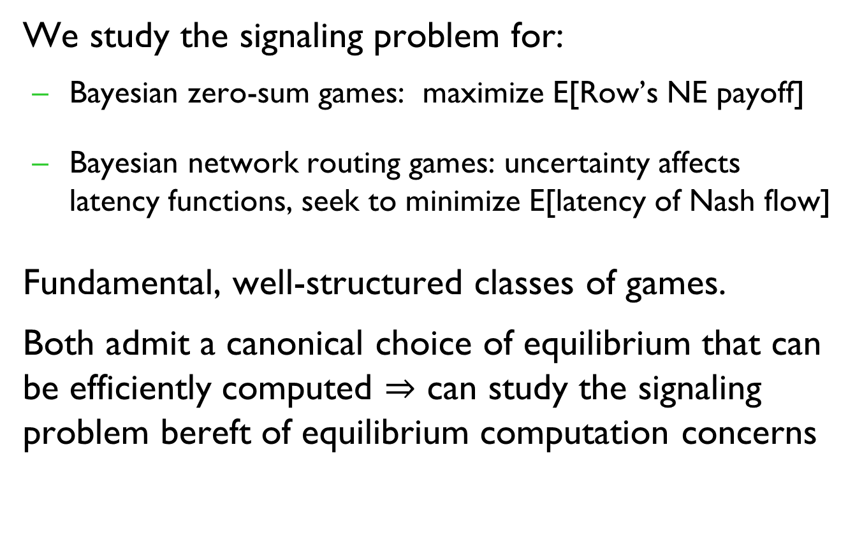
Our contributions
We study the signaling problem for:
Bayesian zero-sum games: maximize E[Row’s NE payoff]
Bayesian network routing games: uncertainty affects latency functions, seek to minimize E[latency of Nash flow]
Fundamental, well-structured classes of games.
Both admit a canonical choice of equilibrium that can be efficiently computed $⇒$ can study the signaling problem bereft of equilibrium computation concerns

Slide 9
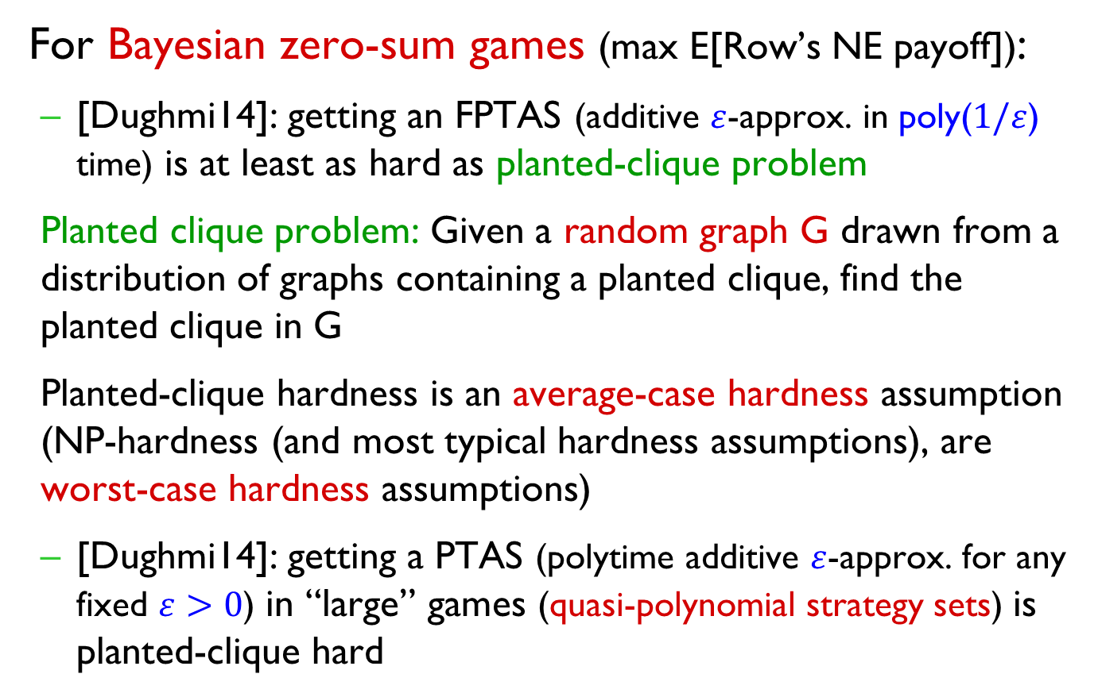
Prior work
For Bayesian zero-sum games (max E[Row’s NE payoff]):
[Dughmi14]: getting an FPTAS (additive $ε$-approx. in poly($1/ε$) time) is at least as hard as planted-clique problem
Planted clique problem: Given a random graph G drawn from a distribution of graphs containing a planted clique, find the planted clique in G
Planted-clique hardness is an average-case hardness assumption (NP-hardness (and most typical hardness assumptions), are worst-case hardness assumptions)
[Dughmi14]: getting a PTAS (polytime additive $ε$-approx. for any fixed $ε>0$) in “large” games (quasi-polynomial strategy sets) is planted-clique hard

Slide 10
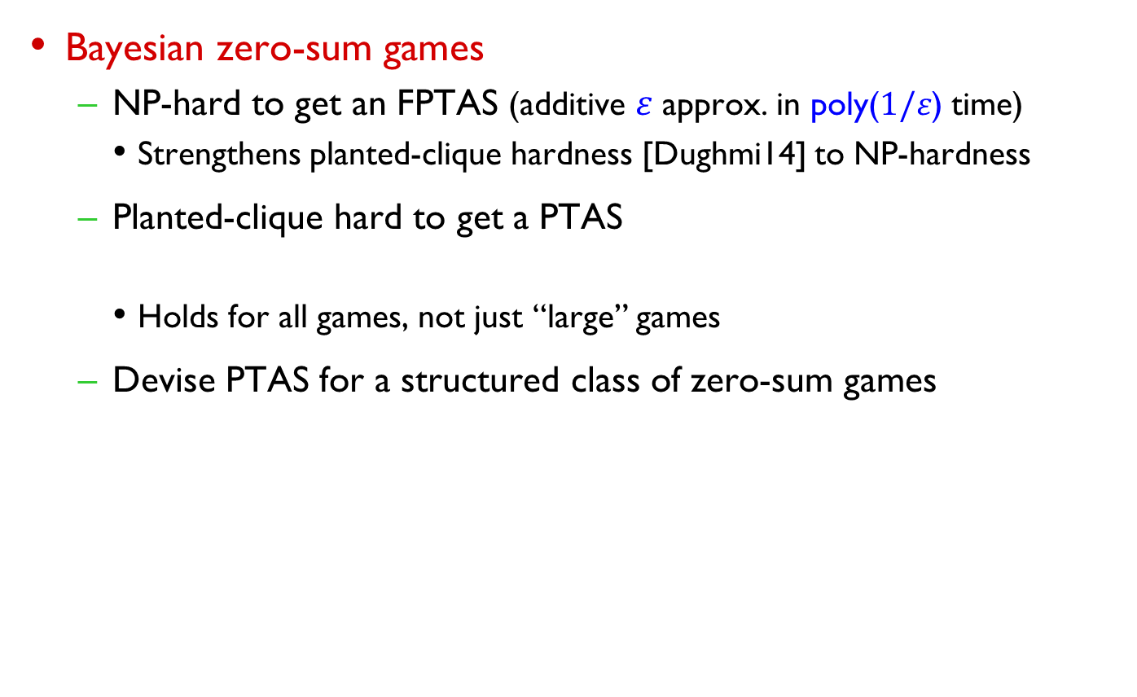
Our results
Bayesian zero-sum games
NP-hard to get an FPTAS (additive $ε$ approx. in poly($1/ε$) time)
Strengthens planted-clique hardness [Dughmi14] to NP-hardness
Planted-clique hard to get a PTAS
Holds for all games, not just “large” games
Devise PTAS for a structured class of zero-sum games
(NP-hardness not possible as quasi-PTAS exists [CCD+15])

Slide 11
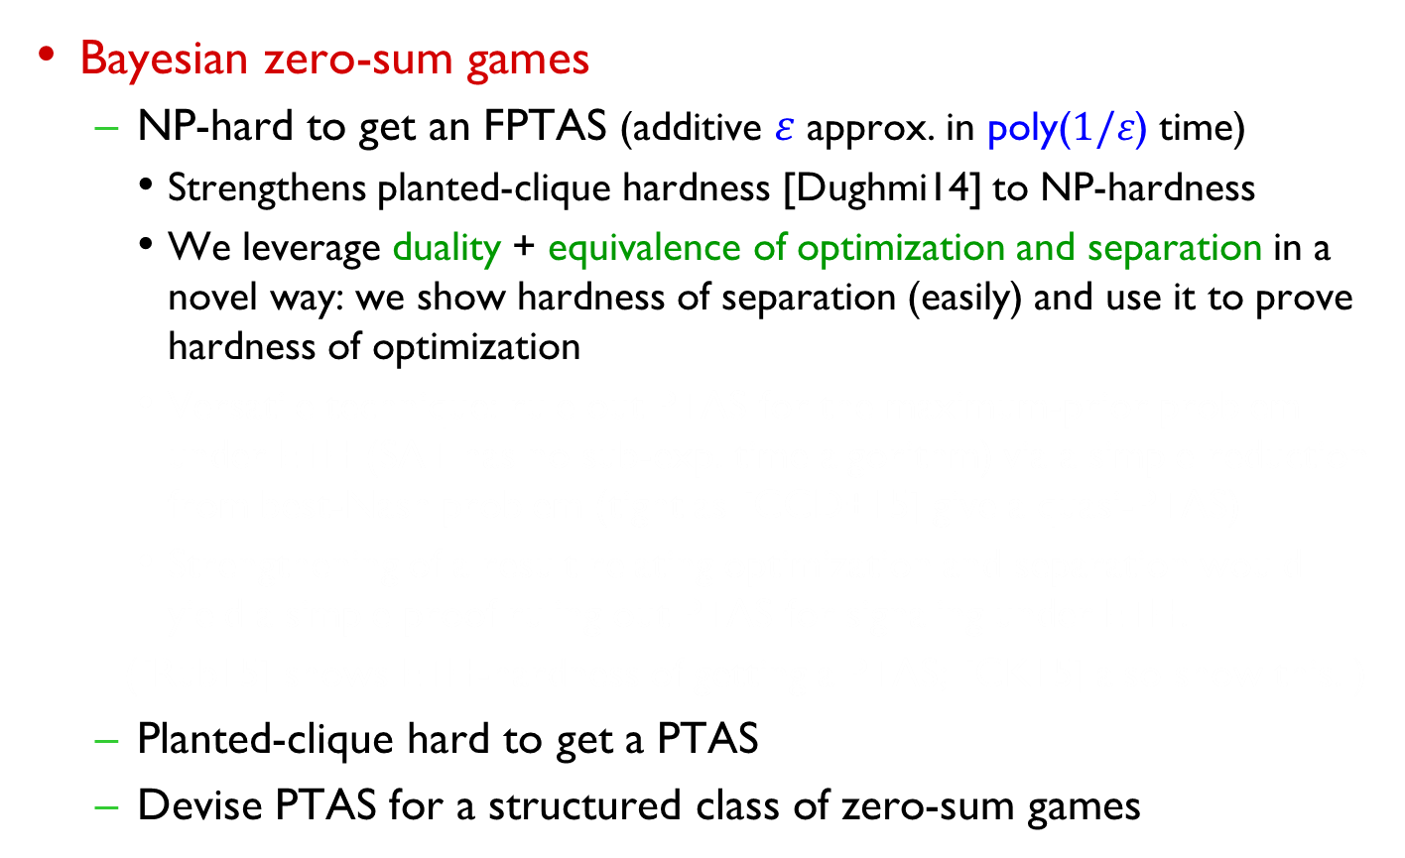
Our results
Bayesian zero-sum games
NP-hard to get an FPTAS (additive $ε$ approx. in poly($1/ε$) time)
Strengthens planted-clique hardness [Dughmi14] to NP-hardness
We leverage duality + equivalence of optimization and separation in a novel way: we show hardness of separation (easily) and use it to prove hardness of optimization
Versatile technique: rule out PTAS for the maximum-prior problem under ETH (SAT has no sub-exp. time algorithm) via a simple reduction from best-Nash problem (tight as [CCD+15] give a quasi-PTAS)
Strengthening of a result relating optimization and separation would yield a simple proof ruling out PTAS for signaling under ETH.
([Rub15] shows ETH-hardness of getting a PTAS; [CK15] also show this. )
Planted-clique hard to get a PTAS
Devise PTAS for a structured class of zero-sum games

Slide 12
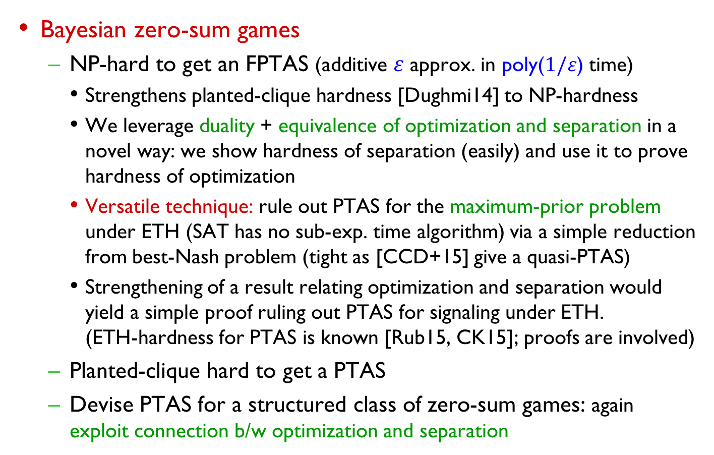
Our results
Bayesian zero-sum games
NP-hard to get an FPTAS (additive $ε$ approx. in poly($1/ε$) time)
Strengthens planted-clique hardness [Dughmi14] to NP-hardness
We leverage duality + equivalence of optimization and separation in a novel way: we show hardness of separation (easily) and use it to prove hardness of optimization
Versatile technique: rule out PTAS for the maximum-prior problem under ETH (SAT has no sub-exp. time algorithm) via a simple reduction from best-Nash problem (tight as [CCD+15] give a quasi-PTAS)
Strengthening of a result relating optimization and separation would yield a simple proof ruling out PTAS for signaling under ETH.
(ETH-hardness for PTAS is known [Rub15, CK15]; proofs are involved)
Planted-clique hard to get a PTAS
Devise PTAS for a structured class of zero-sum games: again exploit connection b/w optimization and separation

Slide 13
Our results (contd.)
Bayesian routing games (uncertainty affects latency functions; seek to minimize E[latency of Nash flow])
NP-hard to get multiplicative approximation better than 4/3, even for single-commodity networks and linear latencies
For linear latencies, we show 4/3 is the tight approximation threshold (full-revelation achieves this approximation)
First results for signaling in network routing games

Slide 14
Open questions
Remove the poly(M)-factor in the reduction from signaling to dual signaling (or show this is necessary)
Would give a simpler proof of ETH-hardness of PTAS for signaling
Polytime (additive) constant-approximations for signaling in Bayesian zero-sum games.
Currently, only quasi-PTAS is known [CCD+15]
Multiplicative approximation for Bayesian routing games with non-linear latencies.
Can one improve the price-of-anarchy via signaling? (NO, for linear latencies; in general, only 4/3-approx. hardness known.)

Slide 15
Thank You

