Slide 1
Approximation Algorithms for Minimum-Norm Optimization Problems
Chaitanya Swamy
University of Waterloo
Joint work with Deeparnab Chakrabarty
Dartmouth College

Slide 2
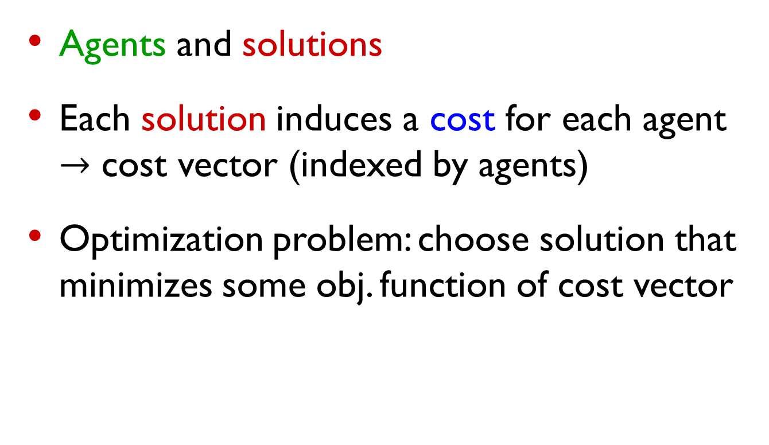
Multidimensional Optimization
Agents and solutions
Each solution induces a cost for each agent $→$ cost vector (indexed by agents)
Optimization problem: choose solution that minimizes some obj. function of cost vector

Slide 3

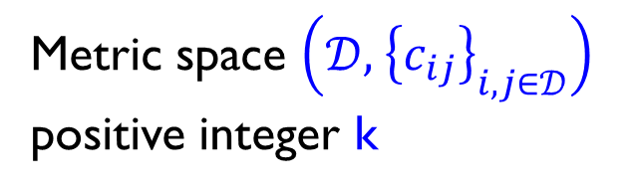
k-Clustering
Metric space $\left(𝒟, { \left\{c_{ij}\right\}}_{i,j∈𝒟}\right)$
positive integer k
k=3
Agents ( ): points in $𝒟$

Slide 4
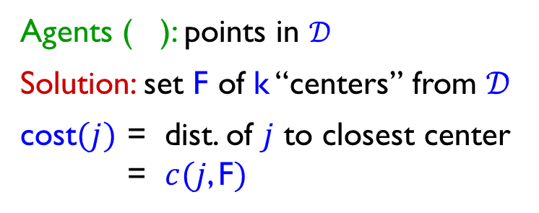

k-Clustering
Metric space $\left(𝒟, { \left\{c_{ij}\right\}}_{i,j∈𝒟}\right)$
positive integer k
k=3
$$j$$
Agents ( ): points in $𝒟$
Solution: set F of k “centers” from $𝒟$
cost$(j)$ = dist. of $j$ to closest center
= $c(j$, F$)$

Slide 5
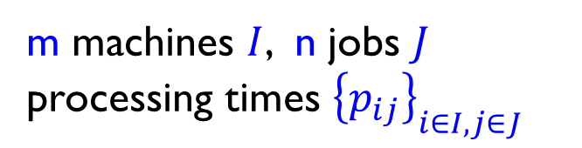



k-Clustering
Load-balancing
Metric space $\left(𝒟, { \left\{c_{ij}\right\}}_{i,j∈𝒟}\right)$
positive integer k
m machines $I$, n jobs $J$
processing times ${\left\{p_{ij}\right\}}_{i∈I, j∈J}$
jobs
machines
k=3
.
.
.
$$i$$
$$j$$
$$p_{ij}$$
$$j$$
Agents ( ): points in $𝒟$
Solution: set F of k “centers” from $𝒟$
cost$(j)$ = dist. of $j$ to closest center
= $c(j$, F$)$
Agents ( ): machines

Slide 6




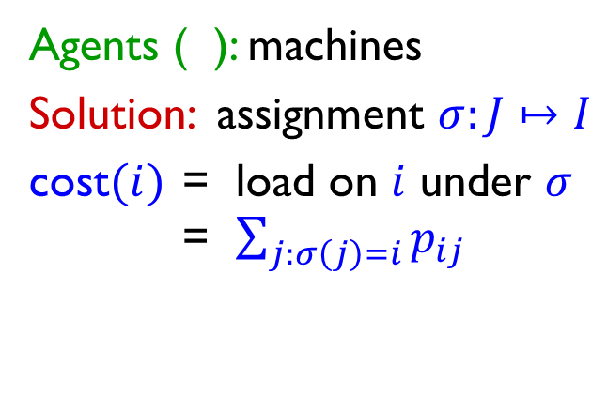
k-Clustering
Load-balancing
Metric space $\left(𝒟, { \left\{c_{ij}\right\}}_{i,j∈𝒟}\right)$
positive integer k
m machines $I$, n jobs $J$
processing times ${\left\{p_{ij}\right\}}_{i∈I, j∈J}$
jobs
machines
k=3
.
.
.
$$i$$
$$j$$
$$p_{ij}$$
$$j$$
Agents ( ): points in $𝒟$
Solution: set F of k “centers” from $𝒟$
cost$(j)$ = dist. of $j$ to closest center
= $c(j$, F$)$
Agents ( ): machines
Solution: assignment $σ:J↦I$
cost$(i)$ = load on $i$ under $σ$
= $\sum_{j:σ\left(j\right)=i}{p_{ij}}$

Slide 7
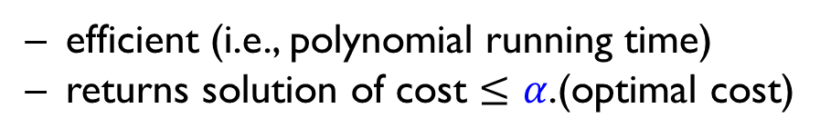
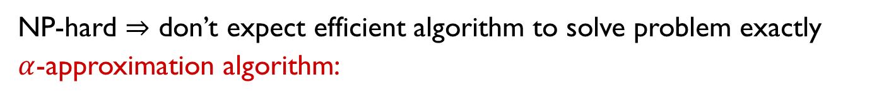

Typical optimization objectives
Minimize maximum agent-cost – egalitarian view
Clustering: k-center
Classical NP-hard problem
Tight 2-approximation
Gonzalez
Hochbaum-Shmoys
Load balancing: minimize
makespan
Classical scheduling objective
2-approx. , NP-hard to go below 1.5
(longstanding problem to close gap)
LenstraST
ShmoysT
NP-hard $⇒$ don’t expect efficient algorithm to solve problem exactly
$α$-approximation algorithm:
efficient (i.e., polynomial running time)
returns solution of cost $≤α$.(optimal cost)
($α≥1$)

Slide 8
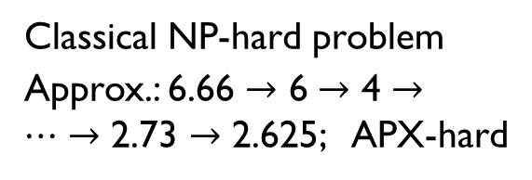
Typical optimization objectives
Minimize maximum agent-cost – egalitarian view
Clustering: k-center
Classical NP-hard problem
Tight 2-approximation
Gonzalez
Hochbaum-Shmoys
Load balancing: minimize
makespan
Classical scheduling objective
2-approx. , NP-hard to go below 1.5
(longstanding problem to close gap)
LenstraST
ShmoysT
No agent is too worse off, but may hurt many agents to reduce max
Minimize sum of all agent-costs – utilitarian view
Clustering: k-median
Classical NP-hard problem
Approx.: 6.66 $→$ 6 $→$ 4 $→…→$ 2.73 $→$ 2.625; APX-hard
CharikarGTS, JainV LiSv, Byrka et al.
Load balancing: min. sum of
machine loads
Trivial greedy algorithm
Optimizes “social welfare”, but could sacrifice individual agents

Slide 9
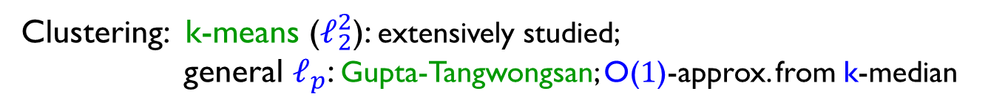
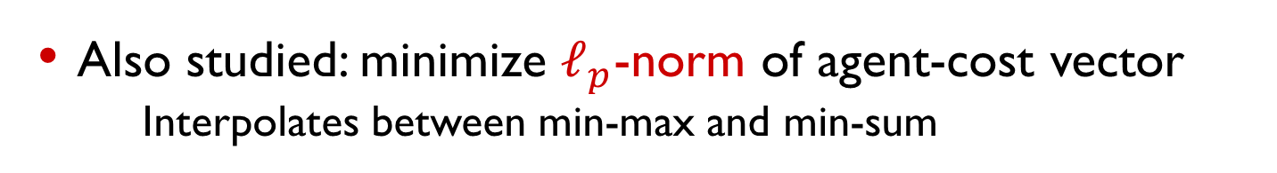
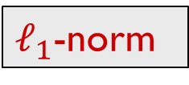
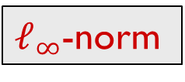
Typical optimization objectives
Minimize maximum agent-cost – egalitarian view
Clustering: k-center
$ℓ_{∞}$-norm
Load balancing: minimize makespan
Minimize sum of all agent-costs – utilitarian view
Clustering: k-median
$ℓ_{1}$-norm
Load balancing: min. sum of machine loads
Also studied: minimize $ℓ_{p}$-norm of agent-cost vector
  Interpolates between min-max and min-sum
Clustering: k-means ($ℓ_{2}^{2}$): extensively studied;
general $ℓ_{p}$: Gupta-Tangwongsan; O(1)-approx. from k-median
Load balancing: 2-approx. (Azar-Epstein) and better (Makarychev-Sviridenko)

Slide 10
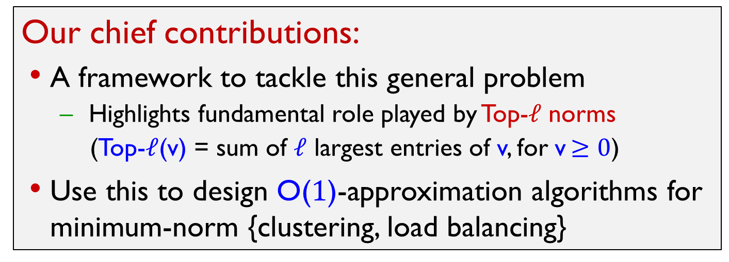
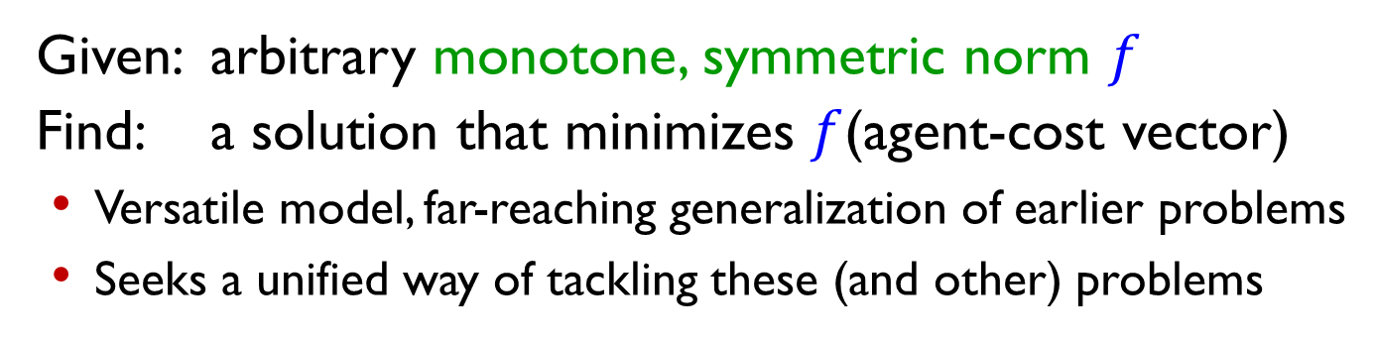
Minimum-norm optimization
Given: arbitrary monotone, symmetric norm $f$
Find: a solution that minimizes $f$(agent-cost vector)
Versatile model, far-reaching generalization of earlier problems
Seeks a unified way of tackling these (and other) problems
Our chief contributions:
A framework to tackle this general problem
  Highlights fundamental role played by Top-$ℓ$ norms
  (Top-$ℓ$(v) = sum of $ℓ$ largest entries of v, for v $≥0$)
Use this to design O(1)-approximation algorithms for minimum-norm {clustering, load balancing}

Slide 11
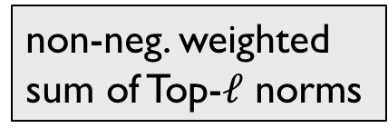
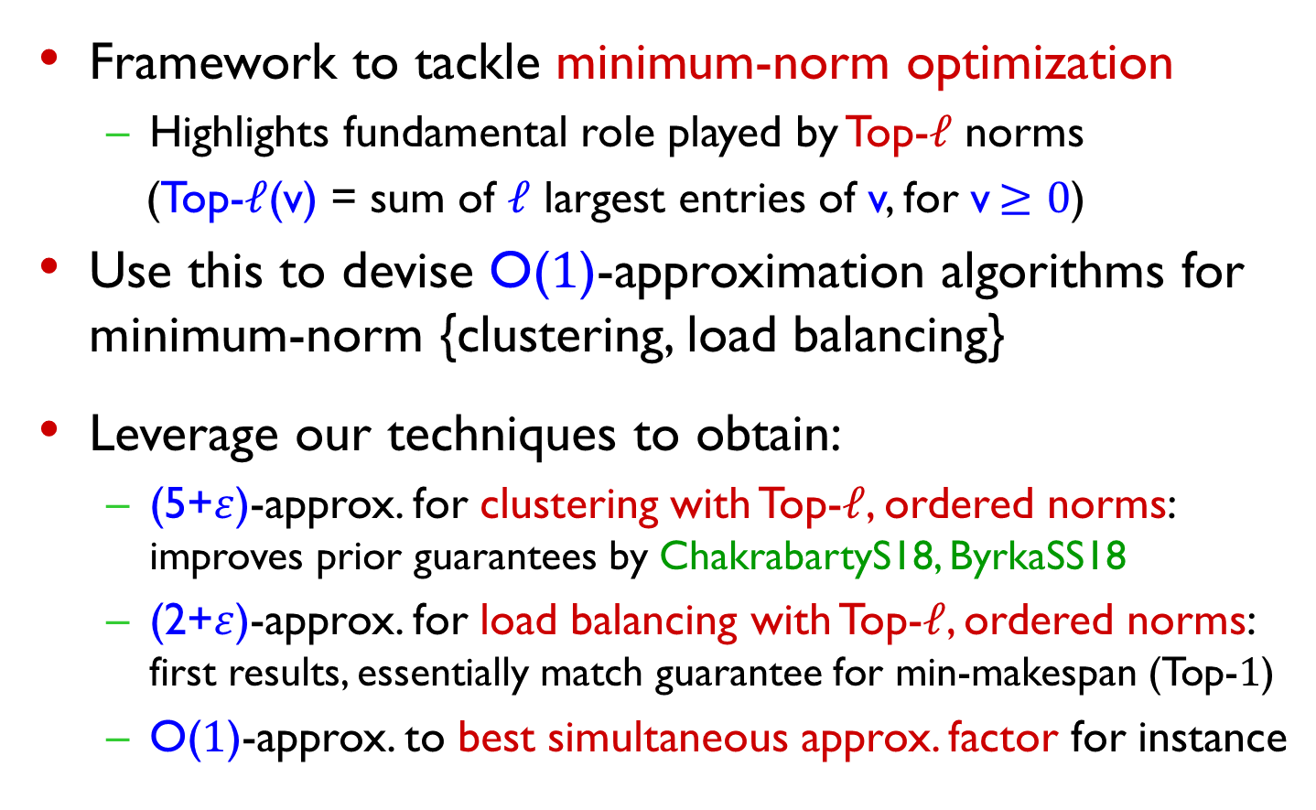
Our contributions
Framework to tackle minimum-norm optimization
  Highlights fundamental role played by Top-$ℓ$ norms
  (Top-$ℓ$(v) = sum of $ℓ$ largest entries of v, for v $≥0$)
Use this to devise O($1$)-approximation algorithms for minimum-norm {clustering, load balancing}
Leverage our techniques to obtain:
  (5+$ε$)-approx. for clustering with Top-$ℓ$, ordered norms: improves prior guarantees by ChakrabartyS18, ByrkaSS18
  (2+$ε$)-approx. for load balancing with Top-$ℓ$, ordered norms: first results, essentially match guarantee for min-makespan (Top-$1$)
  O($1$)-approx. to best simultaneous approx. factor for instance
non-neg. weighted sum of Top-$ℓ$ norms

Slide 12
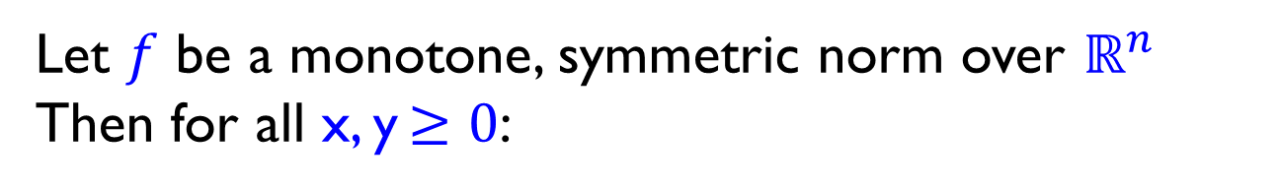
Monotone, symmetric norm
Let $f$ be a monotone, symmetric norm over $ℝ^{n}$
Then for all x, y $≥0$:

Slide 13
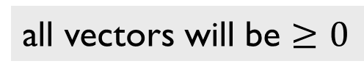
Monotone, symmetric norm
Let $f$ be a monotone, symmetric norm over $ℝ^{n}$
Then for all x, y $≥0$:
all vectors will be $≥0$

Slide 14
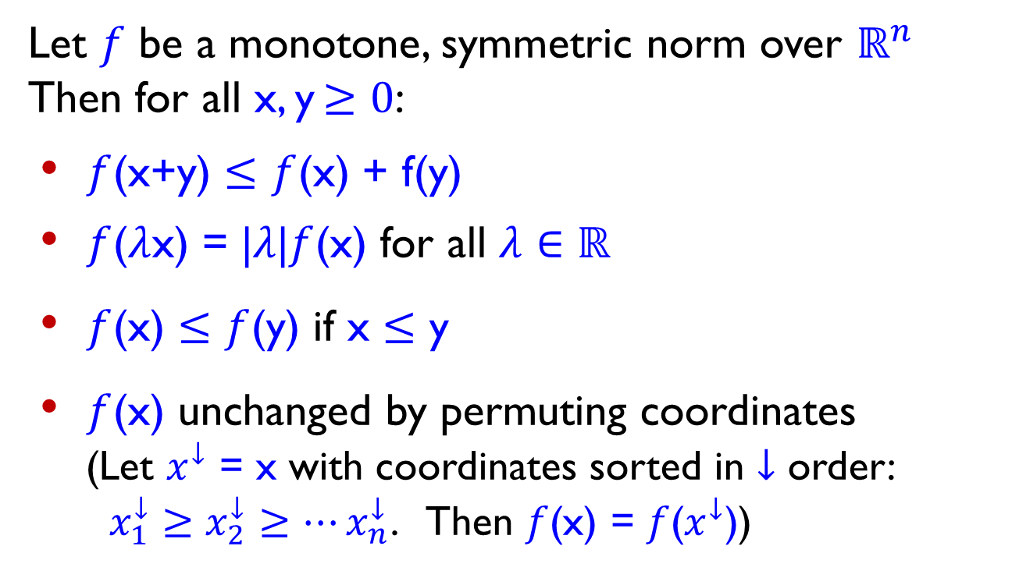
Monotone, symmetric norm
Let $f$ be a monotone, symmetric norm over $ℝ^{n}$
Then for all x, y $≥0$:
$f$(x+y) $≤$ $f$(x) + f(y)
$f$($λ$x) = |$λ$|$f$(x) for all $λ∈ℝ$
$f$(x) $≤$ $f$(y) if x $≤$ y
$f$(x) unchanged by permuting coordinates
(Let $x^{↓}$ = x with coordinates sorted in $↓$ order:
$x_{1}^{↓}≥x_{2}^{↓}≥…x_{n}^{↓}$. Then $f$(x) = $f$($x^{↓}$))
Norm: convex,
homogeneous
Monotone
Symmetry

Slide 15
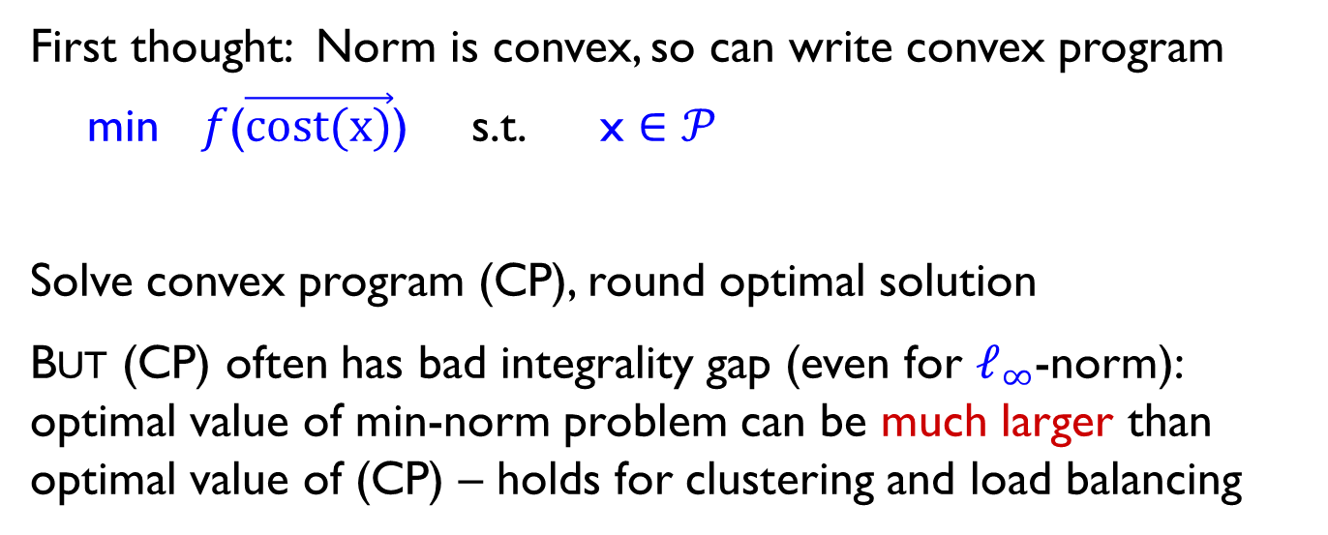
How to handle arbitrary (monotone, symmetric) norm?
First thought: Norm is convex, so can write convex program
min $f$($\vec{cost(x)}$) s.t. x $∈𝒫$
Solve convex program (CP), round optimal solution
But (CP) often has bad integrality gap (even for $ℓ_{∞}$-norm): optimal value of min-norm problem can be much larger than optimal value of (CP) – holds for clustering and load balancing
convex hull of integer solutions, or relaxation of this polytope

Slide 16

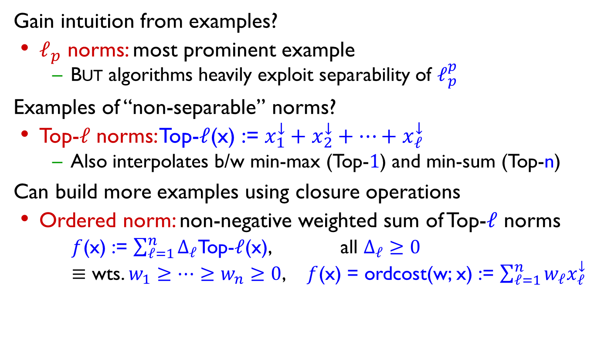
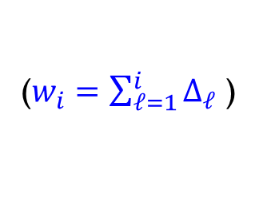
How to handle arbitrary (monotone, symmetric) norm?
Gain intuition from examples?
$ℓ_{p}$ norms: most prominent example
  But algorithms heavily exploit separability of $ℓ_{p}^{p}$
Examples of “non-separable” norms?
Top-$ℓ$ norms: Top-$ℓ$(x) := $x_{1}^{↓}+x_{2}^{↓}+…+x_{ℓ}^{↓}$
  Also interpolates b/w min-max (Top-$1$) and min-sum (Top-n)
Can build more examples using closure operations
Ordered norm: non-negative weighted sum of Top-$ℓ$ norms
  $f$(x) := $\sum_{ℓ=1}^{n}{Δ_{ℓ}}$Top-$ℓ$(x), all $Δ_{ℓ}≥0$
  $≡$ wts. $w_{1}≥…≥w_{n}≥0$, $f$(x) = ordcost(w; x) := $\sum_{ℓ=1}^{n}{w_{ℓ}x_{ℓ}^{↓}}$
Recall x $≥0$
($w_{i}=\sum_{ℓ=1}^{i}{Δ_{ℓ}}$ )

Slide 17
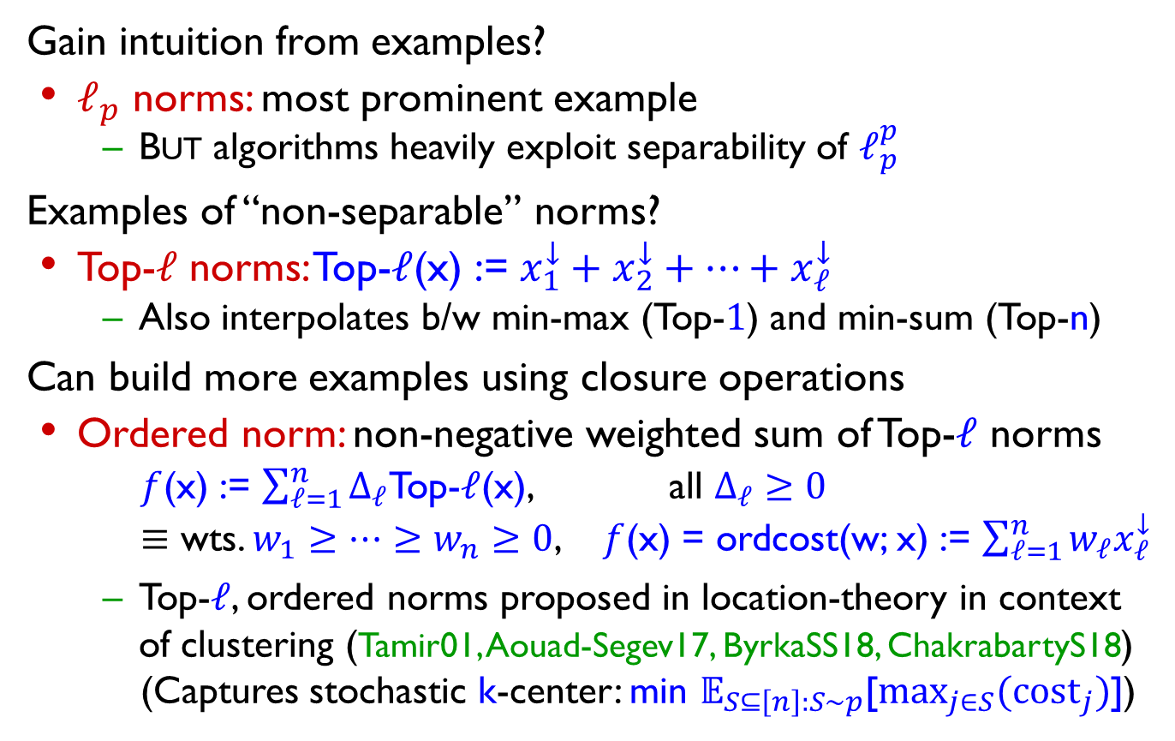
How to handle arbitrary (monotone, symmetric) norm?
Gain intuition from examples?
$ℓ_{p}$ norms: most prominent example
  But algorithms heavily exploit separability of $ℓ_{p}^{p}$
Examples of “non-separable” norms?
Top-$ℓ$ norms: Top-$ℓ$(x) := $x_{1}^{↓}+x_{2}^{↓}+…+x_{ℓ}^{↓}$
  Also interpolates b/w min-max (Top-$1$) and min-sum (Top-n)
Can build more examples using closure operations
Ordered norm: non-negative weighted sum of Top-$ℓ$ norms
  $f$(x) := $\sum_{ℓ=1}^{n}{Δ_{ℓ}}$Top-$ℓ$(x), all $Δ_{ℓ}≥0$
  $≡$ wts. $w_{1}≥…≥w_{n}≥0$, $f$(x) = ordcost(w; x) := $\sum_{ℓ=1}^{n}{w_{ℓ}x_{ℓ}^{↓}}$
  Top-$ℓ$, ordered norms proposed in location-theory in context of clustering (Tamir01, Aouad-Segev17, ByrkaSS18, ChakrabartyS18)
  (Captures stochastic k-center: min $𝔼_{S⊆\left[n\right]:S∼p}$[$\max_{j∈S}{({cost}_{j}})$])
Recall x $≥0$
p: symmetric distribution

Slide 18
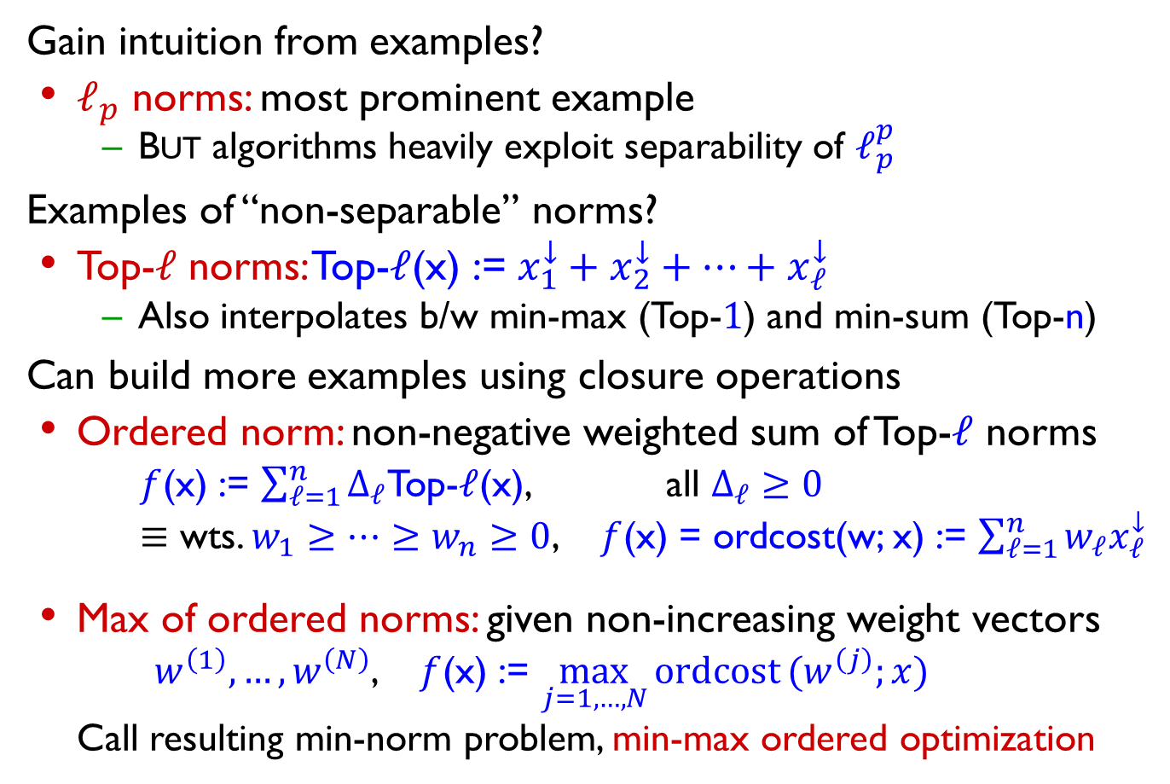
How to handle arbitrary (monotone, symmetric) norm?
Gain intuition from examples?
$ℓ_{p}$ norms: most prominent example
  But algorithms heavily exploit separability of $ℓ_{p}^{p}$
Examples of “non-separable” norms?
Top-$ℓ$ norms: Top-$ℓ$(x) := $x_{1}^{↓}+x_{2}^{↓}+…+x_{ℓ}^{↓}$
  Also interpolates b/w min-max (Top-$1$) and min-sum (Top-n)
Can build more examples using closure operations
Ordered norm: non-negative weighted sum of Top-$ℓ$ norms
  $f$(x) := $\sum_{ℓ=1}^{n}{Δ_{ℓ}}$Top-$ℓ$(x), all $Δ_{ℓ}≥0$
  $≡$ wts. $w_{1}≥…≥w_{n}≥0$, $f$(x) = ordcost(w; x) := $\sum_{ℓ=1}^{n}{w_{ℓ}x_{ℓ}^{↓}}$
Max of ordered norms: given non-increasing weight vectors $w^{\left(1\right)},…,w^{\left(N\right)}$, $f$(x) := $\max_{j=1,…,N}{ordcost}(w^{\left(j\right)};x)$
  Call resulting min-norm problem, min-max ordered optimization
Recall x $≥0$

Slide 19
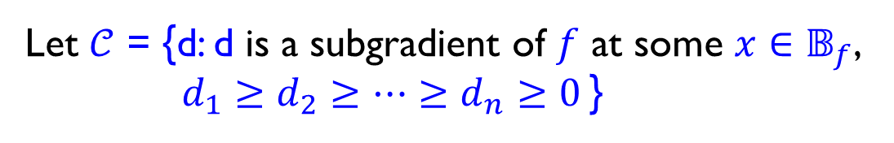
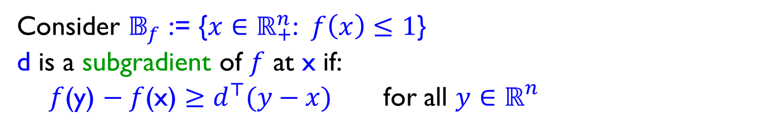
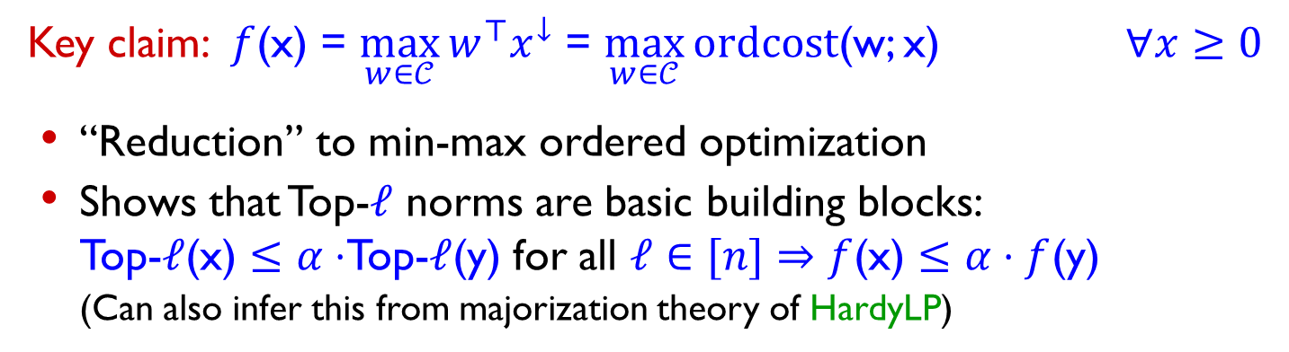
Monotone, symmetric norms: Geometry
d
Consider $𝔹_{f}$ := {$x∈ℝ_{+}^{n}$: $f\left(x\right)≤1$}
d is a subgradient of $f$ at x if:
$f$(y) $− f$(x) $≥d^{⊤}(y−x)$ for all $y∈ℝ_{}^{n}$
d
Let $𝒞$ = {d: d is a subgradient of $f$ at some $x∈𝔹_{f}$,
$d_{1}≥d_{2}≥…≥d_{n}≥0$ }
Key claim: $f$(x) = $\max_{w∈𝒞}{w^{⊤}x^{↓}}$ = $\max_{w∈𝒞}{ordcost}$(w; x) $∀x≥0$
“Reduction” to min-max ordered optimization
Shows that Top-$ℓ$ norms are basic building blocks:
  Top-$ℓ$(x) $≤α⋅$Top-$ℓ$(y) for all $ℓ∈[n]⇒$ $f$(x) $≤$ $α⋅f$(y)
  (Can also infer this from majorization theory of HardyLP)

Slide 20
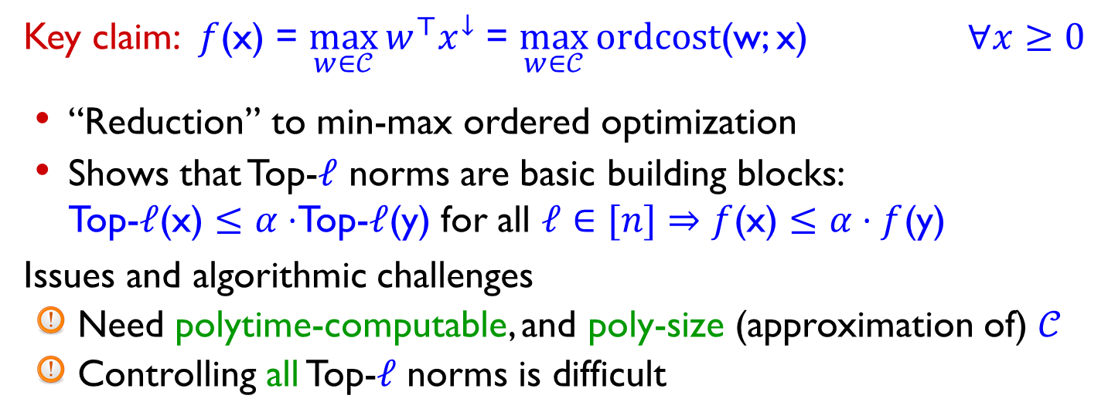

Monotone, symmetric norms: Geometry
d
Consider $𝔹_{f}$ := {$x∈ℝ_{+}^{n}$: $f\left(x\right)≤1$}
d is a subgradient of $f$ at x if:
$f$(y) $− f$(x) $≥d^{⊤}(y−x)$ for all $y∈ℝ_{}^{n}$
d
Let $𝒞$ = {d: d is a subgradient of $f$ at some $x∈𝔹_{f}$,
$d_{1}≥d_{2}≥…≥d_{n}≥0$ }
Key claim: $f$(x) = $\max_{w∈𝒞}{w^{⊤}x^{↓}}$ = $\max_{w∈𝒞}{ordcost}$(w; x) $∀x≥0$
“Reduction” to min-max ordered optimization
Shows that Top-$ℓ$ norms are basic building blocks:
  Top-$ℓ$(x) $≤α⋅$Top-$ℓ$(y) for all $ℓ∈[n]⇒$ $f$(x) $≤$ $α⋅f$(y)
Issues and algorithmic challenges
Need polytime-computable, and poly-size (approximation of) $𝒞$
Controlling all Top-$ℓ$ norms is difficult

Slide 21
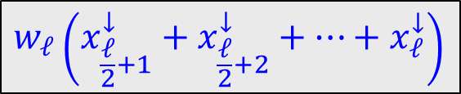
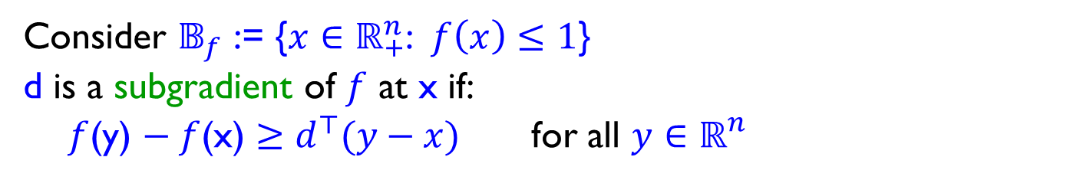

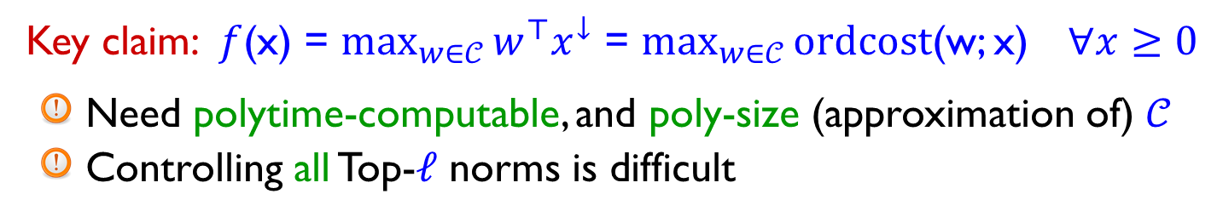

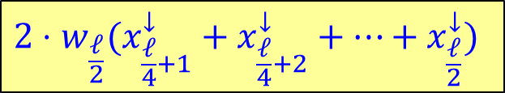
Monotone, symmetric norms: Geometry
Consider $𝔹_{f}$ := {$x∈ℝ_{+}^{n}$: $f\left(x\right)≤1$}
d is a subgradient of $f$ at x if:
$f$(y) $− f$(x) $≥d^{⊤}(y−x)$ for all $y∈ℝ_{}^{n}$
$𝒞$ = {d: d is a subgradient of $f$ at some $x∈𝔹_{f}$, $d_{1}≥…≥d_{n}≥0$ }
Key claim: $f$(x) = $\max_{w∈𝒞}{w^{⊤}x^{↓}}$ = $\max_{w∈𝒞}{ordcost}$(w; x) $∀x≥0$
Need polytime-computable, and poly-size (approximation of) $𝒞$
Controlling all Top-$ℓ$ norms is difficult
Insight: Sparsification – only need Top-$ℓ$ norms for $ℓ$ = powers of 2
ordcost(w; x) = $w_{1}x_{1}^{↓}+…+w_{\frac{ℓ}{2}+1}x_{\frac{ℓ}{2}+1}^{↓}+w_{\frac{ℓ}{2}+2}x_{\frac{ℓ}{2}+2}^{↓}+…+w_{ℓ}x_{ℓ}^{↓}+…$
$$≤$$
$$≤$$
$$w_{ℓ}\left(x_{\frac{ℓ}{2}+1}^{↓}+x_{\frac{ℓ}{2}+2}^{↓}+…+x_{ℓ}^{↓}\right)$$
$${2⋅w}_{\frac{ℓ}{2}}(x_{\frac{ℓ}{4}+1}^{↓}+x_{\frac{ℓ}{4}+2}^{↓}+…+x_{\frac{ℓ}{2}}^{↓})$$

Slide 22
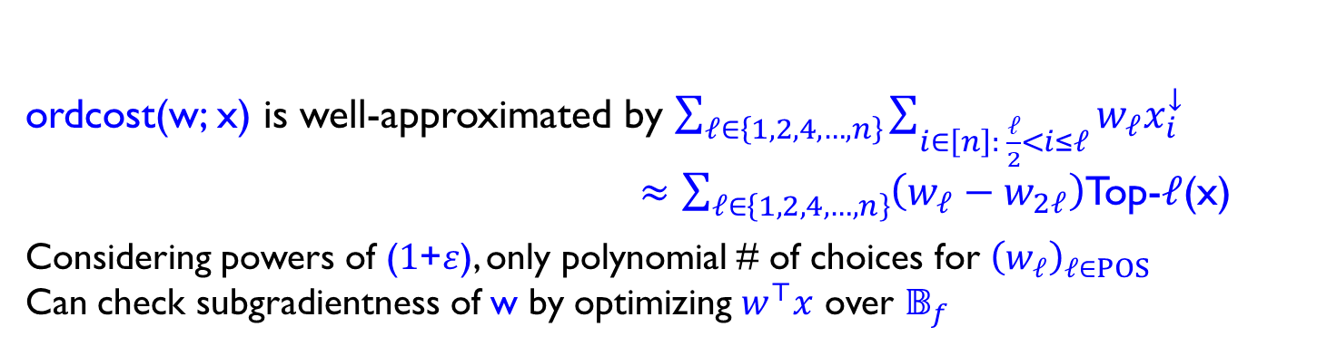
Monotone, symmetric norms: Geometry
Consider $𝔹_{f}$ := {$x∈ℝ_{+}^{n}$: $f\left(x\right)≤1$}
d is a subgradient of $f$ at x if:
$f$(y) $− f$(x) $≥d^{⊤}(y−x)$ for all $y∈ℝ_{}^{n}$
$𝒞$ = {d: d is a subgradient of $f$ at some $x∈𝔹_{f}$, $d_{1}≥…≥d_{n}≥0$ }
Key claim: $f$(x) = $\max_{w∈𝒞}{w^{⊤}x^{↓}}$ = $\max_{w∈𝒞}{ordcost}$(w; x) $∀x≥0$
Need polytime-computable, and poly-size (approximation of) $𝒞$
Controlling all Top-$ℓ$ norms is difficult
Insight: Sparsification – only need Top-$ℓ$ norms for $ℓ$ = powers of 2
ordcost(w; x) is well-approximated by $\sum_{ℓ∈\left\{1,2,4,…,n\right\}}{\sum_{i∈\left[n\right]: \frac{ℓ}{2}<i≤ℓ}{w_{ℓ}x_{i}^{↓}}}$
$≈\sum_{ℓ∈\left\{1,2,4,…,n\right\}}{\left(w_{ℓ}−w_{2ℓ}\right)}$Top-$ℓ$(x)
Considering powers of ($1$+$ε$), only polynomial # of choices for ${\left(w_{ℓ}\right)}_{ℓ∈POS}$
Can check subgradientness of w by optimizing $w^{⊤}x$ over $𝔹_{f}$
POS
reqd. ball-optimization oracle

Slide 23
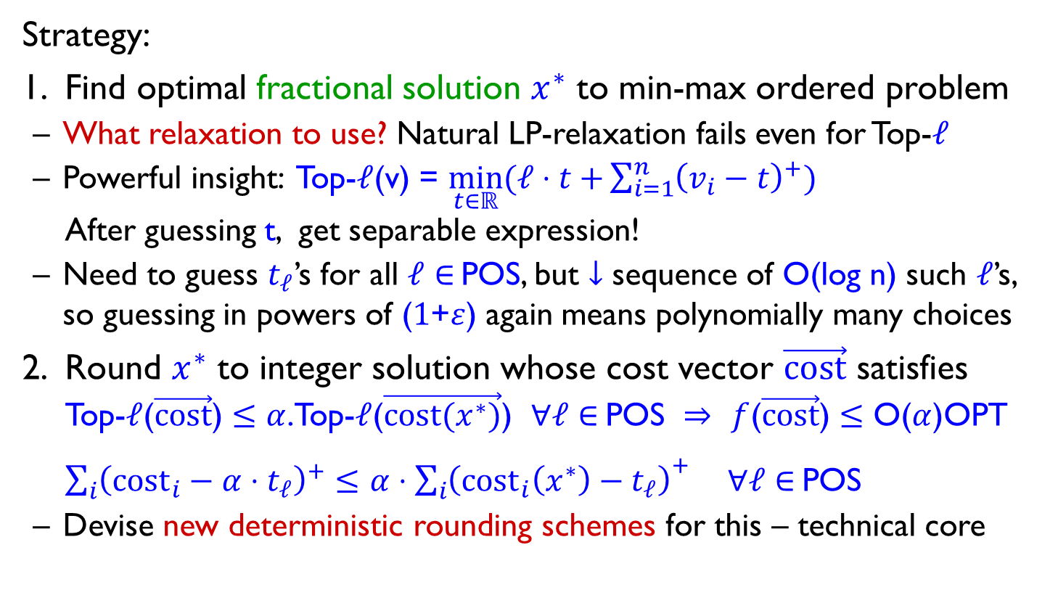
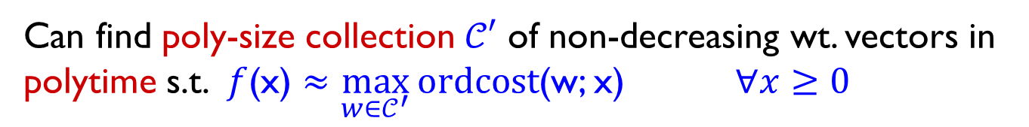
Upshot, and general scheme
Can find poly-size collection $𝒞′$ of non-decreasing wt. vectors in polytime s.t. $f$(x) $≈\max_{w∈𝒞^{′}}{ordcost}$(w; x) $∀x≥0$
non-neg. weighted sum of Top-$ℓ$(x) over $ℓ∈$ POS
Strategy:
Find optimal fractional solution $x^{∗}$ to min-max ordered problem
What relaxation to use? Natural LP-relaxation fails even for Top-$ℓ$
Powerful insight: Top-$ℓ$(v) = $\min_{t∈ℝ}{(ℓ⋅t+}\sum_{i=1}^{n}{{\left(v_{i}−t\right)}^{+})}$
After guessing t, get separable expression!
Need to guess $t_{ℓ}$’s for all $ℓ∈$ POS, but $↓$ sequence of O(log n) such $ℓ$’s, so guessing in powers of ($1$+$ε$) again means polynomially many choices
Round $x^{∗}$ to integer solution whose cost vector $\vec{cost}$ satisfies Top-$ℓ$($\vec{cost}$) $≤$ $α$.Top-$ℓ$($\vec{cost(x^{∗})}$) $∀ℓ∈$ POS $⇒$ $f$($\vec{cost}$) $≤$ O($α$)OPT
$\sum_{i}{{\left({cost}_{i}−α⋅t_{ℓ}\right)}^{+}≤α⋅{\sum_{i}{\left({cost}_{i}\left(x^{∗}\right)−t_{ℓ}\right)}}^{+}}$ $∀ℓ∈$ POS
Devise new deterministic rounding schemes for this – technical core

Slide 24
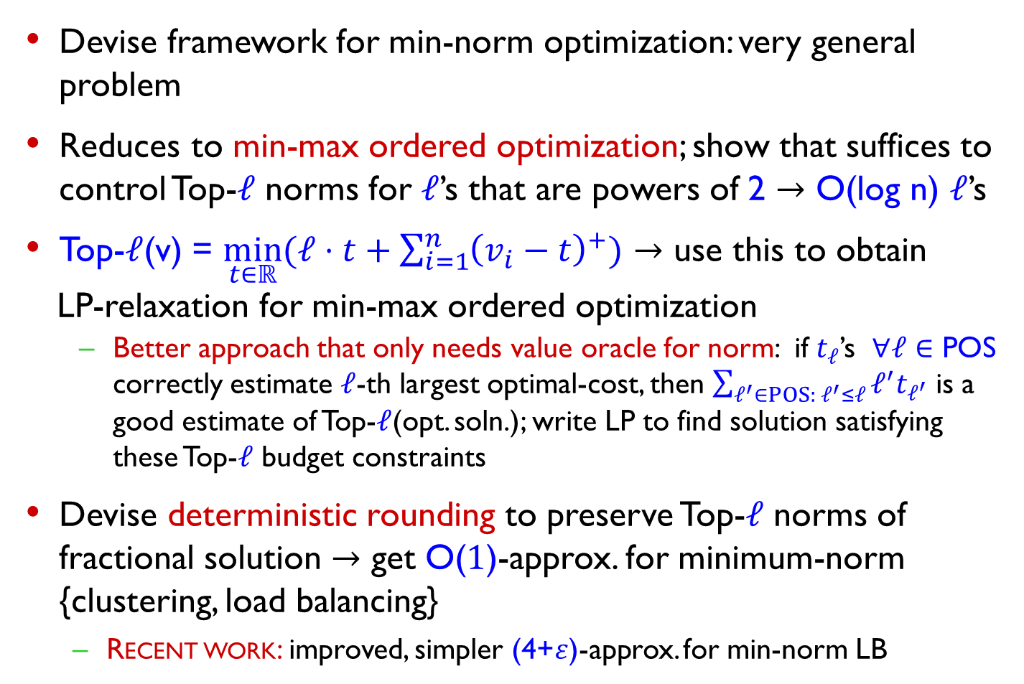
Summary
Devise framework for min-norm optimization: very general problem
Reduces to min-max ordered optimization; show that suffices to control Top-$ℓ$ norms for $ℓ$’s that are powers of 2 $→$ O(log n) $ℓ$’s
Top-$ℓ$(v) = $\min_{t∈ℝ}{(ℓ⋅t+\sum_{i=1}^{n}{{\left(v_{i}−t\right)}^{+})}}$ $→$ use this to obtain
LP-relaxation for min-max ordered optimization
  Better approach that only needs value oracle for norm: if $t_{ℓ}$’s $∀ℓ∈$ POS correctly estimate $ℓ$-th largest optimal-cost, then $\sum_{ℓ^{′}∈POS: ℓ^{′}≤ℓ}{ℓ^{′}t_{ℓ^{′}}}$ is a good estimate of Top-$ℓ$(opt. soln.); write LP to find solution satisfying these Top-$ℓ$ budget constraints
Devise deterministic rounding to preserve Top-$ℓ$ norms of fractional solution $→$ get O($1$)-approx. for minimum-norm {clustering, load balancing}
  Recent work: improved, simpler (4+$ε$)-approx. for min-norm LB

Slide 25
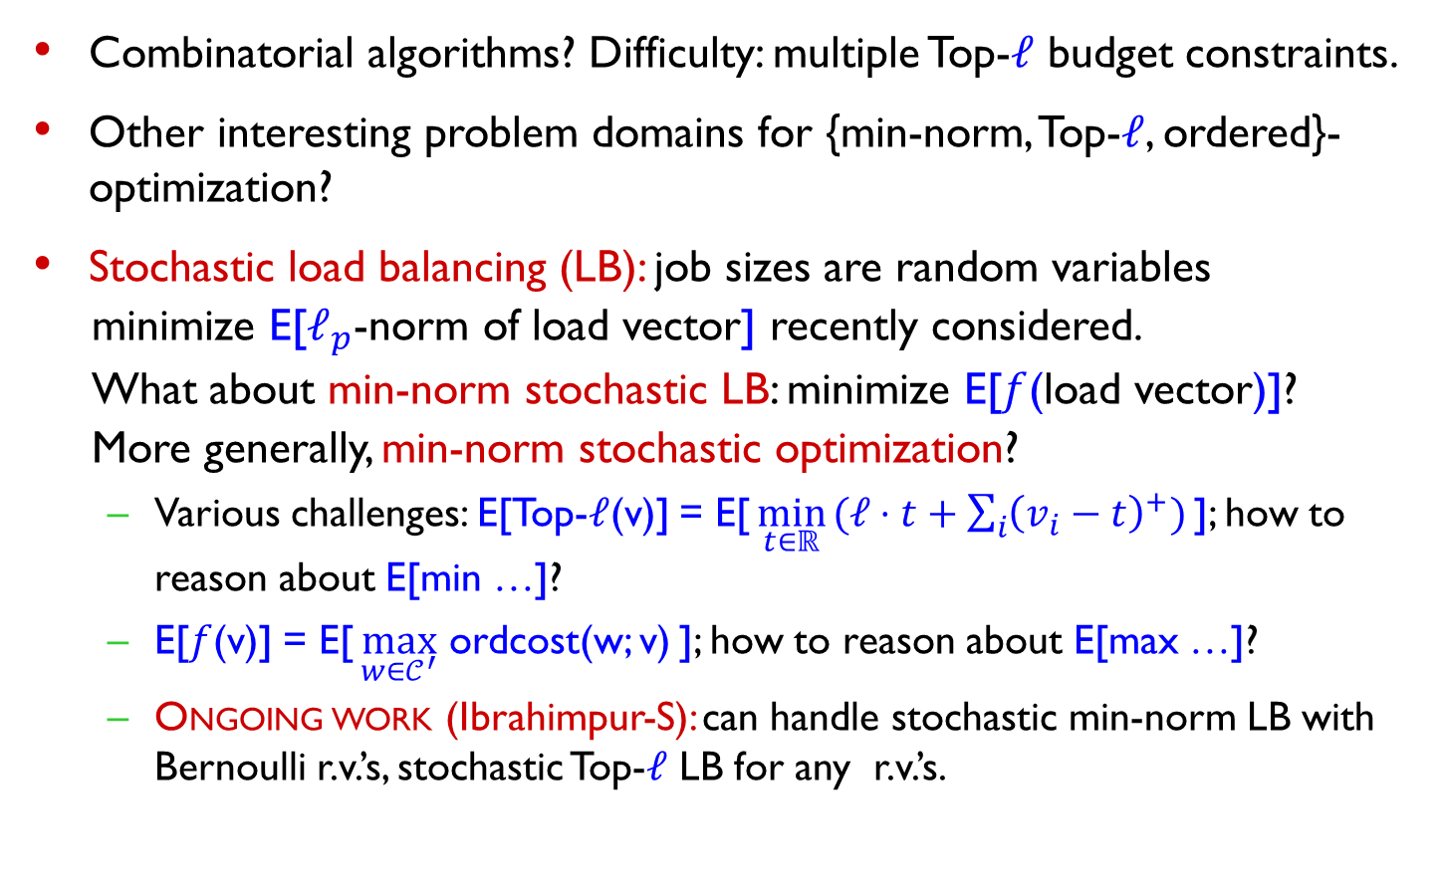
Open questions
Combinatorial algorithms? Difficulty: multiple Top-$ℓ$ budget constraints.
Other interesting problem domains for {min-norm, Top-$ℓ$, ordered}-optimization?
Stochastic load balancing (LB): job sizes are random variables
minimize E[$ℓ_{p}$-norm of load vector] recently considered.
What about min-norm stochastic LB: minimize E[$f$(load vector)]?
More generally, min-norm stochastic optimization?
  Various challenges: E[Top-$ℓ$(v)] = E[ $\min_{t∈ℝ} (ℓ⋅t+\sum_{i}{{\left(v_{i}−t\right)}^{+})}$ ]; how to reason about E[min …]?
  E[$f$(v)] = E[ $\max_{w∈𝒞^{′}}$ ordcost(w; v) ]; how to reason about E[max …]?
  Ongoing work (Ibrahimpur-S): can handle stochastic min-norm LB with Bernoulli r.v.’s, stochastic Top-$ℓ$ LB for any r.v.’s.

Slide 26
Thank You

