Slide 1
Improved Algorithms for MST and metric-TSP Interdiction
Chaitanya Swamy
University of Waterloo
Joint work with André Linhares
University of Waterloo

Slide 2
Minimum spanning tree (MST) interdiction
Given: graph G=(V, E), edge weights {w_{e} ≥ 0}, integer k
Goal: interdict (i.e., remove) k edges to
Maximize weight of MST in remainder graph
2
5
1
0
0
0
3
0
2
3
2
3
1
3
1

Slide 3
Minimum spanning tree (MST) interdiction
Given: graph G=(V, E), edge weights {w_{e} ≥ 0}, integer k
Goal: interdict (i.e., remove) k edges to
Maximize weight of MST in remainder graph
2
5
1
0
0
0
3
0
2
3
2
3
1
3
1
MST_{w}(G) = 6

Slide 4
Minimum spanning tree (MST) interdiction
Given: graph G=(V, E), edge weights {w_{e} ≥ 0}, integer k
Goal: interdict (i.e., remove) k edges to
Maximize weight of MST in remainder graph
2
5
1
0
0
0
k = 2
3
0
2
3
2
3
1
3
1
MST_{w}(G) = 6

Slide 5
Minimum spanning tree (MST) interdiction
Given: graph G=(V, E), edge weights {w_{e} ≥ 0}, integer k
Goal: interdict (i.e., remove) k edges to
Maximize weight of MST in remainder graph
weight of MST in G – R under {w_{e}} weights
2
5
1
0
0
0
k = 2 MST_{w}(G – R) = 9
3
0
2
3
2
3
1
3
1
MST_{w}(G) = 6

Slide 6
Minimum spanning tree (MST) interdiction
Given: graph G=(V, E), edge weights {w_{e} ≥ 0}, integer k
Goal: interdict (i.e., remove) k edges to
Maximize weight of MST in remainder graph
w_{e}
2
5
1
0
0
0
k = 2 MST_{w}(G – R) = 9
More generally, we have
interdiction costs {c_{e} ≥ 0}, budget B
3
0
2
3
2
3
1
3
1

Slide 7
Minimum spanning tree (MST) interdiction
Given: graph G=(V, E), edge weights {w_{e} ≥ 0}, integer k
Goal: interdict (i.e., remove) k edges to
Maximize weight of MST in remainder graph
w_{e} , c_{e}
2, 30
5, 30
1, 20
0, 20
0, 7
0, 13
k = 2 MST_{w}(G – R) = 9
More generally, we have
interdiction costs {c_{e} ≥ 0}, budget B
2, 13
3, 8
0, 13
3, 13
3, 10
2, 7
1, 17
3, 20
1, 20
B = 40
Goal: interdict edges of cost ≤ B to maximize weight of MST in remainder graph ≡ Max MST_{w}(G – R)
R ⊆ E: c(R)≤ B

Slide 8
Minimum spanning tree (MST) interdiction
Given: graph G=(V, E), edge weights {w_{e} ≥ 0}, integer k
Goal: interdict (i.e., remove) k edges to
Maximize weight of MST in remainder graph
w_{e} , c_{e}
2, 30
5, 30
1, 20
0, 20
0, 7
0, 13
k = 2 MST_{w}(G – R) = 9
More generally, we have
interdiction costs {c_{e} ≥ 0}, budget B
2, 13
3, 8
0, 13
3, 13
3, 10
2, 7
1, 17
3, 20
1, 20
B = 40 MST_{w}(G – R) = 14
Goal: interdict edges of cost ≤ B to maximize weight of MST in remainder graph ≡ Max MST_{w}(G – R)
R ⊆ E: c(R)≤ B

Slide 9
Interdiction problems: examples and motivation
Prominent, classical examples are
Matching interdiction:
delete edges to
minimize (max weight of a matching)
Shortest-path interdiction:
delete edges to
maximize (length of shortest s-t path)
Max-flow interdiction:
delete edges to
minimize (value of maximum s-t flow)
And MST interdiction:

Slide 10
Interdiction problems: examples and motivation
Prominent, classical examples are
Matching interdiction:
delete edges to
minimize (max weight of a matching)
Shortest-path interdiction:
delete edges to
maximize (length of shortest s-t path)
Max-flow interdiction:
delete edges to
minimize (value of maximum s-t flow)
And MST interdiction:
O(1)-approximation [Gupta, Dinitz’13]
no O(1)-approximation under UGC [E. Lee’17]
densest k-subgraph hard [Guruganesh, Sanita, S’15, Chestnut-Zenklusen’15]
14-approximation [Zenklusen’15]

Slide 11
Interdiction problems: examples and motivation (contd.)
Interdiction problems study sensitivity of optimization problems under removal of a budgeted set of elements
Can be used to identify vulnerable spots for
reinforcement (e.g., infrastructure protection; strengthening connectivity in a communication network) Or
disruption (models attacker’s problem; or disrupting an undesirable process, e.g., infection control)

Slide 12
Our results
Main result: give a 4-approximation for MST interdiction
(i.e., obtain solution of value ≥ OPT/4 in polytime)
Improves upon previous best 14-approx. (Zenklusen’15)
Simpler and cleaner algorithm and analysis
Key insights:
Problem of extracting a feasible solution from an over-budget set can be captured cleanly by the tree knapsack problem
Replaces a greedy procedure in Z’15, and its intricate analysis
Can obtain a strong LP-relative guarantee for tree knapsack – translates to improved guarantees for MST interdiction
Analysis is nearly tight: show lower bound of 3 on approx. ratio achievable using our upper bound (and the one in Z’15)

Slide 13
Our results (contd.)
4-approximation for MST interdiction also gives 8-approximation for TSP interdiction
Improves upon the 28-approximation in Z’15
Maximum-spanning-tree interdiction is densest-k-subgraph hard
Maximum-spanning-tree interdiction:
minimize (max w-weight of spanning tree of G – R)
R ⊆ E: c(R)≤ B

Slide 14
Related work
General edge weights and interdiction costs
Liri, Chern’93: seem to be the first to consider this generality – showed that MST interdiction is NP-hard
Frederickson, Solis-Oba’99: give an algorithm for unit interdiction costs that also implies O(log |V|)-approximation in general
Zenklusen’15: 14-approx. – first (and prior-best) O(1)-approx.
{0,1} weights, general interdiction costs:
Captures budgeted graph disconnection (remove edges within a given budget to maximize no. of components)
Engelberg et al.’07: give 2-approximation
General weights, unit interdiction costs: k most vital-edges
Frederickson, Solis-Oba’99: O(log k)-approximation

Slide 15
Recall: MST interdiction
Given: graph G=(V, E), edge weights {w_{e} ≥ 0}
interdiction costs {c_{e} ≥ 0}, budget B
Goal: interdict edges of cost ≤ B to maximize w-weight of MST in remainder graph ≡ Max (val (R) := MST_{w}(G – R))
R ⊆ E: c(R)≤ B
w_{e} , c_{e}
2, 30
5, 30
1, 20
0, 20
0, 7
0, 13
0, 13
2, 13
3, 8
3, 13
3, 10
2, 7
1, 17
3, 20
1, 20
B = 40

Slide 16
Recall: MST interdiction
Given: graph G=(V, E), edge weights {w_{e} ≥ 0}
interdiction costs {c_{e} ≥ 0}, budget B
Goal: interdict edges of cost ≤ B to maximize w-weight of MST in remainder graph ≡ Max (val (R) := MST_{w}(G – R))
R ⊆ E: c(R)≤ B
w_{e} , c_{e}
2, 30
5, 30
1, 20
0, 20
0, 7
0, 13
0, 13
val(R) = 14
2, 13
3, 8
3, 13
3, 10
2, 7
1, 17
3, 20
1, 20
B = 40

Slide 17
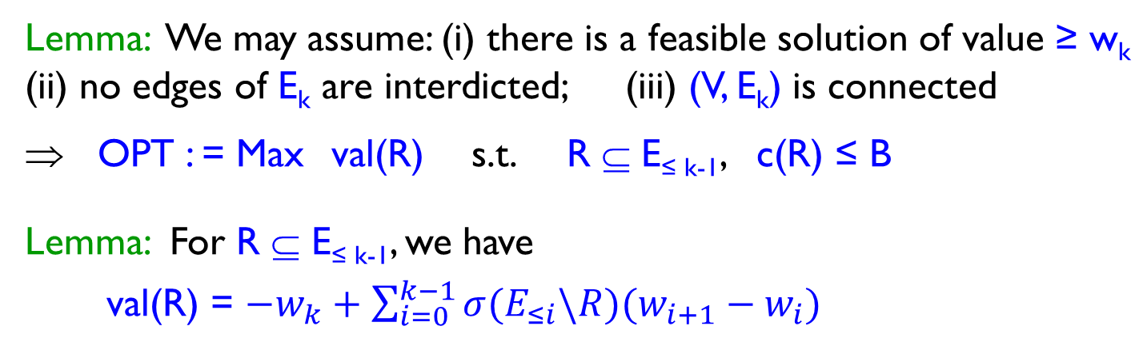
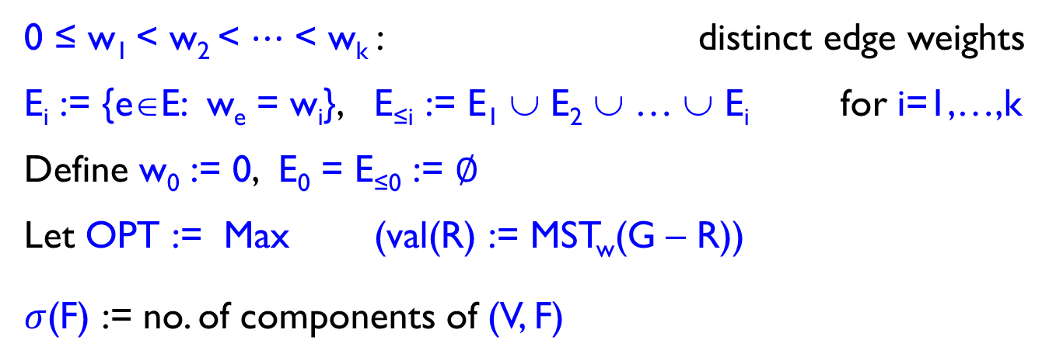
Notation and basic facts
0 ≤ w₁ < w₂ < $⋯$ < w_{k} : distinct edge weights
E_{i} := {e∈E: w_{e} = w_{i}}, E_{≤i} := E₁ ∪ E₂ ∪ … ∪ E_{i} for i=1,…,k
Define w₀ := 0, E₀ = E_{≤0} := $∅$
Let OPT := Max (val(R) := MST_{w}(G – R))
$σ$(F) := no. of components of (V, F)
R ⊆ E: c(R)≤ B
Lemma: We may assume: (i) there is a feasible solution of value ≥ w_{k}
(ii) no edges of E_{k} are interdicted; (iii) (V, E_{k}) is connected
⇒ OPT : = Max val(R) s.t. R ⊆ E_{≤ k-1}, c(R) ≤ B
Lemma: For R ⊆ E_{≤ k-1}, we have
val(R) = $−w_{k}+\sum_{i=0}^{k−1}{σ(E_{≤i}\backslash R)(w_{i+1}−w_{i})}$

Slide 18

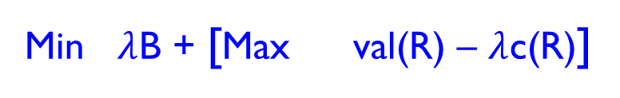
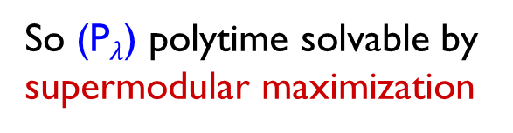
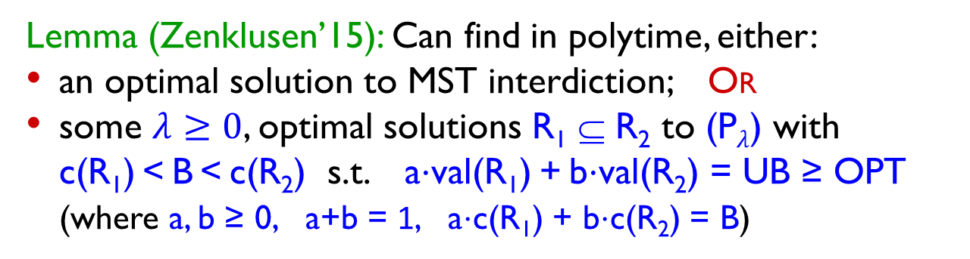
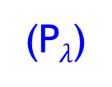
Lagrangian relaxation
OPT : = Max val(R) s.t. c(R) ≤ B
R ⊆ E_{≤ k-1}
Lagrangify budget constraint to obtain relaxation:
UB :=
Min $λ$B + [Max val(R) – $λ$c(R)]
val(R): supermodular
$$λ≥0$$
R ⊆ E_{≤ k-1}
(P$λ$)
So (P$λ$) polytime solvable by supermodular maximization
Lemma (Zenklusen’15): Can find in polytime, either:
an optimal solution to MST interdiction; Or
some $λ≥0$, optimal solutions R₁ ⊆ R₂ to (P$λ$) with
c(R₁) < B < c(R₂) s.t. a$⋅$val(R₁) + b$⋅$val(R₂) = UB ≥ OPT
(where a, b ≥ 0, a+b = 1, a$⋅$c(R₁) + b$⋅$c(R₂) = B)
Main task and chief contribution: show to extract a feasible solution R from R₁ and R₂ s.t. max{w_{k}, val(R₁), val(R)} ≥ UB/4

Slide 19


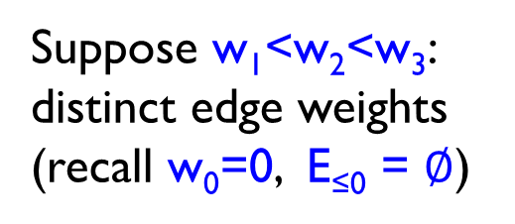
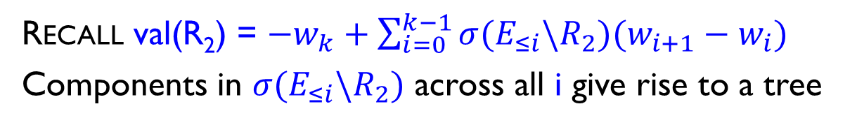



Extracting a good solution from R₂: reduction to tree knapsack
Recall val(R₂) = $−w_{k}+\sum_{i=0}^{k−1}{σ(E_{≤i}\backslash R_{2})(w_{i+1}−w_{i})}$
Components in $σ(E_{≤i}\backslash R_{2})$ across all i give rise to a tree
$$E_{≤3}\backslash R_{2}$$
V= {a,b,c,d,e,f}
Suppose w₁<w₂<w₃: distinct edge weights
(recall w₀=0, E_{≤0} = $∅$)
$$E_{≤2}\backslash R_{2}$$
a,d,e
b,c,f
$$E_{≤1}\backslash R_{2}$$
a,d
e
f
b,c
$$E_{≤0}\backslash R_{2}$$
a
d
e
f
b
c
Idea: Form solution by selecting suitable subset of components from $\bigcup_{i=0}^{k−1}{σ(E_{≤i}\backslash R_{2})}$, or equivalently subset of nodes of tree

Slide 20
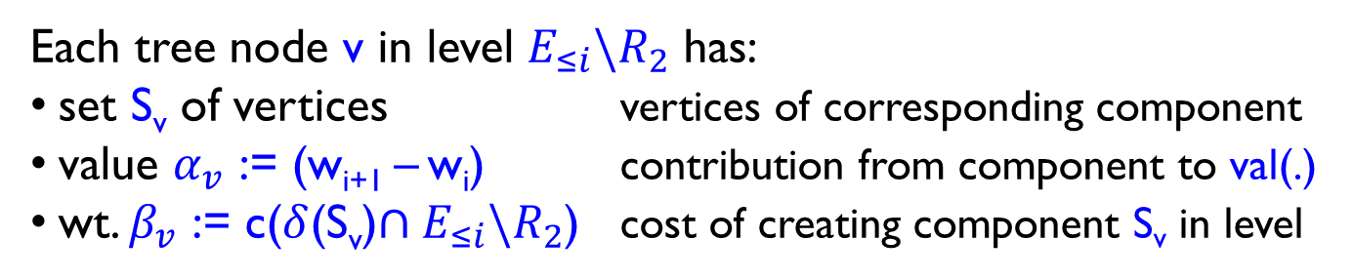





Reduction to tree knapsack (contd.)
Recall val(R₂) = $−w_{k}+\sum_{i=0}^{k−1}{σ(E_{≤i}\backslash R_{2})(w_{i+1}−w_{i})}$
$$E_{≤3}\backslash R_{2}$$
V= {a,b,c,d,e,f}
Suppose w₁<w₂<w₃: distinct edge weights
(recall w₀=0, E_{≤0} = $∅$)
$$E_{≤2}\backslash R_{2}$$
a,d,e
b,c,f
$$E_{≤1}\backslash R_{2}$$
a,d
e
f
b,c
$$E_{≤0}\backslash R_{2}$$
a
d
e
f
b
c
Idea: Form solution by choosing subset of (non-root) tree nodes
Each tree node v in level $E_{≤i}\backslash R_{2}$ has:
set S_{v} of vertices vertices of corresponding component
value $α_{v}$ := (w_{i+1} – w_{i}) contribution from component to val(.)
wt. $β_{v}$ := c($δ$(S_{v})$∩E_{≤i}\backslash R_{2}$) cost of creating component S_{v} in level

Slide 21
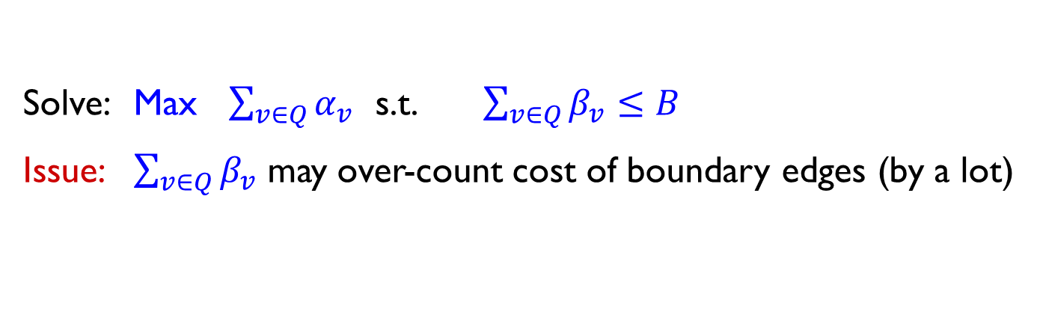

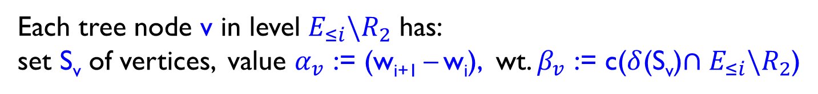




Reduction to tree knapsack (contd.)
Recall val(R₂) = $−w_{k}+\sum_{i=0}^{k−1}{σ(E_{≤i}\backslash R_{2})(w_{i+1}−w_{i})}$
$$E_{≤3}\backslash R_{2}$$
V= {a,b,c,d,e,f}
E₁
E₂
over-counted
$$E_{≤2}\backslash R_{2}$$
a,d,e
b,c,f
a, d
$$E_{≤1}\backslash R_{2}$$
a,d
e
f
b,c
e
$$E_{≤0}\backslash R_{2}$$
a
d
e
f
b
c
Idea: Form solution by choosing subset of (non-root) tree nodes
Each tree node v in level $E_{≤i}\backslash R_{2}$ has:
set S_{v} of vertices, value $α_{v}$ := (w_{i+1} – w_{i}), wt. $β_{v}$ := c($δ$(S_{v})$∩E_{≤i}\backslash R_{2}$)
Solve: Max $\sum_{v∈Q}{α_{v}}$ s.t. $\sum_{v∈Q}{β_{v}≤B}$
Issue: $\sum_{v∈Q}{β_{v}}$ may over-count cost of boundary edges (by a lot)
$$Q⊆N$$

Slide 22
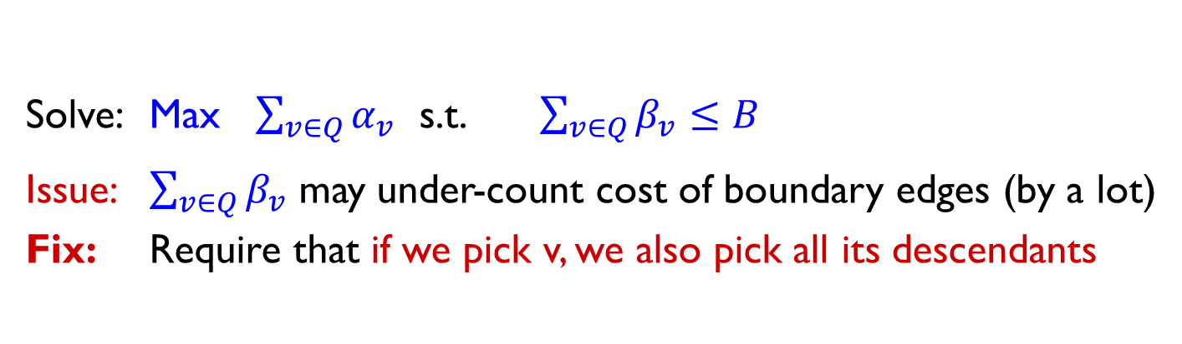
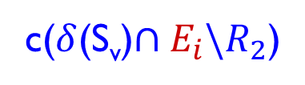
Reduction to tree knapsack (contd.)
Recall val(R₂) = $−w_{k}+\sum_{i=0}^{k−1}{σ(E_{≤i}\backslash R_{2})(w_{i+1}−w_{i})}$
$$E_{≤3}\backslash R_{2}$$
V= {a,b,c,d,e,f}
E₁
E₂
$$E_{≤2}\backslash R_{2}$$
a,d,e
b,c,f
a, d
$$E_{≤1}\backslash R_{2}$$
a,d
e
f
b,c
e
$$E_{≤0}\backslash R_{2}$$
a
d
e
f
b
c
Idea: Form solution by choosing subset of (non-root) tree nodes
c($δ$(S_{v})$∩E_{i}\backslash R_{2}$)
Each tree node v in level $E_{≤i}\backslash R_{2}$ has:
set S_{v} of vertices, value $α_{v}$ := (w_{i+1} – w_{i}), wt. $β_{v}$ := c($δ$(S_{v})$∩E_{≤i}\backslash R_{2}$)
Solve: Max $\sum_{v∈Q}{α_{v}}$ s.t. $\sum_{v∈Q}{β_{v}≤B}$
Issue: $\sum_{v∈Q}{β_{v}}$ may under-count cost of boundary edges (by a lot)
Fix: Require that if we pick v, we also pick all its descendants
$$Q⊆N$$

Slide 23
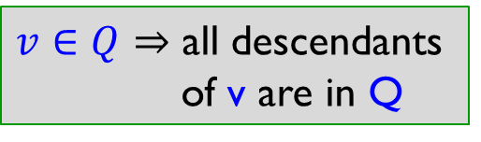
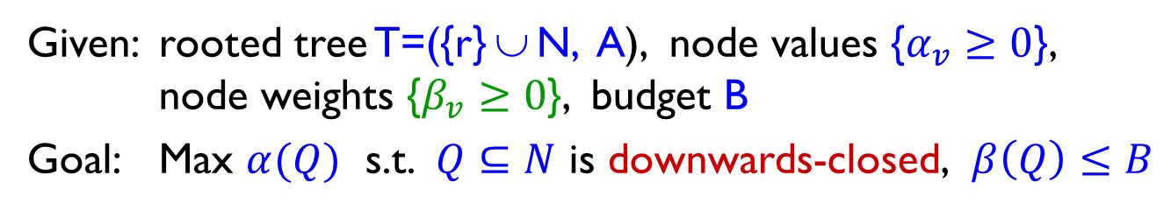
Tree Knapsack problem
Given: rooted tree T=({r} ∪ N, A), node values {$α_{v}≥0$},
node weights {$β_{v}≥0$}, budget B
Goal: Max $α(Q)$ s.t. $Q⊆N$ is downwards-closed, $β\left(Q\right)≤B$
$v∈Q⇒$ all descendants
of v are in Q
r
3, 5
2, 3
1, 0
2, 5
1, 2
9, 5
3, 2
1, 3
4, 2
4, 1
3, 5
5, 1

Slide 24
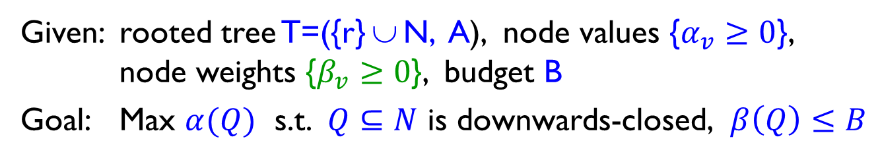
Tree Knapsack problem
Given: rooted tree T=({r} ∪ N, A), node values {$α_{v}≥0$},
node weights {$β_{v}≥0$}, budget B
Goal: Max $α(Q)$ s.t. $Q⊆N$ is downwards-closed, $β\left(Q\right)≤B$
Standard knapsack:
special case when T is a star
Introduced by Johnson-Niemi’83 – gave FPTAS via dynamic programming
We need guarantees relative to the natural LP: not known previously
r
3, 5
2, 3
1, 0
2, 5
1, 2
9, 5
3, 2
1, 3
4, 2
4, 1
3, 5
5, 1

Slide 25
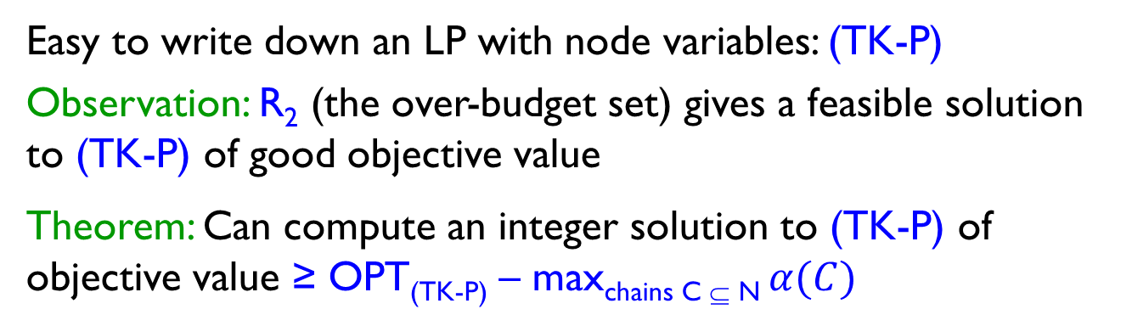
Tree Knapsack problem
Given: rooted tree T=({r} ∪ N, A), node values {$α_{v}≥0$},
node weights {$β_{v}≥0$}, budget B
Goal: Max $α(Q)$ s.t. $Q⊆N$ is downwards-closed, $β\left(Q\right)≤B$
Easy to write down an LP with node variables: (TK-P)
Observation: R₂ (the over-budget set) gives a feasible solution to (TK-P) of good objective value
Theorem: Can compute an integer solution to (TK-P) of objective value ≥ OPT_{(TK-P)} – max_{chains C ⊆ N} $α(C)$
r
3, 5
2, 3
1, 0
2, 5
1, 2
9, 5
3, 2
1, 3
4, 2
4, 1
3, 5
5, 1

Slide 26
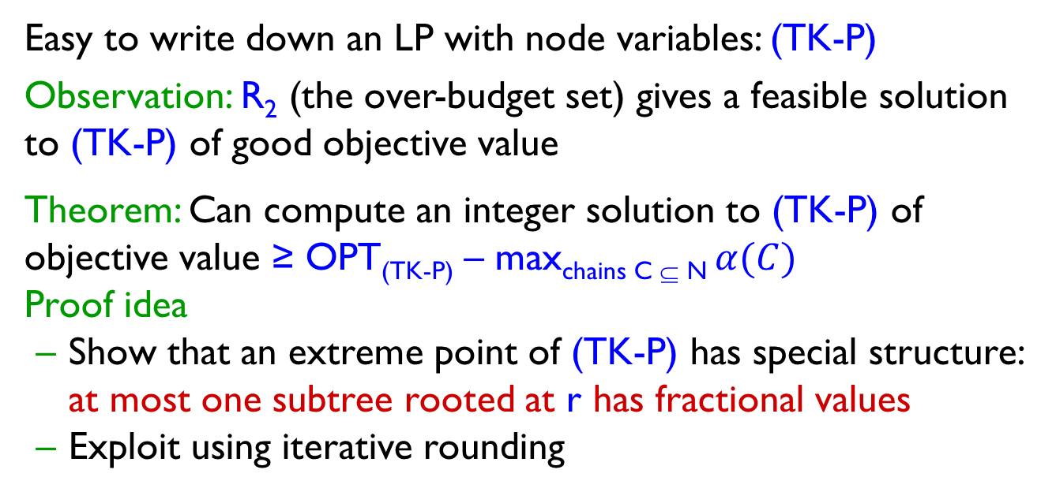
Tree Knapsack problem
Given: rooted tree T=({r} ∪ N, A), node values {$α_{v}≥0$},
node weights {$β_{v}≥0$}, budget B
Goal: Max $α(Q)$ s.t. $Q⊆N$ is downwards-closed, $β\left(Q\right)≤B$
Easy to write down an LP with node variables: (TK-P)
Observation: R₂ (the over-budget set) gives a feasible solution to (TK-P) of good objective value
Theorem: Can compute an integer solution to (TK-P) of objective value ≥ OPT_{(TK-P)} – max_{chains C ⊆ N} $α(C)$
Proof idea
Show that an extreme point of (TK-P) has special structure: at most one subtree rooted at r has fractional values
Exploit using iterative rounding

Slide 27
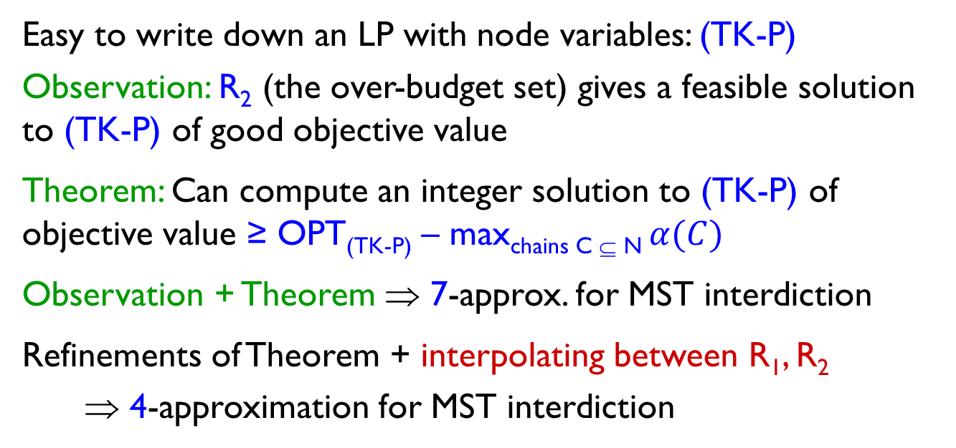
Tree Knapsack to MST interdiction
Given: rooted tree T=({r} ∪ N, A), node values {$α_{v}≥0$},
node weights {$β_{v}≥0$}, budget B
Goal: Max $α(Q)$ s.t. $Q⊆N$ is downwards-closed, $β\left(Q\right)≤B$
Easy to write down an LP with node variables: (TK-P)
Observation: R₂ (the over-budget set) gives a feasible solution to (TK-P) of good objective value
Theorem: Can compute an integer solution to (TK-P) of objective value ≥ OPT_{(TK-P)} – max_{chains C ⊆ N} $α(C)$
Observation + Theorem ⇒ 7-approx. for MST interdiction
Refinements of Theorem + interpolating between R₁, R₂
⇒ 4-approximation for MST interdiction

Slide 28
Summary and open questions
Devise 4-approximation for MST interdiction
Improves upon 14-approximation by Zenklusen’15
Simple, clean algorithm and analysis using tree knapsack
Obtain first LP-relative guarantees for tree knapsack
Show lower bound of 3 on approx. ratio achievable via upper bound used in analysis
Open questions
Close the gap [3, 4] in analysis. Better guarantees using LPs?
LP-relaxation is not obvious, but can be obtained
O(1)-approx. for minimum-spanning-forest interdiction?
Minimum-basis interdiction for general matroids is densest-k-subgraph hard.
Can similar ideas be applied to other network-design interdiction problems?

Slide 29
Thank You

