Slide 1
Improved Approximation Algorithms for
Matroid and Knapsack Median Problems and Applications
Chaitanya Swamy
University of Waterloo
Talk given by Zachary Friggstad
University of Alberta

Slide 2
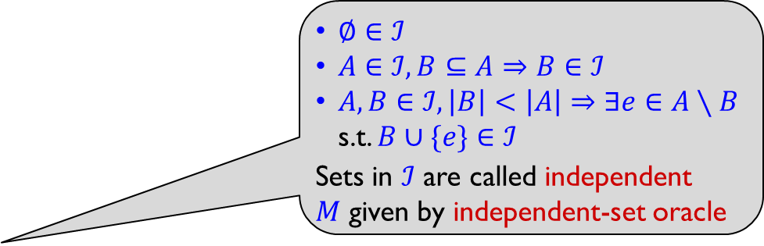
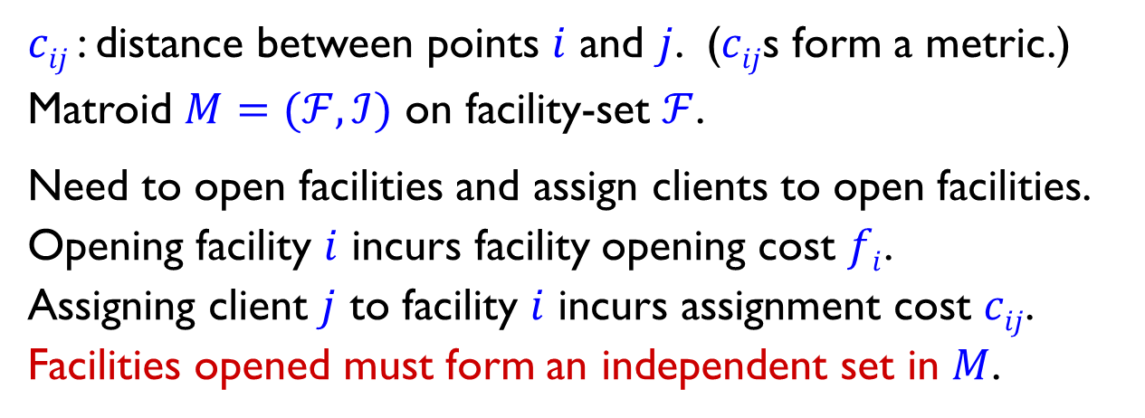


Matroid median
client
facility
$∅∈ℐ$
$A∈ℐ, B⊆A⇒B∈ℐ$
$A, B∈ℐ, \left|B\right|<\left|A\right|⇒∃e∈A∖B$ s.t. $B∪\{e\}∈ℐ$
Sets in $ℐ$ are called independent
$M$ given by independent-set oracle
$≤2$ facilities
$≤3$ facilities
$cij$ : distance between points $i$ and $j$. ($cij$s form a metric.)
Matroid $M=(ℱ, ℐ)$ on facility-set $ℱ$.
Need to open facilities and assign clients to open facilities.
Opening facility $i$ incurs facility opening cost $fi$.
Assigning client $j$ to facility $i$ incurs assignment cost $cij$.
Facilities opened must form an independent set in $M$.

Slide 3
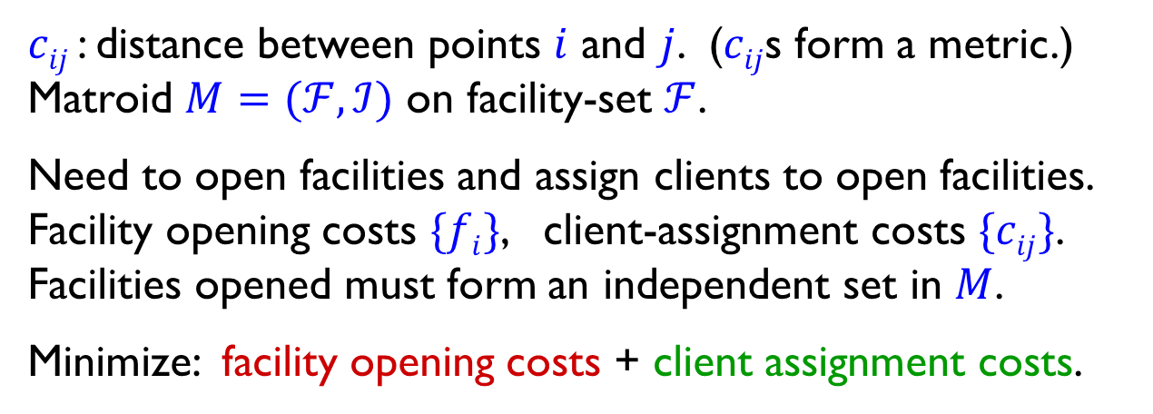

Matroid median
client
facility
matroid $M$
open facility
$≤2$ facilities
$≤3$ facilities
$cij$ : distance between points $i$ and $j$. ($cij$s form a metric.)
Matroid $M=(ℱ, ℐ)$ on facility-set $ℱ$.
Need to open facilities and assign clients to open facilities.
Facility opening costs $\{fi\}$, client-assignment costs $\{cij\}$.
Facilities opened must form an independent set in $M$.
Minimize: facility opening costs + client assignment costs.

Slide 4
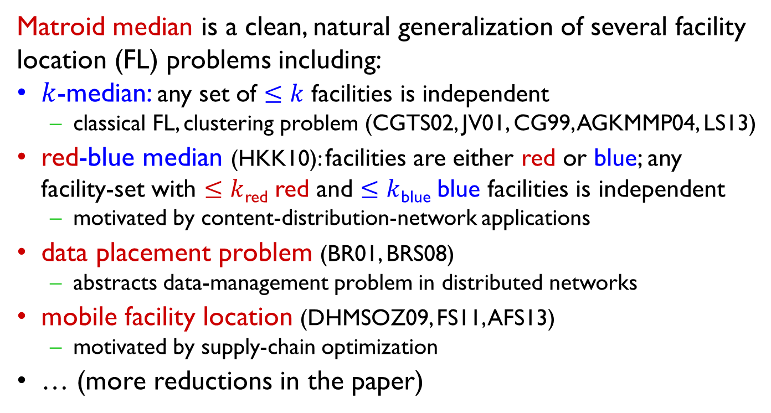
Matroid median is a clean, natural generalization of several facility location (FL) problems including:
$k$-median: any set of $≤k$ facilities is independent
  classical FL, clustering problem (CGTS02, JV01, CG99, AGKMMP04, LS13)
red-blue median (HKK10): facilities are either red or blue; any facility-set with $≤k$_{red} red and $≤k$_{blue} blue facilities is independent
  motivated by content-distribution-network applications
data placement problem (BR01, BRS08)
  abstracts data-management problem in distributed networks
mobile facility location (DHMSOZ09, FS11, AFS13)
  motivated by supply-chain optimization
… (more reductions in the paper)

Slide 5
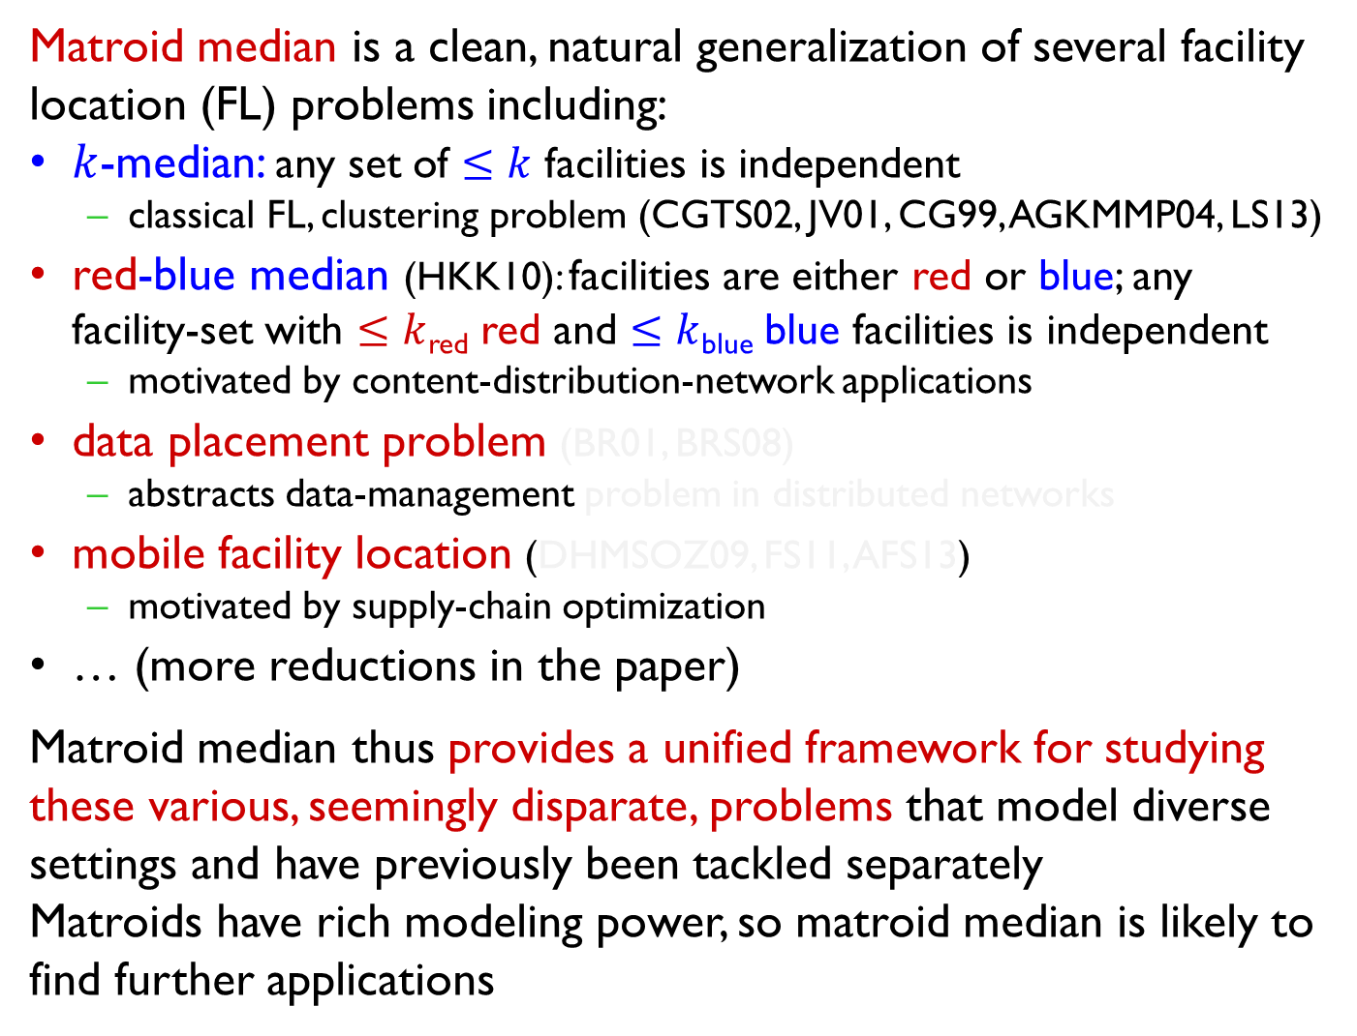
Matroid median is a clean, natural generalization of several facility location (FL) problems including:
$k$-median: any set of $≤k$ facilities is independent
  classical FL, clustering problem (CGTS02, JV01, CG99, AGKMMP04, LS13)
red-blue median (HKK10): facilities are either red or blue; any facility-set with $≤k$_{red} red and $≤k$_{blue} blue facilities is independent
  motivated by content-distribution-network applications
data placement problem (BR01, BRS08)
  abstracts data-management problem in distributed networks
mobile facility location (DHMSOZ09, FS11, AFS13)
  motivated by supply-chain optimization
… (more reductions in the paper)
Matroid median thus provides a unified framework for studying these various, seemingly disparate, problems that model diverse settings and have previously been tackled separately
Matroids have rich modeling power, so matroid median is likely to find further applications
Due to reductions in our paper
Our improvement for matroid median yields improved bounds for these problems

Slide 6
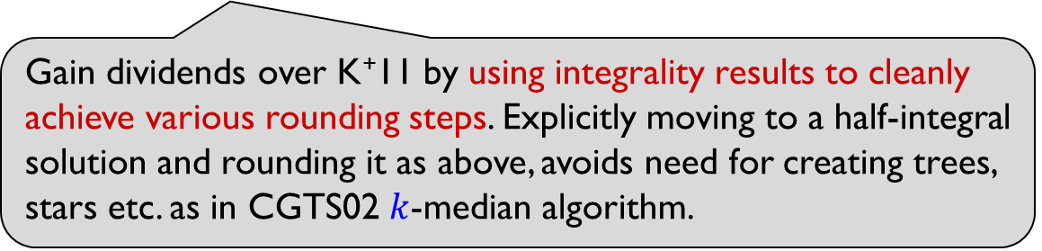
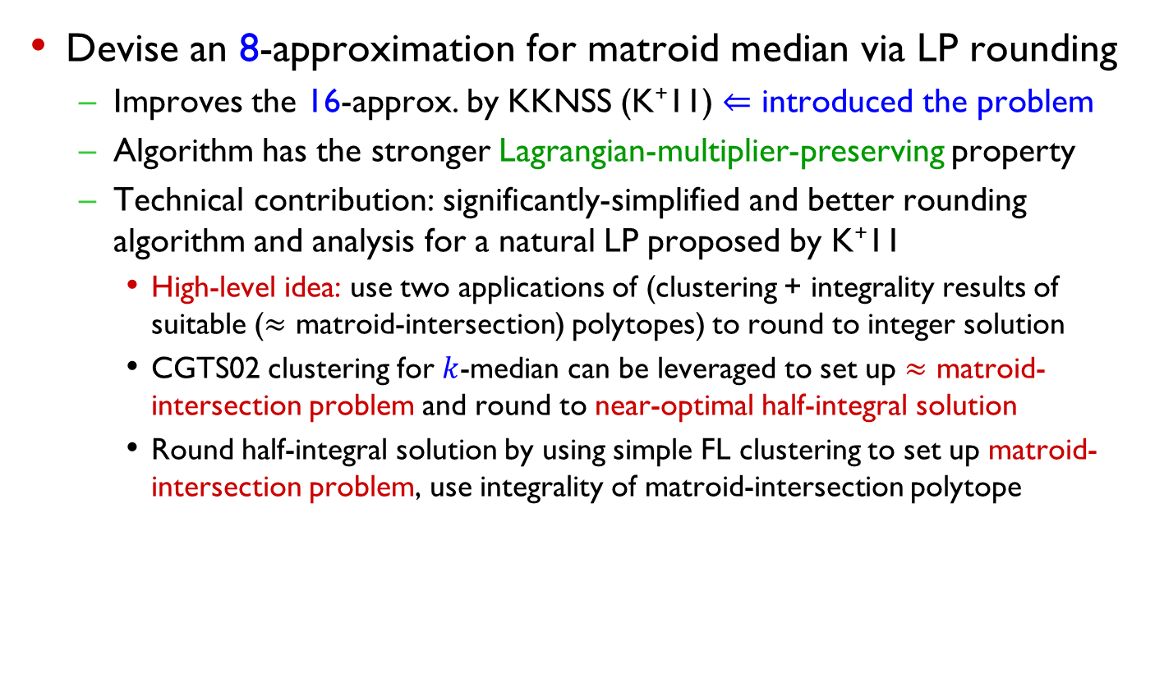
Our contributions
Devise an 8-approximation for matroid median via LP rounding
  Improves the 16-approx. by KKNSS (K⁺11) $⇐$ introduced the problem
  Algorithm has the stronger Lagrangian-multiplier-preserving property
  Technical contribution: significantly-simplified and better rounding algorithm and analysis for a natural LP proposed by K⁺11
    High-level idea: use two applications of (clustering + integrality results of suitable ($≈$ matroid-intersection) polytopes) to round to integer solution
    CGTS02 clustering for $k$-median can be leveraged to set up $≈$ matroid-intersection problem and round to near-optimal half-integral solution
    Round half-integral solution by using simple FL clustering to set up matroid-intersection problem, use integrality of matroid-intersection polytope
Gain dividends over K⁺11 by using integrality results to cleanly achieve various rounding steps. Explicitly moving to a half-integral solution and rounding it as above, avoids need for creating trees, stars etc. as in CGTS02 $k$-median algorithm.

Slide 7
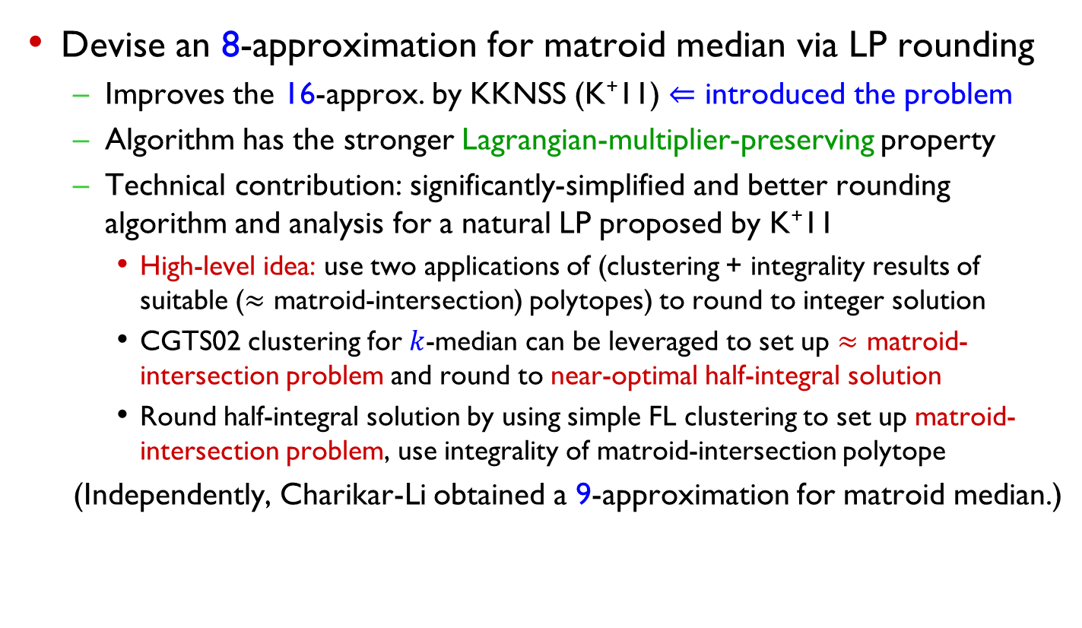
Our contributions
Devise an 8-approximation for matroid median via LP rounding
  Improves the 16-approx. by KKNSS (K⁺11) $⇐$ introduced the problem
  Algorithm has the stronger Lagrangian-multiplier-preserving property
  Technical contribution: significantly-simplified and better rounding algorithm and analysis for a natural LP proposed by K⁺11
    High-level idea: use two applications of (clustering + integrality results of suitable ($≈$ matroid-intersection) polytopes) to round to integer solution
    CGTS02 clustering for $k$-median can be leveraged to set up $≈$ matroid-intersection problem and round to near-optimal half-integral solution
    Round half-integral solution by using simple FL clustering to set up matroid-intersection problem, use integrality of matroid-intersection polytope
  (Independently, Charikar-Li obtained a 9-approximation for matroid median.)

Slide 8
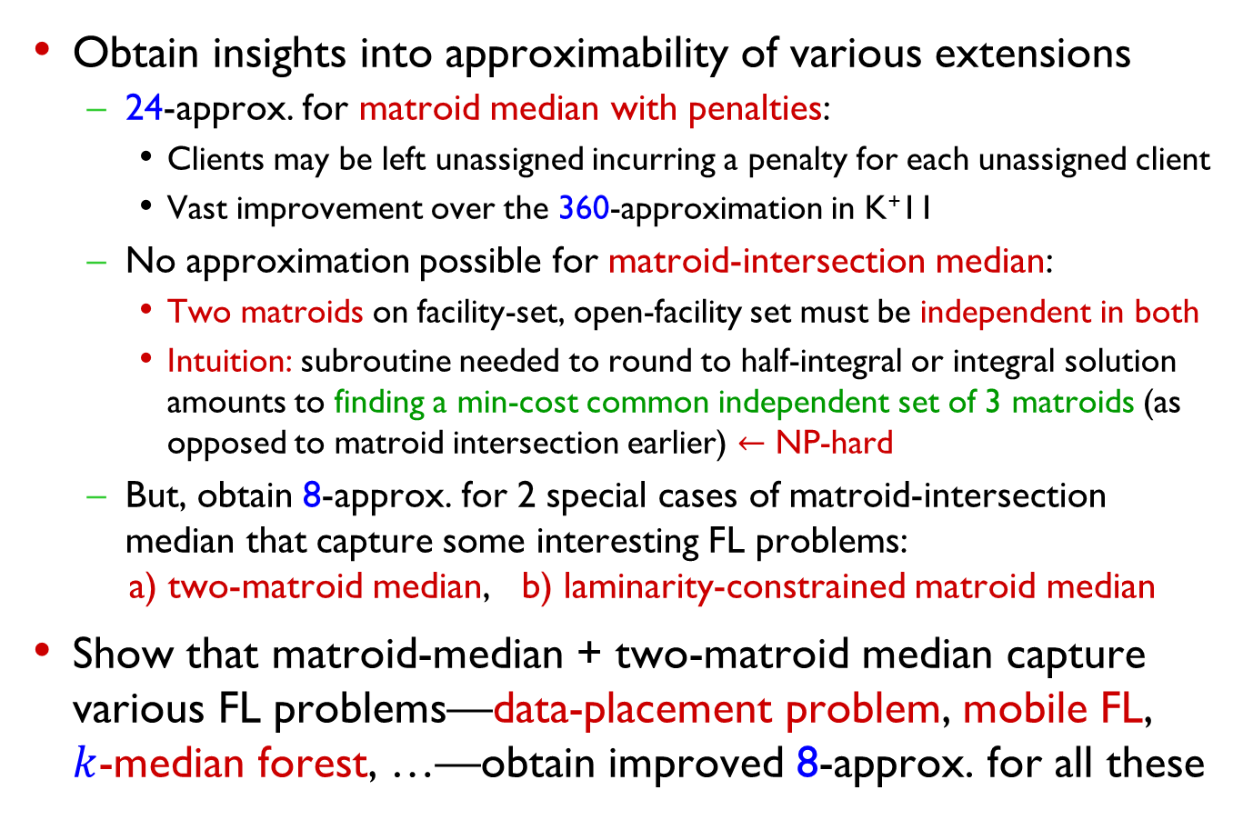
Our contributions (contd.)
Obtain insights into approximability of various extensions
  24-approx. for matroid median with penalties:
    Clients may be left unassigned incurring a penalty for each unassigned client
    Vast improvement over the 360-approximation in K⁺11
  No approximation possible for matroid-intersection median:
    Two matroids on facility-set, open-facility set must be independent in both
    Intuition: subroutine needed to round to half-integral or integral solution amounts to finding a min-cost common independent set of 3 matroids (as opposed to matroid intersection earlier) $←$ NP-hard
  But, obtain 8-approx. for 2 special cases of matroid-intersection median that capture some interesting FL problems:
  a) two-matroid median, b) laminarity-constrained matroid median
Show that matroid-median + two-matroid median capture various FL problems—data-placement problem, mobile FL, $k$-median forest, …—obtain improved 8-approx. for all these

Slide 9

Our contributions (contd.)
Adapt techniques to give a $(32+ε)$-approximation for knapsack median (slightly improves 34-approx. in CL12)
  Knapsack constraint: (total weight of open facilities $≤B$), replaces matroid-independence constraint
  Introduced by HKK10; Kumar12 gave first $O(1)$-approximation

Slide 10
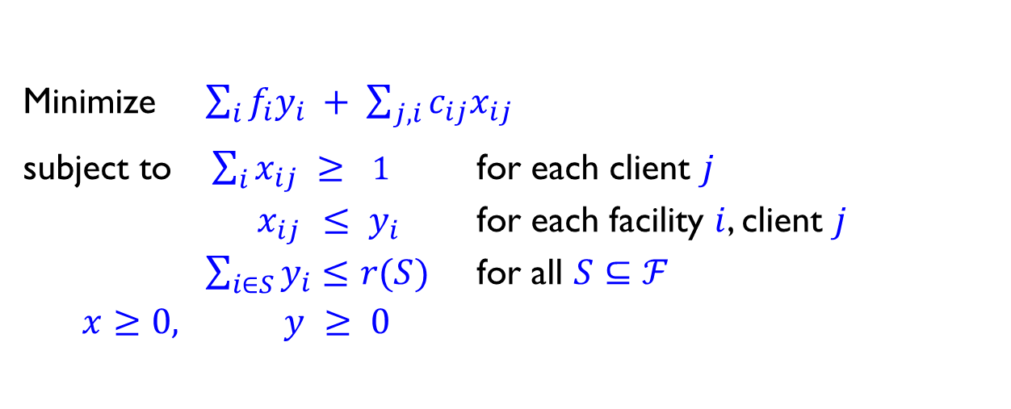
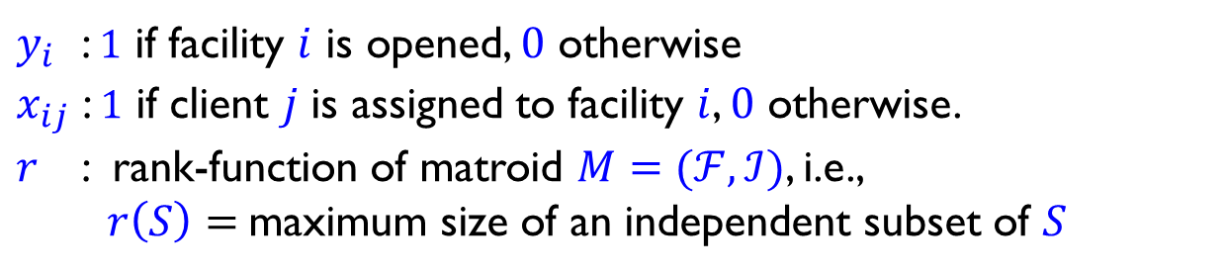
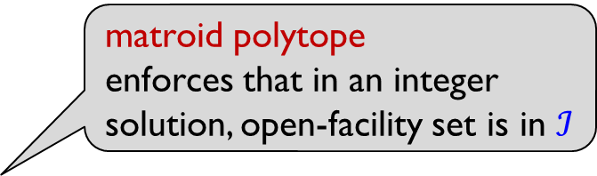
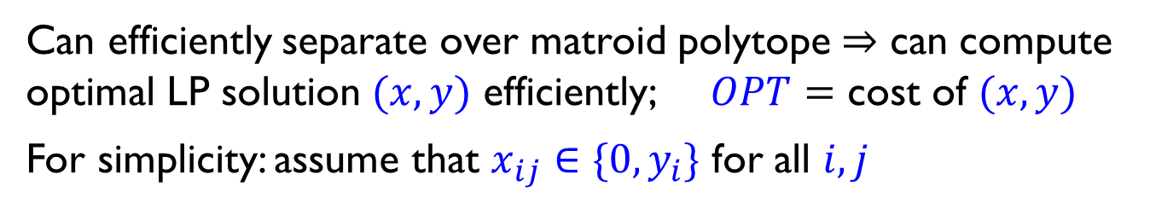
LP for matroid median
$y_{i}$ : $1$ if facility $i$ is opened, $0$ otherwise
$x_{ij}$ : $1$ if client $j$ is assigned to facility $i$, $0$ otherwise.
$r$ : rank-function of matroid $M=(ℱ,ℐ)$, i.e.,
$r\left(S\right)=$maximum size of an independent subset of $S$
Minimize $\sum_{i}{f_{i}y_{i}} + \sum_{j,i}{c_{ij}x_{ij}}$
subject to $\sum_{i}{x_{ij}} ≥ 1$ for each client $j$
$x_{ij} ≤ y_{i}$ for each facility $i$, client $j$
$\sum_{i∈S}{y_{i}}≤r(S)$ for all $S⊆ℱ$
$x≥0,$ $y ≥ 0$
matroid polytope
enforces that in an integer solution, open-facility set is in $ℐ$
Can efficiently separate over matroid polytope $⇒$ can compute optimal LP solution $(x,y)$ efficiently; $OPT=$ cost of $(x,y)$
For simplicity: assume that $x_{ij}∈\{0,y_{i}\}$ for all $i, j$

Slide 11





Rounding $(x,y)$: building intuition
$$y_{i}> 0$$
$$y_{i} = 0$$
$$x_{ij} > 0$$
Easy case: suppose facility-sets $ℱ_{j}≔\{i:x_{ij} > 0\}$ for different clients are either disjoint or identical (*)

Slide 12
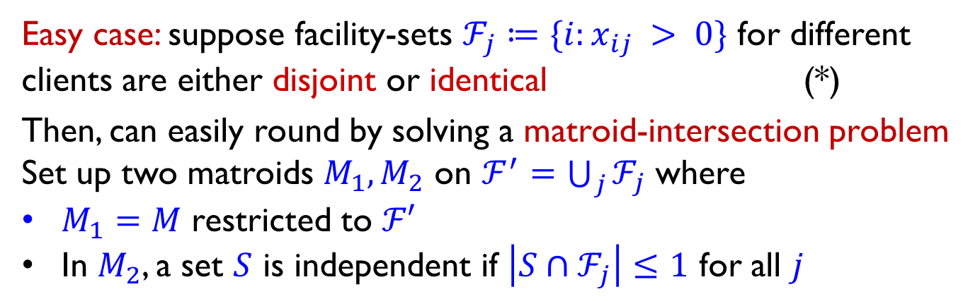
Rounding $(x,y)$: building intuition
$$y_{i}> 0$$
$$y_{i} = 0$$
$$x_{ij} > 0$$
Easy case: suppose facility-sets $ℱ_{j}≔\{i:x_{ij} > 0\}$ for different clients are either disjoint or identical (*)
Then, can easily round by solving a matroid-intersection problem Set up two matroids $M_{1}, M_{2}$ on $ℱ^{′}=\bigcup_{j}{ℱ_{j}}$ where
$M_{1}=M$ restricted to $ℱ′$
In $M_{2}$, a set $S$ is independent if $\left|S∩ℱ_{j}\right|≤1$ for all $j$

Slide 13


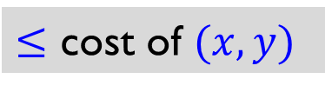
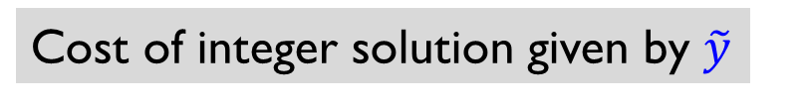
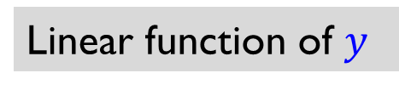
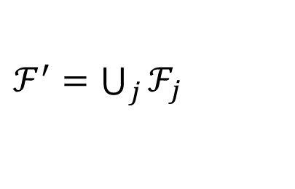

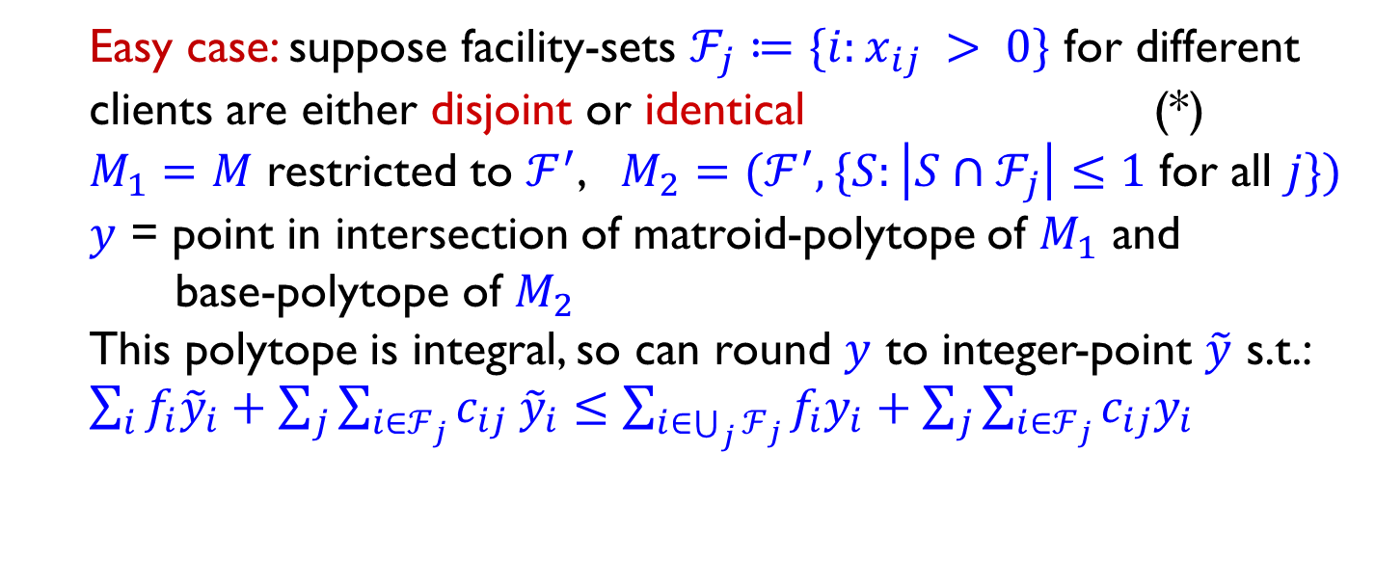

Rounding $(x,y)$: building intuition
$$y_{i}> 0$$
$$y_{i} = 0$$
$$x_{ij} > 0$$
$ℱ^{′}=$ $\bigcup_{j}{ℱ_{j}}$
Easy case: suppose facility-sets $ℱ_{j}≔\{i:x_{ij} > 0\}$ for different clients are either disjoint or identical (*)
$M_{1}=M$ restricted to $ℱ^{′}$, $M_{2}=(ℱ^{′}, \{S:\left|S∩ℱ_{j}\right|≤1$ for all $j\})$
$y$ = point in intersection of matroid-polytope of $M_{1}$ and
base-polytope of $M_{2}$
This polytope is integral, so can round $y$ to integer-point $\tilde{y}$ s.t.:
$\sum_{i}{f_{i}{\tilde{y}}_{i}}+\sum_{j}{\sum_{i∈ℱ_{j}}{c_{ij} {\tilde{y}}_{i}}}≤\sum_{i∈\bigcup_{j}{ℱ_{j}}}{f_{i}y_{i}}+\sum_{j}{\sum_{i∈ℱ_{j}}{c_{ij}y_{i}}}$
Linear function of $y$
Cost of integer solution given by $\tilde{y}$
$≤$ cost of $(x,y)$

Slide 14
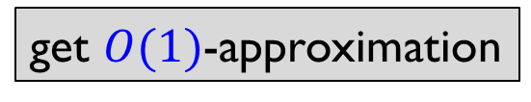

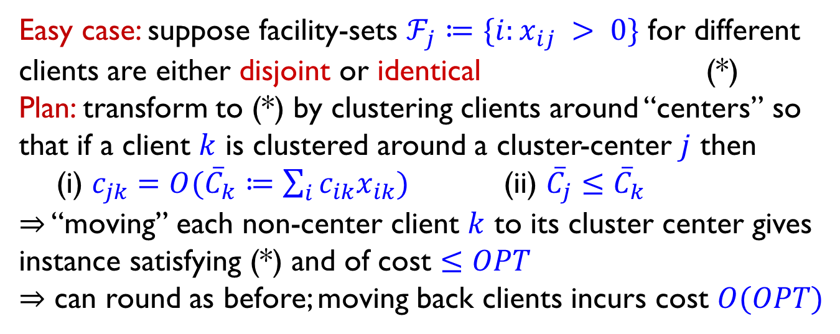
Rounding $(x,y)$: overview
$$y_{i}> 0$$
$$y_{i} = 0$$
$$x_{ij} > 0$$
Easy case: suppose facility-sets $ℱ_{j}≔\{i:x_{ij} > 0\}$ for different clients are either disjoint or identical (*)
Plan: transform to (*) by clustering clients around “centers” so that if a client $k$ is clustered around a cluster-center $j$ then
(i) $c_{jk}=O({\overline{C}}_{k}≔\sum_{i}{c_{ik}x_{ik}})$ (ii) ${\overline{C}}_{j}≤{\overline{C}}_{k}$
$⇒$ “moving” each non-center client $k$ to its cluster center gives instance satisfying (*) and of cost $≤OPT$
$⇒$ can round as before; moving back clients incurs cost $O(OPT)$
get $O(1)$-approximation

Slide 15
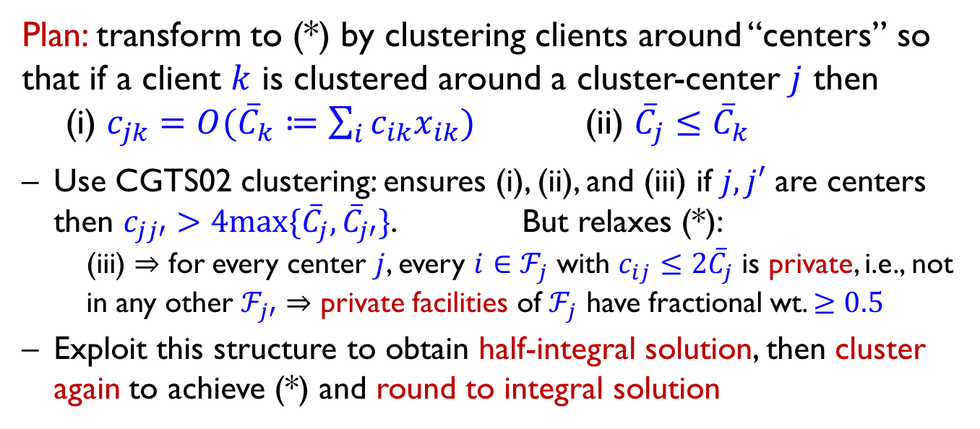
Rounding $(x,y)$: overview
$$y_{i}> 0$$
$$y_{i} = 0$$
$$x_{ij} > 0$$
Plan: transform to (*) by clustering clients around “centers” so that if a client $k$ is clustered around a cluster-center $j$ then
(i) $c_{jk}=O({\overline{C}}_{k}≔\sum_{i}{c_{ik}x_{ik}})$ (ii) ${\overline{C}}_{j}≤{\overline{C}}_{k}$
Use CGTS02 clustering: ensures (i), (ii), and (iii) if $j,j′$ are centers then $c_{jj′}>4max\{{\overline{C}}_{j}, {\overline{C}}_{j′}\}$. But relaxes (*):
  (iii) $⇒$ for every center $j$, every $i∈ℱ_{j}$ with $c_{ij}≤2{\overline{C}}_{j}$ is private, i.e., not in any other $ℱ_{j′}⇒$ private facilities of $ℱ_{j}$ have fractional wt. $≥0.5$
Exploit this structure to obtain half-integral solution, then cluster again to achieve (*) and round to integral solution

Slide 16
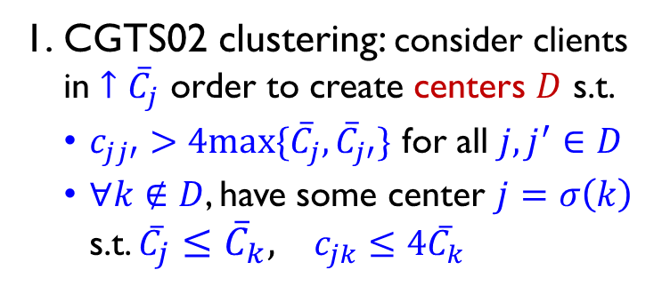

Rounding $(x,y)$: more details
  CGTS02 clustering: consider clients in $↑{\overline{C}}_{j}$ order to create centers $D$ s.t.
  $c_{jj′}>4max\{{\overline{C}}_{j}, {\overline{C}}_{j′}\}$ for all $j,j^{′}∈D$
  $∀k∉D$, have some center $j=σ\left(k\right)$ s.t. ${\overline{C}}_{j}≤{\overline{C}}_{k}, c_{jk}≤4{\overline{C}}_{k}$

Slide 17


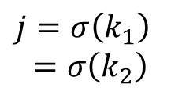
Rounding $(x,y)$: more details
  CGTS02 clustering: consider clients in $↑{\overline{C}}_{j}$ order to create centers $D$ s.t.
  $c_{jj′}>4max\{{\overline{C}}_{j}, {\overline{C}}_{j′}\}$ for all $j,j^{′}∈D$
  $∀k∉D$, have some center $j=σ\left(k\right)$ s.t. ${\overline{C}}_{j}≤{\overline{C}}_{k}, c_{jk}≤4{\overline{C}}_{k}$
$$k_{1}$$
$j=σ\left(k_{1}\right)$
$=σ\left(k_{2}\right)$
$$k_{2}$$
center
non-center

Slide 18
Rounding $(x,y)$: more details
  CGTS02 clustering: consider clients in $↑{\overline{C}}_{j}$ order to create centers $D$ s.t.
  $c_{jj′}>4max\{{\overline{C}}_{j}, {\overline{C}}_{j′}\}$ for all $j,j^{′}∈D$
  $∀k∉D$, have some center $j=σ\left(k\right)$ s.t. ${\overline{C}}_{j}≤{\overline{C}}_{k}, c_{jk}≤4{\overline{C}}_{k}$
center
non-center

Slide 19
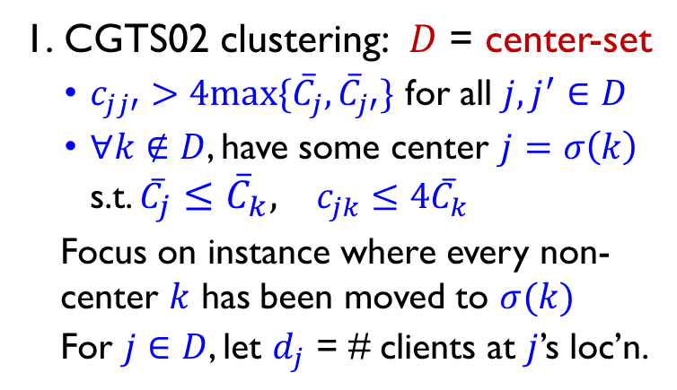
Rounding $(x,y)$: more details
CGTS02 clustering: $D$ = center-set
  $c_{jj′}>4max\{{\overline{C}}_{j}, {\overline{C}}_{j′}\}$ for all $j,j^{′}∈D$
  $∀k∉D$, have some center $j=σ\left(k\right)$ s.t. ${\overline{C}}_{j}≤{\overline{C}}_{k}, c_{jk}≤4{\overline{C}}_{k}$
  Focus on instance where every non-center $k$ has been moved to $σ(k)$
  For $j∈D$, let $d_{j}$ = # clients at $j$’s loc’n.
center
non-center

Slide 20




Rounding $(x,y)$: more details
CGTS02 clustering: $D$ = center-set
  $c_{jj′}>4max\{{\overline{C}}_{j}, {\overline{C}}_{j′}\}$ for all $j,j^{′}∈D$
  $∀k∉D$, have some center $j=σ\left(k\right)$ s.t. ${\overline{C}}_{j}≤{\overline{C}}_{k}, c_{jk}≤4{\overline{C}}_{k}$
  Focus on instance where every non-center $k$ has been moved to $σ(k)$
  For $j∈D$, let $d_{j}$ = # clients at $j$’s loc’n.
$$d_{j}=4$$
$$d_{j}=4$$
$$d_{j}=4$$
$$d_{j}=3$$
center
non-center

Slide 21


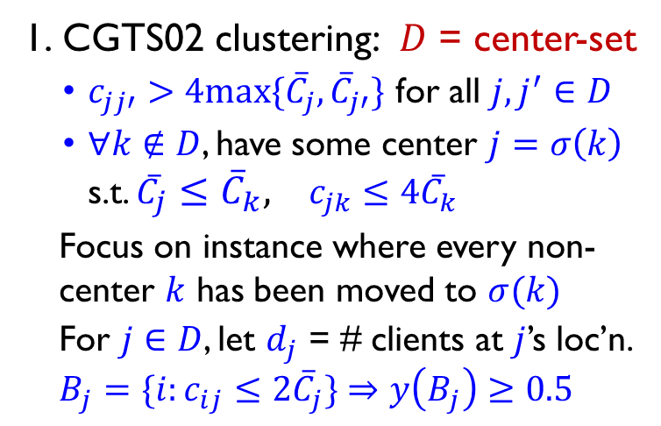
Rounding $(x,y)$: more details
CGTS02 clustering: $D$ = center-set
  $c_{jj′}>4max\{{\overline{C}}_{j}, {\overline{C}}_{j′}\}$ for all $j,j^{′}∈D$
  $∀k∉D$, have some center $j=σ\left(k\right)$ s.t. ${\overline{C}}_{j}≤{\overline{C}}_{k}, c_{jk}≤4{\overline{C}}_{k}$
  Focus on instance where every non-center $k$ has been moved to $σ(k)$
  For $j∈D$, let $d_{j}$ = # clients at $j$’s loc’n.
  $$B_{j}=\{i:c_{ij}≤2{\overline{C}}_{j}\}⇒y\left(B_{j}\right)≥0.5$$
$$j$$
center
non-center
ball $B_{j}$

Slide 22
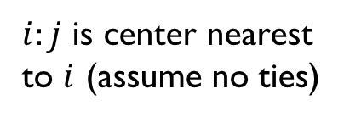

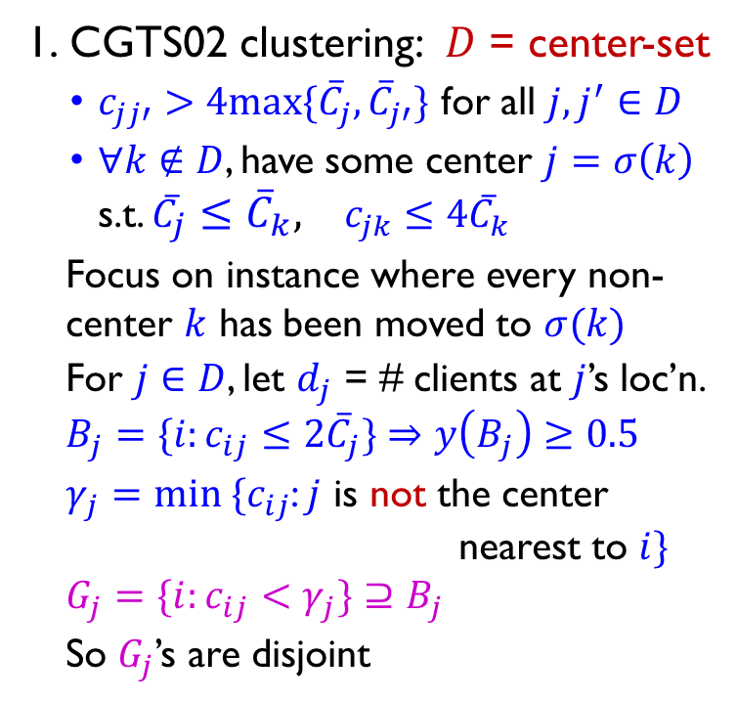

Rounding $(x,y)$: more details
CGTS02 clustering: $D$ = center-set
  $c_{jj′}>4max\{{\overline{C}}_{j}, {\overline{C}}_{j′}\}$ for all $j,j^{′}∈D$
  $∀k∉D$, have some center $j=σ\left(k\right)$ s.t. ${\overline{C}}_{j}≤{\overline{C}}_{k}, c_{jk}≤4{\overline{C}}_{k}$
  Focus on instance where every non-center $k$ has been moved to $σ(k)$
  For $j∈D$, let $d_{j}$ = # clients at $j$’s loc’n.
  $$B_{j}=\{i:c_{ij}≤2{\overline{C}}_{j}\}⇒y\left(B_{j}\right)≥0.5$$
  $γ_{j}=min \{c_{ij}$: $j$ is not the center
  nearest to $i\}$
  $G_{j}=\{i:c_{ij}<γ_{j}\}⊇B_{j}$
  So $G_{j}$’s are disjoint
$$γ_{j}$$
$$j$$
$i:j$ is center nearest to $i$ (assume no ties)
center
non-center
ball $B_{j}$
ball $G_{j}$

Slide 23

Rounding $(x,y)$: more details
CGTS02 clustering: $D$ = center-set
  $c_{jj′}>4max\{{\overline{C}}_{j}, {\overline{C}}_{j′}\}$ for all $j,j^{′}∈D$
  $∀k∉D$, have some center $j=σ\left(k\right)$ s.t. ${\overline{C}}_{j}≤{\overline{C}}_{k}, c_{jk}≤4{\overline{C}}_{k}$
  Focus on instance where every non-center $k$ has been moved to $σ(k)$
  For $j∈D$, let $d_{j}$ = # clients at $j$’s loc’n.
  $$B_{j}=\{i:c_{ij}≤2{\overline{C}}_{j}\}⇒y\left(B_{j}\right)≥0.5$$
  $γ_{j}=min \{c_{ij}$: $j$ is not the center
  nearest to $i\}$
  $G_{j}=\{i:c_{ij}<γ_{j}\}⊇B_{j}$
  So $G_{j}$’s are disjoint
$$γ_{j}$$
$$j$$
center
non-center
ball $B_{j}$
ball $G_{j}$

Slide 24

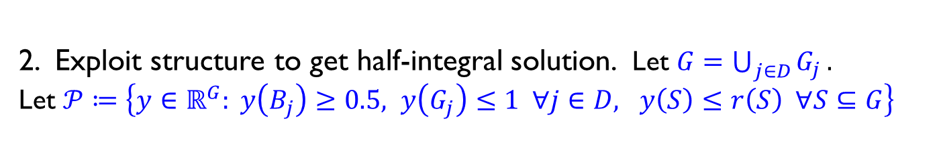


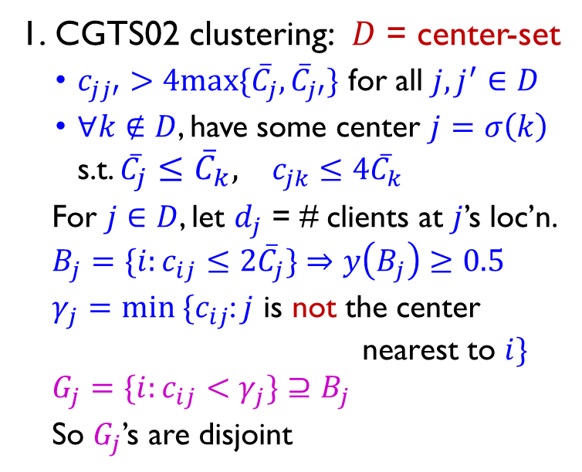
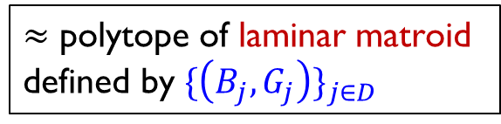
Rounding $(x,y)$: more details
CGTS02 clustering: $D$ = center-set
  $c_{jj′}>4max\{{\overline{C}}_{j}, {\overline{C}}_{j′}\}$ for all $j,j^{′}∈D$
  $∀k∉D$, have some center $j=σ\left(k\right)$ s.t. ${\overline{C}}_{j}≤{\overline{C}}_{k}, c_{jk}≤4{\overline{C}}_{k}$
  For $j∈D$, let $d_{j}$ = # clients at $j$’s loc’n.
  $$B_{j}=\{i:c_{ij}≤2{\overline{C}}_{j}\}⇒y\left(B_{j}\right)≥0.5$$
  $γ_{j}=min \{c_{ij}$: $j$ is not the center
  nearest to $i\}$
  $G_{j}=\{i:c_{ij}<γ_{j}\}⊇B_{j}$
  So $G_{j}$’s are disjoint
$$γ_{j}$$
$$j$$
2. Exploit structure to get half-integral solution. Let $G=\bigcup_{j∈D}{G_{j}}.$
Let $𝒫≔\left\{y∈ℝ^{G}: y\left(B_{j}\right)≥0.5, y\left(G_{j}\right)≤1 ∀j∈D, y\left(S\right)≤r\left(S\right) ∀S⊆G\right\}$
$≈$ polytope of laminar matroid defined by $\{\left(B_{j}, G_{j}\right)\}_{j∈D}$
matroid $M$polytope

Slide 25
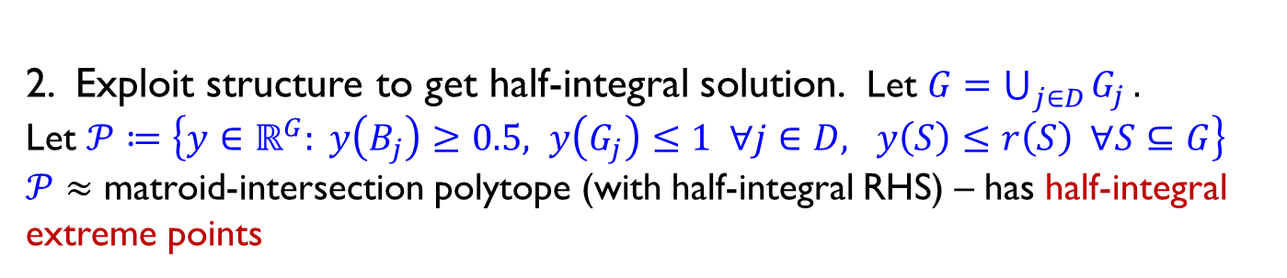
Rounding $(x,y)$: more details
CGTS02 clustering: $D$ = center-set
  $c_{jj′}>4max\{{\overline{C}}_{j}, {\overline{C}}_{j′}\}$ for all $j,j^{′}∈D$
  $∀k∉D$, have some center $j=σ\left(k\right)$ s.t. ${\overline{C}}_{j}≤{\overline{C}}_{k}, c_{jk}≤4{\overline{C}}_{k}$
  For $j∈D$, let $d_{j}$ = # clients at $j$’s loc’n.
  $$B_{j}=\{i:c_{ij}≤2{\overline{C}}_{j}\}⇒y\left(B_{j}\right)≥0.5$$
  $γ_{j}=min \{c_{ij}$: $j$ is not the center
  nearest to $i\}$
  $G_{j}=\{i:c_{ij}<γ_{j}\}⊇B_{j}$
  So $G_{j}$’s are disjoint
$$γ_{j}$$
$$j$$
2. Exploit structure to get half-integral solution. Let $G=\bigcup_{j∈D}{G_{j}}.$
Let $𝒫≔\left\{y∈ℝ^{G}: y\left(B_{j}\right)≥0.5, y\left(G_{j}\right)≤1 ∀j∈D, y\left(S\right)≤r\left(S\right) ∀S⊆G\right\}$
$𝒫≈$ matroid-intersection polytope (with half-integral RHS) – has half-integral extreme points

Slide 26
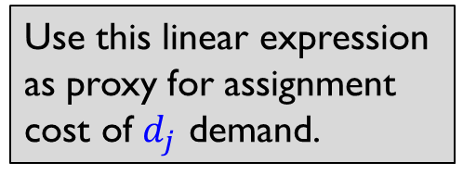
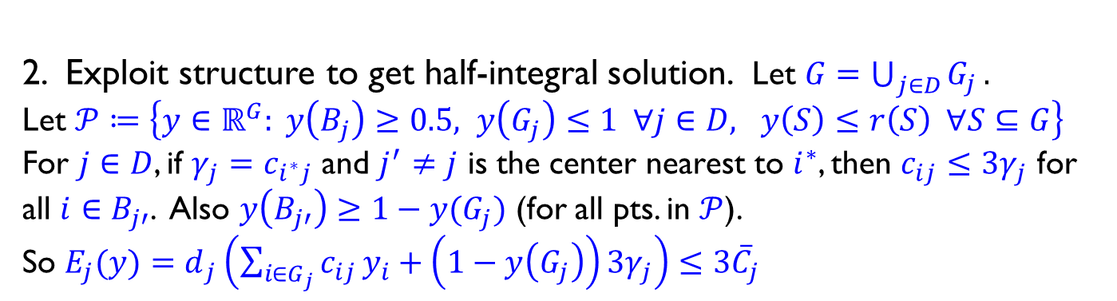


Rounding $(x,y)$: more details
CGTS02 clustering: $D$ = center-set
  $c_{jj′}>4max\{{\overline{C}}_{j}, {\overline{C}}_{j′}\}$ for all $j,j^{′}∈D$
  $∀k∉D$, have some center $j=σ\left(k\right)$ s.t. ${\overline{C}}_{j}≤{\overline{C}}_{k}, c_{jk}≤4{\overline{C}}_{k}$
  For $j∈D$, let $d_{j}$ = # clients at $j$’s loc’n.
  $$B_{j}=\{i:c_{ij}≤2{\overline{C}}_{j}\}⇒y\left(B_{j}\right)≥0.5$$
  $γ_{j}=min \{c_{ij}$: $j$ is not the center
  nearest to $i\}$
  $G_{j}=\{i:c_{ij}<γ_{j}\}⊇B_{j}$
  So $G_{j}$’s are disjoint
$$j′$$
$$i^{∗}$$
$$γ_{j}$$
$$j$$
half-integral extreme points
2. Exploit structure to get half-integral solution. Let $G=\bigcup_{j∈D}{G_{j}}.$
Let $𝒫≔\left\{y∈ℝ^{G}: y\left(B_{j}\right)≥0.5, y\left(G_{j}\right)≤1 ∀j∈D, y\left(S\right)≤r\left(S\right) ∀S⊆G\right\}$
For $j∈D$, if $γ_{j}=c_{i^{∗}j}$ and $j^{′}≠j$ is the center nearest to $i^{∗}$, then $c_{ij}≤3γ_{j}$ for all $i∈B_{j′}$. Also $y\left(B_{j′}\right)≥1−y(G_{j})$ (for all pts. in $𝒫$).
So ${E_{j}(y)=d}_{j}\left(\sum_{i∈G_{j}}{c_{ij}}y_{i}+\left(1−y\left(G_{j}\right)\right)3γ_{j}\right)≤3{\overline{C}}_{j}$
Use this linear expression as proxy for assignment cost of $d_{j}$ demand.

Slide 27
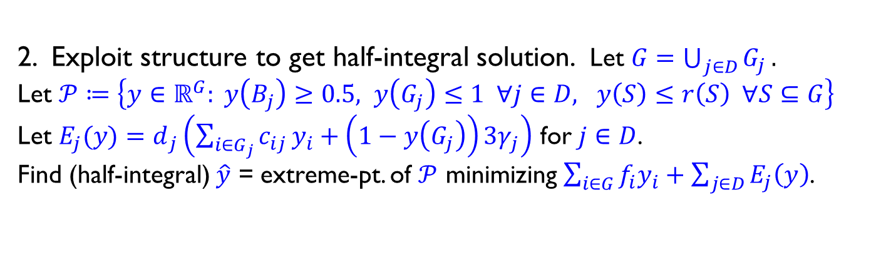
Rounding $(x,y)$: more details
CGTS02 clustering: $D$ = center-set
  $c_{jj′}>4max\{{\overline{C}}_{j}, {\overline{C}}_{j′}\}$ for all $j,j^{′}∈D$
  $∀k∉D$, have some center $j=σ\left(k\right)$ s.t. ${\overline{C}}_{j}≤{\overline{C}}_{k}, c_{jk}≤4{\overline{C}}_{k}$
  For $j∈D$, let $d_{j}$ = # clients at $j$’s loc’n.
  $$B_{j}=\{i:c_{ij}≤2{\overline{C}}_{j}\}⇒y\left(B_{j}\right)≥0.5$$
  $γ_{j}=min \{c_{ij}$: $j$ is not the center
  nearest to $i\}$
  $G_{j}=\{i:c_{ij}<γ_{j}\}⊇B_{j}$
  So $G_{j}$’s are disjoint
half-integral extreme points
2. Exploit structure to get half-integral solution. Let $G=\bigcup_{j∈D}{G_{j}}.$
Let $𝒫≔\left\{y∈ℝ^{G}: y\left(B_{j}\right)≥0.5, y\left(G_{j}\right)≤1 ∀j∈D, y\left(S\right)≤r\left(S\right) ∀S⊆G\right\}$
Let ${E_{j}(y)=d}_{j}\left(\sum_{i∈G_{j}}{c_{ij}}y_{i}+\left(1−y\left(G_{j}\right)\right)3γ_{j}\right)$ for $j∈D$.
Find (half-integral) $\hat{y}$ = extreme-pt. of $𝒫$ minimizing $\sum_{i∈G}{f_{i}y_{i}}+\sum_{j∈D}{E_{j}\left(y\right)}$.

Slide 28
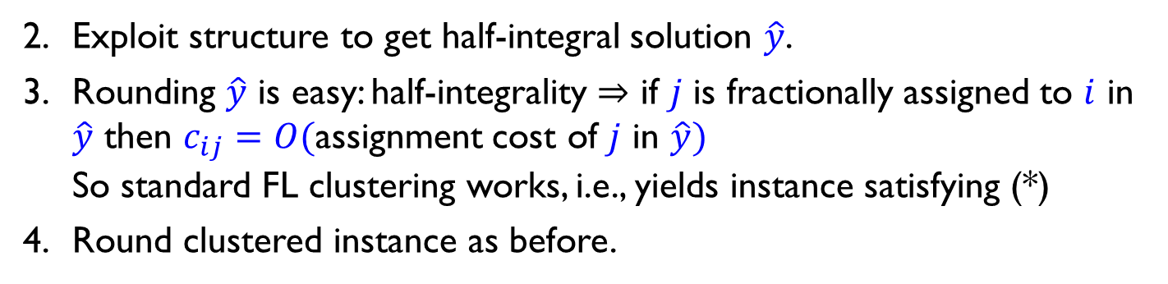
Rounding $(x,y)$: more details
CGTS02 clustering: $D$ = center-set
  $c_{jj′}>4max\{{\overline{C}}_{j}, {\overline{C}}_{j′}\}$ for all $j,j^{′}∈D$
  $∀k∉D$, have some center $j=σ\left(k\right)$ s.t. ${\overline{C}}_{j}≤{\overline{C}}_{k}, c_{jk}≤4{\overline{C}}_{k}$
  For $j∈D$, let $d_{j}$ = # clients at $j$’s loc’n.
  $$B_{j}=\{i:c_{ij}≤2{\overline{C}}_{j}\}⇒y\left(B_{j}\right)≥0.5$$
  $γ_{j}=min \{c_{ij}$: $j$ is not the center
  nearest to $i\}$
  $G_{j}=\{i:c_{ij}<γ_{j}\}⊇B_{j}$
  So $G_{j}$’s are disjoint
Exploit structure to get half-integral solution $\hat{y}$.
Rounding $\hat{y}$ is easy: half-integrality $⇒$ if $j$ is fractionally assigned to $i$ in $\hat{y}$ then $c_{ij}=O($assignment cost of $j$ in $\hat{y})$
So standard FL clustering works, i.e., yields instance satisfying (*)
Round clustered instance as before.

Slide 29
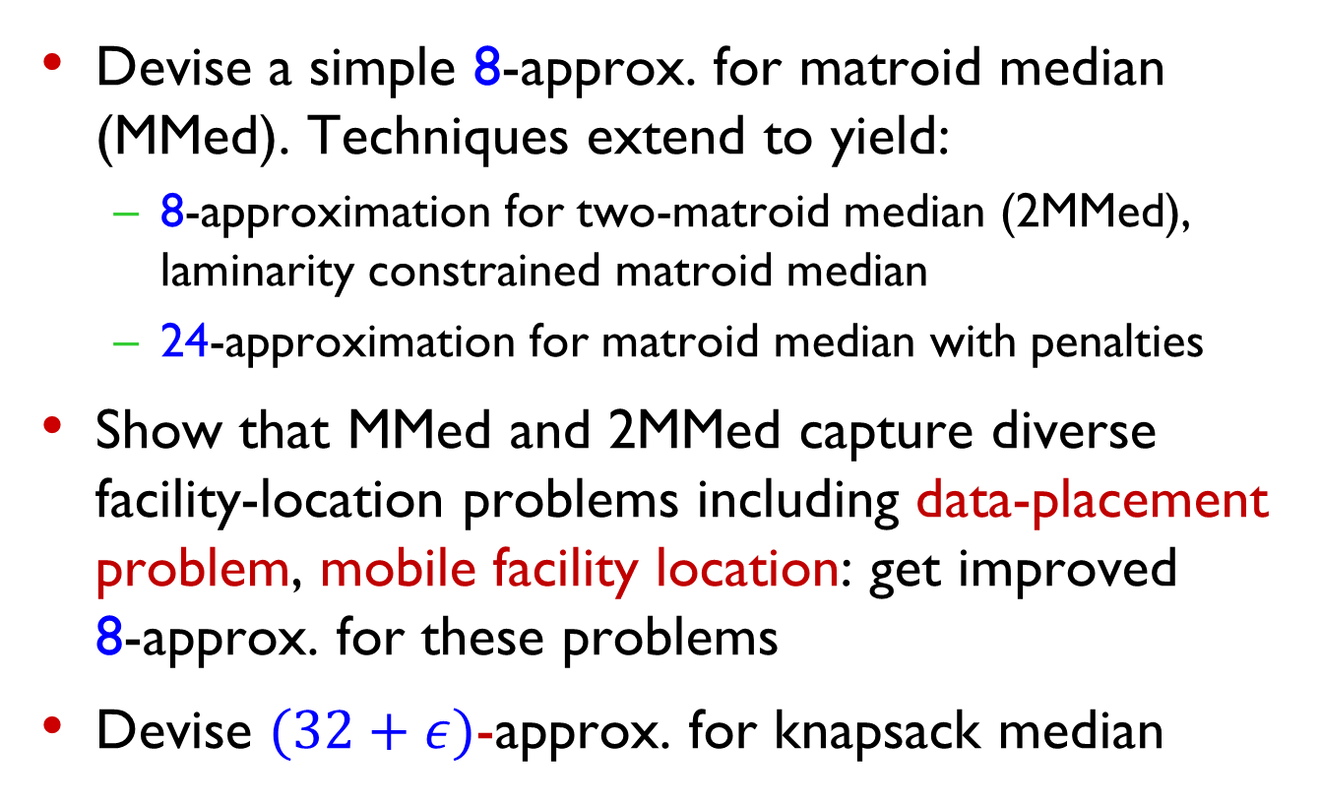
Summary
Devise a simple 8-approx. for matroid median (MMed). Techniques extend to yield:
  8-approximation for two-matroid median (2MMed), laminarity constrained matroid median
  24-approximation for matroid median with penalties
Show that MMed and 2MMed capture diverse facility-location problems including data-placement problem, mobile facility location: get improved 8-approx. for these problems
Devise $(32+ε)$-approx. for knapsack median

Slide 30
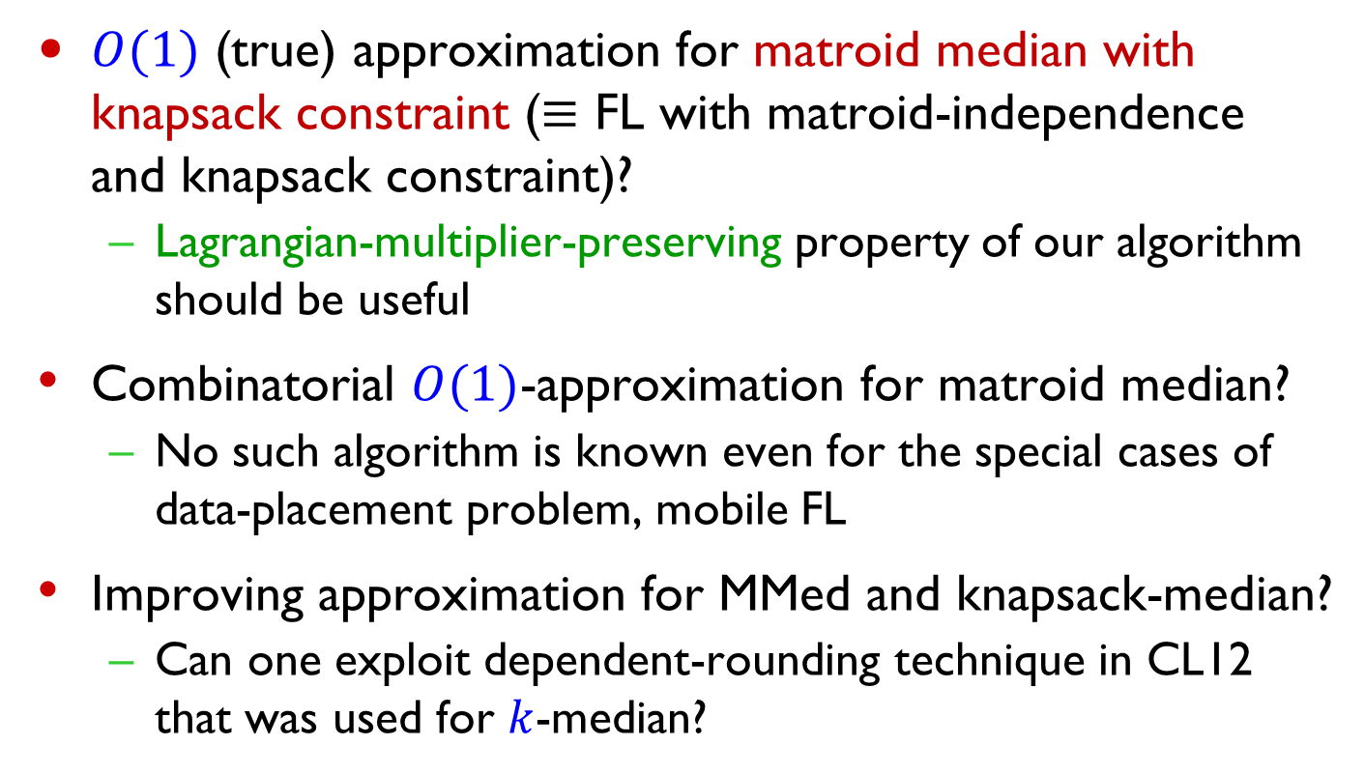
Open questions
$O(1)$ (true) approximation for matroid median with knapsack constraint ($≡$ FL with matroid-independence and knapsack constraint)?
  Lagrangian-multiplier-preserving property of our algorithm should be useful
Combinatorial $O(1)$-approximation for matroid median?
  No such algorithm is known even for the special cases of data-placement problem, mobile FL
Improving approximation for MMed and knapsack-median?
  Can one exploit dependent-rounding technique in CL12 that was used for $k$-median?

Slide 31
Thank You

