Slide 1
LP-based Approximation Algorithms for Multi-Vehicle Minimum Latency Problems
Chaitanya Swamy
University of Waterloo
Joint work with Ian Post
University of Waterloo

Slide 2
Minimum-latency problem (MLP)
starting root/depot
node/client
Find a path P that visits all clients starting from depot to:

Slide 3
Minimum-latency problem (MLP)
starting root/depot
node/client
total latency
Find a path P that visits all clients starting from depot to: minimize (sum of node/client waiting times = ∑_{v∈P} c_{P}(v) )
Classical vehicle-routing problem. Also called
traveling-repairman problem or delivery-man problem
Problem is hard to approximate better than some constant

Slide 4
Multi-vehicle MLP
r₂, r₃
r₁
r₄
root/depot nodes
node/client
Given: (multi) set R={r₁,…,r_{k}} of not necessarily distinct roots
Find paths P₁,…P_{k} rooted at r₁,…,r_{k} that together visit all nodes,
minimize (sum of node waiting times = ∑_{v∈Pi} c_{Pi}(v) )

Slide 5
Multi-vehicle MLP
r₂, r₃
r₁
r₄
multi-depot k-MLP
root/depot nodes
node/client
Given: (multi) set R={r₁,…,r_{k}} of not necessarily distinct roots
Find paths P₁,…P_{k} rooted at r₁,…,r_{k} that together visit all nodes,
minimize (sum of node waiting times = ∑_{v∈Pi} c_{Pi}(v) )
Special case r₁= … = r_{k}: single-depot k-MLP

Slide 6
Our results
Design: 8.497-approx. for multi-depot k-MLP
7.183-approx. for single-depot k-MLP
First improvements in over a decade; previous best factors: 12 for multi-depot (CK04 + CGRT03)
8.497 for single-depot (FHR03 + CGRT03)
Guarantees extend to various generalizations: weighted latency, node-depot service constraints, node service times
Develop LP-based techniques
Exploit configuration LPs (for 8.5-approx. for multi-depot k-MLP) and bidirected LPs (for 7.183-approx. for single-depot k-MLP)
First concrete evidence that LP-relaxations can be effectively leveraged for minimum-latency problems
Chakrabarty-S11 proposed some LPs but no improvements via these LPs; our LPs are subtly different, except when k=1

Slide 7
Our results (contd.)
Obtain a stronger configuration LP that sheds further light on the power of LPs and why they are promising
Integrality gap of LP ≤ 3.5912 for multi-depot k-MLP – give an efficient rounding procedure
OPT_{LP} ≥ combinatorial lower bound that generalizes the q-stroll lower bound for MLP
Shows (non-constructively) integrality gap ≤ 3.03 for MLP (follows from AB10)
Do not know how to solve LP in general, but can “solve” it for k=1 – yields LP-relative (μ*+ε)-approx. for MLP
μ*

Slide 8
Our results (contd.)
Use bidirected LP to obtain following prize-collecting result of independent interest:

Slide 9
Our results (contd.)
Use bidirected LP to obtain following prize-collecting result of independent interest: given root r, node penalties {π_{v}}, can efficiently compute one r-tree T s.t.
Substantially generalizes a result of CGRT03, who show the above when P consists of only one r-path
Our proof is much simpler: exploit bidirected LPs and arborescence-packing results of BFJ95 (unlike CGRT03, infeasible to “guess” end-points of paths in P )
Yields a combinatorial 2μ*-approx. for single-depot k-MLP
c(T)+π(V(T^{c})) ≤ min_{collection P of r-paths} (∑_{P∈P} c(P) + π(V\ U_{P∈P} V(P)))

Slide 10
A brief history of MLP-time
OPT = min_{r-paths P(1) ⊆ P(2) ⊆ … ⊆ P(n)} [c(P(1))+…+c(P(n))]
_{|V(P(q))|=q for all q}

Slide 11
Template for approximating MLP (i.e., 1-MLP)
OPT = min_{r-paths P(1) ⊆ P(2) ⊆ … ⊆ P(n)} [c(P(1))+…+c(P(n))]
≥ min_{r-paths P(1),P(2),…,P(n)} [c(P(1))+…+c(P(n))]
= ∑_{q=1…n} OPT_{q}
_{|V(P(q))|=q for all q}
_{|V(P(q))|=q for all q}
q-stroll lower bound (CGRT03)
min-cost r-path spanning q nodes

Slide 12
Template for approximating MLP
q-stroll lower bound (CGRT03)
OPT ≥ ∑_{q=1…n} OPT_{q}
Theorem (BCCPRS94): Given trees T(1),…,T(n) with |V(T(q))|=q for all q, can obtain solution of cost ≤ O(1).[c(T(1))+…+c(T(n))]
So if each T(q) is an α-approx. q-MST, get α.μ*-approx.
GK96: O(1) = μ*; Concatenation graph to find best way of combining tours obtained from T(q)’s
(2+ε)μ*-approx.: G96, AK00

Slide 13
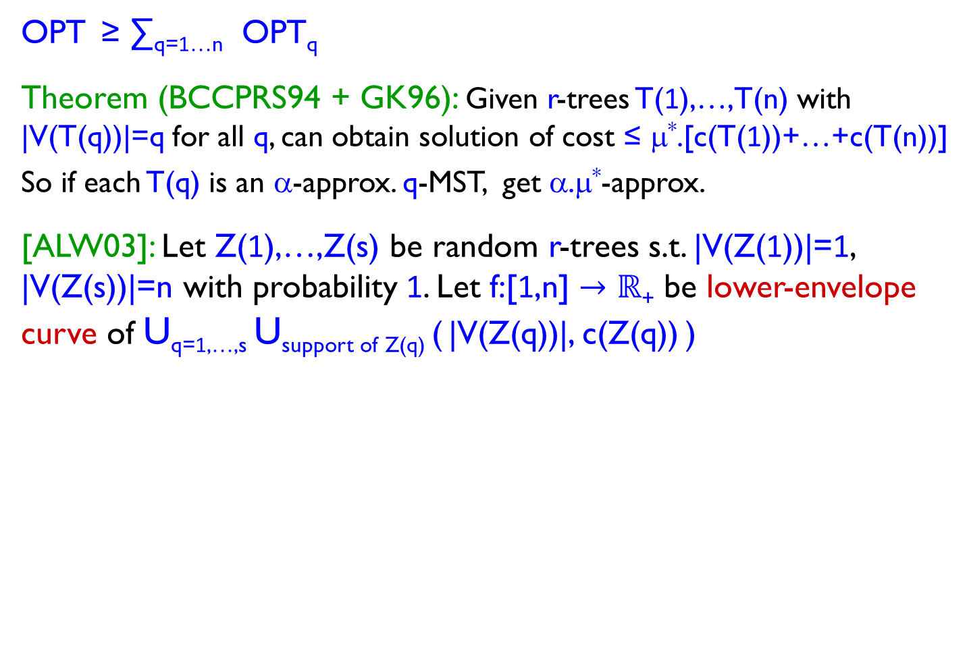
Template for approximating MLP
q-stroll lower bound (CGRT03)
OPT ≥ ∑_{q=1…n} OPT_{q}
Theorem (BCCPRS94 + GK96): Given r-trees T(1),…,T(n) with |V(T(q))|=q for all q, can obtain solution of cost ≤ μ*.[c(T(1))+…+c(T(n))]
So if each T(q) is an α-approx. q-MST, get α.μ*-approx.
[ALW03]: Let Z(1),…,Z(s) be random r-trees s.t. |V(Z(1))|=1, |V(Z(s))|=n with probability 1. Let f:[1,n] $→ℝ$₊ be lower-envelope curve of U_{q=1,…,s} U_{support of Z(q)} ( |V(Z(q))|, c(Z(q)) )
Can get solution of cost ≤ μ*(f(1)+…+f(n))
c(Z)
⇒ 2μ*-approx.: can get trees T(q) s.t. E[|V(T(q))|] ≥ q, E[c(T(q))] ≤ 2OPT_{q-MST}
⇒ μ*-approx. (CGRT03): can get T(q) s.t. E[|V(T(q))|] ≥ q, E[c(T(q))] ≤ OPT_{q}
n
1
|V(Z)|

Slide 14
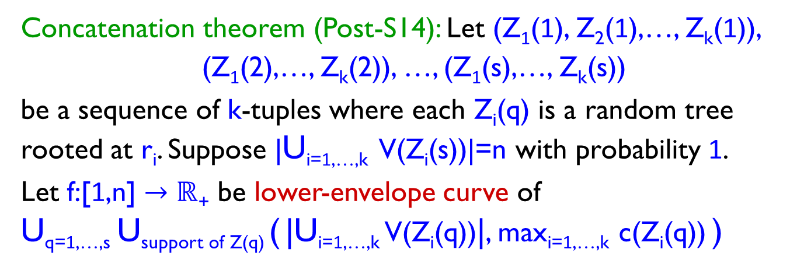
Template for approximating k-MLP
Concatenation theorem (Post-S14): Let (Z₁(1), Z₂(1),…, Z_{k}(1)),
(Z₁(2),…, Z_{k}(2)), …, (Z₁(s),…, Z_{k}(s))
be a sequence of k-tuples where each Z_{i}(q) is a random tree rooted at r_{i}. Suppose |U_{i=1,…,k} V(Z_{i}(s))|=n with probability 1.
Let f:[1,n] $→ℝ$₊ be lower-envelope curve of
U_{q=1,…,s} U_{support of Z(q)} ( |U_{i=1,…,k} V(Z_{i}(q))|, max_{i=1,…,k} c(Z_{i}(q)) )
bottleneck cost
n
1
total coverage

Slide 15
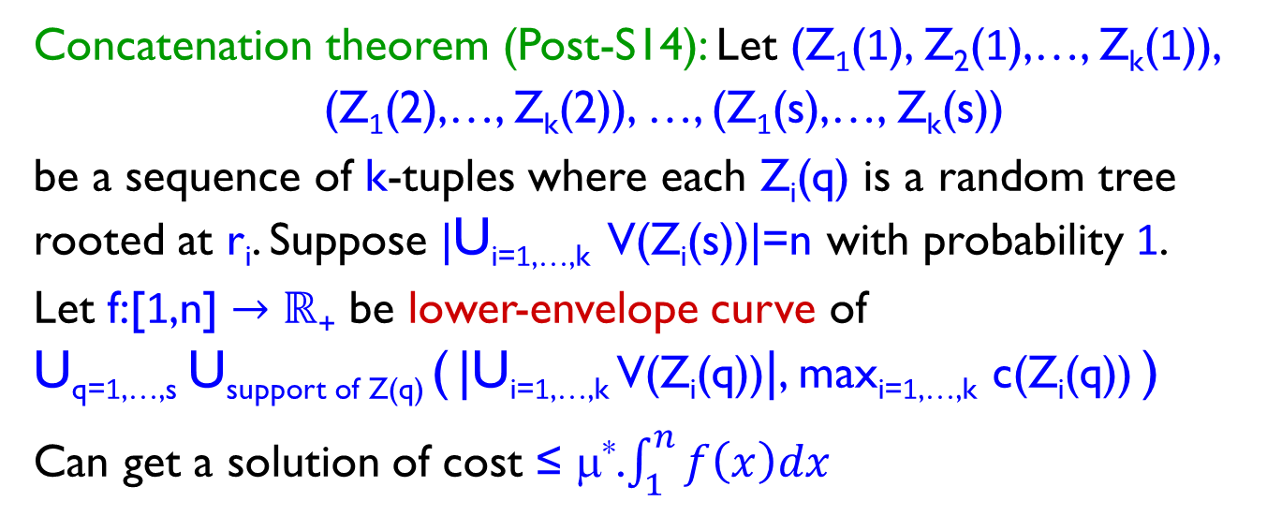
Template for approximating k-MLP
Concatenation theorem (Post-S14): Let (Z₁(1), Z₂(1),…, Z_{k}(1)),
(Z₁(2),…, Z_{k}(2)), …, (Z₁(s),…, Z_{k}(s))
be a sequence of k-tuples where each Z_{i}(q) is a random tree rooted at r_{i}. Suppose |U_{i=1,…,k} V(Z_{i}(s))|=n with probability 1.
Let f:[1,n] $→ℝ$₊ be lower-envelope curve of
U_{q=1,…,s} U_{support of Z(q)} ( |U_{i=1,…,k} V(Z_{i}(q))|, max_{i=1,…,k} c(Z_{i}(q)) )
Can get a solution of cost ≤ μ*.$\int_{1}^{n}{f\left(x\right)dx}$
bottleneck cost
n
1
total coverage

Slide 16
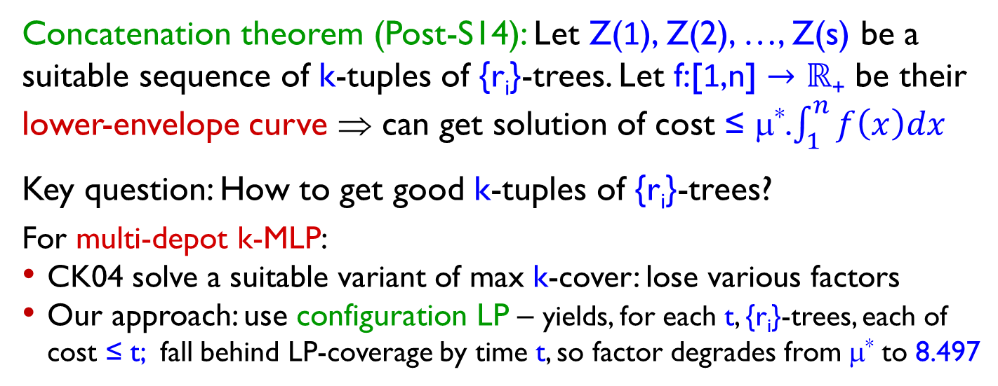
Template for approximating k-MLP
Concatenation theorem (Post-S14): Let Z(1), Z(2), …, Z(s) be a suitable sequence of k-tuples of {r_{i}}-trees. Let f:[1,n] $→ℝ$₊ be their lower-envelope curve ⇒ can get solution of cost ≤ μ*.$\int_{1}^{n}{f\left(x\right)dx}$
Key question: How to get good k-tuples of {r_{i}}-trees?
For multi-depot k-MLP:
CK04 solve a suitable variant of max k-cover: lose various factors
Our approach: use configuration LP – yields, for each t, {r_{i}}-trees, each of cost ≤ t; fall behind LP-coverage by time t, so factor degrades from μ* to 8.497

Slide 17
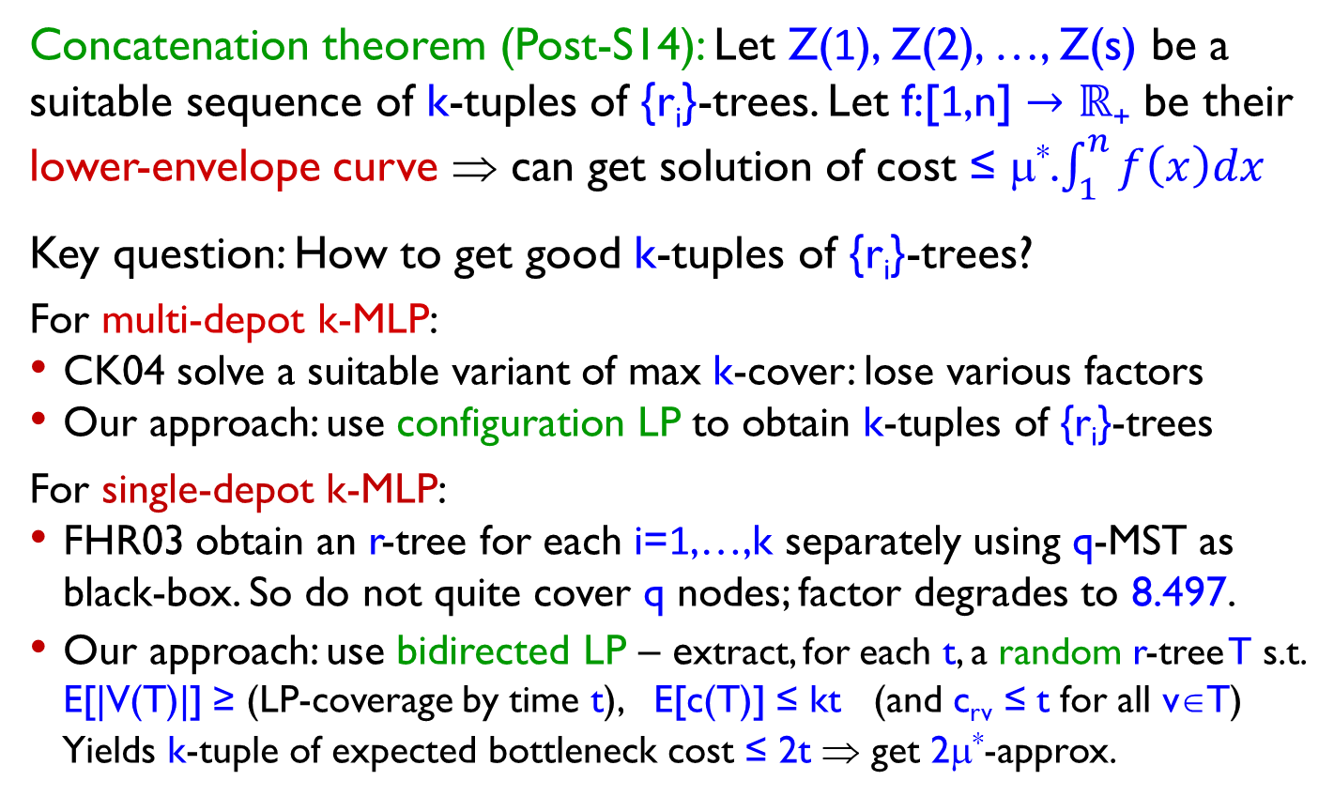
Template for approximating k-MLP
Concatenation theorem (Post-S14): Let Z(1), Z(2), …, Z(s) be a suitable sequence of k-tuples of {r_{i}}-trees. Let f:[1,n] $→ℝ$₊ be their lower-envelope curve ⇒ can get solution of cost ≤ μ*.$\int_{1}^{n}{f\left(x\right)dx}$
Key question: How to get good k-tuples of {r_{i}}-trees?
For multi-depot k-MLP:
CK04 solve a suitable variant of max k-cover: lose various factors
Our approach: use configuration LP to obtain k-tuples of {r_{i}}-trees
For single-depot k-MLP:
FHR03 obtain an r-tree for each i=1,…,k separately using q-MST as black-box. So do not quite cover q nodes; factor degrades to 8.497.
Our approach: use bidirected LP – extract, for each t, a random r-tree T s.t. E[|V(T)|] ≥ (LP-coverage by time t), E[c(T)] ≤ kt (and c_{rv} ≤ t for all v∈T)
Yields k-tuple of expected bottleneck cost ≤ 2t ⇒ get 2μ*-approx.

Slide 18
Open Questions
Improve the approximation factors for k-MLP.
Can one match the current best factor, μ*, for MLP?
Separation oracle for stronger configuration LP (with integrality gap ≤ μ*) is multi-vehicle orienteering problem – how well can this be approximated?
Improve approximation for MLP.
LPs seem promising – advantage over q-stroll bound is that LP couples the different paths. How to exploit this?
How good are (our) LPs for MLP or k-MLP?
For 1-MLP, bidirected LP (weakest) also has integrality gap ≤ μ*
Other uses of configuration LPs for vehicle-routing?
Only aware of Friggstad-S14 as another application.

Slide 19
Thank You

