Slide 1
Compact, Provably-Good LPs for Orienteering and Regret-Bounded Vehicle Routing
Chaitanya Swamy
University of Waterloo
Joint work with Zachary Friggstad
University of Alberta

Slide 2
Orienteering
7
Metric space
5
3
5
root r
2
nodes with rewards (≥ 0)
5
r
π(v)
node v
2
2
reward of v

Slide 3
Orienteering
7
Metric space
5
3
5
root r (π(r) = 0)
2
P
nodes with rewards (≥ 0)
5
r
π(v)
node v
2
2
reward of v
π(P) = 24
length bound B
Rooted orienteering: find r-rooted path P of length ≤ B that collects maximum reward π(P) := ∑_{v∈P} π(v)
Point-to-point (P2P) orienteering: also given end-node t; find r-t path P of length ≤ B collecting max reward π(P)
NP-hard; α-approximation ⇒ get reward ≥ (optimum)/α

Slide 4
Orienteering is a basic vehicle-routing problem (VRP)
Natural, well-motivated problem
Arises as a subroutine both in
designing approximation algorithms for various VRPs: deadline TSP, minimum-latency problems
computational methods for solving VRPs: pricing problem encountered in solving set-covering LPs ≡ configuration LPs via column-generation based approach

Slide 5
Regret-bounded VRP (RVRP)
Metric space
r
root r
node/client
Typical VRP setup: visit all clients via route(s) starting from r so as to minimize client delays: e.g., max client delay (TSP)
But this does not differentiate between clients close to the depot and those far away from it
Nearer clients may face more delay than further-away clients – source of dissatisfaction

Slide 6
Regret-bounded VRP (RVRP)
Metric space
r
root r
node/client
Adopt a more client-centric view: seek bounded client regret regret of client v = (waiting time of v) – (shortest-path distance from r to v)

Slide 7
Regret-bounded VRP (RVRP)
c_{P}(v)
Metric space
r
root r
P
node/client
v
D_{v}
c_{P}(v) = time to reach v along P
Adopt more client-centric view: ensure bounded client regret regret of client v = (waiting time of v) – (shortest-path distance from r to v)
RVRP: Given regret bound R, find minimum no. of r-rooted paths that cover all clients s.t. regret of every client ≤ R
D_{v} (min. possible waiting time of v)

Slide 8
For a rooted path P, let regret of P := regret of end-node of P
=
c(P) – D_{end node of P}

Slide 9
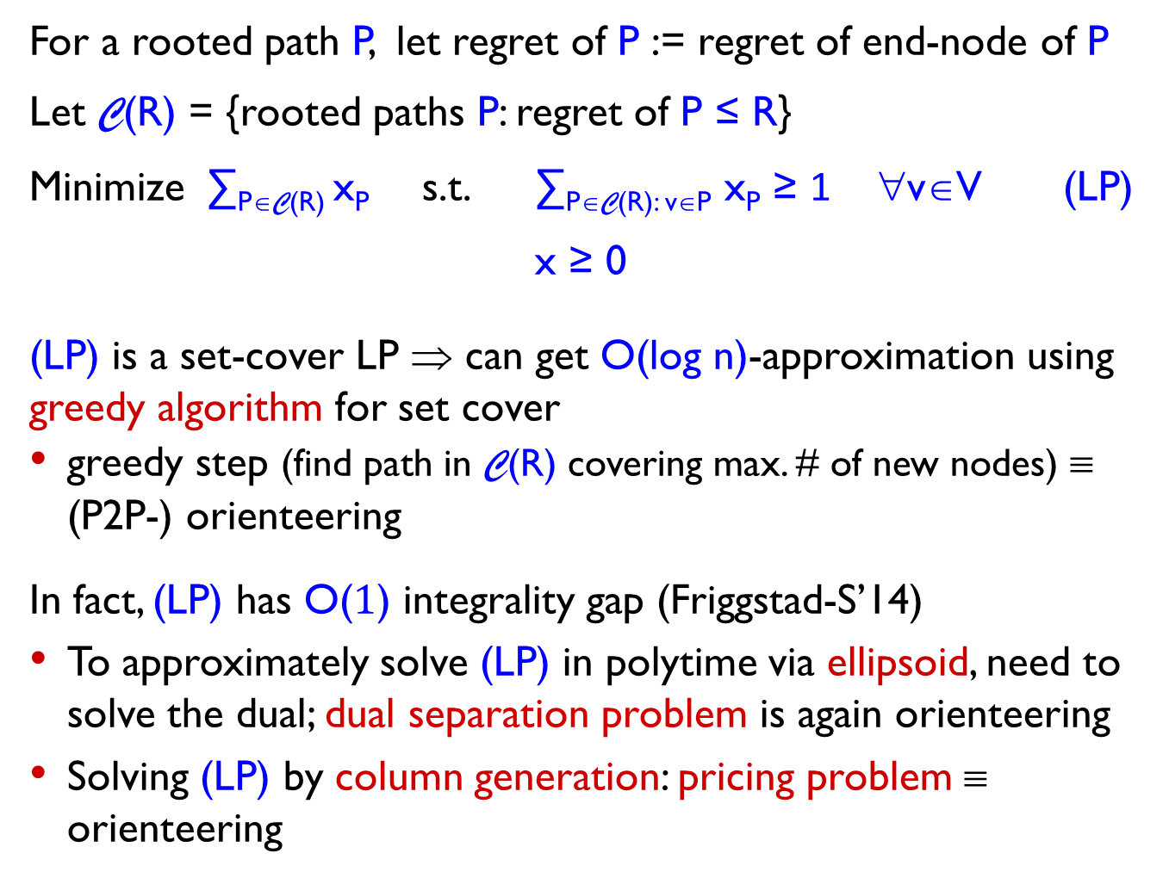
For a rooted path P, let regret of P := regret of end-node of P
Let C(R) = {rooted paths P: regret of P ≤ R}
Minimize ∑_{P∈C(R)} x_{P} s.t. ∑_{P∈C(R): v∈P} x_{P} ≥ 1 ∀v∈V (LP)
x ≥ 0
(LP) is a set-cover LP ⇒ can get O(log n)-approximation using greedy algorithm for set cover
greedy step (find path in C(R) covering max. # of new nodes) ≡ (P2P-) orienteering
In fact, (LP) has O($1$) integrality gap (Friggstad-S’14)
To approximately solve (LP) in polytime via ellipsoid, need to solve the dual; dual separation problem is again orienteering
Solving (LP) by column generation: pricing problem ≡ orienteering

Slide 10
Our results
Give natural, compact LP-relaxation for rooted orienteering + simple LP-rounding 3-approximation algorithm
First, LP-based guarantee for orienteering.

Slide 11
Our results
Give natural, compact LP-relaxation for rooted orienteering + simple LP-rounding 3-approximation algorithm
First, LP-based guarantee for orienteering.
All previous approaches (Blum et al., Bansal et al., Chekuri et al.) used dynamic programming (DP) to stitch together subpaths, which are found using another DP, or by solving a k-MST style problem.
Our approach gives a clean, simple algorithm.
Ideas may lead to compact, strong LPs for other problems that use orienteering (we show this for RVRP).
LP-based insights are often versatile and adaptable to handle variants of the problem.
DP-based approach gives (2+ε)-approximation (Chekuri et al.); it is likely however that our 3-approximation guarantee is not tight.

Slide 12
Our results
Give natural, compact LP-relaxation for rooted orienteering + simple LP-rounding 3-approximation algorithm
First, LP-based guarantee for orienteering.
Ideas may lead to compact, strong LPs for other problems that use orienteering (we show this for RVRP).
Show that P2P-orienteering reduces to regret-version of rooted orienteering (length bound is replaced by regret bound) losing a factor of 2
No such reduction to a rooted problem was known: all previous approaches relied on approximations for P2P-path problems
LP for rooted orienteering extends to regret version ⇒ get LP for P2P-orienteering with integrality gap ≤ 6

Slide 13
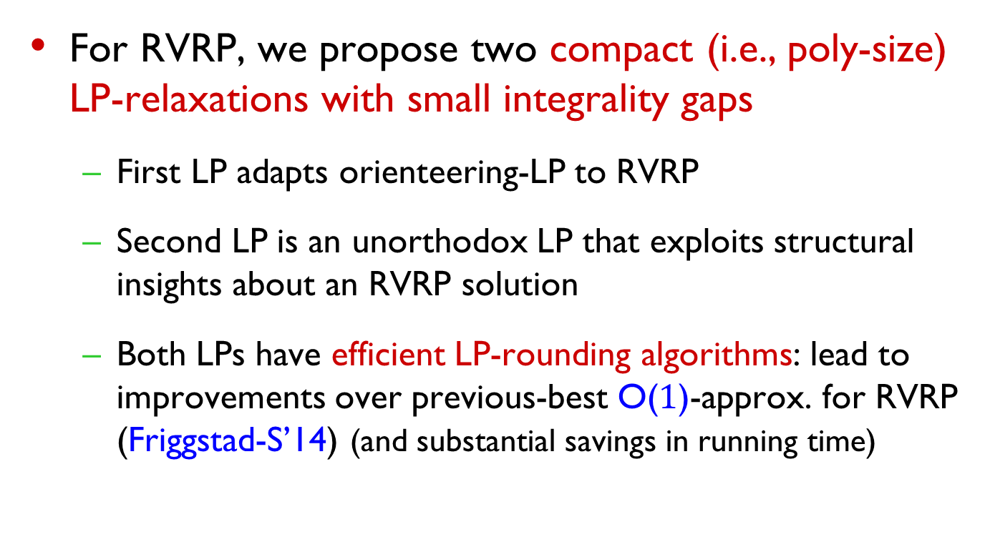
Our results (contd.)
For RVRP, we propose two compact (i.e., poly-size) LP-relaxations with small integrality gaps
First LP adapts orienteering-LP to RVRP
Second LP is an unorthodox LP that exploits structural insights about an RVRP solution
Both LPs have efficient LP-rounding algorithms: lead to improvements over previous-best O($1$)-approx. for RVRP (Friggstad-S’14) (and substantial savings in running time)
yields15-approx. for RVRP

Slide 14
Compact LP for orienteering
c_{uv}
c_{uv}
Metric space ≡ complete graph
Bidirect edges to get digraph
(view rooted path as directed away from r)
Suppose we know node w on optimum path with largest D_{v}
u
v
u
c_{uv}
v
w
r
shortest-path distance from r to v

Slide 15
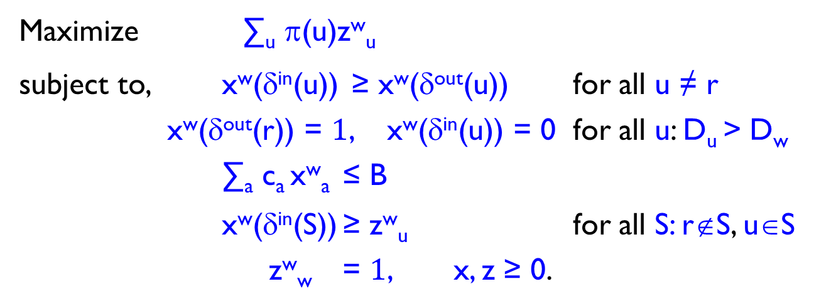
Compact LP for orienteering
c_{uv}
c_{uv}
Metric space ≡ complete graph
Bidirect edges to get digraph
(view rooted path as directed away from r)
Suppose we know node w on optimum path with largest D_{v}
z^{w}_{u} : indicates if node u lies on path
x^{w}_{a} : indictes if arc a lies on path
u
v
u
c_{uv}
v
Maximize ∑_{u} π(u)z^{w}_{u}
subject to, x^{w}(δ^{in}(u)) ≥ x^{w}(δ^{out}(u)) for all u ≠ r
x^{w}(δ^{out}(r)) = $1$, x^{w}(δ^{in}(u)) = 0 for all u: D_{u} > D_{w}
∑_{a} c_{a} x^{w}_{a} ≤ B
x^{w}(δ^{in}(S)) ≥ z^{w}_{u} for all S: r∉S, u∈S
z^{w}_{w} = $1$, x, z ≥ 0.
r
S
u

Slide 16
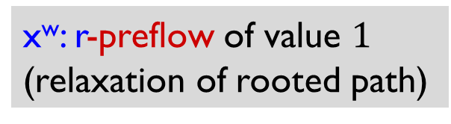
Compact LP for orienteering
c_{uv}
c_{uv}
Metric space ≡ complete graph
Bidirect edges to get digraph
(view rooted path as directed away from r)
Suppose we know node w on optimum path with largest D_{v}
z^{w}_{u} : indicates if node u lies on path
x^{w}_{a} : indictes if arc a lies on path
u
v
u
c_{uv}
v
x^{w}: r-preflow of value $1$ (relaxation of rooted path)
Maximize ∑_{u} π(u)z^{w}_{u}
subject to, x^{w}(δ^{in}(u)) ≥ x^{w}(δ^{out}(u)) for all u ≠ r
x^{w}(δ^{out}(r)) = $1$, x^{w}(δ^{in}(u)) = 0 for all u: D_{u} > D_{w}
∑_{a} c_{a} x^{w}_{a} ≤ B
x^{w}(δ^{in}(S)) ≥ z^{w}_{u} for all S: r∉S, u∈S
z^{w}_{w} = $1$, x, z ≥ 0.
r
S
u

Slide 17
Compact LP for orienteering
c_{uv}
c_{uv}
Metric space ≡ complete graph
Bidirect edges to get digraph
(view rooted path as directed away from r)
Suppose we know node w on optimum path with largest D_{v}
z^{w}_{u} : indicates if node u lies on path
x^{w}_{a} : indictes if arc a lies on path
u
v
u
c_{uv}
v
Maximize ∑_{u} π(u)z^{w}_{u}
subject to, x^{w}(δ^{in}(u)) ≥ x^{w}(δ^{out}(u)) for all u ≠ r
x^{w}(δ^{out}(r)) = $1$, x^{w}(δ^{in}(u)) = 0 for all u: D_{u} > D_{w}
∑_{a} c_{a} x^{w}_{a} ≤ B
x^{w}(δ^{in}(S)) ≥ z^{w}_{u} for all S: r∉S, u∈S
z^{w}_{w} = $1$, x, z ≥ 0.
can be encoded by polynomial # of flow constraints
r
S
u

Slide 18
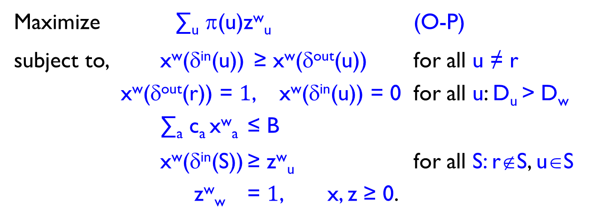
Compact LP for orienteering
Suppose we know node w on optimum path with largest D_{v}
z^{w}_{u} : if node u lies on path,
x^{w}_{a} : if arc a lies on path
Maximize ∑_{u} π(u)z^{w}_{u} (O-P)
subject to, x^{w}(δ^{in}(u)) ≥ x^{w}(δ^{out}(u)) for all u ≠ r
x^{w}(δ^{out}(r)) = $1$, x^{w}(δ^{in}(u)) = 0 for all u: D_{u} > D_{w}
∑_{a} c_{a} x^{w}_{a} ≤ B
x^{w}(δ^{in}(S)) ≥ z^{w}_{u} for all S: r∉S, u∈S
z^{w}_{w} = $1$, x, z ≥ 0.
Constraints ensure: z^{w}_{u} ≤ z^{w}_{w} for all u, z^{w}_{u} = 0 if D_{u} > D_{w}
Can eliminate need for knowing w (use z^{w}_{w} to denote if w is furthest node on optimum path; modify constraints suitably)

Slide 19
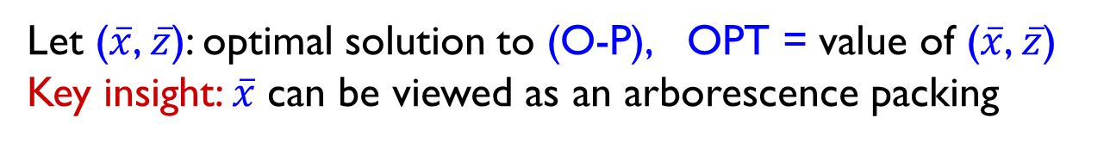
Rounding algorithm
Let ($\overline{x}$, $\overline{z}$): optimal solution to (O-P), OPT = value of ($\overline{x}$, $\overline{z}$)
Key insight: $\overline{x}$ can be viewed as an arborescence packing
0.1
0.1
w
≥
r
+
0.6
0.6
0.1
w
0.1
r
0.3
0.1
0.5
0.3
0.3
0.3
0.1
0.3
w
0.3
r
w
r
0.3
w
+
r
+

Slide 20
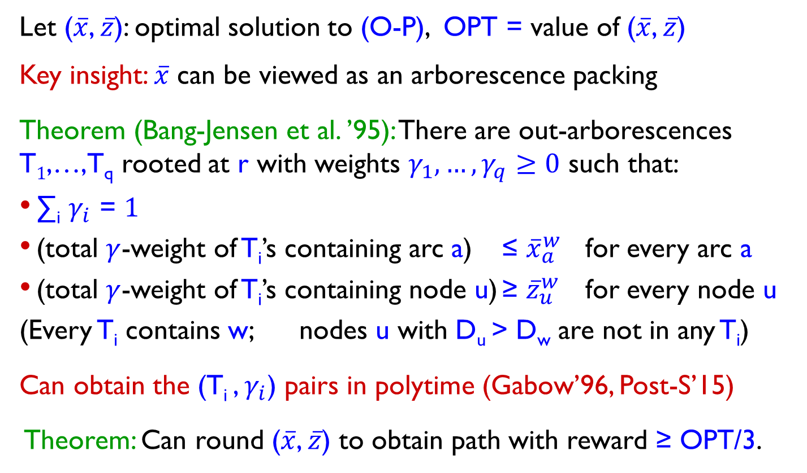
Rounding algorithm
Let ($\overline{x}$, $\overline{z}$): optimal solution to (O-P), OPT = value of ($\overline{x}$, $\overline{z}$)
Key insight: $\overline{x}$ can be viewed as an arborescence packing
Theorem (Bang-Jensen et al. ’95): There are out-arborescences T$1$,…,T_{q} rooted at r with weights $γ_{1},…,γ_{q}≥0$ such that:
∑_{i} $γ_{i}$ = $1$
(total $γ$-weight of T_{i}’s containing arc a) ≤ ${\overline{x}}_{a}^{w}$ for every arc a
(total $γ$-weight of T_{i}’s containing node u) ≥ ${\overline{z}}_{u}^{w}$ for every node u
(Every T_{i} contains w; nodes u with D_{u} > D_{w} are not in any T_{i})
Can obtain the (T_{i} , $γ_{i}$) pairs in polytime (Gabow’96, Post-S’15)
Theorem: Can round ($\overline{x}$, $\overline{z}$) to obtain path with reward ≥ OPT/3.

Slide 21
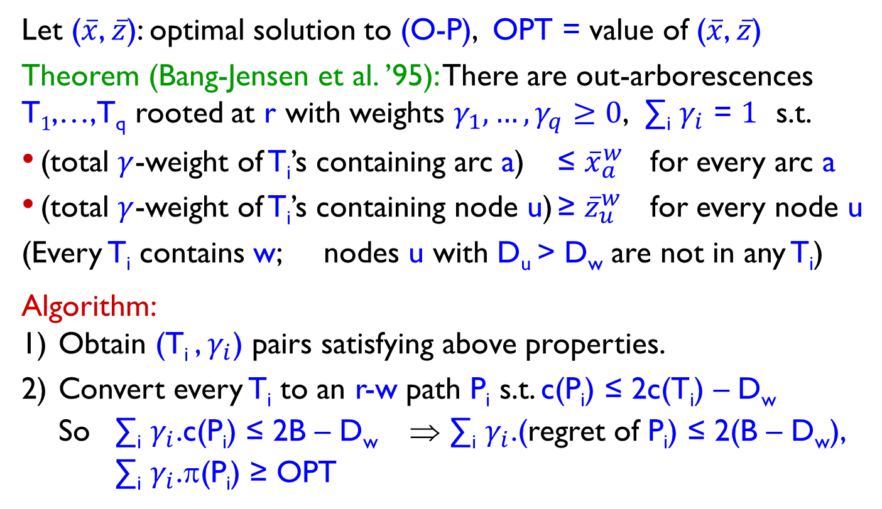
Rounding algorithm
Let ($\overline{x}$, $\overline{z}$): optimal solution to (O-P), OPT = value of ($\overline{x}$, $\overline{z}$)
Theorem (Bang-Jensen et al. ’95): There are out-arborescences T$1$,…,T_{q} rooted at r with weights $γ_{1},…,γ_{q}≥0$, ∑_{i} $γ_{i}$ = $1$ s.t.
(total $γ$-weight of T_{i}’s containing arc a) ≤ ${\overline{x}}_{a}^{w}$ for every arc a
(total $γ$-weight of T_{i}’s containing node u) ≥ ${\overline{z}}_{u}^{w}$ for every node u
(Every T_{i} contains w; nodes u with D_{u} > D_{w} are not in any T_{i})
Algorithm:
Obtain (T_{i} , $γ_{i}$) pairs satisfying above properties.
Convert every T_{i} to an r-w path P_{i} s.t. c(P_{i}) ≤ 2c(T_{i}) – D_{w}
So ∑_{i} $γ_{i}$.c(P_{i}) ≤ 2B – D_{w} ⇒ ∑_{i} $γ_{i}$.(regret of P_{i}) ≤ 2(B – D_{w}),
∑_{i} $γ_{i}$.π(P_{i}) ≥ OPT

Slide 22
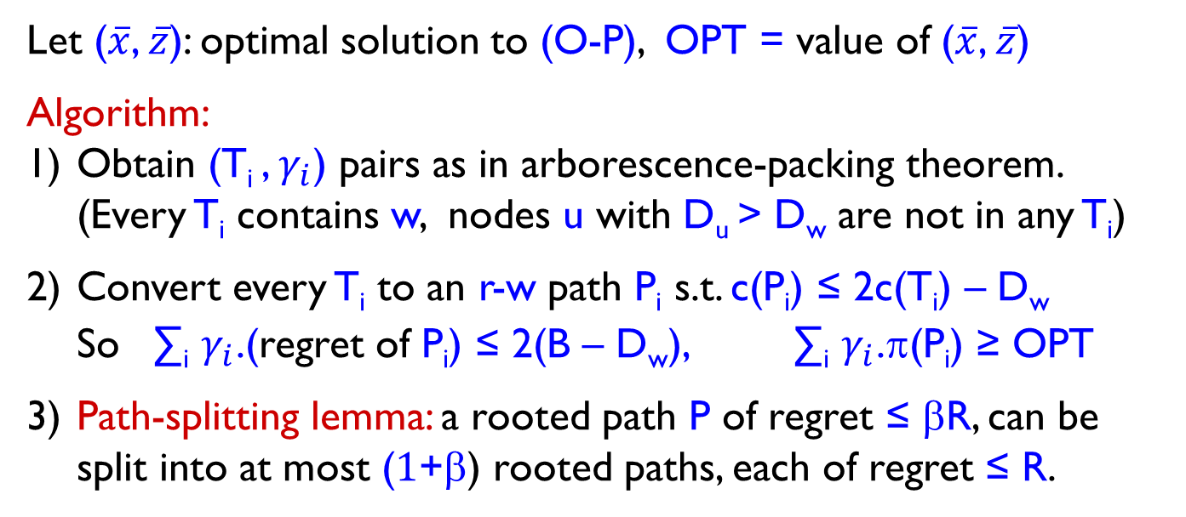
Rounding algorithm
Let ($\overline{x}$, $\overline{z}$): optimal solution to (O-P), OPT = value of ($\overline{x}$, $\overline{z}$)
Algorithm:
Obtain (T_{i} , $γ_{i}$) pairs as in arborescence-packing theorem. (Every T_{i} contains w, nodes u with D_{u} > D_{w} are not in any T_{i})
Convert every T_{i} to an r-w path P_{i} s.t. c(P_{i}) ≤ 2c(T_{i}) – D_{w}
So ∑_{i} $γ_{i}$.(regret of P_{i}) ≤ 2(B – D_{w}), ∑_{i} $γ_{i}$.π(P_{i}) ≥ OPT
Path-splitting lemma: a rooted path P of regret ≤ βR, can be split into at most ($1$+β) rooted paths, each of regret ≤ R.
r

Slide 23
Rounding algorithm
Let ($\overline{x}$, $\overline{z}$): optimal solution to (O-P), OPT = value of ($\overline{x}$, $\overline{z}$)
Algorithm:
Obtain (T_{i} , $γ_{i}$) pairs as in arborescence-packing theorem. (Every T_{i} contains w, nodes u with D_{u} > D_{w} are not in any T_{i})
Convert every T_{i} to an r-w path P_{i} s.t. c(P_{i}) ≤ 2c(T_{i}) – D_{w}
So ∑_{i} $γ_{i}$.(regret of P_{i}) ≤ 2(B – D_{w}), ∑_{i} $γ_{i}$.π(P_{i}) ≥ OPT
Path-splitting lemma: a rooted path P of regret ≤ βR, can be split into at most ($1$+β) rooted paths, each of regret ≤ R.
r

Slide 24
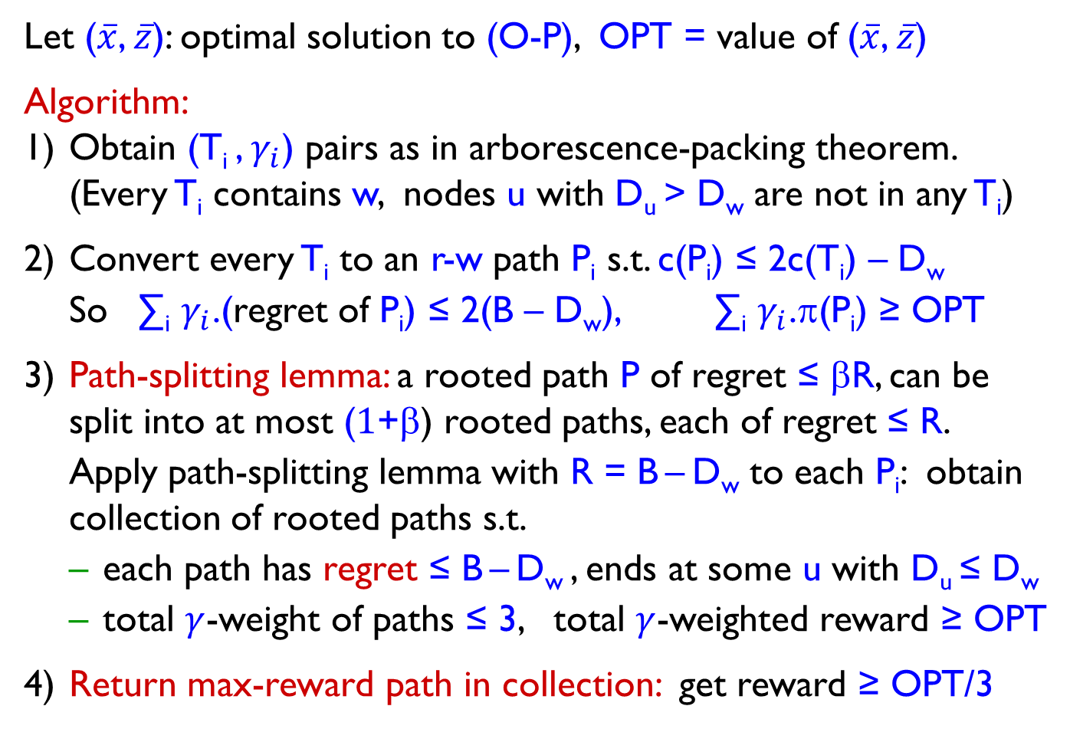
Rounding algorithm
Let ($\overline{x}$, $\overline{z}$): optimal solution to (O-P), OPT = value of ($\overline{x}$, $\overline{z}$)
Algorithm:
Obtain (T_{i} , $γ_{i}$) pairs as in arborescence-packing theorem. (Every T_{i} contains w, nodes u with D_{u} > D_{w} are not in any T_{i})
Convert every T_{i} to an r-w path P_{i} s.t. c(P_{i}) ≤ 2c(T_{i}) – D_{w}
So ∑_{i} $γ_{i}$.(regret of P_{i}) ≤ 2(B – D_{w}), ∑_{i} $γ_{i}$.π(P_{i}) ≥ OPT
Path-splitting lemma: a rooted path P of regret ≤ βR, can be split into at most ($1$+β) rooted paths, each of regret ≤ R.
Apply path-splitting lemma with R = B – D_{w} to each P_{i}: obtain collection of rooted paths s.t.
each path has regret ≤ B – D_{w} , ends at some u with D_{u} ≤ D_{w}
total $γ$-weight of paths ≤ 3, total $γ$-weighted reward ≥ OPT
Return max-reward path in collection: get reward ≥ OPT/3
has length ≤ B

Slide 25
Conclusions and open questions
Give compact LP-relaxations for orienteering and RVRP, devise LP-rounding algorithms for orienteering and RVRP
3-approx. for rooted orienteering: first LP-based guarantee, simple rounding algorithm using arborescence packings
Reduce P2P-orienteering to rooted regret-version of orienteering losing a factor of 2
Two compact LPs for RVRP, one of which leads to 15-approx. for RVRP
Recent work: can “solve” prize-collecting version of (O-P) and obtain arborescences combinatorially (Post-S’17)
What is the integrality gap of (O-P)? Believe 2 is the right answer
Better algorithms for 2 prominent generalizations of orienteering:
Deadline TSP: nodes with deadlines, get reward if visited by deadline
Submodular orienteering: reward function is submodular
Can our ideas/insights help?

Slide 26
Thank You.

