Slide 1
Approximation Algorithms for Min-cost Chain-Constrained Spanning Trees
Chaitanya Swamy
University of Waterloo
Joint work with Andre Linhares
University of Waterloo

Slide 2
RECALL: MST problem
G=(V, E) n=|V|, m=|E|
edge costs {c_{e} ≥ 0}
c(T)
MST problem: find spanning tree T to minimize ∑_{e∈T} c_{e}

Slide 3
RECALL: MST problem
G=(V, E) n=|V|, m=|E|
edge costs {c_{e} ≥ 0}
c(T)
MST problem: find spanning tree T to minimize ∑_{e∈T} c_{e}
Well-understood: various polynomial time algorithms, nice polyhedral characterization
Interested in constrained MST problems: find a min-cost spanning tree satisfying additional packing constraints

Slide 4
Constrained MST problems
Will focus on degree constraints (in various flavors)
Min {c(T): T is spanning tree, deg_{T}(v) ≤ b_{v} for all v}
Degree-bounded MST: NP-hard to satisfy degree-bounds exactly
Can efficiently deduce infeasibility Or find T with c(T) ≤ OPT, And
(Goemans06) deg_{T}(v) ≤ b_{v}+2 ∀v (LP rounding using matroid inters’n.)
(Singh-Lau07) deg_{T}(v) ≤ b_{v}+1 ∀v (iterative rounding + relaxation)
Good understanding of how to handle node-degree constraints
More generally, what about “degree” constraints on cuts?
Min {c(T): T is spanning tree, deg_{T}(S) ≤ b_{S} for all S∈C }
This is the kind of problem that crops up in finding thin trees (C = 2^{V})
no. of edges of T crossing S ⊆ V
collection of node-sets

Slide 5
Constrained MST (contd.)
No known algorithm that: if problem is feasible,
finds T with c(T) = O(OPT) And deg_{T}(S) = O(b_{S}) ∀S∈C
(for any C where edges participate in non-constant # of degree constraints)
What about “degree” constraints on cuts?
Min {c(T): T is spanning tree, deg_{T}(S) ≤ b_{S} for all S∈C }
Very limited understanding: don’t know how to effectively leverage techniques used to handle node-degrees
Can determine infeasibility Or find T with c(T) ≤ OPT, And
(BKN08) deg_{T}(S) ≤ b_{S}+r-1 ∀S∈C r = max_{e} (# of degree constr. containing e)
(CVZ10, AGMOS10) deg_{T}(S) ≤ min {O( )b_{S} , (1+ ε)b_{S} + O( )}
∀S∈C
(BKKNP10) deg_{T}(S) ≤ b_{S} + O(log n) ∀S∈C if C is laminar
If C is a nested collection of sets (chain), then (OZ13) show: one can determine infeasibility Or find T with deg_{T}(S) = O(b_{S}) ∀S∈C
But: there is no bound on c(T)
Our result: Give an algorithm providing the above guarantees when C is a chain
log |C|
log log |C|
log |C|
ε
∀S, T∈C, S∩T=∅ or S ⊆ T or T ⊆ S

Slide 6
Chain-constrained spanning trees
S₃
S₂
S₄
G=(V, E), edge costs {c_{e}}
Nested family (chain) of sets C: S₁ ⊆ S₂ ⊆ … ⊆ S_{k}
S₁

Slide 7
Chain-constrained spanning trees
S₃
S₂
S₄
G=(V, E), edge costs {c_{e}}
Nested family (chain) of sets C: S₁ ⊆ S₂ ⊆ … ⊆ S_{k}
Degree bounds {b_{S} }_{S∈C}
S₁
1
1
2
2
Chain-constrained spanning tree problem:
Min {c(T): T spanning tree, deg_{T}(S) ≤ b_{S} for all S∈C }

Slide 8
Chain-constrained spanning trees
S₃
S₂
S₄
G=(V, E), edge costs {c_{e}}
Nested family (chain) of sets C: S₁ ⊆ S₂ ⊆ … ⊆ S_{k}
Degree bounds {b_{S} }_{S∈C}
S₁
1
1
2
2
Chain-constrained spanning tree problem:
Min {c(T): T spanning tree, deg_{T}(S) ≤ b_{S} for all S∈C }
Our result: Polytime algorithm that detects infeasibility Or returns T with c(T) = O(OPT) And deg_{T}(S) = O(b_{S}) ∀S∈C
an (O(1), O(1))-approximation

Slide 9
Our results
Devise (O(1), O(1))-approximation algorithm for min-cost chain-constrained spanning tree (CCST)
First algorithm to give O(1) approx. to Both cost and degrees
(OZ13: ∃c s.t. NP-hard to obtain additive c. -approx.)
Use Lagrangian-relaxation in a novel way to simplify cost structure and obtain collection of unweighted problems
Technique applicable to a larger class of problems
cost approximation
degree-bound violation
log n
log log n

Slide 10
Our results (contd.)
Consider the following general problem:
Min c^{T}x s.t. x is an extreme point of P, Ax ≤ b (Q^{P})
Generalizes min-cost chain-constrained spanning tree
P: spanning-tree polytope, Ax ≤ b: degree constraints
We show that, under certain assumptions:
O(1)-approx. for ⇒ (O(1), O(1))-approx. for (Q^{P})
unweighted (Q^{P})
Two-sided O(1)-approx. ⇒ (1, O(1))-approx. for (Q^{P})
for unweighted (Q^{P})
returns extreme point x of P s.t. Ax ≤ O(1)b
(no bound on c^{T}x)

Slide 11
Our results (contd.)
Consider the following general problem:
Min c^{T}x s.t. x is an extreme point of P, Ax ≤ b (Q^{P})
We show that, under certain assumptions:
O(1)-approx. for ⇒ (O(1), O(1))-approx. for (Q^{P})
unweighted (Q^{P})
Two-sided O(1)-approx. ⇒ (1, O(1))-approx. for (Q^{P})
for unweighted (Q^{P})
Application to k-budgeted matroid basis:
Obtain randomized n^{O(k1.5/ε)}-time (1,1+ε,…,1+ε)-approx. using randomized algorithm of (BN15)
Get both improved approx. guarantee of (GRSZ14), and improved running time of (BN15)

Slide 12
LP-relaxation for min-cost CCST
δ(S) = boundary of set S = {(u,v)∈E: exactly one of u, v is in S}
E(S) = edges with both ends in S = {(u,v)∈E: both u, v are in S}
x_{e} : indicates if edge e lies in the spanning tree
For F ⊆ E, use x(F) to denote ∑_{e∈F} x_{e}
Minimize ∑_{e} c_{e} x_{e} (P)
subject to, x(E(S)) ≤ |S|-1 for all φ≠S ⊆ V
x(E) = n-1
x ≥ 0
x(δ(S)) ≤ b_{S} for all S∈C.
(*)
Can efficiently compute optimal solution x* to (P)
Let OPT = optimal value of (P)
Call a vector x satisfying (*), a fractional spanning tree

Slide 13
Rounding algorithm ingredients
Tight spanning tree constraints
Let L = maximal laminar family of sets from {S: x*(E(S))=|S|-1}
So L contains E, singletons {v} for all v∈V
(Will always use L to denote set in L, S to denote set in C)
Assume E is support of x*
sets in L
L
Let G_{L} = (V, E_{L}) be graph obtained from (L, E(L)) by contracting children of L

Slide 14
Rounding algorithm ingredients
Tight spanning tree constraints
Let L = maximal laminar family of sets from {S: x*(E(S))=|S|-1}
So L contains E, singletons {v} for all v∈V
(Will always use L to denote set in L, S to denote set in C)
Assume E is support of x*
sets in L
children of L
L
Let G_{L} = (V, E_{L}) be graph obtained from (L, E(L)) by contracting children of L

Slide 15
Rounding algorithm ingredients
Tight spanning tree constraints
Let L = maximal laminar family of sets from {S: x*(E(S))=|S|-1}
So L contains E, singletons {v} for all v∈V
(Will always use L to denote set in L, S to denote set in C)
Assume E is support of x*
sets in L
children of L
L
Let G_{L} = (V, E_{L}) be graph obtained from (L, E(L)) by contracting children of L
For all L, x*_{L} := (x*_{e})_{e∈EL} is a fractional spanning tree of G_{L}
Build spanning tree of G by combining spanning trees of all G_{L}’s

Slide 16
Rounding algorithm ingredients
Let L = maximal laminar family of sets from {S: x*(E(S))=|S|-1}
L
sets in L
children of L
Let G_{L} = (V, E_{L}) be graph obtained from (L, E(L)) by contracting children of L
For all L, x*_{L} := (x*_{e})_{e∈EL} is a fractional spanning tree of G_{L}
Build spanning tree of G by combining spanning trees of G_{L}’s
Theorem (OZ13): For every L, can find spanning tree T_{L} of G_{L} s.t. if T = combination of T_{L}’s, then deg_{T}(S) = O(x*(δ(S))) ∀S∈C.
Based on modifying x*_{L} to satisfy certain property (rainbow-freeness) Can ↑ cost of fractional tree arbitrarily, unless we have uniform costs

Slide 17
Rounding algorithm ingredients
Let L = maximal laminar family of sets from {S: x*(E(S))=|S|-1}
L
sets in L
children of L
Let G_{L} = (V, E_{L}) be graph obtained from (L, E(L)) by contracting children of L
Theorem (OZ13): For every L, can find spanning tree T_{L} of G_{L} s.t. if T = combination of T_{L}’s, then deg_{T}(S) = O(x*(δ(S))) ∀S∈C.
Observation: OZ13 gives low-cost tree if, for all L, all edges in E_{L} have equal cost (weaker than: all edges in E have equal costs)
Key insight: Can equalize costs in E_{L} by perturbing costs using optimal values of dual vars. corresponding to degree constr.
But this also seems rather special !

Slide 18
Equalizing costs in E_{L}
Minimize ∑_{e} c_{e} x_{e} (P)
subject to, x(E(S)) ≤ |S|-1 for all φ≠S ⊆ V
x(E) = n-1
x ≥ 0
x(δ(S)) ≤ b_{S} for all S∈C.
(ST)
y*_{S} ≥ 0: opt. value of dual variable
Define c^{y*}_{e} = c_{e} + ∑_{S∈C: e∈δ(S)} y*_{S}
Key Lemma: For all L∈L, for all e, f∈E_{L}, we have c^{y*}_{e} = c^{y*}_{f}
Proof: By complementary slackness,
c_{e} = (Dual contribution to e from (ST)) – ∑_{S∈C: e∈δ(S)} y*_{S}
c_{f} = (Dual contribution to f from (ST)) – ∑_{S∈C: f∈δ(S)} y*_{S}
But e, f belong to same sets of laminar family L ⇒ incur same dual contribution from spanning tree constraints, so c^{y*}_{e} = c^{y*}_{f} .

Slide 19
Putting everything together
Algorithm (almost)
Solve (P) and its dual to get x* and (y*_{S}) _{S∈C} .
Define laminar family L, use OZ13 to find spanning tree T_{L} of G_{L} for each L∈L; return T = combination of T_{L}’s.
Analysis: By OZ13, have deg_{T}(S) = O(x*(δ(S)) = O(b_{S})
Define c^{y*}_{e} = c_{e} + ∑_{S∈C: e∈δ(S)} y*_{S} for all e in support(x*).
For every L, all edges in E_{L} have same c^{y*}-cost, so
c^{y*}(T_{L}) = ∑_{e∈EL} c^{y*}_{e} x*_{e}
⇒ c(T) ≤ c^{y*}(T) = ∑_{e∈E} c^{y*}_{e} x*_{e} = OPT + ∑_{S∈C} b_{S}y*_{S}
Problem: ∑_{S∈C} b_{S}y*_{S} may be >> OPT
Fix: Start with slightly inflated degree bounds (e.g., 2b_{S})

Slide 20
Putting everything together
with degree bounds (2b_{S})_{S∈C}
Algorithm (almost)
Solve (P) and its dual to get x* and (y*_{S}) _{S∈C} .
Define laminar family L, use OZ13 to find spanning tree T_{L} of G_{L} for each L∈L; return T = combination of T_{L}’s.
Analysis: By OZ13, have deg_{T}(S) = O(x*(δ(S)) = O(b_{S}) O(2b_{S})
Define c^{y*}_{e} = c_{e} + ∑_{S∈C: e∈δ(S)} y*_{S} for all e in support(x*).
For every L, all edges in E_{L} have same c^{y*}-cost, so
c^{y*}(T_{L}) = ∑_{e∈EL} c^{y*}_{e} x*_{e}
⇒ c(T) ≤ c^{y*}(T) = ∑_{e∈E} c^{y*}_{e} x*_{e} = ∑_{e∈E} c_{e} x*_{e} + 2∑_{S∈C} b_{S}y*_{S}
Problem: ∑_{S∈C} b_{S}y*_{S} may be >> OPT
Fix: Start with slightly inflated degree bounds (e.g., 2b_{S})
≤ OPT
≤ 2.OPT

Slide 21
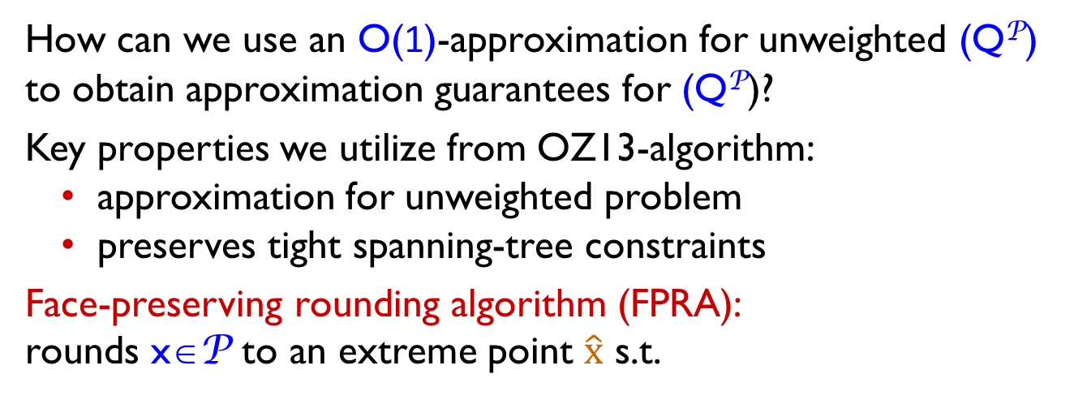
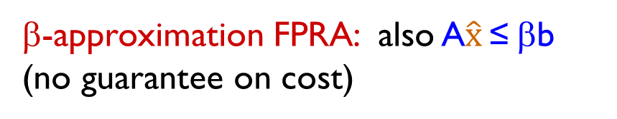

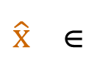

General reduction from weighted to unweighted problems
Min c^{T}x s.t. x is an extreme point of P, Ax ≤ b (Q^{P})
How can we use an O(1)-approximation for unweighted (Q^{P}) to obtain approximation guarantees for (Q^{P})?
Key properties we utilize from OZ13-algorithm:
approximation for unweighted problem
preserves tight spanning-tree constraints
Face-preserving rounding algorithm (FPRA):
rounds x∈P to an extreme point $\hat{x}$ s.t.
minimal face of P containing x
$$\hat{x}$$
$\hat{x}$ ∈
$$x$$
β-approximation FPRA: also A$\hat{x}$ ≤ βb
(no guarantee on cost)

Slide 22
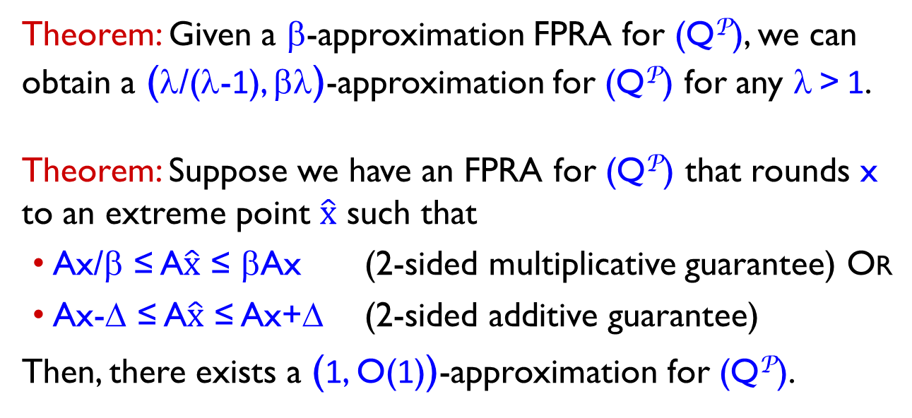
Reductions to unweighted (Q^{P})
Theorem: Given a β-approximation FPRA for (Q^{P}), we can obtain a (λ/(λ-1), βλ)-approximation for (Q^{P}) for any λ > 1.
Theorem: Suppose we have an FPRA for (Q^{P}) that rounds x to an extreme point $\hat{x}$ such that
Ax/β ≤ A$\hat{x}$ ≤ βAx (2-sided multiplicative guarantee) Or
Ax-Δ ≤ A$\hat{x}$ ≤ Ax+Δ (2-sided additive guarantee)
Then, there exists a (1, O(1))-approximation for (Q^{P}).

Slide 23
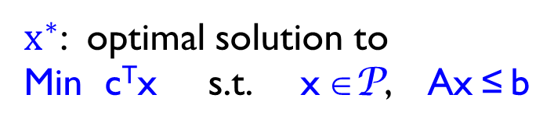

Why is an FPRA useful?
P
$x^{∗}$: optimal solution to
Min c^{T}x s.t. x ∈P, Ax ≤ b
y*: optimal dual values corresp. to side constraints Ax ≤ b
$$x^{∗}$$
Then y* is an optimal solution to Lagrangian problem:
Max { –b^{T}y + [min (c + A^{T}y)^{T}x s.t. x ∈P ] : y ≥ 0 } And
x* is optimal solution to inner problem: min (c^{y*})^{T}x s.t. x ∈P
c^{y}

Slide 24
Why is an FPRA useful?
P
$x^{∗}$: optimal solution to
Min c^{T}x s.t. x ∈P, Ax ≤ b
y*: optimal dual values corresp. to side constraints Ax ≤ b
$$x^{∗}$$
Then y* is an optimal solution to Lagrangian problem:
Max { –b^{T}y + [min (c + A^{T}y)^{T}x s.t. x ∈P ] : y ≥ 0 } And
x* is optimal solution to inner problem: min (c^{y*})^{T}x s.t. x ∈P

Slide 25
Why is an FPRA useful?
P
$x^{∗}$: optimal solution to
Min c^{T}x s.t. x ∈P, Ax ≤ b
y*: optimal dual values corresp. to side constraints Ax ≤ b
$$x^{∗}$$
Then y* is an optimal solution to Lagrangian problem:
Max { –b^{T}y + [min (c + A^{T}y)^{T}x s.t. x ∈P ] : y ≥ 0 } And
x* is optimal solution to inner problem: min (c^{y*})^{T}x s.t. x ∈P
all points on minimal face of P containing x* are optimal solutions to inner problem ≡ essentially unweighted problem
output of FPRA has optimal c^{y*}-cost ( = (c^{y*})^{T}x* )

Slide 26
Summary and open questions
Devise the first algorithm for chain-constrained spanning tree that gives O(1)-approx. to both cost and degrees
Use Lagrangian relaxation in an unorthodox way to obtain a novel reduction to the unweighted setting
Open questions
What about the laminar case (i.e., C is laminar)?
The reduction still works, so can focus on unweighted setting
What about chain degree-constraints for other connectivity problems (e.g., Steiner forest etc.)?
Other applications of our reduction?
Iterative rounding/relaxation based algorithms? Not clear how to make this work even for chains.

Slide 27
Thank You

