Slide 1
C&O 355 Mathematical Programming Fall 2010 Lecture 9
N. Harvey
TexPoint fonts used in EMF.
Read the TexPoint manual before you delete this box.: AAAAAAAAAA

Slide 2
Topics
Semi-Definite Programs (SDP)
Solving SDPs by the Ellipsoid Method
Finding vectors with constrained distances

Slide 3
LP is great, but…
Some problems cannot be handled by LPs
Example: Find vectors v₁,…,v₁₀ 2 R¹⁰ s.t.
All vectors have unit length: kv_{i}k = 1 8i
Distance between vectors is: kv_{i}-v_{j}k 2 [1/3, 5/3] 8i≠j
Sum-of-squared distances is maximized
Not obvious how to solve it.
Not obvious that LP can help.
This problem is child’s play with SDPs

Slide 4
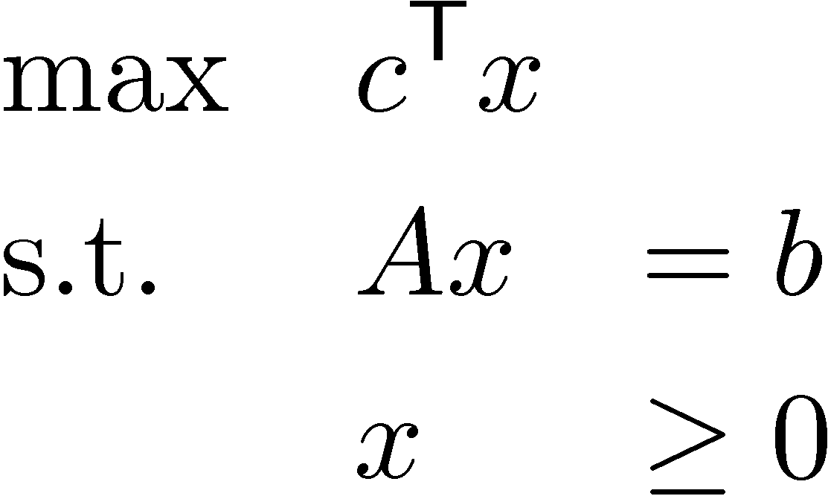
How can we make LPs more general?
An (equational form) LP looks like:
In English:
Find a non-negative vector x
Subject to some linear constraints on its entries
While maximizing a linear function of its entries
What object is “more general” than vectors?
How about matrices?

Slide 5
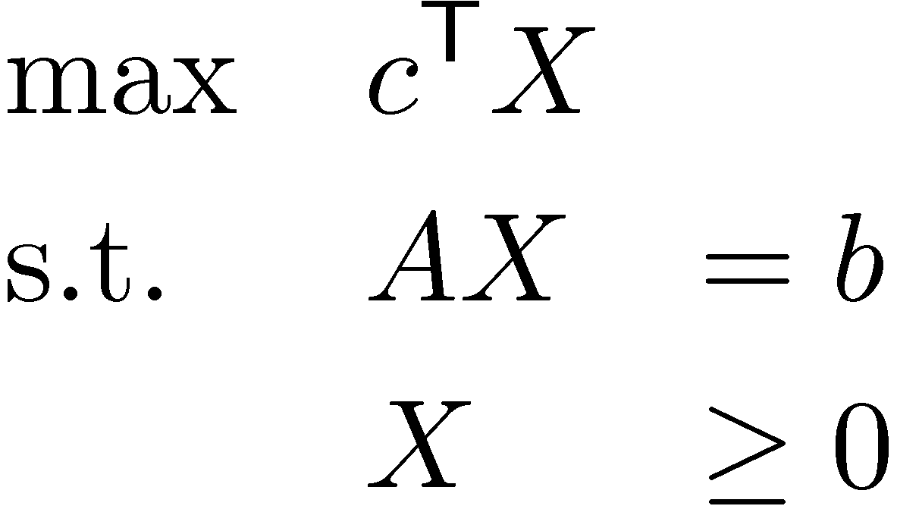
Generalizing LPs: Attempt #1
How about this?
In English:
Find a “non-negative matrix” X
Subject to some linear constraints on its entries
While maximizing a linear function of its entries
Does this make sense? Not quite…
What is a “non-negative matrix”?
Objective function c^{T}X is not a scalar
AX is not a vector

Slide 6
What is a “non-negative matrix”?
Let’s define “non-negative matrix” by “symmetric, positive semi-definite matrix”.
So our “variables” are the entries of an nxn symmetric matrix.
The constraint “X¸0” is replaced by “X is PSD”
Note: The constraint “X is PSD” is quite weird. We’ll get back to this issue.

Slide 7
Vectorizing the Matrix
A dxd matrix can be viewed as a vector in R^{d2}. (Just write down the entries in some order.)
A dxd symmetric matrix can be viewed as a vector in R^{d(d+1)/2}.
Our notation: X is a dxd symmetric matrix, and x is the corresponding vector.
1
2
3
4
1 | 2
3 | 4
1
2
4
X =
1 | 2
2 | 4
x =

Slide 8
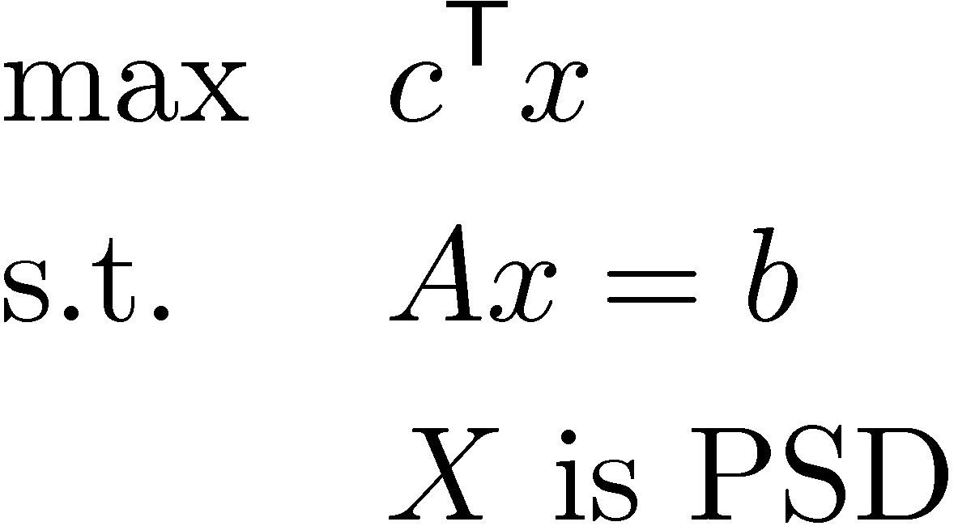
Semi-Definite Programs
This constraint looks suspiciously non-linear
Where
x2R^{n} is a vector
A is a mxn matrix, c2R^{n} and b2R^{m}
X is a dxd symmetric matrix, where n = d(d+1)/2, and x is vector corresponding to X.
In English:
Find a symmetric, positive semidefinite matrix X
Subject to some linear constraints on its entries
While maximizing a linear function of its entries

Slide 9
Review of Eigenvalues
A complex dxd matrix M is diagonalizable if M = U D U⁻¹, where D and U have size dxd, and D is diagonal. (This expression for M is called a “spectral decomposition”)
The diagonal entries of D are called the eigenvalues of M, and the columns of U are corresponding eigenvectors.
An eigenvector of M is a vector y≠0 s.t. My = ¸y, for some ¸2C.
Fact: Every real symmetric matrix M is diagonalizable. In fact, we can write M = U D U^{T}, where D and U are real dxd matrices, D is diagonal, and U^{T} = U⁻¹. (U is “orthogonal”)
Fact: For real symmetric matrices, it is easy to compute the matrices U and D. (“Cholesky Factorization”, very similar to Gaussian Elim.)
Summary: Real symmetric matrices have real eigenvalues and eigenvectors and they’re easily computed.

Slide 10
Positive Semidefinite Matrices (again)
Assume M is a symmetric, d x d matrix
Definition 1: M is PSD iff 9V s.t. M = V^{T}V.
Definition 2: M is PSD iff y^{T}My ¸ 0 8y2R^{d}.
Definition 3: M is PSD iff all eigenvalues are ¸ 0.
Claim: Definition 3 ) Definition 1.
Proof: Since M symmetric, M = U D U^{T} where D is diagonal and its diagonal entries are the eigenvalues.
Let W be diagonal matrix W=D^{1/2}, i.e.,
Then M = U^{T} W W U = U^{T} W^{T} W U = (WU)^{T} (WU) = V^{T} V, where V = WU. ¤

Slide 11
Positive Semidefinite Matrices (again)
Assume M is a symmetric, d x d matrix
Definition 1: M is PSD iff 9V s.t. M = V^{T}V.
Definition 2: M is PSD iff y^{T}My ¸ 0 8y2R^{d}.
Definition 3: M is PSD iff all eigenvalues are ¸ 0.
Notation: Let M[S,T] denote submatrix of M with row-set S and column-set T.
Definition 4: M is PSD iff det( M[S,S] )¸0 8S.
Definitions 1-3 are very useful. Definition 4 is less useful.

Slide 12
The PSD Constraint is Convex
Claim: The set C = { x : X is PSD } is a convex set.
Proof:
By Definition 2, X is PSD iff y^{T}Xy ¸ 0 8y2R^{d}.
Note: . For each fixed y, this is a linear inequality involving entries of X.
Each inequality defines a half-space, and is convex.
So
So C is the intersection of an (infinite!) collection of convex sets, and hence is convex. (See Asst 0)
¥
Remark: This argument also shows that C is closed.

Slide 13
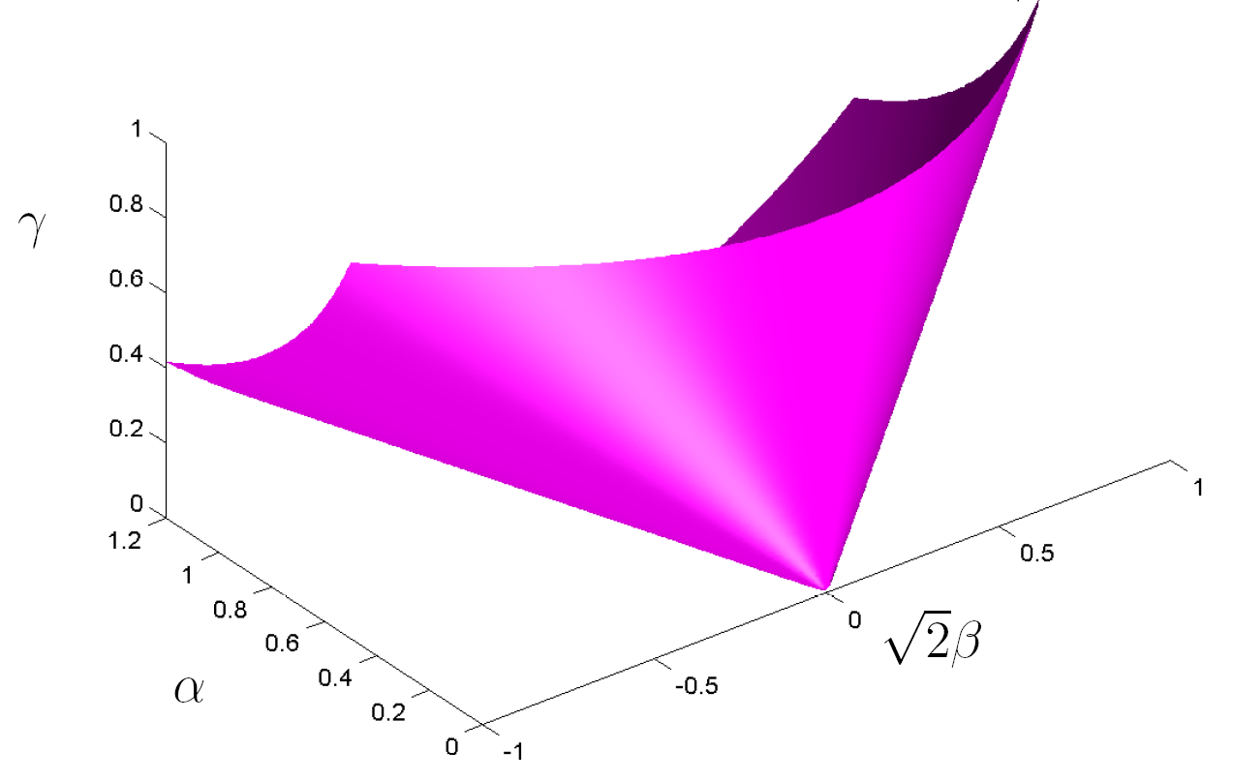
What does the PSD set look like?
Consider 2x2 symmetric matrices.
M =
Let C = { x : X is PSD }.
By Definition 4, M is PSD iff det( M[S,S] )¸0 8S.
So C = { (®,¯,°) : ®¸0, °¸0, ®°-¯²¸0 }.
® | ¯
¯ | °
Note: Definitely not a polyhedral set!
Image from Jon Dattorro “Convex Optimization & Euclidean Distance Geometry”

Slide 14
Semi-Definite Programs
This constraint looks suspiciously non-linear
Definition 2
Where
x2R^{n} is a vector
A is a mxn matrix, c2R^{n} and b2R^{m}
X is a dxd symmetric matrix, where n = d(d+1)/2, and x is vector corresponding to X.
Replace suspicious constraint with Definition 2
This is a convex program with infinitely many constraints!

Slide 15
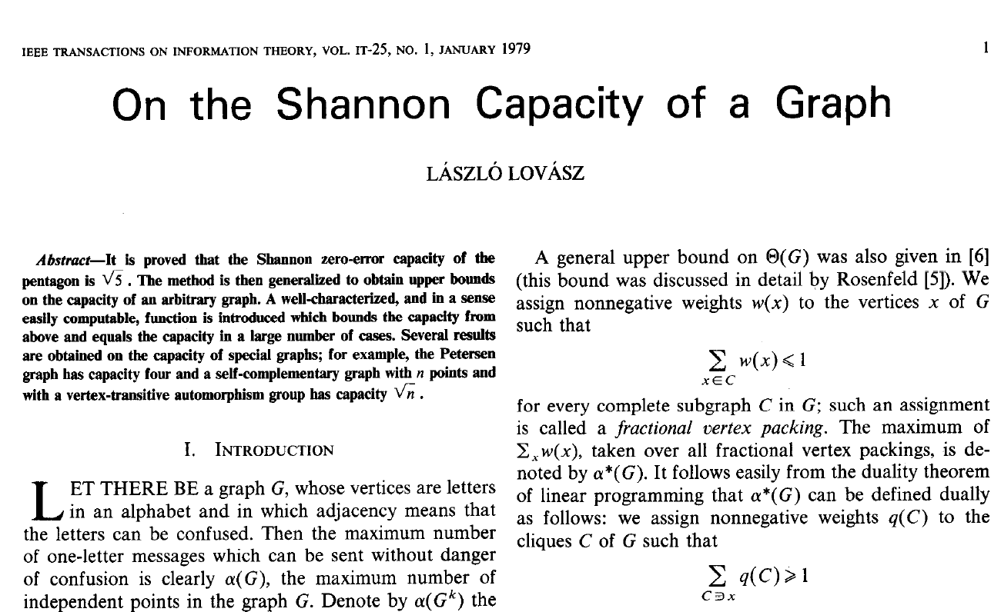
History of SDPs
Implicitly appear in this paper:
We met him in Lecture 8

Slide 16
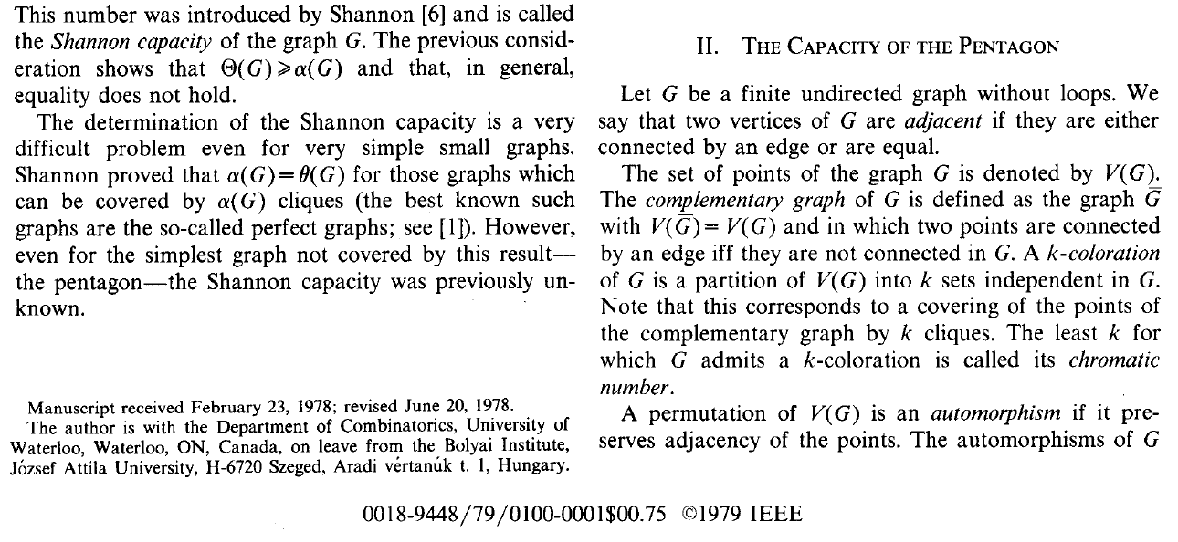
History of SDPs
Scroll down a bit…
SDPs were discovered in U. Waterloo C&O Department!

Slide 17
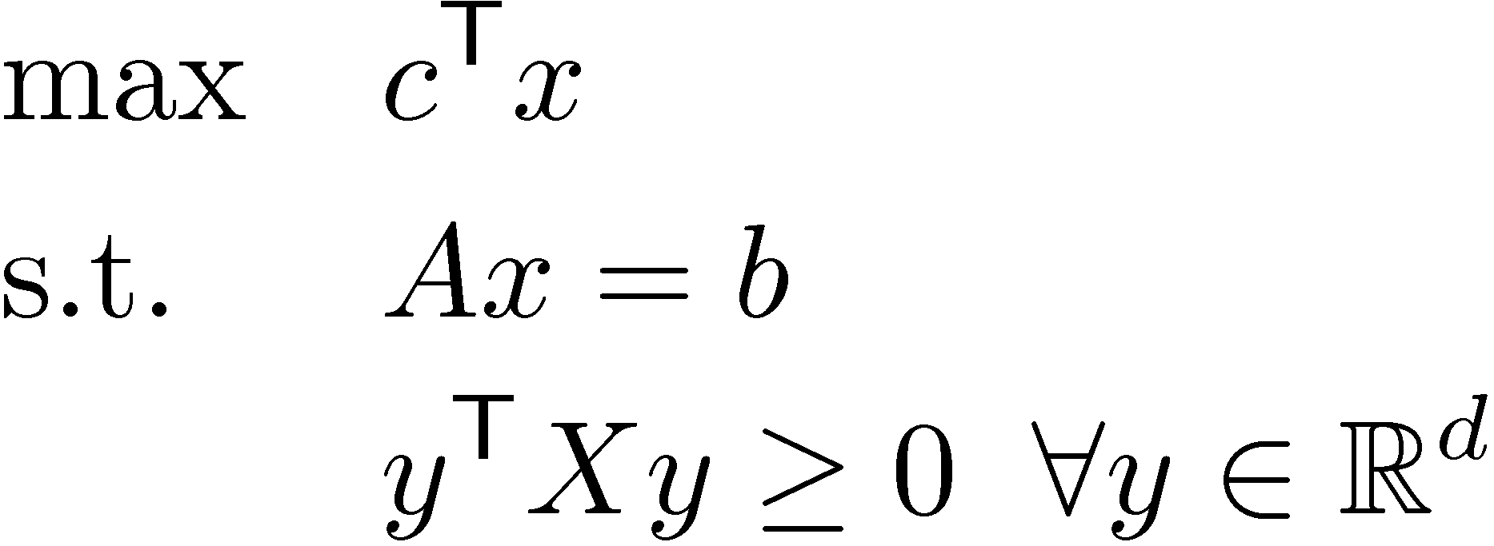
Solving Semi-Definite Programs
There are infinitely many constraints!
But having many constraints doesn’t scare us: we know the Ellipsoid Method.
To solve the SDP, we:
Replace objective function by constraint c^{T}x ¸ ®, and binary search to find (nearly) optimal alpha.
Need to design a separation oracle.

Slide 18
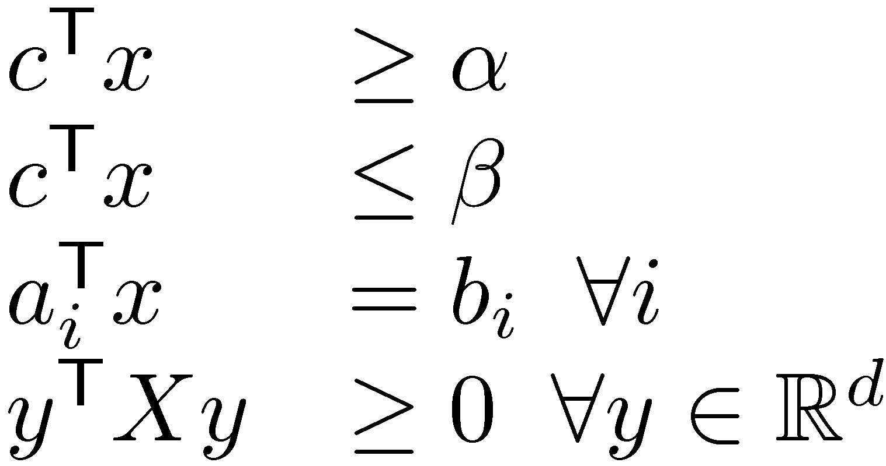
Separation Oracle for SDPs
P =
Separation Oracle
Is z2P?
If not, find a vector a s.t. a^{T}x<a^{T}z 8x2P
Easy to test if Az=b, and if c^{T}z ¸ ®
If not, either a_{i} or -a_{i} or c gives the desired vector a
How can we test if y^{T} Z y ¸ 0 8y?

Slide 19
Separation Oracle for SDPs
P =
Separation Oracle
Is z2P?
If not, find a vector a s.t. a^{T}x<a^{T}z 8x2P
How can we test if y^{T} Z y ¸ 0 8y?
Key trick: Compute eigenvalues & eigenvectors!
If all eigenvalues ¸ 0, then Z is PSD and y^{T} Z y ¸ 0 8y.
If y is a non-zero eigenvector with eigenvalue ¸<0, then Zy = ¸y ) y^{T} Z y = y^{T}¸y = ¸ y^{T}y = ¸ kyk² < 0
Thus the constraint y^{T} X y ¸ 0 is violated by Z!
Notes:
Suppose y^T X y >= 0 is violated by Z. Then what is the vector a?
Let w = [ y1^2, 2 y1 y2, 2 y1 y3, …, y2^2, 2 y2 y3, 2 y2 y4, … ]
Then w*x >= 0 for every x in P, but w*z < 0.
So we can take a = -w.

Slide 20
Separation Oracle for SDPs
P =
Separation Oracle
Is z2P?
If not, find a vector a s.t. a^{T}x<a^{T}z 8x2P
Summary: SDPs can be solved (approximately) by the Ellipsoid Method, in polynomial time. There are some issues relating to irrational numbers and the radii of balls containing and contained in feasible region.
SDPs can be solved efficiently in practice (approximately), by Interior Point Methods.

Slide 21
Example: Find vectors v₁,…,v₁₀ 2 R¹⁰ s.t.
All vectors have unit length: kv_{i}k = 1 8i
Distance between vectors is: kv_{i}-v_{j}k 2 [1/3, 5/3] 8i≠j
Sum-of-squared distances is maximized
Why does this example relate to SDPs?
Key observation: PSD matrices correspond directly to vectors and their dot-products.
Given vectors v₁,…,v_{d} in R^{d}, let V be the dxd matrix whose i^{th} column is v_{i}.
Let X = V^{T}V. Then X is PSD and X_{i,j} = v_{i}^{T}v_{j} 8i,j.

Slide 22
Example: Find vectors v₁,…,v₁₀ 2 R¹⁰ s.t.
All vectors have unit length: kv_{i}k = 1 8i
Distance between vectors is: kv_{i}-v_{j}k 2 [1/3, 5/3] 8i≠j
Sum-of-squared distances is maximized
Key observation: PSD matrices correspond directly to vectors and their dot-products.
Given vectors v₁,…,v_{d} in R^{d}, let V be the dxd matrix whose i^{th} column is v_{i}.
Let X = V^{T}V. Then X is PSD and X_{i,j} = v_{i}^{T}v_{j} 8i,j.
Conversely, given a dxd PSD matrix X, find spectral decomposition X = U D U^{T}, and let V = D^{1/2} U.
To get vectors in R^{d}, let v_{i} = i^{th} column of V.
Then X = V^{T} V ) X_{i,j} = v_{i}^{T}v_{j} 8i,j.

Slide 23
Example: Find vectors v₁,…,v₁₀ 2 R¹⁰ s.t.
All vectors have unit length: kv_{i}k = 1 8i
Distance between vectors is: kv_{i}-v_{j}k 2 [1/3, 5/3] 8i≠j
Sum-of-squared distances is maximized
Key observation: PSD matrices correspond directly to vectors and their dot-products: If X PSD, it gives vectors { v_{i} : i=1,…,d } where X_{i,j} = v_{i}^{T}v_{j}.
Also, distances and lengths relate to dot-products:
kuk²=u^{T}u and ku-vk² = (u-v)^{T}(u-v) = u^{T}u - 2v^{T}u + v^{T}v
So our example is solved by the SDP:
max §_{i,j} (X_{i,i} - 2X_{i,j} + X_{j,j}) (i.e., §_{i,j} kv_{i}-v_{j}k²) s.t. X_{i,i} = 1 (i.e., kv_{i}k = 1) X_{i,i}-2X_{i,j}+X_{j,j}2[1/9,25/9] (i.e., kv_{i}-v_{j}k2[1/3,5/3]) X is PSD

Slide 24
Example: Find vectors v₁,…,v₁₀ 2 R¹⁰ s.t.
All vectors have unit length: kv_{i}k = 1 8i
Distance between vectors is: kv_{i}-v_{j}k 2 [1/3, 5/3] 8i≠j
Sum-of-squared distances is maximized
Our example is solved by the SDP:
max §_{i,j} (X_{i,i} - 2X_{i,j} + X_{j,j}) (i.e., §_{i,j} kv_{i}-v_{j}k²) s.t. X_{i,i} = 1 (i.e., kv_{i}k = 1) X_{i,i}-2X_{i,j}+X_{j,j}2[1/9,25/9] (i.e., kv_{i}-v_{j}k2[1/3,5/3]) X is PSD
Note objective function is a linear function of X’s entries
Note constraints are all linear inequalities on X’s entries

Slide 25
SDP Summary
Matrices can be viewed as vectors.
Can force a matrix to be PSD using infinitely many linear inequalities.
Can test if a matrix is PSD using eigenvalues. This also gives a separation oracle.
PSD matrices correspond to vectors and their dot products (and hence to their distances).
So we can solve lots of optimization problems relating to vectors with certain distances.
In applications of SDP, it is often not obvious why the problem relates to finding certain vectors…

