Slide 1
C&O 355 Mathematical Programming Fall 2010 Lecture 6
N. Harvey
TexPoint fonts used in EMF.
Read the TexPoint manual before you delete this box.: AAAAAAAAAA

Slide 2
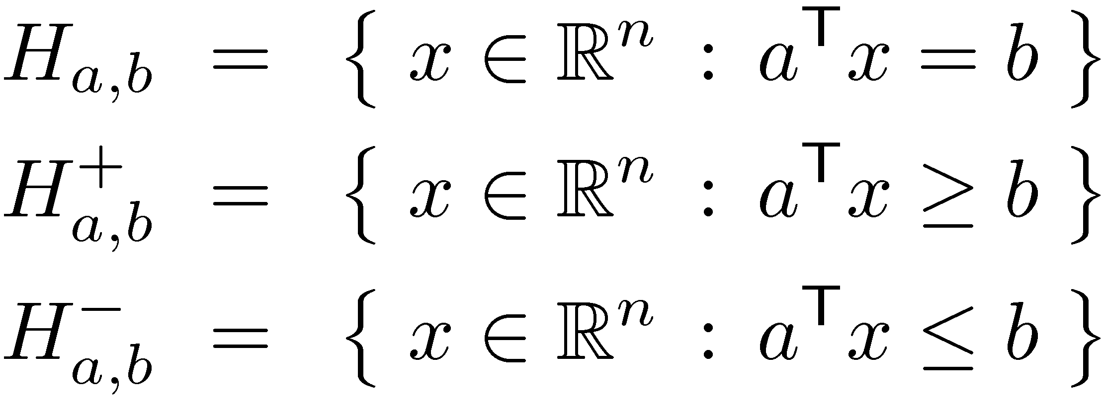
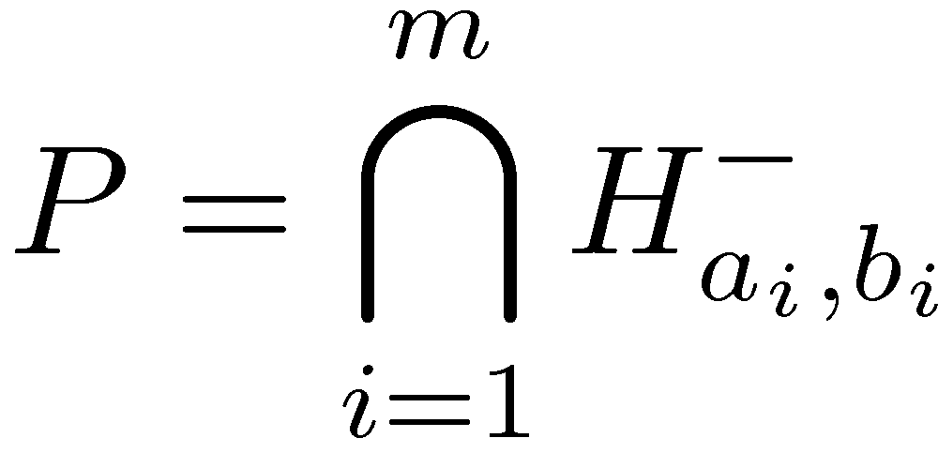
Polyhedra
Definition: For any a2R^{n}, b2R, define
Def: Intersection of finitely many halfspaces is a polyhedron
Def: A bounded polyhedron is a polytope, i.e., P µ { x : -M · x_{i} · M 8i } for some scalar M
So the feasible region of LP
is polyhedron
Hyperplane
Halfspaces
Notes:
Section 4.3

Slide 3
Convex Sets
Def: Let x₁,…,x_{k} 2 R^{n}. Let ®₁,…,®_{k} satisfy ®_{i} ¸ 0 for all i and ∑_{i} ®_{i} = 1. The point ∑_{i} ®_{i}x_{i} is a convex combination of the x_{i}’s.
Def: A set C µ R^{n} is convex if for every x, y 2 C and 8®2[0,1], the convex combination ®x + (1-®)y is in C.
Claim 1: Any halfspace is convex.
Claim 2: The intersection of any number of convex sets is convex.
Corollary: Every polyhedron is convex.
y
y
x
x
Not convex
Convex
Notes:
1: ax<=b and ay<=b
cax<=cb and (1-c)ay<=(1-c)b
cax+(1-c)ay<=cb+(1-c)b=b
a(cx+(1-c)y)<=b
2: x,y in C => x,y in C_i for each i
They are convex, so cx+(1-c)y in C_i for each i
So cx+(1-c)y in C

Slide 4
Convex Functions
Let C µ R^{n} be convex.
Def: f : C ! R is a convex function if f( ®x+(1-®)y ) · ®f(x) + (1-®)f(y) 8x,y2C
Claim: Let f : C ! R be a convex function, and let a2R. Then { x2C : f(x) · a } (the “sub-level set”) is convex.
Example: Let . Then f is convex.
Corollary: Let B = { x : kxk · 1 }. (The Euclidean Ball) Then B is convex.
Notes:
1) Let S = { x in C : f(x) <= a }. Suppose x, y in S.
Then f( alpha x + (1-alpha) y ) <= alpha f(x) + (1-alpha) f(y) <= alpha a + (1-alpha) a = a.
2) ||alpha x + (1-alpha) y|| <= ||alpha x|| + ||(1-alpha) y|| = alpha||x|| + (1-alpha)||y||.

Slide 5
Affine Maps
Def: A map f : R^{n} ! R^{m} is called an affine map if f(x) = Ax + b for some matrix A and vector b.
Fact: Let CµR^{n} have defined volume. Let f(x)=Ax + b. Then vol f(C) = |det A|¢vol C.
Claim 1: Let CµR^{n} be convex and let f : R^{n} ! R^{m} be an affine map. Then f(C) = { f(x) : x in C } is convex.
Question: If PµR^{n} is a polyhedron and f is an affine map, is it true that f(P) is a polyhedron?
Answer: Yes, but it’s not so easy to prove…
Notes:
It is also true that an affine map applied to a polyhedron is a polyhedron. But this is not easy to prove!
Claim 1: Suppose x,y in f(C). We need to show ax+(1-a)y in f(C).
Then there exists X, Y in C such that x=f(X) and y=f(Y).
Since C is convex, aX+(1-a)Y in C.
But f(aX+(1-a)Y) = A(aX+(1-a)Y) + b = aAX + ab + (1-a)AY + (1-a)b = a f(X) + (1-a) f(Y).
Claim 2:
As shown on Asst 0, (A^{-1})^T = (A^T)^{-1}. So we can just call it A^{-T}.

Slide 6
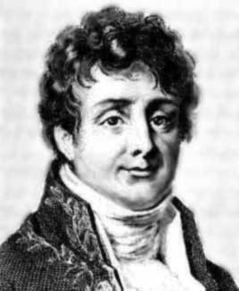
Fourier-Motzkin Elimination
Joseph Fourier
Theodore Motzkin
Given a polyhedron Q µ R^{n}, we want to find the set Q’ µ R^{n-1} satisfying
(x₁,…,x_{n-1})2Q’ , 9x_{n} s.t. (x₁,…,x_{n-1},x_{n})2Q
Q’ is called the projection of Q onto first n-1 coordinates
Fourier-Motzkin Elimination constructs Q’ by generating (finitely many) constraints from the constraints of Q.
Corollary: Q’ is a polyhedron.

Slide 7
Elimination Example
x₃
Q
x₂
x₁
Project Q onto coordinates {x₁, x₂}...

Slide 8
Elimination Example
x₃
Q’
x₂
x₁
Project Q onto coordinates {x₁, x₂}...
Fourier-Motzkin: Q’ is a polyhedron.
Of course, the ordering of coordinates is irrevelant.

Slide 9
Elimination Example
x₃
Q’’
x₂
x₁
Of course, the ordering of coordinates is irrevelant.
Fourier-Motzkin: Q’’ is also a polyhedron.
I can also apply Elimination twice…

Slide 10
Elimination Example
x₃
Q’’’
x₂
x₁
Fourier-Motzkin: Q’’’ is also a polyhedron.

Slide 11
Projecting a Polyhedron Onto Some of its Coordinates
Lemma: Given a polyhedron Q µ R^{n}. Let S={s₁,…,s_{k}}µ{1,…,n} be any subset of the coordinates. Let Q_{S} = { (x_{s1},…,x_{sk}) : x2Q } µ R^{k}.
In other words, Q_{S} is projection of Q onto coordinates in S.
Then Q_{S} is a polyhedron.
Proof: Direct from Fourier-Motzkin Elimination. Just eliminate all coordinates not in S. ¥

Slide 12
Linear Transformations of Polyhedra
Lemma: Let P = { x : Ax·b } µ R^{n} be a polyhedron. Let M be any matrix of size pxn. Let Q = { Mx : x2P } µ R^{p}. Then Q is a polyhedron.
x₃
1 | 0 | 0
-1 | 1 | 0
0 | 0 | 1
Let M =
P
x₂
x₁

Slide 13
Linear Transformations of Polyhedra
Lemma: Let P = { x : Ax·b } µ R^{n} be a polyhedron. Let M be any matrix of size pxn. Let Q = { Mx : x2P } µ R^{p}. Then Q is a polyhedron.
Geometrically obvious, but not easy to prove…
x₃
1 | 0 | 0
-1 | 1 | 0
0 | 0 | 1
Let M =
Q
x₂
x₁

Slide 14
Linear Transformations of Polyhedra
Lemma: Let P = { x : Ax·b } µ R^{n} be a polyhedron. Let M be any matrix of size pxn. Let Q = { Mx : x2P } µ R^{p}. Then Q is a polyhedron.
Geometrically obvious, but not easy to prove…
…unless you know Fourier-Motzkin Elimination!
Proof:
Let P’ = { (x,y) : Mx=y, Ax·b } µ R^{n+p}, where x2R^{n}, y2R^{p}.
P’ is obviously a polyhedron.
Note that Q is projection of P’ onto y-coordinates.
By previous lemma, Q is a polyhedron. ¥

Slide 15
Ellipsoids
Def: Let B = { x : kxk·1 }. Let f : R^{n} ! R^{m} be an affine map. Then f(B) is an ellipsoid.
We restrict to the case n=m and f invertible. (i.e., f(x) = Ax+b where A is square and non-singular)
Claim 2: f(B) = { x2R^{n} : (x-b)^{T}A^{-T}A⁻¹(x-b) · 1 }.
Notes:
It is also true that an affine map applied to a polyhedron is a polyhedron. But this is not easy to prove!
Claim 1: Suppose x,y in f(C). We need to show ax+(1-a)y in f(C).
Then there exists X, Y in C such that x=f(X) and y=f(Y).
Since C is convex, aX+(1-a)Y in C.
But f(aX+(1-a)Y) = A(aX+(1-a)Y) + b = aAX + ab + (1-a)AY + (1-a)b = a f(X) + (1-a) f(Y).
Claim 2:
As shown on Asst 0, (A^{-1})^T = (A^T)^{-1}. So we can just call it A^{-T}.

Slide 16
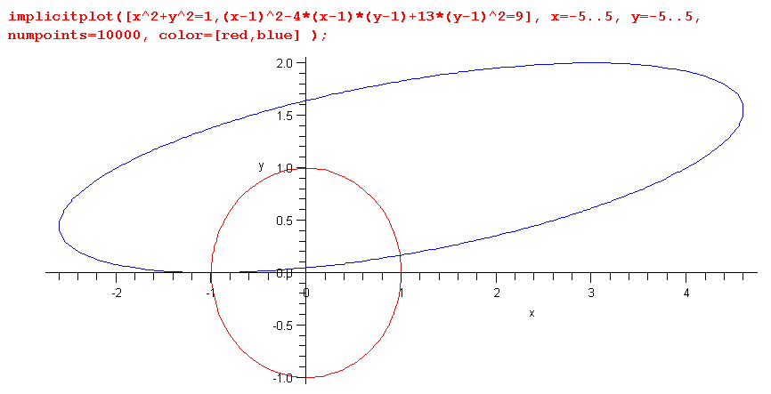
2D Example
Ellipsoid T(B)
Unit ball B

Slide 17
Positive Semi-Definite Matrices
Def: A real, symmetric matrix M is called positive semi-definite if M = V^{T}V, for some matrix V (not necessarily square). If M is also non-singular it is called positive definite.
From now on “positive definite” means “real, symmetric, positive definite”.
Fact: If M is positive definite, then M⁻¹ is also positive definite.
Fact: If M is positive definite, there is a unique positive definite matrix M^{1/2} such that M = M^{1/2} M^{1/2}. M^{1/2} is called the square root of M.
Claim: If M is positive definite then (M^{1/2})⁻¹ = (M⁻¹)^{1/2}.
Notes:
These facts are easy to prove by looking at the spectral decomposition of M.
Claim:
Let A = M^{1/2}. Note A is symmetric.
A^{-1} A^{-1} M
= A^{-1} A^{-1} A A
= I.
This implies that M^{-1} = A^{-1} A^{-1}.
By uniqueness of the square root, we get (M^{-1})^{1/2} = (M^{1/2})^{-1}.

Slide 18
More on Ellipsoids
We’re studying ellipsoids of the form { x2R^{n} : (x-b)^{T}A^{-T}A⁻¹(x-b) · 1 }, for some (non-singular) matrix A and vector b.
Equivalently, this is ellipsoids of the form E(M,b) = { x2R^{n} : (x-b)^{T}M⁻¹(x-b) · 1 }, for some positive definite matrix M and vector b.
This helps us understand positive definite matrices. Consider f(x) = x^{T} M x, where M is positive definite. Its sub-level sets are { x2R^{n} : x^{T}Mx · a } = E(aM⁻¹,0).
Note: E(M,b) = f(B) where f(x) = M^{1/2}x + b. So vol E(M,b) = |det M^{1/2}| ¢ vol B = |det M|^{1/2} ¢ vol B.
Notes:
Not every ellipsoid is of this form – for example, ellipsoids might not be full-dimensional.

Slide 19
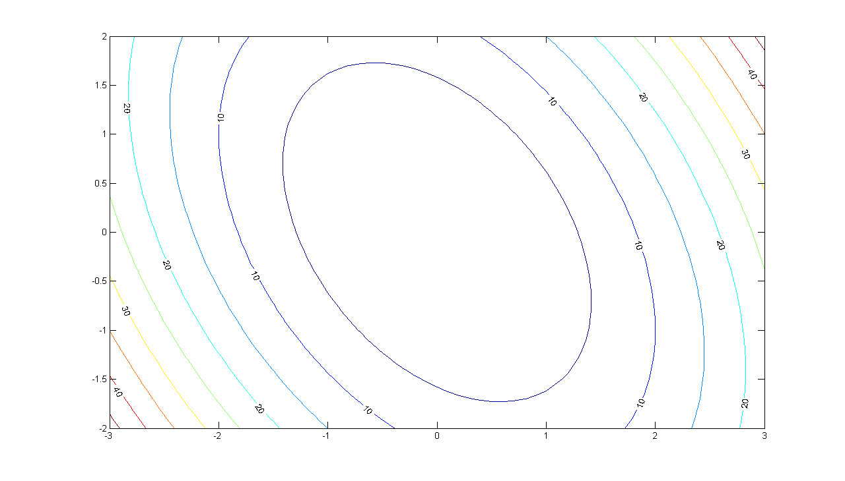
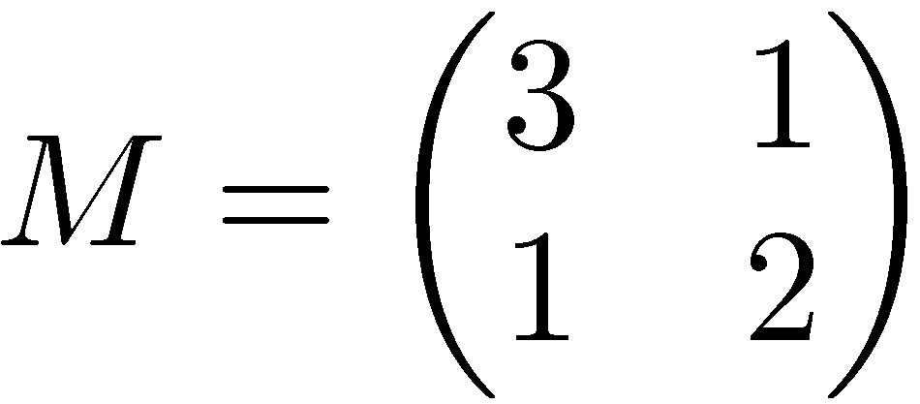
Let
Plot of level sets of x^{T} M x.
Notes:
Matlab code:
[X,Y] = meshgrid(-3:.1:3,-2:.1:2);
Z = 3*X.*X + 2*X.*Y + 2*Y.*Y;
[C,h] = contour(X,Y,Z);
set(h,'ShowText','on','TextStep',get(h,'LevelStep')*2);

Slide 20
Covering Hemispheres by Ellipsoids
B
B’
Let B = { unit ball }.
Let H = { x : x^{T}e₁¸0 } = { x : x₁¸0 }.
Find a small ellipsoid B’ that covers BÅH.

Slide 21
Rank-1 Updates
Def: Let z be a column vector and ® a scalar. A matrix of the form is called a rank-1 update matrix.
Claim 1: Suppose ® ≠ -1/z^{T}z. Then where ¯ = -®/(1+®z^{T}z).
Claim 2: If ®¸-1/z^{T} z then is PSD. If ®>-1/z^{T} z then is PD.
Claim 3:
Notes:
Claim 1: (I + azz^T) (I+bzz^T) = I + azz^T + bzz^T + abzz^Tzz^T
= I + (a+b+abz^Tz) zz^T (since z^T z is a scalar, it commutes)
= I, because a+b(1+az^Tz) = 0.

