Slide 1
C&O 355 Mathematical Programming Fall 2010 Lecture 18
N. Harvey
TexPoint fonts used in EMF.
Read the TexPoint manual before you delete this box.: AAAAAAAAAA

Slide 2
Topics
Network Flow
Max Flow / Min Cut Theorem
Total Unimodularity
Directed Graphs & Incidence Matrices
Proof of Max Flow / Min Cut Theorem

Slide 3
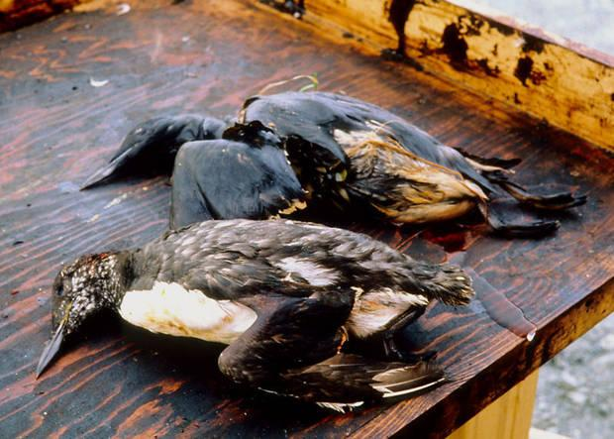
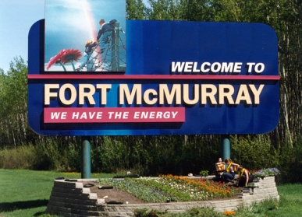
Network Flow
Let D=(N,A) be a directed graph.
Every arc a has a “capacity” c_{a}¸0. (Think of it as an oil pipeline)
Want to send oil from node s to node t through pipelines
Oil must not leak at any node, except s and t: flow in = flow out.
How much oil can we send?
For simplicity, assume no arc enters s and no arc leaves t.
3
7
4
2
5
1
8
1
2
t
s
2
2
2
1
1
3

Slide 4
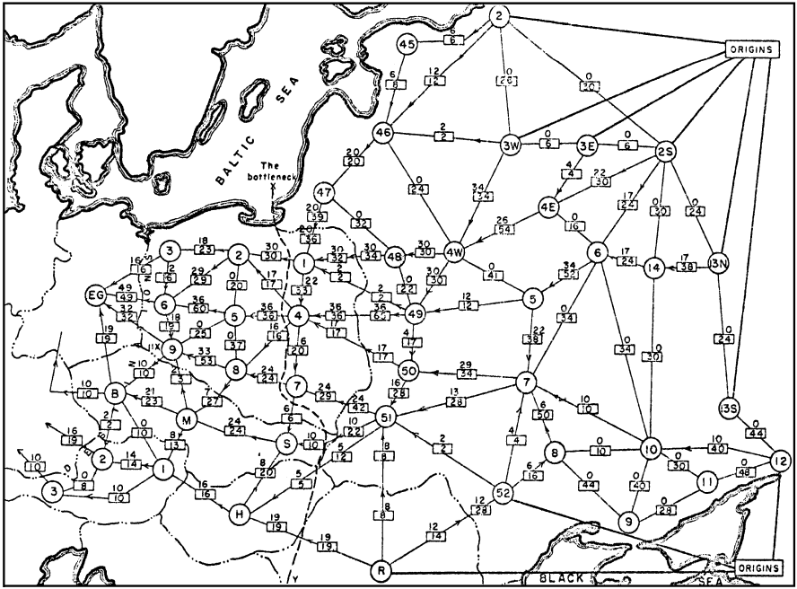
Max Flow & Min Cut
Harris and Ross [1955]
Schematic diagram of the railway network of the Western Soviet Union and Eastern European countries, with a maximum flow of value 163,000 tons from Russia to Eastern Europe, and a cut of capacity 163,000 tons indicated as ‘The bottleneck’. [Schrijver, 2005]

Slide 5
Max Flow & Min Cut
Let D=(N,A) be a digraph, where arc a has capacity c_{a}.
Definition: For any UµN, the cut ±⁺(U) is:
The capacity of the cut is:
Theorem: [Ford & Fulkerson 1956] The maximum amount of flow from s to t equals the minimum capacity of a cut ±⁺(U), where s2U and t2U
Furthermore, if c is integral then there is an integral flow that achieves the maximum flow.
Delbert Ray Fulkerson

Slide 6
LP Formulation of Max Flow
Variables: x_{a} = amount of flow to send on arc a
Constraints: For every node except s & t, flow in = flow out. Flow through each arc can not exceed its capacity.
Objective value: Total amount of flow sent by s.
Notation: ±⁺(v) = arcs with tail at v ±⁻(v) = arcs with head at v
The LP is:

Slide 7
Incidence Matrix of a Directed Graph
What is the matrix M defining the constraints of this LP?
Row for every node (except s or t)
Column for every arc
Goal: Analyze extreme points of this LP.
Plan: Show M is totally unimodular.
+1 if node v is the head of arc a
M_{v,a} =
-1 if node v is the tail of arc a
0 otherwise

Slide 8
Total Unimodularity
Let M be a real mxn matrix
Definition: Suppose that every square submatrix of M has determinant in {0, +1, -1}. Then M is totally unimodular (TUM).
In particular, every entry of M must be in {0, +1, -1}
Key point: Polytopes defined by TUM matrices have integral extreme points.
For example, last time we showed: Lemma: Suppose M is TUM. Let b be any integer vector. Then every basic feasible solution of P = { x : Mx·b } is integral.

Slide 9
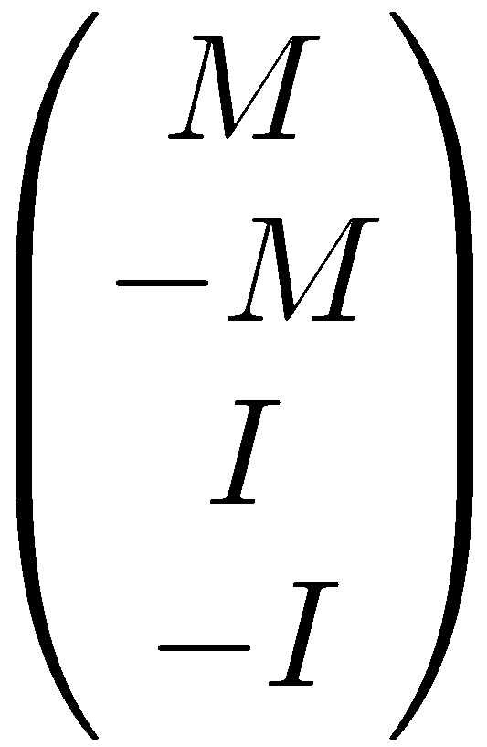
Total Unimodularity
Let M be a real mxn matrix
Definition: Suppose that every square submatrix of M has determinant in {0, +1, -1}. Then M is totally unimodular (TUM).
Lemma: Suppose A is TUM. Let b be any integer vector. Then every extreme point of P = { x : Mx·b } is integral.
Claim: Suppose M is TUM. Then is also TUM.
Proof: Exercise?
Corollary: Suppose M is TUM. Let b and c be integer vectors. Then every extreme point of P = { x : Mx=b, 0·x·c } is integral.

Slide 10
Incidence Matrices are TUM
Let D=(N, A) be a directed graph. Define M by:
Lemma: M is TUM.
Proof: Let Q be a kxk submatrix of M. Argue by induction on k.
If k=1 then Q is a single entry of M, so det(Q) is either 0 or §1.
So assume k>1.
+1 if node u is the head of arc a
M_{u,a} =
-1 if node u is the tail of arc a
0 otherwise

Slide 11
Lemma: M is TUM.
Proof: Let Q be a kxk submatrix of M. Assume k>1.
Case 1:
If some column of Q has no non-zero entries, then det(Q)=0.
Case 2:
Suppose j^{th} column of Q has exactly one non-zero entry, say Q_{t,j} ≠0
Use “Column Expansion” of determinant:
,
where t is the unique non-zero entry in column j.
By induction, det Q_{del(t,j)} in {0,+1,-1} ) det Q in {0,+1,-1}.
Case 3:
Suppose every column of Q has exactly two non-zero entries.
For each column, one non-zero is a +1 and the other is a -1.
So summing all rows in Q gives the vector [0,0,…,0].
Thus Q is singular, and det Q = 0. ¥

Slide 12
The Max Flow LP
Observations:
The LP is feasible (assume the capacities are all non-negative)
The LP is bounded (because the feasible region is bounded)
It has an optimal solution, i.e., a maximum flow. (by FTLP)
The feasible region is
where M is TUM.
Corollary: If c is integral, then every extreme point is integral, and so there is a maximum flow that is integral.
Q: Why does P have any extreme points?
A: It contains no line.

Slide 13
Max Flow LP & Its Dual
Dual variables:
A variable y_{v} for every v 2 N \ {s,t}
A variable z_{uv} for every arc uv
The dual is
Let’s simplify: Set y_{s} = 1 and y_{t} = 0

Slide 14
The Dual
where y_{s} and y_{t} are not variables: y_{s} = 1 and y_{t} = 0
We will show: Given an optimal solution (y,z), we can construct a cut ±⁺(U) such that
In other words, the capacity of the cut ±⁺(U) equals the optimal value of the dual LP.
By strong LP duality, this equals the optimal value of the primal LP, which is the maximum flow value.
Every cut has capacity at least the max flow value, so this must be a minimum cut.
“Rounding”

Slide 15
U₃
¿ =
U₄
¾=
1
2
3
4
U₅
5
6
a
t
c
d
s
b
0
1
Let (y,z) be an optimal dual solution
Every node u lies at some position y_{u} on the real line
Number the nodes 1,…,n so that y₁ · ☹ · y_{n}
Suppose node t numbered ¿ and node s numbered ¾
Let U_{i} = { i, i+1, …, n }, for ¿ < i · ¾ (Here n=|N|, the total # nodes)
Pick cut U_{i} with probability y_{i} - y_{i-1}
Arc jk contributes 0 if j<k, and at most (y_{j}-y_{k})c_{jk} if j>k
So

Slide 16
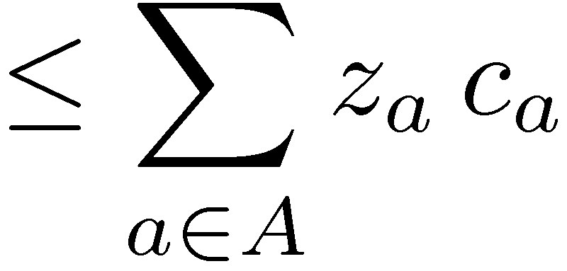
U₃
¿ =
U₄
¾=
1
2
3
4
U₅
5
6
a
t
c
d
s
b
0
1
Let U_{i} = { i, i+1, …, n }, for ¿ < i · ¾
Pick cut U_{i} with probability y_{i} - y_{i-1}
So the average capacity of the U_{i}’s is · Dual Opt. Value
) minimum capacity of a U_{i} is · Dual Opt. Value, and so it is a minimum cut.
By dual feasibility
= Optimum value of Dual LP

Slide 17
Summary
We have proven:
Theorem: [Ford & Fulkerson 1956] The maximum amount of flow from s to t equals the minimum capacity of a cut ±⁺(U), where s2U and t2U Furthermore, if c is integral then there is an integral flow that achieves the maximum flow.
We also get an algorithm for finding max flow & min cut
Solve Max Flow LP by the ellipsoid method.
Get an extreme point solution. It is an integral max flow.
Solve Dual LP by the ellipsoid method.
Use rounding method to get a min cut.
This algorithm runs in polynomial time

