Slide 1
C&O 355 Mathematical Programming Fall 2010 Lecture 15
N. Harvey
TexPoint fonts used in EMF.
Read the TexPoint manual before you delete this box.: AAAAAAAAAA

Slide 2
Topics
Minimizing over a convex set: Necessary & Sufficient Conditions
(Mini)-KKT Theorem Minimizing over a polyhedral set: Necessary & Sufficient Conditions
Smallest Enclosing Ball Problem

Slide 3
Minimizing over a Convex Set: Necessary & Sufficient Conditions
Thm 3.12: Let CµR^{n} be a convex set. Let f : R^{n}!R be convex and differentiable. Then x minimizes f over C iff rf(x)^{T}(z-x)¸0 8z2C.
Proof: ( direction
Direct from subgradient inequality. (Theorem 3.5)
f(z) ¸ f(x) + rf(x)^{T}(z-x) ¸ f(x)
Subgradient inequality
Our hypothesis
Notes:
This is Theorem 3.12

Slide 4
Minimizing over a Convex Set: Necessary & Sufficient Conditions
Thm 3.12: Let CµR^{n} be a convex set. Let f : R^{n}!R be convex and differentiable. Then x minimizes f over C iff rf(x)^{T}(z-x)¸0 8z2C.
Proof: ) direction
Let x be a minimizer, let z2C and let y = z-x.
Recall that rf(x)^{T}y = f’(x;y) = lim_{t!0} f(x+ty)-f(x).
If limit is negative then we have f(x+ty)<f(x) for some t2[0,1], contradicting that x is a minimizer.
So the limit is non-negative, and rf(x)^{T}y ¸ 0. ¥
t

Slide 5
Smallest Ball Problem
Let {p₁,…,p_{n}} be points in R^{d}. Find (unique!) ball (not an ellipsoid!) of smallest volume that contains all the p_{i}’s.
In other words, we want to solve:
min { r : 9y2R^{d} s.t. p_{i}2B(y,r) 8i }
r
y

Slide 6
Smallest Ball Problem
Let {p₁,…,p_{n}} be points in R^{d}. Find (unique!) ball (not an ellipsoid!) of smallest volume that contains all the p_{i}’s.
In other words, we want to solve:
min { r : 9y2R^{d} s.t. p_{i}2B(y,r) 8i }
We will formulate this as a convex program.
In fact, our convex program will be of the form
min { f(x) : Ax=b, x¸0 }, where f is convex. Minimizing a convex function over a polyhedron
To solve this, we will need optimality conditions for convex programs.

Slide 7
LP Optimality Conditions
Theorem: Let x2R^{n} be a feasible solution to the linear program max { c^{T}x : Ax=b, x¸0 }
Then x is optimal iff 9 dual solution y2R^{m} s.t.
A^{T}y ¸ c,
For all j, if x_{j}>0 then A_{j}^{T}y = c_{j}.
j^{th} column of A
Proof: Dual is min { b^{T}y : A^{T} y¸c }.
x optimal ) dual has optimal solution y.
So (1) holds by feasibility of y.
By optimality of x & y, c^{T}x=b^{T}y. Weak duality says:
Equality holds here ) (2) holds. (This is “complementary slackness”)
Notes:
Dual: max { b^T y }{ A^T y <= c }
Optimality conditions:
Dual feasibility: A^T y <= c
Complementary slackness: if x_j > 0 then

Slide 8
LP Optimality Conditions
Theorem: Let x2R^{n} be a feasible solution to the linear program min { -c^{T}x : Ax=b, x¸0 }
Then x is optimal iff 9 dual solution y2R^{m} s.t.
-c^{T} + y^{T}A ¸ 0,
For all j, if x_{j}>0 then -c_{j} + y^{T}A_{j} = 0.
j^{th} column of A
Proof: Dual is min { b^{T}y : A^{T} y¸c }.
x optimal ) dual has optimal solution y.
So (1) holds by feasibility of y.
By optimality of x & y, c^{T}x=b^{T}y. Weak duality says:
Equality holds here ) (2) holds. (This is “complementary slackness”)
Notes:
Dual: max { b^T y }{ A^T y <= c }
Optimality conditions:
Dual feasibility: A^T y <= c
Complementary slackness: if x_j > 0 then

Slide 9
(Mini)-KKT Theorem
Theorem: Let f:R^{n}!R be a convex, C² function. Let x2R^{n} be a feasible solution to the convex program min { f(x) : Ax=b, x¸0 } Then x is optimal iff 9y2R^{m} s.t.
rf(x)^{T} + y^{T}A ¸ 0,
For all j, if x_{j}>0 then rf(x)_{j} + y^{T}A_{j} = 0.
j^{th} column of A
Natural generalization of LP optimality conditions: approximation at x is
Proven by Karush in 1939 (his Master’s thesis!), and by Kuhn and Tucker in 1951.

Slide 10
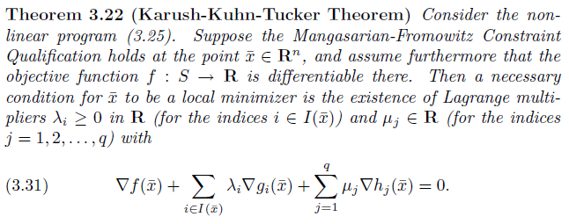
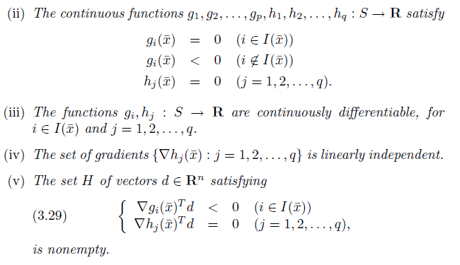
Full KKT Theorem
Even stating it requires a lot of details!
See Section 3.7 and 3.8 of the course notes

Slide 11
Theorem: Let f:R^{n}!R be a convex, C² function. Let x2R^{n} be a feasible solution to the convex program min { f(x) : Ax=b, x¸0 } Then x is optimal iff 9y2R^{m} s.t.
rf(x)^{T} + y^{T}A ¸ 0,
For all j, if x_{j}>0 then rf(x)_{j} + y^{T}A_{j} = 0.
Proof: ( direction. Suppose such a y exists. Then (rf(x)^{T} + y^{T}A) x = 0. (Just like complementary slackness)
For any feasible z2R^{n}, we have
(rf(x)^{T} + y^{T}A) z ¸ 0.
Subtracting these, and using Ax=Az=b, we get
rf(x)^{T}(z-x) ¸ 0 8 feasible z.
So x is optimal. (By Thm 3.12: “Minimizing over a Convex Set”)

Slide 12
Theorem: Let f:R^{n}!R be a convex, C² function. Let x2R^{n} be a feasible solution to the convex program min { f(x) : Ax=b, x¸0 } Then x is optimal iff 9y2R^{m} s.t.
rf(x)^{T} + y^{T}A ¸ 0,
For all j, if x_{j}>0 then rf(x)_{j} + y^{T}A_{j} = 0.
Proof: ) direction. Suppose x is optimal. Let c=-rf(x).
Then rf(x)^{T}(z-x)¸0 ) c^{T}z·c^{T}x for all feasible points z.
By Thm 3.12: “Minimizing over a Convex Set”

Slide 13
Theorem: Let f:R^{n}!R be a convex, C² function. Let x2R^{n} be a feasible solution to the convex program min { f(x) : Ax=b, x¸0 } Then x is optimal iff 9y2R^{m} s.t.
rf(x)^{T} + y^{T}A ¸ 0,
For all j, if x_{j}>0 then rf(x)_{j} + y^{T}A_{j} = 0.
Proof: ) direction. Suppose x is optimal. Let c=-rf(x).
Then rf(x)^{T}(z-x)¸0 ) c^{T}z·c^{T}x for all feasible points z.
So x is optimal for the LP max { c^{T}x : Ax=b, x¸0 }.
So there is an optimal solution y to dual LP min { b^{T}y : A^{T}y¸c }.
So rf(x)^{T} + y^{T}A = -c^{T} + y^{T}A ¸ 0 ) (1) holds.
Furthermore, x and y are both optimal so C.S. holds.
) whenever x_{j}>0, the j^{th} dual constraint is tight
) y^{T} A_{j} = c_{j} ) (2) holds. ¥

Slide 14
Smallest Ball Problem
Let P={p₁,…,p_{n}} be points in R^{d}. Let Q be dxn matrix s.t. Q_{i}=p_{i}. (Q_{i} = i^{th} column of Q) Let z2R^{n} satisfy z_{i}=p_{i}^{T}p_{i}. Define f : R^{n} ! R by f(x) = x^{T}Q^{T}Qx - x^{T}z.
Claim 1: f is convex.
Consider the convex program min { f(x) : ∑_{j} x_{j} = 1, x¸0 }.
(Hessian is PSD)
p₁
Interpretation
Qx is an “average” (convex combination) of the p_{i}’s
x^{T}Q^{T}Qx is norm² of this average point
x^{T}z is average norm² of the p_{i}’s
If x^{T}Q^{T}Qx ¿ x^{T}z, the p_{i}’s are “spread out”
Qx
p₂
p₃
x = [1/3, 1/3, 1/3, 0, 0, … ]

Slide 15
Smallest Ball Problem
Let P={p₁,…,p_{n}} be points in R^{d}. Let Q be dxn matrix s.t. Q_{i}=p_{i}. (Q_{i} = i^{th} column of Q) Let z2R^{n} satisfy z_{i}=p_{i}^{T}p_{i}. Define f : R^{n} ! R by f(x) = x^{T}Q^{T}Qx - x^{T}z.
Claim 1: f is convex.
Consider the convex program min { f(x) : ∑_{j} x_{j} = 1, x¸0 }.
Claim 2: This program has an optimal solution x.
Claim 3: Assume x is optimal. Let p*=Qx and r=√-f(x). Then P½B(p*,r).
Claim 4: B(p*,r) is the smallest ball containing P.
(Hessian is 2Q^{T}Q, which is PSD)
(By Weierstrass’ Theorem: the high-dimensional extreme value theorem)

Slide 16
Claim 3: The ball B(p*,r) contains P.
Proof: By KKT, 9y2R s.t. rf(x) + A^{T}y ¸ 0
For us rf(x) = 2Q^{T}Qx - z = 2Q^{T}p*- z and A = [1, …, 1]
So 2p_{j}^{T}p* - p_{j}^{T}p_{j} + y ¸ 0 8 j. (Here y 2 R)
KKT also says: equality holds 8j s.t. x_{j}>0.
So y = ∑_{j} x_{j} y = ∑_{j} x_{j} p_{j}^{T}p_{j} - 2 ∑_{j} x_{j} p_{j}^{T}p* = ∑_{j} x_{j} p_{j}^{T}p_{j} - 2p^{*T}p*.
So y + p^{*T}p* = ∑_{j} x_{j} p_{j}^{T}p_{j} - p^{*T}p* = -f(x) ) r = √y + p^{*T}p*
It remains to show that B(p*,r) contains P.
This holds iff kp_{j}-p*k · r 8j.
Now kp_{j}-p*k² = (p_{j}-p*)^{T}(p_{j}-p*)
= p^{*T}p*-2p_{j}^{T}p*+p_{j}^{T}p_{j}
· p^{*T}p*+y = r² 8j. ¤
y ¸ p_{j}^{T}p_{j} - 2p_{j}^{T}p* 8 j.

Slide 17
Claim 4: B(p*,r) is the smallest ball containing P.
Proof: See Matousek-Gartner Section 8.7.

Slide 18
Smallest Ball Problem: Summary
Consider the convex program min { f(x) : ∑_{j} x_{j} = 1, x¸0 }.
Claim 2: This program has an optimal solution x.
Claim 3: Let p*=Qx and r=√-f(x). Then P½B(p*,r).
Claim 4: B(p*,r) is the smallest ball containing P.
This example is a bit strange:
Not obvious how convex program relates to balls
Claim 3 is only valid when x is the optimal point
Still, KKT tells us interesting things:
optimal value of convex program gives radius of smallest ball containing P

