Slide 1
C&O 355 Mathematical Programming Fall 2010 Lecture 1
N. Harvey
TexPoint fonts used in EMF.
Read the TexPoint manual before you delete this box.: AAAAAAAAAA

Slide 2
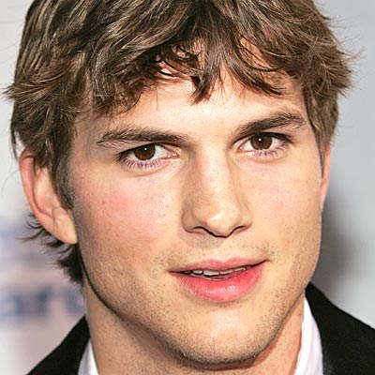
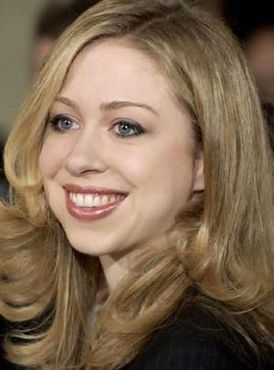
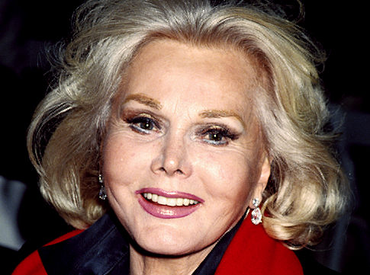
What is Optimization?
Basic Idea: From a certain set of objects, choose the best one.
Example: Getting married
“objects” = { all possible spouses }
“best one”… this is very hard to make precise
Notes:
Ashton Kutcher, Chelsea Clinton, Al Pacino, Zsa Zsa Gabor.

Slide 3
What is Mathematical Optimization?
Additional Idea: Describe objects by vectors in R^{n}
Example:
Each possible spouse described by a vector in R⁴
Best could mean “highest IQ” or “fewest spouses”, etc.
Age | 32 | 30 | 67 | 93
Prev Spouses | 1 | 1 | 0 | 9
IQ | 152 | 200 | 109 | 122
Eye Color | 1 | 2 | 1 | 3
(Using the Encoding: 1 = Brown, 2 = Blue, 3 = Green)

Slide 4
What is Mathematical Optimization?
Additional Idea: Describe objects by vectors in R^{n}
Example:
We can formalize the “highest IQ spouse” problem as:
Age | 32 | 30 | 67 | 93
Prev Spouses | 1 | 1 | 0 | 9
IQ | 152 | 200 | 109 | 122
Eye Color | 1 | 2 | 1 | 3

Slide 5
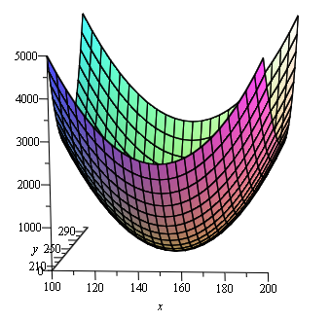
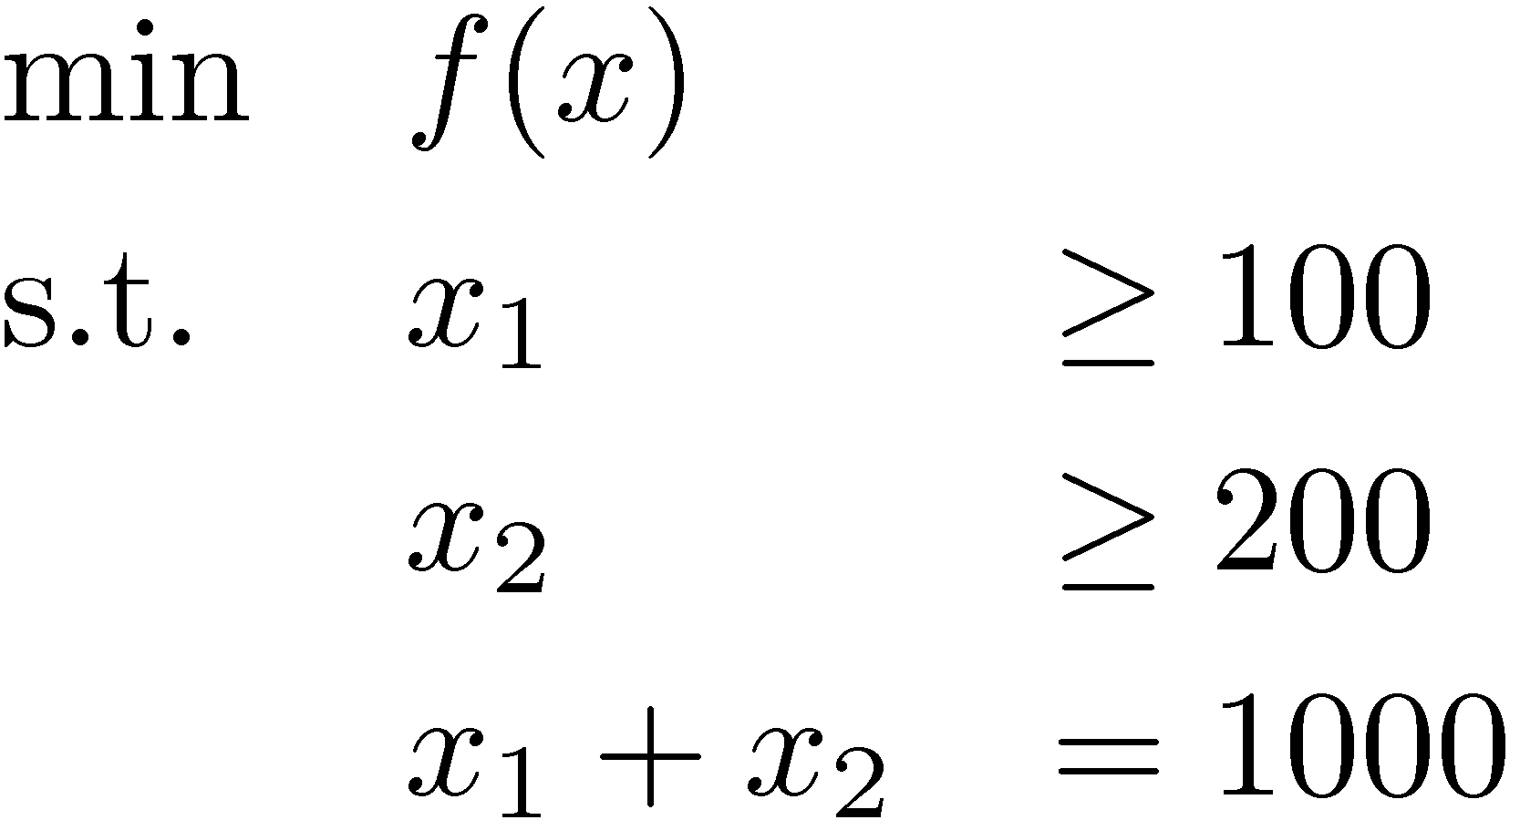
A Continuous Problem
Often there are infinitely many objects from which we want to find the best one.
Example: Allocating assets
x₁ = Dollar value of my Walmart shares
x₂ = Dollar value of my US treasury bonds
Here f : R² ! R is some function that measures “risk”

Slide 6
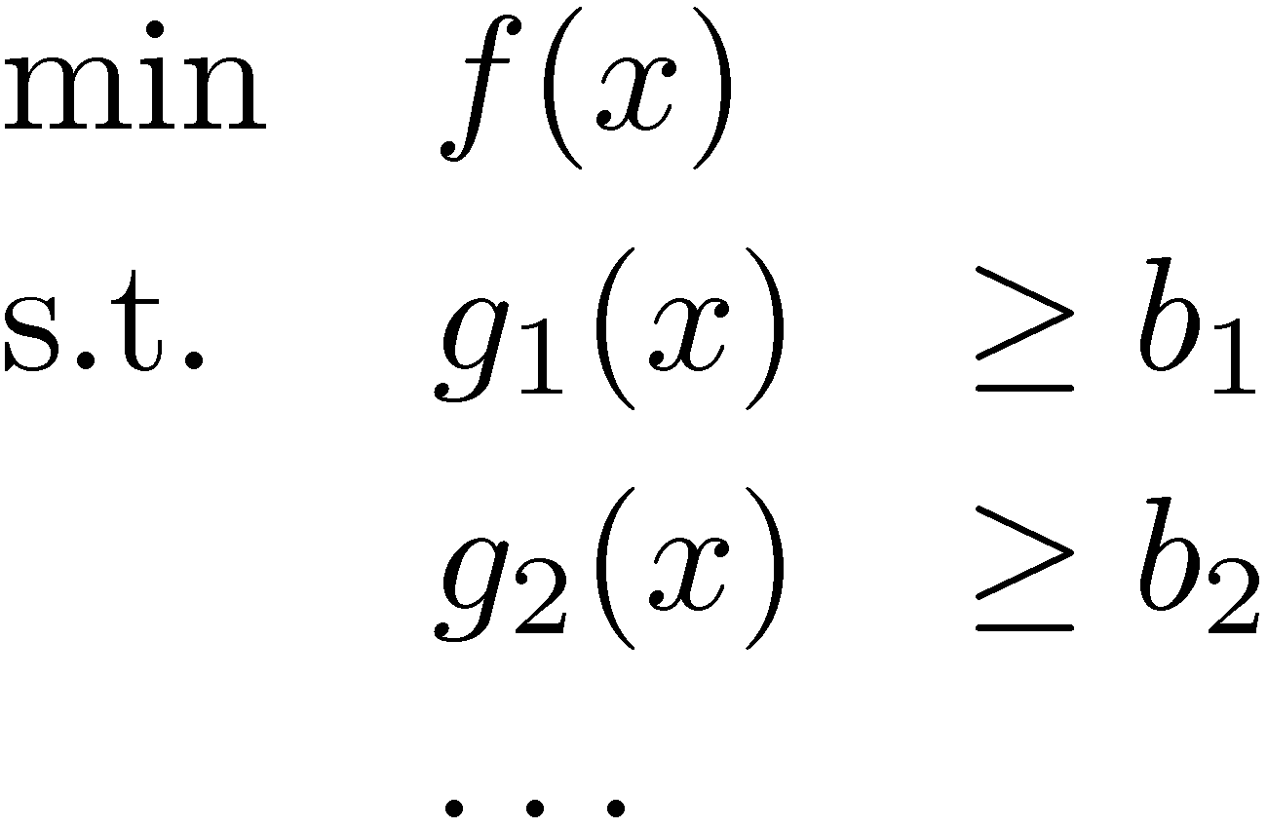
Definition: A mathematical program is an optimization problem that looks like this:
where x2R^{n}, f : R^{n} ! R, g_{i} : R^{n} ! R, b_{i} 2 R
objective function
constraints
could be ¸ or · or =
Definitions:
A point satisfying all constraints is called a feasible solution.
A feasible point x achieving the minimum value of the objective function is called an optimal solution.
Notes:
Jargon: “program” has nothing to do with computer programming.
The main ideas are:
Real-valued variables which indicate possible actions
Constraints which restrict what actions are allowable
Objective function: a way of measuring the quality of a solution

Slide 7
Definition: A mathematical program is an optimization problem that looks like this:
where x2R^{n}, f : R^{n} ! R, g_{i} : R^{n} ! R, b_{i} 2 R
objective function
constraints
could be ¸ or · or =
Goals:
Find an optimal solution, by some algorithm. Typically no closed form-expression.
Find “optimality conditions”: necessary and sufficient conditions for x to be optimal.
Restrictions:
For arbitrary f and g_{i}’s, this is totally hopeless.
We assume f and g_{i}’s are “nice”.
Notes:
This is ridiculously flexible! No surprise you can model many problems in this way.
In general, such problems would be extremely difficult to solve.

Slide 8
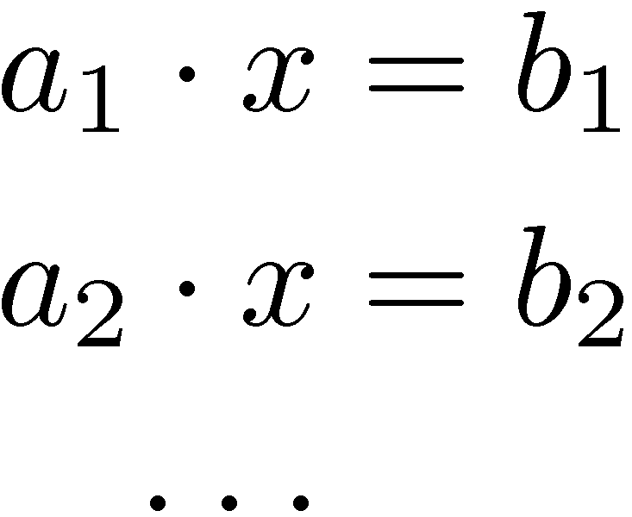
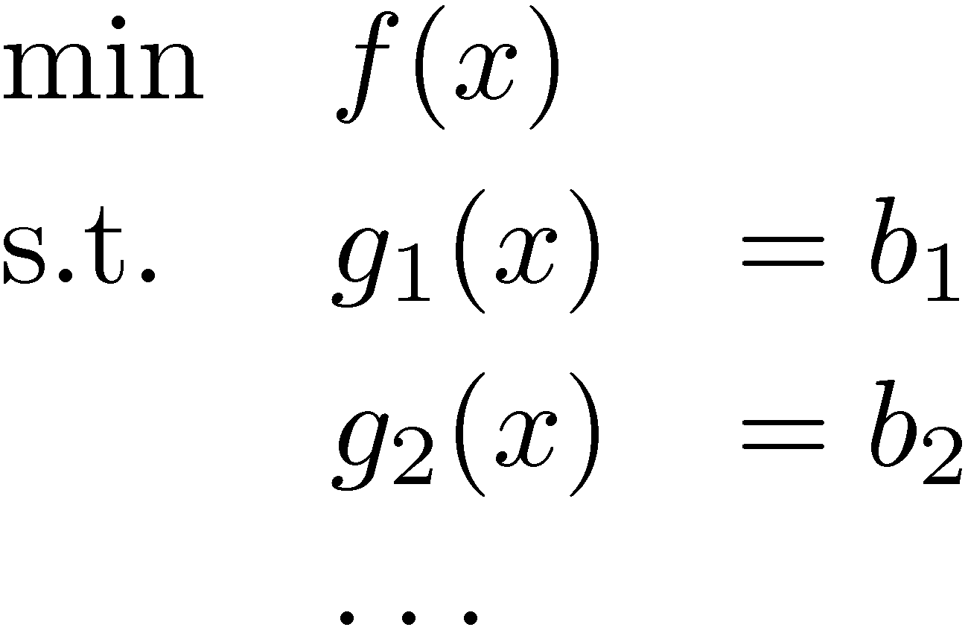
Simple Example: Linear Equations
Consider the system of linear equations Ax = b
Can write this as: where a_{i} is the i’th row of A.
This is a very simple mathematical program:
where f(x) = 0, and g_{i}(x) = a_{i} ¢ x.
(the objective function is irrelevant / trivial)

Slide 9
Purpose of CO 355
Develop a rigorous and useful theory for mathematical programs.
Geometric View:
Algorithms: Gaussian Elimination, Conjugate Gradient…
Linear Systems
Mathematical Programs
x₂
Objective Function
x₂
g₁(x) ¸ b₁
Optimal Solution
Solutions
a₁^{T}x = b₁
a₂^{T}x = b₂
x₁
x₁
x₃
g₂(x) · b₂
x₃
Intersection of Hyperplanes
Intersection of More General Sets
Simplex Method, Ellipsoid Method, Interior Point Methods…

Slide 10
Why care?
Math Programming
Operations
Research
O.R.: applying mathematical modeling and analysis to business decision making.
Notes:
During and after WWII, there was much need for large-scale planning. (100 million military personnel!) Routing ships, organizing military action, scheduling crop rotation, allocating resources, etc. The key observation is that there is an abstract mathematical model that captures all of these problems. Moreover, there are algorithms for solving problems formulated in that model. This observation was made independently by Kantorovich (USSR, 1939), Koopmans (Netherlands/USA, 1944), Dantzig (USA, 1947). The first two received Nobel prize in 1975.
Dantzig is the person considered the "grandfather of LP". (Don't be first to invent something, be the last). His biography is very interesting.

Slide 11
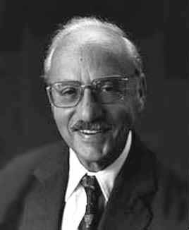
Why care?
Economics
Math Programming
Operations
Research
Math Programming & O.R. were jointly developed during World War II.
Invention of Linear Programming
Dantzig almost won Nobel Prize in Economics
George Dantzig 1914-2005
Notes:
OR

Slide 12
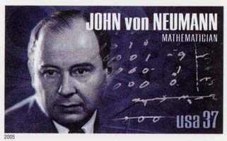
Why care?
Game Theory
Economics
Math Programming
Operations
Research
At same time: the birth of game theory
Zero sum games (closely connected to linear programming)

Slide 13
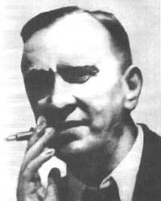
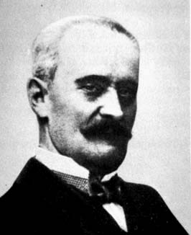
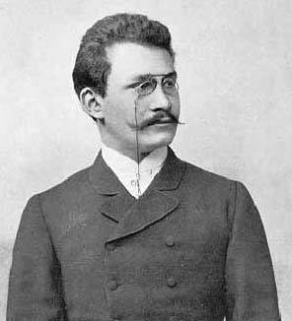
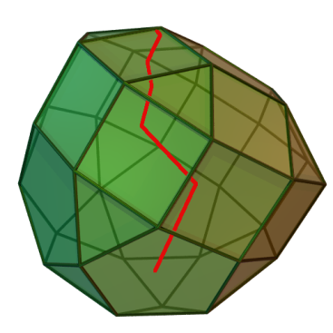
Why care?
Game Theory
Economics
Functional Analysis
Math Programming
Operations
Research
Convex Geometry
~1900: theory of polytopes (closely connected to linear programming)
G. Farkas
H. Minkowski

Slide 14
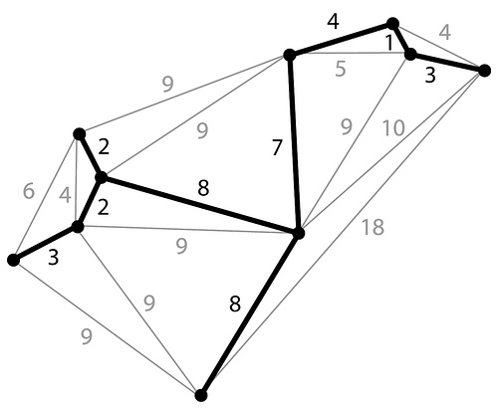
Why care?
Game Theory
Economics
Functional Analysis
Math Programming
Operations
Research
Convex Geometry
Combinatorics
Many theorems in combinatorics can be proven or understood better using mathematical programming

Slide 15
Why care?
Game Theory
Economics
Functional Analysis
Math Programming
Operations
Research
Convex Geometry
Machine Learning
Combinatorics
Machine Learning = Statistics + Optimization

Slide 16
Why care?
Game Theory
Economics
Functional Analysis
Math Programming
Operations
Research
Convex Geometry
Machine Learning
Computer Science
Combinatorics
Many powerful theoretical algorithms are based on mathematical programming.
(max flow, max cut, sparsest cut, traveling salesman, …)

Slide 17
Why care?
Game Theory
Economics
Functional Analysis
Math Programming
Operations
Research
Convex Geometry
Machine Learning
Computer Science
Combinatorics
Even deep complexity theory results are based on math programming!
(Yao’s minimax principle, the “hard-core lemma”, QIP = PSPACE, …)

Slide 18
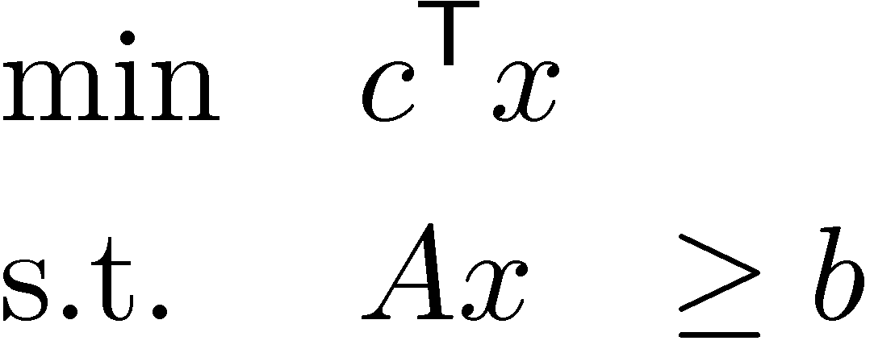
Types of Mathematical Programs
Linear Program (LP):
Rewrite as:
f(x) is a linear function
g_{i}(x) is a linear function
c is vector defining f
A is matrix defining g_{i}’s

Slide 19
Types of Mathematical Programs
Linear Program (LP):
Convex Program:
could be ¸ or · or =
f : R^{n} ! R is a convex function
g_{i} : R^{n} ! R is a convex function
Recall: Assume f is twice-differentiable. Then f is convex , Hessian is positive semi-definite
Notes:
What does convex mean? Graph looks like a bowl. "Positive curvature".
1D: Second derivative is non-negative.
R^n: Hessian is positive semi-definite.

Slide 20
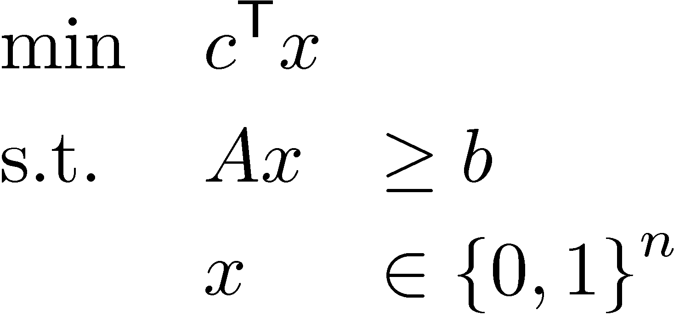
Types of Mathematical Programs
Linear Program (LP):
Convex Program:
Semidefinite Program (SDP): Special type of convex program where x is not a vector but actually a positive semi-definite matrix.
Integer Linear Program (IP): Only finitely many solutions! But harder to solve than LPs.
could be ¸ or · or =
Notes:
What if we're interested in solutions over the integers.
For example, if x is supposed to represent the number of cars to produce, and it tells you to produce half a car, what should you do?
We want to impose constraints x in {0,1}.
Note: this does fit in to our framework. We can add the constraints: xi^2 - xi = 0.

Slide 21
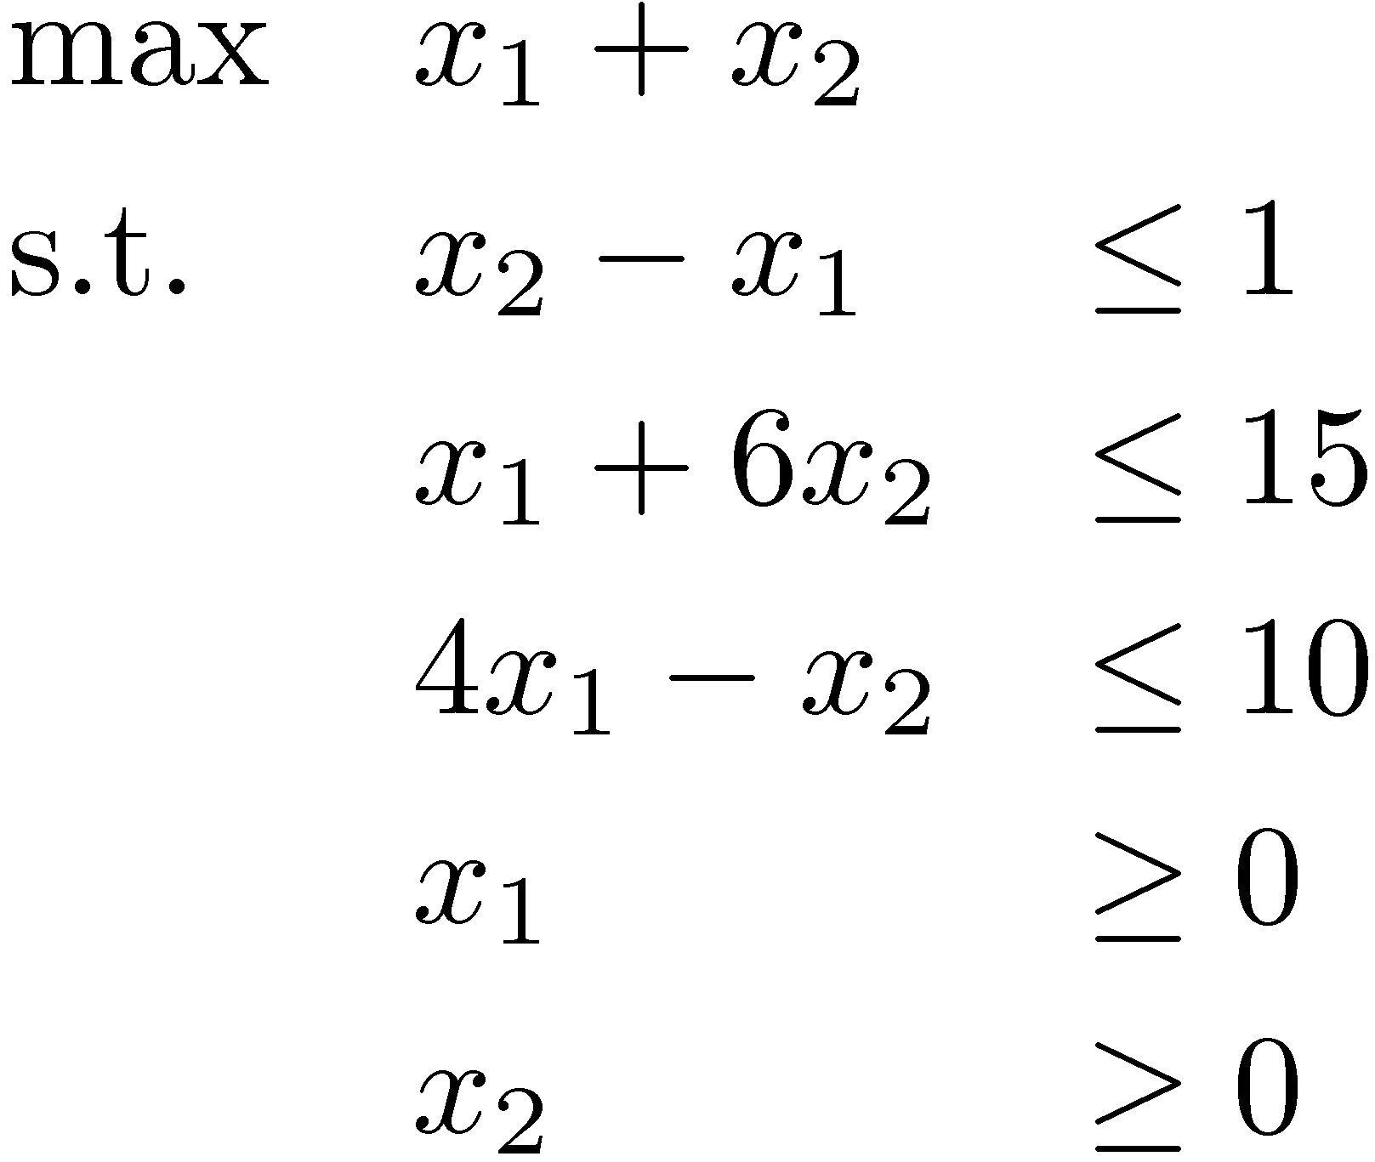
2D Example (Matousek-Gartner, Ch 1)
Constraint
x₂
x₂ - x₁ · 1
Optimal
point
(3,2)
x₁ + 6x₂ · 15
Feasible region
(1,1)
x₂¸0
x₁
(0,0)
x₁¸0
4x₁ - x₂ · 10
Unique optimal solution exists

