Slide 1
C&O 355 Lecture 6
N. Harvey
http://www.math.uwaterloo.ca/~harvey/
TexPoint fonts used in EMF.
Read the TexPoint manual before you delete this box.: AAAAAAAAAA
Notes:
Review of Lecture 2:

Slide 2
Outline
Proof of Optimality
Does the algorithm terminate?
Bland’s Rule
Corollaries

Slide 3
Local-Search Algorithm
Let B be a feasible basis (If none, Halt: LP is infeasible)
For each entering coordinate k∉B
If “benefit” of coordinate k is > 0
Compute y(±) (If ±=1, Halt: LP is unbounded)
Find leaving coordinate h2B (y(±)_{h}=0)
Set x=y(±) and B’=Bn{h}[{k}
Halt: return x
What is a corner point? (BFS and bases)
What if there are no corner points? (Infeasible)
What are the “neighboring” bases? (Increase one coordinate)
What if no neighbors are strictly better? (Might move to a basis that isn’t strictly better (if ±=0), but whenever x changes it’s strictly better)
How can I find a starting feasible basis?
Does the algorithm terminate?
Does it produce the right answer?
Notes:
The key point here is: we might move to a new *basis* that isn’t strictly better (if delta=0),
but we’ll never move to a new *BFS* that isn’t strictly better.

Slide 4
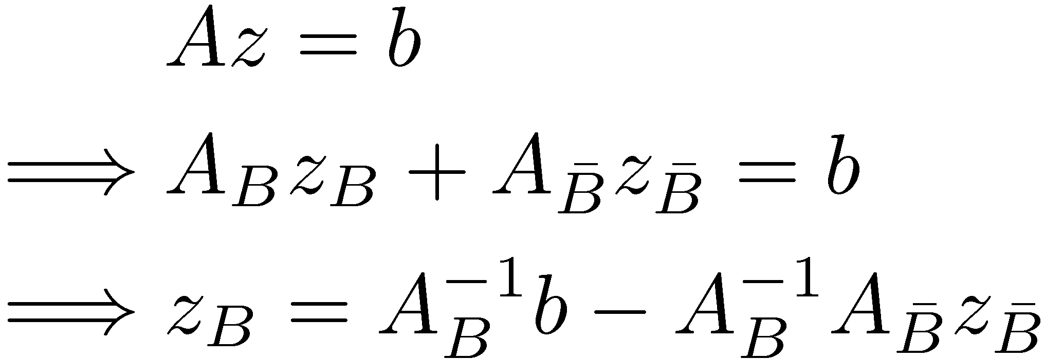
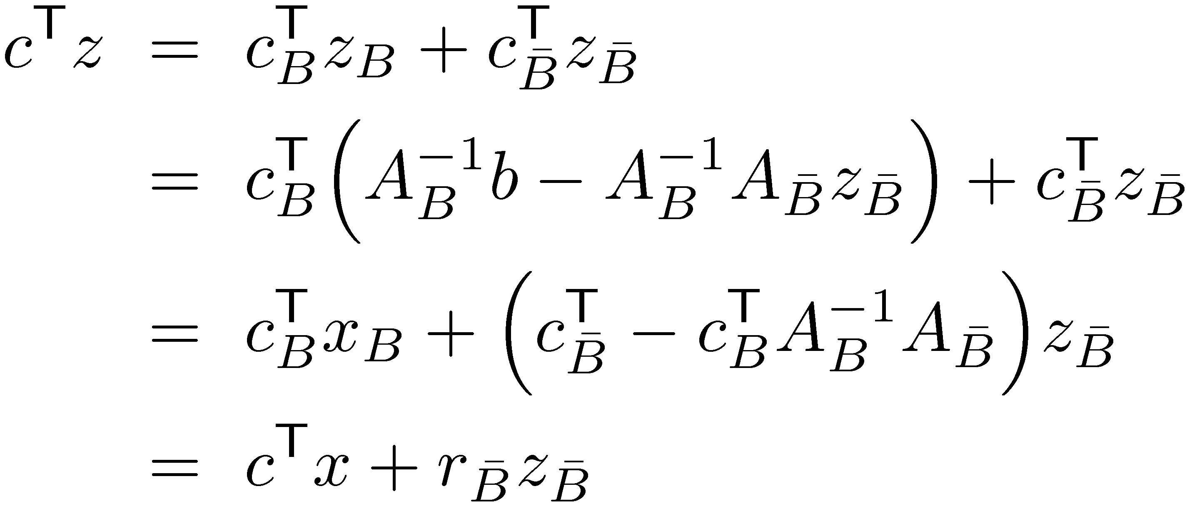
The Benefits Vector
Recall: Benefit of coordinate k is c_{k} - c_{B}^{T}A_{B}⁻¹A_{k}
Let’s define a benefits vector r to record all the benefits
Define:
Note: For k∉B, r_{k} is benefit of coordinate k For k2B, r_{k}=0
Claim: For any point z, we have c^{T}z = c^{T}x + r_{B}^{T}z_{B}
Proof:
Notes:
The usual name for r is the “reduced costs” vector.

Slide 5
Quick Optimality Proof
Suppose algorithm terminates with BFS x and basis B
Claim: x is optimal.
Proof: Loop terminates ) every k∉B has benefit · 0 ) r · 0
For any feasible point z, we have:
c^{T}z = c^{T}x + r_{B}^{T}z_{B} · c^{T}x ) x is optimal. ¥
· 0 since loop terminated
¸ 0 since z feasible
Notes:
The usual name for r is the “reduced costs” vector.

Slide 6
Local-Search Algorithm
Let B be a feasible basis (If none, Halt: LP is infeasible)
For each entering coordinate k∉B
If “benefit” of coordinate k is > 0
Compute y(±) (If ±=1, Halt: LP is unbounded)
Find leaving coordinate h2B (y(±)_{h}=0)
Set x=y(±) and B’=Bn{h}[{k}
Halt: return x
What is a corner point? (BFS and bases)
What if there are no corner points? (Infeasible)
What are the “neighboring” bases? (Increase one coordinate)
What if no neighbors are strictly better? (Might move to a basis that isn’t strictly better (if ±=0), but whenever x changes it’s strictly better)
How can I find a starting feasible basis?
Does the algorithm terminate?
Does it produce the right answer? (Yes)

Slide 7
Does Algorithm Terminate?
Depends on rule for choosing entering / leaving coordinates
For some rules, examples exist where algorithm cycles forever [Hoffman 1951]
How can this happen?
If coordinate k has benefit>0 but ±=0 then basis changes but BFS doesn’t
So the BFS x is degenerate (it is defined by multiple bases)
Geometrically, there are >m tight constraints at x
“Unlikely coincidences” exist among the constraints
Oldest rule to avoid cycling: “Perturbation method” [Dantzig, Orden, Wolfe 1954]
Basic idea: Add random noise to vector b. Then no unlikely coincidences will occur in constraints. If noise very small, optimal basis of noisy problem is also an optimal basis of original problem.
Amazingly simple rule: “Smallest index rule” [Bland 1977]
Choose entering coordinate k to be smallest i.e., k = min{ i : coordinate i has positive benefit }
Choose leaving coordinate h to be the smallest i.e., h = min{ i : coordinate i has y(±)_{i}=0 }

Slide 8
Cycling
Suppose algorithm cycles
Let F = { i : i is an entering coordinate at some step on cycle }
Claim 1: All BFS on cycle are the same BFS x, and x_{i}=0 8i2F.
Proof: If BFS changes then objective value increases. (Positive benefit) Obj. value never decreases, so we can’t cycle back to worse BFS. So every step on cycle has ±=0 ) y(±)=x.
A leaving coordinate h always has y(±)_{h}=0. But y(±)=x, so x_{h}=0. ¤
If it enters during cycle, it must leave during cycle
Notes:
Write claim on blackboard.

Slide 9
Bland’s Rule Works
Claim: Bland’s rule never cycles.
Proof Idea:
Suppose it cycles
Let F = { i : i is an entering coordinate at some step on cycle }
Let v = maximum i in F
Consider steps when v is entering or leaving
If v is entering/leaving, then every other i2F is ineligible (because we always choose smallest i to enter/leave)
We can infer some strong properties about all other i2F
Use those strong properties to get a contradiction
How? Non-obvious…
Define an auxiliary LP, show that it has an optimal solution, and it is also unbounded.

Slide 10
Let B be a basis on cycle just before v enters Let r be the benefits vector at this step
) v has a positive benefit (r_{v}>0)
No other i2F is eligible to enter
) every other i2F has non-positive benefit (r_{i}·0 8i2Fn{v})
Let B’ be a basis on cycle just before v leaves (some u2F enters) Let d be the direction we’re trying to move in at this step Recall: y(±) = x+±d, where d_{B’}=- A_{B’}⁻¹ A_{u}, d_{u}=1, d_{i}=0 8i∉B’[{u}
Recall: leaving coordinate is a minimizer of min{ -x_{i}/d_{i} : i s.t. d_{i}<0 } ) d_{v}<0
Recall: x_{v}=0 (by Claim 1)
No other i2F is eligible to leave ) every other i2F is not a minimizer of this
But x_{i}=0 too ) They are not minimizers because d_{i}¸0 8i2Fn{v}

Slide 11
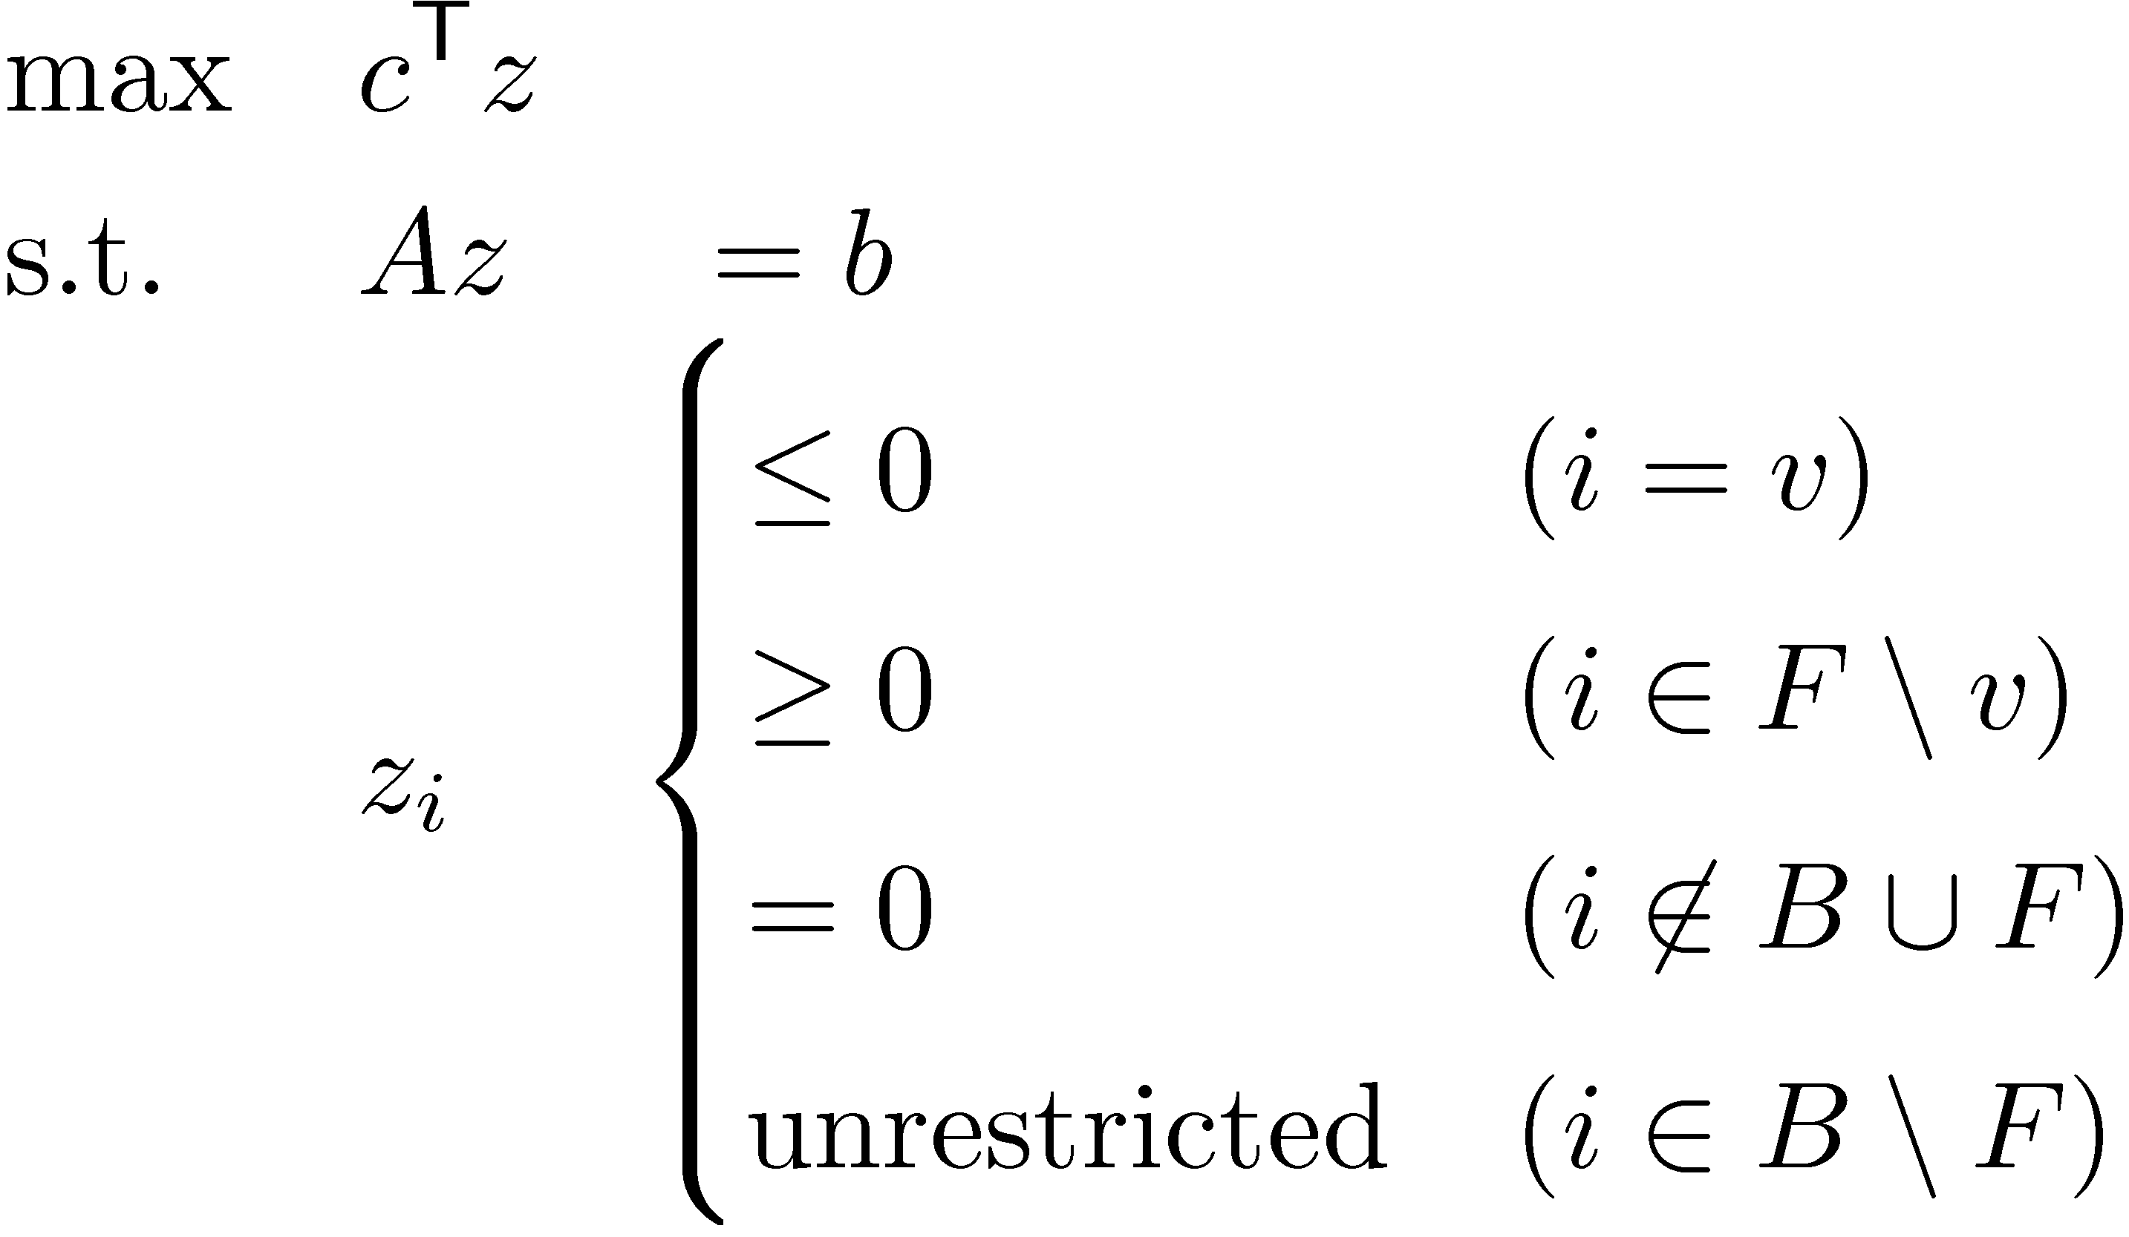
Auxiliary LP
(AuxLP)
Let x be the BFS (of original LP) for all bases in the cycle
Claim 2: x is an optimal solution of AuxLP.
Claim 3: We can increase x_{u}→1 without ruining feasibility. So AuxLP is unbounded.

Slide 12
Claim 2: x is optimal for AuxLP
(AuxLP)
Subclaim: x is feasible for AuxLP
x_{i}=0 8i∉B, since B is a basis determining x
x_{i}=0 8i2F, by Claim 1
For any z, we have c^{T}z = c^{T}x + r_{B}^{T}z_{B}
Subclaim: For z feasible for AuxLP, r_{B}^{T}z_{B} · 0
For coordinate i∉B[F, we have z_{i}=0
For coordinate i2Fn{v}, we have r_{i}·0 but z_{i}¸0
For coordinate v, we have r_{v}>0 but z_{v}·0
So c^{T}z · c^{T}x ) x is optimal ¥

Slide 13
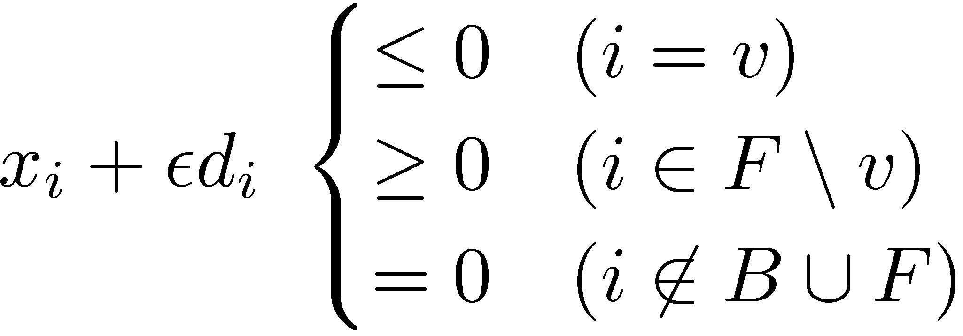
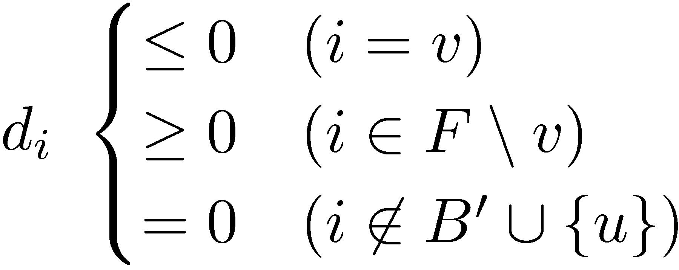
Claim 3: AuxLP is unbounded
(AuxLP)
Claim: B’ is a basis for AuxLP and it determines BFS x.
Claim: coordinate u has positive benefit. (Definition of benefit does not depend on sign constraints)
If we increase x_{u} to ², must adjust x_{B’} to preserve “Az=b” constraint
New point is z(²)=x+²d.
The d vector is the same as before: it does not depend on sign constraints
z(²) feasible , .
But i∉B[F ) i∉B’[{u}. So z(²) feasible 8²¸0. ¥
We know:

Slide 14
Local-Search Algorithm
Let B be a feasible basis (If none, Halt: LP is infeasible)
For each entering coordinate k∉B
If “benefit” of coordinate k is > 0
Compute y(±) (If ±=1, Halt: LP is unbounded)
Find leaving coordinate h2B (y(±)_{h}=0)
Set x=y(±) and B’=Bn{h}[{k}
Halt: return x
What is a corner point? (BFS and bases)
What if there are no corner points? (Infeasible)
What are the “neighboring” bases? (Increase one coordinate)
What if no neighbors are strictly better? (Might move to a basis that isn’t strictly better (if ±=0), but whenever x changes it’s strictly better)
How can I find a starting feasible basis?
Does the algorithm terminate? (If Bland’s rule used)
Does it produce the right answer? (Yes)

Slide 15
Corollaries
Corollary: “Fundamental Theorem of LP” For any LP, the outcome is either:
An optimal solution exists
Problem is Infeasible
Problem is Unbounded
Corollary: For any equational form LP, if an optimal solution exists, then a BFS is optimal.
More coming soon…

Slide 16
Finding a starting basis
Consider LP max { c^{T}x : x2P } where P={ x : Ax=b, x¸0 }
How can we find a feasible point?
Trick: Just solve a different LP!
Note: c is irrelevant. We can introduce a new objective function
WLOG, b¸0 (Can multiply constraints by -1)
Get “relaxation” of P by introducing more “slack variables”: Q = { (x,y) : Ax+y=b, x¸0, y¸0 }
Note: (x,0)2Q , x2P. Can we find such a point?
Solve the new LP min { §_{i} y_{i} : (x,y)2Q }
If the optimal value is 0, then x2P. If not, P is empty!
How do we find feasible point for the new LP?
(x,y)=(0,b) is a trivial solution!

Slide 17
Local-Search Algorithm
Let B be a feasible basis (If none, Halt: LP is infeasible)
For each entering coordinate k∉B
If “benefit” of coordinate k is > 0
Compute y(±) (If ±=1, Halt: LP is unbounded)
Find leaving coordinate h2B (y(±)_{h}=0)
Set x=y(±) and B’=Bn{h}[{k}
Halt: return x
What is a corner point? (BFS and bases)
What if there are no corner points? (Infeasible)
What are the “neighboring” bases? (Increase one coordinate)
What if no neighbors are strictly better? (Might move to a basis that isn’t strictly better (if ±=0), but whenever x changes it’s strictly better)
How can I find a starting feasible basis? (Solve an easier LP)
Does the algorithm terminate? (If Bland’s rule used)
Does it produce the right answer? (Yes)

