Slide 1
C&O 355 Lecture 16
N. Harvey
TexPoint fonts used in EMF.
Read the TexPoint manual before you delete this box.: AAAAAAAAAA

Slide 2
Topics
Review of Fourier-Motzkin Elimination
Linear Transformations of Polyhedra
Convex Combinations
Convex Hulls
Polytopes & Convex Hulls

Slide 3
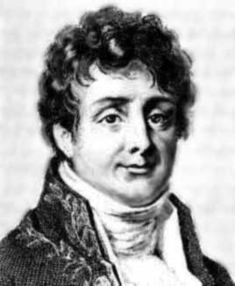
Fourier-Motzkin Elimination
Joseph Fourier
Theodore Motzkin
Given a polyhedron Q µ R^{n}, we want to find the set Q’ µ R^{n-1} satisfying
(x₁,…,x_{n-1})2Q’ , 9x_{n} s.t. (x₁,…,x_{n-1},x_{n})2Q
Q’ is called the projection of Q onto first n-1 coordinates
Fourier-Motzkin Elimination constructs Q’ by generating (finitely many) constraints from the constraints of Q.
Corollary: Q’ is a polyhedron.

Slide 4
Elimination Example
x₃
Q
x₂
x₁
Project Q onto coordinates {x₁, x₂}...

Slide 5
Elimination Example
x₃
Q’
x₂
x₁
Project Q onto coordinates {x₁, x₂}...
Fourier-Motzkin: Q’ is a polyhedron.
Of course, the ordering of coordinates is irrevelant.

Slide 6
Elimination Example
x₃
Q’’
x₂
x₁
Of course, the ordering of coordinates is irrevelant.
Fourier-Motzkin: Q’’ is also a polyhedron.
I can also apply Elimination twice…

Slide 7
Elimination Example
x₃
Q’’’
x₂
x₁
Fourier-Motzkin: Q’’’ is also a polyhedron.

Slide 8
Projecting a Polyhedron Onto Some of its Coordinates
Lemma: Given a polyhedron Q µ R^{n}. Let S={s₁,…,s_{k}}µ{1,…,n} be any subset of the coordinates. Let Q_{S} = { (x_{s1},…,x_{sk}) : x2Q } µ R^{k}.
In other words, Q_{S} is projection of Q onto coordinates in S.
Then Q_{S} is a polyhedron.
Proof: Direct from Fourier-Motzkin Elimination. Just eliminate all coordinates not in S. ¥

Slide 9
Linear Transformations of Polyhedra
Lemma: Let P = { x : Ax·b } µ R^{n} be a polyhedron. Let M be any matrix of size pxn. Let Q = { Mx : x2P } µ R^{p}. Then Q is a polyhedron.
x₃
1 | 0 | 0
-1 | 1 | 0
0 | 0 | 1
Let M =
P
x₂
x₁

Slide 10
Linear Transformations of Polyhedra
Lemma: Let P = { x : Ax·b } µ R^{n} be a polyhedron. Let M be any matrix of size pxn. Let Q = { Mx : x2P } µ R^{p}. Then Q is a polyhedron.
Geometrically obvious, but not easy to prove…
x₃
1 | 0 | 0
-1 | 1 | 0
0 | 0 | 1
Let M =
Q
x₂
x₁

Slide 11
Linear Transformations of Polyhedra
Lemma: Let P = { x : Ax·b } µ R^{n} be a polyhedron. Let M be any matrix of size pxn. Let Q = { Mx : x2P } µ R^{p}. Then Q is a polyhedron.
Geometrically obvious, but not easy to prove…
…unless you know Fourier-Motzkin Elimination!
Proof:
Let P’ = { (x,y) : Mx=y, Ax·b } µ R^{n+p}, where x2R^{n}, y2R^{p}.
P’ is obviously a polyhedron.
Note that Q is projection of P’ onto y-coordinates.
By previous lemma, Q is a polyhedron. ¥

Slide 12
Convex Sets
Let SµR^{n} be any set.
Recall: S is convex if
Proposition: The intersection of any collection of convex sets is itself convex.
Proof: Exercise.

Slide 13
Convex Combinations
Let SµR^{n} be any set.
Definition: A convex combination of points in S is any point where k is finite and
Theorem: (Carathéodory’s Theorem) It suffices to take k·n+1.
Proof: This was Assignment 2, Problem 4.

Slide 14
Convex Combinations
Theorem: Let SµR^{n} be a convex set. Let comb(S) = { p : p is a convex comb. of points in S }. Then comb(S) = S.
Proof: S µ comb(S) is trivial.

Slide 15
Convex Combinations
Theorem: Let SµR^{n} be a convex set. Let comb(S) = { p : p is a convex comb. of points in S }. Then comb(S) = S.
Proof: We’ll show comb(S) µ S.
Consider .. Need to show p2S.
By induction on k. Trivial if k=1 or if ¸_{k}=1.
So assume k>1 and ¸_{k}<1.
Note:
Note so p’ is a convex combination of at most k-1 points in S. By induction, p’2S.
But , so p2S since S is convex. ¥
Call this point p’

Slide 16
Convex Hulls
Let SµR^{n} be any set.
Definition: The convex hull of S, denoted conv(S), is the intersection of all convex sets containing S.

Slide 17
Convex Hulls
Let SµR^{n} be any set.
Definition: The convex hull of S, denoted conv(S), is the intersection of all convex sets containing S.

Slide 18
Convex Hulls
Let SµR^{n} be any set.
Definition: The convex hull of S, denoted conv(S), is the intersection of all convex sets containing S.
Claim: conv(S) is itself convex.
Proof:
Follows from our earlier proposition
“Intersection of convex sets is convex”. ¥

Slide 19
Convex Hulls
Let SµR^{n} be any set.
Definition: The convex hull of S, denoted conv(S), is the intersection of all convex sets containing S.
Let comb(S) = { p : p is a convex comb. of points in S }.
Theorem: conv(S)=comb(S).
Proof: We’ll show conv(S)µcomb(S).
Claim: comb(S) is convex.
Proof: Consider and , where
So p,q2comb(S). For ®2[0,1], consider
Thus ®p + (1-®)q 2 comb(S). ¤

Slide 20
Convex Hulls
Let SµR^{n} be any set.
Definition: The convex hull of S, denoted conv(S), is the intersection of all convex sets containing S.
Let comb(S) = { p : p is a convex comb. of points in S }.
Theorem: conv(S)=comb(S).
Proof: We’ll show conv(S)µcomb(S).
Claim: comb(S) is convex.
Clearly comb(S) contains S.
But conv(S) is the intersection of all convex sets containing S, so conv(S)µcomb(S). ¥

Slide 21
Convex Hulls
Let SµR^{n} be any set.
Definition: The convex hull of S, denoted conv(S), is the intersection of all convex sets containing S.
Let comb(S) = { p : p is a convex comb. of points in S }.
Theorem: conv(S)=comb(S).
Proof: Exercise: Show comb(S)µconv(S).

Slide 22
Convex Hulls of Finite Sets
Theorem: Let S={s₁,…,s_{k}}½R^{n} be a finite set. Then conv(S) is a polyhedron.
Geometrically obvious, but not easy to prove…

Slide 23
Convex Hulls of Finite Sets
Theorem: Let S={s₁,…,s_{k}}½R^{n} be a finite set. Then conv(S) is a polyhedron.
Geometrically obvious, but not easy to prove…
…unless you know Fourier-Motzkin Elimination!
Proof: Let M be the nxk matrix where M_{i} = s_{i}.
By our previous theorem,
But this is a projection of the polyhedron
By our lemma on projections of polyhedra, conv(S) is also a polyhedron. ¥

Slide 24
Polytopes & Convex Hulls
Let P½R^{n} be a polytope. (i.e., a bounded polyhedron)
Is P the convex hull of anything?
Since P is convex, P = conv(P). Too obvious…
Maybe P = conv( extreme points of P )?

Slide 25
Polytopes & Convex Hulls
Theorem: Let P½R^{n} be a non-empty polytope.
Then P = conv( extreme points of P ).
Proof: First we prove conv( extreme points of P ) µ P.
We have: conv( extreme points of P ) µ conv( P ) µ P.
Obvious
Our earlier theorem
proved comb(P) µ P

Slide 26
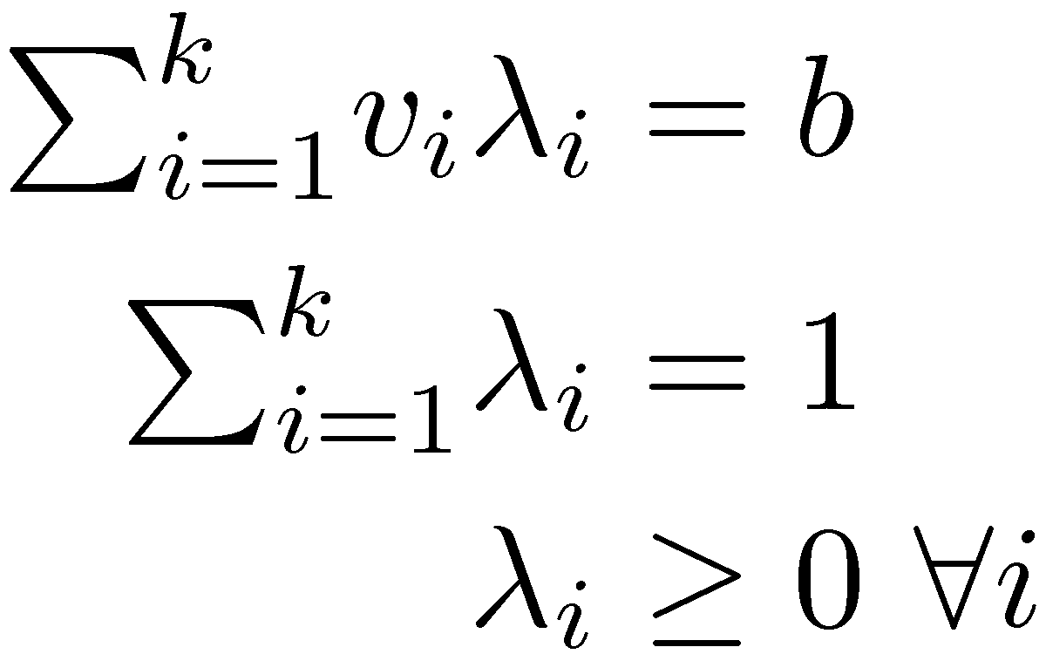
Polytopes & Convex Hulls
Theorem: Let P½R^{n} be a non-empty polytope.
Then P = conv( extreme points of P ).
Proof: Now we prove P µ conv( extreme points of P ).
Let the extreme points be {v₁,…,v_{k}}. (Finitely many!)
Suppose 9b 2 P n conv( extreme points of P ).
Then the following system has no solution:
By Farkas’ lemma, 9u2R^{n} and ®2R s.t.
and
So -u^{T}b > -u^{T}v_{i} for every extreme point v_{i} of P.

Slide 27
Polytopes & Convex Hulls
Theorem: Let P½R^{n} be a non-empty polytope.
Then P = conv( extreme points of P ).
Proof: Now we prove P µ conv( extreme points of P ).
Let the extreme points be {v₁,…,v_{k}}. (Finitely many!)
Suppose 9b 2 P n conv( extreme points of P ).
Then the following system has no solution:
…
By Farkas’ lemma, 9u2R^{n} and ®2R s.t.
and
So -u^{T}b > -u^{T}v_{i} for every extreme point v_{i} of P.
Consider the LP max { -u^{T}x : x2P }.
It is not unbounded, since P is bounded.
Its optimal value is not attained at an extreme point.
This is a contradiction. ¥

Slide 28
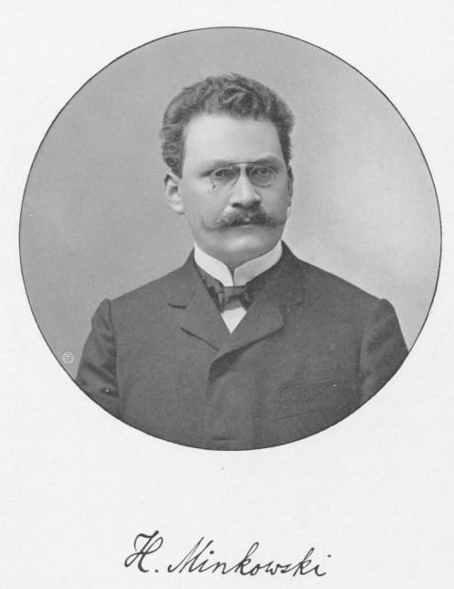
Generalizations
Theorem: Every polytope in R^{n} is the convex hull of its extreme points.
Theorem: [Minkowski 1911] Every compact, convex set in R^{n} is the convex hull of its extreme points.
Theorem: [Krein & Milman 1940] Every compact convex subset of a locally convex Hausdorff linear space is the closed convex hull of its extreme points.

Slide 29
Undergrad Research Assistantships (URAs)
for Spring 2010 with the C&O Dept.
Duration: 3-4 months during May - August, 2010
Salary: Around $2,500 per month
Eligibility: Undergrads in Math or CS, with an A standing
Application: To apply, address the following documents to Professor I.P. Goulden:
- cover letter
- resume
- recent grade report
- names and email addresses of two references
By email: send documents to t3schmid@uwaterloo.ca
(No need to specify a particular area of interest, specialized background is not needed)
Last date for applications: December 14, 2009
http://www.math.uwaterloo.ca/CandO_Dept/SummerResearch/Summer.shtml
All of this information can be accessed from our homepage

